Slide 1
Computer simulation modelling of bloodstream infection Hospital in a box
Alessandro Gerada

Slide 2
System wide decision making
For example, antimicrobial formulary decisions
Based on aggregate retrospective data
Forward modelling of impact is difficult, relies mainly on surveillance
Understanding impact on longitudinal patient journey is difficult without time consuming manual audit
The challenge is that healthcare systems are complex and difficult to model

Slide 3
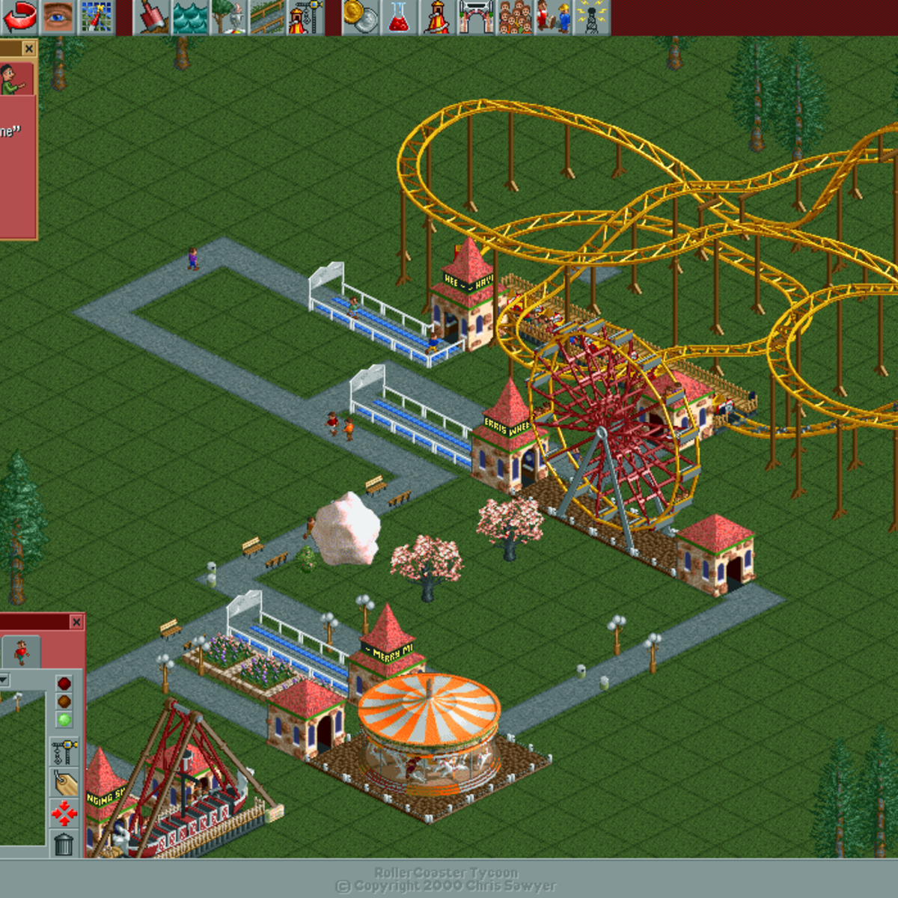
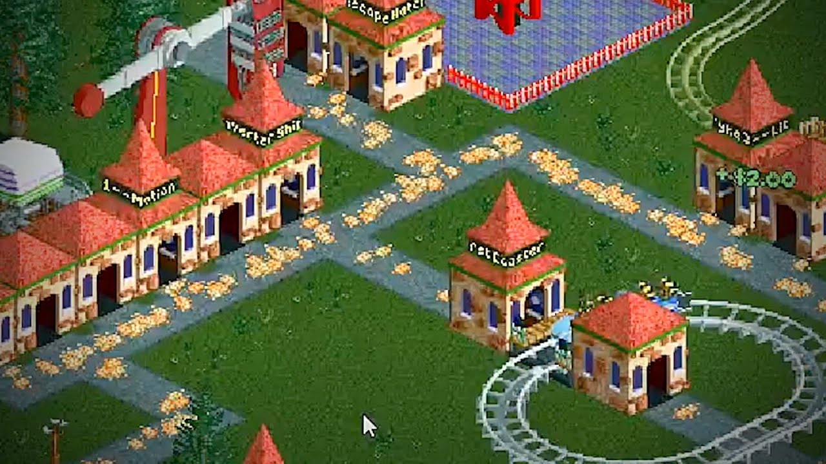

Slide 4
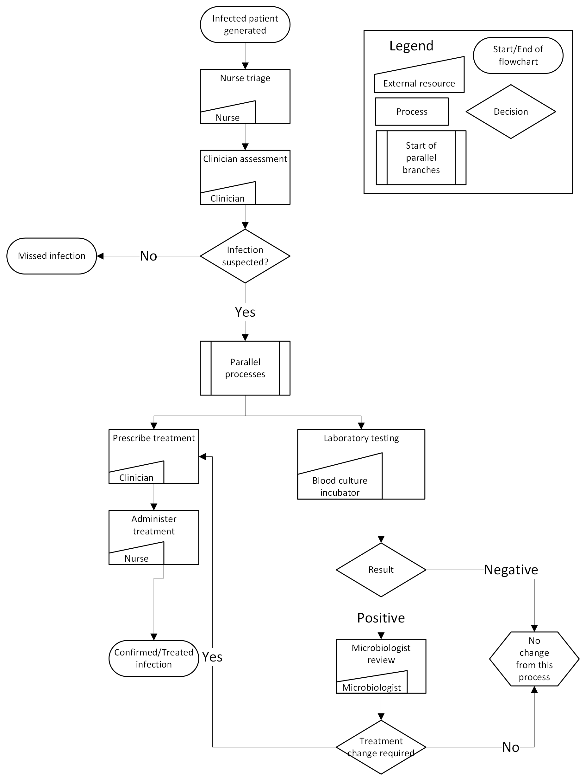

Slide 5
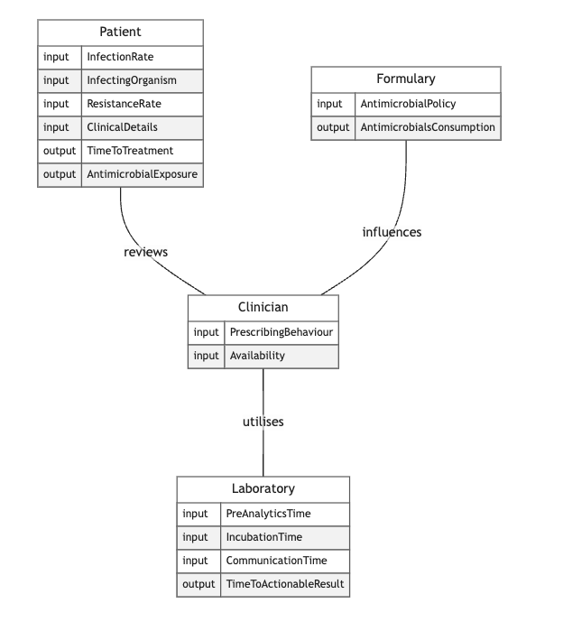

Slide 6
Next Steps
Structured interviews to produce flowcharts
Collect retrospective data on time intervals
Direct patient observations as necessary
Start programming the laboratory simulation module

