Slide 1



Adaptive Antimicrobial Susceptibility Testing
Alex Howard
Consultant in Medical Microbiology

Slide 2
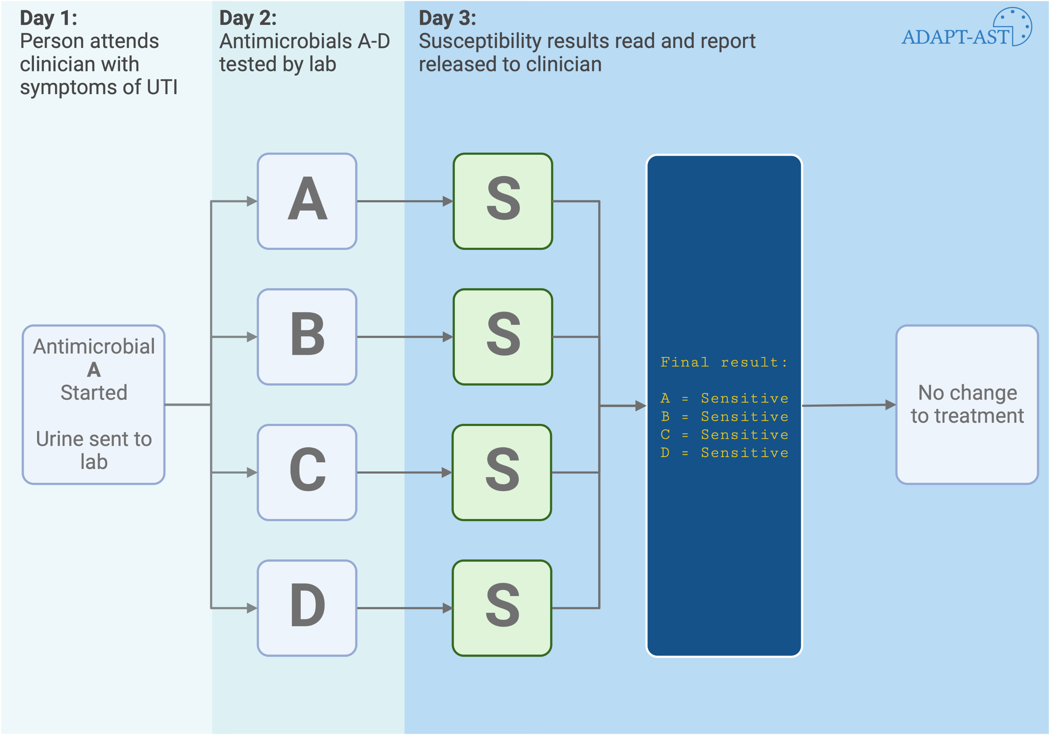

Slide 3
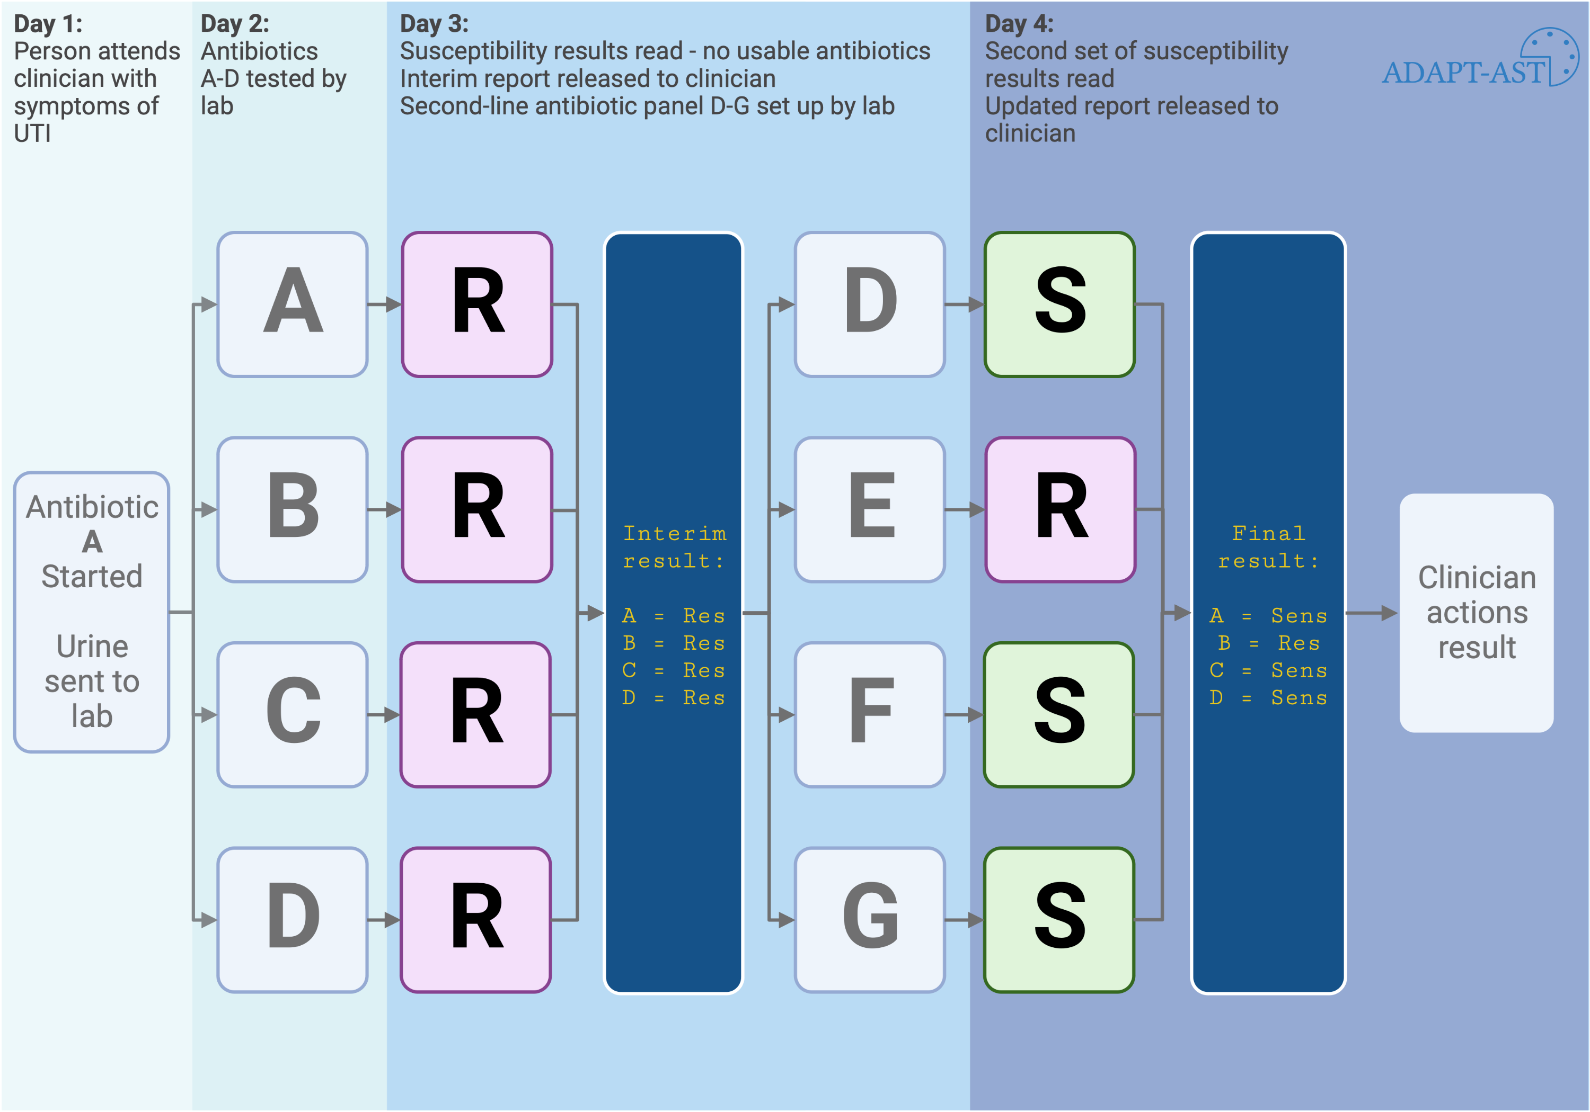

Slide 4
