Slide 1
Hospital-in-a-Box – an update
Alessandro Gerada
Anoop Velluva

Slide 2
Outline
Brief review of simulation (AG)
Update on Hospital-in-a-Box (AG)
Demo (AV)

Slide 3
Simulation – a brief introduction
Agent based models
Start – initialise the environment and agents
At every time point of the simulation, update each agent
Continue until simulation end condition
Best for:
complex systems with high levels of randomness at every time point
Geospatial modelling
Disadvantages:
Even if an event is unlikely to happen, we still check whether it has happened at every time point
Can be computationally expensive
http://www.netlogoweb.org/launch#http://ccl.northwestern.edu/netlogo/models/models/Sample%20Models/Social%20Science/Rebellion.nlogo

Slide 4
Discrete event simulation
Generate processes that are run in parallel
Processes often include one or more ‘holds’
Key entity is the future event list
Simulation usually runs until all processes finished
Advantages:
Abstraction fits better with process (flow-chart) based problems
Can be computationally more efficient by jumping forwards in time
Disadvantages:
One has to think in parallel, can be challenging
System Dynamics
Differential equations
SIR is a typical example

Slide 5

Time
0
Future event list

Slide 6

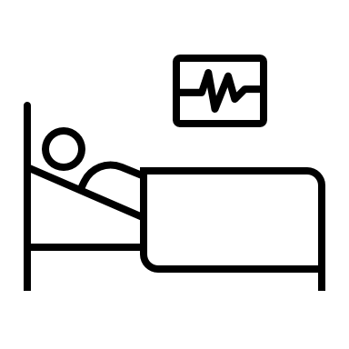

Time
0
5 days
Future event list

Slide 7
Time
0
Complete
5
Future event list

Slide 8
Time
0
Complete
5
Future event list
Passive/Waiting

Slide 9
Time
0
Complete
5
Future event list
Passive/Waiting

Slide 10


Time
3
Complete
5
1 day
Future event list
Passive/Waiting

Slide 11
Time
3
Complete
4
Complete
5
Future event list
Passive/Waiting

Slide 12
Time
3
Complete
4
Complete
5
Future event list
Passive/Waiting

Slide 13
Time
4
Complete
5
Future event list
Passive/Waiting

Slide 14
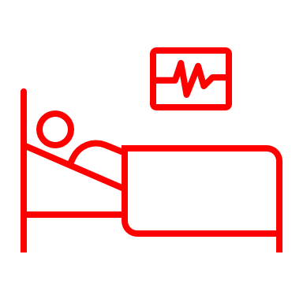

Time
4
Complete
5
10 days
Future event list
Passive/Waiting

Slide 15
Time
4
Complete
5
Complete
14
Future event list
Passive/Waiting

Slide 16
Time
4
Complete
5
Complete
14
Future event list
Passive/Waiting

Slide 17
Time
5
Complete
14
Future event list
Passive/Waiting

Slide 18
Time
14
Future event list
Passive/Waiting

Slide 19
Simulation finishes when no more events in future events list

Slide 20
Hospital-in-a-Box
Back-end module that drives the sim
Front-end module that animates the sim
Clinical study (CSM-BSI)
Retrospective data ☐
Observational data ☐
Focus groups and structured interviews ☐
Laboratory module
Retrospective data ☑︎
Observational data ☑︎
Implementation

Slide 21
Laboratory Data
High certainty parameters hardcoded, highly discrete (mainly observational data, some retrospective)
Moderate certainty data, less discrete, calibration targets – (mainly retrospective)
Abstract data, calibrated to target (waste time, time doing other things)

Slide 22
Demo

Slide 23
Feedback
What laboratory applications could the simulate be useful for?
What features are we missing?

