Slide 1

Addressing health inequalities in infection care access and care quality through data
Nina Zhu
Application of AI to optimise the management of infectious diseases and the use of antimicrobials: CAMO-UK researchers meeting
14 December 2023

Slide 2
Health inequalities within routine AMR and AMU surveillance
Domains of health inequalities with data:
Ethnic minority communities
Multiple deprivation
Protected characteristics group defined by the Equality Act 2010
People in adult social care
Geographic locations
Notes:
; including electronic patient records and hospital bed occupancy

Slide 3
Health inequalities within routine AMR and AMU surveillance
Domains of health inequalities without data:
people with learning disabilities and autistic people
people with multiple long-term health conditions
coastal communities with pockets of deprivation hidden amongst relevant affluence
young carers, looked after children or care leavers
inclusion health groups (homeless, drug and alcohol dependent, Roma / Gypsy / traveller communities, sex workers, migrants, people in contact with justice systems and victims of modern slavery)
Notes:
; including electronic patient records and hospital bed occupancy

Slide 4
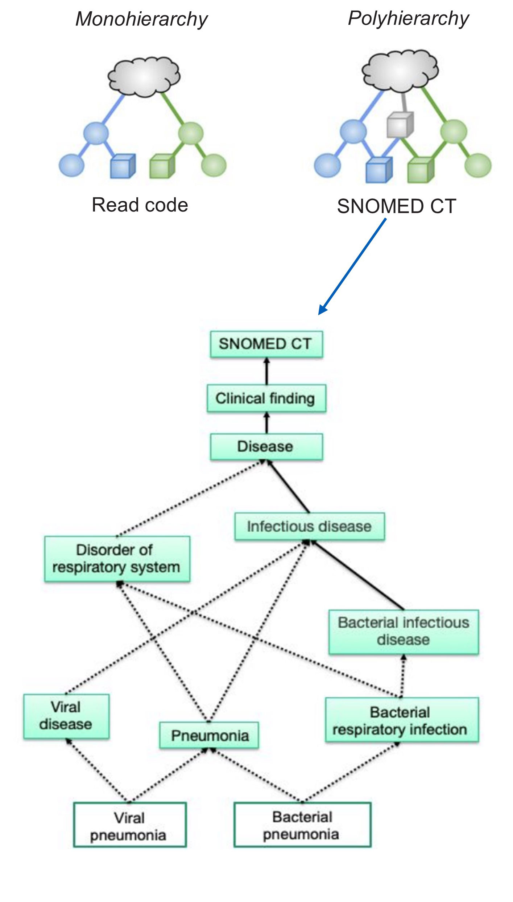
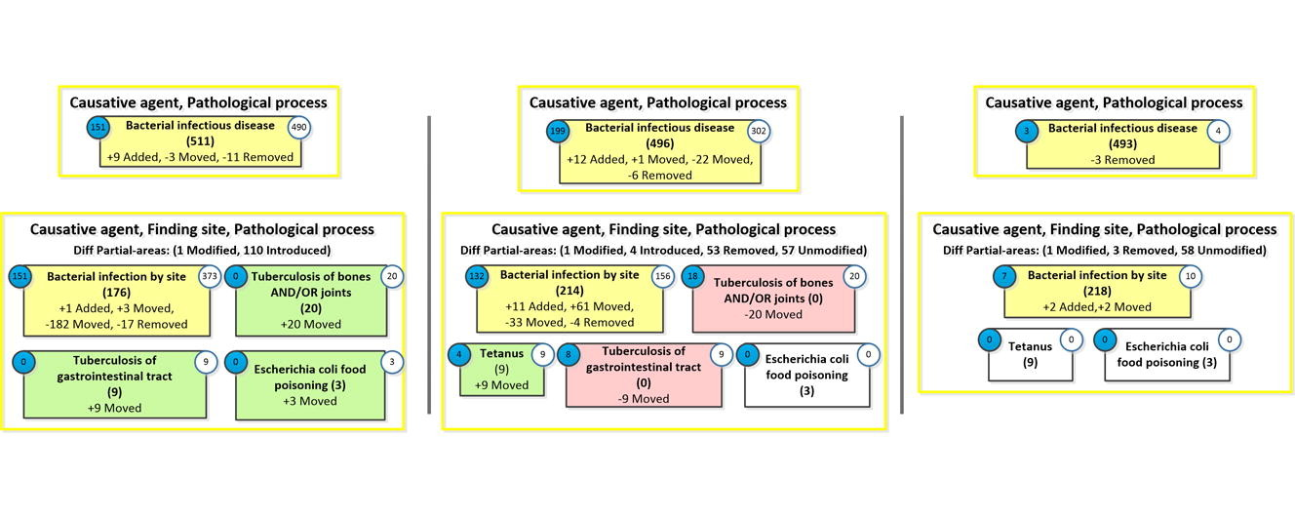
Identify infection cases and patients in the current coding system
Notes:
; including electronic patient records and hospital bed occupancy

Slide 5
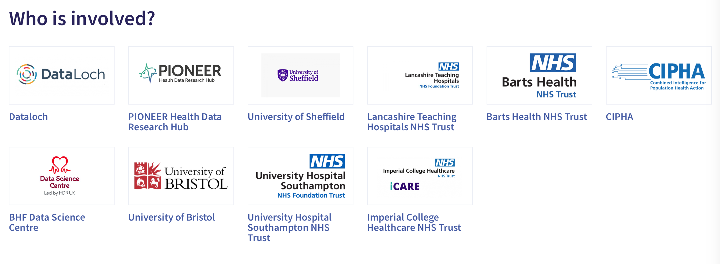
Identify infection cases and patients in the current coding system
NHS Data and Connectivity Collaboration Regional Linked Health Data for Research Programme
OpenSAFELY clustered condition groups relevant to COVID-19
Notes:
; including electronic patient records and hospital bed occupancy

Slide 6
Predict of risks of infection acquisition and treatment failure
For patients with multiple long-term health conditions and polypharmacy
Machine-learning based algorithms
Allow embedding in the current NHS routine data landscape
Acute-care based: risk of HCAI acquisition
Community-based: risk of UTI treatment failure

Slide 7
Predict of risks of infection acquisition and treatment failure
Community-based: risk of UTI treatment failure
Retrospective case identification using clinical observations, prescribing, and microbiology data
Differentiate urine-related and non-urine-related bacteraemia based on pathogen (Gram-negatives) and past urine culture
Consider drug-drug interaction

Slide 8
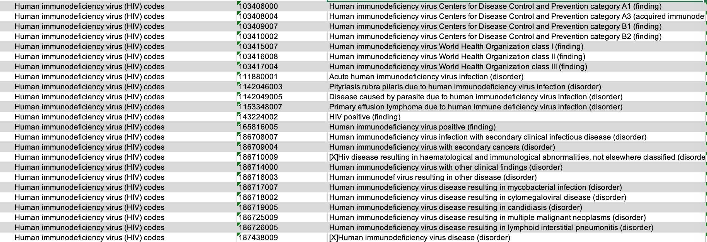
Challenges
Device-associated infections
Increased prescribing threshold during COVID-19
Co-morbidities: particularly patients who were immunocompromised (consider clinical phenotypes and history procedure and prescribing records)
Example: HIV ~510 codes

