Slide 1
An Overview of Pharmacokinetic- Pharmacodynamic modelling
Dr Christopher Darlow
NIHR Academic Clinical Lecturer (Infectious Disease / Medical Microbiology)
University of Liverpool

Slide 2
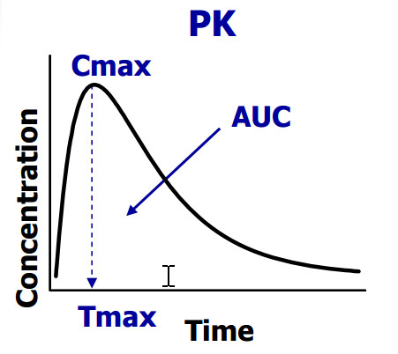
A few basic definitions
Pharmacokinetics – What a human (or animal) body does to a drug

Slide 3
A few basic definitions
Pharmacodynamics – What a drug does to the ‘body’ (whether the host or the pathogen)

Slide 7
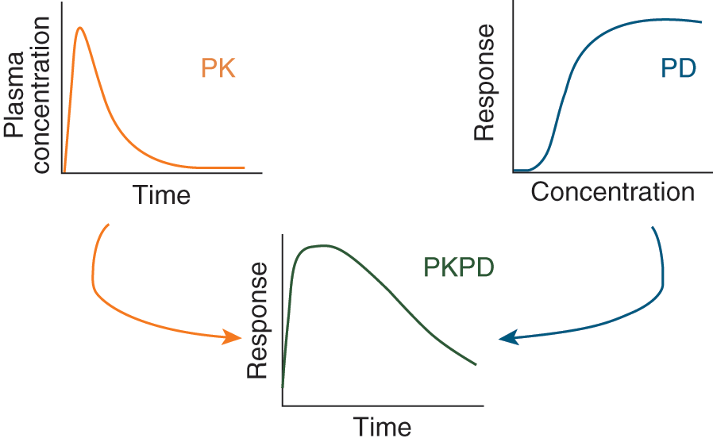
A few basic definitions
PK-PD modelling – A structural model and mathematical equations that describe the dynamic concentration of a drug in a given compartment and the effects of the drug in that compartment.

Slide 8
Pharmacokinetics

Slide 9
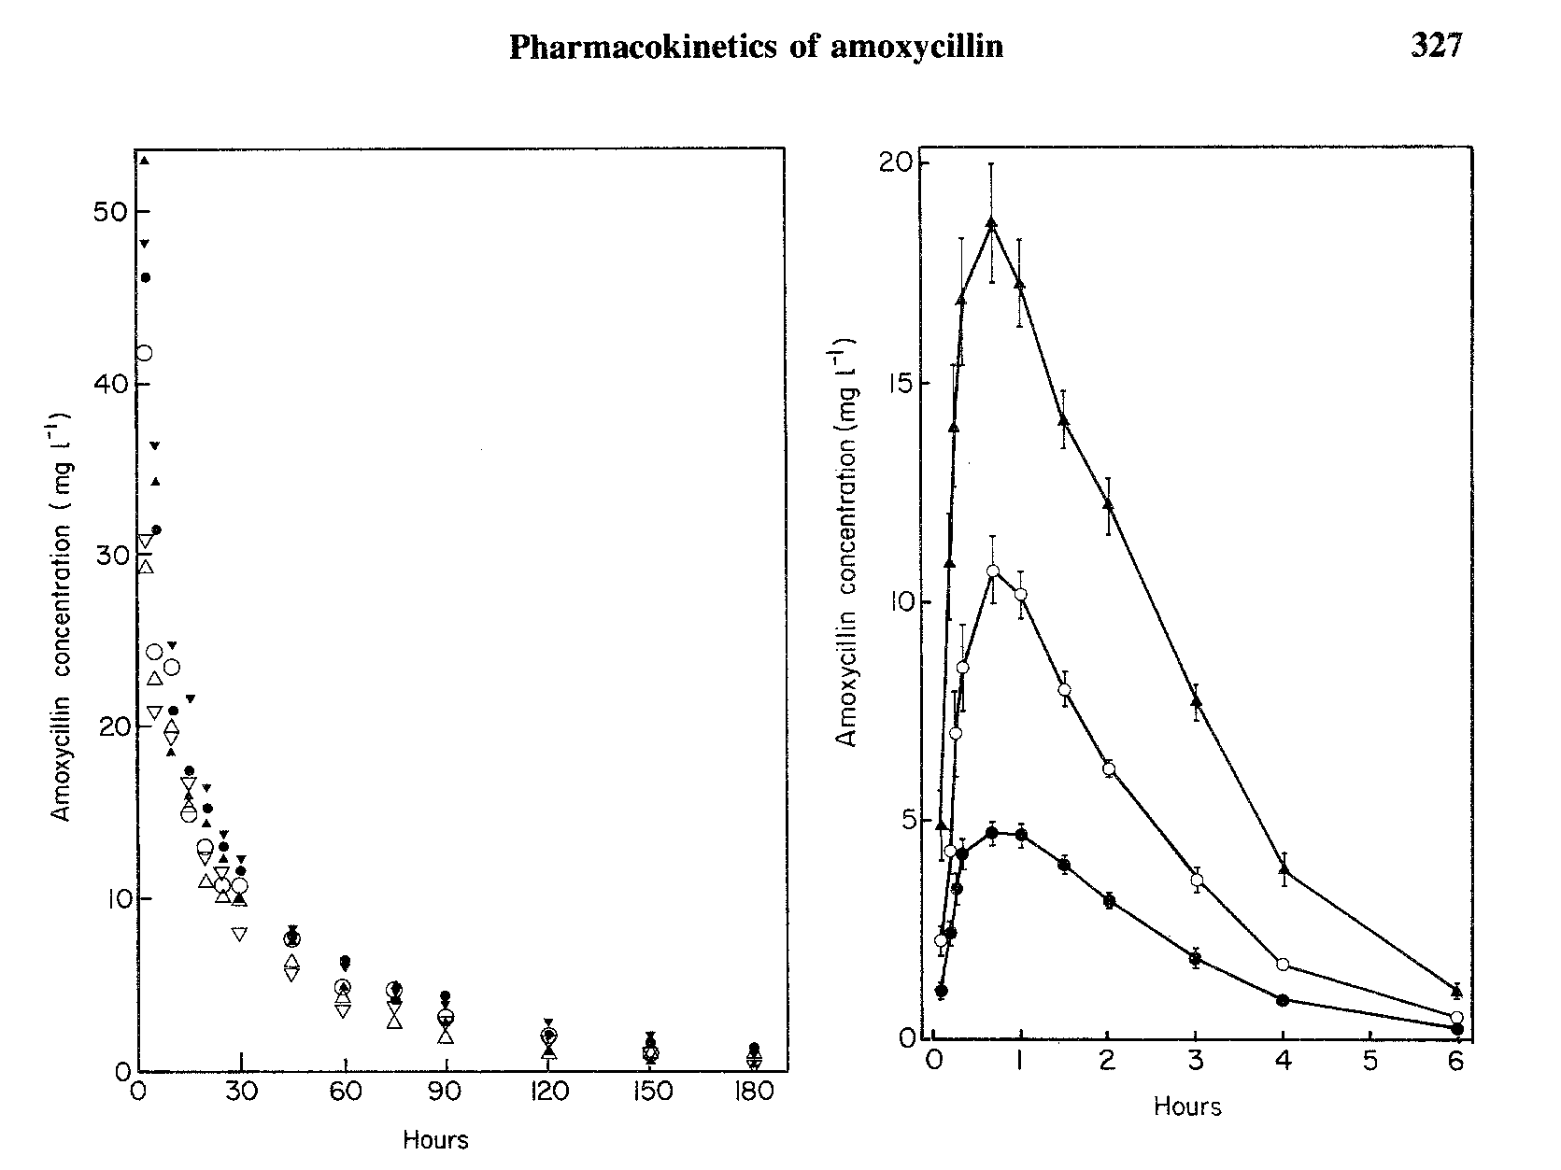
Tradition antimicrobial pharmacokinetics
Hill et al, Journal of Infection 1980 2, 320-332

Slide 10
Population Pharmacokinetic modelling
Vc = x * (y*body weight) * (z*age)
CL = x * (y*renal function) * (z*liver function)
IV drug
Plasma
(Vc)
Peripheral compartment
(Vp)
Movement constants (KCP KPC)
Drug clearance
(CL)

Slide 11
PopPK modelling
Allows incorporation of population variables that may affect the drug pharmacokinetics (e.g. body weight, renal function)
Can simulate pharmacokinetics for population limits

Slide 12
However…
PopPK models only as good as the available PK data, and most PK data is from healthy (usually male) Caucasian volunteers
Limitations in extrapolation of prediction to
- Certain demographics (ethnicities, age)
Co-morbidities (e.g. Renal and liver disease)
Certain medical contexts (e.g. Pregnancy, critical illness)
Body sites beyond that sampled (e.g. bone, CNS)

Slide 13
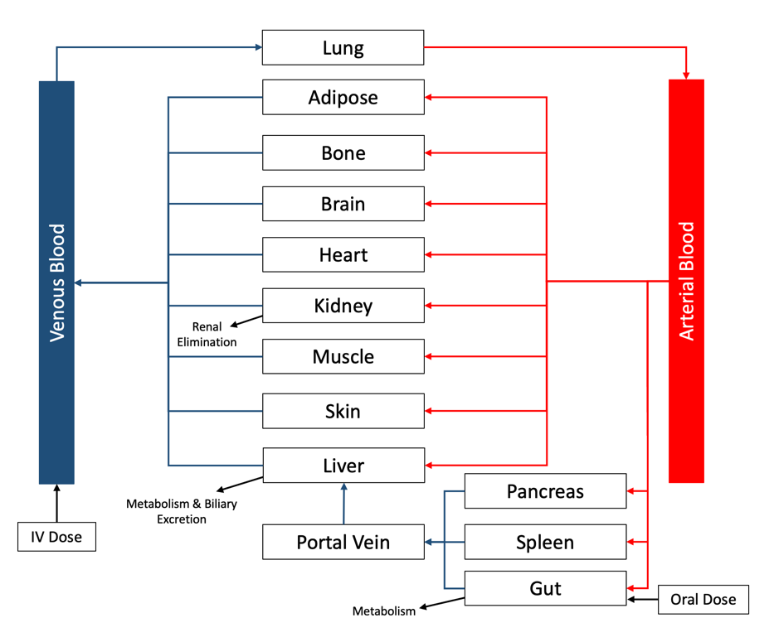
Physiology-based PK modelling
Uses physiological, biochemical and anatomical insights of the body
with
Phys-chemical and pharmacological properties of drug to predict pharmacokinetics
Can predict:
Drug concentrations in particular tissues
Variations of pharmacokinetics with different special populations
Interactions of drugs not tested in combination
Predict human pharmacokinetics for molecules in early drug development)

Slide 14
Pharmacodynamics

Slide 15
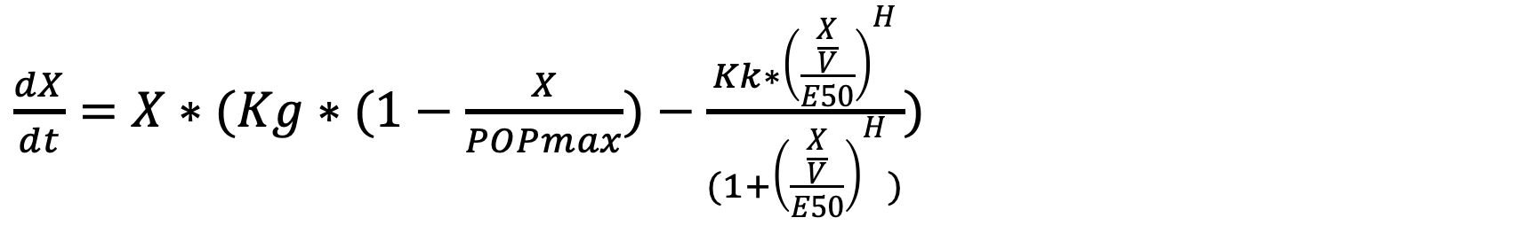
Pharmacodynamic modelling
$\frac{dX}{dt}=X∗(Kg∗(1−\frac{X}{POPmax})−\frac{Kk∗{\left(\frac{\frac{X}{V}}{E50}\right)}^{H}}{(1+{\left(\frac{\frac{X}{V}}{E50}\right)}^{H})})$
Where X = bacterial population

Slide 16
Pharmacodynamic data from Humans
In theory, most ideal situation
However
Data usually either categorical (e.g. mortality, microbiology success) or use of surrogates (e.g. inflammatory markers)
Cannot measure effect for sub-maximal effect (ethically, at least)

Slide 17
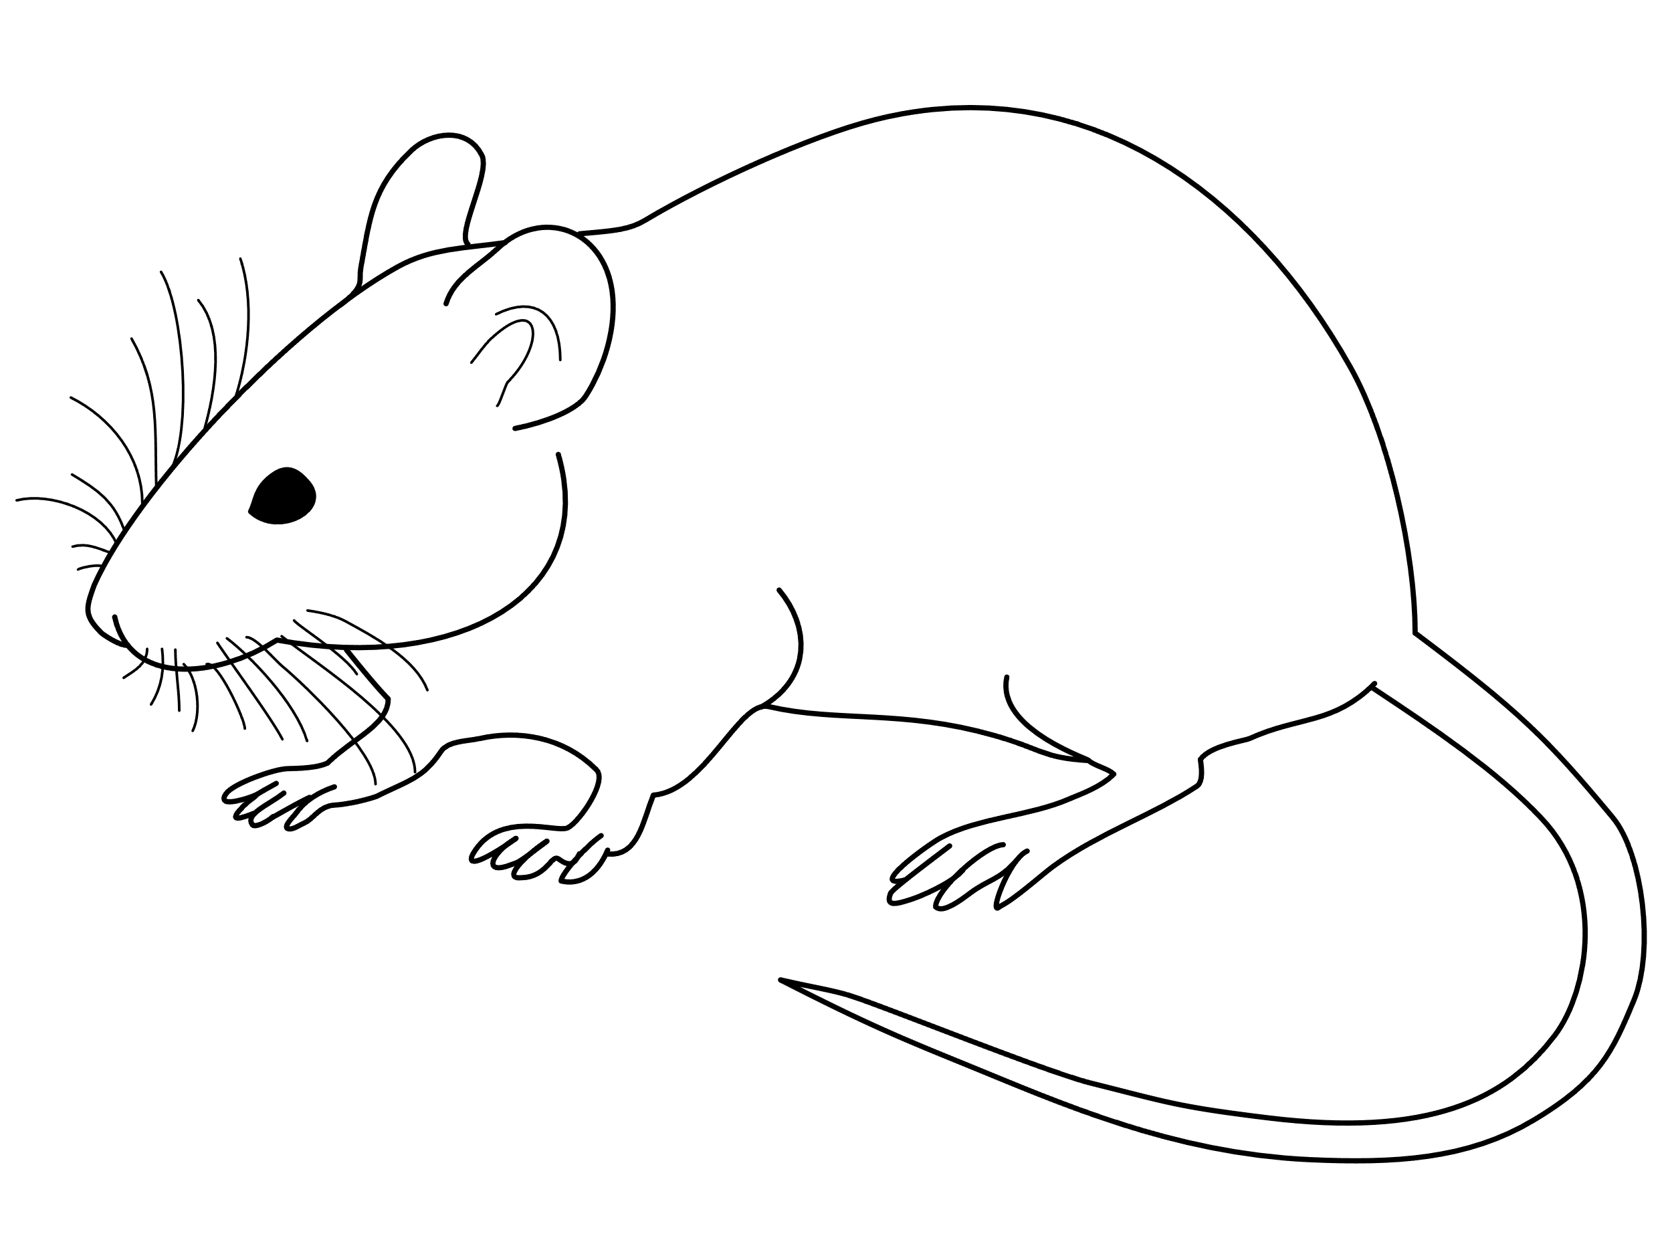
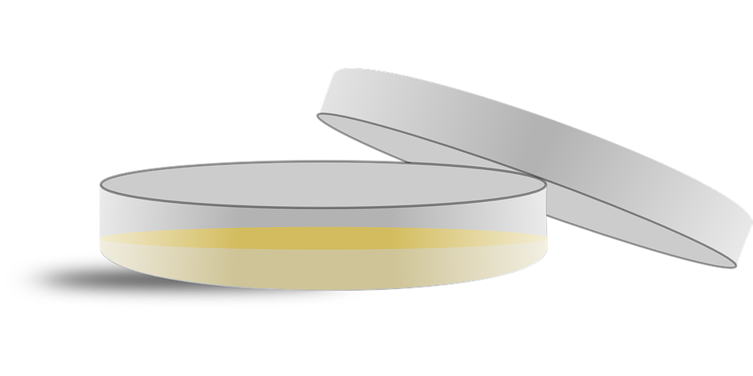
Neutropenic mouse model
Administer Cyclophosphamide
Inject bacterial inoculum
Administer antibiotic
Neutropenic mouse
Quantification

Slide 18
Neutropenic mouse model
Benefits
Standardised and reproducible
Lots of experience with the model
Conclusions readily translate to humans
Cornerstone of PK/PD target definition
Limitations
Resistance is almost never measured
Mice usually cannot survive for >24-48h
Mice are small, and therefore small inoculum
Differences in animal PK and physiology

Slide 19
Hollow Fibre infection model

Slide 20
Hollow Fibre infection model
Benefits
Can examine resistance
Can use high inoculum infections over a long period of time
No use of animals
Can use whichever PK profile you like
Limitations
Expensive
Cannot replicate holistic tissue partitioning
Lacks physiological context (protein binding, immune effectors etc.)
Lack of track record with translation to humans

Slide 21
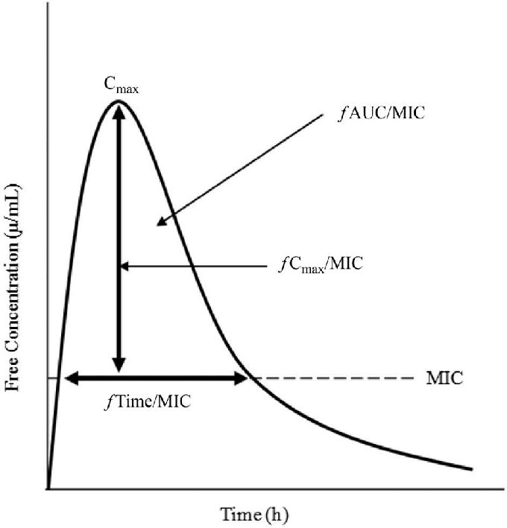
PK/PD model outcomes
1. Define the relevant pharmacodynamic index

Slide 22
PK/PD model outcomes
2. Define the pharmacodynamic target index for e.g. bacterial stasis, 1-log bacterial kill or suppression of emergence of resistance
e.g.
Cmax:MIC > 10
AUC:MIC >200
%Time above MIC >50%
…and define regimen in humans that meets them

Slide 23
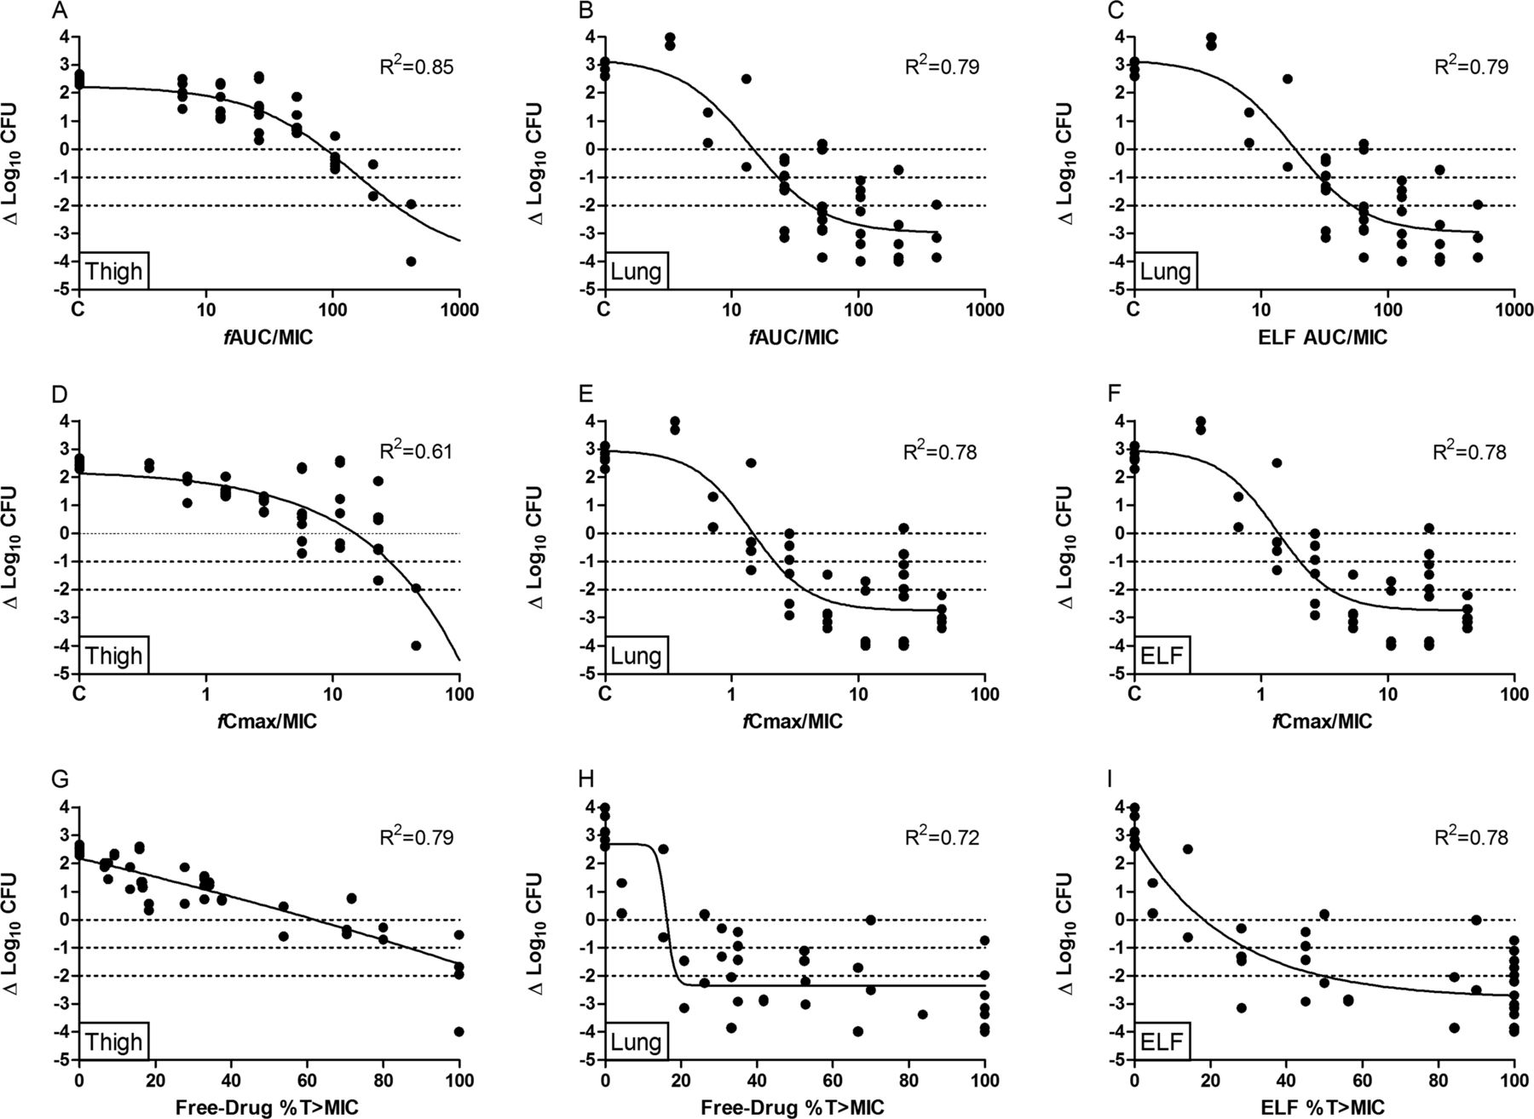
Melchers et al, AAC, 2018

Slide 24
PK/PD model outcomes
3. Simulate pharmacodynamic outcome in humans.
Mouse
PK model
Mouse PD model
Human meropenem PK model

Slide 25
PK/PD model outcomes
4. Characterise pharmacodynamic interactions of drugs
i.e. Determine if drugs are synergistic or antagonistic for both bactericidal effect and emergence of resistance

Slide 26
* Arm contaminated and terminated early
Notes:
The full pharmacodynamic output is shown here with the arms are laid out as the previous slide, with increasing dose of administered flomoxef as you go across to the right, and increasing fosfomycin as you go down. The black line with circles indicates the total bacterial count; the blue line indicates flomoxef ‘resistant’ bacterial counts; and the green line indicates fosfomycin resistance counts.
Talking you through this, if we start with arm 1 – with no drugs administered. The natural course of the bacterial inncoulum is to grow to the natural limits of log 10-11, with naturally emerging levels of resistance to both agents due to mutational frequency
If we look at the left-hand column, with increasing fosfomycin monotherapy, you have increasing initial kill, but with rapid emergence of fosfomycin resistance replacing the entire population, with MICs >128mg/L
If we looking at the arms with increasing flomoxef monotherapy, you see similarly increasing bacterial kill in the first 24h, but an inability to kill to sterility, with an equilibrium forming at just above or below the LoD. Despite this, no resistance emerges in any arm.
In the remaining 9 arms with varying combination of doses, we see a greater magnitude of kill compared to comparable monotherapies, with sustained >3-log kill in all arms, with no emergence of resistance. (it is worth noting at this point that arm 8 contaminated halfway through the experiment and was terminated early).

Slide 27
In summary…
This whole process underpins optimal dose selection of antimicrobials

Slide 28
Some big limitations…

Slide 29
Human pharmacokinetics is often poorly characterised and/or from a limited population
Early antimicrobials not modelled well (if at all)
Data largely from (usually male) Caucasian healthy volunteers
Data often lacking from specific demographics and patient groups
Pharmacodynamics for bactericidal effect typically not characterised well for many antibiotics
Particularly older (and more frequently used antibiotics)
e.g. amoxicillin, flucloxacillin
Particularly in certain infection sites

Slide 30
Pharmacodynamics for antimicrobial resistance often not characterised at all
Drugs are not dosed appropriately to prevent emergence of resistance
Includes newly developed drugs
Arguably is the main reason for antimicrobial resistance

Slide 31
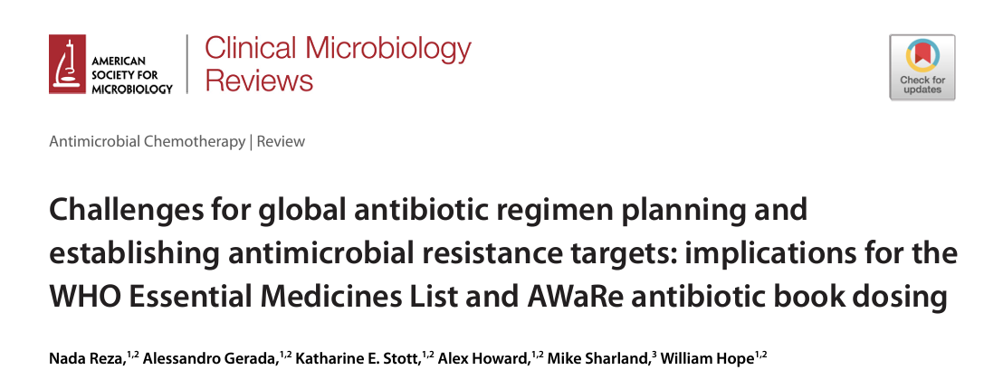

Slide 32
There are lot of assumptions built in
Translatability from in vivo / in vitro platform
The true ‘MIC’
Extrapolation of pharmacodynamics to other strains/species
Resource and time intensive
A PK/PD experimental package for a single drug-bug combination will take 6+ months and cost £100,000s
Impossible to keep up with evolving microbiology
Impossible to cover every drug-bug combination

Slide 33
Possible solutions
Just need to do more of everything
Utilise novel in silico options e.g. PBPK modelling
Greater PK data availability
Regulatory input (for antimicrobial resistance emergence)
Rethink of how we examine pharmacodynamics
Better ways to use human pharmacodynamic data?
Better measures of antimicrobial susceptibility than MIC?

Slide 34
Thank you

