Slide 1

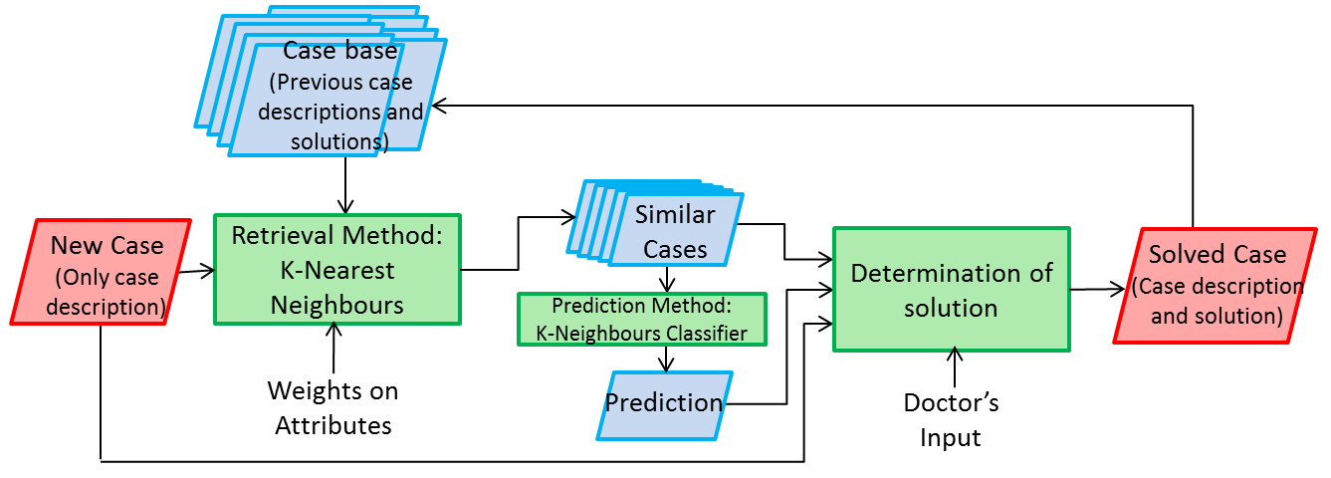
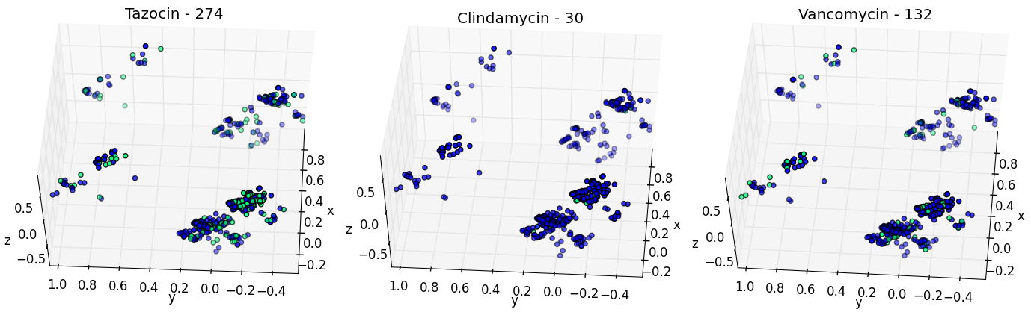
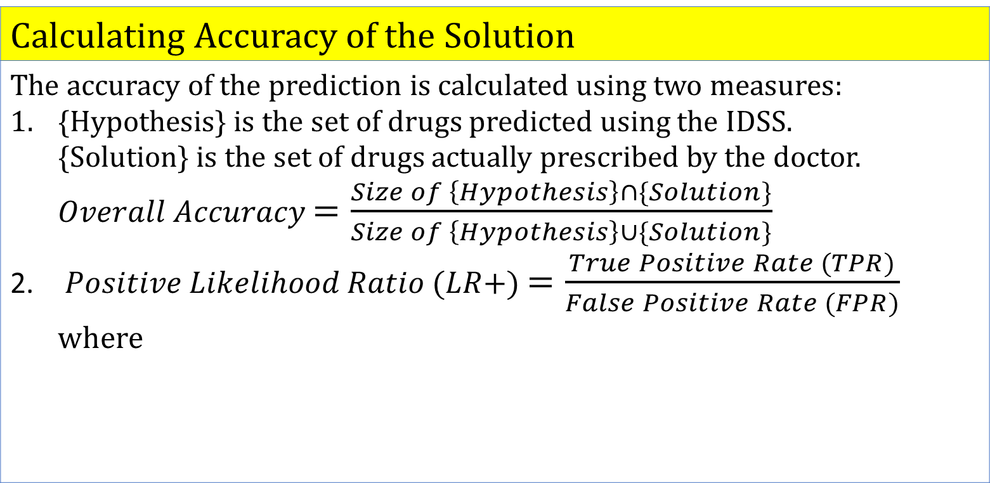
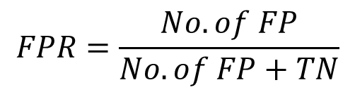
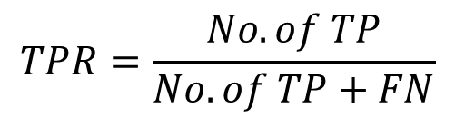
Helping Doctors Tackle Antibiotic Resistance:
Applying Machine Learning to the Development of an Intelligent Decision Support System for Antibiotic Prescribing
Done by: Kan Yan Ting Jamie Project Supervisor: Dr Pau Herrero Viñas, Dr Pantelis Georgiou
Background
Motivation
Rising antibiotic resistance is a major problem in UK and worldwide. Inappropriate prescriptions is a leading cause of antibiotic resistance. Effective antibiotic prescription is especially crucial for critically ill patients as antibiotic therapy often must be administered before laboratory results can be collected.
Objectives
Understand the decision process of an expert when prescribing drugs – i.e. understand the relative importance of attributes. Develop an Intelligent Decision Support System (IDSS) that is able to model the thinking process of an expert so as to present similar cases and alternative antibiotic therapy options. Measure the performance of the system.
1,2
2
Methodology
Intelligent Decision Support System
The system uses the technique of Case Based Reasoning (Fig. 1): A new case is received containing attributes e.g. age, lactate levels. Similar cases are retrieved from the case base of previous cases using the K-Nearest Neighbours (KNN) algorithm. The solutions of the K most similar cases (lowest overall distance), together with a prediction (if available), are presented as possible treatments to the doctor, who decides on final antibiotic prescription. The solved case (attributes and solution) is added into the case base.
Measuring Performance of IDSS
Stratified K-folds cross validation is used to measure system performance using the existing case base. The case base is split into a training set and a testing set. The prediction is compared to the actual solution of the test case.
Calculating Accuracy of the Solution
The accuracy of the prediction is calculated using two measures: {Hypothesis} is the set of drugs predicted using the IDSS. {Solution} is the set of drugs actually prescribed by the doctor. $Overall Accuracy$ $=\frac{Size of \left\{Hypothesis\right\}∩\{Solution\}}{Size of \left\{Hypothesis\right\}∪\{Solution\}}$ $Positive Likelihood Ratio (LR+)$ $=\frac{True Positive Rate (TPR)}{False Positive Rate (FPR)}$ where
Fig 1: Flow chart showing concept of IDSS
3
$$TPR=\frac{No. of TP}{No. of TP+FN}$$
$$FPR=\frac{No. of FP}{No. of FP+TN}$$
TP: True Positive
FP: False Positive
TN: True Negative
FN: False Negative
,
Results
Clustering using Principal Component Analysis (PCA)
Relative Importance of Attributes
There are 239 combinations of drugs in the case base – a random guess has an accuracy of 0.4%. By using IDSS with equal weights, overall accuracy of 19.7% – better than random guess. Optimally assigned weights (Fig. 3) gives an improved average accuracy of 25.5% per case. Attribute’s weight indicates how important an expert perceived that attribute to be. Most significant attributes like patient age and ventilation support indicate severity of situation. This is consistent with a qualitative study done by Kushniruk et al.
Broad-spectrum drugs (e.g. Tazocin) occur in all 4 main clusters.
Narrow-spectrum drugs (e.g. Clindamycin) are well clustered.
Fig. 2: Clustering of drugs for (a) Tazocin, (b) Clindamycin, (c) Vancomycin
Vancomycin is a special situation: narrow spectrum drug but frequently prescribed and occurs in all the clusters. Doctors have confirmed that it was overprescribed.
Accuracy of Prediction
 | The baseline for LR is 1, and the higher the LR, the higher the confidence in the prediction. Basic LR+: Equal weights given to all attributes Best LR+: Optimal set of weights for each drug For all 12 drugs, Best LR+ >Basic LR+>1 Shows that IDSS can model the decision process of the expert, and weights achieves more accurate predictions. Broad-spectrum drugs (e.g. Amikacin) have a lower prediction accuracy. Narrow-spectrum drugs (e.g. Clindamycin) were prudently prescribed, well-clustered and well-modelled
Weights = 0:
Respiration Rate
Chest Examination
Oxygen Requirements
Drug Name | Basic LR+ | Best LR+
Vancomycin | 2.02 | 3.56
Ceftriaxone | 6.81 | 10.83
Amikacin | 2.60 | 6.88
Clindamycin | 7.02 | 22.46
Fig. 3: Weights of attributes for highest overall accuracy
Table 1: Positive likelihood ratio focussing on 4 drugs as key examples out of 12 drugs studied
4
Conclusion
The IDSS developed was successful in recommending antibiotics that an expert would have prescribed. However, the accuracy of the prediction depends on the quality of the database/ training set. We have assumed that the doctors’ prescriptions in the database are the “gold standard”. However, this is not true e.g. Vancomycin is overprescribed. | The weights assigned models the decision making process of the doctor and indicates which attributes they placed more emphasis on. The doctors can also use the weights as a feedback and refocus their emphasis if necessary, so as to prevent misuse of a drug The next step will be to perform clinical trials to measure the usefulness of the IDSS.
References: BBC (2015, April 6) Antibiotic resistance: 80,000 'might die' in future outbreak [online] Available: http://www.bbc.co.uk/news/uk-32193606 [accessed 17 August 2015]. The NHS in England – NHS Choices (2014, September 24) The Antibiotic Awareness Campaign [online] Available: http://www.nhs.uk/NHSEngland/ARC/Pages/AboutARC.aspx [accessed 15 August 2015] | Aamodt, Agnar, and Enric Plaza. "Case-based reasoning: Foundational issues, methodological variations, and system approaches." AI communications 7.1 (1994): 39-59. Kushniruk, Andre, Vimla Patel, and David Fleiszer. "Analysis of medical decision making: a cognitive perspective on medical informatics." Proceedings of the Annual Symposium on Computer Application in Medical Care. American Medical Informatics Association, 1995.

