Slide 1

T-Reqs: HTTP Request Smuggling with Differential Fuzzing
Bahruz Jabiyev¹, Steven Sprecher¹, Kaan Onarlioglu², Engin Kirda¹
(¹ Northeastern University, ² Akamai Technologies)

Slide 2

HTTP protocol
POST /search HTTP/1.1
Host: google.com
Content-Length: 16
query=funny+cats
POST /search HTTP/1.1
Host: google.com
Transfer-Encoding: chunked
6
query=
A
funny+cats
0
;foo=bar
funny cats
X-Header: Value

Slide 3
HTTP Request Smuggling (HRS)
POST /search HTTP/1.1
Host: google.com
Content-Length: 16
query=funny+cats
POST /search HTTP/1.1
Host: google.com
Transfer-Encoding: chunked
6
query=
A ;foo=bar
funny+cats
0
X-Header: Value

Slide 4
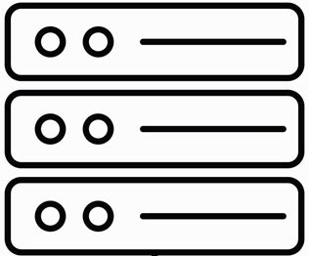
HTTP Request Smuggling (HRS)
POST /search HTTP/1.1
Host: google.com
Transfer-Encoding: chunked
6
query=
A ;foo=bar
funny+cats
0
X-Header: Value
Reverse Proxy
Origin

Slide 5
HTTP Request Smuggling (HRS)
POST /search HTTP/1.1
Host: google.com
Transfer-Encoding: chunked
Content-Length: 64
6
query=
A ;foo=bar
funny+cats
0
X-Header: Value AAAAAAAAAA
;
Reverse Proxy
Origin
Notes:
Note that reverse proxy uses the same connection for the next request

Slide 6
HTTP Request Smuggling (HRS)
POST /search HTTP/1.1
Host: google.com
Transfer-Encoding:;chunked
Content-Length: 64
6
query=
A ;foo=bar
funny+cats
0
X-Header: Value AAAAAAAAAA
Reverse Proxy
Origin
AAAAAAAAAA
Notes:
Note that reverse proxy uses the same connection for the next request

Slide 7
HTTP Request Smuggling (HRS)
GET /blog HTTP/1.1
Host: google.com
AAAAAAAAAA
AAAAAAAAAA
Notes:
Note that reverse proxy uses the same connection for the next request

Slide 8
HTTP Request Smuggling (HRS)
GET /abc HTTP/1.1
Host: google.com
GET /js HTTP/1.1
X:X
GET /blog HTTP/1.1
Host: google.com
Notes:
Note that reverse proxy uses the same connection for the next request

Slide 9




Attacks
Response Queue Poisoning
Notes:
Note that reverse proxy uses the same connection for the next request

Slide 10

Attacks
Response Queue Poisoning
Web Cache Poisoning
Notes:
Note that reverse proxy uses the same connection for the next request

Slide 11
Attacks
Response Queue Poisoning
Web Cache Poisoning
Bypassing Security Controls
Paypal and Slack cases
Notes:
Note that reverse proxy uses the same connection for the next request

Slide 12
Summary 1: Discrepancies in body parsing behavior of servers can be used for HRS, which in turn can pave the way for several attacks.

Slide 13
Research Questions
Can we systematically test for HRS at scale?
What technology stacks are at risk?
What parts of a request can induce body parsing discrepancies?
What escalates a body parsing discrepancy to HRS?

Slide 14
T-Reqs Fuzzer
POST /abcdef HTTP/1.1
<METHOD><URI><PROTO><VER>
TRACE /abc HTTP/1.0
Host: example.com
Content-Length: 13
query=bananas
<METHOD> : [GET, POST, TRACE]
Generating Inputs
<URI> : [/abc, http://a.bc/]
<PROTO> : [HTTP]
<VER> : [0.9, 1.0, 1.1]

Slide 15
T-Reqs Fuzzer
Generating Inputs
Mutating Inputs
String mutations
TR/ACE /a?c HTTP/10
TR/ACE /abc HTTP/1.0
TR/ACE /a?c HTTP/1.0
TRACE /abc HTTP/1.0
Host: example.com
Content-Length: 13
query=bananas

Slide 16
T-Reqs Fuzzer
Generating Inputs
Mutating Inputs
String mutations
Tree mutations
TR/ACE /a?c HTTP/10
<METHOD><URI><PROTO><VER>
HTTP /a?c HTTP/a?c/10
HTTP /a?c HTTP/a?c
TR/ACE /a?c HTTP/a?c/10
Host: example.com
Content-Length: 13
query=bananas

Slide 17
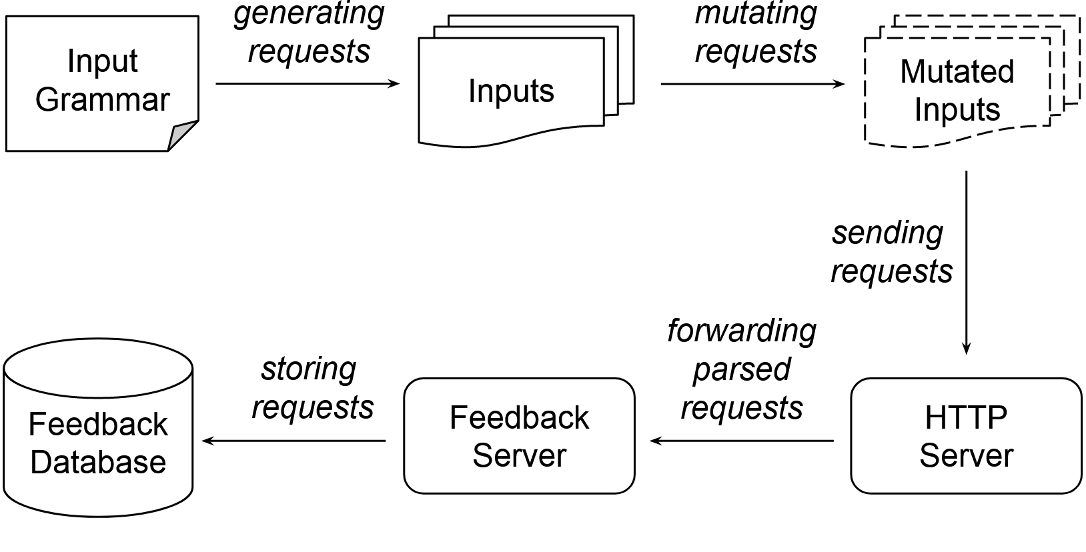
Experiment Setup
Apache httpd
NGINX
Apache Tomcat
ATS
HAProxy
Squid
Varnish
Akamai
Cloudflare
CloudFront

Slide 18
Summary 2: T-Reqs Fuzzer and the experiment setup let us systematically analyze the body parsing behavior of servers.

Slide 19
Research Questions
Can we systematically test for HRS at scale?
What technology stacks are at risk?
What parts of a request can induce body parsing discrepancies?
What escalates a body parsing discrepancy to HRS?

Slide 20
Experiments
Request Line
Request Headers
Request Body

Slide 21
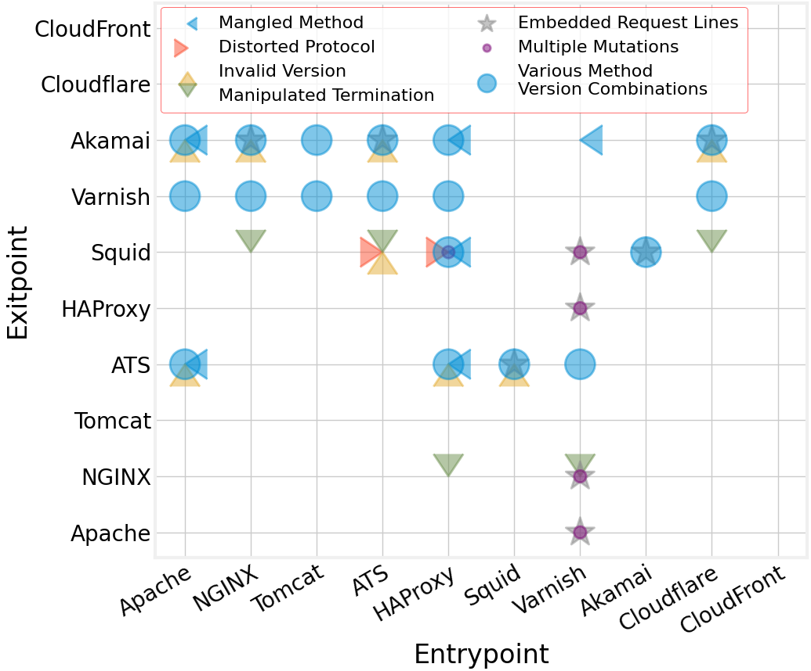

Slide 22
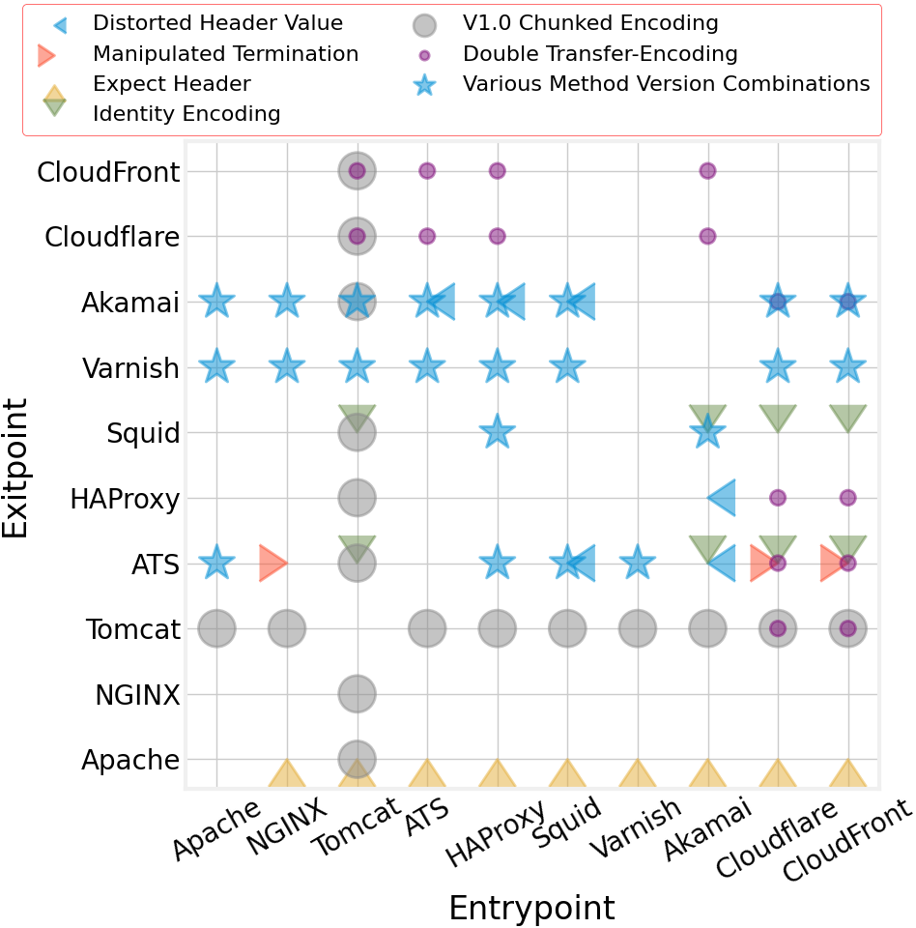
Category | Request Line
Distorted Protocol | GET / PTTP/1.1
Mangled Method | . / HTTP/0.9
Method Version Comb. | DELETE / HTTP/0.9
Multiple Mutations | GET / HTTP//1.1

Slide 23
Experiments
Request Line
Request Headers
Request Body

Slide 24
Category | Request Header(s)
Double Transfer-Encoding | Transfer-Encoding: identity Transfer-Encoding: chunked
Identity Encoding | Transfer-Encoding: identity
Manipulated Termination | Transfer-Encoding: chunked {Some-Header}:{Some-Value}

Slide 25
Experiments
Request Line
Request Headers
Request Body

Slide 26
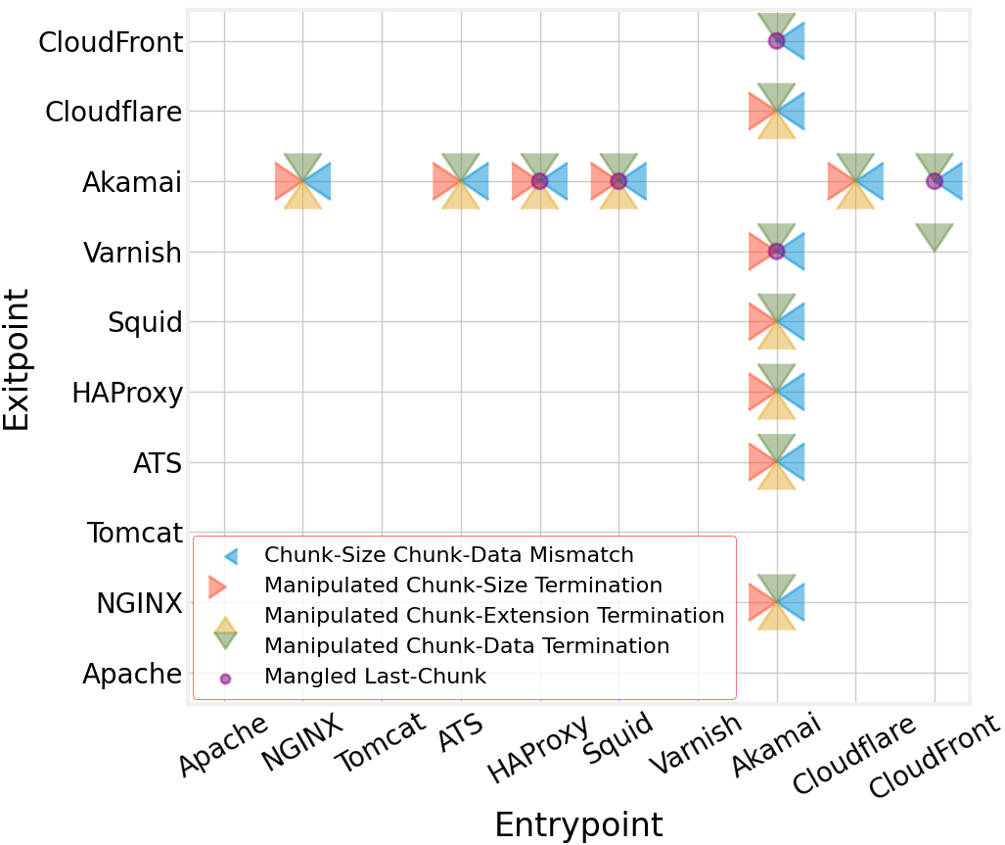
Category | Request Line
Size Data Mismatch | 4\r\nBBBB\r\n
Chunk Size Termination | 4\t\nBBBB\r\n
Chunk Extension Termination | 4;foo=bar\r\nBBBB\r\n
Chunk Data Termination | 4\r\nBBBB\r\n

Slide 27
Summary 3: Mutations in all parts of the HTTP request – request line, headers and body – can cause discrepancies between servers.

Slide 28
Research Questions
Can we systematically test for HRS at scale?
What technology stacks are at risk?
What parts of a request can induce body parsing discrepancies?
What escalates a body parsing discrepancy to HRS?

Slide 29
Testing for HRS
Technique inspired by previous research
Each pair is put together in proxy - origin
Smuggler request is sent
Benign request is sent right after
Error response from the origin server

Slide 30
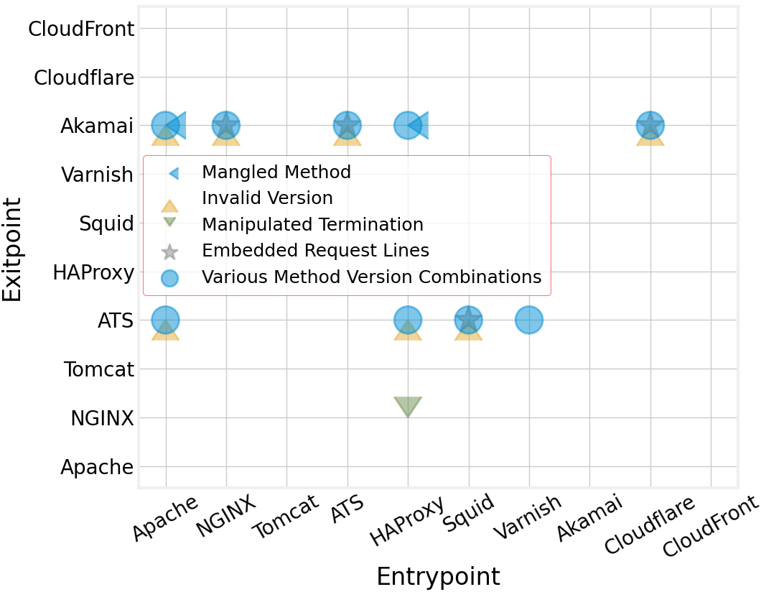
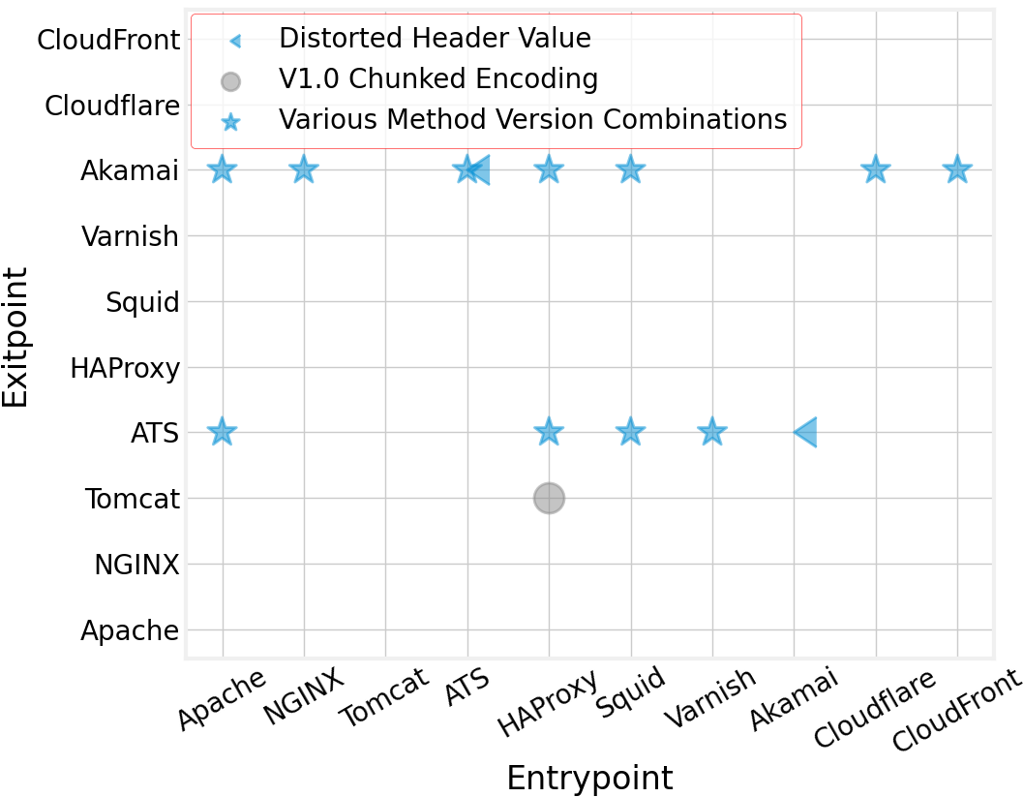
Confirmed HRS

Slide 31
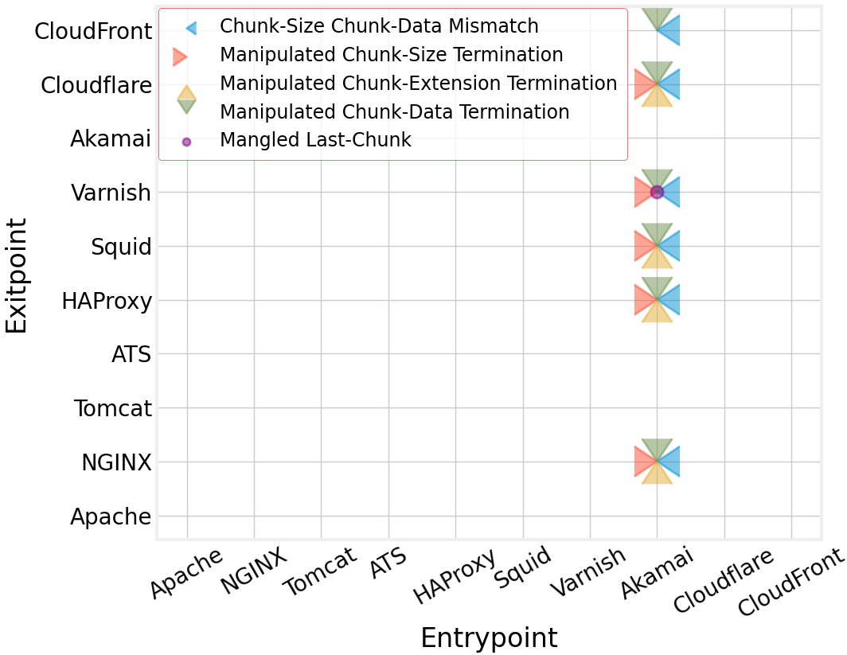
Confirmed HRS

Slide 32
Summary 4: Body parsing discrepancies on popular servers are opening the door to HRS.

Slide 33
Failure Conditions
Mutation not preserved
Notes:
Note that reverse proxy uses the same connection for the next request

Slide 34
Failure Conditions
Mutation not preserved
Connection closed
Notes:
Note that reverse proxy uses the same connection for the next request

Slide 35
Failure Conditions
Mutation not preserved
Connection closed
Exitpoint cleans
Notes:
Note that reverse proxy uses the same connection for the next request

Slide 36
Summary 5: Body parsing discrepancies can be exploited for HRS only when certain conditions hold.

Slide 37
Disclosure
Apache Tomcat assigned a CVE
NGINX implemented hardening measures
ATS showed its willingness to add T-Reqs to their toolset
CloudFront discovered holes in their defense
Akamai coordinated a response with the co-author

Slide 38
Discussion
There is a lot more to explore
Non-standard HTTP headers
Non-default configurations
High number of mutations
Longer experiments
Nobody to blame
Combinations create HRS, not individual servers

Slide 39
Conclusion
We developed an HTTP fuzzer to discover new HRS attack vectors.
We designed an experimental setup for more complete and effective testing.
We also provided insights into the conditions for a discrepancy to be used for HRS.
We showed the possibility of HRS attacks on popular servers.

Slide 40
Thank You!

