Slide 1


Biblical Phrases in To End All Wars
Origins · Meanings · Examples

Slide 2
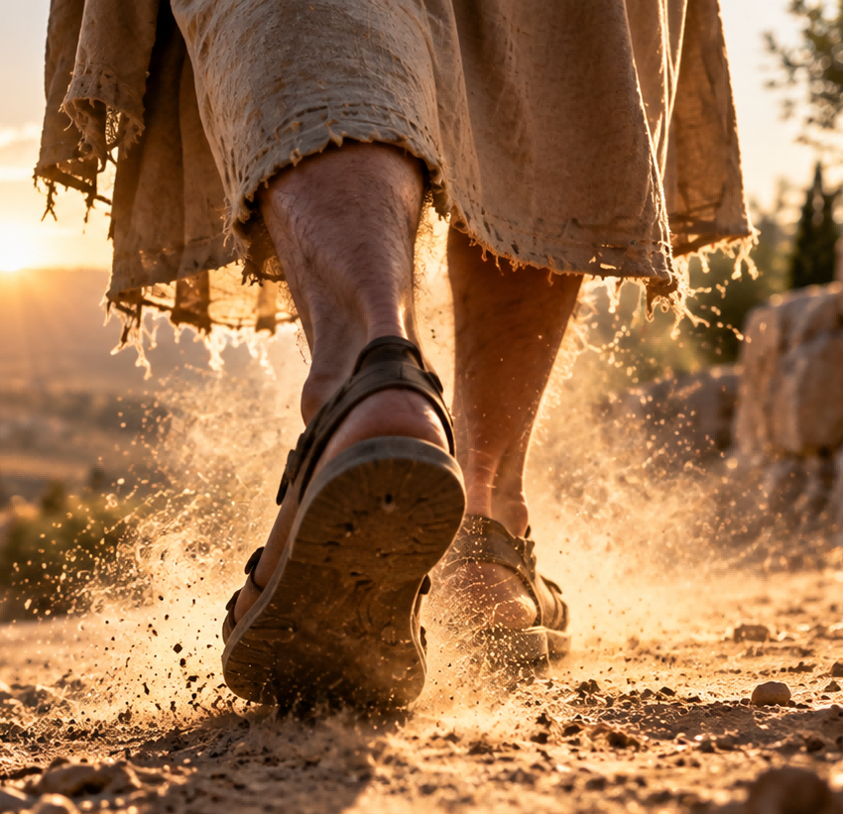
Shake the Dust Off One's Feet
抖掉脚上的灰尘，放下过去，转身离开
Origin
Jesus instructed his disciples to shake the dust off their feet when people refused to welcome them or listen to their message. The action symbolized leaving rejection behind.
Meaning
To walk away from an unpleasant situation, especially after being rejected or treated unfairly, and move on without dwelling on the past.
Example
After years of being treated unfairly, she finally shook the dust off her feet and found a better job.
阶段工作概述

Slide 3

Cast Pearls Before Swine
对牛弹琴，明珠暗投
Origin
Jesus used the image of throwing precious pearls before pigs to illustrate the importance of wisdom and judgment. Pearls represent something valuable that may not be appreciated.
Meaning
To offer something valuable, such as knowledge, advice, or kindness, to people who cannot or will not appreciate its worth.
Example
To offer something valuable, such as knowledge, advice, or kindness, to people who cannot or will not appreciate its worth.
阶段工作概述

Slide 4

Can the Leopard Change His Spots?
江山易改，本性难移。
Origin
The Bible asks whether a leopard can change its spots, using this natural image to show how difficult it is to change deeply rooted patterns of behavior.
Meaning
Used to express doubt about whether someone can truly change their character, nature, or long-established habits.
Example
He promised that he would never lie again, but can the leopard change his spots?
阶段工作概述

Slide 5
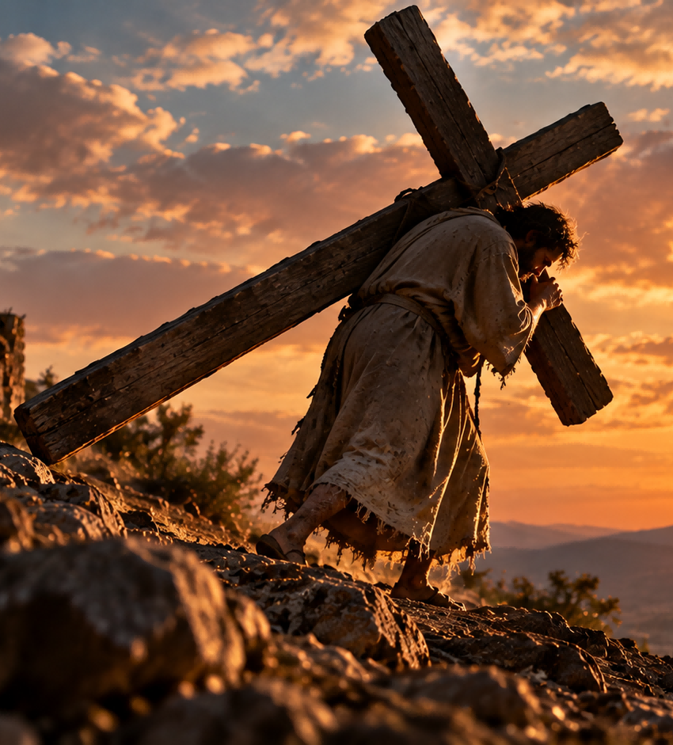
Bear One's Cross
背负自己的十字架
Origin
Jesus spoke about carrying one's cross as a symbol of the suffering, sacrifice, and commitment involved in following him.
Meaning
To accept and endure a difficult responsibility, personal burden, or suffering with patience and determination.
Example
Taking care of his seriously ill father was a heavy responsibility, but he accepted it as his cross to bear.
阶段工作概述

Slide 6
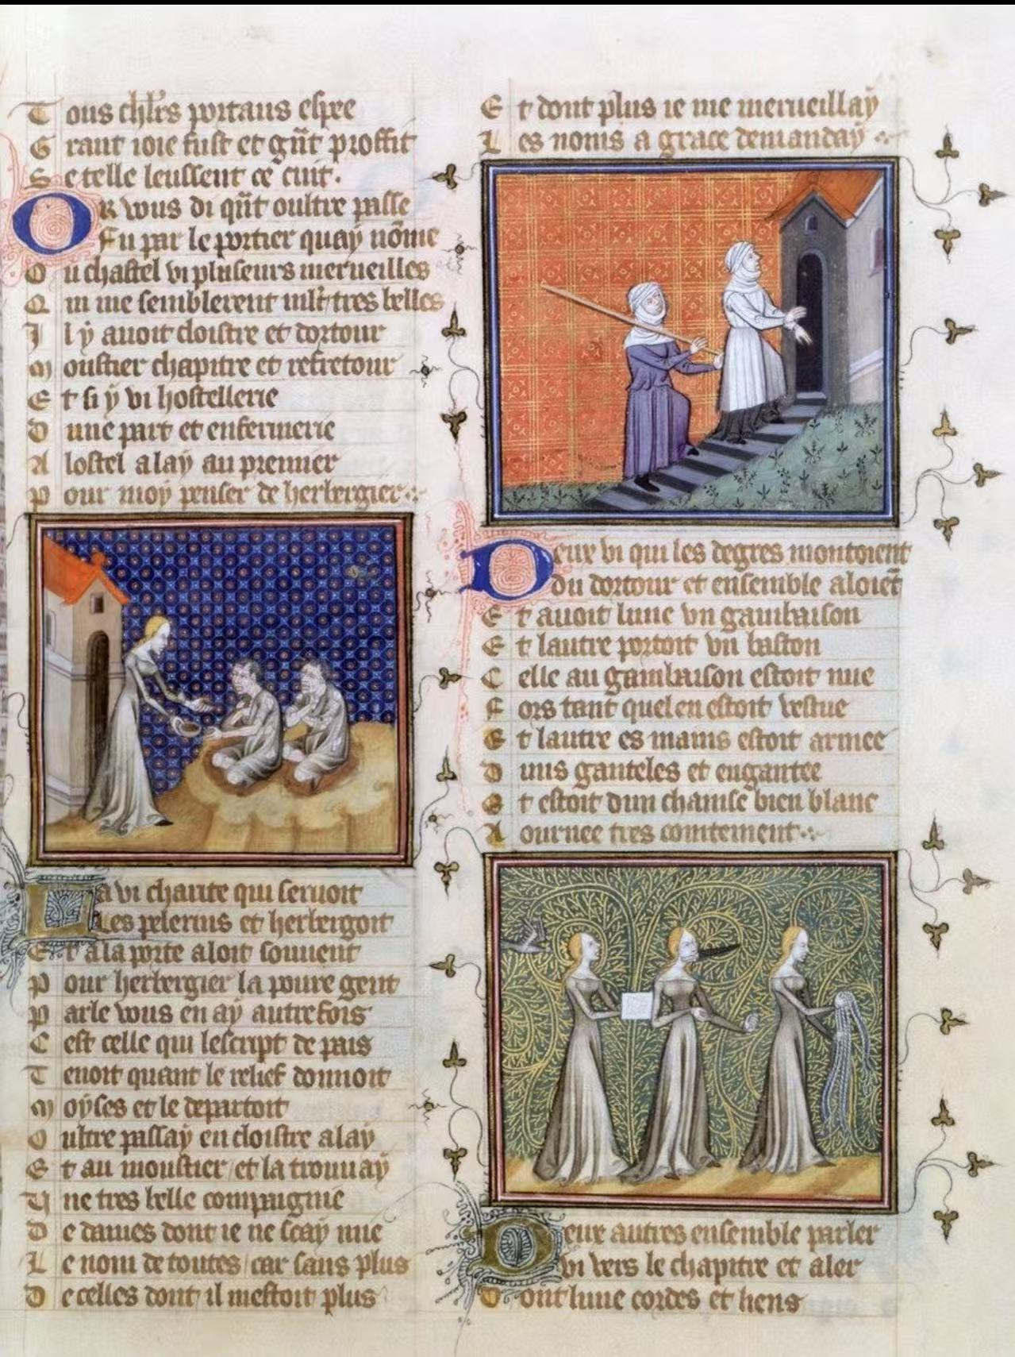
5.Not to let one's left hand know what one's right hand does
Source：
This phrase originates from the Bible, the sacred text of Christianity— from Matthew 6:3 in the New Testament, and it is part of Jesus’ Sermon on the Mount.
Meaning：
Original meaning: Do good secretly, seeking no recognition.
Modern meaning: Poor internal communication; each acts independently.
Example：
Original meaning: “She quietly paid for a stranger’s groceries and never told anyone—she really doesn’t let her left hand know what her right hand is doing.”
Modern meaning: “The sales team promised a Friday delivery, but the warehouse knew nothing about it—clearly the left hand doesn’t know what the right hand is doing.”

Slide 7
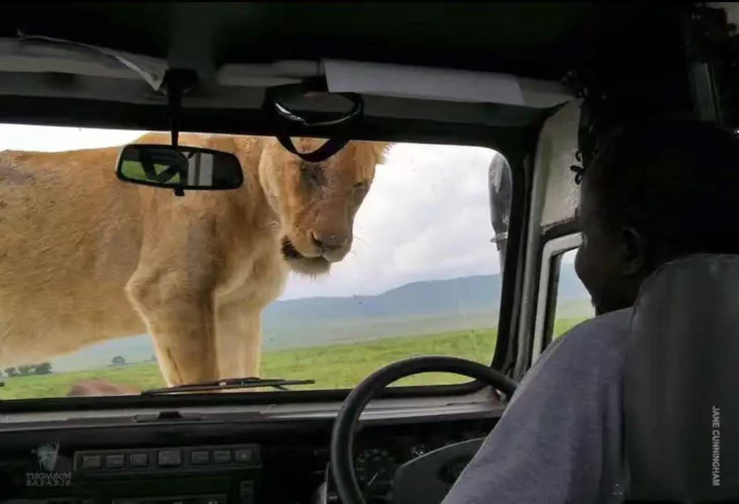
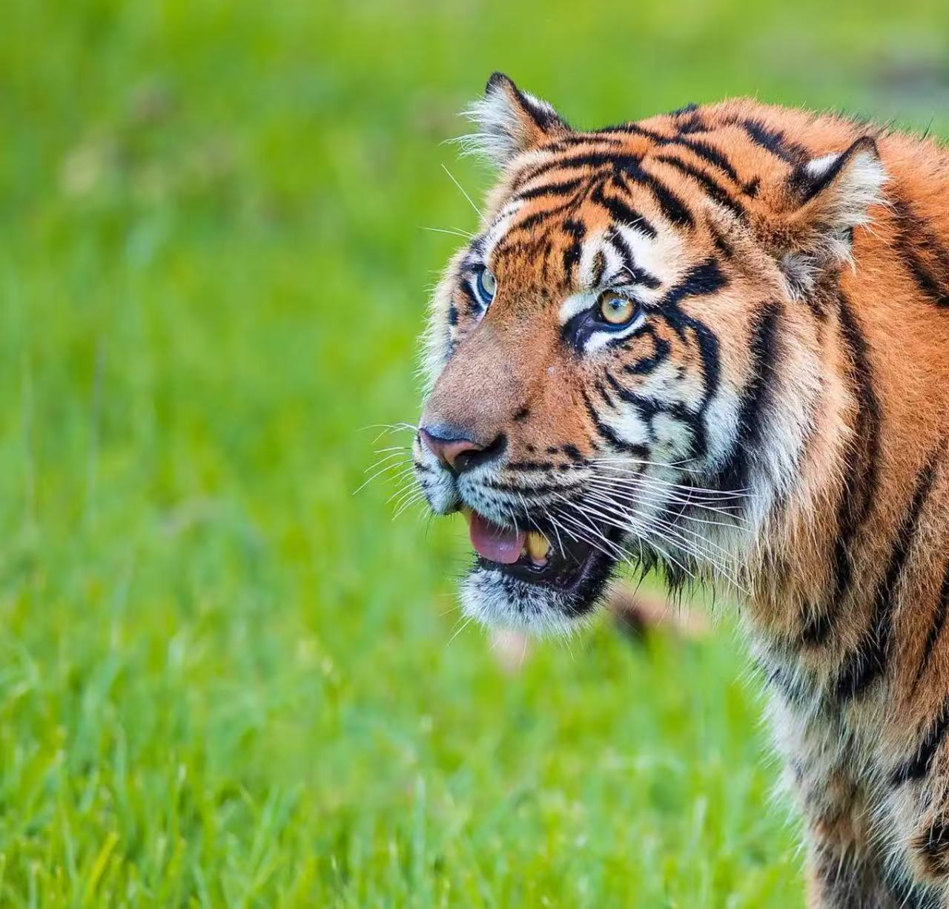
6.lion in the way
Source：
It comes from Proverbs 22:13, which describes a lazy person making excuses: "The slothful man saith, There is a lion without, I shall be slain in the streets."
Meaning：
An imaginary obstacle or excuse used to avoid doing something; a supposed danger that is really just a pretext for laziness or inaction.
Example：
“She claimed the traffic made it impossible to come, but it was a lion in the way; she simply didn’t want to go.”
阶段工作概述

Slide 8
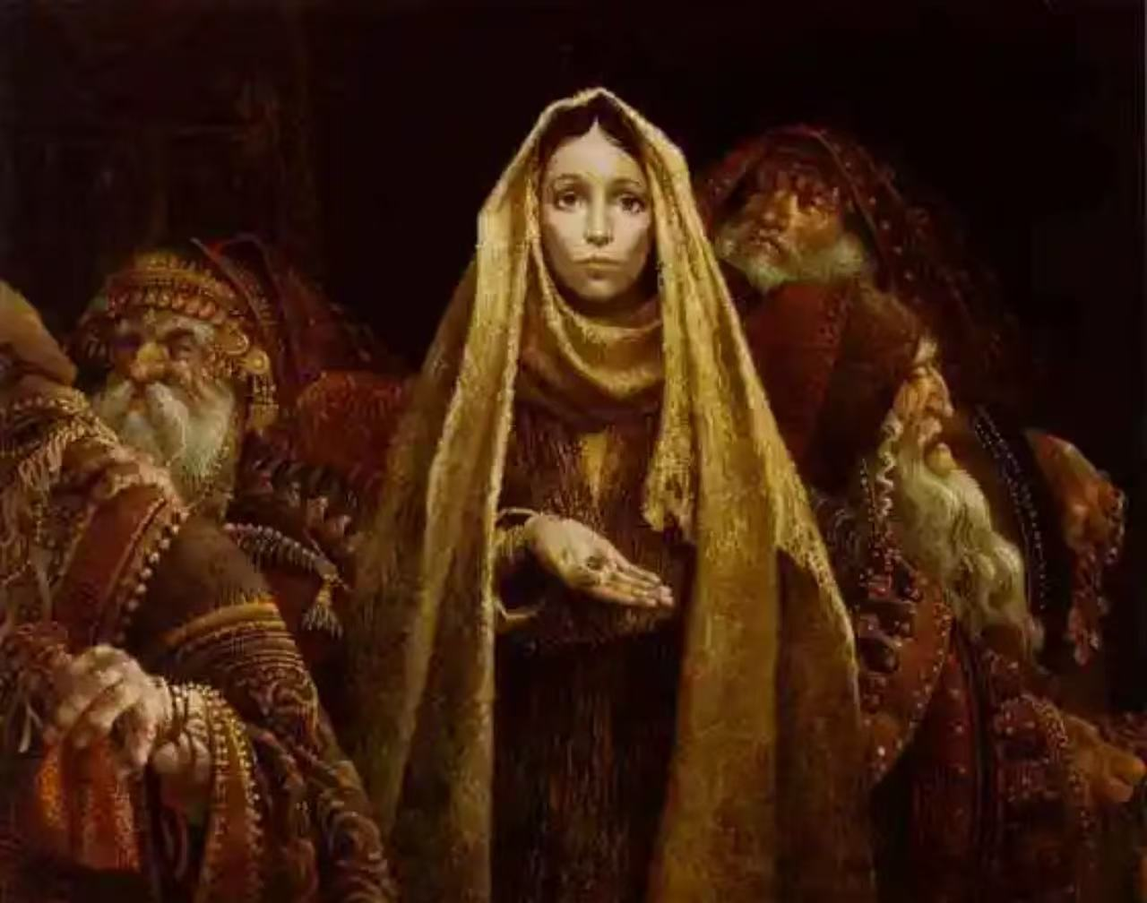
7.the widow's mite
Source：
Gospel of Mark 12:41–44. It refers to the story of a poor widow who gave two small coins (called "mites") to the temple treasury—an amount that was all she had to live on.
Meaning：
A small but generous contribution that costs the giver much—valued more than a large gift given from surplus; a humble offering made sacrificially.
Example：
“He only donated five dollars, but for him that was the widow’s mite—it was all he had.”
阶段工作概述

Slide 9

8.built on sand
Source：
Jesus’ parable in Matthew 7:24–27 (also Luke 6:46–49) about a house built on sand that collapses in the storm.
Meaning：
Having a weak or unreliable foundation; something built on shaky ground that will fail or collapse.
Example：
“Their business plan is built on sand—no real market research, just wishful thinking.”
阶段工作概述

Slide 10
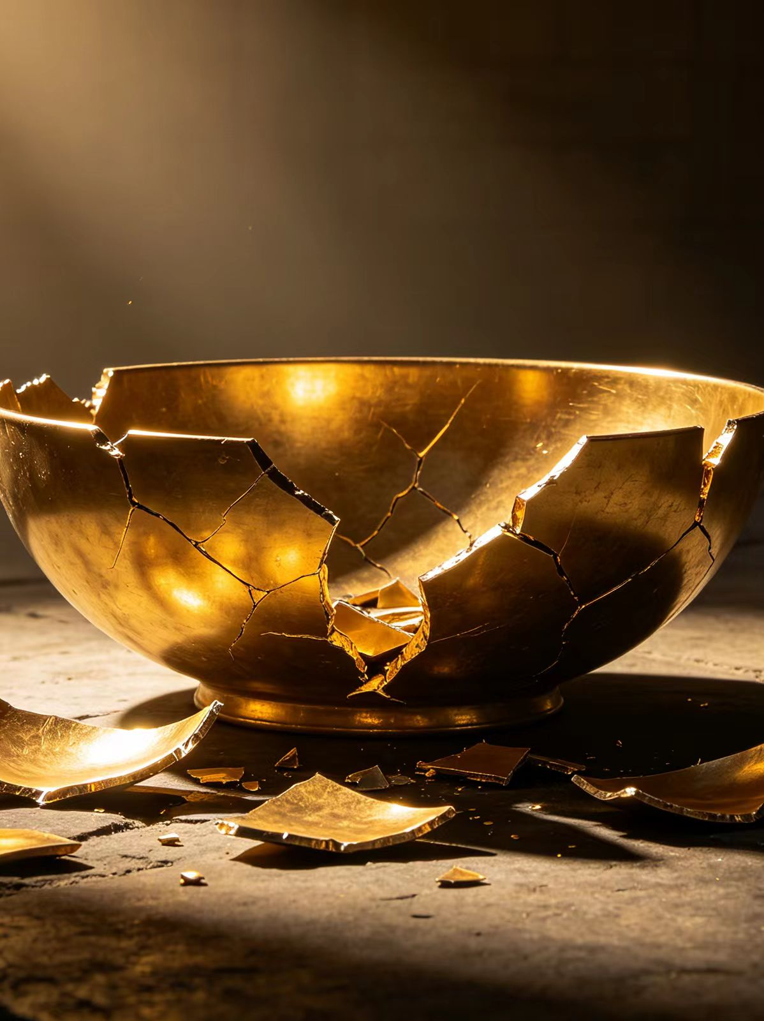
9. The golden bowl is broken
Source:
Ecclesiastes 12:6(Chapter12 Verse6)
In Ecclesiastes chapter 12, the author uses a series of metaphors to depict the process of human aging and death. The scripture reads: "The silver cord is snapped, and the golden bowl is broken; the pitcher is shattered at the fountain, and the wheel broken at the well."
Meaning:
This sentence is used to refer to the fragility of death and life.
Example Sentence:
The poet wrote a melancholy verse about the passing of time, lamenting that eventually, the golden bowl is broken for us all.

Slide 11
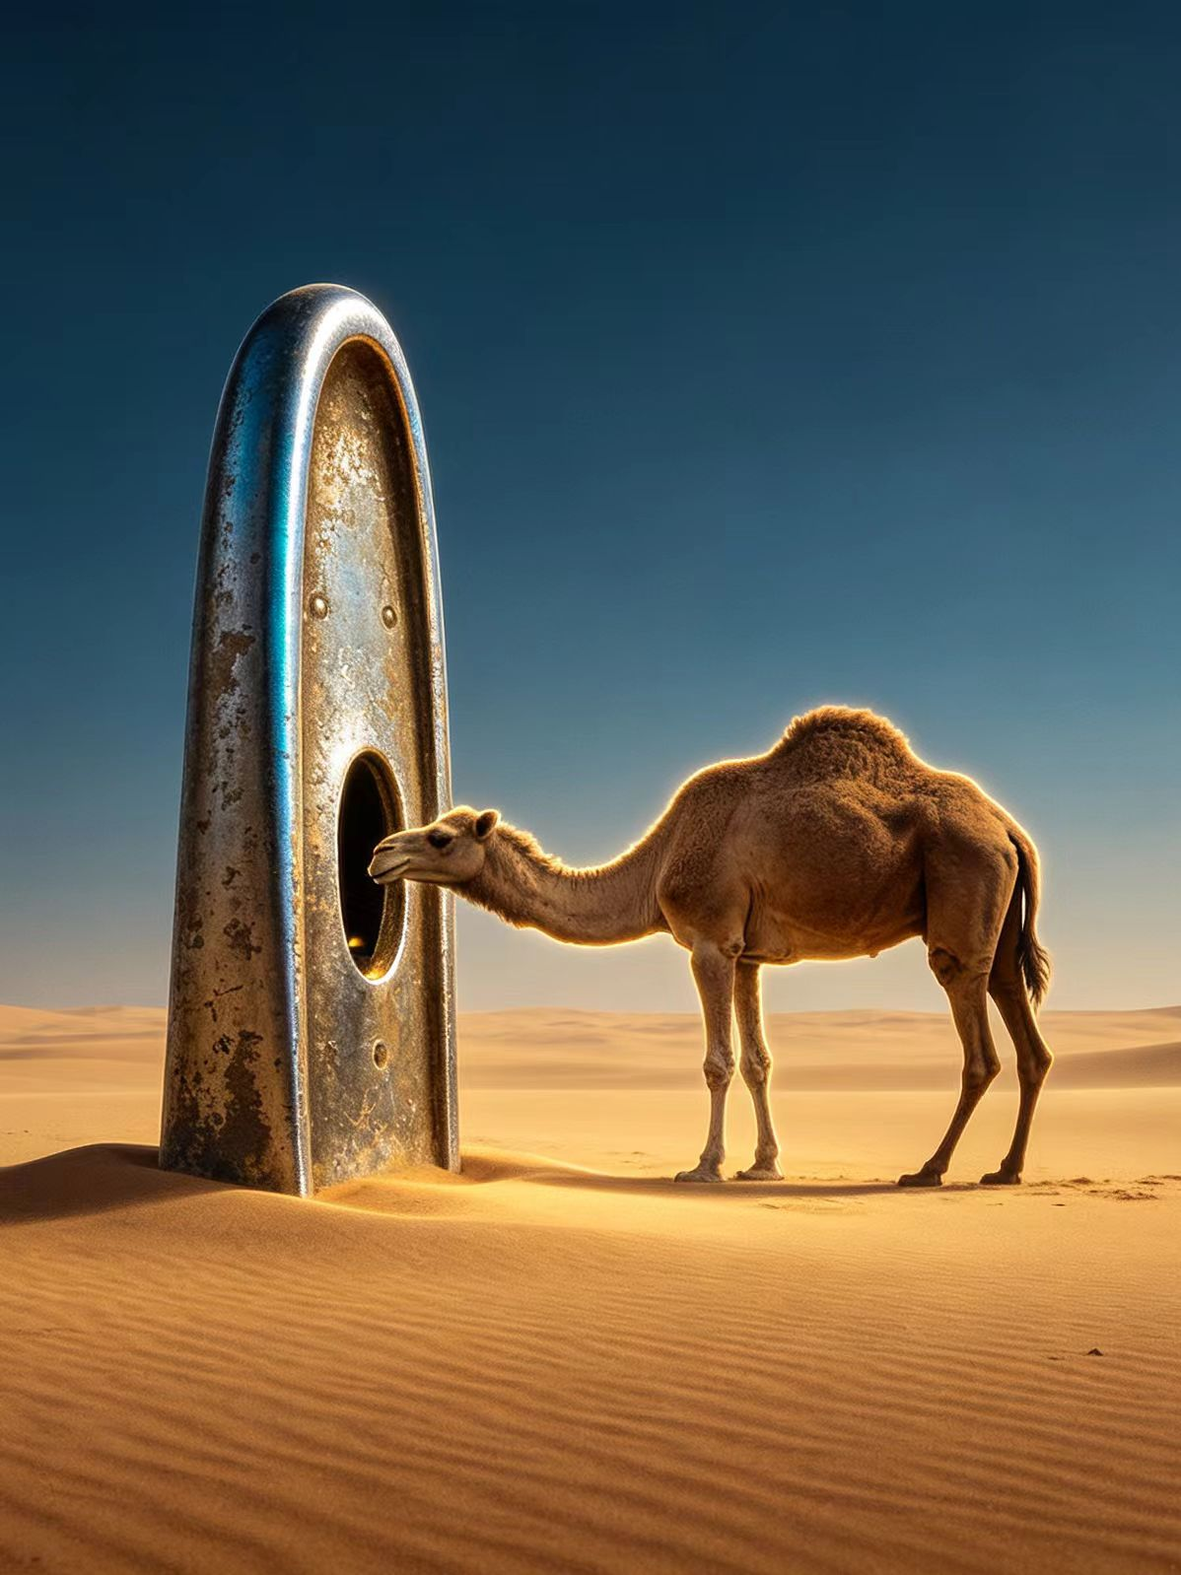
10.The camel goes through the eye of a needle
Source:
Matthew 19:24(Chapter19 Verse24); Mark 10:25(Chapter10 Verse25); Luke 18:25(Chapter18 Verse25).
Jesus said to his disciples, "It is easier for a camel to go through the eye of a needle than for a rich man to enter the kingdom of God." Here, the "eye of a needle" literally refers to the eye of a sewing needle. The camel was the largest common animal in the Middle East at that time. This is an extreme use of hyperbole.
Meaning:
Metaphorically speaking, something that is absolutely impossible to happen.
Example Sentence:
Getting him to apologize is like trying to get a camel to go through the eye of a needle.
阶段工作概述

Slide 12
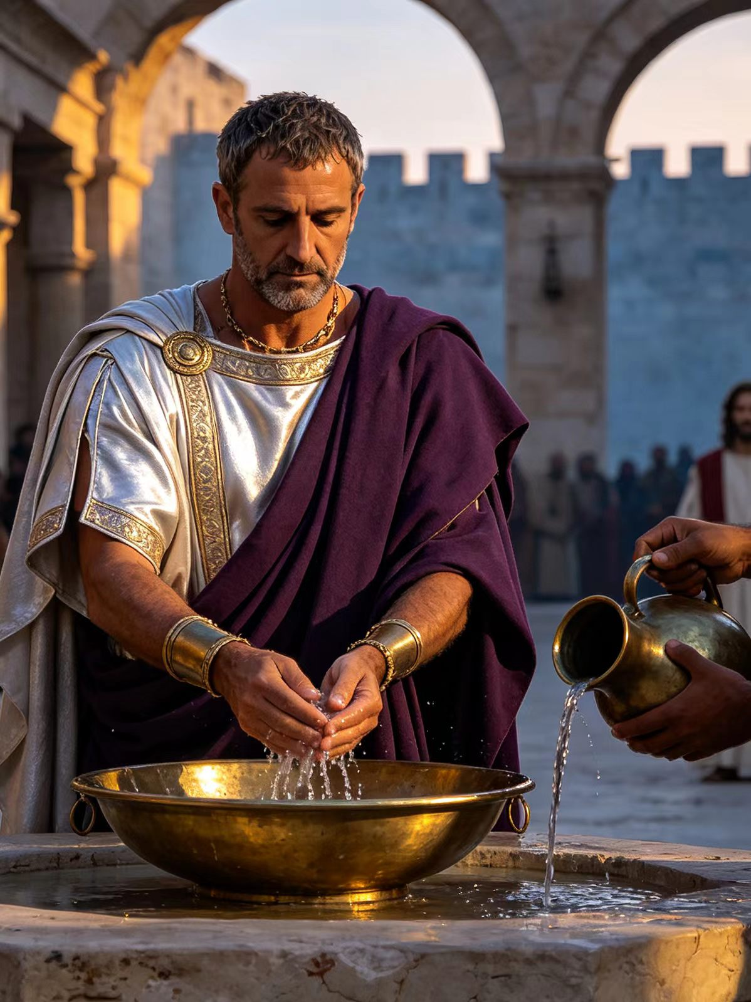
11. Wash one's hands of
Source:
Matthew 27:24(Chapter27 Verse24)
This was the famous act of Pontius Pilate, the Roman governor, during the trial of Jesus. At that time, the crowd demanded Jesus' execution. Seeing that his words were of no avail and that a riot was instead starting, Pilate took water and washed his hands before the crowd, saying, "I am innocent of the blood of this righteous man; it is your responsibility."
Meaning:
The actual meaning is to declare oneself unrelated to something bad, shirk responsibility, or refuse to participate in something again.
Example Sentence:
After years of trying to help him with his gambling problem, his family finally washed their hands of him.
阶段工作概述

Slide 13
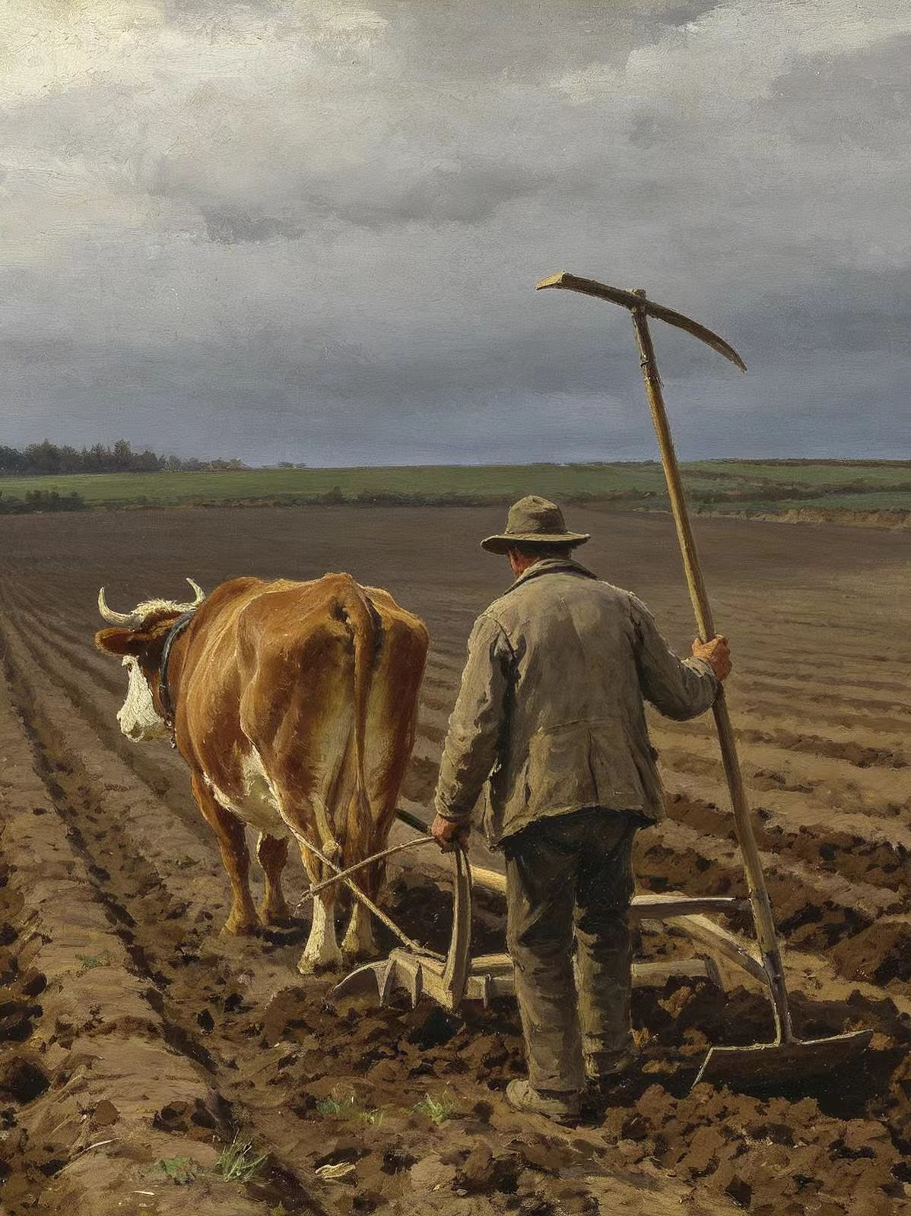
12. Put one's hand to the plough
Source:
Luke 9:62(Chapter9 Verse62)
Jesus said to a man, "Follow me!" But the man replied, "Lord, first let me go and bury my father." Jesus said to him, "No one who puts his hand to the plough and looks back is fit for service in the kingdom of God." In ancient agriculture, one had to keep looking forward while guiding a plough; if one looked back, the furrow would become crooked.
Meaning:
Metaphorically speaking, making up one's mind to start a job and persevering without hesitation. Once you start, you cannot be distracted or give up halfway.
Example Sentence:
Once you put your hand to the plough of starting your own business, you can't afford to look back with regrets.
阶段工作概述

Slide 14
At the eleventh hour
Meaning:at the last possible moment;just in time
Film source(subtitle):Yanker joined the group"a bit late in the term,but eager to catch up.".

Slide 15
Literary source:the story
The parable tells of a landowner who goes out early in the morning to hire laborers for his vineyard, agreeing to pay them a denarius (a typical day's wage).
He continues to hire more workers at the third hour (9 a.m.), the sixth hour (noon), and the ninth hour (3 p.m.), promising to pay them "whatever is right".
Finally, at the eleventh hour (around 5 p.m.), with only one hour left in the workday, he finds still others standing idle. When they explain that "no one has hired us," he sends them into the vineyard as well.

Slide 16
When evening comes, the owner instructs his foreman to pay the workers, beginning with the last and ending with the first. Those hired at the eleventh hour each receive a full denarius.The workers hired first expect to receive more, but they also receive a single denarius. They grumble, saying, "These last worked only one hour, and you have made them equal to us who have borne the burden of the day and the scorching heat".The owner responds: "Friend, I am doing you no wrong. Did you not agree with me for a denarius? ... Am I not allowed to do what I choose with what belongs to me? Or do you begrudge my generosity?

Slide 17
Sentence
And I just listened all the time. And then you're in Texas. You know, the job came in at the eleventh hour. So for me I was -- MATT-LAUER# Back to television -- PIERCE-BROSNAN# Hmm. (SPOK:NBC)
(chuckles) Hard enough finding one guy to do the job. Good luck finding a second at the eleventh hour. So it's safe to assume, then, that the night he was attacked, this place was left unguarded until the next morning? (TV:Elementary)

Slide 18
By skin of one's teeth(*by the skin of your teeth)
Meaning:if you do something by the skin of your teeth,you only just manage to do it.
Film source:During the Allied air attack,Yanker is nearly killed by his own side but still alive.
Sentence:He escaped defeat by the skin of his teeth.(Oxford learners' dictionaries)
阶段工作概述

Slide 19
Literary source:the story
The story tells of Job, a righteous man who suffered immense tragedies—losing his wealth, his children, and his health. In this verse, he describes his extreme physical affliction and emaciation.
He cries out: "My bones cling to my skin and flesh; I have escaped with the skin of my teeth." The "skin of the teeth" likely refers to the gums, the only part of his skin spared from a severe disease.

Slide 20
Sentence
To the contrary, it incorporates numerous of the wonderful idiomatic expressions that William Tyndale used to translate the original languages -- expressions like 'the skin of one's teeth' or the like.(WEB)
The haves and have-nots, heads on plates, thieves in the night, scum of the earth, best until last, sackcloth and ashes, streets paved in gold, and the skin of one's teeth: All of them have been transmitted to us by the translators who did their magnificent work 400 years ago.(MAG:National Geaographic)

Slide 21
fly in the ointment(*a/the fly in the ointment)
Meaning:a person or thing that makes a situation or an occasion less pleasant,successful,etc.
Film source:The railway is finished six months early,but the prisoners immediately remeber that it was built "over the white man's body" and call it the "railway of death."
阶段工作概述

Slide 22
Literary source:the story
This is a proverb from Ecclesiastes, traditionally attributed to King Solomon. The verse reads: "Dead flies cause the ointment of the apothecary to send forth a stinking savour: so doth a little folly him that is in reputation for wisdom and honour."
It uses the image of tiny dead flies falling into a jar of costly perfumer's oil (ointment) and causing the entire batch to stink and putrefy.

Slide 23
Sentence
Instead of saying that Iran had gone too far, he dismissed the attack as " a new wrinkle, a new fly in the ointment.(NEWS:Los Angeles Times)
But there is a fly in the ointment: Donen was given his Honorary Academy Award " in appreciation of a body of work marked by grace, wit, and visual innovation. " (MAG:Slate Magazine)

Slide 24
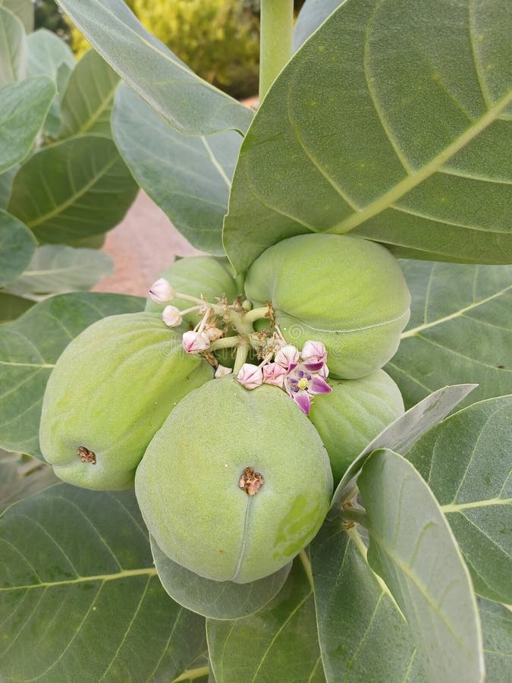
16. Apple of Sodom——Don't judge by the skin！
Source:
The Jewish historian Josephus (The Jewish War, c. AD 75) and the Roman writer Tacitus told of a fruit near the Dead Sea that looks beautiful, but turns to smoke and ashes the moment you touch it.
Echoed in Deuteronomy 32:32, "the vine of Sodom."
Meaning:
Something that looks attractive and promising on the surface, but is in fact hollow, rotten and deeply disappointing — beauty that deceives.
Example:
The five-star online reviews turned out to be an apple of Sodom — the hotel was dirty, noisy and far overpriced.
ps：The real fruit is Calotropis procera — green outside, soft and cotton-like inside.

Slide 25
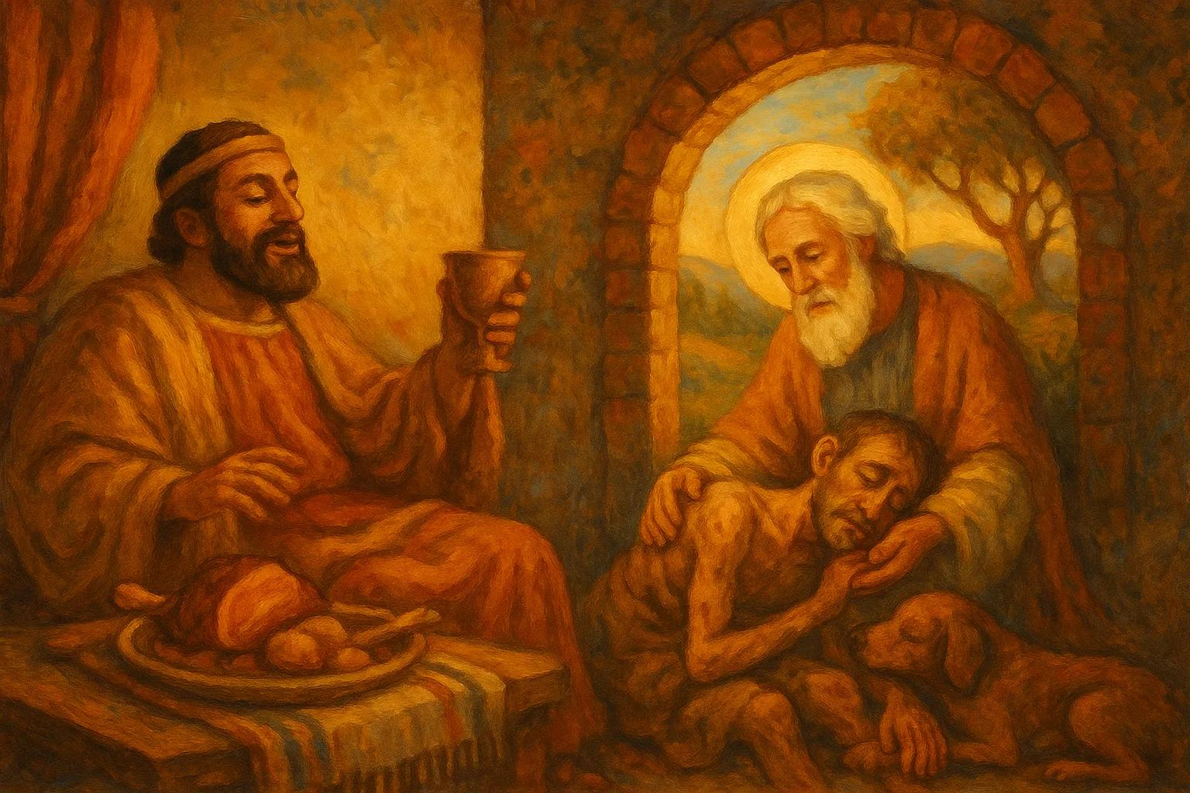
17. In Abraham's Bosom——A warm welcome home.
Source:
Luke 16:22–23
Jesus' parable of the rich man and the beggar Lazarus. When Lazarus died, "he was carried by the angels to Abraham's bosom," while the rich man was sent to Hades.
Meaning:
A peaceful, blessed rest in heaven after death; the warm welcome that faithful people receive.
"Bosom" recalls an ancient banquet, where lying close to a friend meant true intimacy.
Example:
After a long life of teaching children, the old teacher was finally laid in Abraham's bosom, remembered with gratitude by all her former students.
Lazarus resting in Abraham's arms (Luke 16)
阶段工作概述

Slide 26
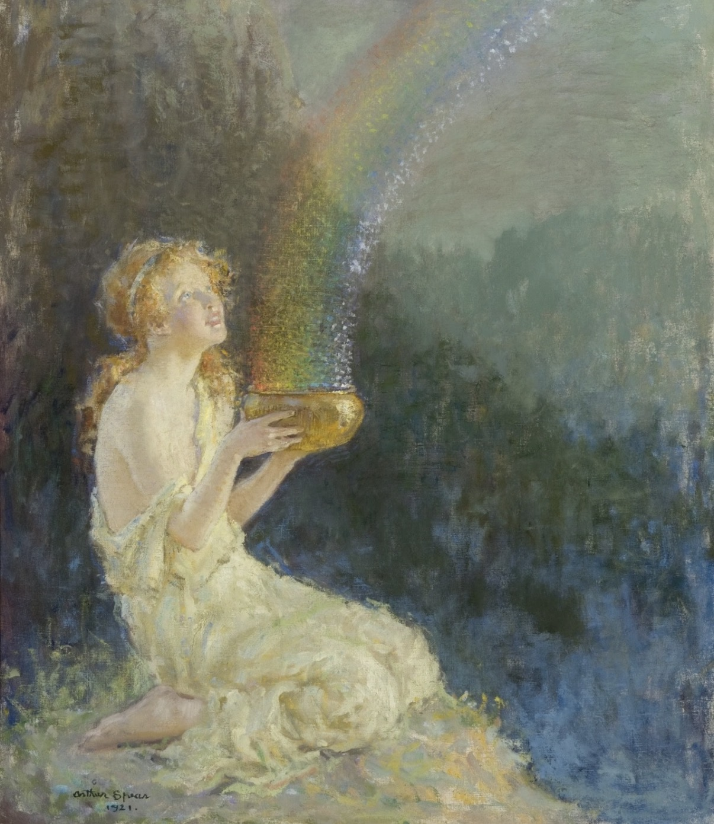
18. At the End of the Rainbow
——No "end" really exists.
Source:
from Irish folklore.
Leprechauns, the tiny shoemaker fairies, hide their crocks of gold; people say the treasure is buried wherever the rainbow touches the ground.
Meaning:
Something wonderful that is always just out of reach — an elusive, unattainable dream or reward that you can never actually catch.
Example:
Chasing a huge salary without a clear plan is like hunting for the pot of gold at the end of the rainbow.
ps: a rainbow is just an optical illusion, not a real object — it has no fixed "end", so the treasure can never be found.
阶段工作概述

Slide 27
Phrase | Origin | Core Meaning | Hook
Apple of Sodom | Josephus & Tacitus; the Dead Sea fruit that turns to ashes | Looks great, rots inside — beautiful but disappointing | Don't judge by the skin.
In Abraham's Bosom | Luke 16:22–23; the parable of the rich man and Lazarus | Peaceful, blessed rest in heaven after a good life | A warm welcome home.
At the End of the Rainbow | Irish folklore; leprechauns and their hidden pot of gold | A dream always just out of reach; an elusive reward | No "end" really exists.
阶段工作概述

