Slide 1
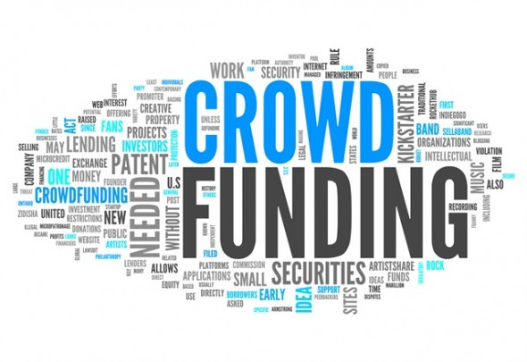
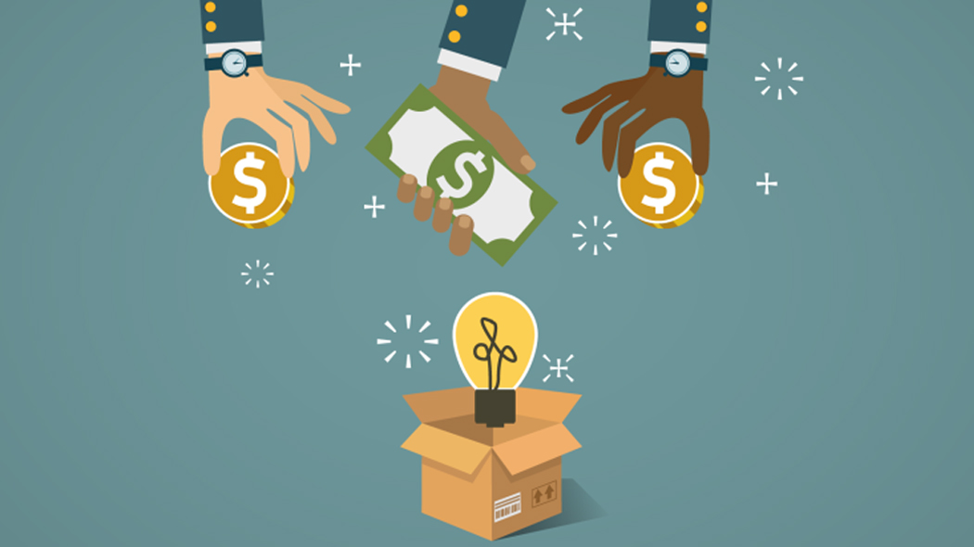

Slide 2
GROUP MEMBERS
VEDANT MULE
VAIBHAV NEGI
MOHIT DIWAKAR
KUNAL ANDHALE
MANISH CHAUDHARI

Slide 3

WHAT IS CROWDFUNDING Crowdfunding is the practice of funding a project or venture by raising small amounts of money from a large number of people, typically via the Internet. Crowdfunding is a form of crowdsourcing and alternative finance. In 2015, over US$34 billion was raised worldwide by crowdfunding.

Slide 4




FAMOUS CROWDFUNDINGS WEBSITES

Slide 5
Thousands of creative projects are funding on Kickstarter at given moment . Each project is in dependently created and crafted by the person behind it. They spend weeks building their project pages , shooting their videos, and brainstorming what rewards too offer backers. When they’re ready, creators launch their project and share it with their community. Every project creator sets their project’s funding goal and deadline. If people like the project, they can pledge money to make it happen. If the project succeeds in reaching its funding goal, all backers’ credit cards are charged when time expires. If the project falls short, no one is charged. Funding on Kickstarter is all-or-nothing.

Slide 6
DASHBOARS AND SUMMARY

Slide 7
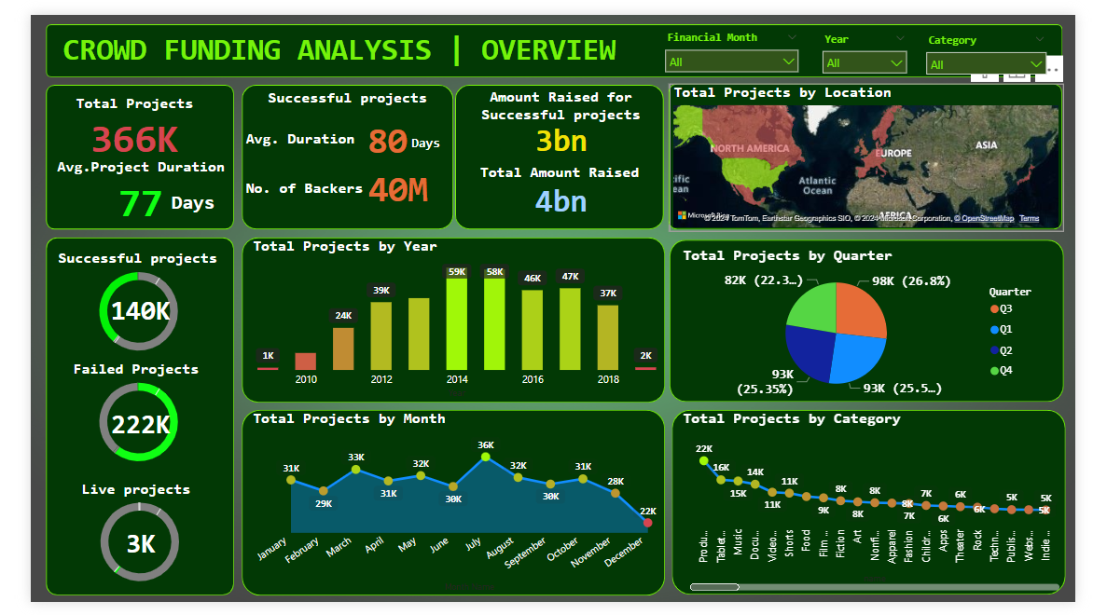

Slide 8
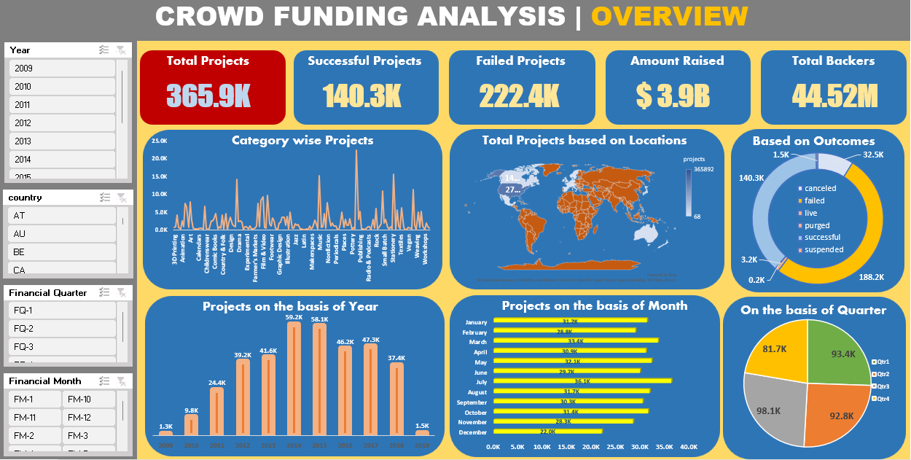

Slide 9
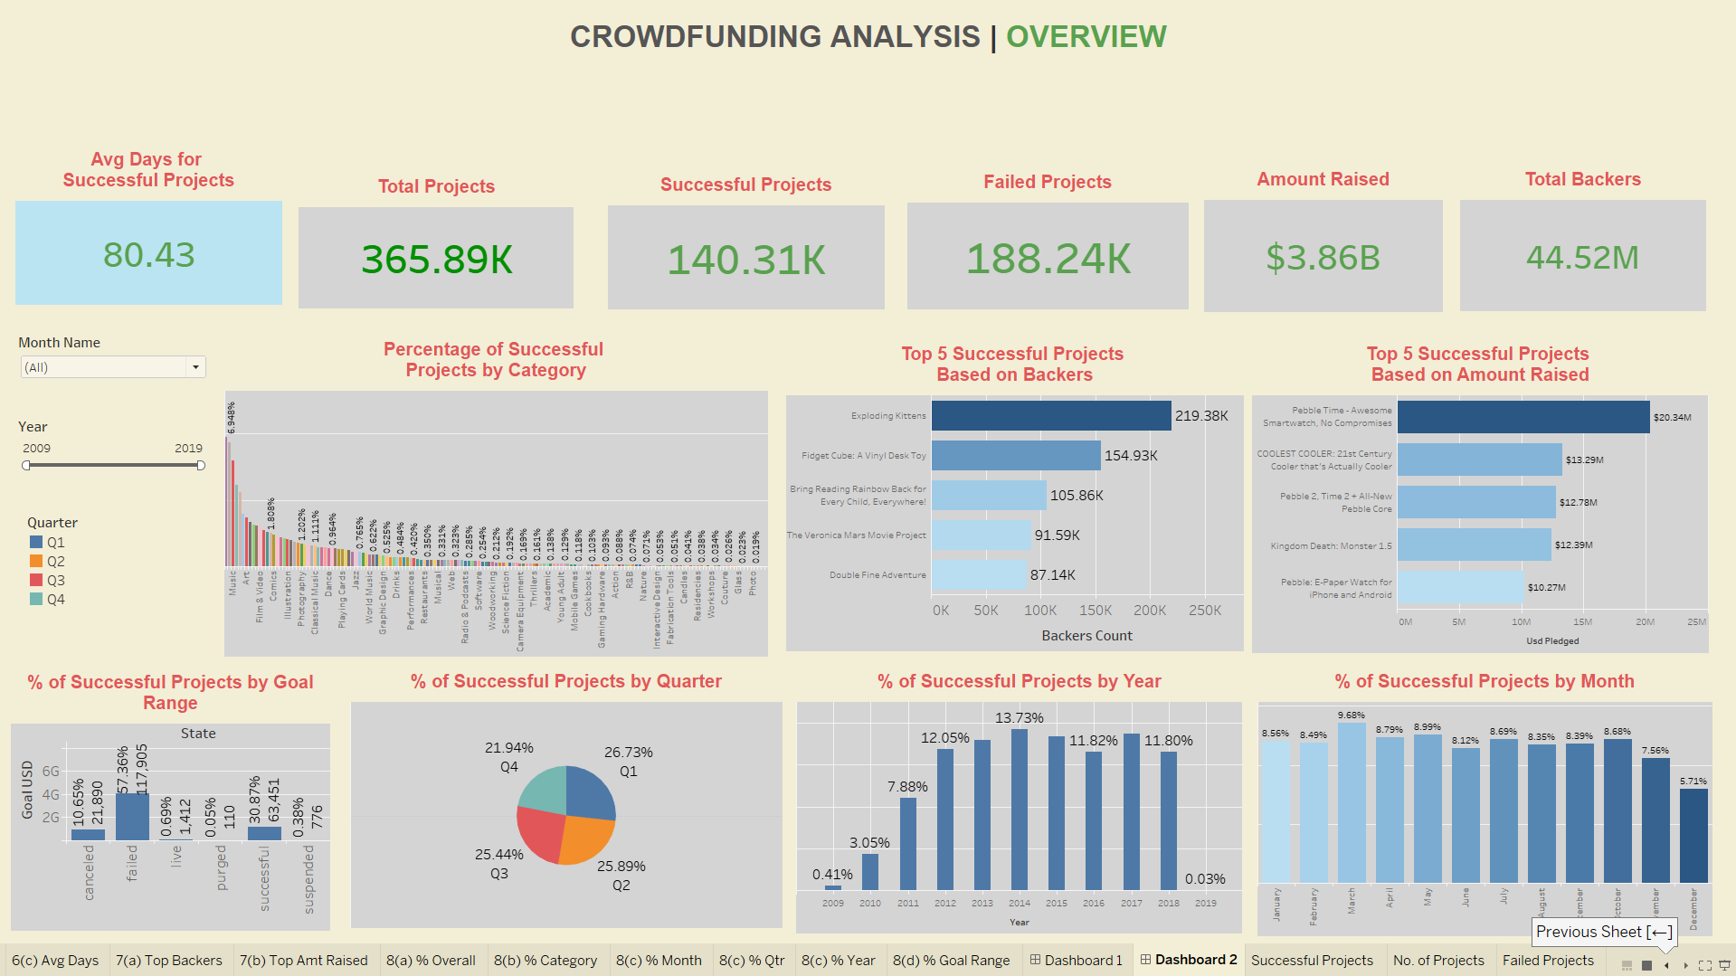

Slide 10
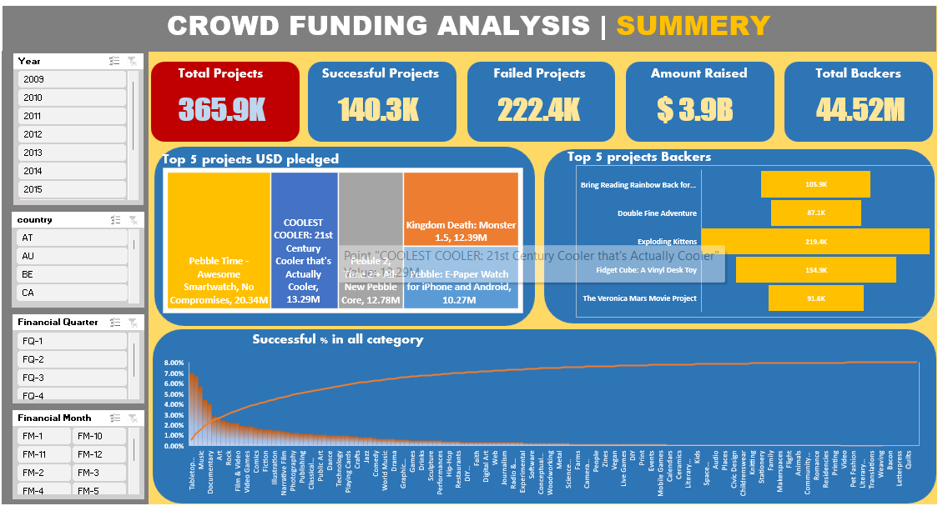

Slide 11

FINDINGS AND ANALYSIS

Slide 12
While the Successful Projects are 144k over the years as compared to the failed ones(222k) , the amount raised for successful projects are substantially high which is 3 billion dollar.
The average project duration is normally 77 days while the project duration for the successful projects are 80 days.
Since 2009 up to 2014 number of projects increased rapidly but after the after year 2014 up to 2019 number of projects registered in the official sites are exponentially low.
This data shows that while the concept of crowdfunding is very active in the region of north America and western Europe , the countries in Asia, Africa and Eastern Europe are not getting any benefits.
Success Rate over the years for all those projects is 38.35% which should be in the higher metrics.

Slide 13
THANK YOU

