Slide 1
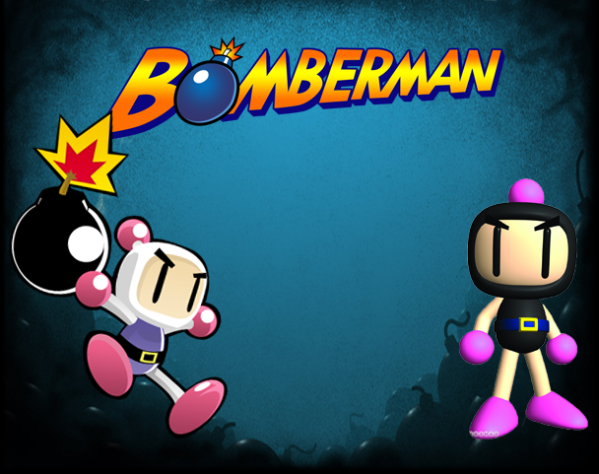
Baibhav Bista
Lumanti Dangol
Mohit Kedia

Slide 2
Objective of the project:
To practice the Object Oriented Programming. approach using C++ Programming Language.
To gain GUI skills in programming using SFML toolkit. To be familiar with SFML for enhancing the graphics of the application coded in C++ language.
To develop the user friendly interface and entertain the user.
To learn to work in a group as team.
To make a base for the development of the larger and complex programs working in a team in the future.

Slide 3
About:
strategized maze-based game
originally developed for home computers in Japan and first game developed in 1983
can play single player as well as double player game
easy for playing and understanding the concept of the game

Slide 4
About:
select the mode of the game
in single player mode the user needs to kill the opponent and if touched by the opponent in the process gets killed himself
in double player mode, the two users try to kill each other and the one who survives wins.

Slide 5
Bomberman is built by using:
Compiler: GCC compiler
IDE: Code::Blocks
GUI library: SFML-2.40

Slide 6
Gameplay:
unbreakable block are placed in fixed position and the wooden blocks in the random position of the map.
the players place the bombs in the process to remove the obstacles to reach to the opponent
the wooden block explodes with the bomb and clears the way for the players
some of these blocks contain powerups
the players die if they are in the range of explosion

Slide 7
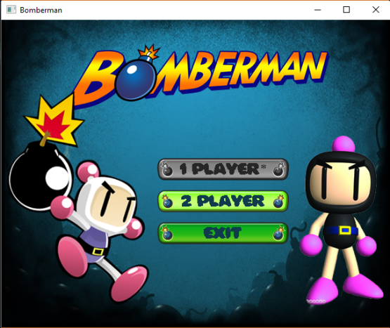

Slide 8
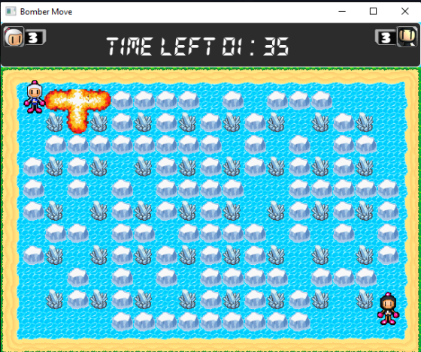

Slide 9
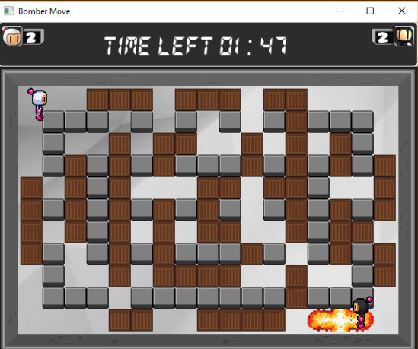

Slide 10
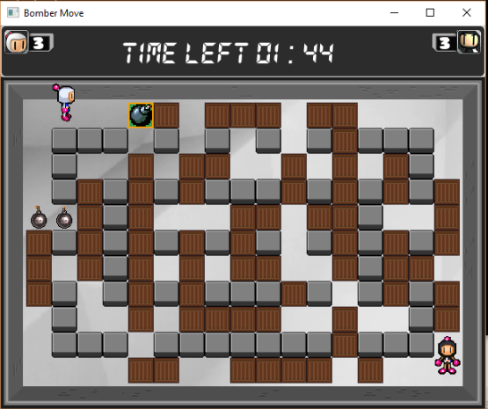

Slide 11
Powerups:
Bombup:increases the player’s number of bomb by 1
Fireup: increases the max blast radius of the bomb by 1
Skate powerup:increases the player’s speed

Slide 12
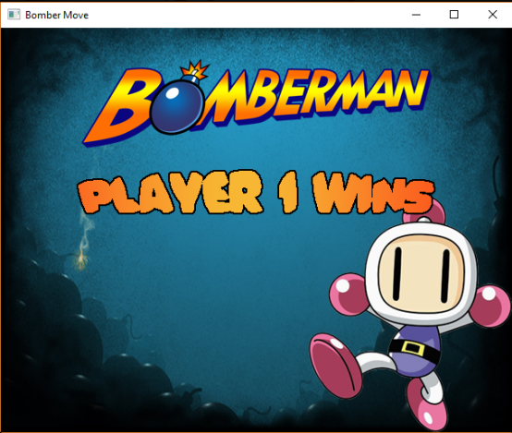

Slide 13
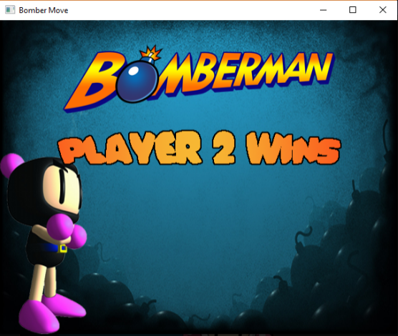

Slide 14
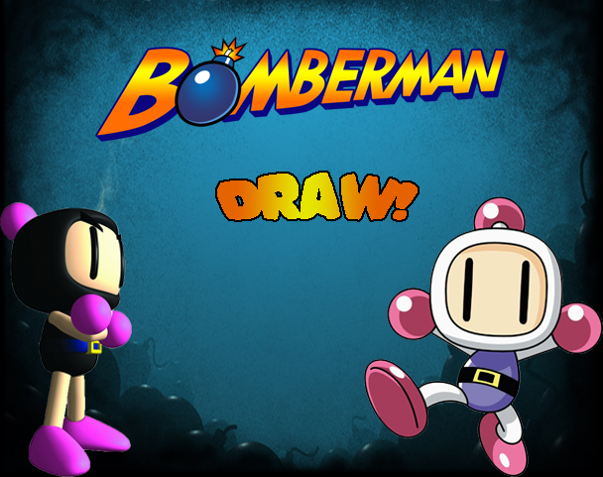

Slide 15
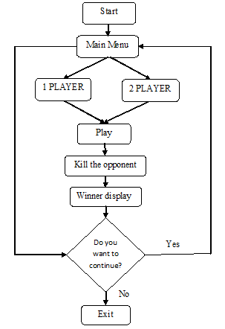
Flow of the
game:

Slide 16
Header files
MainMenu
Engine
Level
Bomber
Bomb
Explosion
RCintoCoor
PausableTimer

Slide 17
Mobility:
the movement of the players is programmed through the coordinate system so the players can move in any position of the block
the position of the block is determined through the row and columns (matrix system) so the bomb always appear at the center of the cell
this is done so that the range upto which bomb explodes is symmetric in all four directions

Slide 18
Limitations and future enhancements:
few maps due to span of time
Could be developed with many maps in the future.
The facility of saving the game is not possible
Could save and retrieve in future
The facility of challenging the other player can be added up in the future
might attract more users and make this game more exciting.
Different mini games like cart racing, pong, flappy bird, etc can be added in between the game with each progressing

Slide 19
Conclusion and recommendations:
Implementation of the theoretical knowledge of OOP approach
Development of concept and skills on Project Management
Development of the program that can be implemented practically
Sense of professionalism and advantage of working together as a team

Slide 20
Thank you!!!

