Slide 1

Risk Communication
Communications intended to supply laypeople with information they need to make informed independent judgments about assuming or managing risks
Notes:
Risk communication is practiced
when people have to assume a risk and there is information that could minimize that risk
When there is a risky situation and people could avoid it altogether by practicing certain behaviors
When something bad has already happened, so people can know if they are subject to subsequent risk

Slide 2
Why important to Homeland Security?
People will have to modify normal behaviors in order to avoid harm
Help people identify best choices
To prevent unnecessary illness
Notes:
The orthodoxy.
Convince people the risk is worthy of attention
Help them identify best buys in risk:
where there are large compensating benefits for taking risks or
no missed opportunities for cheaply reducing risk or
gaining large benefits by accepting a little more risk
To get people to do what managers think is best for them.

Slide 3
Historical Stages in Risk Communication
All we need to do is get the numbers right
All we have to do is tell them the numbers
All we nave to do is explain what we mean by the numbers
All we have to do is show them that they’ve accepted similar risks in the past
All we have to do is show them that it’s a good deal for them
All we have to do is treat them with respect
All we have to do is make them partners
Fischhoff B. 1995. “Risk Perception and Communication Unplugged: Twenty Years of Process,” Risk Analysis, 15:137-145.
Notes:
Stages 1-6 involve increasing stages of viewing the recipients of the message as individuals with complex concerns. The last step engages them as individuals, opening a communication channel in the opposite direction

Slide 4
Common pitfalls
Temptation to exaggerate or underestimate risk
Omitting critical information
Presenting irrelevant information
Untrustworthy source
Framing bias
Notes:
If it omits critical information, then it fails the most obvious responsibility of communicators.
It may leave recipients worse off if it creates an illusion of competence, so that recipients erroneously believe themselves to be adequately informed.
If it presents irrelevant information, then it wastes the recipients’ time and diverts their attention from more important tasks.
If the source is perceived as biased, the public does not know whom or what to trust, and that may make their risk decisions seem intractable, and open the door to even less credible sources

Slide 5
Framing
 | Mortality rates |  | Survival rates
 | Surgery | Radiation | Surgery | Radiation
initial | 10% | 0% | 90% | 100%
After 1 yr | 32% | 23% | 68% | 77%
After 5 yr | 66% | 78% | 34% | 22%
Treatment choice |  | 44% |  | 18%
McNeil BJ, SG Pauker, HC Sox, A. Tversky. 1982 On the elicitation of preferences for alternative therapies NEJM 306:1259-1262
Notes:
Different ways of summarizing the same risk information can lead to different understandings and different preferences for decisions.
People had to chose between 2 cancer therapies, surgery and radiation, either framed as cumulative survival or death rates.
The effect was as strong with physicians as among lay people.

Slide 6
Prospect theory
According to prospect theory, outcomes of a decision are evaluated as gains or losses from some reference point – usually the status quo. Furthermore, the impacts of gains and losses are nonlinearly related to their magnitudes.
Kahneman, D. and A. Tversky,1972. Subjective probability: A judgment of representativeness. Cognitive Psychology 3:430-454.
Notes:
Such systematic differences in preferences that depend on the ware the question is framed is explained by prospect theory of Kahneman and Tversky.
According to prospect theory, outcomes of a decision are evaluated as gains or losses from some reference point – usually the status quo. Furthermore, the impacts of gains and losses are nonlinearly related to their magnitudes.
That is, gaining $200 gives less than twice the value that is obtained from gaining $100, and loosing $200 hurts more than a $200 gain pleases.

Slide 7
Illustration for Decision Making
Problem 1: US prepares for pandemic expected to kill 6 million people
 | People will be saved | Probability
Program A | 2 million | 1
Program B | 6 million | 1/3
 | 0 | 2/3
 | People will die | Probability
Program C | 4 million | 1
Program D | 0 | 1/3
 | 6 million | 2/3
Problem 2: US prepares for pandemic expected to kill 6 million people
Notes:
Ask for a vote a vs b, c vs d
The two problems are formally identical. A cnd C are the same, as are B and d.
In one study 72% given problem 1 chose program A over B
While 78% of those given problem 2 chose program D (the equivalent of program B)
This reversal of preference is predicted by prospect theory
Program A is chose over program B because people see little additional gain from saving all the lives, because that outcome is uncertain and low probability.
Program D is chosen over C because people see little extra loss from losing all 6 million (uncertainly) over 4 million definite deaths.
The policy implications of characterizing risks in terms of potential gains or potential losses can be important. Neither way of framing a risk situation (loss or gain) is right or unbiased, when they accurately reflect the data.
Because subtle differences in how risk is framed can have marked effects on understanding, those responsible for communicating the choice may have considerable ability to influence perceptions and behaviors.
Peoples loss aversion gives extra salience to accusations such as “cut and run”, for instance
Any policy strategy involves the acceptance of some nonzero level of risk in pursuit of some objective.

Slide 8
What do people want?
What a risk communication contains should depend on what the audience members intend to do with it.
  Sometimes recipients just want to be told what to do
  Sometimes they want to make their own choices but need quantitative details (probabilities, prices)
  Sometimes they want help in organizing their thinking
Notes:
When the situation associated with dread, uncontrollable, catastrophic, fatal, unfair, a risk to future generations, difficult to fix, involuntary, or personal – people prefer to have an expert manage their choices
When they have to tradeoff risks and risks or risk or benefits, they need the tools to evaluate the decisions
When the situation is complex and changing, they need the concepts that will allow them to apply knowledge in new situations
Sometimes people just want an authority to tell them what to do, summarizing the conclusions that they would reach if they had sufficient knowledge and time.
Sometimes they need to know the probabilities of outcomes for different choices
Probability of success, of adverse effects associated with different treatments. They can then make the choice that makes the most sense for their personal situations. To serve this process, communicators must analyze the decisions their audience members face and then determine the information that is most relevant. Focusing on decisions reduces the expert knowledge that people need (from the core dump available to the expert)
Sometimes the important features are not quantitative, like when people need to know how a risk is created and how it can be controlled. That information allows them to monitor their own surroundings, identify risky situations, and devise appropriate responses. It allows people to follow and join the public debate.

Slide 9
Ideal Content?
the minimum that enables a person to construct an adequate mental model of the risky process, allowing people to know which facts are relevant and how they fit together.
Notes:
These enabling communications face a huge selection problem: supplying the minimum that enables a person to construct an adequate mental model of the risky process, allowing people to know which facts are relevant and how they fit together. That knowledge should help them make sense out of any new facts as they arise.
Attention should be focused on those facts that make the greatest difference in determining risk levels.

Slide 10
Anthrax mail attacks Oct-Nov 2001
Anthrax letters sent through mail
22 cases, 9 postal employees
Hart Senate Office Bldg closed Oct 17, 600 staffers get Cipro
Trenton PO closed Oct 18
4 Brentwood PO workers hospitalized Oct 19-21. Two died, both African-Americans
Brentwood PO closed Oct 21, 2743 workers offered doxycycline + vaccine
Anthrax found in Morgan Central PO NY. Stays open

Slide 11
Adherence to advice
60% didn’t take their drugs full 60 days
18% quit immediately
Vaccine was rejected as “experimental”
Notes:
Clearly not what risk managers intended

Slide 12
Focus group reactions
Attitudes toward information or source of information | 36 Brentwood workers (percent of occurrences in topic discussion) | 7 Senate staffers (percent of occurrences in discussion)
General absence of info | 40 | 52
Confusing info | 20 | 24
Delay in communication | 24 | 0
Poor quality of info | 4 | 24
Distrusted info source | 33 | 14
Disrespectful treatment | 16 | 11
Race or status bias | 16 | 2
Felt treated like experiments | 12 | 2
Sources poorly informed | 8 | 19
Felt private Dr poorly informed | 26 | 2
Felt treatment info incomplete | 28 | 33
Got info from media | 41 | 10
Blanchard, J. et al. 2005. “In their own words: Lessons learned from those exposed to anthrax,” Am J Pub Health 90(3):489-95.
Notes:
Amerithrax was a clear example of failed risk communication. Failure of credibility, failure of content analysis, failure of trust, failure to think through the problem.

Slide 13
What is common practice for generating risk communications?
Ask technical experts what information they think people should be told
Pass communications around to staff or expert committees for approval
Notes:
Anyone see anything wrong with this approach?
It leaves the public out of the process
Lacks consideration of what public already believes
Not a systematic evaluation of risk
Without rigorous empirical evaluation by people like those in the target audience no guarantee the message will be understood, trusted, followed, meet needs

Slide 14
Social Science Methods
Focus groups
Surveys
Problems
People don’t always do what they say they will.
Problems interpreting what is said: leaders report group as having an opinion; small n bias; recruiting bias; frequency of mentioning a topic means what?
Question choice or wording may bias the information or miss important content

Slide 15
What is the better practice?
Clear analysis of what needs to be communicated
Solid evidence that communications have achieved their intention
Notes:
In retrospect, it is obvious that the early expert model was too narrow. A systems analytic approach would have identified postal workers as a potentially vulnerable population.
Need analysis of not only what needs to be communicated, but to whom
Content: should address audience and not tell them what they already know
Format: should be tested on target audience before use

Slide 16
Mental Models Approach for Risk Communication
Create an expert model
Conduct and analyze lay public mental models interviews. Identify knowledge gaps.
Conduct structured interviews or surveys to estimate prevalence of beliefs in population
Draft risk communication
Evaluate risk communication
Iterate until communication is understood as intended by target audience

Slide 17
Morgan, M. G., B. Fischhoff, A. Bostrom and C. J. Atman (2002). Risk Communication: A Mental Models Approach. Cambridge, UK, Cambridge University Press.

Slide 18
Expert model
Review current scientific knowledge about the processes that determine the nature and magnitude of the risk and how it is managed
Summarize it explicitly, often graphically
External review by experts with different perspectives for accuracy, completeness, relevance, balance, authoritativeness

Slide 19
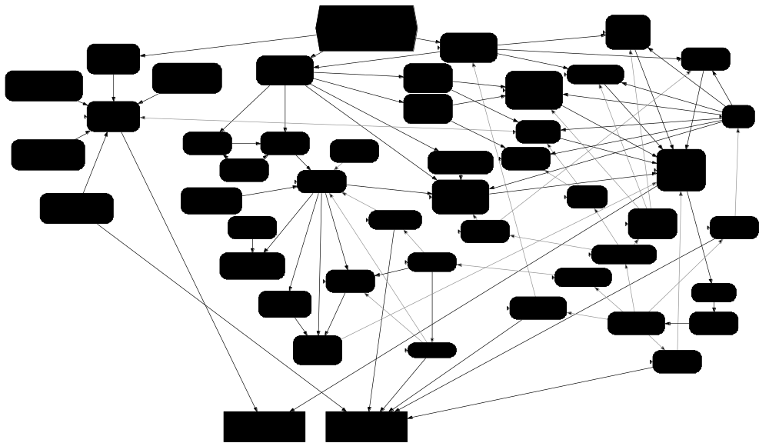
Influence Diagram
Notes:
An influence diagram is a directed graph drawn from decision theory.
The nodes represent and interpret the knowledge of experts from diverse disciplines.
This one is for a covert aerosol plague bioattack.
On the top is the attack, at the bottom, plague and non-plague mortality and morbidity
It is a flow chart of sorts
Events follow from causes
Information is generated, delivered, and processed
Choices are made by actors
Basically the attack infects a lot of humans (purple)
They get sick and seek treatment
The attack is detected by the medical community or by project biosense or by announcement. How long it takes to detect the attack determines the timeliness of the response
The response is mounted, communications made, actions taken, snafus happen
The people involved are identified, along with populations with higher exposure risks (microbiology lab technicians, doctors, coroners)
While infecting people, some wild animals also are infected
Depending on the ecosystem, plague could become endemic (permanent), epizootic (a big die off in animals) or just burn out and disappear.
The connection between sylvatic plague and people is through the fleas and carcasses of the infected wild animals.
People with dealings with fleas and dead rodents are identified as having higher risk of exposure (children, dog and cat owners, homeless people, drug addicts, veterinarians, animal shelter workers, outdoorsmen, pest exterminators)
The kind of information that is required for special and general populations is identified
The risk-reducing actions that municipalities and private citizens would take are shown
And at the bottom the bubonic plague deaths and illnesses are shown, along with the incidental non-plague illness and death (such as burns from destroying rat harborage)
At the bottom, the plague dead and ill are counted, along with the incidental but related health effects like PSTD and trauma victims from violence
Pink shows sentinel and especially at-risk populations
Yellow shows opportunities for risk communication

Slide 20
Mental Models Interviews
Conduct “open-ended” interviews eliciting people’s beliefs about the hazard, expressed in their own terms
The interview protocol is shaped by the influence diagram, so that is covers potentially relevant topics.
It allows the expression of both correct and incorrect beliefs and ensures that the respondents’ intent is clear to the interviewer.
Responses are recorded and analyzed in terms of how well the mental models correspond to the expert model.

Slide 21
Structured Interviews
Create a confirmatory questionnaire whose items capture the beliefs expressed in the open-ended interviews and the expert model.
Administer it to larger groups, sampled appropriately from the intended audience, in order to estimate the population prevalence of these beliefs.

Slide 22
Draft Risk Communication
Use the results from the interviews and questionnaires, along with an analysis of the decisions that people face, to determine which incorrect beliefs most need correcting and which knowledge gaps most need filling
Draft a communication and subject it to expert review to ensure its accuracy

Slide 23
Evaluate Communication
Test and refine the communication with individuals selected from the target population: closed-form questionnaires, problem solving tasks, focus groups
Repeat this process until the communication is understood as intended.
Morgan, MG, B Fischhoff, A Bostrom, CJ Atman (2002) Risk Communication, A mental models approach, Cambridge University Press

Slide 24
Exercise
DHS Disaster Planning Scenario 2
Terrorists spray aerosolized anthrax from a van in 3 cities initially, followed by 2 more cities shortly afterward:
13,000 dead
Econ impact: $Billions

