Slide 1

Risk Management

Slide 2
The Risk Analysis-Risk Management Distinction
Risk assessment – the scientific analysis and characterization of adverse effects (understanding)
Risk management – the activities of identifying, evaluating, and implementing actions to reduce risk (values, action)
  The goal of risk management is scientifically sound, cost-effective, integrated actions that reduce or prevent risks while taking into account social, cultural, ethical, political, and legal considerations.
Notes:
Risk managers are supposed to deal with broad social, economic, ethical, and political issues in choosing from among a set of decision options by using the results of the risk assessment and their understanding of the other issues.
The conceptual distinction between risk assessment and risk management has several important purposes:
Insulating scientific activity from political pressure
Maintaining the analytic distinction between the magnitude of a risk and the cost of coping with it
However, the concept does not fully represent the reality of practice.

Slide 3
Decisions involving tradeoffs
Benefit-Cost
Risk-Benefit
Risk-Risk
Notes:
Making tradeoffs are part of risk management and each management option will have it’s good points and its downside.
If all the outcomes, good and bad, can be monitized, you can compare different options by their cost-benefit ratios.
But often it is difficult or repugnant to assign a dollar value to a risk or benefit
Sometimes the benefits and risks accrue to different parties. In economics it doesn’t matter, but in politics it’s everything.
Some options will drop out because they are infeasible given the available timeframe and resources or because they are illegal or unethical, or because they create new risks.

Slide 4
Structuring a decision
choices
states
outcomes
Notes:
Usually risk managers identify a set of possible risk reduction options and then try to pick the best.
A systematic representation of this process

Slide 5
Structuring a decision
p
p
+
1-p
1-p
p
p
+
1-p
1-p
p
p
+
1-p
1-p
Expected value of the choice
choices
states
Notes:
Estimate the probability of the different possible states allows you to probabilistically weight the different outcomes

Slide 6
Stockpile smallpox vaccine?
Big attack occurs
yes
Outcome 1
Stockpile?
no
Outcome 2

Slide 7
Stockpile smallpox vaccine?
Scenario 1
Probability of attack | net benefits Billions
0.00000 | -$18.30
0.00002 | -$15.30
0.00004 | -$12.30
0.00006 | -$9.30
0.00008 | -$6.31
0.00010 | -$3.31
0.00012 | -$0.31
0.00014 | $2.69
0.00016 | $5.69
0.00018 | $8.69
0.00020 | $11.68
0.00022 | $14.68
0.00024 | $17.68
0.00026 | $20.68
0.00028 | $23.68
0.00030 | $26.68
0.00032 | $29.67
Cost per dose $20
Number of doses 150 million
Overhead 10%
Stockpile cost $3.3 billion C1
Death rate 10%
# susceptibles 300 million
Max fraction infected 50%
Value of 1 life $10 million
Cost of attack deaths no vac. $150 trillion B1
Vaccine efficacy 90%
Cost of deaths with vaccine $82.5 trillion B2
Death rate from vaccine 0.00001
Number of vaccine deaths 1,500
Cost of vaccine deaths $15 billion C2
Net benefits = p (B1-B2) – (C1 + C2)
Notes:
Depends on how likely I think a large scale smallpox attack is

Slide 8
So the decision is stockpile, right?
If the probability of a giant attack is greater than roughly 1 in 10 thousand the benefits exceed the costs
For an investment of a paltry $3 billion you can avoid $68 trillion of losses
probability | net benefits Billions
0.00000 | -$18.30
0.00002 | -$15.30
0.00004 | -$12.30
0.00006 | -$9.30
0.00008 | -$6.31
0.00010 | -$3.31
0.00012 | -$0.31
0.00014 | $2.69
0.00016 | $5.69
0.00018 | $8.69
0.00020 | $11.68
0.00022 | $14.68
0.00024 | $17.68
0.00026 | $20.68
0.00028 | $23.68
0.00030 | $26.68
0.00032 | $29.67
Notes:
So the decision is go for it, right?
Can anyone come up with any reason this analysis could be misleading?
Assumptions:
that whole country is involved: maybe just one city
Ring vaccination might be able to contain the outbreak so fatalities much smaller
Smallpox could be engineered to defeat vaccine
You could have other size stockpiles than 150million doses
Other parameters are uncertain: 50% infection rate
So how would you go about analyzing that decision with a lot of different possible scenarios?

Slide 9
Net benefits, Prob(attack) = 1
 | 300,000 | 30,000 | 3,000
0.5 | $132T | $10.2T | -$2B
0.05 | $10T | -$2B | -$3.2B
0.01 | -$630M | -$3B | -$3.3B
susceptibles
fraction infected
Notes:
examine the other assumptions as well
These are just 2

Slide 10
Decision Making Under Uncertainty
vaccine works
Outcome 1
Big attack occurs
stockpile
vaccine fails
Outcome 2
1
don’t stockpile
Outcome 3
vaccine works
Outcome 4
No attack
stockpile
vaccine fails
Outcome 5
2
don’t stockpile
Outcome 6
vaccine works
Outcome 7
Small attack occurs
stockpile
vaccine fails
Outcome 8
3
don’t stockpile
Outcome 11
scenarios
choices
payoffs

Slide 11
Decision Making Under Uncertainty
p₄
vaccine works
E[Outcome 1]
stockpile
1-p₄
vaccine fails
E[Outcome 2]
1
1
don’t stockpile
E[Outcome 3]
p₁
p₄
vaccine works
E[Outcome 4]
p₂
stockpile
1-p₄
vaccine fails
E[Outcome 5]
2
don’t stockpile
p₃
E[Outcome 6]
3
p₄
vaccine works
E[Outcome 7]
Σ p_{I} = 1
stockpile
i=1
1-p₄
vaccine fails
E[Outcome8]
3
don’t stockpile
E[Outcome9]
Notes:
It would be great if you could estimate the probability of the different scenarios, and were sure you covered all possilbe scenarios. if you did you could, sum up the expected utilities of stockpiling under the different scenarios
but in reality, all we have are educated guesses.

Slide 12
MaxMin Rule:
Select the choice that has the highest minimum utility regardless of the scenario
vaccine works
-$82.52T
Big attack occurs
stockpile
vaccine fails
-$150.02T
*
1
don’t stockpile
-$150T
*
No attack
stockpile
-$3.3B
2
don’t stockpile
$0
vaccine works
-$4.4B
Small attack occurs
stockpile
vaccine fails
-$12.4B
3
don’t stockpile
-$9B
Notes:
For the situation when probabilities are unreliable or nonexistent:
maxmin rule: select the choice that has the highest minimum utility regardless of the scenario: select the choice with the most desirable worst-case outcome
This rule says don’t stockpile unless you are pretty sure it is going to work.
The maxmin rule is very conservative. When a decision problem provides no probability information, and when one of the outcomes I clearly worse than the others that are more or less alike, then it makes sense to make the decision that gives you absolute protection against that worst case outcome.
If you knew the vaccine worked, the decision is reversed

Slide 13
Optimizing Decision Rules
Expected value: choose the outcome with greatest expected dollar value
MaxMin Rule: Select the choice with the most desirable worst-case outcome
Expected utility: choose the outcome with greatest expected utility
Notes:
Optimizing decision rules pick the best solution from a set of alternatives.
If you have probabilities and monetizable outcomes you can make the decision with the greatest expected value.
if you can’t measure all the gains and losses in terms of money? What if you can monitize but the value of money (its utility) changes nonlinearly with changing circumstances.
Sometime money and utility are not linearly related. An example is that if you need a down payment to buy a house, sums less than that amount have no utility, but sums greater than and equal to have utility. Expected utility is the most important and sophisticated decision rule for decision making under risk. It is calculated like expected value, except that the outcome utilities are multiplied by the probability of that outcome’s state
What if you cant come up with probabilities but have some sense of the utilities? You can use the max min rule.

Slide 14
Satisficing
In some situations asking a decision maker to select an optimal choice is unrealistic.
It should be satisfactory for him to make an acceptable one.
If there is more than one acceptable choice, then selecting any of them is OK, even if some are superior on some more stringent standard
Establish a standard of acceptability and compare candidate choices to this standard
Label each choice as acceptable or unacceptable
Select any choice that gives you a better than 50% chance of an acceptable outcome
Examine potential choices only until one acceptable choice is found.
This rule does not require real probability numbers, only that you can distinguish p > 0.5 from p < 0.5
This rule does not require a numerical evaluation of utility
Notes:
There is yet another decision rule, that doesn’t pick the optimum decision, but only gets you to an acceptable solution.

Slide 15
Outbreak contained?
probability
Acceptable
p > 0.5
*
yes
Isolate suspected SARS patients in special facility
no
Unacceptable
p > 0.5
yes
Acceptable
p < 0.5
Treat suspected SARS patients same as other patients
no
Unacceptable
p > 0.5
yes
Acceptable
p < 0.5
Do not sequester potential SARS patients
no
Unacceptable
p > 0.5

Slide 16
Choice of decision rule reflects the quality of the input and the nature of the decision.
It also reflects the values of the decision maker.
Notes:
The choice is not only dependent on the quality of the input, it also reflects the values of the decision maker, and hopefully the values of the society he lives in.

Slide 17
Ethical Systems & Distributional Effects (Schulze & Kneese 1981)
Utilitarian | The greatest good for the greatest number | max (U_{a} + U_{b})
Egalitarian | The well being of society is measured by the well-being of the worst off person in that society | max min {U_{a}, U_{b}}
Elitist | The well being of society is measured by the well-being of the best off person in that society | max max {U_{a}, U_{b}}
Libertarian (Pareto) | Harm no one. Everyone’s changes in utility must be at least as good as they were in their original state. | U_{a1} ≥ U_{a2} _{and} U_{b1} ≥ U_{b2}
Notes:
Utilitarian – maximize the sum of the utilities of all individuals in society. The decision to stockpile vaccine minimizes the number of deaths in society if there is a smallpox attack, even if some people die of side effects
For the 2 person society A and B, maximize the sum of their utilities
Egalitarian. If you are the guy who dies from myocarditis induced by a smallpox vaccine, taken for a threat you are not so sure even exists, you are pissed off. If you want to eradicate polio, you have to eradicate it everywhere.
If airbags saved 25,000 lives a year but also caused 10 fatal accidents – air bags must be fixed or capable of being disabled.
We allocate organs according to this rule. The person closest to death gets the organ transplant, even if he doesn’t have the best chance of survival.
Elitist. What’s good for GM is good for America. Tax cuts for the rich.
Give health care workers and first responders vaccines and prophylaxsis first, so they can safely perform their humanitarian duties.
Restore water and power to rich New Orleans neighborhoods and businesses because they are able to rebuild.
It is sometimes suggested as a principle to guide triage in mass casualty situations: treat the people most likely to survive.
Libertarian (Pareto superiority)
The decision to vaccinate for smallpox would fail this test.
Only the first philosophy ignores distributional effects, doesn’t care who gets the risks and who gets the benefits. This is the traditional economic perspective that inspired cost-benefit tests. It is also why people often reject the results of these tests.

Slide 18
Attributes of the Decision Maker Influence the Decision
Two fair coin-toss game set-ups, A & B
choices
states
outcomes
A
heads or tails
$1000
heads
$2000
B
tails
$0
Notes:
Risk is the existence of states beyond the decision maker’s control that affect the outcomes of his choices.
The degree of risk is a function of the size of the potential loss and the probability of that loss
Every risky decision has something at stake. The greater the stake the greater the risk.
Different people respond to risk in different ways, as shown by the decision maker’s preference for gambles, such as this fair coin toss experiment.
Here the expected value of choice A is $1000 and so is the expected value of choice B.
If you apply the expected value decision rule , you are indifferent between A and B. You are risk neutral.
If you preferred the sure thing of $1000 over the equally valuable gamble, it would mean you are a risk averter.
If you preferred B, you are a risk seeker (assuming that utility is linearly related to money and there is no increasing or decreasing marginal utility for dollars)
To find out how much of a risk averter or seeker you are, put a dollar amount in the box that would make you indifferent between A and B. If you put $2000 then you would be risk neutral. The greater the number that you would require, the greater is your aversion to risk.
Is it better to be a risk averter or a risk seeker? Technically, it is better to be neither (risk neutral). If you were gambling over the long run with an opponent who was risk neutral, and you were either risk seeking or risk averse, you would lose.
Now that you all have a firm grasp of the philosophical and psychological underpinnings of risk management and decision making, we should move on to some outcome valuation techniques.

Slide 19
Recap: Decision making
Structuring a decision
Choosing a decision rule
Ethical systems (societal values)
Decision maker’s personal risk affinity
Measures of Utility

Slide 20
Concepts commonly used in calculating health-related outcomes
Value of a statistical life
Disability adjusted life year
Quality adjusted life year

Slide 21
Value of a Statistical Life Methods
Foregone earnings
Willingness to pay to reduce risk of dying by small amount
Willingness to accept a small amount of risk of dying in return for monetary compensation
Notes:
When you are trying to make economic decisions about life and death, you have to have some number for what a life is worth.
You remember in the smallpox vaccine example, a death was valued at $10 million.
Where does that number come?

Slide 22
Value of a Statistical Life
Hedonic wage methodology
A worker is offered $500 a year of additional pay to accept a more risky job where the increase in the mortality rate is 1 in 10,000 a year
The value of a statistical life is defined as the observed amount of monetary compensation divided by the level of risk
$500/(1/10,000) = $5,000,000
Viscusi, W. K., and J. E. Aldy, 2003, “The Value of a Statistical Life: A Critical Review of Market Estimates from Around the World,” The Journal of Risk and Uncertainty, Vol. 27 (August), pp. 5–76
Notes:
This is an explicit tradeoff between risk and money.
Willingness to pay to avoid risk rises with income. That is why VSL is larger in rich countries.
A rule of thumb for a range of VSL values is around 100 to 200 times GCP per capita.

Slide 23
Labor market studies of Value of a Statistical Life, United States (Viscusi & Aldy 2003)
Author (year) | Implicit VSL (millions 2000 UD$)
Smith (1974) | $9.2
Thaler & Rosen (1975) | $1.0
Smith (1976) | $5.9
Viscusi (1978, 1979) | $5.3
Brown (1980) | $1.9
Viscusi (1981) | $8.3
Olson (1981) | $6.7
Arnould & Nichols (1983) | $0.5, $1.3
Butler (1983) | $1.3
Low & McPheters (1983) | $1.4
Dorsey & Walzer (1983) | $11.8, $12,3
Leigh & Folsom (1984) | $10.1-$13.3
Smith & Gilbert (1984, 1985) | $0.9
Dillingham & Smith (1984) | $4.1-$8.3
Leigh (1987) | $13.3
Author (year) | Implicit VSL (millions 2000 UD$)
Moore & Viscusi (1988) | $3.2, $9.4
Garen (1988) | $17.3
Dillingham & Smith (1984) | $4.1-$8.3
Leigh (1987) | $13.3
Moore & Viscusi (1988) | $3.2, $9.4
Garen (1988) | $17.3
Viscusi & Moore (1989) | $10.0
Herzog & Schlottman (1990) | $11.7
Moore & Viscusi (1990) | $20.8
Kniesner & Leeth (1991) | $0.7
Gegax, et al. (1991) | $2.1
Leigh (1991) | $7.1-$15.3
Berger & Gabriel (1991) | $8.6, $10.9
Dorman & Hagstrom (1990) | $8.7 - $20.3
Lott & Manning (2000) | $1.5, $3.0
Notes:
Different occupations yield different VSLs
Factors influencing mortality risk premiums such as union affiliation and age.
While the tradeoff estimates may vary significantly across studies, the value of a statistical life for prime-aged workers has a median value of about $6 million in the United States. Range half a million to 20 million
meta-analysis characterizes some of the uncertainty in estimates of the value of a statistical life, and finds that the 95 percent confidence interval upper bounds can exceed the lower bounds by a factor of two or more.
Other developed countries appear to have comparable VSLs, although some studies of the United Kingdom have found much larger risk premiums.
Consistent with the fact that safety is a normal good, developing countries’ labor markets also have significant, but smaller, values of statistical life.

Slide 24
 | Year | Country | Implicit VSL (millions 2000 US$)
Kneisner & Leeth | 1991 | Australia | $4.2
Miller et al. | 1997 | Australia | $11.3 - $19.1
Weiss, et al. | 1986 | Austria | $3.9. $6.5
Meng | 1989 | Canada | $3.9 - $4.7
Meng & Smith | 1990 | Canada | $6.5 - $10.3
Cousineau et al. | 1992 | Canada | $4.6
Martinello & Meng | 1992 | Canada | $2.2
Lanoie et al. | 1995 | Canada | $19.6-$21.7
Meng & Smith | 1999 | Canada | $5.1 - $5.3
Siebert & Wei | 1998 | Hong Kong | $1.7
Shanmugam | 1996/7 | India | $1.2, $1.5
Shanmugam | 2000 | India | $1.0, $1.4
Shanmugam | 2001 | India | $4.1
Kniesner & Leeth | 1991 | Japan | $9.7
Kim & Fishbock | 1993 | S. Korea | $0.8
Baranzini & Ferro Luzzi | 2001 | Switzerland | $6.3, $8.6
Liu et al. | 1997 | Taiwan | $0.2 - $0.9
Liu & Hammit | 1999 | Taiwan | $0.7
Marin & Psacharopoulos | 1982 | UK | $4.2
Siebert & Wei | 1994 | UK | $9.4-$11.5
Sandy & Elliott | 1996 | UK | $5.2 - $69.4
Arabsheibani & Marin | 2000 | UK | $19.9
Non-US
VSL
calculations
Notes:
Researchers have also evaluated the VSL in several of the newly industrialized countries of Asia, including Hong Kong, South Korea, and Taiwan. Note that these countries have on-the-job mortality risks three to five times greater than the average in Australia, the United States, and the United Kingdom. Further, the average worker earnings are two to four times lower than labor earnings in developed countries.
Kim and Fishback estimate a VSL of approximately $0.5 million. They note that the estimated VSL is about 94 times the average annual earnings of workers. Siebert and Wei (1998) estimate a VSL for the Hong Kong workforce that is larger than the Korean estimate by about a factor of three. The ratio of VSL to average annual earnings for Hong Kong is about 150. These estimates are of the same order of magnitude as the ratio of VSL to annual earnings evident in the U.S. labor market.
Estimates for the Indian labor market yield a value of a statistical life greater than the VSLs in other developing countries despite the fact that per capita income in India is an order of magnitude smaller than in these countries. Shanmugam (1996/1997, 1997, 2000, 2001) assessed the wage-risk tradeoff in a variety of studies using survey data of manufacturing workers in Madras, India in 1990. The VSL estimates from these studies range by nearly a factor of four, even though they reflect the same wage and risk data, illustrating how a variety of econometric specifications can produce in some cases a range of results.
The review of the VSLs shows that developing countries tend to have lower values of statistical life than do developed countries. A variety of factors could account for such an outcome, such as cultural influences on risk preferences and variations in labor market institutions. The dominant cause, however, is most likely that developing countries are poorer, and safety is a normal good, as shown in Viscusi (1978a). The value of a statistical life should increase with per capita income.

Slide 25
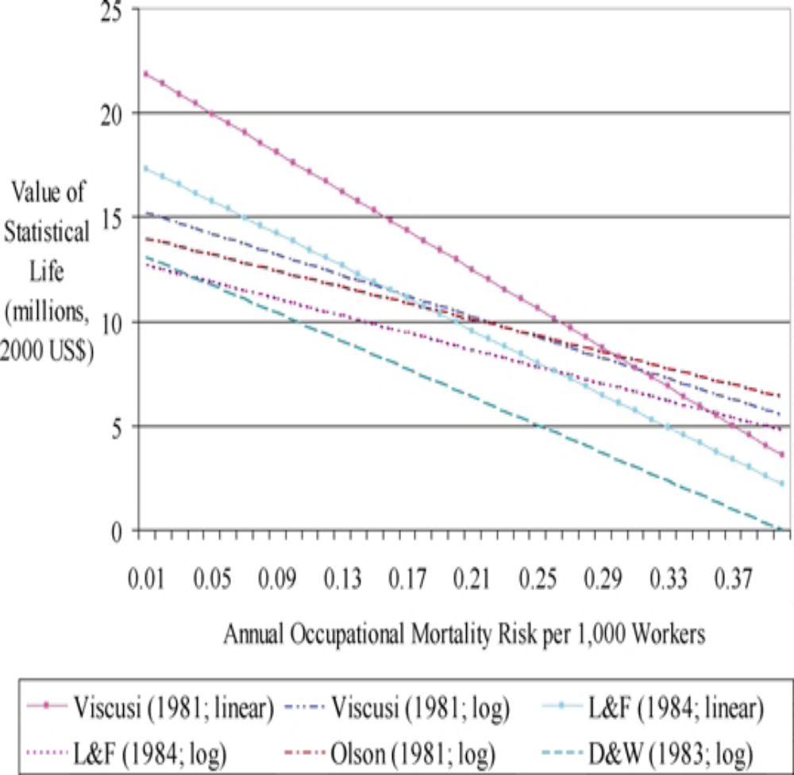
VSL is a function of mortality risk
Notes:
Where life is cheap, life is cheap

Slide 26
Voluntary vs Involuntary
Hedonic wage VSL represents voluntary risk tradeoff
The public’s willingness to accept involuntary risks is several orders of magnitude lower than their willingness to accept voluntary risks.
Notes:
We are loathe to let others do unto us what we happily do unto ourselves.

Slide 27
Values of a statistical life used by U.S. Regulatory Agencies, 1985–2000
Year | Agency | Regulation | VSL (millions, 2000 $US)
1985 | Federal Aviation Administration | Protective Breathing Equipment | $1.00
1985 | Environmental Protection Agency | Regulation of Fuels and Fuel Additives; Gasoline Lead content | $1.7
1988 | Federal Aviation Administration | Improved Survival Equipment for Inadvertent Water Landings | $1.50
1988 | Environmental Protection Agency | Protection of Stratospheric Ozone (53 FR 30566) | $4.8
1990 | Federal Aviation Administration | Proposed Establishment of the Harlingen Airport Radar Service | $2.00
1994 | Food and Nutrition Service (USDA) | National School Lunch Program and School Breakfast Program | $1.7, $3.5
1995 | Consumer Product Safety Commission | Multiple Tube Mine and Shell Fireworks Devices | $5.60
1996 | Food Safety Inspection Service (USDA) | Pathogen Reduction; Hazard Analysis & Control Systems | $1.9
1996 | Food and Drug Administration | Restricting the Sale and Distribution of Tobacco to Minors | $2.70
1996 | Federal Aviation Administration | Aircraft Flight Simulator Use in Pilot Training, Testing | $3.00
1996 | Environmental Protection Agency | Requirements for Lead-Based Paint Activities in Child Care | $6.3
1996 | Food and Drug Administration | Medical Devices; Current Good Manufacturing Practice | $5.50
1997 | Environmental Protection Agency | National Ambient Air Quality Standards for Ozone | $6.3
1999 | Environmental Protection Agency | Drinking Water Radon Health Risk Reduction & Cost Analysis | $6.3
1999 | Environmental Protection Agency | Control of Air Pollution from New Motor Vehicles: Tier 2 & sulfur | $3.9, $6.3
2000 | Consumer Product Safety Commission | Portable Bed Rails; Advance Notice of Proposed Rulemaking | $5.00
Viscusi & Aldy 2003
Notes:
The median $3.7million, is lower than the median hedonic wage VSL estimate.
While the value of a statistical life can be used to monetize the benefits for risk policy
evaluation, most laws do not require that agencies undertake such balancing and some laws
in the United States actually preclude the consideration of benefit-cost analysis in setting
standards. For example, the courts have interpreted the Clean Air Act such that the U.S.
Environmental Protection Agency cannot base ambient air quality standards on benefit-
cost analysis or an assessment of the costs. Even if a benefit-cost test cannot be applied,
policies that on balance harm individual health presumably should not be adopted.
This hedonic wage method has also been applied to risk of injury, which come in at around $150-200,000 per work related injury

Slide 28
EPA Clear Skies Analysis
EPA used median of Viscusi studies, $6.3M
OMB asked EPA to redo using $3.7M
  Rated people over 70 as worth 63%, (i.e. $2.3M)
 | cost | benefit
original | $6.5B | $93B
New analysis | $6.5B | $11B
Notes:
The result was a bargaining tool to block tougher regs on PM

Slide 29
Disability-Adjusted Life Year*
DALY = YLL + YLD
Years of Life Lost + Years Lost to Disability
YLL = N x L
Number of deaths x standard Life expectancy minus age at death
YLD = C x DW x D
Cases x Disability Weight x Duration of illness until death or remission
*WHO
Notes:
The Disability Adjusted Life Year is the only quantitative indicator of burden of disease that reflects the total amount of healthy life lost, to all causes, whether from premature mortality or from some degree of disability during a period of time.
The Disability Adjusted Life Year or DALY is a health gap measure that extends the concept of potential years of life lost due to premature death (PYLL) to include equivalent years of ‘healthy’ life lost by virtue of being in states of poor health or disability (1). The DALY combines in one measure the time lived with disability and the time lost due to premature mortality. One DALY can be thought of as one lost year of ‘healthy’ life and the burden of disease as a measurement of the gap between current health status and an ideal situation where everyone lives into old age free of disease and disability.YEARS OF LIFE LOST PLUS YEARS LOST TO DISABILITYDALYs for a disease or health condition are calculated as the sum of the years of life lost due to premature mortality (YLL) in the population and the years lost due to disability (YLD) for incident cases of the health condition:
The years of life lost (YLL) basically correspond to the number of deaths multiplied by the standard life expectancy at the age at which death occurs. The basic formula for YLL (without yet including other social preferences discussed below), is the following for a given cause, age and sex:
where:
N = number of deaths
L = standard life expectancy at age of death in years
Because YLL measure the incident stream of lost years of life due to deaths, an incidence perspective is also taken for the calculation of YLD. To estimate YLD for a particular cause in a particular time period, the number of incident cases in that period is multiplied by the average duration of the disease and a weight factor that reflects the severity of the disease on a scale from 0 (perfect health) to 1 (dead). The basic formula for YLD is the following (again, without applying social preferences):
where:
I = number of incident cases
DW = disability weight
L = average duration of the case until remission or death (years)
DISABILITY WEIGHTS
The disability weights used in the GBD 2000 are listed in detail elsewhere (2). Egalitarian principles were explicitly built into the DALY, and the Global Burden of Disease Study used the same values for all regions of the world (3) . It used the same life expectancy ‘ideal’ standard for all population subgroups and it excluded all non-health characteristics (such as race, socioeconomic status or occupation) apart from age and sex from consideration in calculating lost years of healthy life. Most importantly, it used the same ‘disability weight’ for everyone living a year in a specified health state. Additionally, 3% time discounting and non-uniform age weights which give less weight to years lived at young and older ages were used in calculating DALYs for the original Global Burden of Disease study (3). These value choices have continued to be used for the Global Burden of Disease 2000 study results reported in recent World Health Reports (4).
With non-uniform age weights and 3% discounting, a death in infancy corresponds to 33 DALYs, and deaths at ages 5 to 20 to around 36 DALYs. Thus a disease burden of 3,300 DALYs in a population would be the equivalent of 100 infant deaths or to approximately 5,500 persons aged 50 years living one year with blindness (disability weight 0.6).::

Slide 30
World Bank Assumptions
The standard life expectancy chosen matches the highest national life expectancy observed, which is that of Japanese women (82 years)
Disabilties are fungible: 6 blindness = 1 death
The age weights rise from birth until age 25 and decline slowly thereafter: Age-Weighting function = Cxe^{-βx} where C= 0.16243 β= 0.04 x= age
3% discount of future health: Discounting function = e^{–r(x-a)} where x= age, r = 0.03, a = age at onset
Health is a public good:
Two people each losing 10 years of disability-free life = one person losing 20 years

Slide 31
QALY – Quality Adjusted Life Year
measure of utility which combines life years gained as a result of health interventions with a judgment about the quality of these life years
e.g., A patient is expected to die in 1 year during which his quality of life is 0.6 on a [0,1] scale. Intervention results in patient living for an additional 4 years at 0.6 level.
4 years extra life at 0.6 yields 2.4
Less 1 year at reduced quality (1 - 0.6) = - 0.4
2.0 QALYs
Notes:
Quality Adjusted Life Year: Units of measure of utility which combine life years gained as a result of health interventions/health care programs with a judgment about the quality of these life years.
It is based on the number of years of life that would be added by the intervention. Each year in perfect health is assigned the value of 1.0 down to a value of 0 for death. If the extra years would not be lived in full health, for example if the patient would lose a limb, or be blind or be confined to a wheelchair, then the extra life-years are given a value between 0 and 1 to account for this.
Thus an intervention which results in a patient living for an additional four years rather than dying within one year, but where quality of life fell from 1 to 0.6 on the continuum will generate:-
4 years extra life @ 0.6 quality of life values 2.4
less 1 year @ reduced quality (1 - 0.6) 0.4
QALYs generated by the intervention 2.0

Slide 32
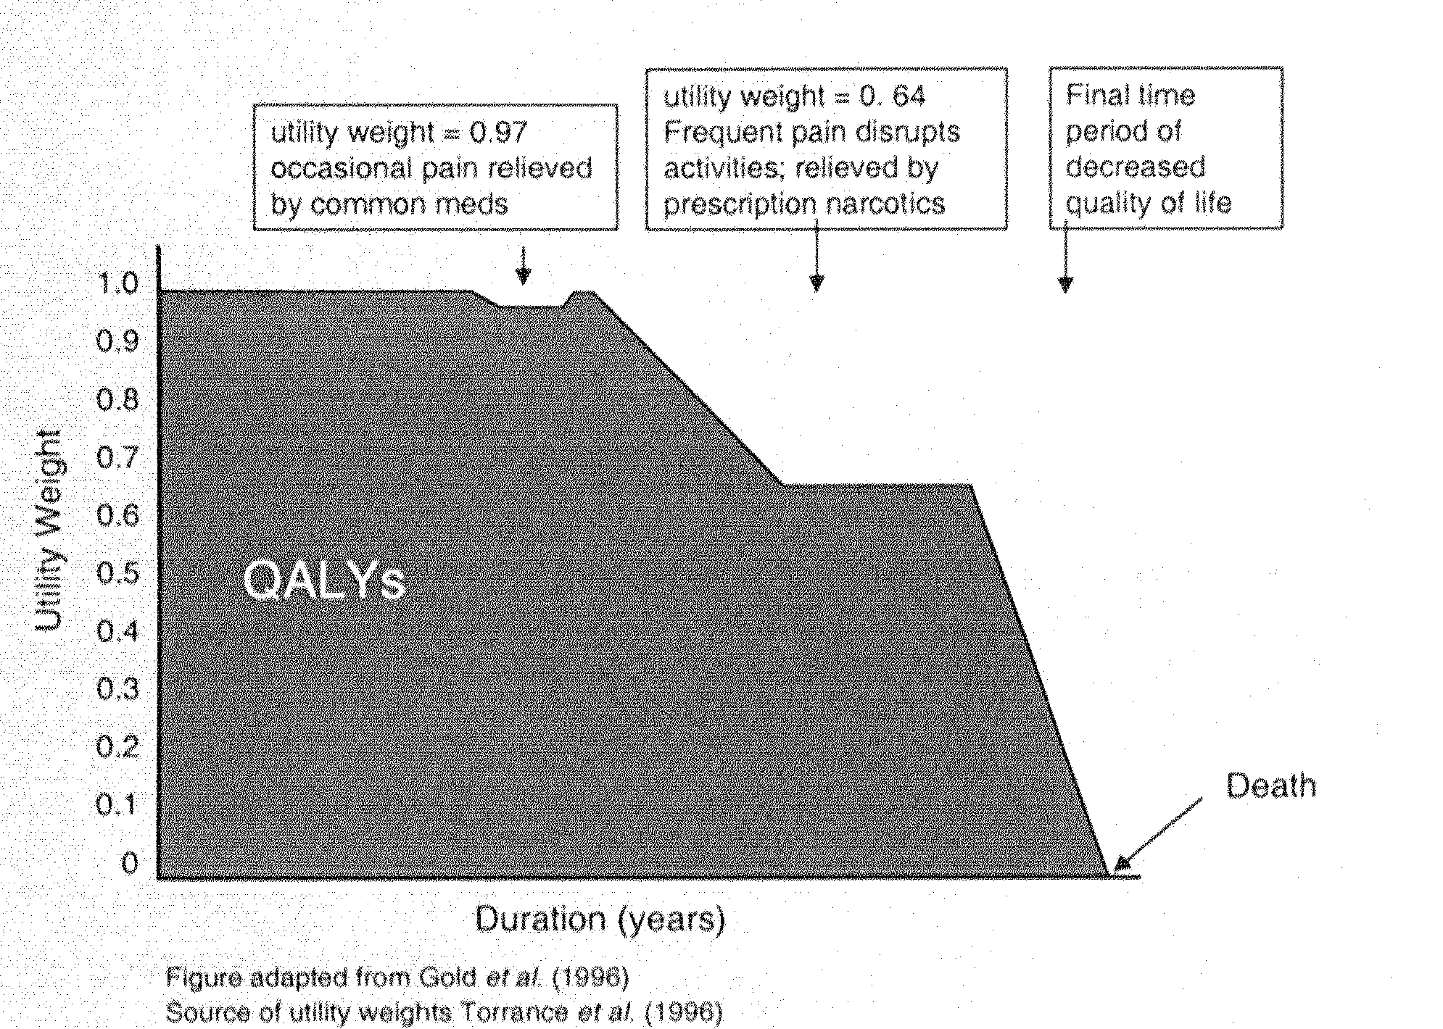
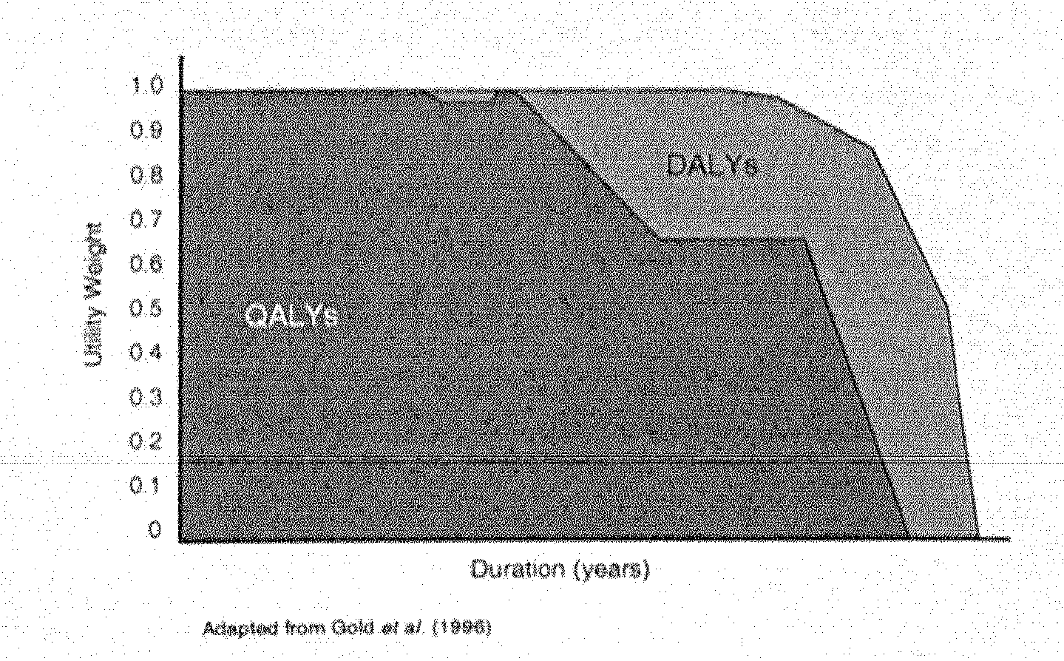
Relationship between DALYs and QALYs

Slide 33
Exercise
Scenario: Philadelphia is dusted with 1 kg of antibiotic-resistant (ie, incurable) anthrax spores
unknown distribution of spores
300,000 houses known to be contaminated
2.7 people per home
Sequence of cumulative decontamination options (must be applied in order)
Option cost/house lifetime reoccupation risk person⁻¹
No treatment 0 0.01-0.015
D1 $3,000 0.0005-0.00075
D2 $3,000 0.0004-0.0006
D3 $10,000 0.0003-0.00045
D4 $20,000 0.0001-0.00015
Condemn house $300,000 0-0.00001
What should the feds do?

Slide 34
Number of homes: 300,000 @$300,000
Number of people: 810,000
VSL: $10 million
Option total cost reoccupation dead lives saved marginal risk per person cumulative benefits cost/life saved
Do nothing 0 0.01-0.015 8,100-12,150 $0 na
1 $0.9 B 0.0005-0.00075 405-608 $77B-$115B $78K-$117K
2 $1.8 B 0.0004-0.0006 324-486 $78B-$117B $7M-$11M
3 $4.8 B 0.0003-0.00045 243-364 $79B-$118B $25M-$37M
4 $10.8 B 0.0001-0.00015 81-122 $80B-$120B $25M-$37M
Condemn $90 B 0-0.00001 0-8 $81B-$121B $1B-$2B
Notes:
The utilitarian says it’s a good deal to spend 11 billion to save 80-120 Billion in lives, (option 4) but feels a little nervous about spending 90 billion, if the value of the lives saved could be anywhere between 81 and 121 billion.
To save the last 81 - 114 people he has to spend 1-2 billion apiece, assuming there are no other options. Is that the welfare-maximizing way to spend that 80Billion?
However, if you look at the cost per life saved, is it that much more than 10 M?
Are we confident in the VSL enough to condemn these 81 people?
What would the egalitarian say
What would the libertarian say? Compensate everyone for losses

Slide 35
What about Patrick?
He has a wife and 2 beautiful children and $50,000 of equity in his $300k house.
If the feds treat up to the 0.0001 lifetime infection risk level,
should he re-occupy?
0.0001 * 4 people * $10 million = $4,000
If he defaults on his loan, what does that imply his value of a Gurian life is?
Notes:
Can he use benefit cost analysis to help him decide what to do?
Is it worth 50k to patrick to save $4k of life?
If it is, that means he values his family members at $125 million each

