Slide 1


Attenuation of Micororganisms
Charles P. Gerba
Department of Soil, Water and Environmental Science
And
Department of Epidemiology and Biosatistics
University of Arizona
Notes:
Microbial standards have been used for almost a century to assess the presence of fecal contamination. Food and water borne outbreaks of disease have been associated with the fecal contamination of drinking water and with fecal contaminated irrigation water. Because of the difficulty of detecting pathogens in water bacteria commonly found in the feces of warm blooded animals have been used as indicators of fecal contamination.

Slide 2
Microbial Die-off /Decay/Inactivation (Viruses)/Loss of Infectivity
Viruses and protozoan parasites can not replicate outside of the host
Under some environmental conditions bacterial pathogens (borne i.e waterborne) can replicate (food, sediments, biosolids)
“based” pathogens naturally occur in the environment i.e. waterbased (Legionella, Pseudomonas) and grow in the environment

Slide 3
Microbial Die-off /Decay/Inactivation (Viruses)/Loss of Infectivity
Virus inactivation occurs by either denaturization of the protein coat or nucleic acid
Some viruses contain a lipid coat and its damage (by detergents) will result in its loss of infectivity
As a general rule enteric viruses survive longer than respiratory viruses
As a general rule enteric viruses are more resistant to disinfectants than vegetative bacterial cells

Slide 4
Microbial Die-off /Decay/Inactivation /Loss of Infectivity
Bacteria can enter a non-cultural state in the environment or exposure to stress
Bacterial die-off occurs from damage to cell wall/membrane/nucleic acid/ enzyme systems. Repair of damage is possible dependent on the degree of damage.
Most disinfectant resistant bacteria are mycobacterium and spore formers

Slide 5
Factors Controlling the Survival of Enteric Pathogens in Water
Temperature – longer survival at lower temperatures
pH –best survival between pH 7 to 8.0. Viruses can survive pH 3.0 to 10.0.
Organic matter – lower survival in sewage
Turbidity – longer survival in turbid waters
Sediments – longer survival in sediments. Thermal stabilization of viral capsid. Bacteria are protected from predation and more degradable organic matter in sediments

Slide 6
Factors Controlling the Survival of Enteric Pathogens in Water
Salts – Shorter survival in seawater. Giardia dies quickly in seawater.
Sunlight – UV light. Die-off of enteric bacteria can be modeled using incidence of UV light. Viruses more resistant to inactivation by UV light than bacteria.
Antagonistic microflora – Shorter survival time in non-sterile environments

Slide 7
Additional Factors Controlling the Survival of Enteric Pathogens in Soil
Soil moisture – Generally longer survival at higher soil moisture
Type of soil – Longer survival in clay soils and soils higher in organic matter
Hydrophobicity – shorter survival in unsaturated soils do to inactivation at the air water interface

Slide 8
Survival in Aerosols/Fomites
Suspending media
  Organic matter and salts can prolong survival
Relative humidity
  Rate of inactivation depends upon the organism
Rate of drying
Outdoor air factor

Slide 9
Microbial Die-off
Number
Of
Organisms
Time

Slide 10
Microbial Die-off /Decay/Inactivation (Viruses)/Loss of Infectivity
T₉₉ = 99% Die-off
T_{99.9} = 99.9% Die-off
N/N₀ = Log Survival
N = Concentration after a given period of time
N₀ = Initial concentration of organisms

Slide 11
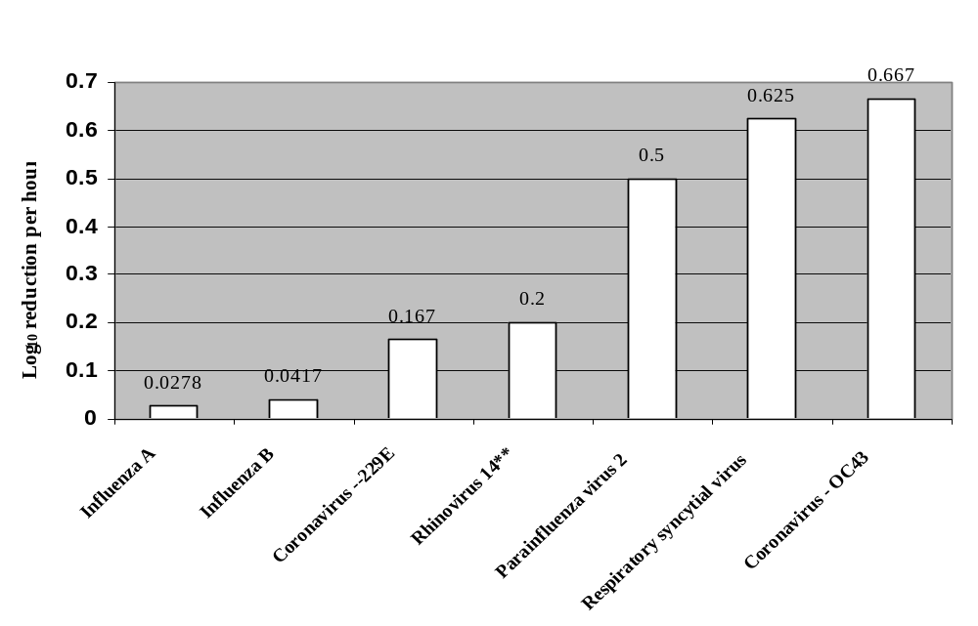
Inactivation of Respiratory Viruses on Fomites

Slide 12
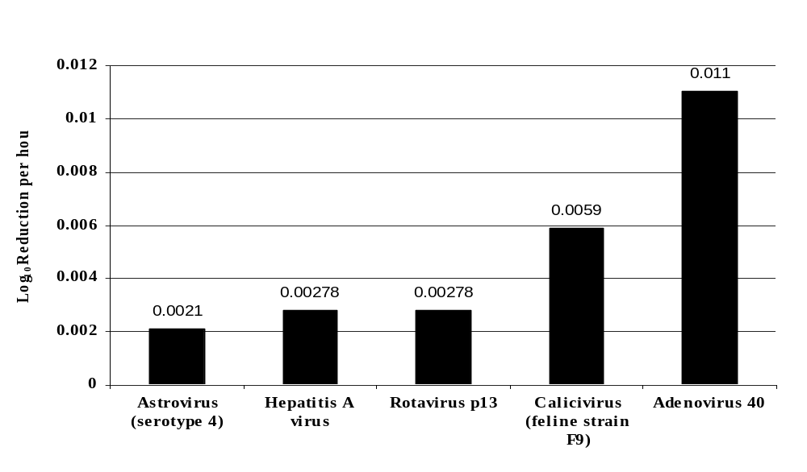
Inactivation of Enteric Viruses on Fomites

Slide 13
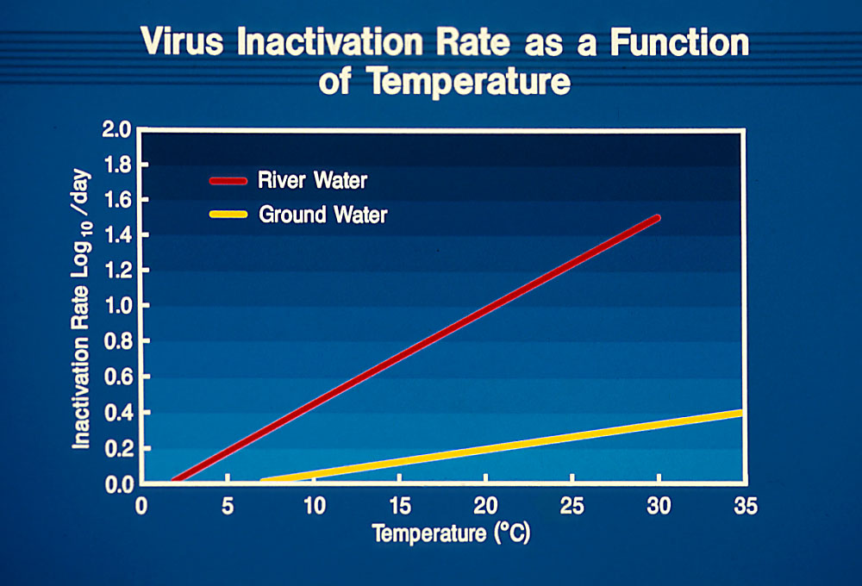

Slide 14
