Slide 1
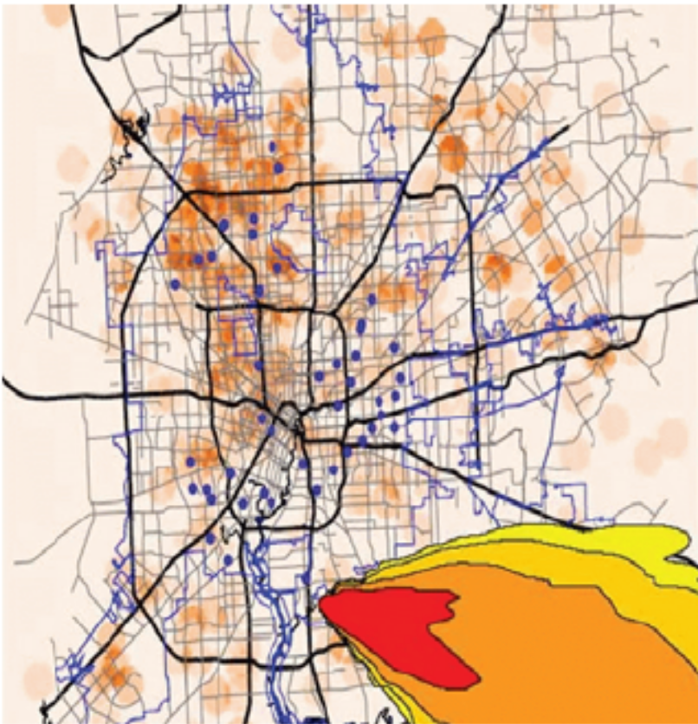
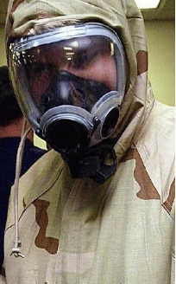
BioWatch Program

Slide 2
Background
Rising concerns
  Terrorists could aerosolize biological agents in the air
  Potentially causing thousands of causalities
  Without early detection, the magnitude of the problem might only be revealed as people arrived at hospitals with symptoms
Early-warning system
  Department of Homeland Security
  Tested at the winter Olympic, Salt Lake City in 2002
  BioWatcat Program in 2003

Slide 3
Agencies & Responsibilities
Department of Homeland Security (DHS)
Environmental Protection Agency (EPA)
Center for Disease Control and Prevention (CDC)
Department of Energy (DOE)
Department of Defense (DOD)
DHS
Funding,
Oversight,
Coordination
DOE and DOD
Site selection,
Sampler unit,
Tech support
EPA
Field coordination,
Site maintenance,
Sampling operation
CDC
Sample analysis &
data management,
Consequence management
strategy

Slide 4
Sampling
Outdoor
  Pre-existing EPA air quality station
  Manually collect samples 24-hr intervals, 7 days/week, 365 days/year
    Potable sampling unit (PSU)
    Dry filter unit (DFU)
    Distributed sampling unit
  Deliver samples daily to CDC-operated facilities
Indoor (enhancing & developing the protocols)
  Suggested methods
    HEPA socks?
    Swabs for areas where water pools?
    Swipes for surfaces, e.g. computer screens, air intake vents?

Slide 5
Analysis & Responses
CDC-operated BioWatch facility
  Federal, State, or local public health laboratories
  Primary analysis
    Polymerase chain reaction (PCR)
    If a biological agent is detected, perform 2^{ndary} test
  Secondary analysis
    PCR-verified positive
      existence of a biological material in the air due to either an intentional or a natural
Notification by local level with health authorities
Low enforcement by Federal Bureau Investigation (FBI)

Slide 6
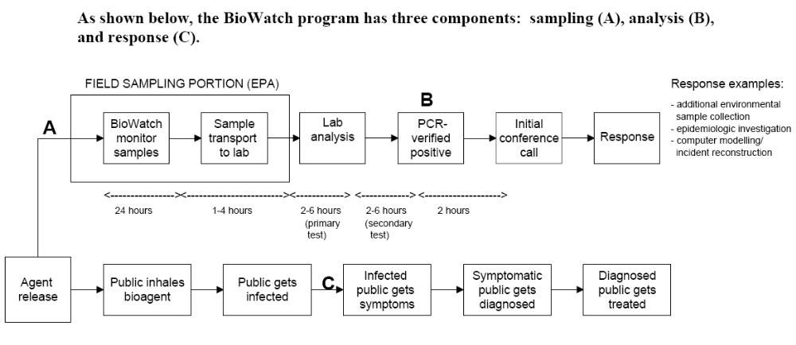
BioWatch Program Model
< 36 hrs

Slide 7
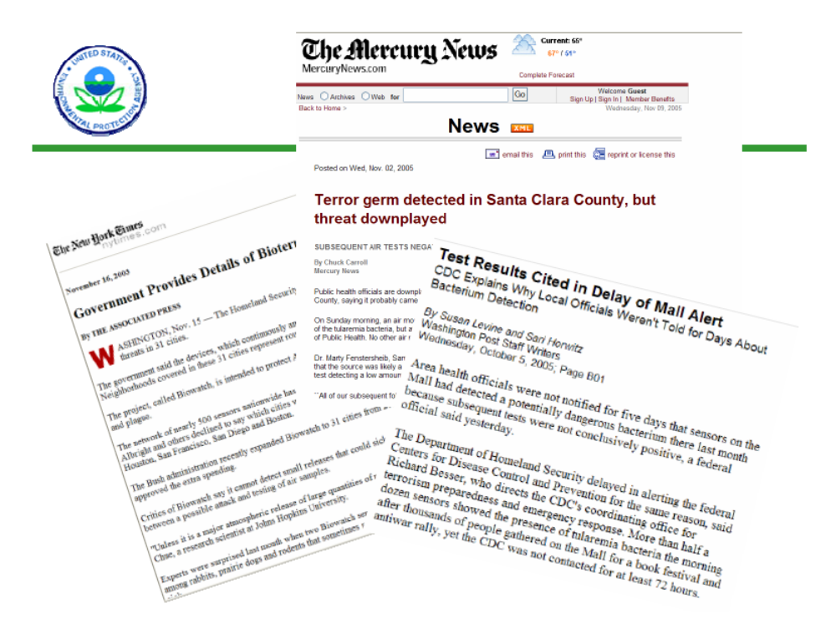
Evaluations of the Program
EPA concerns
  Quality assurance and quality control (QAQC)
  Protocols and response systems

