Slide 1

Balancing risks
Gertjan Medema
CAMRA, Summer Institute
August 2006

Slide 2


Risk management: balancing costs
Safety
Cost

Slide 3
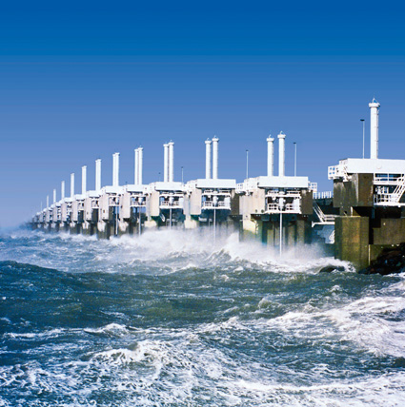
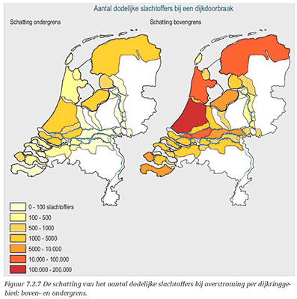
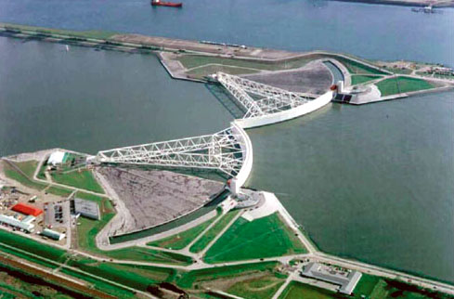
Safety comes at a price

Slide 4
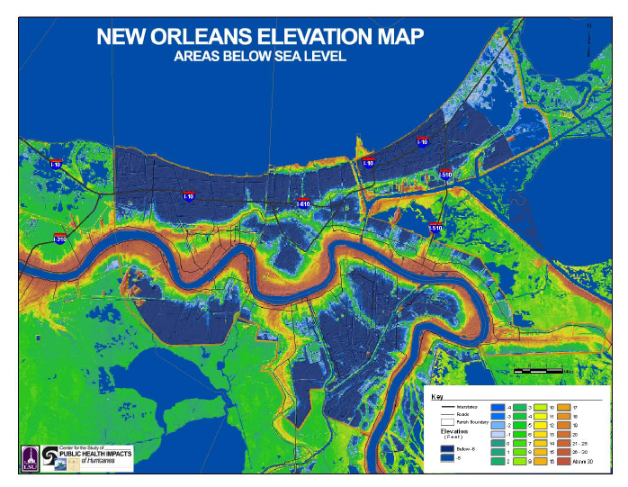
Safety comes at a price (2)

Slide 5
Risk management: balancing risks
Risk 1
Risk 2

Slide 6
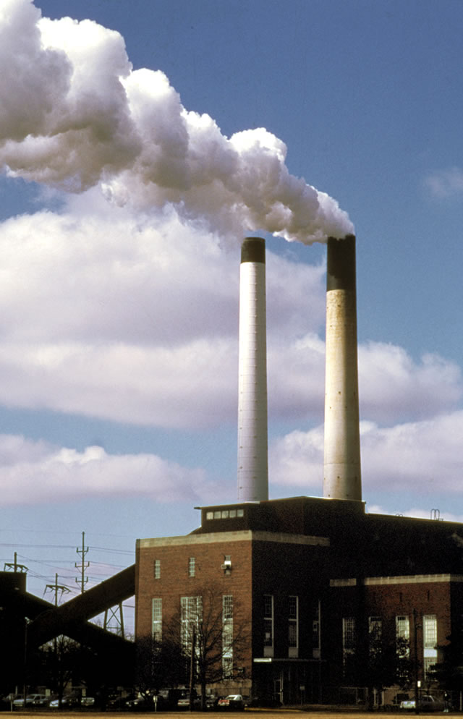
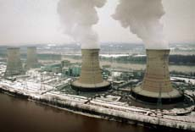
Uranium or coal?

Slide 7

Vaccination?

Slide 8
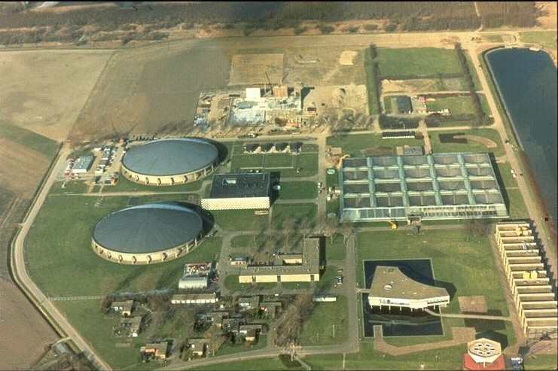
Drinking water disinfection?

Slide 9
Risk management: balancing risks
Cancer
GI illness

Slide 10

Balancing risks different health risks on the same scale
Cancer
Infectious diseases

Slide 11
Risk assessment
Death, DALY’s or Dollars?
Guus den Hollander, 2004

Slide 12
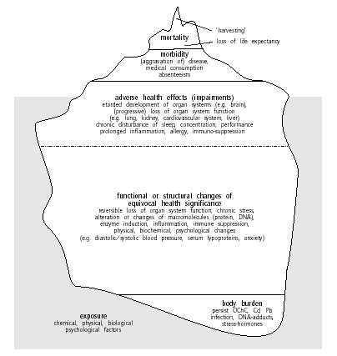

Slide 13
Balancing risks different health risks on the same scale
Cancer
Infectious diseases

Slide 14
Risk scale: death
Mortality
+
  Clear outcome
  History of statistics
-
  Cause?
  Live expectancy not accounted for
  No morbidity/disability accounted for

Slide 15
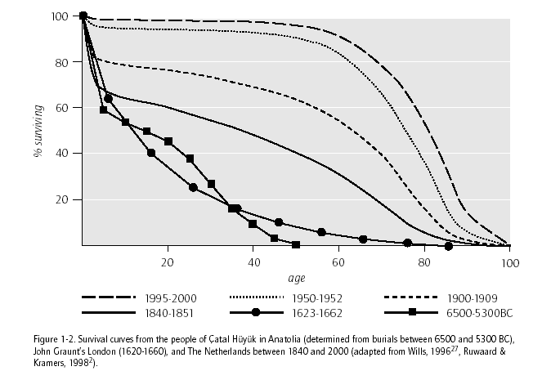
Mortality over the millenia

Slide 16
Risk scale: YLL
Years of Life Lost (YLL)
+
  Includes life expectancy
-
  Cause?
  Disability due to illness (aftermath) not accounted for

Slide 17
Risk scale: DALY
Disability Adjusted Life Years
+
  Includes life expectancy
-
  Cause?
  Disability due to illness (aftermath) not accounted for

Slide 18
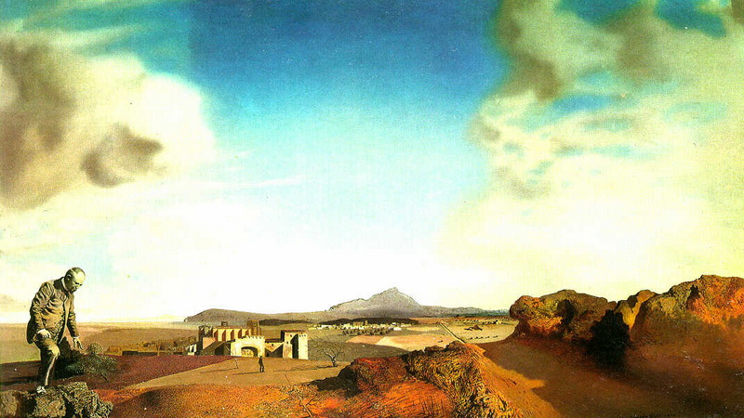
What is a DALY?
Salvador Dali: The pharmacist of Ampurdan in search of absolutely nothing, 1936
Notes:
De presentatie heeft 3 onderdelen: microbiologische veiligheid in het nieuwe Waterleidingbesluit, de uitwerking van de risicoanalyse in de Inspectierichtlijn en het stappenplan om tot de voorlopige risicoanalyse te komen.

Slide 19
What is a DALY?
DALY = Disability Adjusted Life Years
Measure for the Burden of Disease: number of healthy life years lost due to disease in a population
Components: years life lost by premature death (YLL)) and years life lived with disability (YLD) and severity of disability (s)
DALY = YLL + YLD*s
Burden of disease measure that takes into account: number of persons affected, severity of disease, mortality and prematurity of death
Notes:
De presentatie heeft 3 onderdelen: microbiologische veiligheid in het nieuwe Waterleidingbesluit, de uitwerking van de risicoanalyse in de Inspectierichtlijn en het stappenplan om tot de voorlopige risicoanalyse te komen.

Slide 20
What is a DALY?
Population of 3 persons with life expectancy of 80 years (240 years “available”)
 | YLL | YLD | s | DALY
Person 1 dies in car crash at age of 40 | 40 | 0 |  | 40
Person 2 gets reuma at age of 50 | 0 | 30 | 0.5 | 15
Person 3 gets diabetis at age of 30 and dies of consequences at age of 60 | 20 | 30 | 0.2 | 26
Total years lost due to disease in population |  |  |  | 81
Notes:
De presentatie heeft 3 onderdelen: microbiologische veiligheid in het nieuwe Waterleidingbesluit, de uitwerking van de risicoanalyse in de Inspectierichtlijn en het stappenplan om tot de voorlopige risicoanalyse te komen.

Slide 21
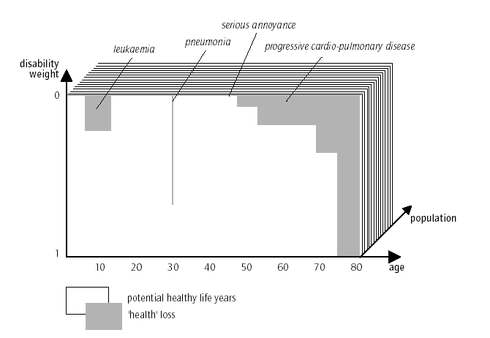
DALY of a population

Slide 22
Why do we need DALY’s?
Priorities in health policy
Disease | # deaths | YLL | # disease | Severity | YLD | DALY’s
Heart diseases | 17.443 | 186.746 | 556.600 | 0,29 | 160.300 | 347.100
Fobiae (total) | 0 | 0 | 1.316.700 | 0,17 | 226.300 | 226.300
Stroke | 12.275 | 107.757 | 139.700 | 0,61 | 85.100 | 192.900
CARA | 6.634 | 58.175 | 289.500 | 0,31 | 126.300 | 184.500
Alcohol dependancy | 815 | 19.156 | 290.000 | 0,55 | 159.500 | 178.600
Depression | - | - | 407.700 | 0,42 | 169.800 | 169.800
Lung cancer | 8.559 | 119.607 | 19.900 | 0,44 | 8.800 | 128.400
Arthrosis | 77 | 481 | 654.400 | 0,19 | 122.200 | 122.700
Diabetes mellitus | 3.345 | 34.551 | 414.100 | 0,20 | 81.800 | 116.400
Dementia | 5.343 | 30.081 | 81.400 | 0,71 | 57.700 | 87.800
Traffic accidents | 1.085 | 44.736 | 93.900 | 0,43 | 40.400 | 85.100
Breast cancer | 3.452 | 61.572 | 95.500 | 0,21 | 19.900 | 81.500
Pneumonia | 6.984 | 49.448 | 638.600 | 0,04 | 24.500 | 73.900
Impaired vision | 0 | 0 | 438.400 | 0,16 | 72.100 | 72.100
Reumatoïd arthritis | 165 | 1.608 | 132.800 | 0,53 | 69.700 | 71.300
Top 15 disease in The Netherlands, National Health Compass, data RIVM

Slide 23
DALY’s: different health risks on the same scale
DALY’s
Objective
Best available evidence
Death & disease
Severity weight
Importance of risk factors
Cancer
Infectious diseases

Slide 24
DALY issues
Ethics of severity weight: is disabled life of less value?
Severity weight limitations: same disability different severiy for different people
Who can judge severity: experts on health, general public, those experiencing disability?
Age weighting
Discounting eldery life years
Co-morbidity (eldery) not accounted for
Burden to relatives, social/public services not accounted for

Slide 25
DALY’s, water & health
Setting priorities for risk management
Setting priorities for research
Balancing different risks
Setting water quality targets
Quantitative risk assessment

Slide 26
DALY’s, water & health
Setting priorities for risk management
Setting priorities for research
Balancing different risks
Setting water quality targets
Quantitative risk assessment

Slide 27
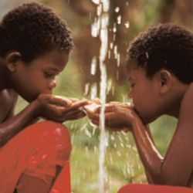
DALY’s, water & health
Global priorities
WHO: water & sanitation in global burden of disease
  Diarrhea: 4.3% of global DALYs (62.5 MDALY)
  Lack of access to safe water & sanitation: 88%

Slide 28
DALY’s, water & health
Regional priorities
WHO: cost effectiveness of intervention
Region: WHO African Region (AFR) – E
Category: Unsafe Water Supply, Sanitation and Lack of Hygiene Related Risk
 |  | Average Year Cost (in international [I$]) |  |  | Effectiveness (DALYs averted: average 1 year) | Cost Effectiveness
 | Intervention | Programme |  | Total |  | Average | Incremental
 | Disinfection at point of use with education | 826,324,525 |  | 826,324,525 | 3,398,430 | 243 | 243.15
 | Halving the population without improved water supply | 563,092,965 |  | 563,092,965 | 627,627 | 897 | Dominated
 | Halving the population without improved water supply and sanitation | 1,527,910,726 |  | 1,527,910,726 | 1,512,576 | 1,010 | Dominated
 | Improved water supply and sanitation (98%) | 2,994,705,024 |  | 2,994,705,024 | 3,392,285 | 883 | Dominated
 | Improved water supply and sanitation with disinfection (98%) | 3,967,801,683 |  | 3,967,801,683 | 8,264,523 | 480 | 645.59
 | Piped water supply and sewage with treatment (98%) | 13,160,732,747 |  | 13,160,732,747 | 12,274,239 | 1,072 | 2292.66

Slide 29
DALY’s, water & health
Setting priorities for risk management
Setting priorities for research
Balancing different risks
Setting water quality targets
Quantitative risk assessment

Slide 30
Risk management: balancing DBPs and disinfection in surface water treatment
DALY’s
Bromate
Crypto
Havelaar et al., 1998

Slide 31
Drinking water disinfection?

Slide 32
Water treatment plant
Coagulation/filtration
Ozonation
Activated carbon filtration
Chlorination

Slide 33
Cryptosporidium data for QMRA
Cryptosporidium concentrations in source water
Recovery efficiency of the detection method
Removal by COA/SED/FIL
Inactivation by ozone
GACF + chlorination: not effective against Crypto
Consumption
Dose response
DALY’s

Slide 34
Bromate data for QMRA
Bromide concentrations in source water
Dose response
DALY’s

Slide 35
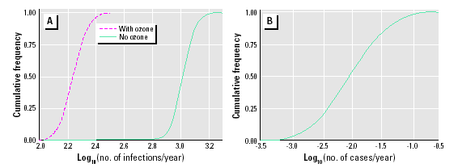
Dose response

Slide 36
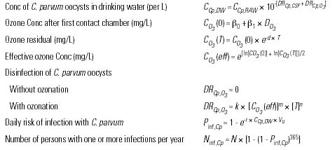
Models

Slide 37

Models

Slide 38
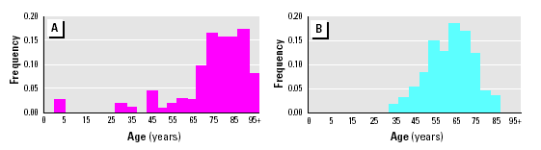
Age distribution of cases
GI illness
Renal cancer

Slide 39
Cancer vs GI illness cases
DALY’s
Cancer
GI illness
Havelaar et al., 1998

Slide 40
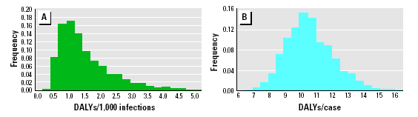
DALY’s
GI illness
Renal cancer

Slide 41
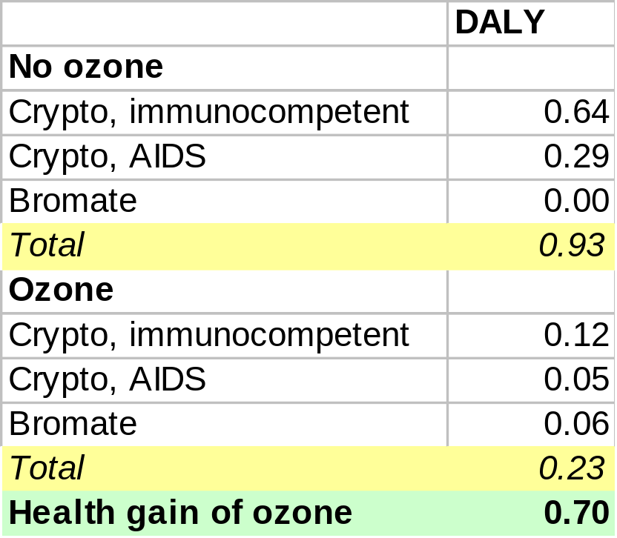
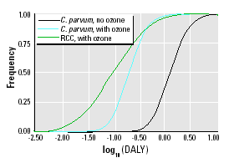
DALY’s with or without ozone

Slide 42
Sensitivity of balance
Crypto removal by coagulation/filtration
Dose response parameter of Crypto
Consumption of unboiled tap water
Concentration of Crypto in source water
pH
Probability, duration, severity of GI illness in the immunocompetent

Slide 43
Cancer vs GI illness cases
DALY’s
Cancer
GI illness
Havelaar et al., 1998

Slide 44
Risk management: diarrhea from use of surface water versus arsenic from ground water (Bangladesh)
DALY’s
Pathogens
Arsenic
Lokuge et al., 2004

Slide 45
DALY’s, water & health
Setting priorities for risk management
Setting priorities for research
Balancing different risks
Setting water quality targets
Quantitative risk assessment

Slide 46
DALY’s for setting water quality targets, WHO
Reference level of tolerable risk
10⁻⁶ DALY (= 1 μDALY) per personyear
Current reference level: tolerable lifetime risk of death of 10⁻⁵ per person (carcinogens)
At life expectance of 70 years: tolerable annual risk of death = 1.4 x 10⁻⁷ per person
Bromate and renal cancer: DALY/case = 10.91
Tolerable DALY = 1.6 x 10⁻⁶ per personyear

Slide 47
DALY’s for setting water quality targets
Different parameters, different diseases
Cryptosporidium
E.coli O157
Legionella
Bromate
Atrazin
Cyanotoxins
Endocrine disruptors
THMs
….
Diarrhea, arthritis?
Diarrhea, HUS, kidney failure
Pneumonia, lung damage
Renal cancer
Cancer
Liver intoxication
Birth defects??
Bladder cancer, stillbirth??
…
Notes:
De presentatie heeft 3 onderdelen: microbiologische veiligheid in het nieuwe Waterleidingbesluit, de uitwerking van de risicoanalyse in de Inspectierichtlijn en het stappenplan om tot de voorlopige risicoanalyse te komen.

Slide 48
DALY’s for setting water quality targets
Different parameters, different basis
Basis for water quality standards:
  Carcinogens: tolerable/negligible risk level 10^{-4 / -5 / -6} lifetime risk of death
  Pathogens: 10⁻⁴ annual risk of infection
  Toxic compounds: NOAEL
Notes:
De presentatie heeft 3 onderdelen: microbiologische veiligheid in het nieuwe Waterleidingbesluit, de uitwerking van de risicoanalyse in de Inspectierichtlijn en het stappenplan om tot de voorlopige risicoanalyse te komen.

Slide 49
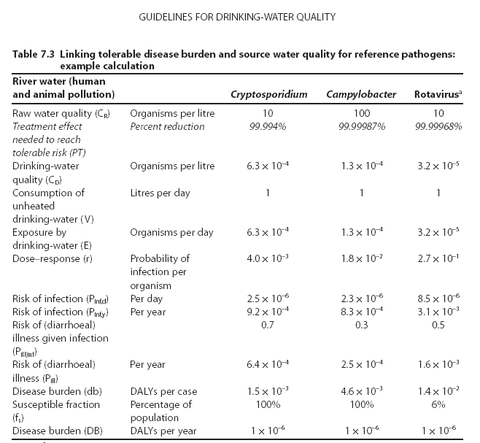
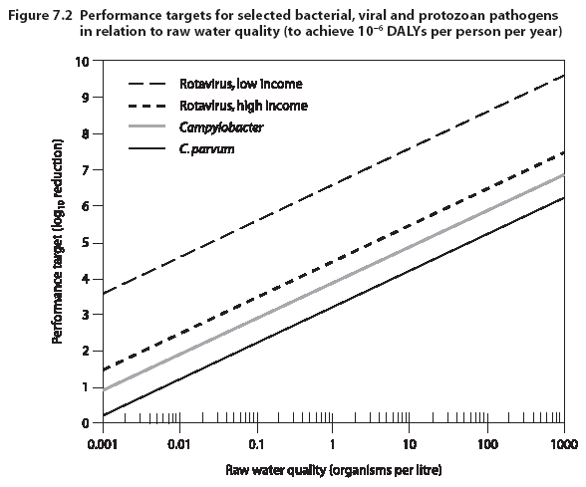
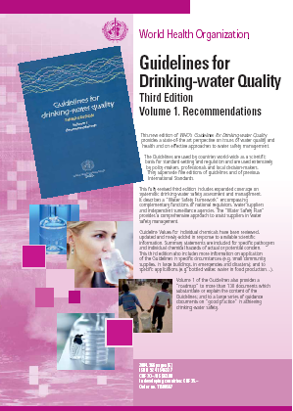

DALY’s as basis of water quality targets

Slide 50
DALY’s: different health risks on the same scale
Setting priorities for risk management
Setting priorities for research
Balancing different risks
Setting water quality targets
Quantitative risk assessment
DALY’s
Objective
Best available evidence
Death & disease
Severity weight
Importance of risk factors
Cancer
Infectious diseases

