Slide 1


Integrating Population Dynamics into Microbial Risk Estimation:
Environmental Models of Infection Transmission Systems
Project II
CAMRA PI Meeting
February 28 2006
Joe Eisenberg
Jim Koopman
University of Michigan

Slide 2
Our Mission
Develop transmission system models that follow pathogens through the environment and through humans
  Social, environmental, and biological structure
Develop methods that use these models to
  Provide guidance on policy needs and options
    Surveillance and control (humans and the environment)
  Provide guidance on future research directions
    Define critical unknown factors
    Define experimental and observational study designs
  Predict intervention effects
    Identify factors important in determining primary transmission modes (social, environmental, and biological)
    Analyze epidemiological and environmental data

Slide 3
Focus in Year 2
Influenza prevention trials and environmental sampling
  Dormitories at UM
Model development
  Modes of transmission, dose-response
Statistical tools to analyze data using transmission models
  Need to modify standard techniques
Study design to estimate intervention effects
  Need to account for direct and indirect effects

Slide 4
Influenza Prevention Trials
Dormitory trial in Ann Arbor
  7 dorms, 4 with students wearing masks, 1 with both masks and hand decontamination, 2 controls
  Environmental samples from surfaces frequently touched & from surfaces not touched (contamination through air settling)
  This year serves for planning next years trial
Possible additional collaboration with a school & household trial in Pittsburgh
  Masks, hand washing, & decontamination

Slide 5
Influenza Prevention Trials
Environmental pathogen measurement can
  Improve parameter identifiability in transmission models
  Add power to mask & decontamination effect estimates
Use models and data from trial to design and analyze future trials of mask use and/or hand decontamination
  Focus on university dormitories
  Determine whether environmental data can enhance analytic precision & identifiability

Slide 6
Model Development:
Mode of Transmission and Movement
Understanding principal modes of transmission will help define optimal intervention strategies
  Preliminary results from Year 1 suggest that which mode dominates is a function of
    Movement patterns (behavior processes)
    Cumulative effect of dose-response relationship (biologic processes)
    Fate and transport processes (environmental processes
  How can different movement patterns (movie house vs. office setting) tip the balance between modes of transmission (air vs. hand-fomite)?
    May depend on cumulative effect of dose response and on fate and transport processes

Slide 7
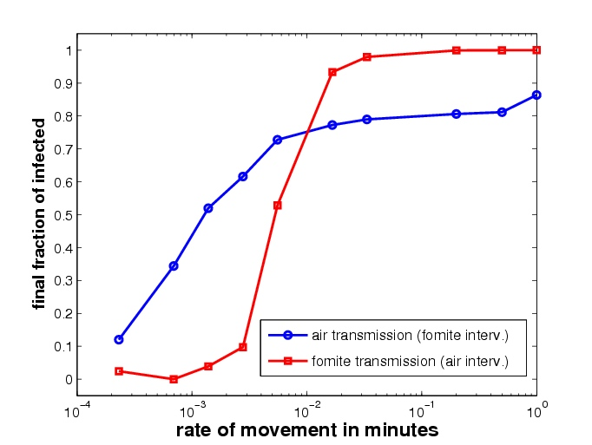
Model Development:
Mode of Transmission and Movement
Person parameters:
Breathing rate (0.014 cells/min)
Intake from fomite (0.0092 min⁻¹)
Initial fraction of infected (2%)
Movement rate (1 min⁻¹, 2.3 10 ⁻⁴ min⁻¹)
Infection parameters:
Mass shedding (18700 particles)
Fraction excreted to air (0.5)
Shedding rate (0.014min⁻¹)
Fomite die-out (0.05min⁻¹)
Air die-out (0.006 min⁻¹)
TCID₅₀ (500)
Recovery rate (2.3 10 ⁻⁴ min⁻¹; 3 days)
Venue characteristics:
60x60 cell (60x60x3 m³)
Ventilation (0.10min⁻¹)
Diffusion (0.05min⁻¹)

Slide 8
Model Development:
Cumulative Dose Response
Results from Year 1 analysis suggests that
  50 one unit exposures (over period of time) ≠ one 50 unit exposure.
  Airborne exposure is low dose over long times
  Hand-Fomite exposure is intermittent concentrated doses
Dynamic model of dose-response
  Outcome of dosing is result of battle between pathogens and immune system
  Immune replenishment dynamics become an important factor
    Slow replenishment (hours vs. minutes) could favor hand-fomite transmission

Slide 9
Model Development:
Cumulative Dose Response
Continuous time Markov chain model
  Dose has less probability of infection if the time of inoculation is longer.
  Need for time-dependent dose-response experiments.
System state variables and parameters
P # of pathogens
I # of immune particles
D total dose
T total inoculation time
g_{p} growth rate of pathogens
μ_{p} natural death rate of pathogens
d_{p} deactivation rate of pathogens
a_{i} arrival rate of immune particles
μ_{p} natural death rate of immune particles
d_{p} deactivation rate of immune particles
(P-1,I)
Pg_{p} + D/T
Pμ_{p} + PId_{p}
a_{i}
(P,I)
(P,I+1)
Iμ_{i} + PId_{i}

Slide 10
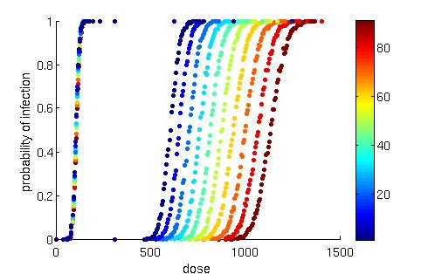
Model Development:
Cumulative Dose Response
Slow immune replenishment
Fast immune replenishment
Fast immune replenishment (c=0.1):
  Shorter dosing regimes shifts dose-response function to left (increased infectivity)
Slow immune replenishment (c=0.001):
  Dose-response function is independent of dosing time periods
Blue to red transition represents longer/lower concentration dosing periods

Slide 11
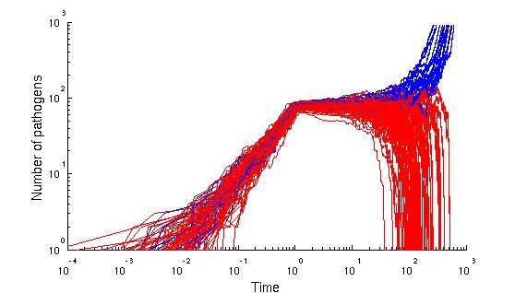
Model Development:
Cumulative Dose Response
Dynamic response from dosing (pathogen growth in time)
  22% of the trials ended up with infection (blue lines)
  78% of the trials ended up with no infection (red lines)
Infection (Immune particles depleted)
Constant Inoculation Period
Transient Period
No Infection (Immune particles grow back to equilibrium)

Slide 12
Statistical Tools:
Data analysis using transmission models
Complex nonlinear dynamics make parameter estimation problematic
  Identifiability & local minima problems
  An epidemic is one realization of a stochastic process.
Will focus on deterministic models
  To assess performance of methods that employ nonlinear transmission models
    Least square fitting
    MCMC methods
    Likelihood methods

Slide 13
Study Design:
Intervention effects when outcomes are not independent
Assess the validity of currently used statistics in estimating effects (e.g., logistic regressions)
Focusing on two types of effects
  Direct effects: Effect of intervention received by an individual with intervention
    Biologically relevant effect of an intervention in an individual.
  Indirect effects: Effect of the intervention felt by an entire intervention group, due to reduced force of infection in group.
    Effect produced by the intervention in a population.

Slide 14
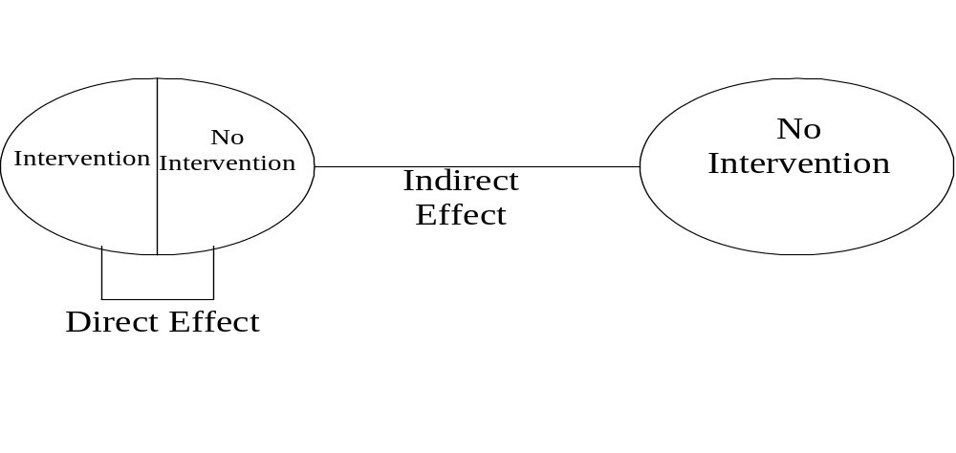
Study Design:
Intervention effects when outcomes are not independent
Group I
Group II
R_{x}
R_{n}
R_{c}
These two groups are assumed to mix independently and be comparable in all relevant characteristics.
Direct Effect = (Risk_{n} – Risk_{x} ) / Risk_{n}
Indirect Effect = (Risk_{c} – Risk_{n} ) / Risk_{c}

Slide 15
Summary
Influenza prevention trials and environmental sampling
  Models of dorms, simulations of interventions, design of trials
Model development
  Cumulative dose-reponse, movement patterns, fate and transport proceses
Statistical tools to analyze data using transmission models
  Modify standard techniques
Study design to estimate intervention effects
  Assessing validity/bias of standard statistical techniques
Apply above concepts to norovirus transmission
  Primary focus to date is on influenza

