Slide 1

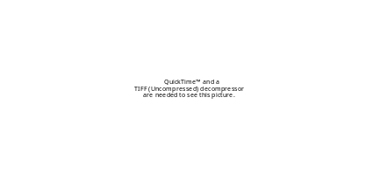
CAMRA All Hands Meeting
Project III - Dose Response
Charles Haas -- Drexel
Carole Bolin -- MSU

Slide 2
Project III Objectives
Comprehensive and synoptic review, analysis and development of DR relationships for cat. A and other agents
Targeted animal studies to provide dose-response data for the static and dynamic risk assessment models (MSU)

Slide 3
Tool Development
Developed and validated fitting tool in “R”
  Validation against prior data sets using MATLAB and Excel
  Enables more rapid fitting in a widely available cross-platform solution

Slide 4
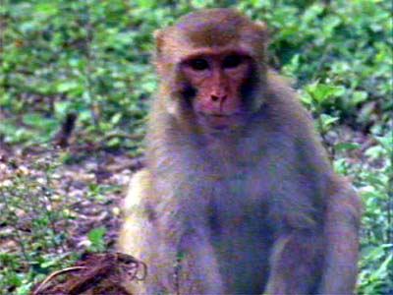
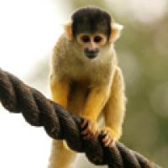
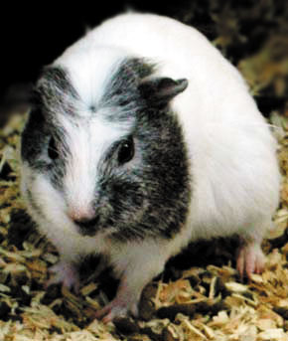
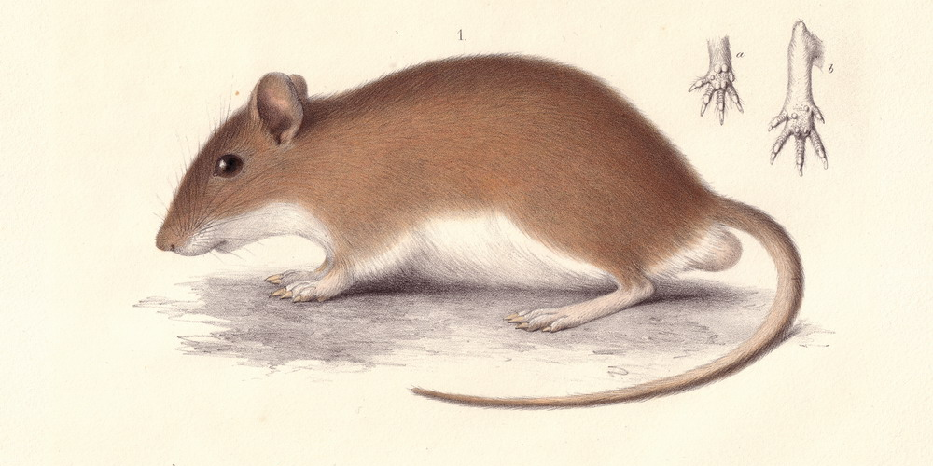
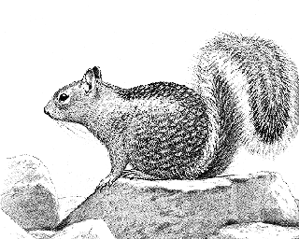
Characteristics of Available Dose-Response Data
Animal studies
  Hosts
    Primates
    Rodents
    (human as available)
  Other characteristics
    Inbred v. outbred
    Endpoint: death in all data sets except one Lassa experiment
Exposure Route
  B. anthracis inhalation exposure
  Y. pestis and Lassa: subcutaneous exposure
  V. major: intraperitoneal and intracerebral exposure
Nature of data sets
  Number of doses between 4 and 12
  Number of subjects at each dose between 3 and 9
  Acceptable only if a data set contains at least three doses, with at least one dose at intermediate response
http://www.zsl.org/shop/london-zoo-adoptions/adopt-a-squirrel-monkey-from-london-zoo/
http://www.bbc.co.uk/nature/wildfacts/factfiles/211.shtml
http://www.gerbils.pwp.blueyonder.co.uk/gerbils/images/tateralarge.jpg1
http://free-picture-graphic.org.uk/fat-guinea-pig.htm
http://www.etc-etc.com/sqrlinfo.htm

Slide 5
Suitable Data Identified for Category A Pathogens (22 data sets)
Bacillus anthracis (7 data sets, all inhalation exposure)
  Rhesus monkeys, Vollum strain (9 doses)
  Guinea pigs, Vollum strain (6 doses)
  Guinea pigs, ATCC 6605 strain (6 doses)
Yersinia pestis (10 data sets, all subcutaneous exposure)
  Rock squirrel, lab-reared (8 doses) and wild-caught (8 doses)
  Multimammate mice 2n32 (3 doses) and 2n36 (4 doses)
  Multimammate mice, caught in Transvaal (6 doses) and caught in Natal (7 doses)
  Bushveld gerbils exposed to SAIMR strain (7 doses) and to SF329 strain (3 doses)
  White tailed rabbits, (7 doses)
  Califorinia ground squirrels, subcutaneous exposure (7 doses)
Variola major (2 data sets, two exposure routes)
  Suckling mice, intraperitoneal exposure (18 doses, 4 age groups)
  Suckling mice, intracerebral exposure (5 doses)
Lassa (3 data sets, 2 exposure routes)
  Guinea pigs, inbred, subcutaneous exposure (6 doses)
  Guinea pigs, outbred, subcutaneous exposure (5 doses)
  Guinea pigs, outbred, aerosol exposure (4 doses)
Francisella tularensis
  Analysis is underway

Slide 6
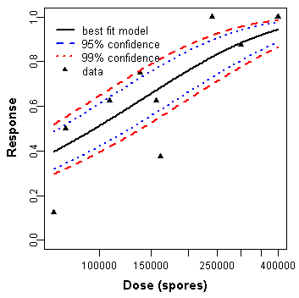
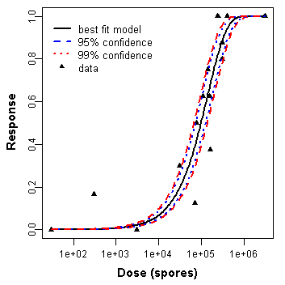
Findings: B. anthracis, inhalation exposure, rhesus monkey and guinea pig models
Refined dose-response estimate for inhalation exposure
Not all data could be pooled
  Pooling acceptable for data of guinea pigs exposed to different strains
  Pooling acceptable for rhesus monkeys exposed to Vollum strain and guinea pigs exposed to ATCC-6605 strain
Rhesus monkeys
Rhesus monkeys pooled with guinea pigs exposed to ATCC 6605 strain

Slide 7
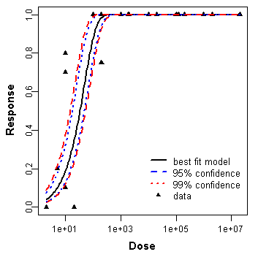
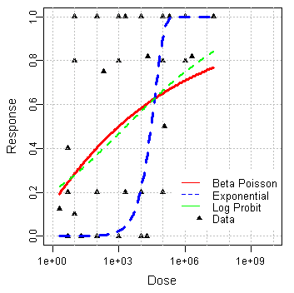
Findings: Y. pestis, subcutaneous exposure, various rodent models (early 20th century data)
Data sets presented two behaviors
  Marked response (dose-response models demonstrating goodness of fit)
  Significant dispersion (no goodness of fit)
  We are developing models for hyper-binomial variability
No pooling of data was not possible
Data for which models could be developed
Data exhibiting dispersion

Slide 8
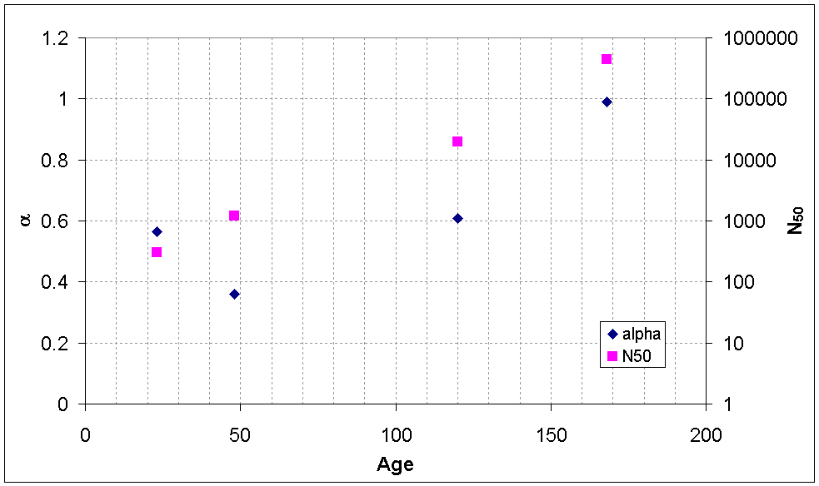
Findings: V. major, intraperitoneal exposure, mouse model¹
Developed dose-response relation with parameters accounting for host age
  Young suckling mice far more susceptible than mice only 1 to 2 days older
  When trends in susceptibility with age are included, data for different age groups may be pooled
Systematic dependency of dose response parameters to host age -- first finding of its kind
¹ Marshall, R.G., and Gerone, P.J., 1960, “Susceptibility of Suckling Mice to Variola Virus,” Journal of Bacteriology, 82(1):15-19

Slide 9
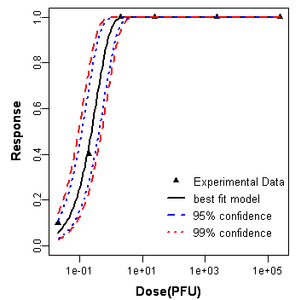
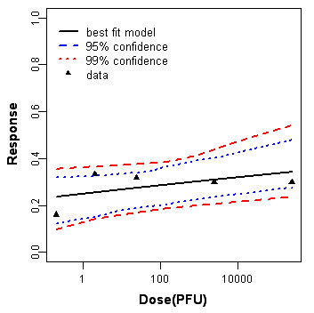
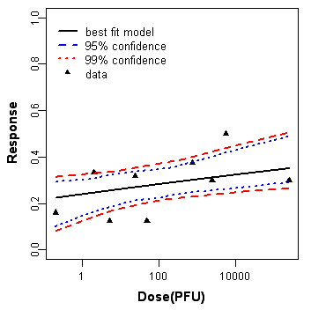
Findings: Lassa, subcutaneous and aerosol exposures, guinea pig model^{1,2}
Subcutaneous exposure, inbred
Subcutaneous exposure, outbred
Pooled subcutaneous exposure, outbred with aerosol exposure, outbred
Strong difference in response between inbred and outbred populations, subcutaneous exposure
Pooling of subcutaneous and aerosol exposure route data possible
¹ Jahrling et al., 1982, “Pathogenesis of Lass Virus Infection in Guinea Pigs,” Infection and Immunity, 37(2):771-778
² Stephenson et al., 1984, “Effect of Environmental Factors on Aerosol-Induced Lassa Virus Infection,” Journal of Medical Virology, 14:295-303

Slide 10
Upcoming Work
Additional data acquisition
  Continued literature search for dose-response data
  Search for outbreak/natural exposure data for validation
Other organisms
  (Category B) (to be discussed)
    Melioidosis (Burkholderia pseudomallei)
    Q fever (Coxiella burnetii)
    Typhus fever (Rickettsia prowazekii)
    Viral encephalitis (alphaviruses [e.g., Venezuelan equine encephalitis, eastern equine encephalitis, western equine encephalitis])
  Influenza?
---->

Slide 11
Upcoming Work (con’t)
Development of mechanistically-based dose-response models
  Dose-time-response models tracking “body burden”
  Fitting to data library
Publications
  Drafts in preparation
Overdispersion model development (e.g. for plague)
MSU experiments with F. tularensis

Slide 12
MSU Tularemia Experiments
Study 1:
  Examine three strains of F. tularensis Type A
  Mouse model + oral exposure
  Groups of mice given 10⁸, 10⁶, 10⁴, 10²
  Mice monitored at day 1, 2, 3, 4, 14 for infection and disease
  Endpoint is infection not death
    Animals that are infected but not ill can maintain the infection
    May develop disease and die when antibiotic treatment stops or immunosuppressed
Study 2:
  Most virulent strain from Study 1 will be used
  Larger groups of mice will be used to study the critical part of the dose-response curve
Future?
  Effect of post-exposure prophylaxis on dose-response
  Effect of vaccination on dose-response

Slide 13
Drexel Personnel
Tim Bartrand (post doc-partial)
Sushil Tamrakar (doctoral)
Mark Weir (doctoral, other support)
Additional student being recruited
Summer 2007 DHS undergrad fellows (2)

