Slide 1
Project IV: The Assessment Analysis Interface
Center for Advancing Microbial Risk Assessment
Year 2 Annual Meeting
Liz Casman
Patrick Gurian

Slide 2

Risk Communication
Pandemic Flu
Project IV: Year 2

Slide 3
Mental Models Interviews
How do people conceptualize flu transmission and flu avoidance?
Are their beliefs consistent with current scientific understanding? Is their knowledge comprehensive?
What avoidance behaviors do they practice and why?
Do they act in ways that are contrary to their conceptualization? When?

Slide 4
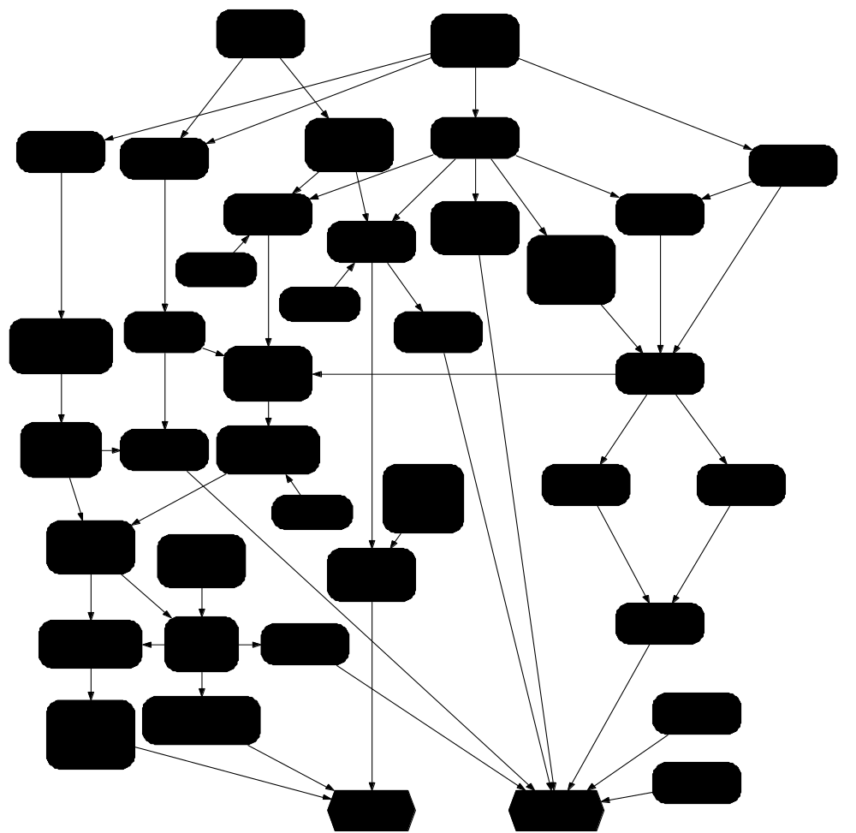


“Expert Model”
Draft 2/10/07

Slide 5
Risk Communication
Planning for Complex Dynamic Bioterrorism Scenarios
Project IV: Year 1

Slide 6
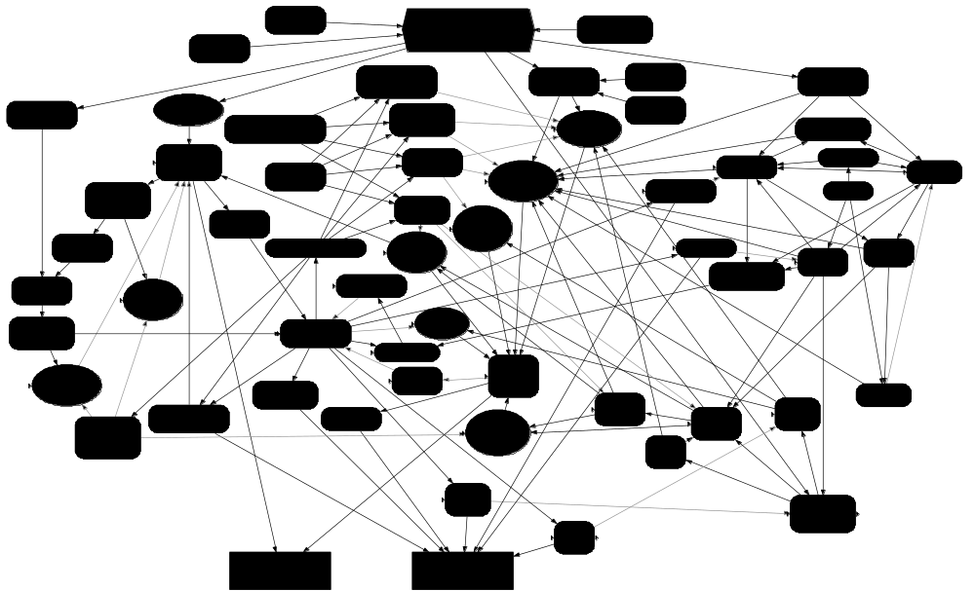
Can I let my children play outdoors?
Influence Diagram
Notes:
Risks are heterogeneous
Will have different communications depending on the population at risk
Can prepare for these in advance
But there will be lots of situations that you didn’t anticipate

Slide 7
What if the bacterium is multiply antibiotic-resistant?

Slide 8
Anthrax Scenario Modeling
Project IV: Year 1

Slide 9
Anthrax Scenario
SRA Dec. 2006-slides available
Simulate fate of anthrax in a building
  can be indoor or outdoor source
  persistent fraction of release will be indoors (Wein et al.)
Map risk due to air exposure with amount of anthrax on surfaces

Slide 10
Wall samples
Diameter, µM | 1 | 3 | 5 | 10
1 in 1000 retrospective risk, B. anthracis /m² | 30 | 80 | 80* | 40*
2,000-5,000 bugs/office, *assumes respirable
No HVAC filter, Druett/Glassman k (Haas 2002)

Slide 11
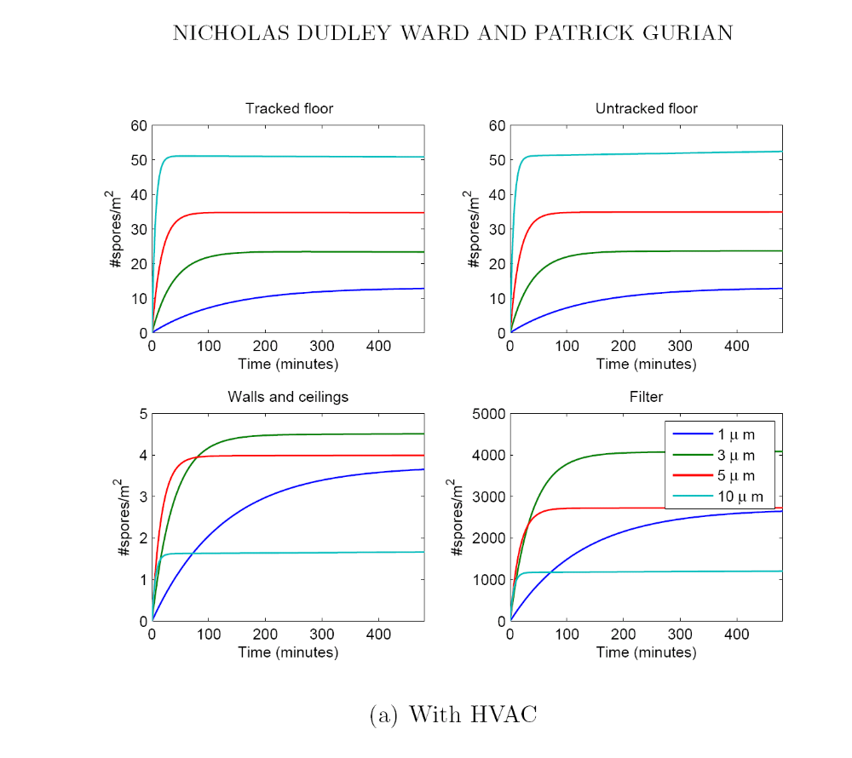
Concentration on HVAC filter

Slide 12
Potential future directions
Swabbing sounds rough….vacuuming maybe better (water trap per Syed)….HVAC concentration effect worth the PCR interference?
Interpretation of samples and selection of appropriate sample size is non-trivial
  False positives/false negatives
  How large an area to swab?
  How to pronounce site “clean enough”?

Slide 13
Bayesian updating on site risk
Use a discrete prior for probability of contamination
Tunable to particular release (results from fate and transport model if available)
  Computationally tractable
  Can be implemented in a spreadsheet
What do we get?
  Posterior estimate of risk
  Guidance on sample size selection

Slide 14
Uncertainty in use of surrogate data
Project IV: Year 2

Slide 15
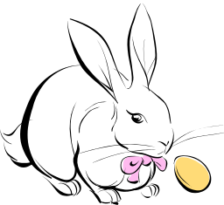


Original Plan:
Hierarchical Structure
Distribution
Ln r ~ N (grand mean, grand variance)
Rabbit r
Human r
Monkey r

Slide 16
Dose-response (r)
hot
Strain
rabbits
humans
not so hot
rabbits
monkeys
Less humanlike More humanlike
Host Species

Slide 17
Dose-response (r)
hot
Strain
Group 1
Group 3
not so hot
Group 2
Group 4
Less humanlike More humanlike
Host Species

Slide 18
Dose-response (r)
hot
Strain
Group 1
Group 3
not so hot
Group 2
Group 4
Less humanlike More humanlike
Host Species

Slide 19
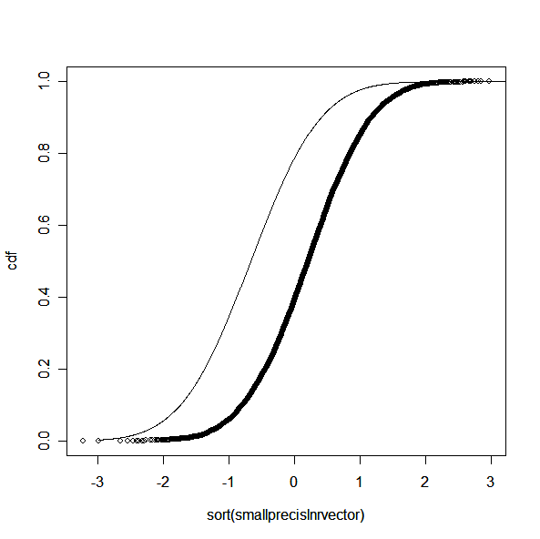
Once we have the framework (the map) we can estimate degree of relatedness from data
prior
posterior

Slide 20
Environmental persistence (k)
Microbial characteristic
Fomite character

Slide 21
Potential
When we have data
  May help us organize and interpret large database of surrogate information
When we don’t have data
  May provide a useful structure to capture experts’ knowledge of relatedness and interspecies/strain variability

Slide 22
Difficulties
Requires some priors that do have an intuitive interpretation, but not a straightforward one
Expert elicitation is fraught with potential biases
Could be a tendency to group together surrogates with known similarities on outcome variable
  underestimate overall variability
  get surprised

Slide 23
Key interfaces for collaboration/exchange
Experts for strain/species variability
Data for other hierarchical applications
  Projects I and III
MDL for surface/HVAC sampling
  Project I
Water scenario
  Project I
Input on how to define affected area after a release
  Qualitative algorithms
  Quantitative approaches (Bayesian updating)
  Agencies?

Slide 24

and NSF Grant SES-0433152

Slide 25
Extra slides

Slide 26
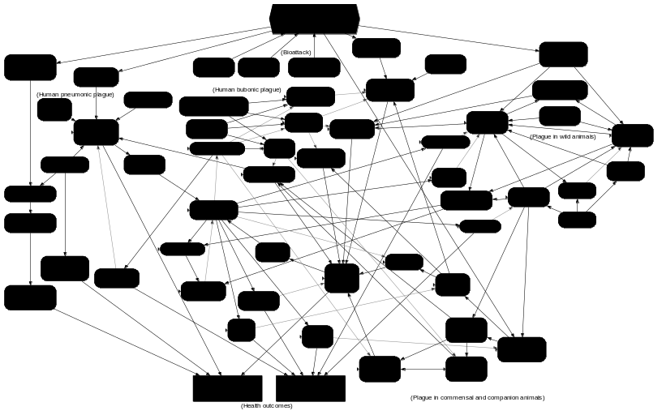
Anticipate and discourage counterproductive behaviors
Burning down derelict buildings or other rodent harborage
Illegal, counterfeit, “alternative”, or slow acting flea control products
Killing stray animals or sick pets
Poisoning rodents (vs safe rodent traps)
Notes:
Thinking through the scenario gives you the opportunity to

Slide 27
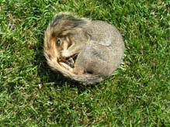
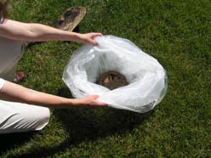
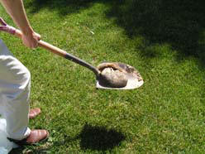
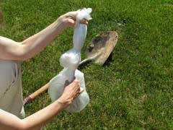
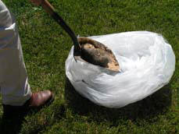
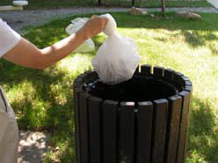
There is a dead squirrel on my lawn. What do I do?
Step One: Do no pick up or touch dead animals.
Step Four: Using the shovel, place the animal in the plastic bag.
Step Two: Use a long-handled shovel to pick up the dead animal.
Step Five: Tie a knot in the bag.
Step Three: Place a strong plastic bag on the ground.
Step Six: Dispose of the bag in an outdoor trash container.
http://www.co.boulder.co.us/health/environ/vector/deadAnimal.htm

