Slide 1
Modeling Infectious Disease Processes
CAMRA
August 10th, 2006
Notes:
Intro:

Slide 2
Why Use Mathematical Models?
Modeling perspective
  Mathematical models
    reflect the known causal relationships of a given system.
    act as data integrators.
    take on the form of a complex hypothesis.
Benefits of modeling
  Provides information on knowledge gaps.
  Provide insight into the process that can then be empirically tested.
  Provides direction for further research activities.
  Provides explicit description of system (mathematical vs. conceptual models)
Notes:
Note that I don’t mention that we’ll be using models to ‘predict the future’. That’s kind of a misconception…

Slide 3
Milestones of Modeling Studies
The importance of simple models stems not from realism or the accuracy of their predictions but rather from the simple and fundamental principles that they set forth.
Three fundamental principles inferred from the study of mathematical models.
  The propensity of predator-prey systems to oscillate (Lotka and Volterra)
  The tendency of competing species to exclude one another (Gause, MacAurther)
  The threshold dependence of epidemics on population size (Kermack and McKendrick).
Notes:
This is the key…the principles: models aren’t perfect – they’re goal is NOT to predict ‘what will happen’ but rather they are to be used a tool to help gain understanding about processes. Example: model of the atom – just a tiny sphere…then the Bohr model, then shells, etc…models serve as a launching point.

Slide 4
Classification of Model Structures
Statistical vs. Mechanistic
Classes of mechanistic models
  Deterministic vs. Stochastic
  Continuous vs. Discrete
  Analytical vs. Computational
Notes:
Statistical models are used to fit data – Mechanistic models are used describe processes.

Slide 5
History of Mathematical Epidemiology
Historical Background
  Prior to 1850 disease causation was attributed to miasmas
  mid 1800’s germ theory was developed
  John Snow identifies the cause of cholera transmission.
  Early Modeling: William Farr develops a method to describe epidemic phenomena. He fits normal curves to epidemic data.
Notes:
Note here, that what Farr was doing was after the fact…using a stat model to describe the natural history of an outbreak/epidemic

Slide 6
History of Mathematical Epidemiology
Germ theory leads to mass action model of transmission
  The rate of new cases is directly proportional to the current number of cases and susceptibles
    C_{t+1} = r . C_{t} . S_{t}
  Different than posteriori approach to modeling.
Notes:
R is the ‘transmission parameter’ – think about this for a minute – until it makes sense – cases at time t+1 depend on S and C and some other factor

Slide 7
Post-germ Theory Approach to a Priori Modeling
William Hamer (1906)
  First to develop the mass action approach to epidemic theory.
  Beginnings of the development of a firm theoretical framework for investigation of observed patterns.
Ronald Ross (1910's)
  Used models to demonstrate a threshold effect in malaria transmission.

Slide 8
Post-germ Theory Approach to a Priori Modeling
Diagram of a simple infection-recovery system, analogous to Ross’s basic model (Fine, 1975b)
  Distinguishes between dependent and independent happenings
h
SUSCEPTIBLE
INFECTED
r
Notes:
Dependent – because whether or not you become infected is dependent on how many infected people there are (are your rate of contact with them). This is different that saying your chance of infection is constant and is equal to x (as is the case in the chemical paradigm).

Slide 9
Post-germ Theory Approach to a Priori Modeling
Kermack and McKendrick (1927)
  Mass action. Developed epidemic model taking into consideration susceptible, infected, and immune.
Conclusions
  An epidemic is not necessarily terminated by the exhaustion of the susceptible.
  There exists a threshold density of population.
  Epidemic increases as the population density is increased. The greater the initial susceptible density the smaller it will be at the end of the epidemic.
  The termination of an epidemic may result from a particular relation between the population density, and the infectivity, recovery, and death rates.
Notes:
I.e. low density can terminate an epidemic
Previously it was thought that the epidemic doesn’t end until all susceptible are exhausted…
-thought that organism virulence declined throughout epidemic

Slide 10
Post-germ Theory Approach to a Priori Modeling
Major contributors since Kermack and McKendrick
  Wade Hampton Frost, Lowell Reed (1930's). First description of epidemics using a binomial expression
  George Macdonald (1950's). Furthers the work of Ross. Develops notion of breakpoint in helminth transmission.
  Roy Anderson and Robert May (1970 - present). Development of a comprehensive framework for infectious disease transmission.
Notes:
Anderson and May’s framework are what I’m going to present (ideas exisited previously but they contextualized and put them into a framework).

Slide 11
The Microparasites - Viruses, Bacteria, and Protozoa
Basic properties
  Direct reproduction within hosts
  Small size, short generation time
  Recovered hosts are often immune for a period of time (often for life)
  Duration of infection often short relative to life span of host.
Notes:
From Anderson and May…

Slide 12
The Macroparasites - Parasitic Helminths and Arthropods
Basic properties
  No direct reproduction within definitive host
  Large size, long generation time
  Many factors depend on the number of parasites in a given host: egg output, pathogenic effects, immune response, parasite death rate, etc.
  Rarely distributed in an independently random way.
Notes:
Won’t be discussing this in much detail, here…but you may be interested. (these models can become very complicated very quickly.)

Slide 13
References Used in Lecture
    Anderson, R. M., and R. May. 1991. Infectious Diseases of humans: Dynamics and Control. Oxford University Press, New York.
    Fine, P. E. M. 1975a. Ross's a priori pathometry - a perspective. Proceedings of the Royal Society of Medine 68: 547-551.
    Fine, P. E. M. 1975b. Superinfection - a problem in formulating a problem. Tropical Diseases Bulletin 72: 475-486.
    Fine, P. E. M. 1979. John Brownlee and the measurement of infectiousness: an historical study in epidemic theory. Journal of the Royal Statistical Society, A 142: 347-362.
    Kermack, K. O., and A. G. McKendrick. 1927. Contributions to the mathematical theory of epidemics - I. Proceedings of the Royal Society 115A: 700-721.
    Kermack, K. O., and A. G. McKendrick. 1932. Contributions to the mathematical theory of epidemics - II. The problem of endemicity. Proceedings of the Royal Society 138A: 55-83.
    Kermack, K. O., and A. G. McKendrick. 1933. Contributions to the mathematical theory of epidemics - II. Further studies of the problem of endemicity. Proceedings of the Royal Society 141A: 94-122.
    Ross, R. 1915. Some a priori pathometric equations. British Medical Journal 2818: 546-547.

Slide 14
Disease Transmission
Application of the “law of mass action”
  Originally used to describe chemical reactions
    Hamer (1906) and Ross (1908) proposed it as a model for disease transmission.
  The rate of new cases is directly proportional to the current number of cases and susceptibles
    C_{t+1} = r . C_{t} . S_{t}
  Assumptions:
    All individuals
      Have equal susceptibility to a disease.
      Have equal capacity to transmit.
      Are removed from the population after the transmitting period is over.
Notes:
Population is homogeneous…no immunocomprimised….age variations….naturally immune people…etc.
Incubation period: point of infection to appearance of disease symptoms…
-The period of infectiousness is short relative to the incubation period.
-The time interval is the average incubation period.

Slide 15
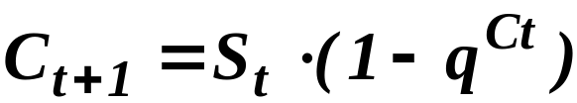
Disease Transmission
Reed-Frost approach
  Based on the premise that contact between a given susceptible and one or more cases will produce only one new case.
  Derivation of model
    The probability that an individual comes into contact with none of the cases is q^{Ct}.
    The probability that an individual comes into contact with one or more cases is 1 - q^{Ct}.
Notes:
‘homogenous mixing” = q is the same for everyone…prob than you don’t contact that person – 1-qC is prob that you come into contact with at least one case. Rolling dice prob that if you roll 4 times…what the chance that you get at least one six? 1 – 5/6 ^ 4 . Same thing.

Slide 16
Disease Transmission
Reed-Frost approach
  Assumptions
    Infection spreads directly from infected to susceptible individuals.
    After contact, a susceptible individual will be infectious to others only within the following time period.
    All individuals have a fixed probability of coming into adequate contact with any other specified individual.
    The individuals are segregated from others outside the group.
    These conditions remain constant throughout the epidemic.

Slide 17
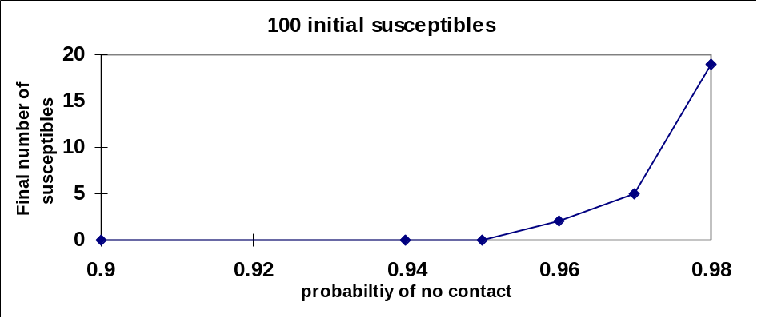
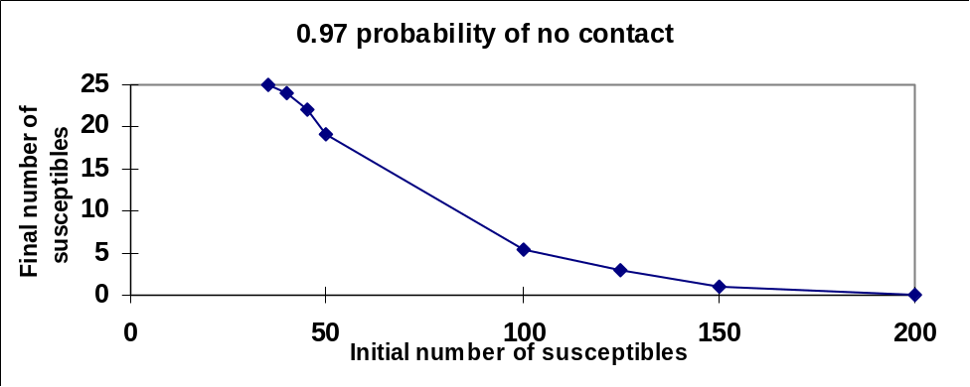
Reed-Frost Model
Measles fit these assumptions well
  Long term immunity
  High infectivity
  Short infectious period
Simulation results
Notes:
Final number of S increases as prob of no contact increases.
“ “ decreases as initial number of susceptible increases.
You’lll verify this in Lab.

Slide 18
Reed-Frost Model
Fitting the model to the data from Aycock.
  1934 outbreak in a New England boys’ boarding school.
  Characteristic of a closed community (uniform susceptibility and homogeneous mixing).
  Data pooled in 12 day intervals.
Explanation of poor fit
  Error in counting susceptibles.
  Choice of interval.
  Variation in contact rate.
  Lack of homogeneity within the school.
Notes:
Fit was okay but not great…reasons…

Slide 19
Population Dynamics
Defined by change, movement, addition or removal of individuals in time.
Four biological processes that determine how the number of individuals change through time
  Birth
  Death
  Immigration
  Emigration
Population processes are assumed independent (basis of most population models).
Notes:
Shift gears…a bit here….one way to think about modeling is to group people into compartments (S, I, R) and then describe how movement between compartments occurs (rates of change, movement from S to I…what dictates movement out of S and into I?). This is where calculus and differential equation come into play…we have a dynamic process…the population is in flux – some people are leaving S but at the same time some are entering….complex process.

Slide 20
Modeling Populations
Model structure based on ordinary differential equations
  Types of population dynamics models
    Exponential growth
    Logistic growth (density dependence)
      Relevance to disease ecology - population regulation of disease agents or vectors
      Basis of some demographic models
    Interspecies competition
      For example, Aedes albopictus invasion of Aedes triseriatus habitat.
    Prey-predator
    Host-parasite
      Microparasites
      Macroparasites

Slide 21
The Microparasites - Viruses, Bacteria, and Protozoa
Basic properties
  Direct reproduction within hosts
  Small size, short generation time
  Recovered hosts are often immune for a period of time (often for life)
  Duration of infection often short relative to life span of host.
Notes:
Generation time = time from point of infection to time which you are no longer infectious.

Slide 22
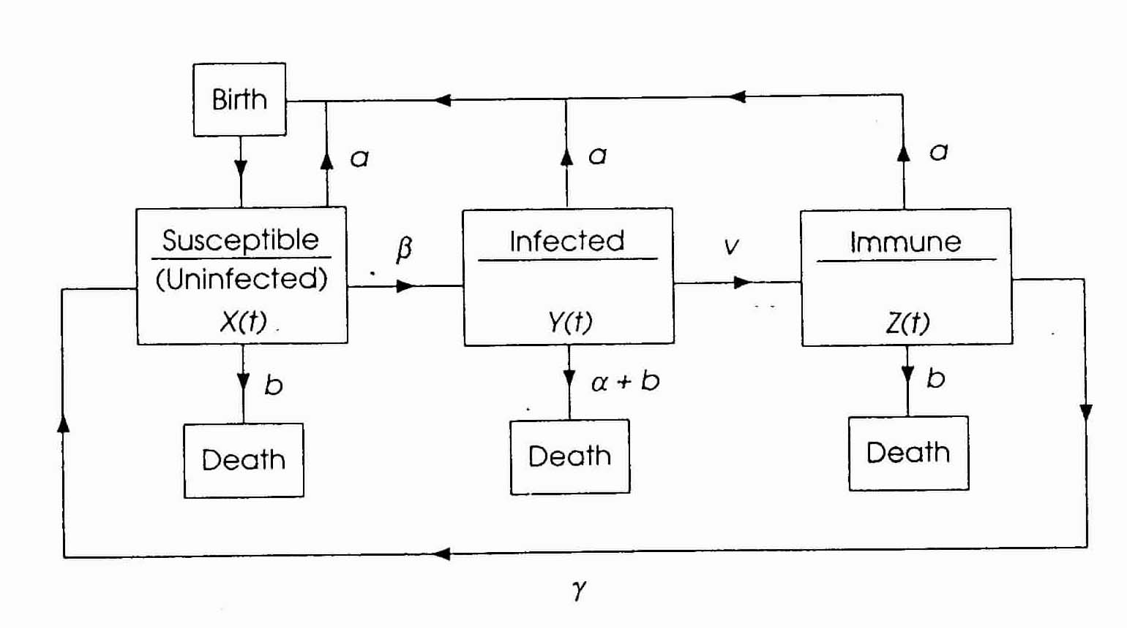

Slide 23
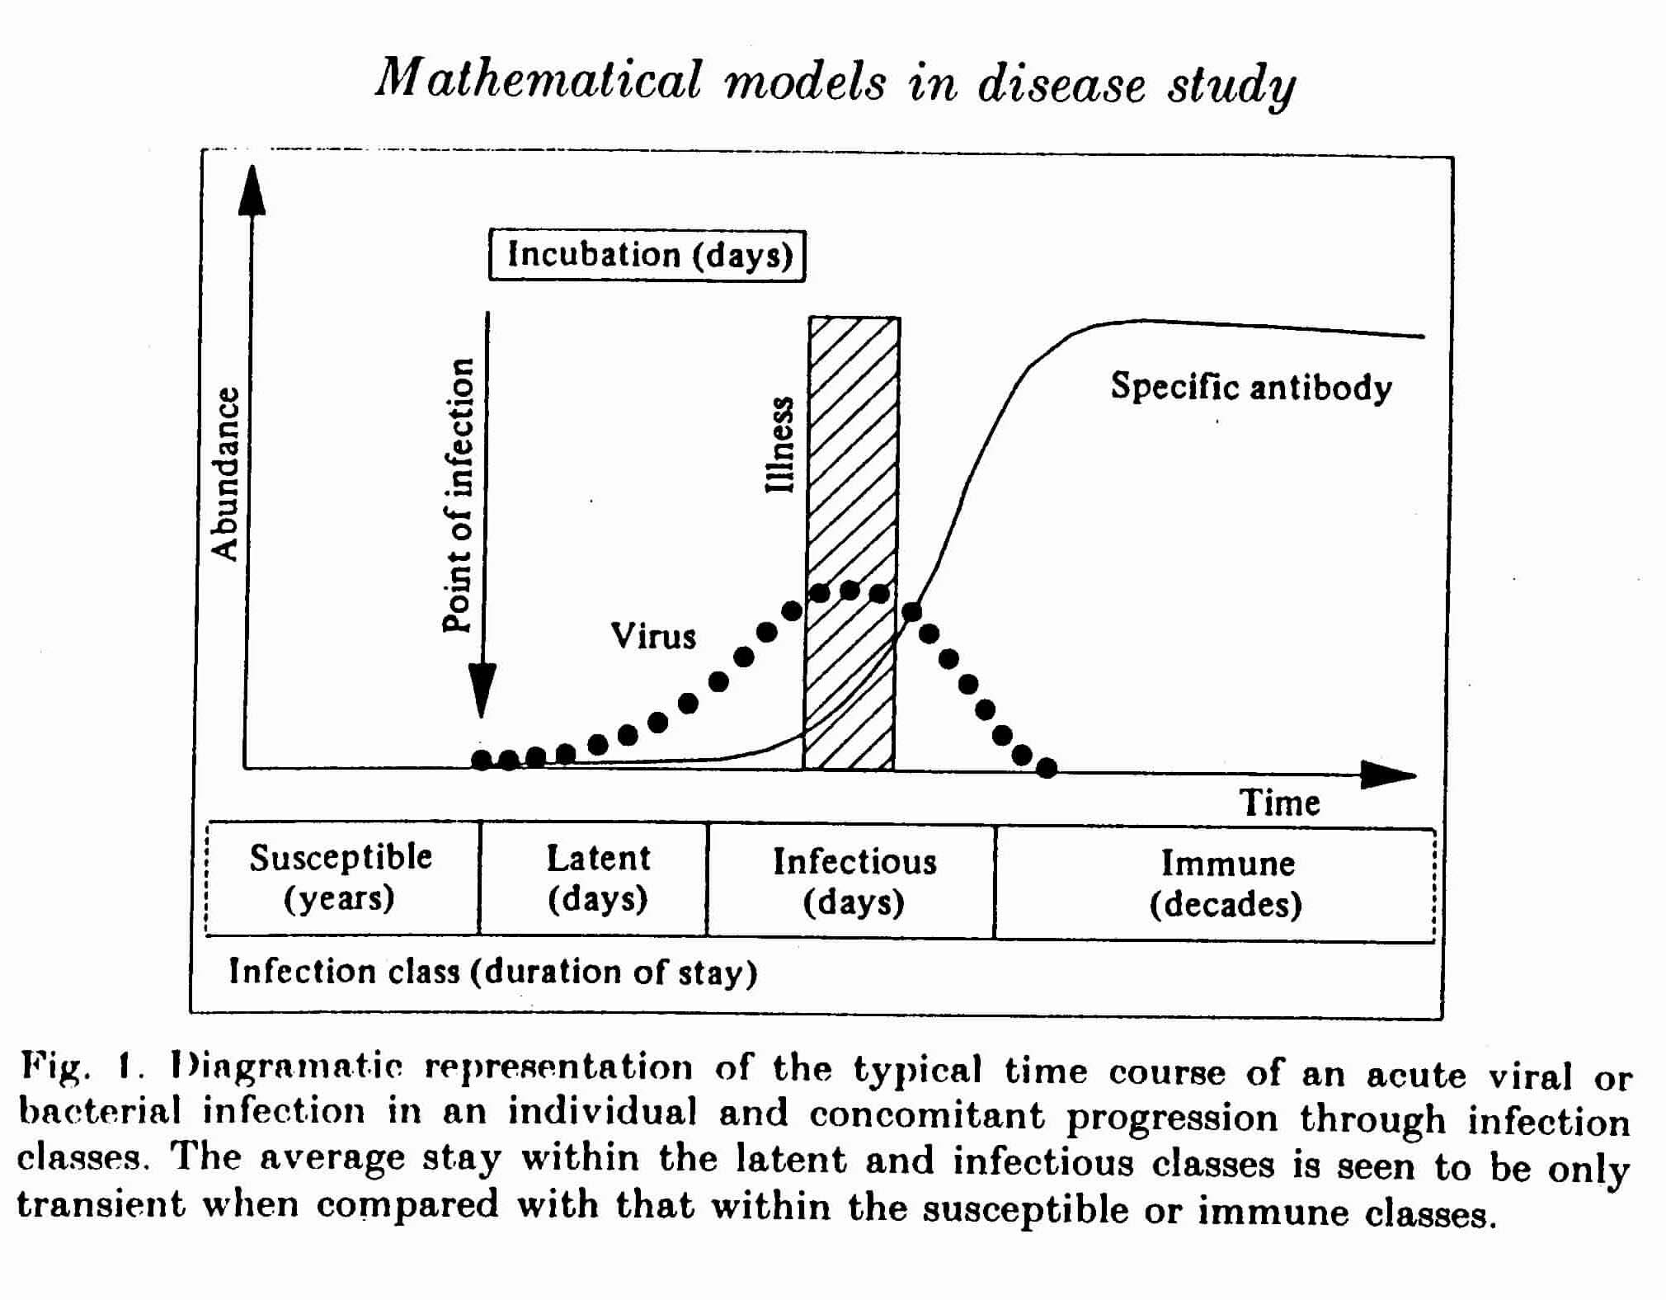

Slide 24
The Infection Process for Microparasites
Similarities in transmission processes
How transmission processes differ
  Parametric differences
    Lifelong immunity, long incubation period (measles), short term immunity (Typhoid Fever), lifelong immunity, short incubation period (polio), no immunity (gonorrhea)
  Structural differences
    Direct vs. sexually transmitted, waterborne vs. vectorborne
Factors affecting incidence data
  Disease related
    latency, incubation, infectious periods
  Environment related
    Population density, hygiene, nutrition, other risk factors.
Notes:
Latent – point of infection to point at which you are infectious
Incubation – point of infection to point at which you present with symptoms
Environment – things that affect likeliyhood of contact.

Slide 25
What Can We Do With These Models?
Test theoretical predictions against empirical data.
  How will changes in demographic or biologic factors affect incidence of disease?
  What is the most effective vaccination strategy for a particular disease agent and environmental setting?
  What effect does a large-scale vaccination program have on the average age to infection?
  What are the critical factors for transmission?
    Many factors influence a process, few dominate outcomes.
    Role of a simple model: to provide a precise framework on which to build complexity as quantitative understanding improves
      As in experiments, some factors are held constant others are varied.
Notes:
Gain insight to processes related to disease transmission?
What variables are most important?
How does changing parameter ‘x’ influence ‘y’?

Slide 26
Model Assumptions
  Population, N, is constant and large.
    The size of each class is a continuous variable.
  Birth and natural deaths occur at equal rates;
    All newborns are susceptible.
    Population has a negative exponential age structure (average lifetime = 1/μ.)
  The population is homogeneous.
  Mass action governs transmission.
    β, is the likelihood of close contact per infective per day
    Transmission occurs from contact.
  Individuals recover and are removed from the infective class
    Rate is proportional to the # of infectives.
  Latent period = zero.
  Removal rate from infective class is γ + μ.
    The average period of infectivity is 1/(γ + μ).
Notes:
Lets get started…lets be a little more specific about some assumptions…simplify at first.

Slide 27
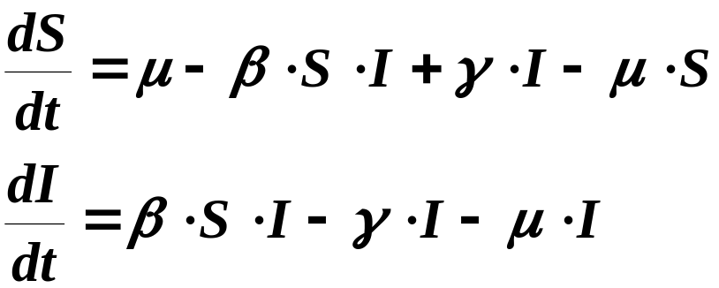
SIS Model
μ
μ
S
γ
β
I
μ
Notes:
Note: no immunity

Slide 28
SIS Model
Class of diseases for which infection does not confer immunity (e.g., Gonorrhea)
  Properties of Gonorrhea
    Gonococcal infection does not confer protective immunity.
    Individuals who acquire gonorrhea become infectious within a day or two (short latency).
    Seasonal oscillations of incidence are small.
    An infectious man is roughly twice as likely to infect a susceptible woman as when the roles are reversed.
    Five percent of the men are asymptomatic but account for 60-80% of the transmission.
  Scale and resolution of model.
    Stratify on gender, sexual activity, etc.
    Depends on your question of interest.

Slide 29
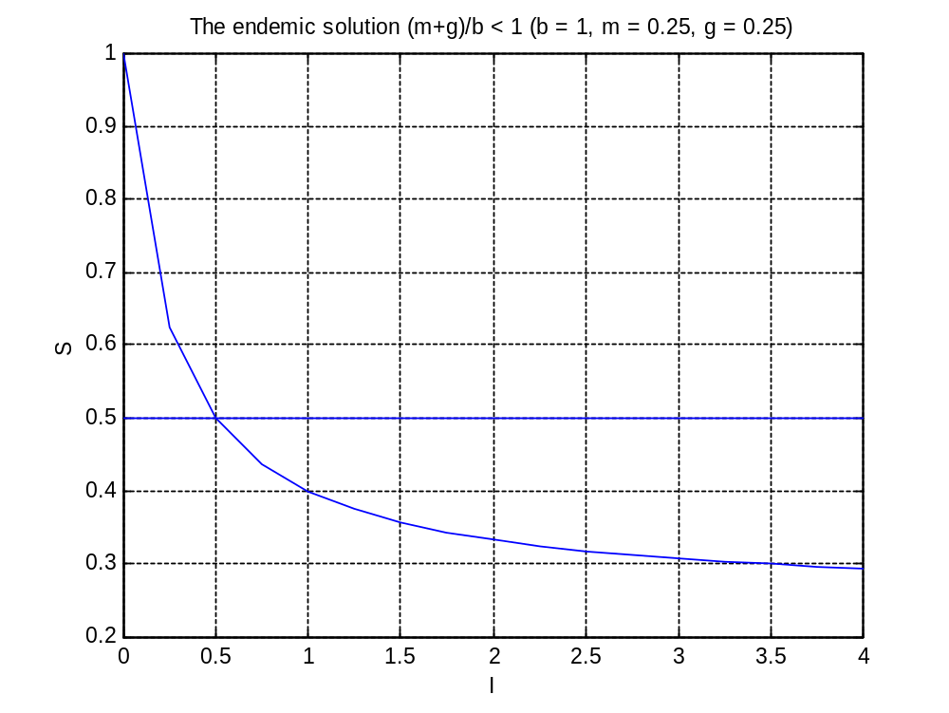
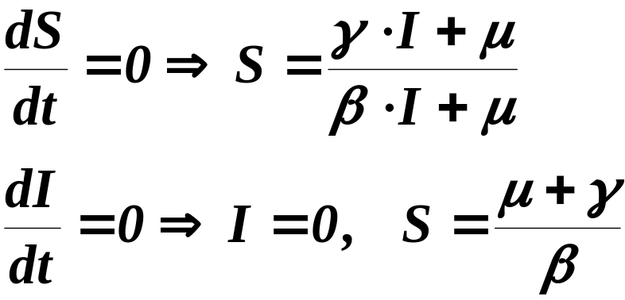
SIS Model
Notes:
One question to ask is When are the rates of change in both S and I stable. Beta = 1, Mu = .25, Gamma = .25
Curve represent the values of S(t) and I(t) that make dS/dt = 0
Line reps when dI/dt = 0

Slide 30
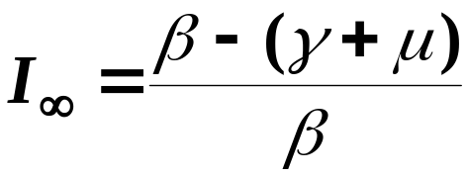
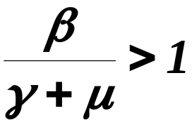
SIS Model
Analysis
  Calculation of endemic levels
  Criteria for endemic condition
  Two equilibrium points
    Which one is stable depends on the above parametric constraint.
Notes:
From the previous equations, we can determine an expression for what I will be at t=infinity : two equations…two unknowns (S & I). Solve.
So two equilibrium points, I=0, S=1 and I=b-(g+m) / b, S = m+g / b these are points where stability is reached, nothing is changing. Is there disease?
Yes, if b-(g+m) / b is greater than zero….when does this occur? When b/(g+m) > 1. The endemic condition.

Slide 31
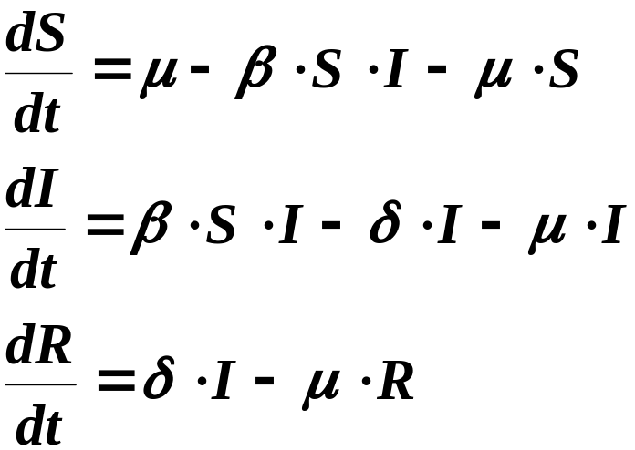
SIR Model
b
μ
S
β
I
μ
δ
R
μ
Notes:
Maybe “chicken pox”.

Slide 32
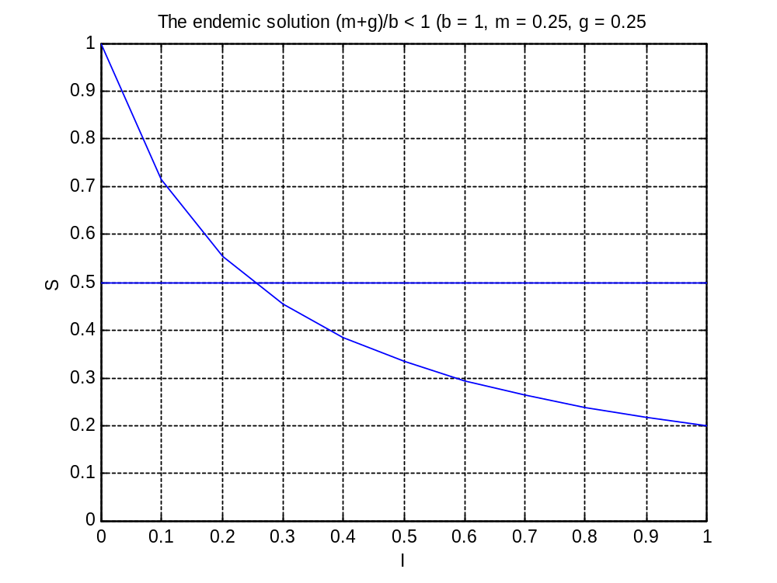
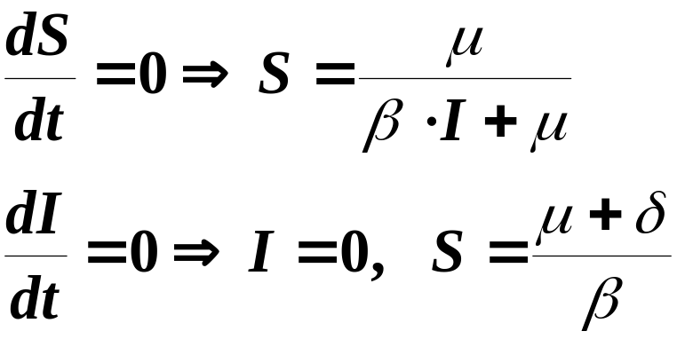
SIR Model

Slide 33
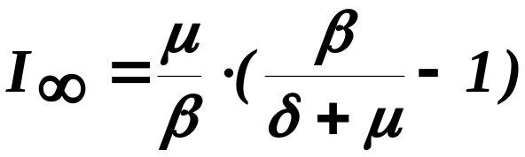
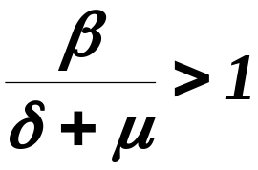
SIR Model
Endemic conditions.
  Interested in long-term dynamics so that birth and death processes are important
Calculation of endemic levels
Criteria for endemic condition

Slide 34
SIR Model
Two equilibrium points
  which one is stable depends on the above parametric constraint.
Frequency of reoccurring epidemics depend on:
  Rate of incoming susceptibles.
  Rate of transmission.
  Incubation period.
  Duration of infectiousness.

Slide 35
Variations of the SIS and SIR Model
  Disease fatality
    Disease disappears.
    Final susceptible fraction is positive.
  Carriers (asymptomatic)
    Disease is always endemic.
  Migration between two communities
    If contact rate is slightly > 1 in one community and < 1 in the other.
      Migration can cause the disappearance of disease.
    If contact rate is much > 1 in one community and < 1 in the other.
      Migration can cause the disease to remain endemic.
  Two dissimilar groups/Vectors
    Endemicity possible even if contact rate for both groups < 1.
Notes:
Remember, key is to start simple…

Slide 36
Summary
Anderson and May provide framework for modeling disease transmission – compartmental models
Differential equations govern the ‘rate of change’ in each compartment
Properties can be deduced from these equations (endemic conditions, equilibrium points, etc.)
Packages like Matlab can be used to obtain solutions for S(t) and I(t).

Slide 38
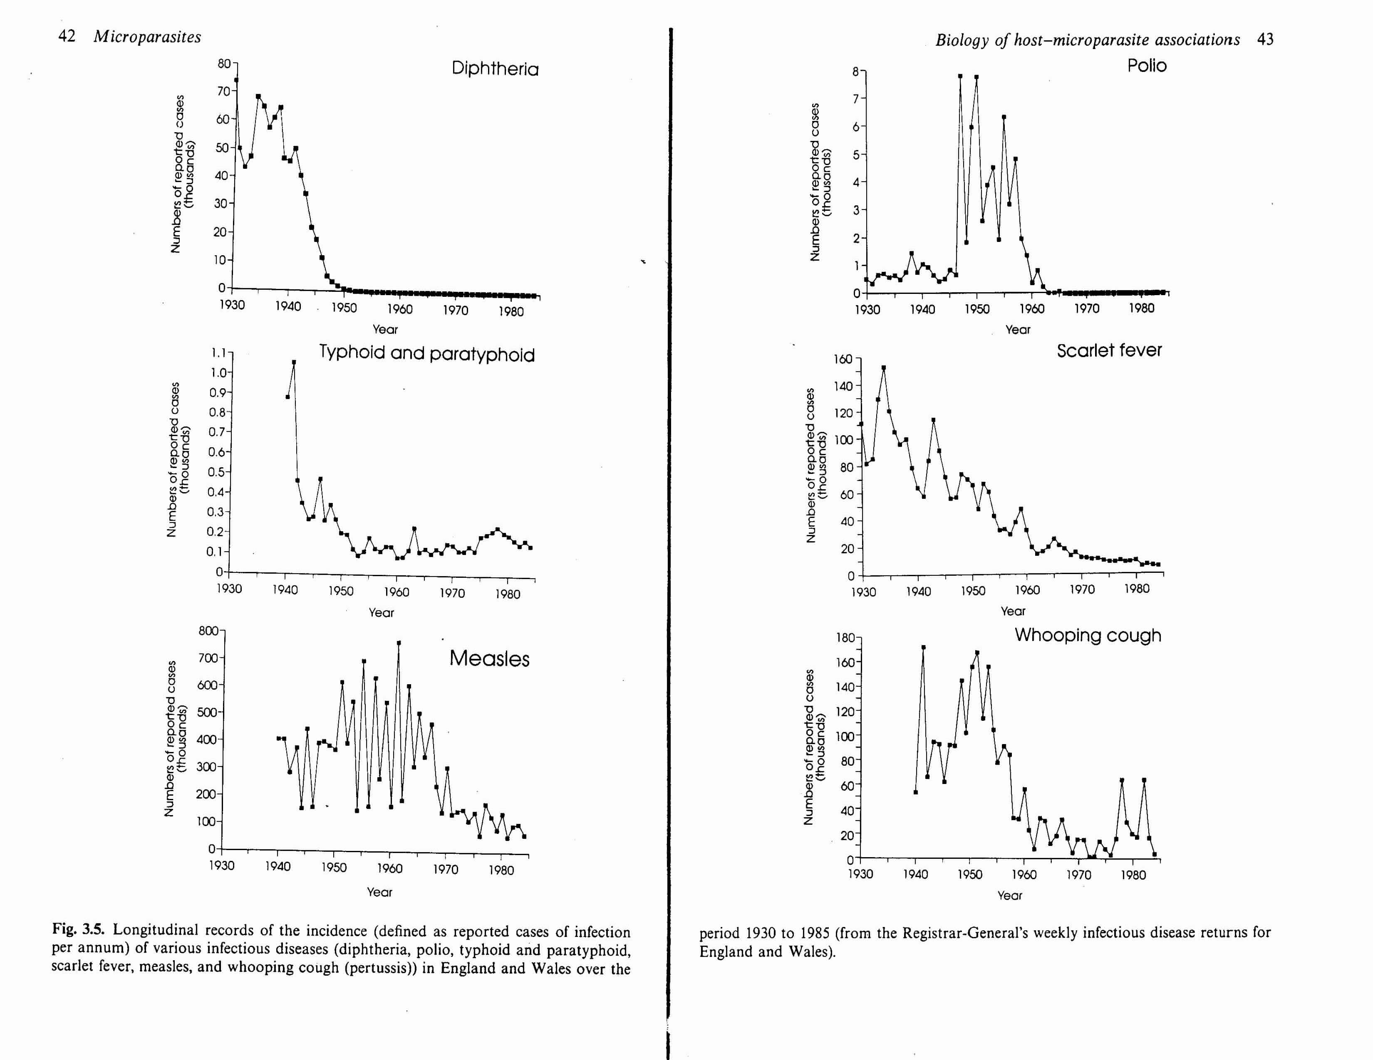

Slide 39
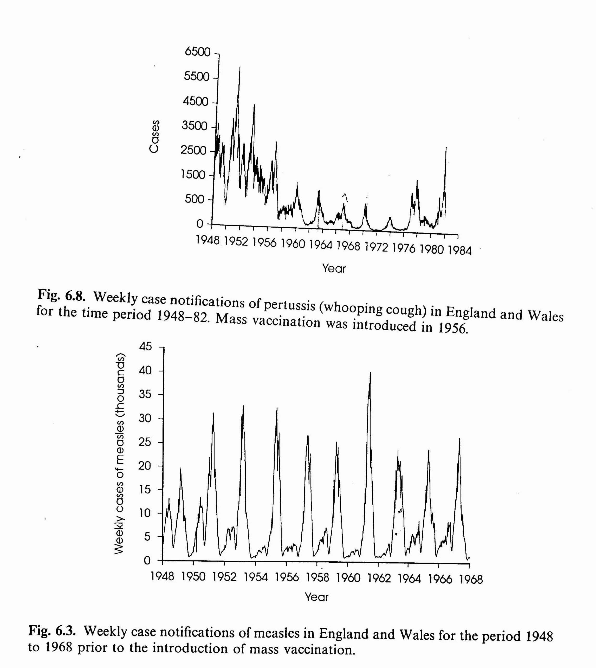

Slide 40
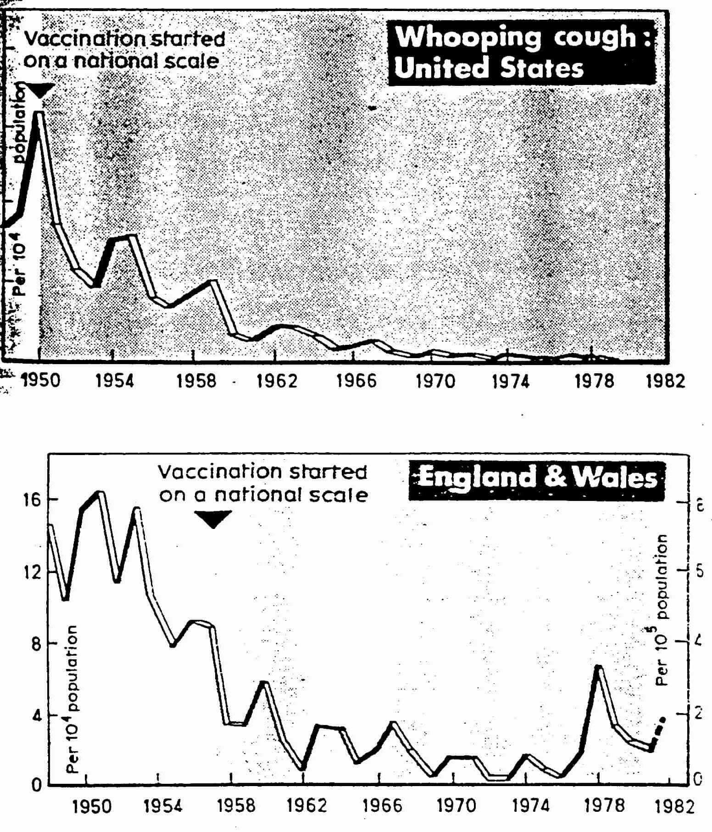

Slide 41
The Infection Process for Microparasites
b
Unit of analysis is the infection status of the individual
  Each state is represented by a differential equation.
M
α
μ
S
β
E
μ
γ
σ
I
μ
δ
R
μ

Slide 42
SIS Model
Analysis
  Notation
    Hethcote uses λ rather then β. Refers to λ as the contact rate and λ/(γ + μ ) as the contact number
    Anderson and May refer to (β /(γ + μ ) )N as the reproductive rate.
  Periodic contact rates.
    Data on incidence rates show a peak between August and October.
    Model predicts contact rates to peak in summer.

Slide 43
SIR Model
Epidemic conditions. Interested in short-term dynamics so that birth and death processes are not important
  Threshold condition
  Epidemic features
    Size of epidemic (peak incidence)
    Time to peak incidence
    Number of susceptibles after end of epidemic.

Slide 44
Post-germ Theory Approach to a Priori Modeling
Population perspective to infectious disease classification
  Framework based on population biology rather than taxonomy
  Two-species prey-predator interaction vs. host-microparasite interaction
    Modeling the viral population dynamics is both not tractable and uninteresting since it misses the one interesting dynamic and that is how the disease is spread.
Notes:
Classifying based on disease status not species – not interested in following dynamics of virus, etc. We want to keep track of whose sick and whose recovered.

Slide 45
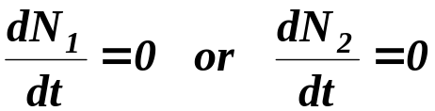
Analysis of Population Models
Studying the behavior of ordinary differential equations
  Phase plane analysis
    A portrait of population movement in the N₁ - N₂ plane.
    Provides a graphical means to illustrate model properties.
  Nullclines
    Sets of points (e.g., a line, curve, or region) that satisfy one of the following equations.
  Steady state (equilibrium points)
    Points of intersection between the N₁ nullcline and the N₂ nullcline
Notes:
Orientated to basic notation….

