Slide 1
Using Models to Assess Microbial Risk: A Case Study
CAMRA
August 10th, 2006
Notes:
Intro:

Slide 2
Assessing Risk from Environmental Exposure to Waterborne Pathogen
Importance of waterborne pathogens
Risk assessment framework
  Traditional view (chemical perspective)
  Alternative approach (disease transmission perspective)
A case study
  Risk of giardiasis from exposure to reclaimed water.
Notes:
You might wonder…is that really a big problem? well…

Slide 3
Importance of waterborne pathogens
U.S. interest in water quality
  1993 Cryptosporidium outbreak.
  Increasing number of E. coli outbreaks
  Congressional mandate (Safe Drinking Water Act).
  Emphasis on risk assessment and regulation.
WHO interest in estimating GBD associated with water, sanitation, and hygiene
  Diarrheal diseases are a major cause of childhood death in developing countries.
    Attributed to 3 million of the 12.9 million deaths in children under the age of 5.
  Emphasis on intervention and control
Notes:
Background – why waterborne pathogens?
Other types….

Slide 4
Waterborne pathogens
Viruses: enteroviruses (polio), hepatitis A, rotavirus, Norwalk viruses
Bacteria: Salmonella (typhi), E. coli (O:157H), cholera
Protozoa: Giardia, Cryptosporidia
Ameoba: E. histolytica
Helminths: Ascaris
Notes:
-> transmission pathways….

Slide 5
Pathways of transmission
Person-person
  Mediated through fomites (e.g., phone, sink, etc.)
  Often associated with hygiene practices
Person-environment-person
  Mediated through water, food, or soil
  Contamination can occur through improper sanitation
    For example, sewage inflow into drinking water source or lack of latrines.
  Animals are often sources
  Exposure can occur through improper treatment of food or water.

Slide 6
Disease Transmission Process
Risk estimation depends on transmission dynamics and exposure pathways
Transport to other water sources
Agricultural
Runoff
Drinking
Water
Animals
Poor Sanitation
Wastewater reuse
Person-person
Food
Notes:
Note: prob of disease is not independent of disease status of other.
I.e. your likelihood of getting sick depends on how may other people are sick.
So…how do we estimate risk?

Slide 7
Approaches to Risk Estimation
Direct: The intervention trial
  Examples: Drinking water and recreational water exposures.
    Sensitivity could be a problem (sample size issue).
    Trials are expensive.
Indirect: Mathematical models
  Must account for properties of infectious disease processes
    Pathogen specific models.
    Uncertainties and variabilities make interpretation difficult.
Combining both approaches
  Models can define the issues and help design studies.
  Epidemiology can confirm current model structure and provide insight into how to improve the model.
Notes:
…another way, Chem

Slide 8
Chemical Risk Assessment Paradigm
  Hazard identification
  Dose-response assessment
  Exposure assessment
  Risk characterization
CRA Models are Static and Assess Individual Risk
  Risks are manifested directly upon the individual
Issues Unique to Assessing Risks Associated with Pathogens
  Secondary Spread of Infection, Immunity
  Risks effects are manifested at a population level

Slide 9
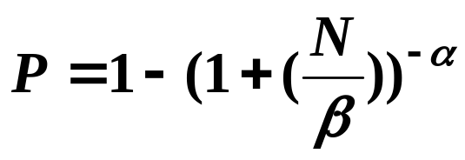
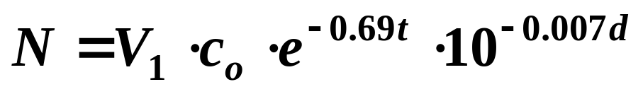
Chemical Risk Assessment Paradigm
Model structure (Regli, 1991; Haas 1983; Dudely 1976; Fuhs 1975):
  where P is the probability that a single individual, exposed to a dose of N organisms, will become infected or diseased.
Exposure calculation:
Notes:
Note that p is in no way dependent on the number of people that are sick or on an individuals previous exposure (immunity)

Slide 10
Comparison of Microbial Risk Assessment Paradigms
Chemical
  Risk at individual level
  Static disease process
  No secondary infections
  No immune response
  Chemicals decay in time
Infectious disease
  Risk at population level
  Dynamic disease process
  Secondary infections
  Immune response
  Pathogen populations are dynamic
Notes:
So we cant really use the Chemical paradigm for microbial risk assesment – not suited for the task…so what do we do?

Slide 11
Epidemiologically Based Modeling
Environmental component to transmission of waterborne pathogens
  Human -> Human
  Human -> Environment (e.g., water) -> Human
  Incorporation of dose-response hazard function.
Risk depends on characteristics of:
  Exposed population: susceptibility, demographics, etc.
  Pathogens: viability, virulence, population dynamics
  Environment: exposure medium, fate and transport
  Disease: symptoms, incubation, duration, immunity
Notes:
Many things to consider…multiple transmission pathways, H to H, H to E to H, risk based on exposure
Many variable to characterize/define
Example…

Slide 12
Using Models to Estimate Risk
An example
  Exposure scenario: Recreational swimming impoundment sourced by reclaimed water.
Study objectives
  To compare the relative contributions of two environmental exposure pathways.
    Contamination from reclaimed water
    Contamination from infectious swimmers
  To compare the effectiveness of localized vs. centralized control.
Notes:
Reclaimed water: water collected and treated after human use…

Slide 13
Microbial Risk Model
Exposure from swimming in a recreational swimming impoundment using reclaimed water.
γ
P
ß_{pe}
ß_{se}
α
σ
S
E
I
ß_{p}
λ
W
T
r
δ
D
    S = # susceptible E = # exposed I = # asymptomatic/infectious
    D= # symptomatic/infectious P = # protected W = # of pathogens
Notes:
E – exposed but not yet infectious…all in E will eventually be in I or D.

Slide 14
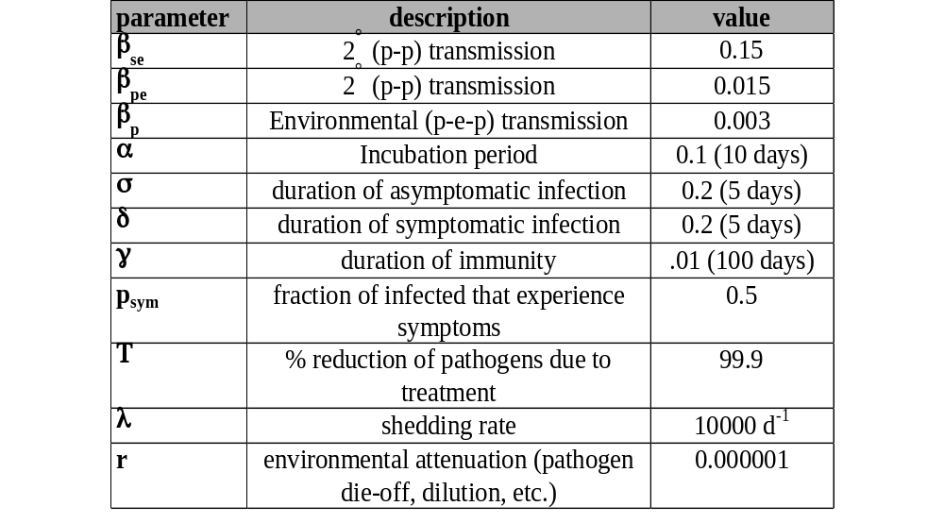
Parameter Identification
Uncertainty and variability
  Literature data used to quantify parameter values, ranges, or distributions.
Notes:
Some of these paramters we know pretty well…some we don’t…the ones we don’t know, we need to estiamte? How?

Slide 15
Baseline Simulation
Scenario definition
  A parameter set is saved if simulation output is between 20 and 60 cases per 100,000.
Monte Carlo Simulations
  Values obtained by sampling parameter distributions
    For example
      λ = Shedding rate
      β_{p} = Environmental transmission rate
        Water contact (exposure)
        Infectivity
      T = Water treatment efficiency
Notes:
we sample them from a distrubution. Then, the model is allowed to run using the parameter set. If the parameter set that was sampled produces a IR outside this region, we through it out. How did we come up with 20 – 60? Expect to see 40-45 cases/100000 py based on previous data from non-outbreak conditions.

Slide 16
Results: Baseline Simulation
100
80
Cases / 100,000 person-years
60
40
20
0
0.1
1
10
10
2
10
3
10
4
Average Daily Prevalence per 100,000 (P)
Notes:
Output of each run was ordered by ADP/100,000. The parameter sets associated with prevs between 20 and 60 were saved (other sets aren’t interesting – everyone becomes infected or no one becomes infected.
ADP over 1year simulation period.

Slide 17
Reclaimed Water Scenario
Parameters that are most important in determining high risk conditions
  Shedding
  Water Treatment
  Exposure frequency/time

Slide 18
Relationship Between Parameter Values and Risk
0.19
3022
λ
High Shedding Rate
Low Shedding Rate
F
<= 2.0e4
λ
F
> 2.0e4
0.09
REGION I
REGION II
0.48
High Treatment Efficacy
Low Treatment Efficacy
2266
Small exposure time
756
Large exposure time
T
E
<= 2.6e-3
T
E
> 2.6e-3
ε
T
<= 1.6
ε
T
> 1.6
0.03
0.37
0.25
0.68
1840
426
344
412
Low Risk
High Risk
Low exposure frequency
High exposure frequency
Low exposure frequency
High exposure frequency
ε
F
<= 23.3
ε
F
> 23.3
ε
F
<= 9.6
ε
F
> 9.6
0.09
0.50
0.20
0.82
211
133
92
320
Low Risk
High Risk
Low Risk
High Risk
Value in circle = percent of scenarios that met criteria for
an outbreak (i.e. risk of outbreak occurring)
Notes:
Roughly 6000 parameter set were classified (based on baseline sim). 19% of these resulted in a outbreak situation.
Biggest predictor = shedding rate. Low shedding rate = low risk.

Slide 19
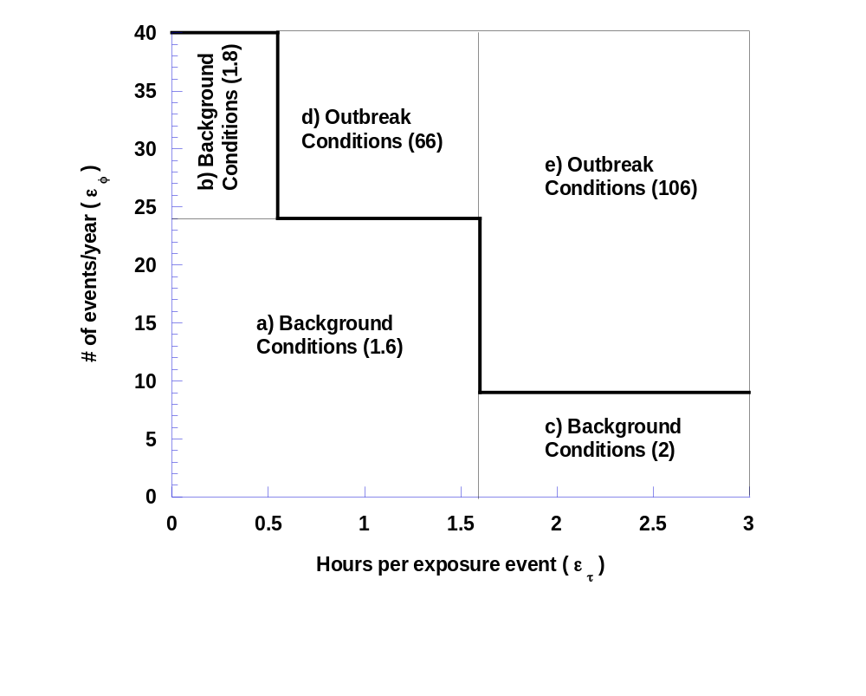
Likelihood of Outbreak
Notes:
Another way to look at it….Breakdown based on exposure frequency –
Number in parentheses is the incidence per 100000 py.

Slide 20
The Interdependencies of Transmission Pathways
Identifying the rate of shedding was crucial to determining the most effective control strategy.
  Improving water treatment (control option 1) or limiting exposure (control option 2).
Control option 1
Control option 2
•
•
A
2 x 10⁴
B
Shedding rate, λ (pathogens excreted/time)
Water treatment > 3 log removal effective if λ=A and not effective if λ=B.
Notes:
Fall out of this: it’s most important to know the shedding rate. We were able to deduce from using the model…didn’t know this before.

Slide 21
Sensitivity: measure of confidence in decision
Given A is the estimate for λ, a decision-maker is provided with two pieces of information:
  Water treatment > 3 log-removal can effectively control risk.
  λ can increase by as much as
  ( 2x10⁴ - A ) / A %
  without affecting the decision on control strategy.

Slide 22
Conclusions From Case Study
Life in a data-sparse world.
  Less interested in predictive abilities.
  More interested in the sensitivity of a given decision to variation in parameters.
    What parameters need better resolution and and to what degree.
Simulations
  Monte Carlo techniques used to obtain uncertainty and sensitivity information.
    Binary classification of output is an alternative to traditional statistical approaches.

Slide 24
Choice of Model Structure
Trade-offs to consider when evaluating different model structures
  Simplicity vs. Comprehensiveness
  Bias vs. Variability
Beyond use as a predictive tool, risk models can also be a valuable
  Scientific tool.
  Decision-making tool.
  Tool to help define research needs.

Slide 25
Choice of Model Structure
Simplicity
  Easy to use
    Simple spreadsheet calculation
  May produce biased results
    May not include certain components that contribute to the risk estimate.

Slide 26
Choice of Model Structure
Comprehensiveness
  Model structure attempts to explicitly account for properties of the system.
    Has scientific integrity
  May add complexity to the model structure
    Complexity may mean
      Computation requirements
      Additional variability in the risk estimate

Slide 27
Models as a Scientific Tool
Disease Transmission Process
Risk estimation depends on transmission dynamics and exposure pathways
Transport to other water sources
Agricultural
Runoff
Drinking
Water
Animals
Recreational Waters
or
Wastewater reuse
2°
Trans.
Notes:
Before jumping into our specific studies I would like to elaborate on what we mean by a disease transmission process

Slide 28
Models in Decision-Making and Setting Research Agendas
Models can help us gain understanding of processes
  Information useful in decision making
    Regulatory
    Management
Models can be a tool to prioritize research
  Initial conceptual model
  Sensitivity and uncertainty analysis

Slide 29
Population-Level Risk Assessment
Examples of population-level issues important in assessing risk
  Amplification of cases (indirect cases)
  Dilution of cases (competing sources)
  Exhaustion of susceptible individuals (immunity)
  Dissemination of cases from one community to another (a model for enteric viruses)
  Differential susceptibility (integrating results from DW intervention trials to account for variability in susceptible groups; e.g. age, CD4 count)

