Slide 1
Risk
Paul B. Thompson
W.K. Kellogg Professor of Agricultural, Food and Community Ethics
Michigan State University

Slide 2
Risk is a word.
What does it mean?

Slide 3
Risk: The Mainstream View
Risk = F(hazard, exposure)

Slide 4
Risk: The Mainstream View
Risk = F(H(e), P(e))
H(e) = Harm associated with event
P(e) = Probability of event

Slide 5
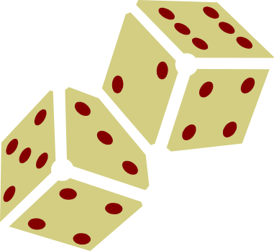




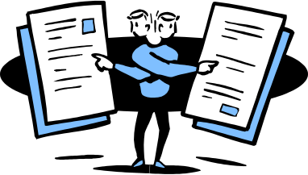




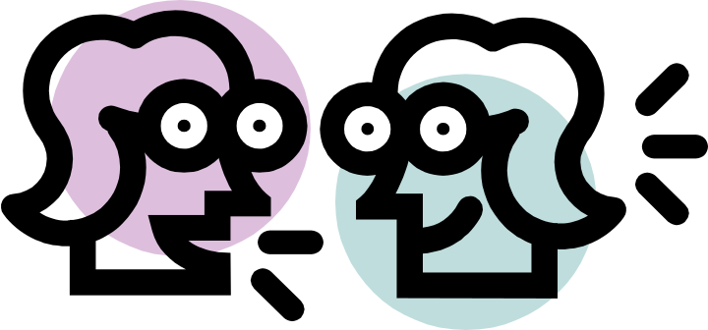
Risk: “Ordinary” View
Smiling Sam's Used Cars

Slide 6
Risk and Philosophy
Inside the mainstream
Between the mainstream and ordinary usage

Slide 7
Inside the Mainstream
(Just for Grins)
Value Judgments in Hazard Identification
  Human Death and Disease?
  Economic losses? Affects on ecosystems or non-human species?
What Do We Do with Uncertainty?

Slide 8
Pushing the Envelope
What’s the relationship between “the mainstream” and all that other stuff?
The Mainstream Answer: Purification. Risk is hazard and exposure. All the rest is noise.

Slide 9

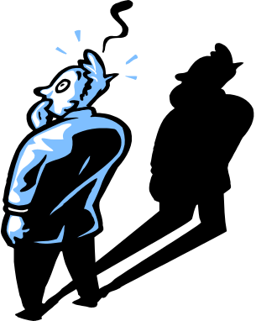

What “Contaminants” Are Being
Eliminated by Purification?
Vagueness
Emotionalism
Confusion
Ambiguity

Slide 10
Something Else?
In ordinary language, ordinary conversation, risk is a verb.

Slide 11
Something Else?
Jim risked it all with his latest “big idea.”

Slide 12
Something Else?
You risk your children’s health with all your smoking around the house.

Slide 13
Something Else?
Getting a traffic ticket?
I’ll risk it.

Slide 14
“Hazard X Exposure” is not a verb.
“Hazard X Exposure” characterizes (describes, names) a possible state of affairs.
But what is more, ‘risk’ is a particularly interesting verb.

Slide 15
Some verbs: “happen”
“occur”
“cause”
“initiate”
Unlike all of these common English verbs, the grammar for the verb ‘risk’ requires a grammatical subject that is capable of intentional action.

Slide 16
Some sentences
Jim causes traffic accidents.
The police force causes traffic accidents.
The bear causes traffic accidents.
The thunderstorm causes traffic accidents.
The earthquake causes traffic accidents.
The Stock Market causes traffic accidents.

Slide 17
Some more sentences
Jim risks traffic accidents.
The police force risks traffic accidents.
The bear risks traffic accidents.
The thunderstorm risks traffic accidents.
The earthquake risks traffic accidents.
The Stock Market risks traffic accidents.

Slide 18
Other sentences
Jim caused some loss of life.
The police force caused some loss of life.
The bear caused some loss of life.
The thunderstorm caused some loss of life.
The earthquake caused some loss of life.
The Stock Market caused some loss of life.

Slide 19
Some other sentences
Jim risked some loss of life.
The police force risked some loss of life.
The bear risked some loss of life.
The thunderstorm risked some loss of life.
The earthquake risked some loss of life.
The Stock Market risked some loss of life.

Slide 20
Still more sentences
You risk your life by smoking and drinking.
You risk your life by having seizures and catching pneumonia.

Slide 21
The ordinary
English grammar
of risk suggests
that (at least
in some usage)
risk is related to
action in a
communicatively
deep way.

Slide 22
What’s the relationship between “the mainstream” and all that other stuff?
My answer: At least some information that ties risk to intentional action is “lost” in the mainstream interpretation of risk.

Slide 23
What kind of information might that be?
My answer: At least some information that ties risk to intentional action is “lost” in the mainstream interpretation of risk.

Slide 24
1. Risks are related to responsibility.
I know.
Isn’t it terrible what we’ve done to it?
You risk your
health, swimming
in that water.

Slide 25
2. Risks call attention to the need for action.
Really?
Why?
You risk your
health, swimming
in that water.
The pool boy
needs to add some
chlorine after the big
rain last night.

Slide 26
3. Some things are risky. Others are not.
Really?
Why?
The ordinary grammar of risk is embedded with “cognitive filters,” some reflecting cultural and ethical norms about when it is appropriate to assign responsibility or when action is needed. These cognitive filters help us organize our lives, telling us when it is important to expend effort to address a problem, and how what duties or responsibilities we owe to one another. “Hazard X Exposure” eliminates all this embedded information.
You risk your
health, swimming
in that water.
Ha, ha ha, you
idiot! Don’t you know?
There are no zero
risks!

Slide 27

Conclusion: Does this mean that “Hazard X Exposure” is wrong?
In these situations it is very helpful to sharpen the focus of analysis in just the way that “hazard’ & ‘exposure” suggest.
Obviously not. In most of the contexts where science is used to assess risk, key judgments about responsibility and the need for action have already been made.
But the “Purification View” (that risk just is hazard X exposure) is wrong.
Scientists and risk experts do indeed err when they build risk communication efforts on this view, (and when they say, “There is no zero risk”).

Slide 28
Thank you.

