Slide 1




Knowledge Management Approach for CAMRA Community
Rosina Weber
College of Information Science & Technology
Drexel University

Slide 2
Overview
Knowledge management
Why does CAMRA need KM
KM approach for CAMRA
Repository of learning units
  Knowledge workers
  CAMRA domain structure
  Learning units
How does this approach achieve CAMRA goals?
Planning research activities
Benefits
FAQ

Slide 3
Knowledge management
What is it?
  Knowledge Management (KM) is a field of study concerned with the management of intellectual assets. KM approaches target communities to promote knowledge sharing and leveraging.
Knowledge vs. Information
  Information artifacts are distributed to humans and require knowledge to be managed in the human mind.
  Knowledge artifacts represent a computational form of knowledge, which does not require humans to contribute knowledge for making decisions.

Slide 4
Why does CAMRA need KM?
Knowledge sharing, leveraging
Integration
Collaboration
So, we created a KM approach

Slide 5

KM Approach
Knowledge repository
Domain Structure
Knowledge facilitators will guide CAMRA members and complement technology to support knowledge management
Project II
Project I
Knowledge facilitators
Project III
The Domain structure will organize the contents of interest of CAMRA members.
The work of CAMRA investigators translates into scientific contributions.

Slide 6
Knowledge repository
(CAMRA KR)
Project II
Project I
Retains learning units
  Allows CAMRA members to see your units
  Allows CAMRA members to find units
  Allows CAMRA members to find each other
Project III

Slide 7
Knowledge facilitators
Educate and motivate members about the KM approach for CAMRA
Design KR to meet CAMRA goals
  How can we improve the design
Help members use CAMRA KR
Guide members on how to enter LUs

Slide 8
CAMRA domain structure
We have to identify what the consensual view of the domain of CAMRA is
It will allow integration
All units will be associated with this structure

Slide 9
Learning unit is a knowledge artifact
Research activity
Contexts
Contribution
Results
Research activity
Contexts
Results
Contribution
What is the general research activity?
In what contexts does this activity occur?
Summarize your results.
What is the contribution you learned?

Slide 10
Types of Learning Units
Things I have completed
What is the general research activity?
In what contexts does this activity occur?
Summarize your results.
What is the contribution you learned.
Things that are in progress
What is the general research activity?
In what contexts does this activity occur?
Describe your experimental design.
What is your hypothesis?
Things that I have read
What is the general research activity?
In what contexts does this activity occur?
List your references.
What is the contribution you learned?
Fitting dose response models
Investigating particle fate and transport
Investigating particle fate and transport
Bacillus anthracis, rhesus monkeys, guinea pig, rabbit, inhalations, dose response, exponential, beta Poisson, log probit
Environment is indoors, pathogens are multiple, particle associated pathogens
Environment is indoors, pathogen is tuberculosis, particle associated pathogens
Using the statistical programming package R the exponential, beta Poisson and log probit models were used in a maximum likelihood estimation approach to parameter estimation, to find the best fitting model and associated parameters for the data obtained. It is found that with the exception of guinea pigs and rhesus monkeys exposed to the ATCC-6605 and Vollum strains of Bacillus anthracis respectively all other data sets (guinea pigs and rabbits exposed to Vollum strain of Bacillus anthracis) along with the pooled data sets can all be modeled with the beta Poisson dose response model (the exceptions fit to the exponential model).
We will compare fate and transport of three different pathogens spreaded from the same point of origin.
Ko G, Thompson KM, Nardell EA. Estimation of tuberculosis risk on a commercial airliner. Risk Analysis, 24:379-388, 2004.
Do different pathogens have common or distinguished fate and transport in indoor environments?
Exposure intensity to airborne pathogens decreases with distance from the point of emission.
Different species of test animals (guinea pigs, rabbits and rhesus monkeys) can be pooled together and described using a single beta Poisson model (alpha = 0.974 , N50 = 62,817 spores).

Slide 11
Types of Learning Units
Things that are in progress
What is the general research activity?
In what contexts does this activity occur?
Describe your experimental design.
What is your hypothesis?
modeling particle fate and transport
airborne release of particles
A Markov chain describes the fate and transport of particles in indoor environments (a single room). The Markov model predictions for particle deposition is compared to experimental particle release and deposition data obtained by Sajo et al (2002) Health Physics 83: 871-883. The Markov model is simulated to illustrate applications to the transport of airborne infectious agents in a hospital room.
A Markov chain model can describe the fate and transport of supermicron particles, which may contain infectious agents, in indoor environments.

Slide 12
Types of Learning Units
Things that I have read
What is the general research activity?
In what contexts does this activity occur?
List your references.
What is the contribution you learned?
Investigating particle fate and transport
Environment is indoors, pathogen is tuberculosis, particle associated pathogens
Ko G, Thompson KM, Nardell EA. Estimation of tuberculosis risk on a commercial airliner. Risk Analysis, 24:379-388, 2004.
Exposure intensity to airborne pathogens decreases with distance from the point of emission.

Slide 13
Status of Units
Saved
  You started typing on it, but did not submit it
Submitted
  You submitted and lost editing rights so knowledge facilitators can examine it without further changes
Approved
Returned
  A knowledge facilitator has a suggestion to one of the four core fields

Slide 14
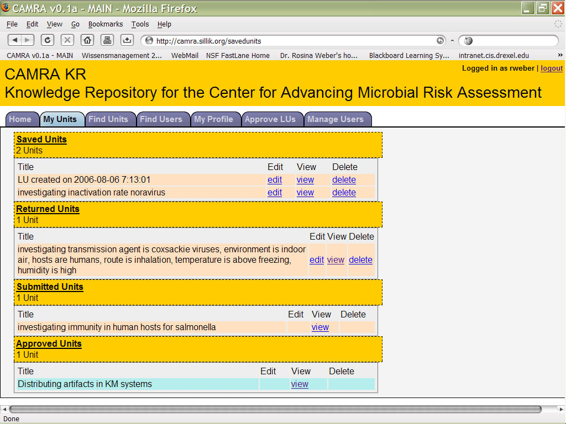
Status of Units

Slide 15
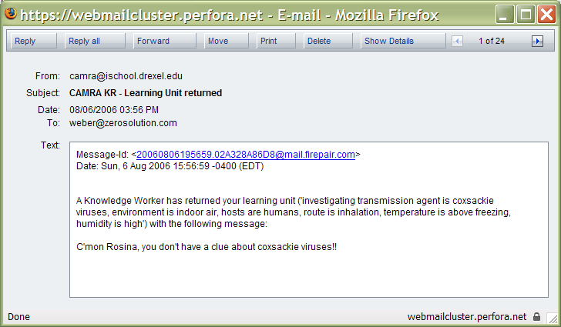

Slide 16

Knowledge facilitators are coninuously trying to improve design and motivate knowledge sharing and leveraging through collaboration and integration
But we know you guys are so busy…

Slide 17
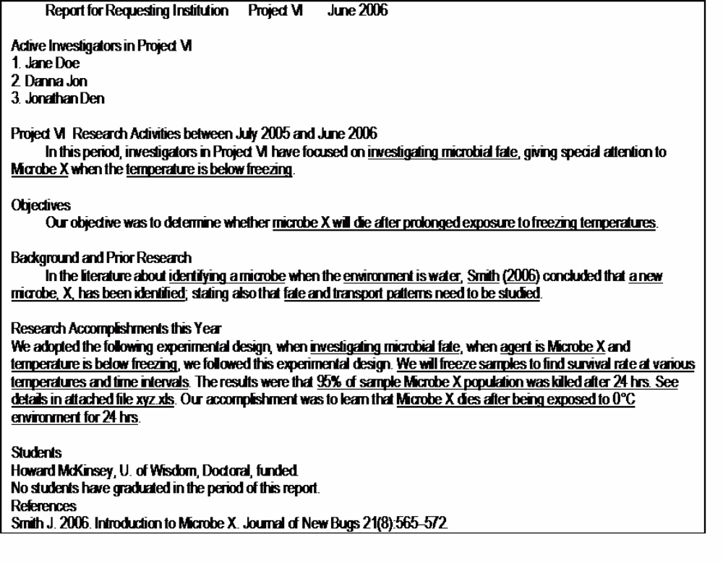
Reports

Slide 18
Orphan Units
How are research plans related to learning units?
Research plans for next years will become learning units
When you make a unit orphan, they become adoptable by all members
Share incomplete units, collaborate submitting a unit, enter planned activities
The year when they are planned can be indicated in the Notes field

Slide 19
Orphan Units (cont’d)
When you orphan a unit, you lose editing rights
When a unit is up for adoption, it appears to all members of your project
You can adopt a unit and orphan it again
When a unit is submitted, you can no longer orphan it

Slide 20
How does this approach achieve CAMRA goals?
Knowledge sharing
Integration
Collaboration

Slide 21
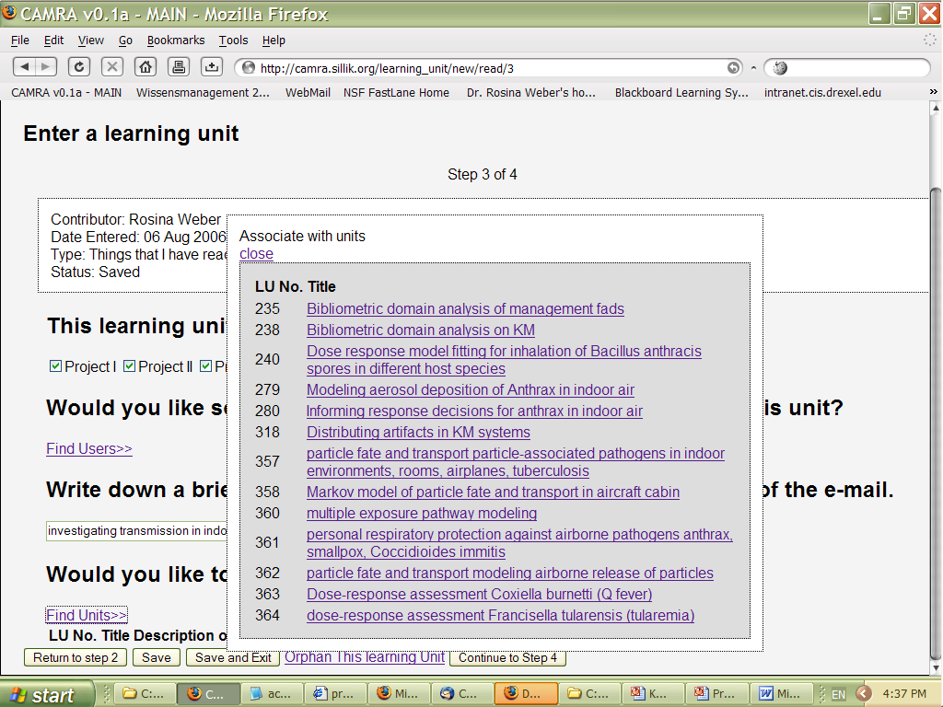
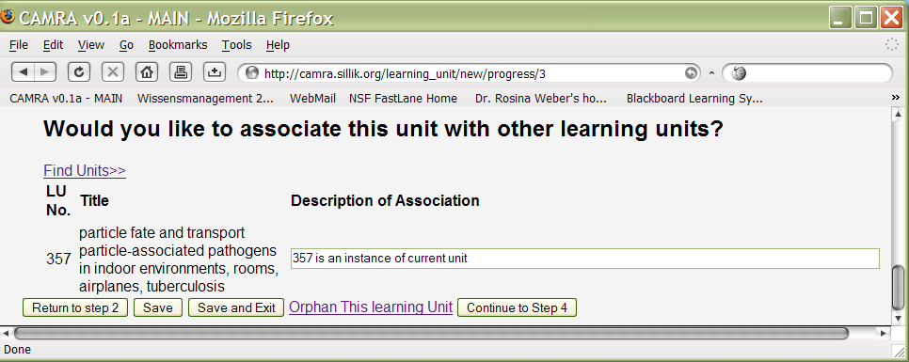
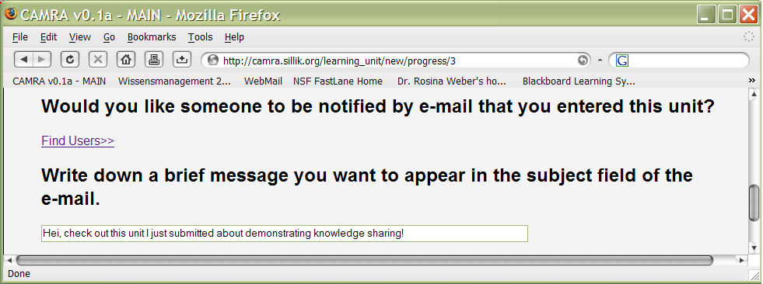
Knowledge sharing
Making each one’s work visible
Recommending units to each other
Asking members to associate units to each other e.g., unit A preceeds unit B
Asking members to associate units to the CAMRA domain structure
Showing how associated units are evidences of knowledge sharing and leveraging

Slide 22
Integration
Every new unit will be integrated
The integration will be oriented by the CAMRA domain structure
Making a whole by combining each member’s work
Members will understand theirs and others’ units within the CAMRA context

Slide 23
Collaboration
Collaboration requires transparency
Learning units make each one’s interests, work, and plans transparent
Learning units are designed to explicitly show all aspects that support knowledge reuse

Slide 24
Benefits
Members
Project Leaders
Project Directors
Program Directors from EPA, DHS

Slide 25
Members
Members can keep track of their work
KR facilitates organization of literature review
Members will have drafts for their reports: only enter things ONCE
Privacy – share units with whom you choose
Search units
Who can help me with this specialty?
Ask for review on a topic*.

Slide 26
Project Leaders
What’s next to do?
What has been done?
Are we getting where we have to?
What’s left to do?
Report progress of entire project
Train newcomers about the project
What do others do?
Who are CAMRA members?
How do I enter learning units?

Slide 27
Project Directors
KR allows them to have an overview of how the project advances
KR helps transmit needs of integration, knowledge sharing, and collaboration to CAMRA members
Fosters integration, knowledge sharing, and collaboration
Report of entire center
How’s center advancing?
Education: courses, who can teach them?

Slide 28
Program Directors
Fosters integration, knowledge sharing, and collaboration
Sharing and leveraging will be demonstrated
They will have access to the collected knowledge
How’s the money we invested being used?
Knowledge produced to generate outcomes is linked to references through threads of units
Educational components, who to invite to workshops, to invited talks, what courses to prepare workforce?

Slide 29
Questions about KR (i)
What if I want to send a paper to my colleagues?
Should I use the CAMRA KR?
If I do, do I have to submit a learning unit?
Why?
How can the KR help me?
Go find users- select by areas of interest, get the list of emails and send it by email.

Slide 30
Questions about KR (ii)
So, a learning unit either has an author or it is an orphan?
YES

Slide 31
Questions about KR (iii)
Where do I enter outputs?
Notes:
  Outcomes and outputs:
  Year planned:
Can I enter attachments?
Yes, and you can add more after your unit is approved.

Slide 32
Questions about KR (iv)
Could I submit a unit of the kind “Things that I have read.” when I am the author?
When should I submit a completed unit?
When you have done work for CAMRA.
Completed units will be included in your reports under “Research Accomplishments this year”.

Slide 33
Questions about KR (v)
How specific should a unit be?
exposure
characterization
die-off rate
removal rate
inactivation rate
growth rate
occurrence
fequency
concentrations
seasonality

Slide 34
Questions about KR (vi)
Can I use shortcuts such as
Ctrl+S to save?
No

Slide 35
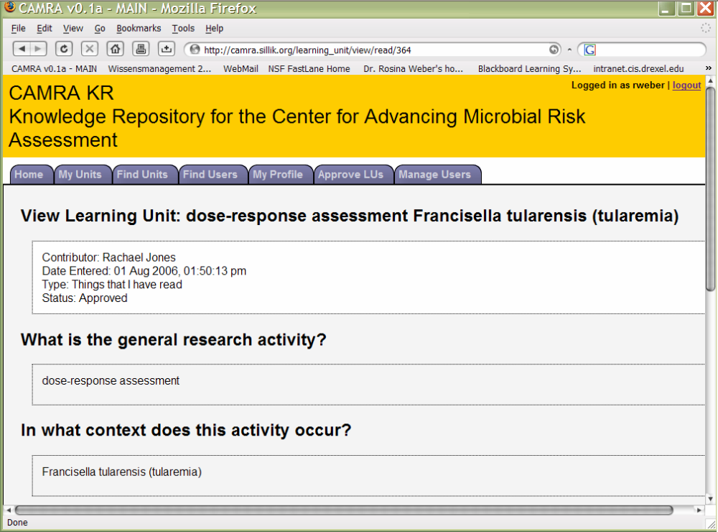
Questions about KR (vii)
Why isn’t there a tab for entering learning units?
The goal is to enter learning units, so entering learning units is not a tab, it is home

Slide 36
Questions about KR (viii)
How does authorization/registration work?

Slide 37
Two-day Visits
Background
Enter learning units

Slide 38
Acknowledgements
Jason M. Proctor, doctoral student
This work is supported in part by the U.S. EPA-Science to Achieve Results (STAR) Program and the U.S. Department of Homeland Security Programs, Grant # R83236201.
Members of the CAMRA community
Mike E Atwood, co-investigators expert in HCI
Marcia Morelli, doctoral student (HCI)
Nicholas M. Sillik, programmer

Slide 39
Associating Units
Units will be associated with other units
Units will be associated with the CAMRA domain network
Link your learning unit with the following units
  List unit Label association
How does this unit relate to other work on CAMRA?

