Slide 1



U.S. EPA and DHS Center of Excellence
CAMRA is an interdisciplinary research center established to develop scientific knowledge on the fate and risk from high priority infectious agents.
(Michigan State University, Drexel University, University of Michigan, Carnegie Mellon University, Northern Arizona University, University of Arizona and University of California Berkeley)
Homepage: http://www.camra.msu.edu/

Slide 2

Introduction to Quantitative Microbial Risk Assessment
Joan B. Rose, Ph.D., Yin Huang, Ph.D.
Michigan State University

Slide 3

Quantitative Microbial Risk Assessment (QMRA)
What is QMRA?
A method for assessing risks from microbial agents in a framework that defines the statistical probability of an infection from the environmental pollution of water, soil, food, surfaces and hands
Problem formulation
The problem should be formulated to respond directly to the needs of decision makers, stakeholders, as well as the interested public, and to guide the risk assessment paradigm

Slide 4
Risk Assessment Paradigm
HAZARD IDENTIFICATION
Types of microorganisms and disease end-points
DOSE-RESPONSE Human feeding studies, clinical studies, less virulent microbes and health adults
EXPOSURE
Monitoring data, indicators and modeling used to address exposure
RISK CHARACTERIZATION Magnitude of the risk,
uncertainty and variability
Need to tie risk assessments to
management and decision science
Hazard Identification
Dose Response
Exposure Assessment
Risk Characterization
Risk Management

Slide 5
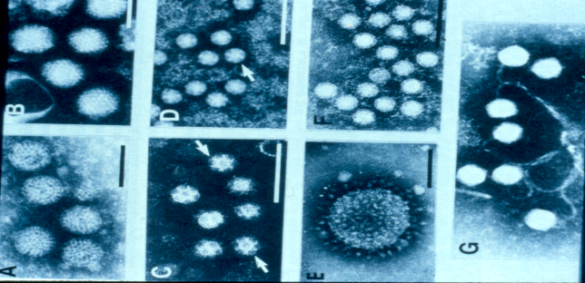
Hazard Identification
Determine what microorganisms cause which human illnesses
Develop diagnostic tools to identify the hazards to link to and quantify the associated the infection, incubation time, symptoms in individuals (and communities), severity, duration, and excretion rates
Understand possible transmission routes
Data sources: Clinical data, outbreak investigations, experimental and epidemiological studies

Slide 6
Dose Response
Provides a quantitative relationship between the likelihood of adverse effects and the level of microbial exposure
- End point: infection, illness or death
- Dose: number of organisms ingested or inhaled
Data come from human and animal feeding studies
Enables low dose extrapolation
Have Dose-response models for most Class A and B agents

Slide 7
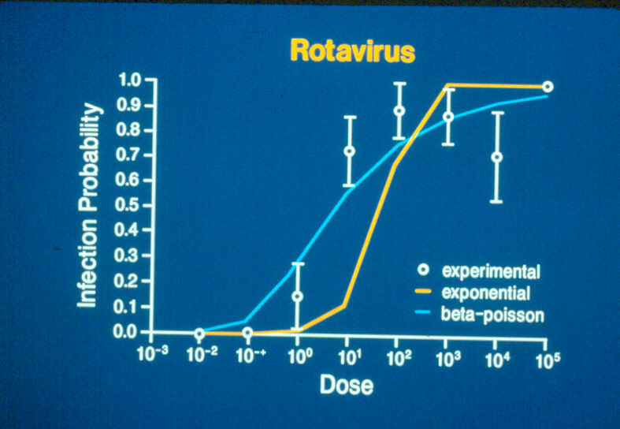
Dose-Response Models
Exponential Approximate Beta Poisson
P= probability of infection (risk)
d=dose
K, α, N₅₀ model specific
parameters

Slide 8
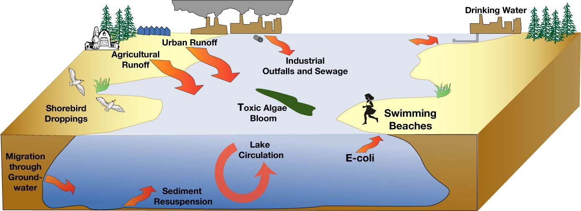
Exposure Assessment
Identifies affected population
Determines the exposure pathways and environmental fate
Calculates the amount, frequency, length of
time, and route of exposure
Estimates dose or distribution of doses

Slide 9
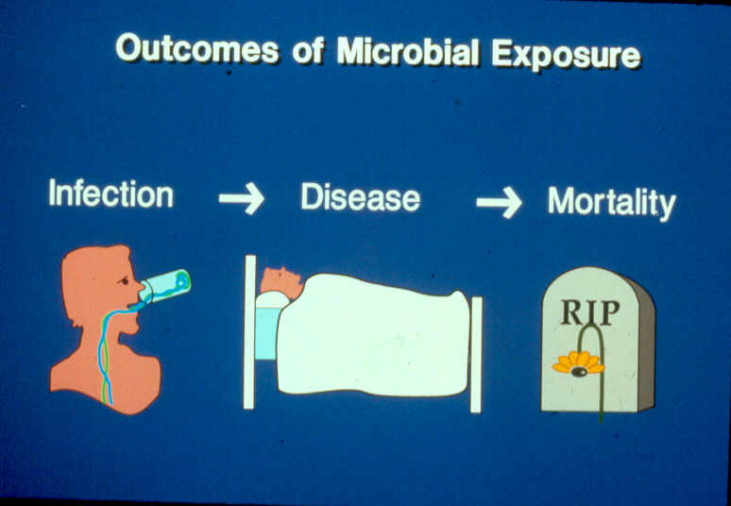
Risk Characterization
Integrates dose-response analysis and exposure assessment to estimate magnitude of risk, uncertainty and variability
Monte Carlo analysis gives distribution of risks and population/community models

Slide 10
Monte Carlo Uncertainty Analysis
Risk assessments are often subject to large uncertainties
Monte Carlo generates or “samples” parameters X1 and X2 based on certain distributions while calculating corresponding risk Y = F(X1, X2)
A discrete distribution of Y that approximates true distribution of Y is used
True percentiles of Y ~= percentile of Y_{i} values are included
Typically the analysis summarizes the data by mean, median, upper bound, and lower bound

Slide 11
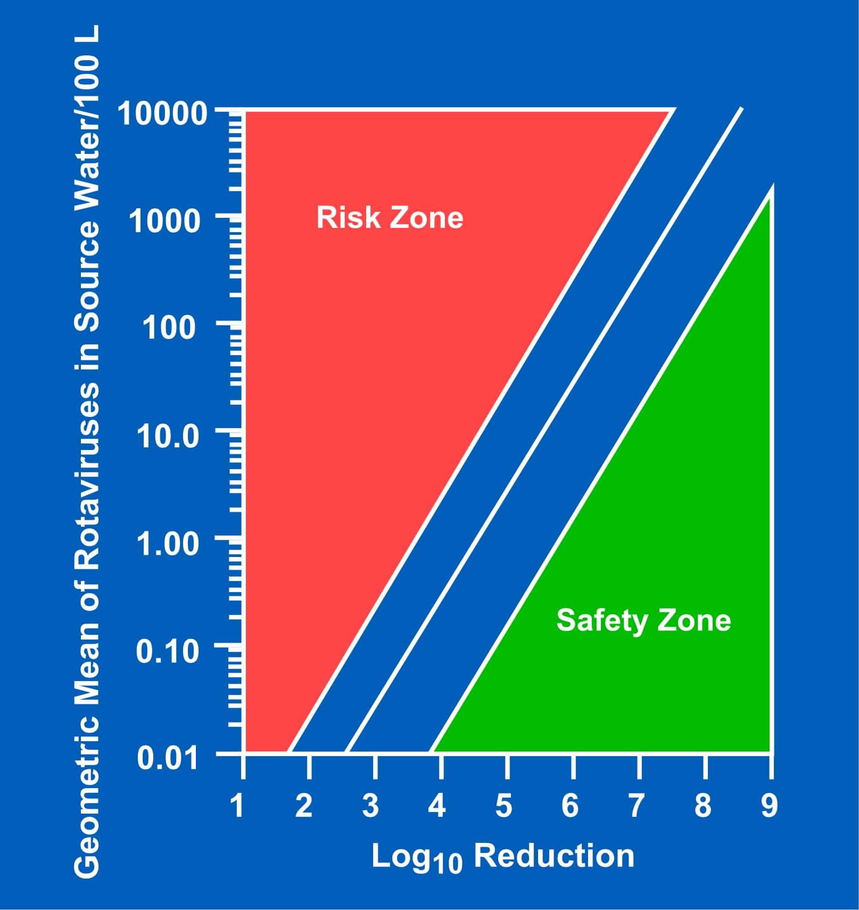
Applications for QMRA
Establish policies for protection of health using standards or performance based criteria
Compare risks
Evaluate alternative solutions
Prioritize risks
Identify scientific data gaps
Develop protocols for monitoring
Communicate effectively with the public

Slide 12
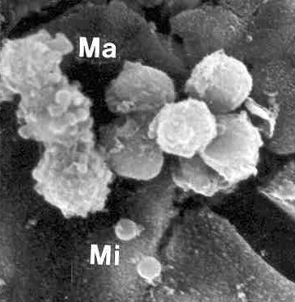
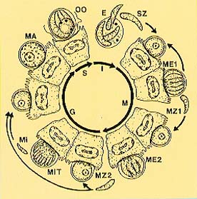
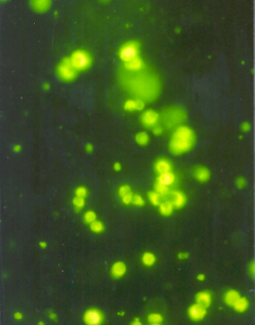
Example: Cryptosporidium Risk Assessment
What is the risk of waterborne disease from swimming ?
According to CDC, diarrheal recreational water illnesses (RWIs) outbreaks, the most commonly reported RWI, has sickened almost 19,000 people from 1984 to 2002
One of the most commonly reported parasites that cause diarrheal RWI is Cryptosporidium
Cryptosporidium
- protozoan parasite
- environmentally transmissible form:
oocysts
- exposure route: fecal-oral
- Risk analysis scenario: swimming
in contaminated pool

Slide 13
Dose-Response Modeling for Cryptosporidium
Fitting dose-response model to available data
Exponential with k= 0.00419
Risk = 1-exp(-dose x 0.00419)
Exponential model fit to data on oral exposure to oocysts and infectivity of Cryptosporidium in humans (Dupont 1995)

Slide 14
Cryptosporidium Risk per Swim
Exposure assessment: Swimming after a fecal accident
i. 0.016 liters consumed per swim (Dufour et al. 2006)
ii. assume 15 infective oocysts/liter
iii. Dose =0.016 liters/swim x 15 oocysts/liter = 0.24
Risk Characterization
- Risk = 1-exp(-0.00419 x dose )
- Risk = 1-exp(-0.00419 * 0.24)= 0.0010

Slide 15
Risk from Multiple Exposures
Seasonal Risk of swimming [probability of infection with multiple exposures] assumes each exposure event is independent.
Example:
Seasonal swimming occurs for 8 events throughout the year.
Probability of Infection for one swim event = 0.0010
Multiple Exposure Risk =1-[1-SingleRisk]⁸
Seasonal Swim Risk =1-[1-0.0010]⁸ = 0.0080

Slide 16
Monte Carlo Uncertainty
Risk=1-exp(-k * ingestion * concentration)
suppose we don’t know true average concentration?
Choose input distributions that reflect plausible spread in these values
Assuming Ln (natural log) of the average oocyst concentration is normally distributed with mean = 2.7 and standard deviation = 0.20
generate Ln [average concentration] from normal generator in excel

Slide 17
From Point Estimate to Probabilistic Risk Assessment
Probabilistic Seasonal Risk=1-{1-[1-exp(-k * ingestion * concentration)]}⁸
Only concentration of oocysts used as a distribution for the risk output.
A series of risks are calculated based on randomly generated oocyst levels from the distribution of the concentration of oocysts (see slide 16)
Output can be described by distribution as shown below (inclusive of mean , median, upper bound, and lower bound, etc)
From the output below, mean=0.0081, median=0.0079, 95% upper bound=0.0109, 95% lower bound =0.0059

Slide 18
Swimming Risks
After a fecal accident risks are as high as 1% with 15 oocysts/liter. Higher levels of contamination are possible and would result in significantly higher risks.
In order to reduce the risk, pools should be closed, and the water filtered and disinfected (eg with UV disinfection) to reduce the risk.

Slide 19
Selected QMRA References
Casman, E. A. and B. Fischhoff (2008). "Risk Communication Planning for the Aftermath of a Plague Bioattack." Risk Analysis 28(5): 1327-1342.
Dufour, A., O. Evans, et al. (2006). "Water ingestion during swimming activities in a pool: A pilot study." Journal of Water and Health 4(4): 425-430.
DuPont, H., C. Chappell, et al. (1995). "The infectivity of Cryptosporidium parvum in healthy volunteers." New England Journal of Medicine 332(13): 855-859.
Eisenberg, J., E. Seto, et al. (1998). "An analysis of the Milwaukee cryptosporidiosis outbreak based on a dynamic model of the infection process." Epidemiology 9(3): 228-231.
Gerba, C., J. Rose, et al. (1996). "Sensitive populations: who is at the greatest risk?" International Journal of Food Microbiology 30(1-2): 113-123.
Haas, C. N., J. B. Rose, et al. (1999). Quantitative Microbial Risk Assessment. New York, John Wiley and Sons.
Huang, Y., T. Hong, et al. (2010). "How Sensitive Is Safe? Risk-Based Targets for Ambient Monitoring of Pathogens." IEEE Sensors Journal 10(3): 668-673.
Ives, R. L., A. M. Kamarainen, et al. (2007). "Use of Cell Culture to Assess Cryptosporidium parvum Survival Rates in Natural Groundwaters and Surface Waters." Applied and Environmental Microbiology 73(18): 5968-5970.
Rose, J. B., C. N. Haas, et al. (1991). "Risk assessment and control of waterborne giardiasis." American Journal of Public Health 81(6): 709-713.
National Academy of Sciences (1983). Risk assessment in the federal government: managing the process. Washington, DC, National Academy Press.

