Slide 1
CAMRA Knowledge Management
Project V
Year 1
Year 2
Principal Investigator: Rosina Weber
Co-Investigator: Michael Atwood
Doctoral students: Sid Gunawardena, Marcia Morelli, Jason M. Proctor
The iSchool @ Drexel
The views and opinions expressed herein do not necessarily reflect those of the United States Environmental Protection Agency, the department of Homeland Security, or the US Government.

Slide 2
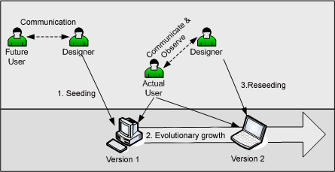
Use-centered Design

Slide 3
Usage of CAMRA KR by End Year 1
64 units in the repository
26 (40%) units linked to another unit
TYPE COUNT %
Things I have read 18 28.1%
Things that are in progress 37 57.8%
Things I have completed 9 14.0%

Slide 4
Knowledge Sharing
Units associated to a unit submitted by a different author
6 learning units link units from different projects
6 out of 64 units represent 9.375%
links

Slide 5
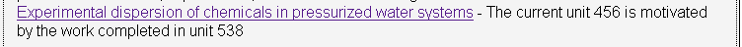
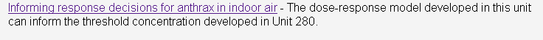
Knowledge Leveraging
Units associated to a unit submitted by a different author with a label such as “builds upon”

Slide 6
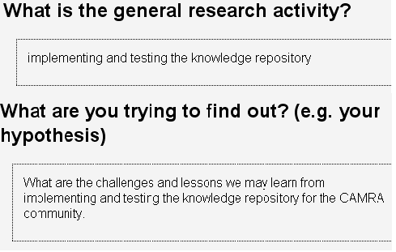
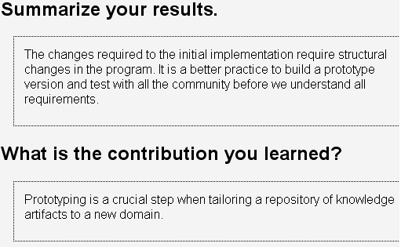
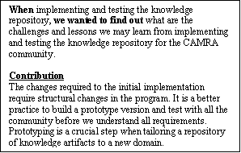
From Units to Reports
Types of LU and Labels
Contribution (Output)

Slide 7
New functions and recommendations for
Version 2.0
Year 2

Slide 8
Reviewing
More and less reviewing
  Three levels of reviewing
    Advisor-advisee if applicable
    Reviewed for formatting
    Reviewed by ESI
Units become immediately visible
    But are not included in reports or other forms of summary; and depending on the formatting, may be excluded from search results

Slide 9
Less reviewing
Research activity
  Will be a drop down selection with two fields
  Yes, in both there will be a blank option to enter items not in the drop down
In what contexts is this research activity applicable?
  Also a drop down, this will be multiple choice

Slide 10
Outbreak Units
An outbreak or another emergency situation may require the request for learning units of some kind.
The originator of the request will be asked to enter either a research activity or a context so that others receive a link to access the system directly into the draft of a learning unit that include the portions submitted by the originator of the request

Slide 11
Collaboration Units
The originator of a collaboration unit will select the members who will be invited to participate in building one learning unit together
Multiple collaborations may be created
All collaborators have full access to the unit and will, by default, be listed as contributors
Others will lose editing rights when one of the members requests to edit the unit; editing rights are immediately restored to all collaborators

Slide 12
Accomplishment Units
Publications
Presentations
Graduated students
Patents
Participation or organization of workshops
Etc.
These are objective outcomes
We need to know all required features

Slide 13
Messaging
It is fast and easy to implement a messaging system
We also want to offer a visible location in the units for a blog
We will have to discuss about it

Slide 14
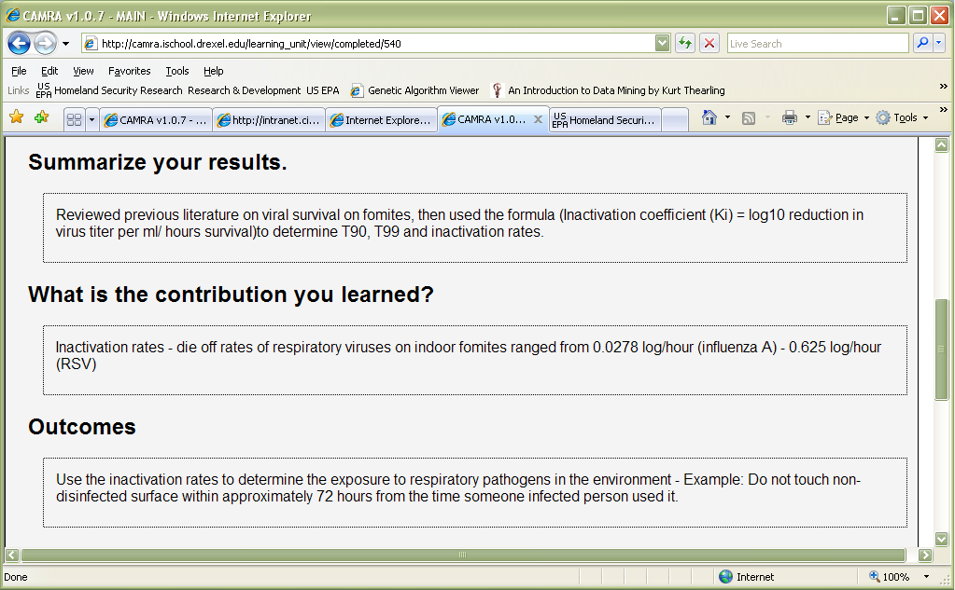
Reporting and other summaries
In addition to the reporting capability, we would like to send to CAMRA’s, EPA’s, DHS’ websites, summaries of completed activities
Those would be triggered by accomplishment units
This will require users to associate accomplishments to learning units of the type “Things that are completed”.
Use outputs, outcomes, impact

Slide 15
Next steps
To get to Version 2.0 and beyond
Gather revisions and recommended changes
Sending email to all users asking for more opinions
Requirements, Storyboard, HCI
First prototype of Version 2
User feedback for features and work practices

Slide 16
Planning the Data Warehouse
What is that users expect from the DW.
What do you expect to be there?
How do you use what will be there?
What do you expect it to provide to you?

Slide 17
CAMRA KM Workshop
After so many things we have to discuss, what if we get together to talk about it for a day or two?

Slide 18
Types of Learning units and their Labels
Things that I have read
What is the general research activity?
In what contexts does this activity occur?
List your references.
What is the contribution you learned?
Things that are in progress
What is the general research activity?
In what contexts does this activity occur?
Describe your experimental design.
What are you trying to learn e.g., hypothesis?
Things I have completed
What is the general research activity?
In what contexts does this activity occur?
Summarize your results.
What is the contribution you learned?
Back to 6

Slide 19
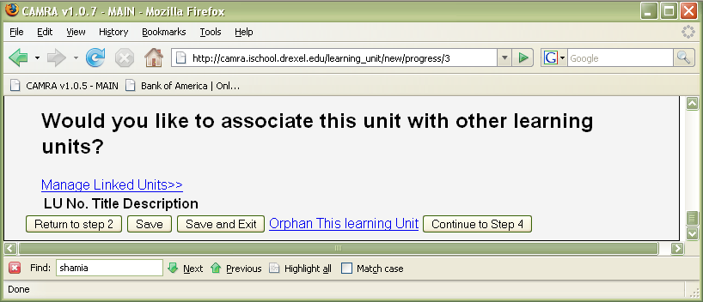
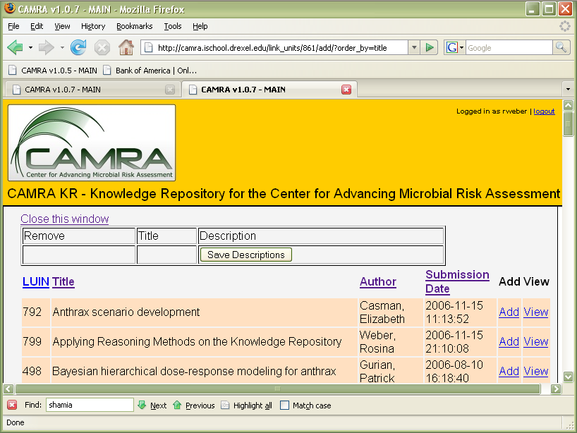
Back to 4

