Slide 1
BCA 2022-2025 Batch
Project Topic: FoodSphere: Food Ordering Web-Application
College Name: Dinabandhu Andrews Institute of Technology & Management
Paper Name: Major Project & Grand Viva
Paper Code: BCAD681
Group Number: 15
Mentoring Faculty: Amrita Nandi

Slide 2
Roles and Responsibilities
Team members and their responsibilities
Sl.no | Name | Class Roll no | University Roll no | University Registration no | Roles
1 | Ripan Baidya | 08 | 15401222024 | 221541010055 | Backend & Database
2 | Torsha Dey | 44 | 15401222065 | 221541010106 | Documentation
3 | Shruti Karmakar | 74 | 15401222083 | 221541010074 | Frontend
4 | Pranoy Bhattacharya | 45 | 15401222052 | 221541010049 | Documentation
5 | Sayan Mallick | 54 | 15401222053 | 221541010069 | Documentation
6 | Jit Mondal | 77 | 15401222085 | 221541010034 | Frontend

Slide 3
Table of Contents
Contents
Introduction
Project Objectives and Overview
Key Technologies
Frontend Technologies
Backend Technologies
Architecture Overview
User Features
Admin Features
Frontend and Backend Implementation
Security and Performance
Testing Procedure
User guide
Challenges and Solution
Conclusion and future scope

Slide 4
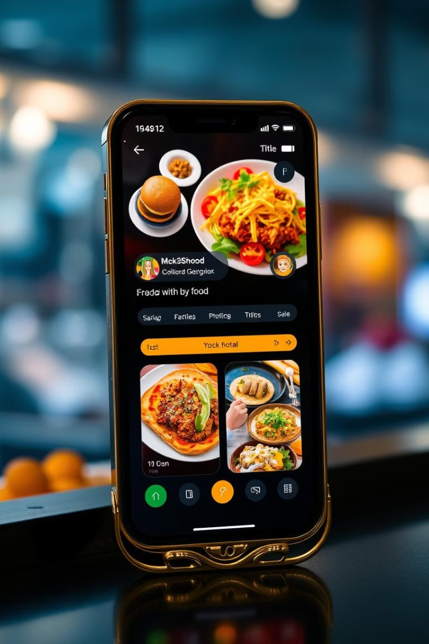
FoodSphere: Revolutionizing Online Food Ordering
FoodSphere is a comprehensive web-based food ordering system designed to streamline the process of ordering food online. Built with a robust Spring Boot backend and a modern React frontend, this role-based web=application assigns specific roles to, ensuring tailored access and functionality based on there role
The system offers a wide array of features, including user account management, food browsing, order tracking, and secure payment processing. For restaurant owners, FoodSphere provides tools to manage profiles, menus, and ingredients, ensuring smooth operations and enhanced user satisfaction.

Slide 5

Project Objectives and Scope
1
Reliable Platform
3
User-Friendly Interface
Create a secure and intuitive online platform for food ordering, catering to both consumers and restaurant owners.
Provide an easy-to-use interface for consumers to place orders, manage carts, and track past orders efficiently.
3
Restaurant Management
4
Administrative Oversight
Enable restaurant owners to manage information, food items, and ingredient customization effectively.
Facilitate comprehensive control over orders, restaurant listings, and secure payment processing for system administrators.

Slide 6





Key Technologies
Spring Boot
React
Core backend framework for efficient handling of RESTful APIs and business logic.
JavaScript library for building the frontend with a component-based architecture.
PostgreSQL
Stripe
Relational database for storing essential application data.
Payment gateway integration for secure online transactions.

Slide 7
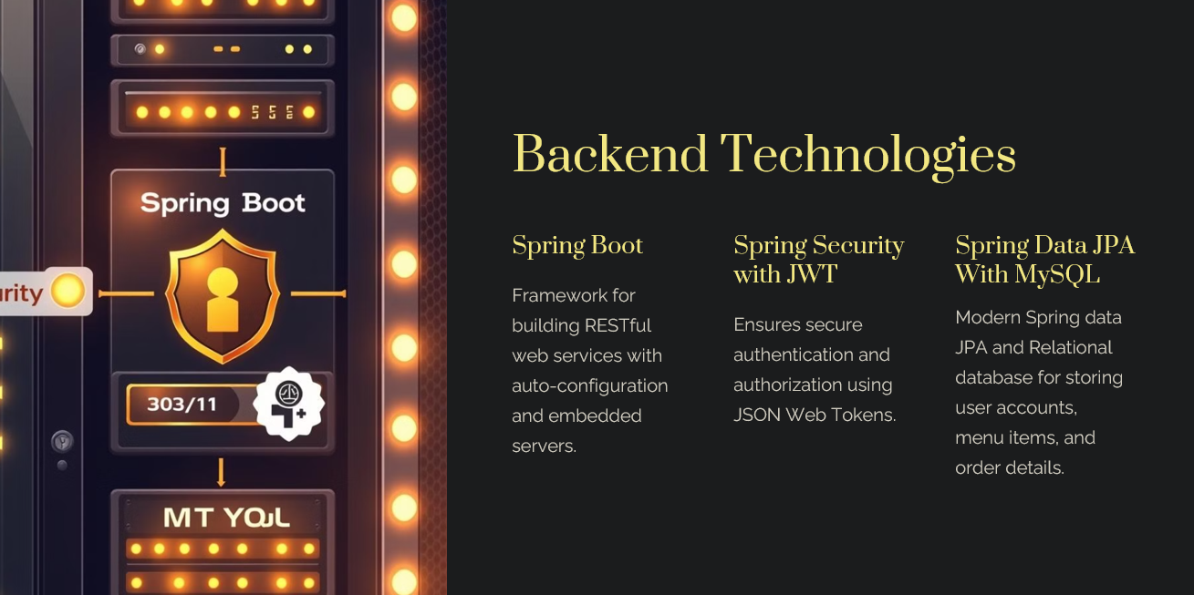

Slide 8
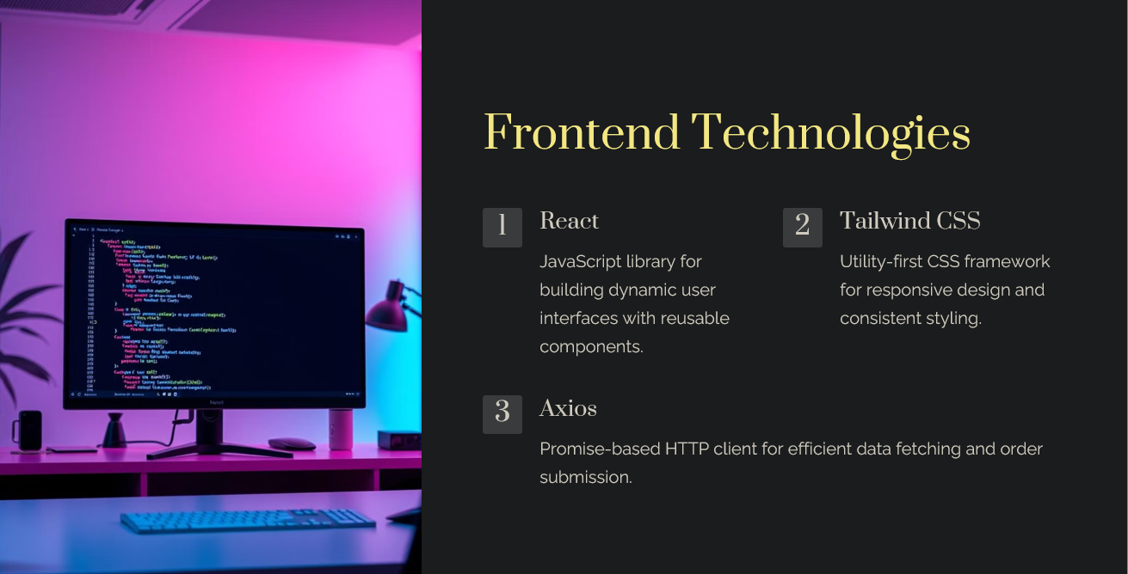

Slide 9
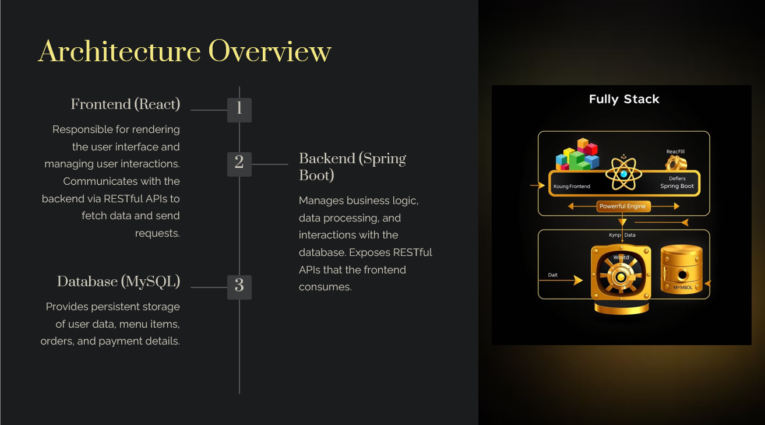

Slide 10
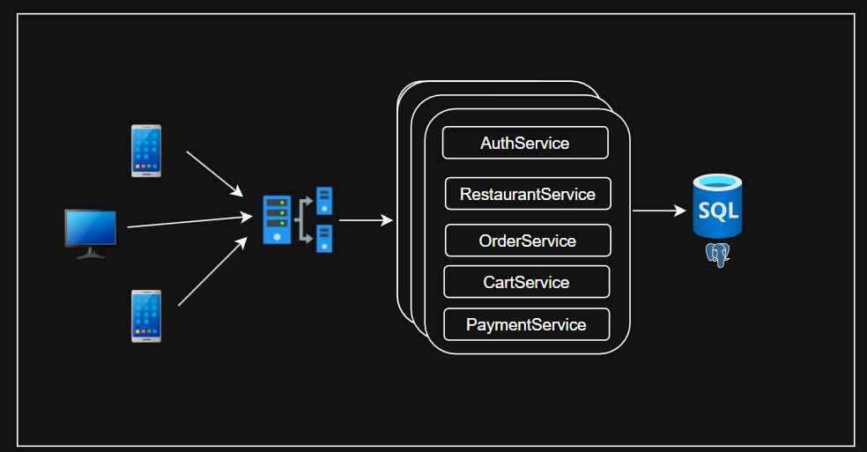
System Desing Overview
This architecture supports web and mobile clients with secure Authentication & Authorization. The UI interacts with an API Gateway, which connects to backend services like User Management, Cart, Orders, and Payments. A MySQL Database ensures data storage. The design ensures scalability and efficiency.

Slide 11
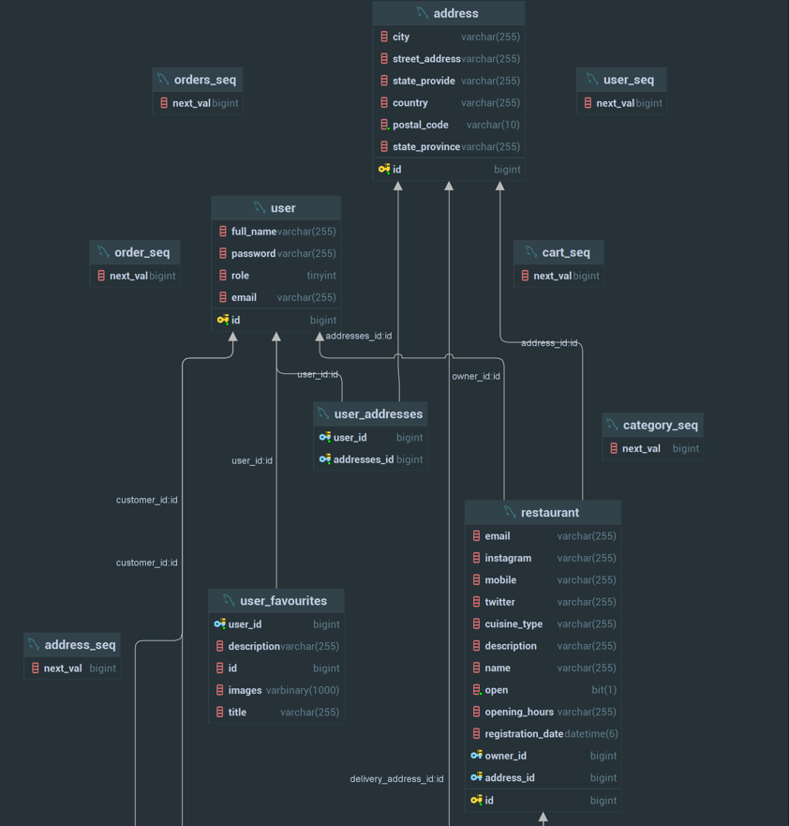
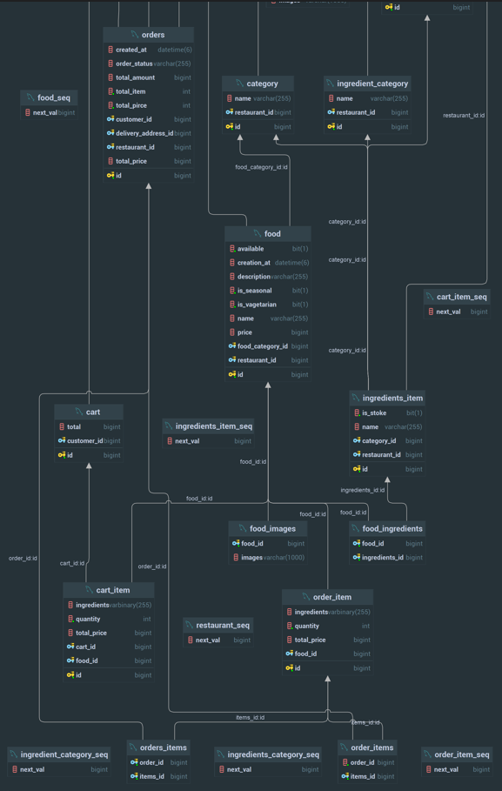
Class Diagram of our Application

Slide 12
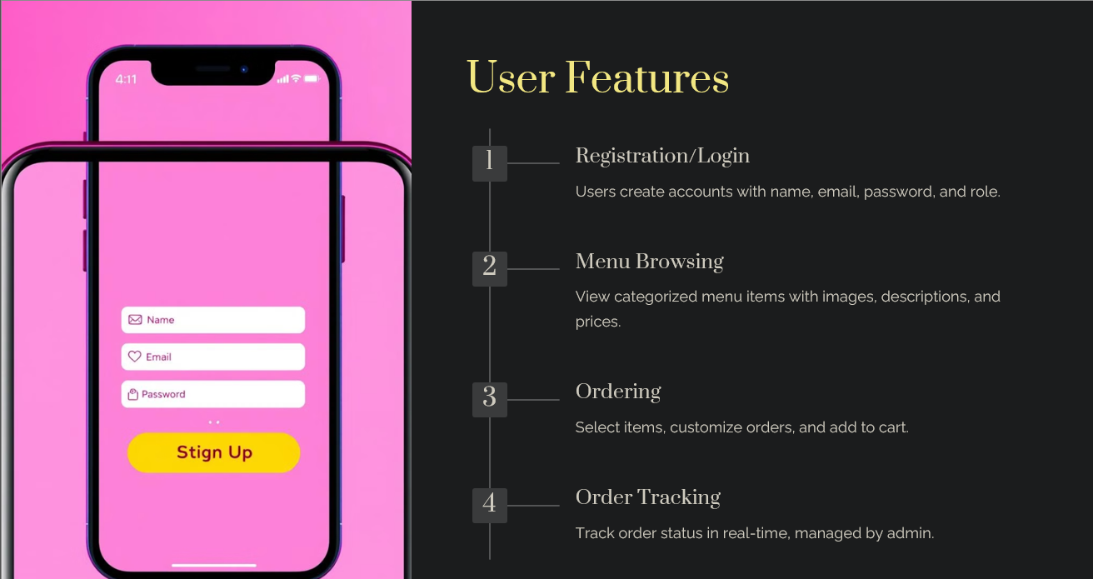

Slide 13
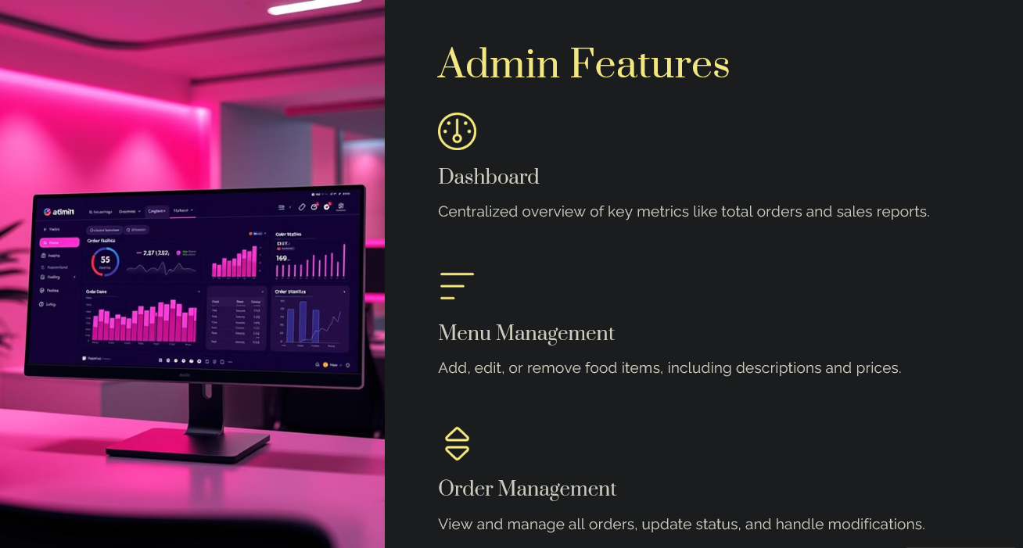

Slide 14
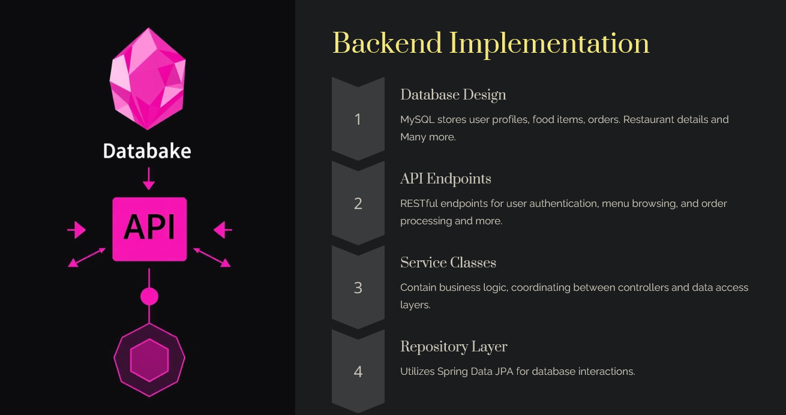

Slide 15
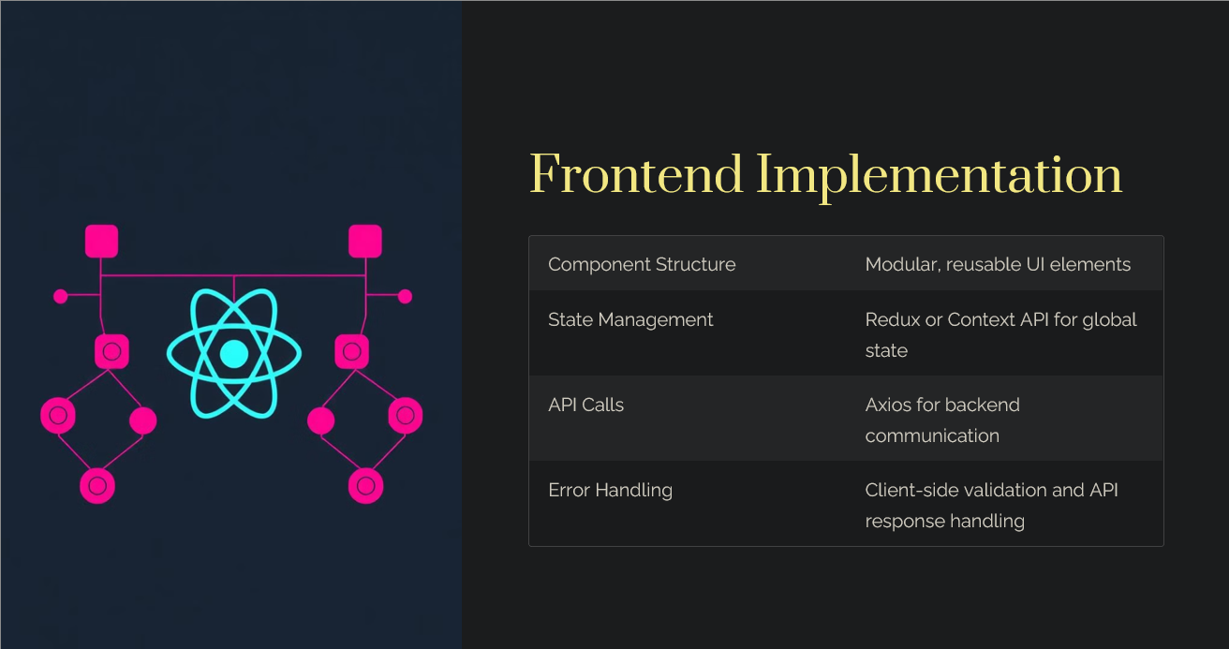

Slide 16
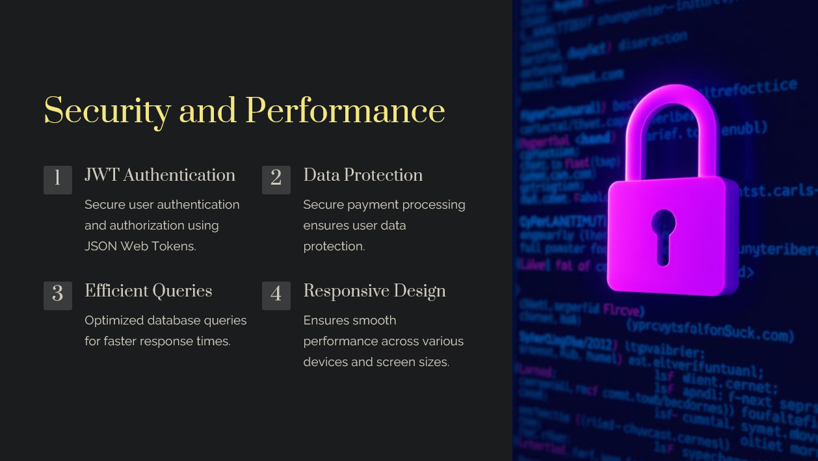

Slide 17
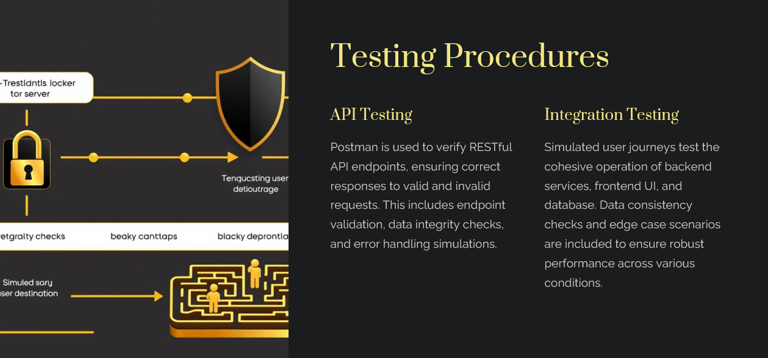

Slide 18
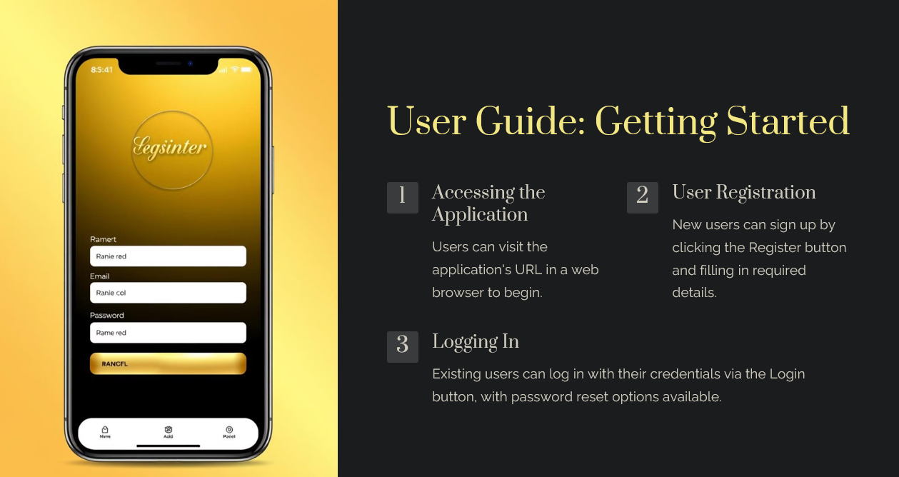

Slide 19
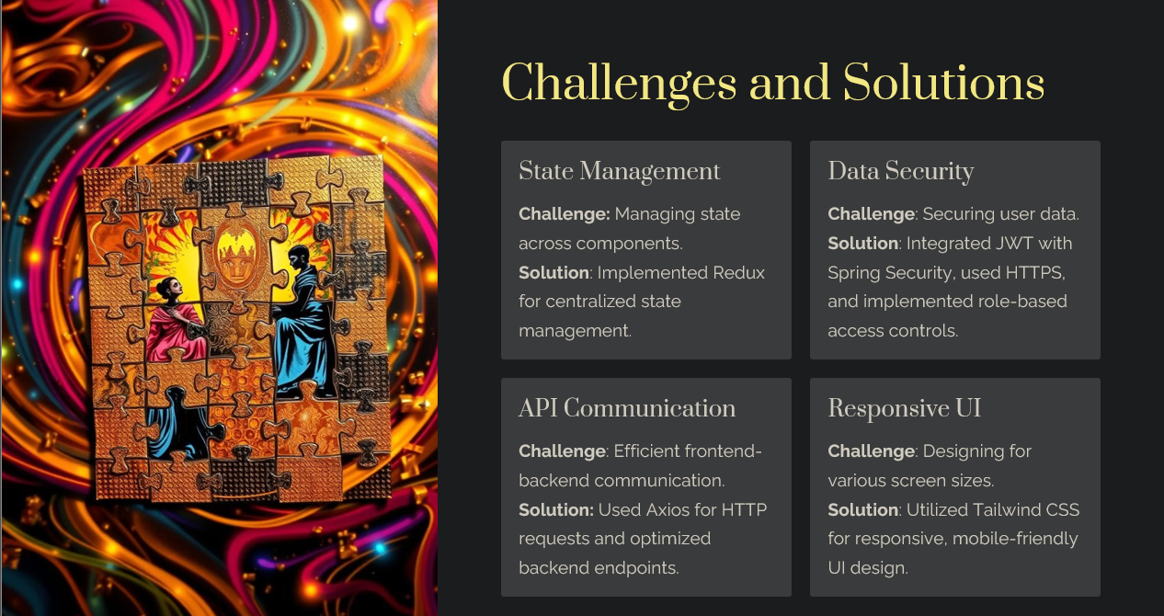

Slide 20
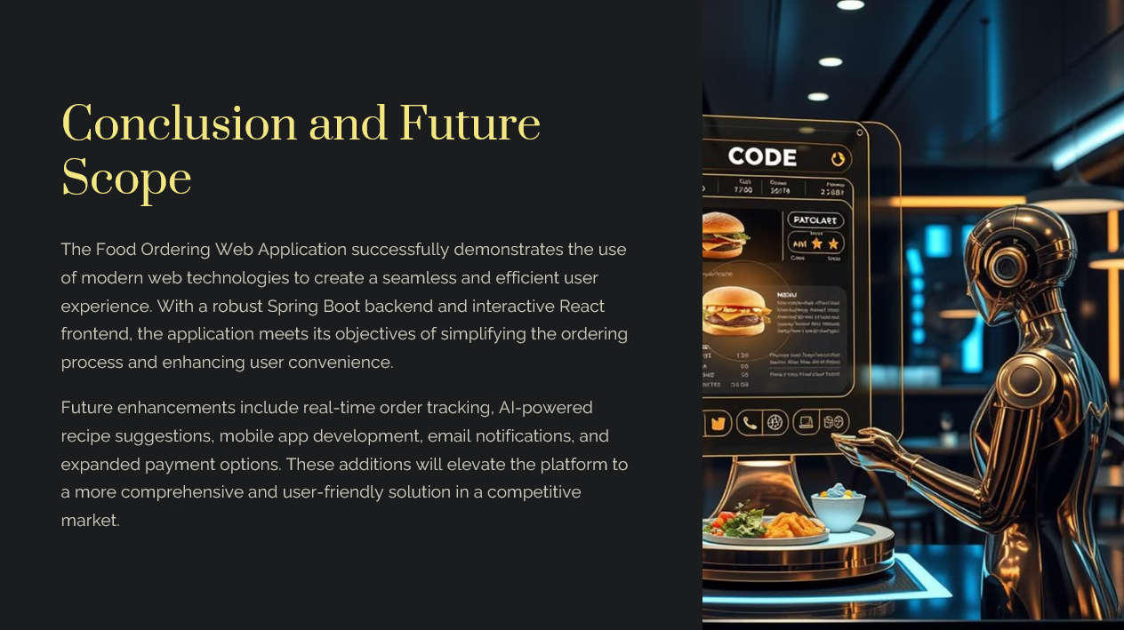

Slide 21
Thank You

