Slide 1
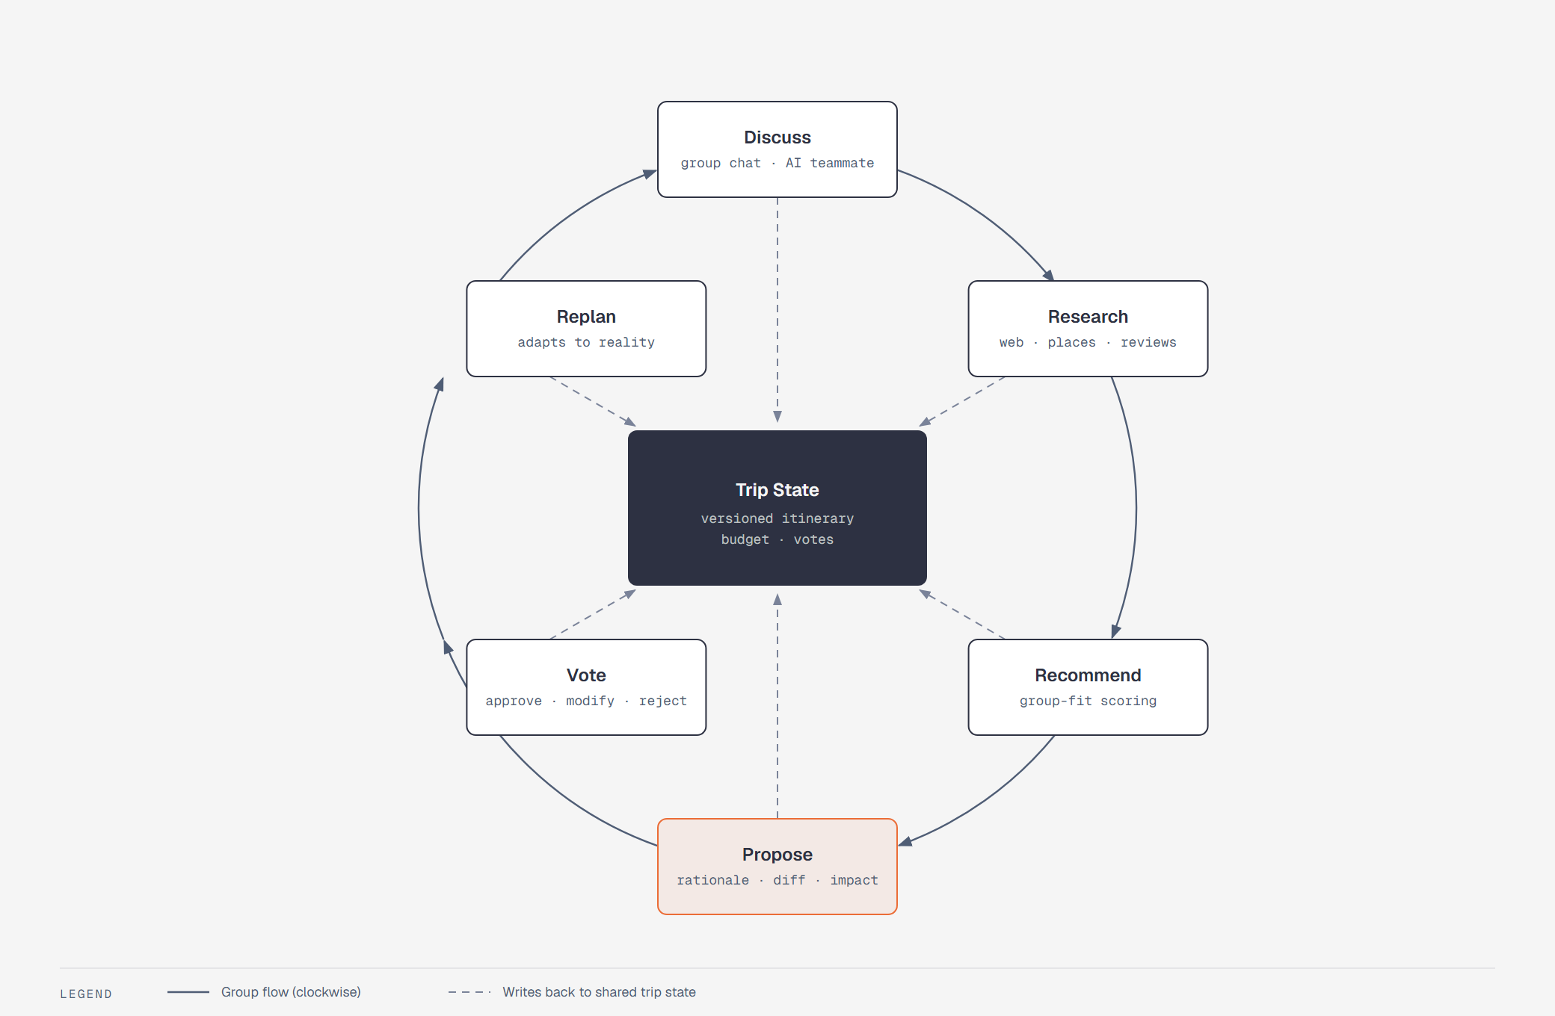
TEAM STUDIFY · HACKATHON VIDEO PITCH
Tripify.
The AI travel teammate that helps groups decide together —
and replans when reality breaks the plan.
The Tripify loop — every change is proposed, voted, and versioned
Tan Sim Po · She Jia Xuan · Chong Wei Xuan
Notes:
[0:00–0:10] Hi — we're Team Studify, and this is Tripify: an AI travel teammate that helps groups plan trips together. In the next four minutes: what it is, what makes it different, a walkthrough of the prototype, and how we'll build it in three weeks.

Slide 2
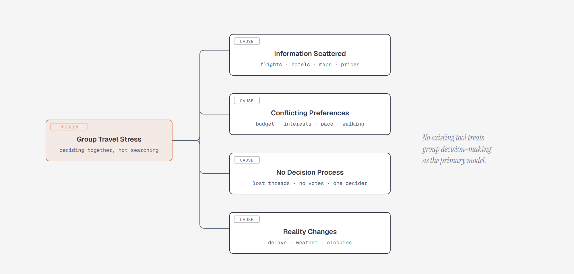
THE PROBLEM
Group travel planning is a decision problem —
not a search problem.
5+
apps to plan one trip — flights, stays, maps, splits, and a WhatsApp group that scrolls into oblivion
0
tools own the group's decision — no proposals, no votes, no shared memory
1
person quietly ends up deciding everything for everyone
Four root causes of group travel stress — from our problem tree
02
Notes:
[0:10–0:40] Planning a group trip was never a search problem — it's a group decision-making problem. Today the research lives across five different apps: flights here, hotels there, the actual debate buried in a WhatsApp group. Everyone has a different budget, a different pace, a different tolerance for walking. And when the group finally agrees, a flight delay or a rainy forecast resets everything. No existing tool owns that decision.

Slide 3
THE SOLUTION
Tripify is an AI teammate — not another itinerary generator
It researches real places, proposes changes with a clear rationale, and replans when reality breaks the plan. And it has one hard rule: it never touches the trip without the group's vote.
01
RESEARCH
Listens in the group chat, then researches real destinations — Google Places, routes, reviews, and the open web.
02
PROPOSE
Turns debate into structured proposals: why it matters, what changes, and the impact — scored for this specific group.
03
REPLAN
Watches weather and delays, detects every affected activity, and proposes backups through the same vote loop.
03
Notes:
[0:40–1:05] Tripify is an AI travel teammate that lives in your group's trip workspace. Three verbs: it researches real destinations, it proposes changes with a clear rationale, and it replans when reality changes. And one rule that never bends: it never modifies the trip without the group's vote.

Slide 4
WHAT'S DIFFERENT
The AI proposes. The group decides. Every change is versioned.
PROPOSAL ≠ CHANGE
Nothing applies to the itinerary without a vote — the AI drives the process, never the outcome.
VERSION CONTROL
Every approved proposal bumps the itinerary to a new version. Stale AI decisions are structurally impossible.
DECISION INTELLIGENCE
A rejected proposal is analysed: the AI reads the objections and returns with a compromise.
04
Notes:
[1:05–1:35] Here's the twist. Most AI travel tools generate an itinerary and hope you like it. Tripify treats trip planning like a pull request. The AI proposes — with the why, the diff, and the impact. The group votes — approve, modify, reject. Every approved change bumps the itinerary to a new version, so nothing is ever stale or silently overwritten. And a 'no' vote isn't a dead end — the AI reads the objections and comes back with a compromise. That loop is the product.

Slide 5
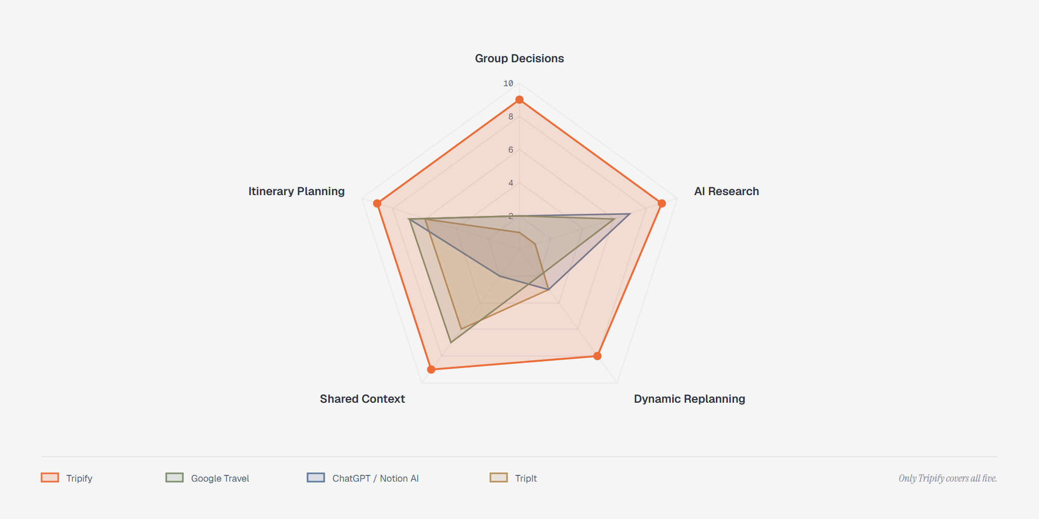
THE GAP
No existing tool treats the group decision as the product
Proposal & vote layer
Borrowed from Linear and GitHub PRs — no travel app has it.
Group-fit scoring
“Is this good for OUR group?” — not generic popularity.
A living itinerary
Detects disruptions and rebases the plan, like version control.
Team scoring across five capabilities (0–10) — Team analysis of existing tools
05
Notes:
[1:35–1:55] That's also the gap. Across group decisions, AI research, shared context, dynamic replanning and itinerary planning, the tools you know each cover one slice. Tripify is the only one that covers all five — because for us the group decision is the product, not a feature.

Slide 6
PROTOTYPE WALKTHROUGH
Four screens, one loop.
A guided tour of the UI prototype — design decisions called out as we go.
01
02
03
04
Dashboard
Recommendation
Proposal & vote
Replanning
the decision workspace
scored for the group
the core screen
the loop closes
06
Notes:
[1:55–2:00] Let me show you the prototype — four screens, walking the loop end to end.

Slide 7
DEMO · 1 — TRIP DASHBOARD
A decision workspace, not a travel portal
Tokyo Trip Oct 20–24 RM4,120 / RM5,000
25 / 45 / 30
ITINERARY
MAP · ROUTE
TRIPMATE AI
The itinerary is the source of truth, the map is context, the AI is a teammate — sized accordingly.
Day 1 Asakusa
Day 2 Shibuya
Day 3 Odaiba
Day 4 Hakone
Day 5 Shopping
“Any ideas for Day 3?”
Researching places near Odaiba…
Decisions surface
Alerts, pending votes, and budget sit in a persistent bar — nothing needs hunting.
Proposal: lighter Day 3
Vote open — 3/4 approved
TeamLab → lunch → cafe → Shibuya
travel times rendered live
SMART ALERT: Rain on Day 3 · PENDING: 1 proposal · ON BUDGET
UI mock — final screens ship as a clickable Figma prototype
07
Notes:
[2:00–2:25] This is the trip dashboard — deliberately a decision workspace, not a travel portal. Three panels: the itinerary on the left is the source of truth; the map in the middle gives context — routes and live travel times; and TripMate, our AI, sits on the right chatting with the group like a teammate. The bottom bar always shows what needs a decision and what's left in the budget.

Slide 8
DEMO · 2 — AI RECOMMENDATIONS
Scored for this group, not for popularity
TEAMLAB BORDERLESS
Five scores, one meaning
91 / 100 · AI recommendation
Group Fit weighs every member's preferences — budget, interests, pace — before popularity is even considered.
Group Fit
94
Experience
92
Risks come with the rec
Every card flags what could go wrong and names a backup activity up front.
Convenience
90
Reliability
91
Cost
78
Grounded in research
✓ 4/4 members interested
✓ Indoor — good for rain
! Crowded after 14:00
Backup: Tokyo National Museum
Best-time windows and crowd notes come from live sources — Places data, reviews, recent posts.
08
Notes:
[2:25–2:45] When someone asks for ideas, recommendations are scored for this specific group — group fit, experience, cost, convenience, reliability. TeamLab scores 91 because all four of us are interested and it's indoor on a rainy day. Every card flags its risks — crowded after two — and ships with a named backup plan.

Slide 9
DEMO · 3 — PROPOSALS & VOTES
Rationale, diff, impact, and the vote — in one view
AI PROPOSAL
Review before merge
Make Day 3 less tiring
Why, diff, and impact are shown before a single itinerary line changes — borrowed from PR review.
WHY Day 3 currently needs ~11.2 km of walking.
CHANGES
TeamLab to 09:30 · drop Shibuya Sky · add a cafe break · shopping to 18:00
No vote, no change
Walking
11.2 km → 6.1 km
Trip state is append-only and versioned; nothing is silently overwritten.
Cost
RM 120 → RM 140
Group fit
82 → 91
A 'no' is a conversation
Alice ✓ Bob ✓ Charlie × David ✓
3 / 4 approve — applied as itinerary v4
The AI analyses why members rejected and returns with a compromise proposal.
Approve
Modify
Reject
09
Notes:
[2:45–3:15] Now the core screen — the proposal card. Day 3 currently needs eleven kilometres of walking, so the AI proposes a lighter day. It shows why, exactly what changes, and the impact: walking drops from 11.2 to 6.1 kilometres, group fit rises from 82 to 91. Members vote right on the card. Three of four approve — and the moment it passes, the itinerary updates as version four. If it's rejected, the AI reads the objections and comes back with a compromise.

Slide 10
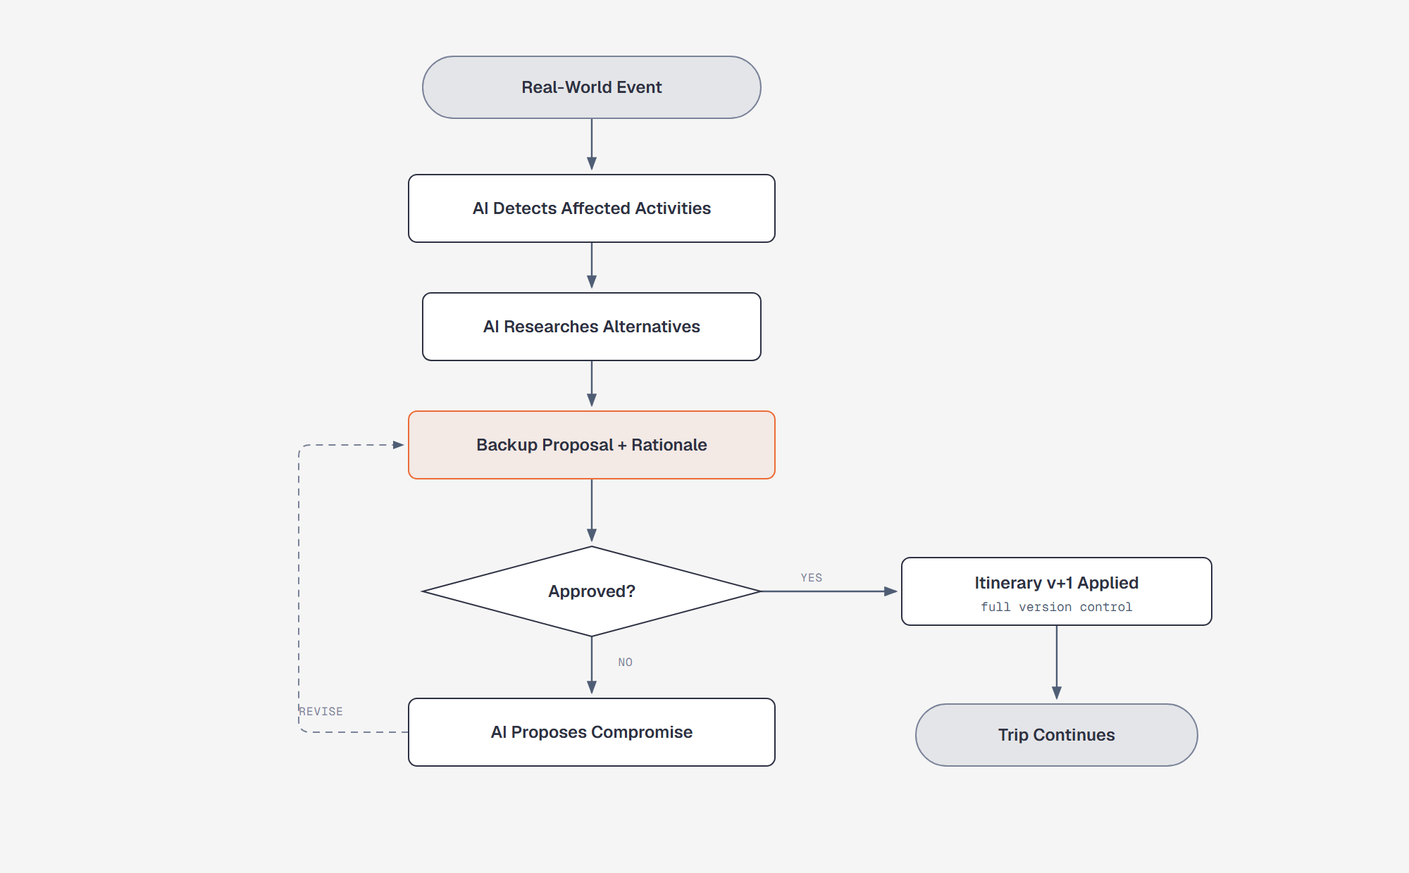
DEMO · 4 — DYNAMIC REPLANNING
When reality breaks the plan, the loop closes itself
Events hit the plan
A delayed flight, rain on Day 3 — triggers land on the live itinerary.
Impact is computed
The AI matches the event against every activity: times, travel legs, weather, opening hours.
Same vote loop
A backup proposal enters the exact same proposal → vote → version flow. Approved means itinerary v+1.
A rejected backup proposal loops back as a compromise — never a dead end
10
Notes:
[3:15–3:35] And when reality breaks the plan — a delayed flight, rain on day three — the AI detects every affected activity, researches alternatives, and drops a backup proposal into the same vote loop. The trip never stalls; it rebases.

Slide 11
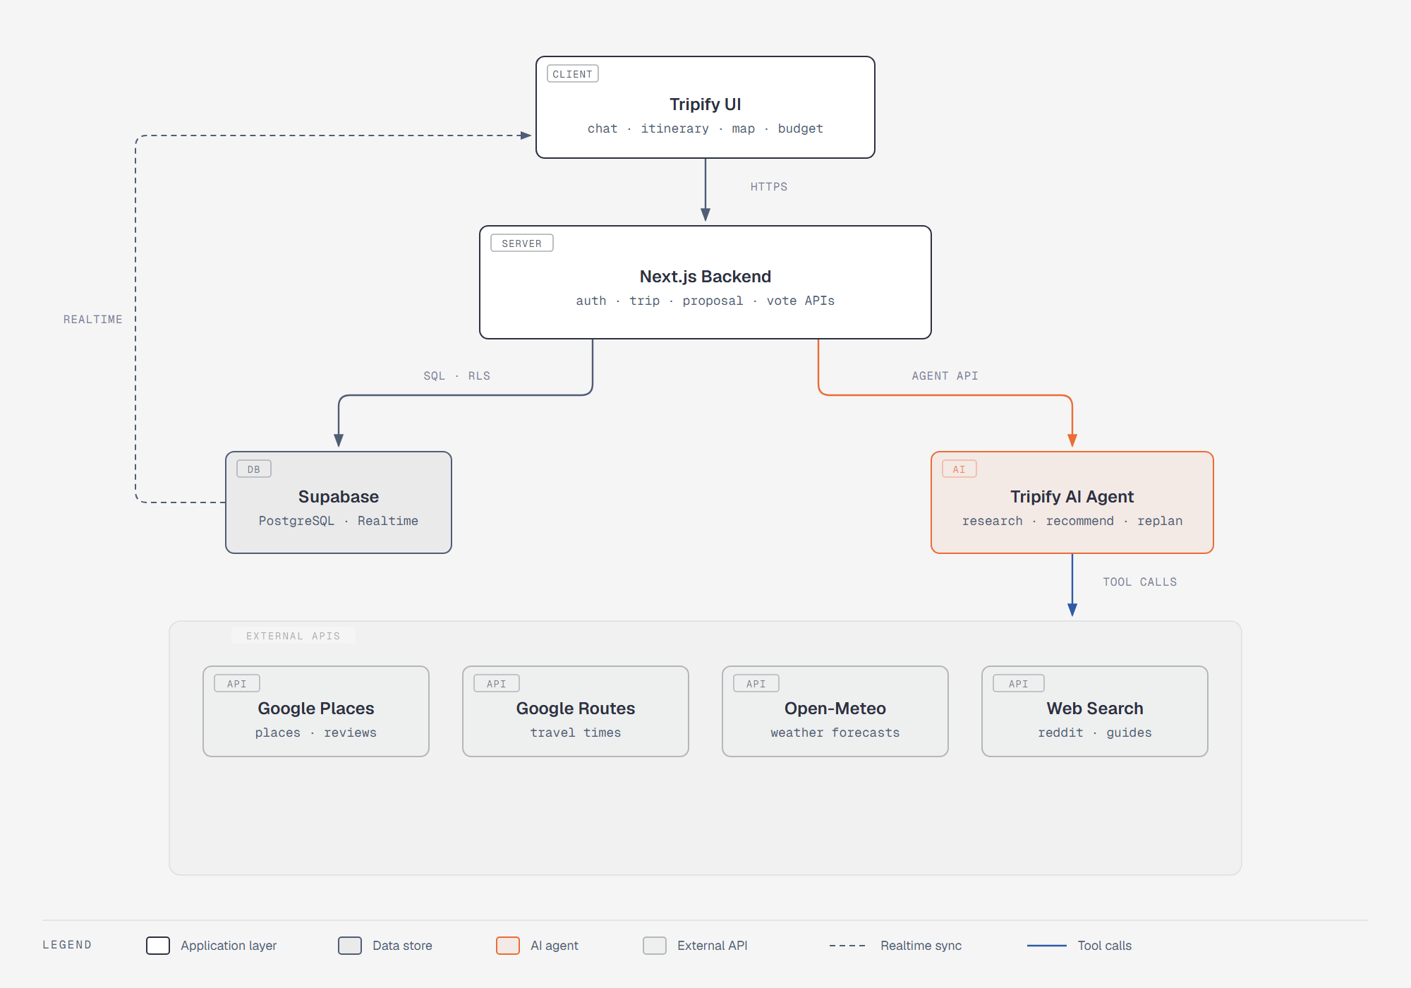
TECH STACK
Deliberately boring technology, so we can build fast
FRONTEND
Next.js 15 · TypeScript · Tailwind · shadcn/ui
BACKEND
Next.js API routes + Server Actions — colocated, zero ops
DATA
Supabase — Postgres, Auth, Realtime, Row Level Security
AI
OpenRouter + LangChain — tool-calling, structured output
SERVICES
Google Places & Routes · Open-Meteo · web search
I18N & HOSTING
next-intl (EN · ZH · MS) · Vercel + Supabase Cloud
11
Notes:
[3:35–3:55] Under the hood we kept the stack deliberately boring so we can build fast: Next.js with TypeScript end to end; Supabase for Postgres, auth, realtime and row-level security; LangChain on OpenRouter for tool-calling; Google Places and Routes plus Open-Meteo for live data; next-intl for three languages from day one; and Vercel plus Supabase Cloud for hosting.

Slide 12
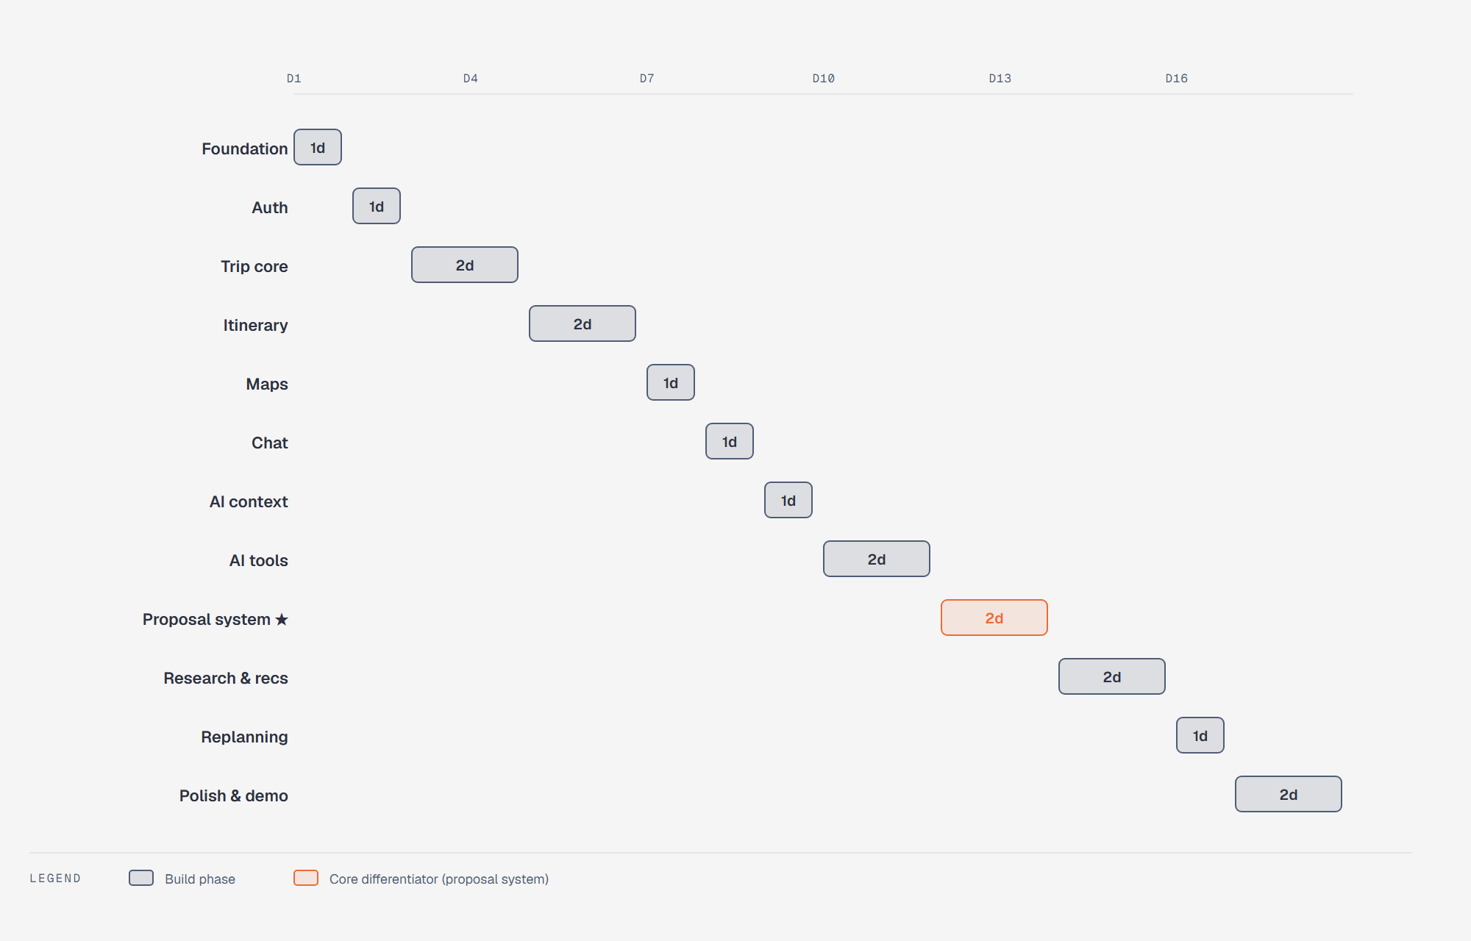
BUILD PLAN — 3 WEEKS
18 days, 12 phases — the proposal system is the critical path
D1–8
Core app — auth, trips, itinerary, maps, chat
D9–11
AI foundation — context builder + 9 agent tools
D12–13
Proposal system — the differentiator, built early
D14–16
Research, recommendations, dynamic replanning
D17–18
Polish — states, mobile layout, demo scenario
12
Notes:
[3:55–4:15] The build is eighteen days across twelve phases. Week one is the core app — trips, itinerary, maps, chat. Then the AI foundation, then the proposal system — our critical path, in orange — then research and replanning, and two full days of polish for the demo.

Slide 13
IMPACT
What concretely changes
No more lost threads — every decision lives with the plan, with a rationale attached
No silent overrides — changes ship only when the group votes — the plan is versioned
Plans that survive reality — replanning is built in, not bolted on after things go wrong
Tripify · Studify — Tan Sim Po · She Jia Xuan · Chong Wei Xuan
Notes:
[4:15–4:30] For a group planning one trip, Tripify means no more lost threads, no silent overrides, and plans that survive contact with reality. Groups don't need another itinerary generator — they need a way to decide together. That's Tripify. Thank you.

