Slide 1
Optimizing Agentic Language Model Inference via Speculative Tool Calls
Nichols, Singhania, Jekel, Bhatele, Menon
Lawrence Livermore National Laboratory & University of Maryland
arXiv: 2512.15834
Motivation › Method › Theory › Results › Discussion
Group Meeting | Presented by [Presenter] | April 2026
Notes:
(~1 min)
• Introduce title, authors, affiliation
• Preview talk structure: Motivation → Method → Theory → Results → Discussion
• Paper from LLNL + UMD, on optimizing agent inference
→ Transition: Let’s start with why tool calls matter.

Slide 2
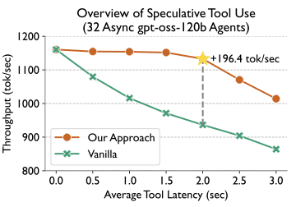
[Motivation] › Method › Theory › Results › Discussion
Tool Calls Are a First-Order Bottleneck
Every tool call forces stop → wait → evict → re-prefill. Agents call 5–20 tools per task; latencies compound.
Idle Wait
Eviction
Accumulation
Tool exec takes 0.5–3 s. Model sits idle.
Sequence evicted from batch. Must re-prefill on return.
5–20 sequential calls. Latencies stack up.
Up to 196 tok/s improvement with speculative tool calls across 32 concurrent agents.
Notes:
(~2 min)
• Tool calls interrupt inference: stop, wait, evict, re-prefill
• Three cards: idle wait (0.5–3s), eviction overhead, accumulation (5–20 calls)
• Bottom figure: headline result (196 tok/s improvement)
→ Transition: Let’s look at the standard pipeline to see where the bottleneck sits.

Slide 3
[Motivation] › Method › Theory › Results › Discussion
The Standard Tool-Calling Cycle
One full cycle per tool call. The WAIT phase dominates.
Prefill
Decode
Emit Tool Tokens
WAIT: Tool Runs
Re-prefill
Decode
→
→
→
→
→
0.5–3 s idle per call. Model evicted from batch.
This cycle repeats 5–20× per task. What if we start tool execution before the model requests it?
Notes:
(~1.5 min)
• Walk through the 6-phase timeline left to right
• Emphasize WAIT (red box): 0.5–3s idle, model evicted
• Takeaway: this repeats many times per task
→ Transition: What partial solutions exist, and what gap remains?

Slide 4
[Motivation] › Method › Theory › Results › Discussion
Prior Work & the Gap
Existing methods reduce round-trips but cannot hide tool-wait time.
Parallel Tool Calls
Prefix Caching
Fewer round-trips, but needs training and can’t help sequential deps.
Reuses KV-cache, but eviction overhead remains under contention.
This Paper’s Key Insight
Use a small model to predict the next tool call before the main model finishes. Launch it immediately → overlap tool exec with generation. Correct → zero wait. Wrong → no worse than baseline.
Notes:
(~1.5 min)
• Parallel tool calls: fewer trips, needs training, sequential deps unsolved
• Prefix caching: reuses KV, but eviction overhead stays
• Green box: this paper’s core idea — speculate the tool call early
• Note: spec decoding overlaps ms-level tokens; this overlaps s-level tools
→ Transition: How does the client-side algorithm work?

Slide 5
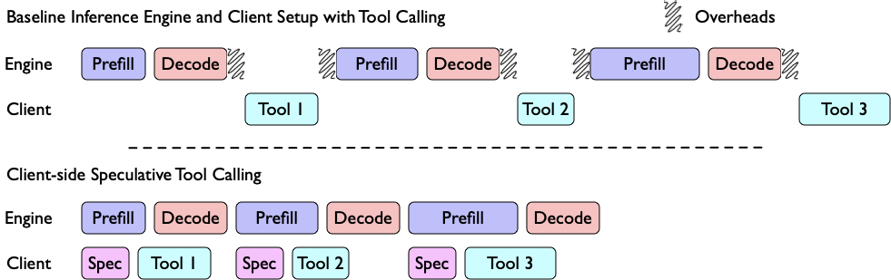
Motivation › [Method] › Theory › Results › Discussion
Client-side: Zero Engine Changes
Send prompt to M and S in parallel. S predicts the tool; it runs while M generates.
• S returns first → tool launched early
• M returns → cache hit: reuse; miss: run
• λ parallel samples boost hit rate
S returns first, launches the predicted tool. M agrees → result already cached, saving 0.5–3 s.
No engine changes needed. Gains come from launching predicted tools early.
Notes:
(~2 min)
• Walk through the figure: dual dispatch to M and S
• S is smaller/faster, returns first → tool starts immediately
• M returns → cache check: hit = reuse, miss = run normally
• λ parallel samples: 1B@9× ≈ 8B@1× in hit rate
→ Transition: The engine-side adds three more optimizations on top.

Slide 6
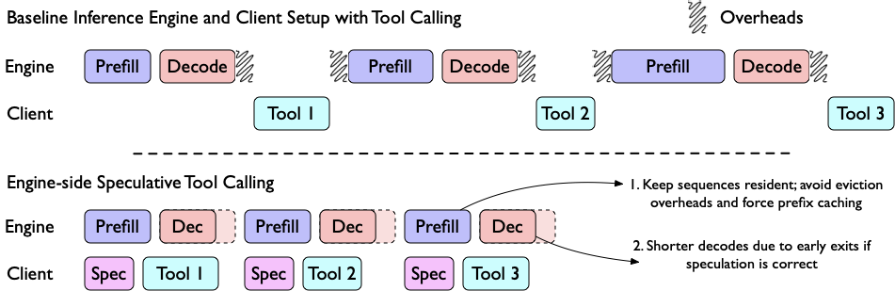
Motivation › [Method] › Theory › Results › Discussion
Engine-side: Avoid Eviction Entirely
Three optimizations: speculate + early-exit decode + inject result into KV-cache.
O1 Speculate
Same as client-side: overlap tool exec with gen.
O2 Early Exit
Cached tool call → validate in one forward pass.
O3 No Eviction
Append result to KV-cache. No re-prefill needed.
Tool result injected directly into KV-cache, skipping re-prefill — adds 2–3% on top of client-side.
Notes:
(~2 min)
• O1: same speculative launch as client-side
• O2: inject cached tool-call tokens as draft, validate in 1 pass (skip decode)
• O3: append tool output to KV-cache in-place (no evict, no re-prefill)
• Requires vLLM engine modification (fork)
• Proposed API: POST /cache-tool-output/{response_id}
→ Transition: When do these extra optimizations actually help?

Slide 7
Motivation › [Method] › Theory › Results › Discussion
When Does Engine-side Help?
O2 and O3 help only when the tool finishes before the model stops reasoning. Fast tools + long reasoning = ideal regime.
Works Well
No Extra Benefit
• Short tools: ls, search, file read (0–1 s execution)
• Long reasoning traces (o1-style models: many tokens)
• Tool finishes while model is still thinking
• Long tools: DB queries, builds (>3 s execution)
• Short reasoning traces (model finishes before tool)
• Result arrives too late for O2/O3 to help
Key condition: tool time < reasoning time. Modern reasoning models make this true for most common tools.
Notes:
(~1.5 min)
• Plain-language condition: tool must finish before model stops reasoning
• Left: fast tools (ls, search) + long reasoning = ideal
• Right: slow tools or short reasoning = no extra gain from O2/O3
• Formally: Tᵢ < δRᵢ (tool time < decode time for reasoning)
→ Transition: Now let’s look at the theoretical speedup bound.

Slide 8
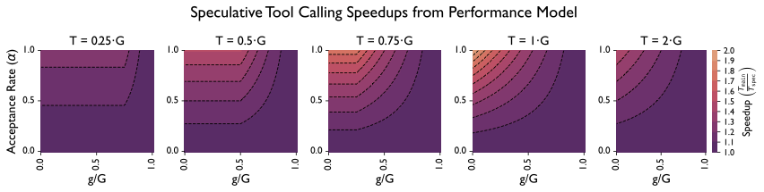
Motivation › Method › [Theory] › Results › Discussion
Speedup Bound: Strictly Below 2×
You can only hide one phase at a time. If tool time ≈ gen time, you approach 2× — but never reach it.
Client-side speedup
Lemma
S = (G + T) / [α · max{G, g+T} + (1−α)(G+T)]
S < 2 (strictly)
▸ G = how long M takes to generate
▸ g = how long S takes (much shorter)
▸ T = how long the tool takes to run
▸ α = how often S predicts correctly
▸ Best when T ≈ G
▸ Needs α > 0, g < G
▸ Proof: Appendix A
Speedup peaks near 1.8× at T≈G, α>0.5 — the <2× bound is tight.
Notes:
(~2 min)
• Start with intuition: can only hide one of two phases
• Point to formula briefly — each symbol has a verbal label
• Lemma: S < 2 strictly. Best at T≈G, proof in appendix
• Heatmap confirms: practical peak ~1.8×
→ Transition: Let’s see if experiments match the theory.

Slide 9
Motivation › Method › Theory › [Results] › Discussion
Experimental Setup
120B reasoning model + xLAM speculative models, BFCL benchmark.
Models & Workload
What We Measure
• Main model: gpt-oss-120b
• Spec models: xLAM-2 {1B, 3B, 8B} (~80% acc)
• BFCL benchmark, controlled tool latencies, {1, 8, 32} agents
• Throughput: tok/s per agent
• Time Saved: % reduction vs no-speculation baseline
• Cost: extra $ per 100 turns (commercial API pricing)
3 configs compared: baseline, client-side speculation, engine-side speculation.
Notes:
(~1 min)
• Quick overview: 120B main + xLAM spec on 4×A100
• BFCL benchmark with pre-computed tool outputs
• Three metrics: throughput, time saved, cost
• Backup detail: λ={1,3,5,7,9}, latency short 0–0.5s / long 0–3s, 5 runs/config
→ Transition: Client-side results first.

Slide 10
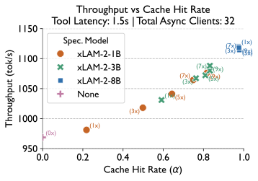
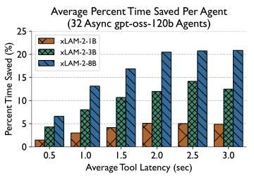
Motivation › Method › Theory › [Results] › Discussion
Client-side Results
6–21% end-to-end time saved. Sweet spot: tool time ≈ gen time.
Higher acceptance rate → higher throughput. 8B best; 1B@9× approaches it.
32 agents: savings peak at T≈2–2.5 s (≈G). Even short tools yield 6%.
Results match theory: best when T ≈ G. Parallel sampling is cost-effective.
Notes:
(~2 min)
• Left: throughput vs acceptance rate — 8B best, 1B@9× close
• Right: time saved vs tool latency (32 agents) — peak at T≈2–2.5s
• Even short tools (0.5s) give 6% savings
• Theory and experiment match perfectly — a paper highlight
→ Transition: What does this cost in real money?

Slide 11
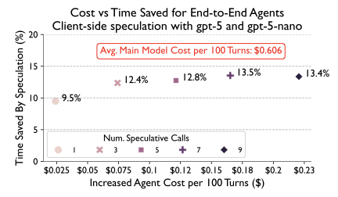
Motivation › Method › Theory › [Results] › Discussion
Cost: Cheap Speculation, Real Savings
λ=1 speculation: ~10% time saved for only ~4% extra cost.
λ = 1 (best ratio)
~10% time saved ~4% cost increase
λ = 9 (diminishing)
Marginal extra savings 25–30% cost increase
gpt-5 + gpt-5-nano: λ=1 is the sweet spot. Beyond λ=3, cost rises 25–30% with marginal gain.
Notes:
(~1.5 min)
• λ=1 (one speculative sample) is the sweet spot
• 10% time saved for 4% cost — easy sell for production
• λ=9: diminishing returns, 25–30% cost increase
• Fits prefix-cache discount pricing naturally
→ Transition: How much more does engine-side add?

Slide 12
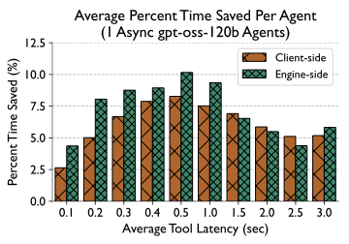
Motivation › Method › Theory › [Results] › Discussion
Engine-side Results
Additional 2–3% on top of client-side for short tools. Combined: 8–24%.
• Best: fast tools (ls, search, read)
• Tested batch=1 (vLLM limitation)
1 agent, xLAM-8B: engine-side adds 2–3% for 0–1 s tools. No benefit for long tools — result arrives too late.
Main gains come from client-side. Engine-side is a meaningful add-on for short tools.
Notes:
(~1 min)
• Figure: client vs engine-side, engine adds 2–3% for short tools
• Long tools: no extra benefit (result arrives after decode)
• Only tested batch=1 due to vLLM spec-dec overhead
• Combined total: 8–24% per agent turn
→ Transition: Let’s step back and evaluate the contribution.

Slide 13
Motivation › Method › Theory › Results › [Discussion]
What This Paper Does Well
A strong, deployable contribution with solid theoretical grounding.
• Client-side works with ANY API today — zero changes, immediate deployment. This is the headline contribution.
• Tight theoretical bound (S < 2×) verified by experiments. Theory and results match — rare and valuable.
• Practical cost analysis on real commercial APIs: 10% time saved for 4% extra cost. Easy sell for production.
Notes:
(~1 min)
• Three strengths, lead with the practical one: deploy today
• Theory-experiment match is a standout quality
• Cost analysis makes this actionable, not just theoretical
• Also: clean API design (one POST endpoint) — mention verbally if asked
→ Transition: What are the key limitations?

Slide 14
Motivation › Method › Theory › Results › [Discussion]
Key Limitations
The main restriction: only works for stateless, cheap tools.
• Stateless tools only — no file writes, DB updates, or state mutation. Wrong speculation can’t be undone.
• Client-side speedup bounded at <2×. This is fundamental, not an artifact — you can only hide one phase.
• Engine-side tested at batch=1 only; simulated tool latencies. Unclear how it scales under real multi-tenant load.
Notes:
(~1 min)
• Three limitations, lead with the most important: stateless only
• <2× bound is fundamental (not fixable)
• Engine-side maturity: batch=1, simulated tools
• Also: no multi-tool sequential evaluation — mention verbally if asked
→ Transition: Some open questions for discussion.

Slide 15
Motivation › Method › Theory › Results › [Discussion]
Discussion
Open questions for our group:
Can speculation compose with parallel tool calling?
Would speedups stack, or do they target the same latency?
Does 80% accuracy hold on custom internal tools?
BFCL is standard; production toolsets may differ sharply.
Could transactional rollback extend this to stateful tools?
The paper restricts to stateless — what if wrong calls are reversible?
These are my questions — not claims from the paper.
Notes:
(~3 min)
• Q1: parallel tool calls + speculation — additive or redundant?
• Q2: real-world accuracy beyond BFCL benchmarks
• Q3: transactional rollback for stateful extension
• Backup Q4 (if time): connection to our spec-decoding work
• Give the group time to discuss each — this is the most valuable part
→ Transition: Let me wrap up with a quick summary.

Slide 16
Motivation › Method › Theory › Results › [Discussion]
Summary
Use a small model to predict tool calls early. Cheap, effective, and deployable today.
→ Client-side: 6–21% time saved, zero API changes
→ Engine-side: +2–3% for short tools via KV-cache injection
→ Theory: speedup < 2×; sweet spot at T ≈ G
→ Cost: λ=1 gives ~10% savings at ~4% extra cost
Notes:
(~1 min)
• Headline: small model predicts tools early — cheap and effective
• Four key takeaways, read if needed or just land the headline
• If time remains: proposed /cache-tool-output/ API for providers
→ Transition: Thank you — questions?

Slide 17
Thank You!
Questions & Discussion
Paper: arXiv 2512.15834 Nichols et al. — LLNL & University of Maryland
─── Backup slides follow ───
Notes:
(~0.5 min)
• Thank the audience
• Open for questions
• Backup slides available if deep questions arise

Slide 18
APPENDIX
Why S < 2 (Proof Sketch)
Backup for Q&A
S = (G + T) / [α · max{G, g+T} + (1−α)(G+T)]
• At α=1, g→0⁺: S → (G+T) / max{G, T}
• If G ≥ T: S → 1 + T/G ≤ 2 (equality only at T = G)
• If T > G: S → 1 + G/T < 2 (since G < T)
• Since g > 0, denominator is strictly larger → S < 2. □
Intuition: you can hide at most one phase. The other always remains.
Notes:
(Backup) Proof sketch for Q&A.
• Four steps: definition → limit → case analysis → strict inequality
• Key insight: can only overlap one of G or T, never both
• Full proof in paper Section 4, Lemma 1

Slide 19
APPENDIX
Engine-side Runtime Model
Backup for Q&A
Baseline
T = 2Ko + φ(prefill) + δΣ(Rᵢ+tᵢ) + Σ Tᵢ
overhead + prefill + decode + tool wait
With speculation (α = acceptance rate)
T* = (1−α)·2Ko + φ(prefill) + δ(αK+ΣRᵢ+(1−α)Σtᵢ) + (1−α)ΣTᵢ
At α=1: saves all overhead + decode savings + all tool wait
Optimal: Tᵢ < δRᵢ — tool finishes before reasoning ends.
Notes:
(Backup) Engine-side runtime for deep questions.
• Symbols: o=API overhead, φ=prefill rate, δ=decode rate
• Rᵢ=reasoning tokens, tᵢ=tool call tokens, Tᵢ=tool exec time
• At α=1: saves 2Ko + δ(Σtᵢ-K) + ΣTᵢ
• Prefill cost unchanged (φ term stays)
• Modern reasoning models have long Rᵢ → Tᵢ<δRᵢ for most tools

