Slide 1
Analysis of Coffee Café night
Submitted by- Baijayanti Chakraborty

Slide 2

Agenda
Exploratory Data Analysis
Trend Analysis
Market Basket Analysis :- General Recommendations

Slide 3
Overview
Exploratory Analysis of data & an executive summary of your top findings, supported by graphs.
What kind of trends do you notice in terms of consumer behavior over different times of the day and different days of the week?
Can you give concrete recommendations based on the same?
Are there certain menu items that can be taken off the menu?
Are there trends across months that you are able to notice?
Identify the most popular combos that can be suggested to the restaurant chain after a thorough analysis of the most commonly occurring sets of menu items in the customer orders. The restaurant doesn’t have any combo meals. Can you suggest the best combo meals?

Slide 4
Exploratory Data Analysis

Slide 5
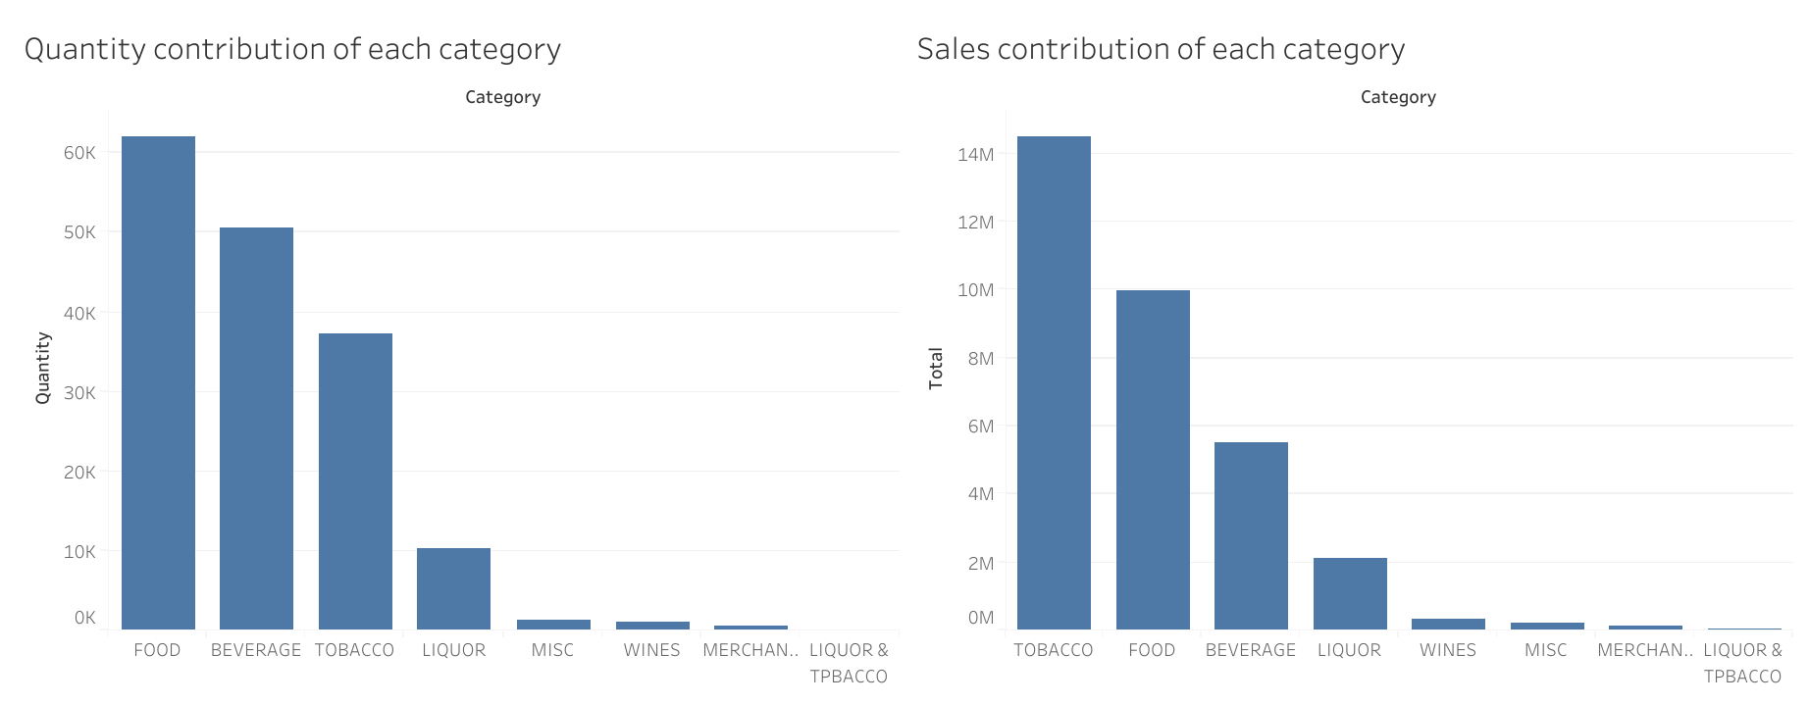
Quantity and Sales for each category
Food has the highest quantity but Sales contribution is highest of Tobacco.

Slide 6
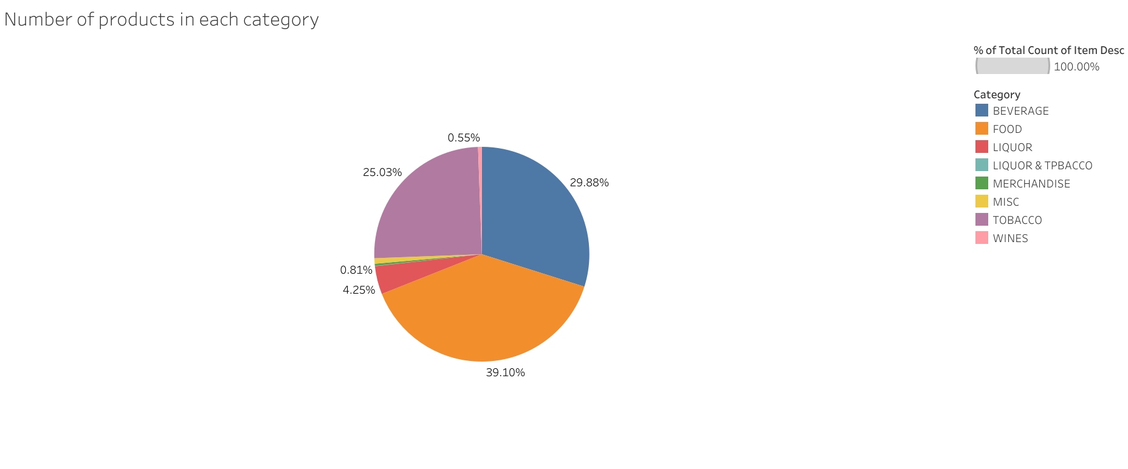
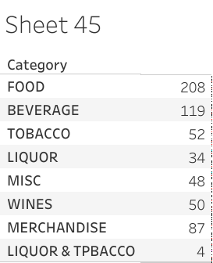
Product percentage for each category

Slide 7
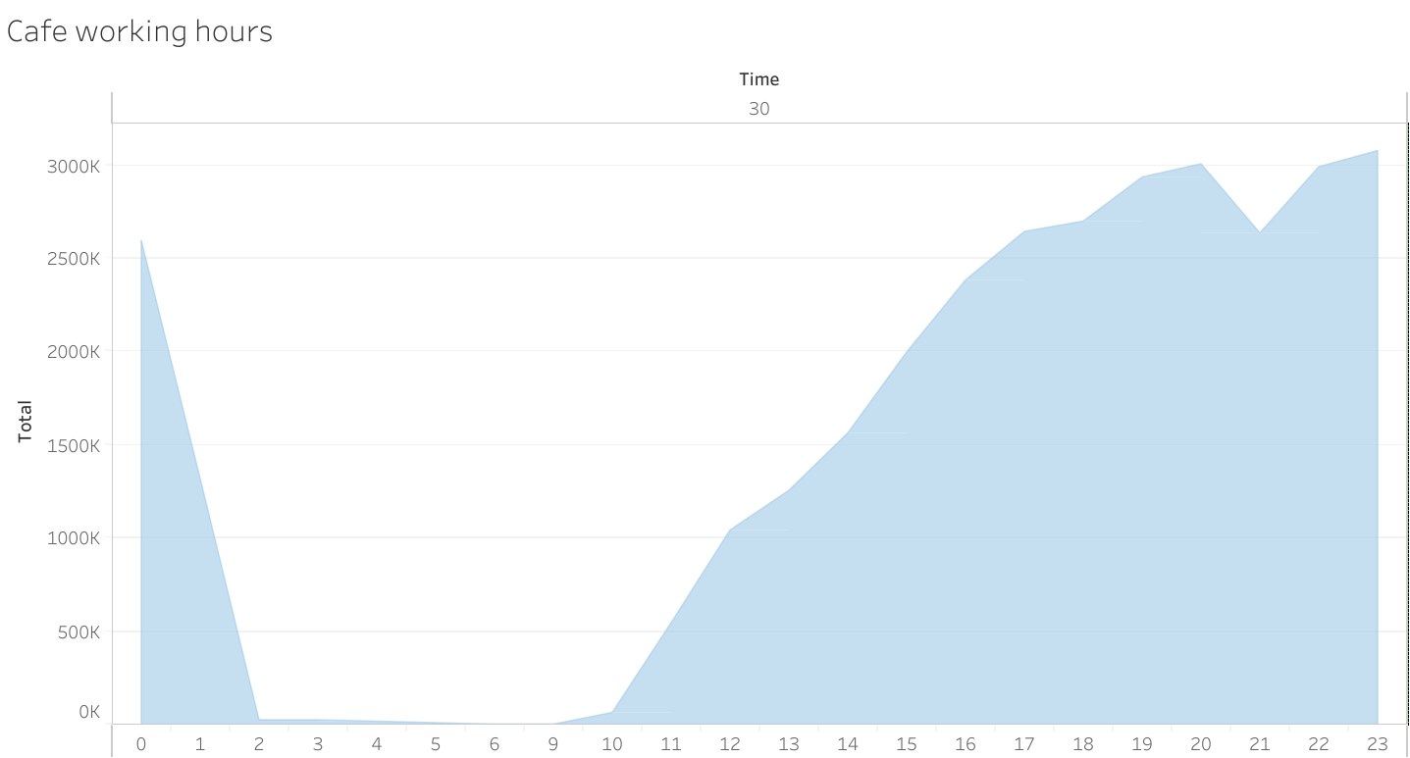
Daily sales distribution

Slide 8
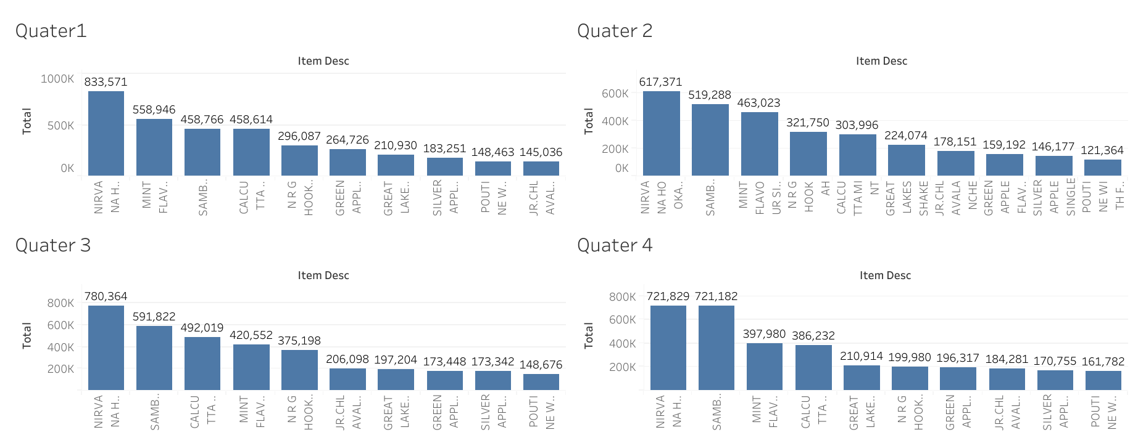
Trend :- Quarter wise.

Slide 9
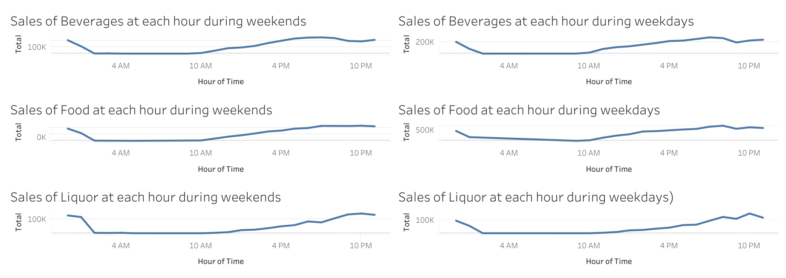
TREND :- WEEKDAY VS WEEKEND
Beverages has an upward trend after 12 noon in all the 7 days which comes down slightly at 7-8 PM and then goes up.
Food has one of highest sales which can be shown in both weekends and weekdays.
Liquor tends to go on a higher side on weekends after 6 PM.

Slide 10
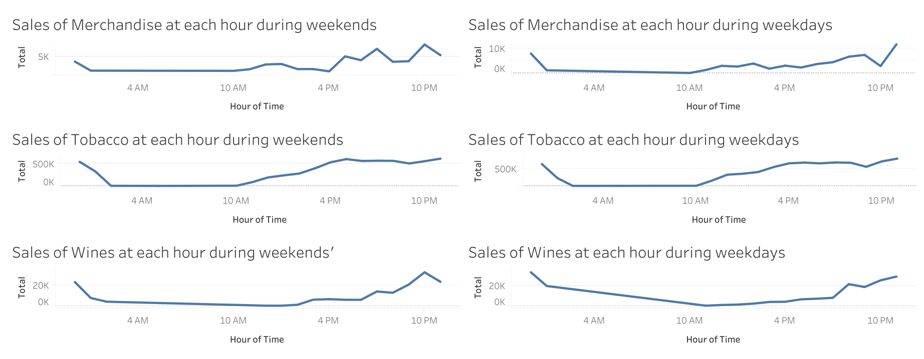
Weekdays/Weekends Hourly Trends
Merchandise has high sales in weekdays during the evening time at around 4-8 PM.
Tobacco has comparatively very high sales in the evening at around 10 PM which considerably increases in weekends.
Similarly to tobacco, Wines have a good sale during night at around 10 PM.

Slide 11
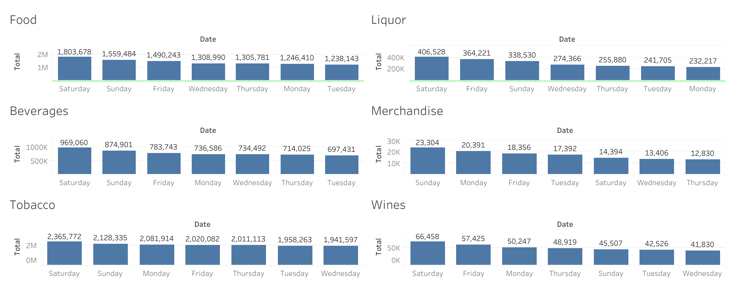
Weekdays/Weekends Categorical Distribution
Saturday is the most productive day for the café
Tobacco and Food holds the major sale of all the categories

Slide 12
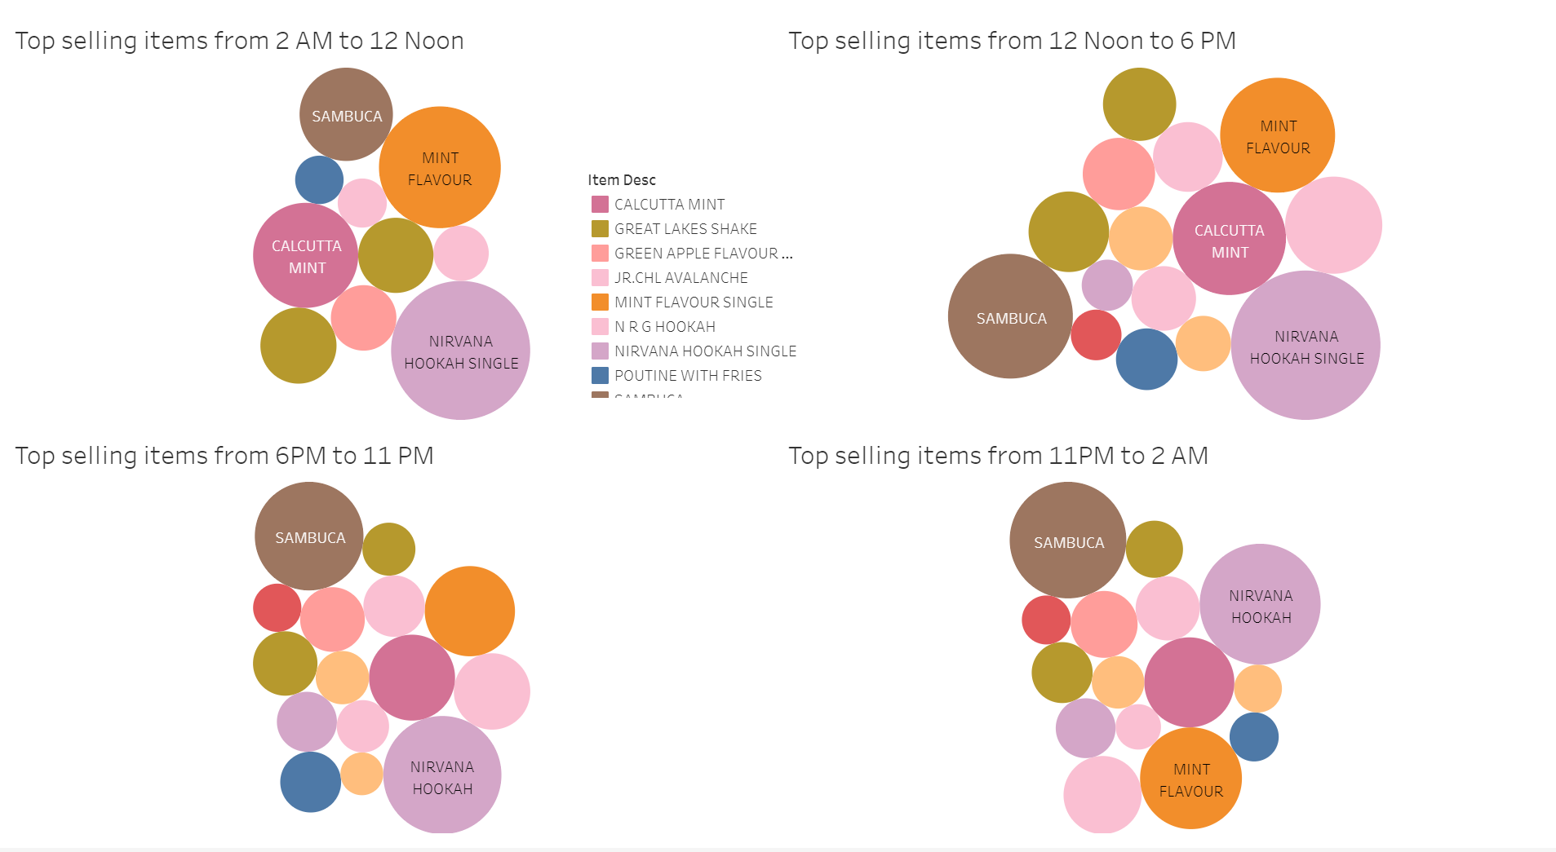
Top selling items in different hours

Slide 13
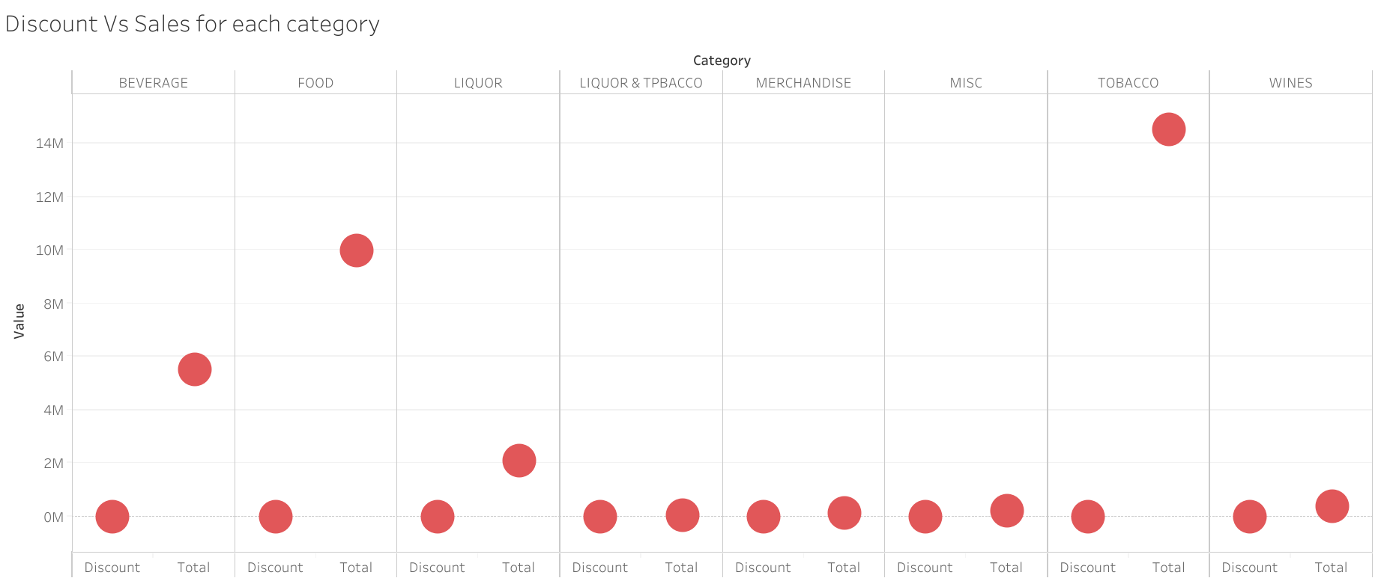
Discount Vs Sales for each category

Slide 14
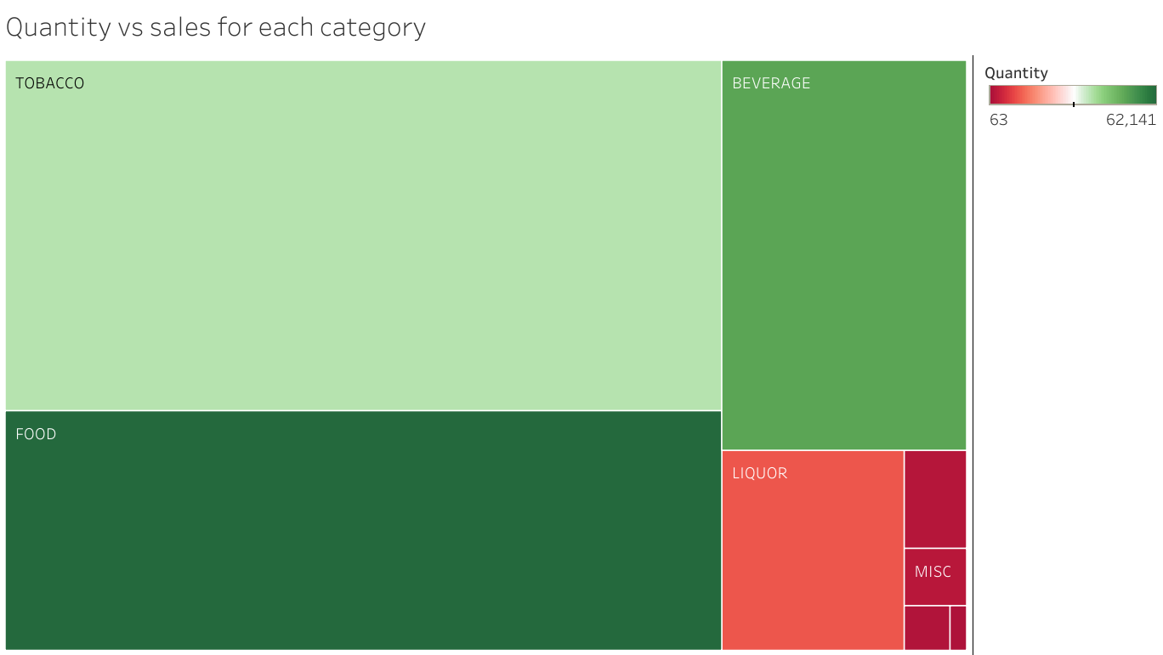
Quantity Vs Sales for each category

Slide 15
Summary
The café starts at 10 AM and closes at 2 AM.
Food and Beverages items sells more but Tobacco has higher contribution towards total sales. This also means tobacco has higher rates and is sold frequently.
NIRVANA HOOKAH SINGLE is the highest contributor towards sales among all the items followed by SAMBUCA.
Saturday is the most productive day for the café

Slide 16
Recommendations on different trends
Beverages have an increase in sales on weekends along with Food and Liquor as compared to Weekdays.
We can provide happy hours in weekdays for working people so that they can come to the café for lunch or after their working hours
Also we can provide fancy coupons on weekdays so that people who usually work from home can avail onto.
Combos of food and beverages/liquors could be a good idea in the evening for people who likes to chill after office hours.
We can also include some merchandise in discounts in weekdays as weekday collection is less than weekends.
We can lower the prices of Food and Beverages items who are not doing good to increase their sales from 12 noon to 6 PM.

Slide 17
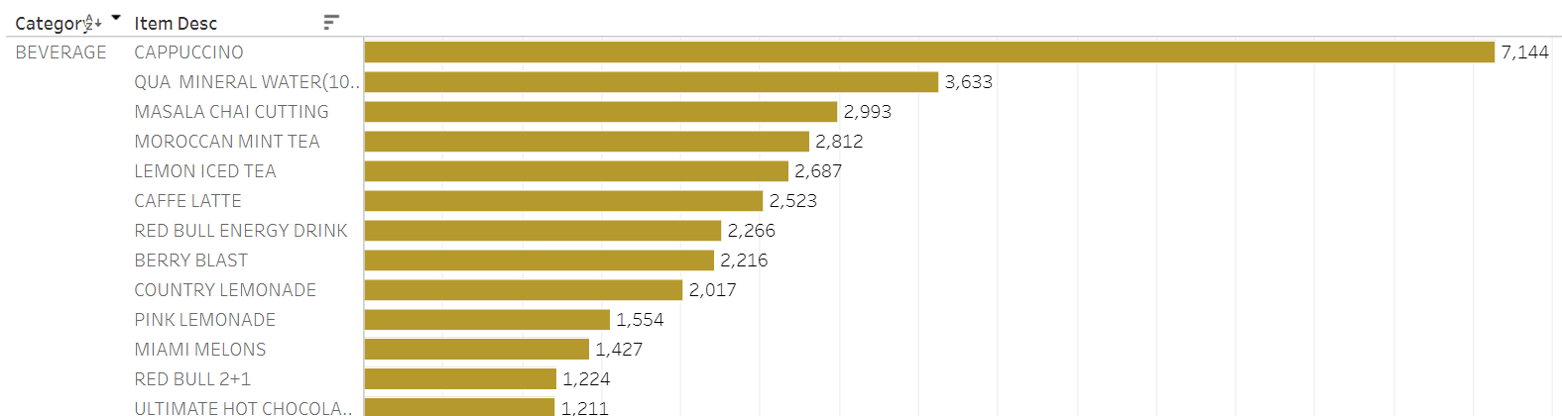
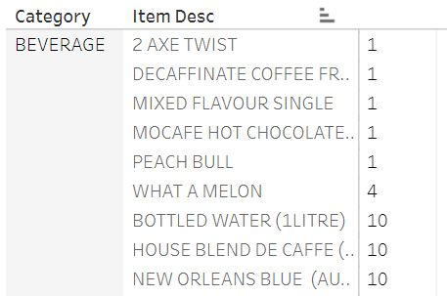
Best And Worst performing Beverages Items
The top few items can be sold without any discounts or as a part any coupons or combos as they are gold items and are doing very well.
The last 6 worst performers can be dropped off the menu as beverages requires expensive raw material.

Slide 18
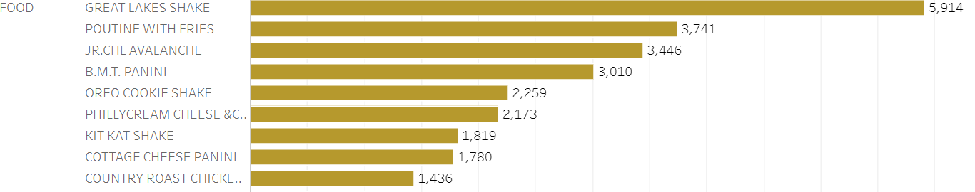
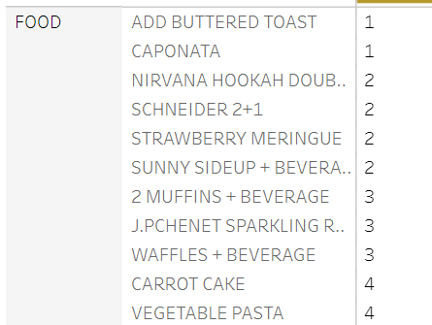
Best And Worst performing Food Items
Fries is the 2nd best item. It can clubbed with Burger combos to increase its sales.
Shakes which are average performers can also be clubbed with pastas and other food items which are under performing.
I would not recommend you to wipe out the least performing Food items as food never go out of fashion.
As suggested above, we can club the best performing food items to the least ones to get the best out of them.

Slide 19
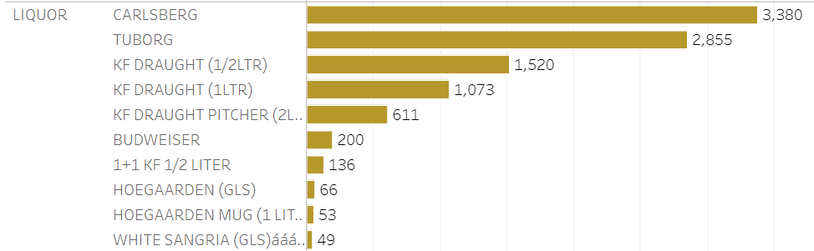
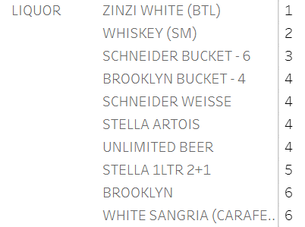
Best And Worst performing Liquor Items
We can slightly increase the prices of top 5 liquor items as they are doing considerably well.
In Liquor, apart from high performing items, majority are performing average. We can combine these into 1+1 offer in may be day time to increase the sales.
In night, we can take a leaf out of Bar Stock Exchange’s book to fluctuate the prices of the items to make sales of low performing liquor items.

Slide 20
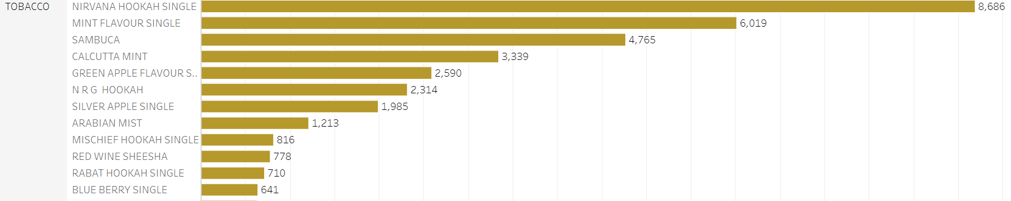
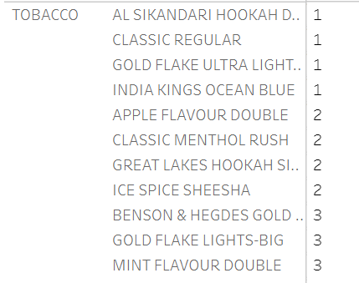
Best And Worst performing Tobacco Items
Tobacco contributes the highest in terms of sales in the café. The 5th-10th ranked items can be combined in the package with liquor or beverages to make them gold items.
The lower items can be removed from the menu as they generally comes as expensive. And that money can be used in marketing the medium performing items.

Slide 21
Market Basket Analysis Results

Slide 22
Items that are frequently clubbed | Frequency | Confidence
Café Latte with Vanilla, Irish cream, caramel, cinnamon and hazelnut flavor | 20 times | 60%
Kheema ghotala with toast butter | 115 times | 50%
Salgon noodles with chicken | 950 times | 40%
Cappuccino with hazelnut or whipped cream | 5 times | 40%
Red bull, Maggie noodles arrabiata with Sambuca | 8 times | 50%
Red bull with N.R.G Hookah | 25 times | 80%
Fries, masala chai with B.M.T. Panini | 11 times | 40%
Vanilla ice cream with mocha shake | 5 times | 40%

Slide 23
My Recommendations

Slide 24
Saturday is the most productive day for the café. We should target weekdays to improve sales by introducing attractive deals, combos and coupons.
Merchandise can be sold at discounted price during weekdays and off season like buy 2 get 1 scheme.
To increase the morning sales, we can include breakfast items in the menu.
The least performing food items can be combined with High performing Liquors to increase sales.
We can also combine all the good items like hookah food, beverages or liquor to further increase their performance.

Slide 25
My Combo Suggestions
Combo 1 :- Any Panini with Any Ice tea
Combo 2 :- Chicken Salami Panini with Eng Breakfast Tea
Combo 3 :- Any chicken panini with Moroccan Mint tea
Combo 4 :- Any Panini with BUDWEISER, CARLSBERG, KF DRAUGHT (1/2LTR), STELLA ARTOIS, or TUBORG

Slide 26
Thank You!

