Slide 1


Bunch-to-Bucket (B2B)
Transfer System for FAIR
Jiaoni Bai
Thibault Ferrand
23.05.2016
May 23, 2016 | GSI | CSCO & PBRF | Jiaoni Bai & Thibault Ferrand | <number>

Slide 2
Outlines
Introduction (Bai)
Kicker and bucket pattern (Bai)
B2B transfer procedure (Bai)
Synchronization methods (Bai)
Example: U²⁸⁺ B2B transfer from SIS18 to SIS100 (Bai)
Functional implementation (Thibault)
Task sharing (Thibault)
Functional specification and requirements (Thibault)
May 23, 2016 | GSI | CSCO & PBRF | Jiaoni Bai & Thibault Ferrand | <number>

Slide 3
Introduction
Bucket : a bucket defines the potential
well in (E_{kin},t) - phase space, where
the particles can be trapped.
Bunch : a bunch defines the packet of
particles gathered within a bucket.
Focus mainly on the B2B transfer from SIS18 to SIS100
Firstly tested in B2B transfer from ESR to CRYRING
May 23, 2016 | GSI | CSCO & PBRF | Jiaoni Bai & Thibault Ferrand | <number>

Slide 4
Kicker & Bucket pattern
Assumption:
Virtual cavity is located at the extraction/injection kicker position.
There is no distance between two virtual cavities.
Bucket #1 and #2
U²⁸⁺
SIS100
#2
SIS18
#1
~1
# 1
SIS18 revolution
frequency marker @SIS18
time
SIS100 revolution frequency marker @SIS18
Extraction Kick
time
SIS100 revolution frequency marker @SIS100
Injection Kick
time
May 23, 2016 | GSI | CSCO & PBRF | Jiaoni Bai & Thibault Ferrand | <number>

Slide 5
Kicker & Bucket pattern
#2
#3
#4
Consideration:
1. Bucket pattern (#3 and #4)
#1
# 1
SIS18 revolution
frequency marker @SIS18
time
SIS100 revolution frequency marker @SIS18
1
Extraction Kick
time
1
SIS100 revolution frequency marker @SIS100
Injection Kick
time
May 23, 2016 | GSI | CSCO & PBRF | Jiaoni Bai & Thibault Ferrand | <number>

Slide 6
Kicker & Bucket pattern
Consideration:
1. Bucket pattern (#3 and #4)
2. Time Of Flight (TOF)
TOF
SIS18 revolution
frequency marker @SIS18
# 1
TOF
time
SIS100 revolution frequency marker @SIS18
2
1
TOF
time
1
Extraction Kick
2
SIS100 revolution frequency marker @SIS100
Injection Kick
time
May 23, 2016 | GSI | CSCO & PBRF | Jiaoni Bai & Thibault Ferrand | <number>

Slide 7
Kicker & Bucket pattern
Consideration:
1. Bucket pattern (#3 and #4)
2. Time Of Flight (TOF)
3. Distance between virtual cavity and extraction/injection kicker position (t_{src} and t_{trg} )
tsrc
TOF
ttrg
# 1
SIS18 revolution
frequency marker @SIS18
t_{src}+TOF+t_{trg}
time
SIS100 revolution frequency marker @SIS18
3
2
1
t_{trg}
TOF
time
Extraction Kick
1
3
2
SIS100 revolution frequency marker @SIS100
t_{trg}
Injection Kick
time
May 23, 2016 | GSI | CSCO & PBRF | Jiaoni Bai & Thibault Ferrand | <number>

Slide 8
Kicker & Bucket pattern
Consideration:
1. Bucket pattern (#3 and #4)
2. Time Of Flight (TOF)
3. Distance between virtual cavity and transport line (t_{src} and t_{trg} )
4. Extraction and injection kicker delay (Dext and Dinj)
tsrc
TOF
ttrg
# 1
t_{src}+TOF+t_{trg}
SIS18 revolution
frequency marker @SIS18
time
SIS100 revolution frequency marker @SIS18
4
3
2
1
t_{trg}
TOF
time
Extraction Kick
1
3
2
SIS100 revolution frequency marker @SIS100
4
t_{trg}
Injection Kick
time
May 23, 2016 | GSI | CSCO & PBRF | Jiaoni Bai & Thibault Ferrand | <number>

Slide 9
Procedure for the B2B transfer system
Supply
room
SIS100
Cavity input signal
Virtual
cavity
SIS18
Virtual
cavity
Location at the ring corresponding to Group DDS reference rf signals
1. Synchronization window calculation
EVT_START_B2B
Phase
prediction
1
Synchronization window
B2B Status
check
time
SIS18
Ext kick
Phase info from
SIS100 to SIS18
Synch window from
SIS18 to WR network
Extract kick info
B2B status
Beam injection ts
WR network
Inject kick info
Phase
prediction
Synchronization window
SIS100
Inj kick
May 23, 2016 | GSI | CSCO & PBRF | Jiaoni Bai & Thibault Ferrand | <number>

Slide 10
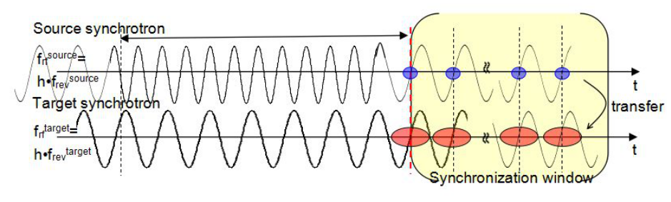
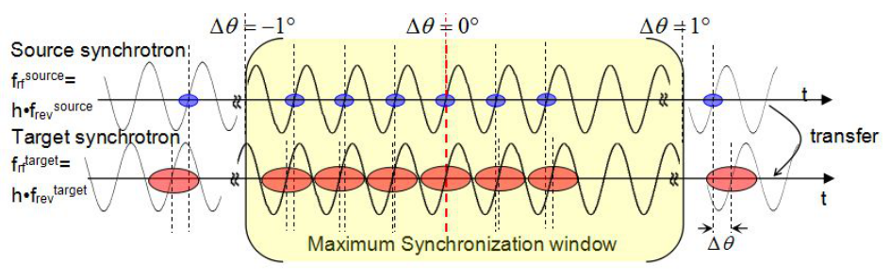
Synchronization methods
Phase shift method
Synchronization window
Features
Adiabaticity
Infinite synchronization window
B2B transfer time is predictable
Phase jump
Frequency beating method
Features
Bunch and bucket center Mismatch
Mismatch within the synchronization window is better than 1°
Only choice for some pair of machines
Automatically beating
Bunch
Bucket
May 23, 2016 | GSI | CSCO & PBRF | Jiaoni Bai & Thibault Ferrand | <number>

Slide 11
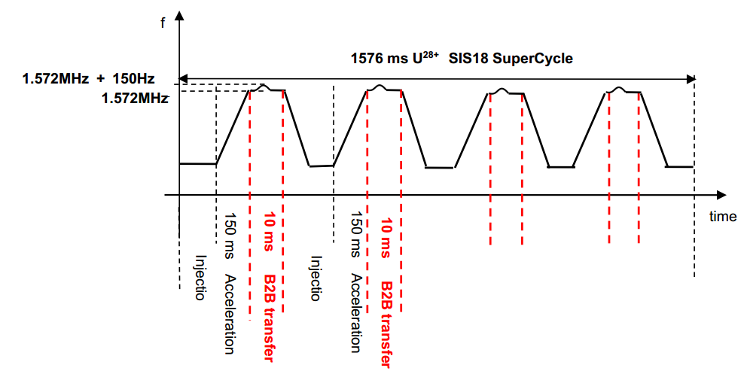
Example: U²⁸⁺ B2B from SIS18 to SIS100 with the phase shift method
From SIS18, four batches of the U²⁸⁺ at 200 MeV/u, each of two bunches,
are injected into eight out of ten buckets of SIS100.
U²⁸⁺ | SIS18 | SIS100
Energy | 200Mev/u | 200Mev/u
Circumference | 216.72 m | 1083.6m
Ratio | 5
Cavity frequency | 1.572MHz | 1.572MHz
h | 2 | 10
Phase shift | Parabola modulation for SIS18 Max 64Hz/ms Offset 150Hz 7ms for phase shift 180°
SIS18
Synchronization window
Phase
prediction
1
B2B Status
check
time
WR network
Ext kick
Phase info from
SIS100 to SIS18
Synch window from
SIS18 to WR network
Extract kick info
B2B status
Beam injection ts
Inject kick info
SIS100
Synchronization window
Phase
prediction
Inj kick
May 23, 2016 | GSI | CSCO & PBRF | Jiaoni Bai & Thibault Ferrand | <number>

Slide 12
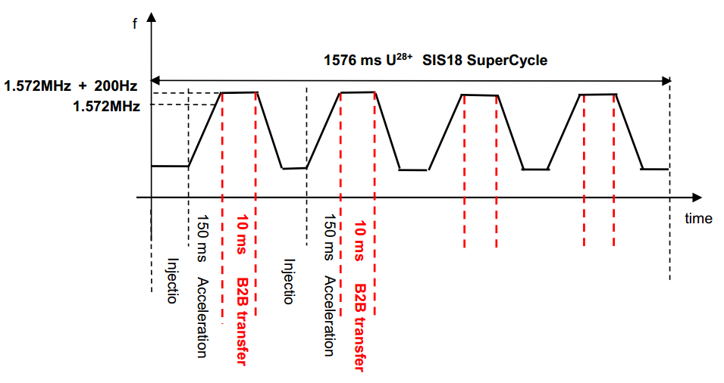
Example: U²⁸⁺B2B from SIS18 to SIS100 with the frequency beating method
U²⁸⁺ | SIS18 | SIS100
Energy | 200Mev/u | 200Mev/u
Circumference | 216.72 m | 1083.6m
Ratio | 5
Cavity frequency | 1.572MHz | 1.572MHz
h | 2 | 10
Frequency beating | Detune 200Hz for SIS18 Beating period 5 ms Bunch and bucket center mismatch ± 0.46°
SIS18
Synchronization window
Phase
prediction
1
B2B Status
check
time
WR network
Ext kick
Phase info from
SIS100 to SIS18
Synch window from
SIS18 to WR network
Extract kick info
B2B status
Beam injection ts
Inject kick info
SIS100
Synchronization window
Phase
prediction
Inj kick
May 23, 2016 | GSI | CSCO & PBRF | Jiaoni Bai & Thibault Ferrand | <number>

Slide 13
Functional specification and implementation
May 23, 2016 | GSI | CSCO & PBRF | Jiaoni Bai & Thibault Ferrand | <number>

Slide 14
Functional specification and implementation
EVT_START_B2B
Kicker electronics
EVT_B2B_STATUS
SIS18
SIS18 Trigger SCU
Trigger decision
Phase correction
Signal reproduction
SIS18
Ref SCU
Group DDS
SIS18 B2B SCU
Phase advance prediction
1. Phase measurement & Prediction
Phase correction
400us ~ 1ms
Signal reproduction
Phase shift
WR network
Kicker electronics
SIS100
SIS100 Trigger SCU
Trigger decision
Phase correction
Signal reproduction
SIS100
Ref SCU
Group DDS
SIS100 B2B SCU
Phase advance prediction
1. Phase measurement & Prediction
May 23, 2016 | GSI | CSCO & PBRF | Jiaoni Bai & Thibault Ferrand | <number>
Phase correction
Signal reproduction
Time
Phase shift

Slide 15
Functional specification and implementation
SIS18
RF Supply Room
B2B
SCU
PAP
PSM
PCM
SR
OSA
Switch
Matrix
REF
SCU
Gp DDS
rf1
Gp DDS
rf2
Gp DDS
rf3
Gp DDS
rf4
DSP
Copy
SCU
SYNC
May 23, 2016 | GSI | CSCO & PBRF | Jiaoni Bai & Thibault Ferrand | <number>

Slide 16
Functional specification and implementation
EVT_START_B2B
Kicker electronics
SIS18
SIS18 Trigger SCU
EVT_START_B2B
1. Phase measurement & Prediction
Trigger decision
Phase correction
Signal reproduction
SIS18
Ref SCU
Group DDS
SIS18 B2B SCU
Phase advance prediction
Phase correction
Signal reproduction
Phase shift
500us
EVT_B2B_STATUS
WR network
2.Phase info from SIS100 to SIS18
Kicker electronics
SIS100
SIS100 Trigger SCU
Trigger decision
Phase correction
Signal reproduction
SIS100
Ref SCU
Group DDS
SIS100 B2B SCU
Phase advance prediction
May 23, 2016 | GSI | CSCO & PBRF | Jiaoni Bai & Thibault Ferrand | <number>
Phase correction
Signal reproduction
Time
May 23, 2016 | GSI | CSCO & PBRF | Jiaoni Bai & Thibault Ferrand | <number>
Phase shift

Slide 17
Functional specification and implementation
Trigger
SCU
B2B
SCU
REF
SCU
Copy
SCU
WR Switch
DM
May 23, 2016 | GSI | CSCO & PBRF | Jiaoni Bai & Thibault Ferrand | <number>

Slide 18
Functional specification and implementation
EVT_START_B2B
Kicker electronics
SIS18
SIS18 Trigger SCU
EVT_START_B2B
1. Phase measurement & Prediction
2. Phase info from SIS100 to SIS18
Trigger decision
Phase correction
Signal reproduction
SIS18
Ref SCU
Group DDS
Phase shift method
SIS18 B2B SCU
3.Calculation synch window and phase correction (phase shift)
Phase advance prediction
5us
Phase correction
Signal reproduction
Phase shift
EVT_B2B_STATUS
WR network
Kicker electronics
SIS100
SIS100 Trigger SCU
Trigger decision
Phase correction
Signal reproduction
SIS100
Ref SCU
Group DDS
SIS100 B2B SCU
Phase advance prediction
May 23, 2016 | GSI | CSCO & PBRF | Jiaoni Bai & Thibault Ferrand | <number>
Phase correction
Signal reproduction
Time
May 23, 2016 | GSI | CSCO & PBRF | Jiaoni Bai & Thibault Ferrand | <number>
Phase shift

Slide 19
Functional specification and implementation
EVT_START_B2B
Kicker electronics
SIS18
SIS18 Trigger SCU
Trigger decision
Phase correction
Signal reproduction
SIS18
Ref SCU
Group DDS
2ms
SIS18 B2B SCU
Phase advance prediction
Phase correction
4.Transfer phase correction value to signal reproduction module
Signal reproduction
Phase shift method
Phase shift
4. Produce phase shift profile
WR network
4. Beginning of the synchronization window
Phase correction
Kicker electronics
SIS100
SIS100 Trigger SCU
Trigger decision
Phase correction
EVT_START_B2B
1. Phase measurement & Prediction
2. Phase info from SIS100 to SIS18
3. Calculation synchronization window and phase correction
(phase shift)
Signal reproduction
SIS100
Ref SCU
Group DDS
SIS100 B2B SCU
Phase advance prediction
May 23, 2016 | GSI | CSCO & PBRF | Jiaoni Bai & Thibault Ferrand | <number>
Phase correction
Signal reproduction
Time
May 23, 2016 | GSI | CSCO & PBRF | Jiaoni Bai & Thibault Ferrand | <number>
Phase shift

Slide 20
Functional specification and implementation
EVT_START_B2B
Kicker electronics
SIS18
SIS18 Trigger SCU
Trigger decision
Phase correction
Phase shift method
Signal reproduction
5.Reproduction of the revolution signal of SIS100 at SIS18
SIS18
Ref SCU
Group DDS
5. Phase shift for group DDS
SIS18 B2B SCU
<7ms
Phase advance prediction
Phase correction
Signal reproduction
5.Reproduction of the revolution signal of SIS100 at SIS18
Phase shift
EVT_B2B_STATUS
WR network
Kicker electronics
SIS100
SIS100 Trigger SCU
Trigger decision
Phase correction
EVT_START_B2B
1. Phase measurement & Prediction
2. Phase information from SIS100 to SIS18
3. Calculation synchronization window and phase correction
(phase shift)
4. Transfer phase correction value to signal reproduction module
Produce phase shift profile (phase shift)
Send beginning of the synchronization window to WR network
Signal reproduction
SIS100
Ref SCU
Group DDS
SIS100 B2B SCU
Phase advance prediction
May 23, 2016 | GSI | CSCO & PBRF | Jiaoni Bai & Thibault Ferrand | <number>
Phase correction
Signal reproduction
Time
May 23, 2016 | GSI | CSCO & PBRF | Jiaoni Bai & Thibault Ferrand | <number>
Phase shift

Slide 21
Functional specification and implementation
SIS18
RF Supply Room
B2B
SCU
PAP
PSM
PCM
SR
OSA
Switch
Matrix
REF
SCU
Gp DDS
rf1
Gp DDS
rf2
Gp DDS
rf3
Gp DDS
rf4
DSP
Copy
SCU
SYNC
May 23, 2016 | GSI | CSCO & PBRF | Jiaoni Bai & Thibault Ferrand | <number>

Slide 22
Functional specification and implementation
Kicker Supply Room
Trigger
SCU
PCM
SR
TD
Kicker
SCU
KE
May 23, 2016 | GSI | CSCO & PBRF | Jiaoni Bai & Thibault Ferrand | <number>

Slide 23
Functional specification and implementation
EVT_START_B2B
Kicker electronics
SIS18
SIS18 Trigger SCU
Trigger decision
6.Produce trigger signal
Phase correction
Signal reproduction
SIS18
Ref SCU
Group DDS
SIS18 B2B SCU
EVT_START_B2B
1. Phase measurement & Prediction
2. Phase information from SIS100 to SIS18
3. Calculation synchronization window and phase correction
(phase shift)
4. Transfer phase correction value to signal reproduction module
Produce phase shift profile (phase shift)
Send beginning of the synchronization window to WR network
5. Reproduction of the revolution signal of SIS100
Phase shift for group DDS (phase shift)
Phase advance prediction
Phase correction
Signal reproduction
Phase shift
EVT_B2B_STATUS
WR network
Kicker electronics
SIS100
SIS100 Trigger SCU
Trigger decision
6.Produce trigger signal
Phase correction
Signal reproduction
SIS100
Ref SCU
Group DDS
SIS100 B2B SCU
Phase advance prediction
May 23, 2016 | GSI | CSCO & PBRF | Jiaoni Bai & Thibault Ferrand | <number>
Phase correction
Signal reproduction
Time
Phase shift

Slide 24
Functional specification and implementation
Kicker Supply Room
Trigger
SCU
PCM
SR
TD
Kicker
SCU
KE
May 23, 2016 | GSI | CSCO & PBRF | Jiaoni Bai & Thibault Ferrand | <number>

Slide 25
Functional specification and implementation
Kicker Supply Room
Trigger
SCU
PCM
SR
TD
Kicker
SCU
KE
May 23, 2016 | GSI | CSCO & PBRF | Jiaoni Bai & Thibault Ferrand | <number>

Slide 26
Functional specification and implementation
Kicker electronics
EVT_START_B2B
SIS18
SIS18 Trigger SCU
7.Trigger timestamp & Kicker timestamp
Trigger decision
Phase correction
Signal reproduction
SIS18
Ref SCU
Group DDS
EVT_START_B2B
1. Phase measurement & Prediction
2. Phase information from SIS100 to SIS18
3. Calculation synchronization window and phase correction
(phase shift)
4. Transfer phase correction value to signal reproduction module
Produce phase shift profile (phase shift)
Send beginning of the synchronization window to WR network
5. Reproduction of the revolution signal of SIS100 at SIS18
Phase shift for group DDS (phase shift)
6. Produce extraction and injection trigger signals
SIS18 B2B SCU
Phase advance prediction
Phase correction
Signal reproduction
Phase shift
EVT_B2B_STATUS
WR network
Kicker electronics
SIS100
SIS100 Trigger SCU
7.Trigger timestamp & Kicker timestamp
Trigger decision
Phase correction
Signal reproduction
SIS100
Ref SCU
Group DDS
SIS100 B2B SCU
Phase advance prediction
May 23, 2016 | GSI | CSCO & PBRF | Jiaoni Bai & Thibault Ferrand | <number>
Phase correction
Signal reproduction
Time
Phase shift

Slide 27
Functional specification and implementation
EVT_START_B2B
1. Phase measurement & Prediction
2. Phase information from SIS100 to SIS18
3. Calculation synchronization window and phase correction
(phase shift)
4. Transfer phase correction value to signal reproduction module
Produce phase shift profile (phase shift)
Send beginning of the synchronization window to WR network
5. Reproduction of the revolution signal of SIS100 at SIS18
Phase shift for group DDS (phase shift)
6. Produce extraction and injection trigger signals
7. Collection of trigger timestamp and Kicker timestamp
Kicker electronics
EVT_START_B2B
SIS18
SIS18 Trigger SCU
Trigger decision
Phase correction
Signal reproduction
SIS18
Ref SCU
Group DDS
SIS18 B2B SCU
Phase advance prediction
Phase correction
Signal reproduction
11ms
Phase shift
EVT_B2B_STATUS
WR network
8.SIS18 trigger ts & kicker ts to SIS18 B2B SCU
8.SIS100 trigger ts & kicker ts to SIS18 B2B SCU
Kicker electronics
SIS100
SIS100 Trigger SCU
Trigger decision
Phase correction
Signal reproduction
SIS100
Ref SCU
Group DDS
SIS100 B2B SCU
Phase advance prediction
May 23, 2016 | GSI | CSCO & PBRF | Jiaoni Bai & Thibault Ferrand | <number>
Phase correction
Signal reproduction
Time
Phase shift

Slide 28
Functional specification and implementation
Kicker electronics
EVT_START_B2B
SIS18
SIS18 Trigger SCU
Trigger decision
Phase correction
Signal reproduction
SIS18
Ref SCU
Group DDS
SIS18 B2B SCU
9.B2B transfer status check
Phase advance prediction
5us
Phase correction
Signal reproduction
Phase shift
EVT_B2B_STATUS
WR network
Kicker electronics
EVT_START_B2B
1. Phase measurement & Prediction
2. Phase information from SIS100 to SIS18
3. Calculation synchronization window and phase correction
(phase shift)
4. Transfer phase correction value to signal reproduction module
Produce phase shift profile (phase shift)
Send beginning of the synchronization window to WR network
5. Reproduction of the revolution signal of SIS100 at SIS18
Phase shift for group DDS (phase shift)
6. Produce extraction and injection trigger signals
7. Collection of trigger timestamp and Kicker timestamp
8. Transfer SIS18 trigger timestamp and kicker timestamp to
SIS18 B2B SCU
SIS100
SIS100 Trigger SCU
Trigger decision
Phase correction
Signal reproduction
SIS100
Ref SCU
Group DDS
SIS100 B2B SCU
Phase advance prediction
May 23, 2016 | GSI | CSCO & PBRF | Jiaoni Bai & Thibault Ferrand | <number>
Phase correction
Signal reproduction
Time
Phase shift

Slide 29
Functional specification and implementation
Kicker electronics
EVT_START_B2B
SIS18
SIS18 Trigger SCU
Trigger decision
Phase correction
Signal reproduction
SIS18
Ref SCU
Group DDS
SIS18 B2B SCU
Phase advance prediction
Phase correction
Signal reproduction
Phase shift
EVT_B2B_STATUS
WR network
10.B2B transfer status and beam injection timestamp
Kicker electronics
EVT_START_B2B
1. Phase measurement & Prediction
2. Phase information from SIS100 to SIS18
3. Calculation synchronization window and phase correction
(phase shift)
4. Transfer phase correction value to signal reproduction module
Produce phase shift profile (phase shift)
Send beginning of the synchronization window to WR network
5. Reproduction of the revolution signal of SIS100 at SIS18
Phase shift for group DDS (phase shift)
6. Produce extraction and injection trigger signals
7. Collection of trigger timestamp and Kicker timestamp
8. Transfer SIS18 trigger timestamp and kicker timestamp to
SIS18 B2B SCU
9. B2B transfer status check
SIS100
SIS100 Trigger SCU
Trigger decision
Phase correction
Signal reproduction
SIS100
Ref SCU
Group DDS
SIS100 B2B SCU
Phase advance prediction
May 23, 2016 | GSI | CSCO & PBRF | Jiaoni Bai & Thibault Ferrand | <number>
Phase correction
Signal reproduction
Time
Phase shift

Slide 30
Block diagram
SIS18
Extraction Kicker Supply Room
SIS18
RF Supply Room
WR Switch
B2B
SCU
PAP
PSM
PCM
SR
Trigger
SCU
PCM
SR
TD
OSA
Switch
Matrix
Kicker
SCU
KE
WR Switch
REF
SCU
Gp DDS
rf1
Gp DDS
rf2
Gp DDS
rf3
Gp DDS
rf4
DSP
Trigger
SCU
PCM
SR
TD
Copy
SCU
SYNC
Kicker
SCU
KE
SIS100
Injection Kicker Supply Room
WR Switch
WR Switch
BI
SCU
DM
WR Switch
SIS100
RF Supply Room 3
B2B
SCU
PAP
PSM
PCM
SR
B2B
SCU
PAP
PSM
PCM
SR
B2B
SCU
PAP
PSM
PCM
SR
Switch
Matrix
OSA
Switch
Matrix
OSA
Switch
Matrix
OSA
REF
SCU
Gp DDS
rf1
Gp DDS
rf2
Gp DDS
rf3
Gp DDS
rf4
SIS100
RF Supply Room 1
REF
SCU
Gp DDS
rf1
Gp DDS
rf2
Gp DDS
rf3
Gp DDS
rf4
SIS100
RF Supply Room 2
REF
SCU
Gp DDS
rf1
Gp DDS
rf2
Gp DDS
rf3
Gp DDS
rf4
DSP
Copy
SCU
SYNC
Copy
SCU
SYNC
Copy
SCU
SYNC
May 23, 2016 | GSI | CSCO & PBRF | Jiaoni Bai & Thibault Ferrand | <number>

Slide 31
Task sharing
Hardware VIEW
SCU
MHU
WR network
DM
Infrastructure (LM32, VHDL code)
DDS
CSCO (Hardware)
PBRF
CSCO (Timing group)
CSCO (Timing group)
CSCO (Timing group)
PBRF
Software VIEW
Synchronization window calculation (B)
Phase shift and correction calculation (B)
B2B status check (B)
Send/receive to/from WR network (B)
B2B FESA configuration (B)
Phase shift profile and phase shift (T)
Signal reproduction (T)
Phase advance measurement and prediction (T)
May 23, 2016 | GSI | CSCO & PBRF | Jiaoni Bai & Thibault Ferrand | <number>

Slide 32
Functional Requirements
Modular all in rack topology
All B2B transfers for FAIR
Transfer to a fixed target
Phase shift and frequency beating method
Maximum synchronization time. E.g. 10 ms for U²⁸⁺ from SIS18 to SIS100
Bunch to bucket center mismatch less than 1°.
Timing messages for beam instrumentation (BI)
Inhibit and emergency extraction signals from the Machine Protection System (MPS)
B2B transfer status back to the DM
Flexible bucket filling pattern
May 23, 2016 | GSI | CSCO & PBRF | Jiaoni Bai & Thibault Ferrand | <number>

Slide 33
Thank you for your attention !
May 23, 2016 | GSI | CSCO & PBRF | Jiaoni Bai & Thibault Ferrand | <number>

