Slide 1
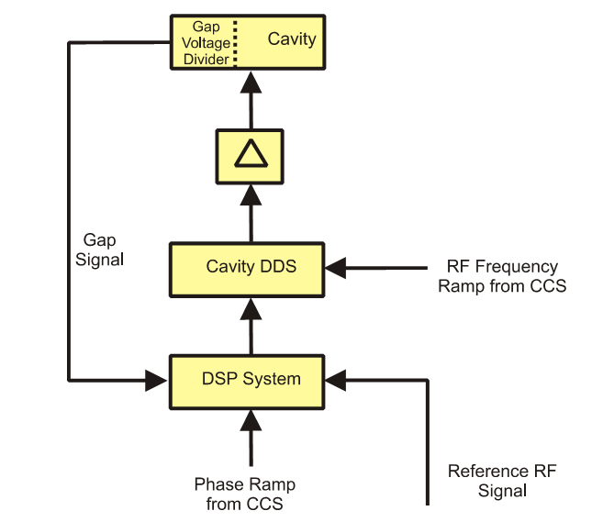
RF cavity
Virtual cavity

