Slide 1
Throughput and packet loss measurement
Test - No VLAN + 1 Layer WR switch
Test - VLAN + 1 Layer WR switch
Test - No VLAN + 2 Layer WR switch
Test - VLAN + 2 Layer WR switch
Timing WR network simulation
Latency measurement without Noise
Latency measurement with Noise

Slide 2
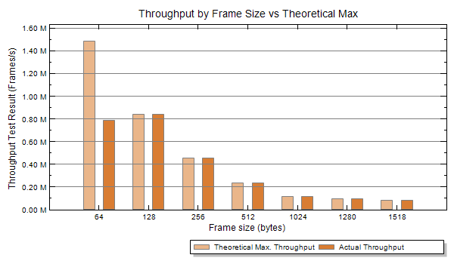
Test by Xena 2544 - No VLAN + 1 Layer
Throughput
×
√
√
√
√
√
√

Slide 3
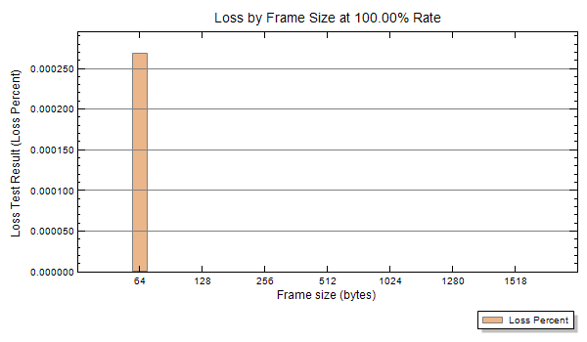
Test by Xena 2544 - No VLAN + 1 Layer
Packet loss
×
√
√
√
√
√
√

Slide 4
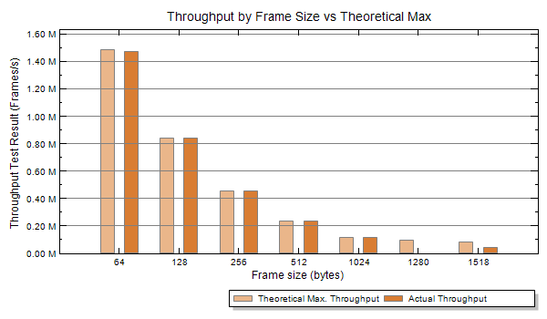
Test by Xena 2544 - 2 VLAN + 1 Layer
Throughput
×
√
√
√
√
×
×

Slide 5
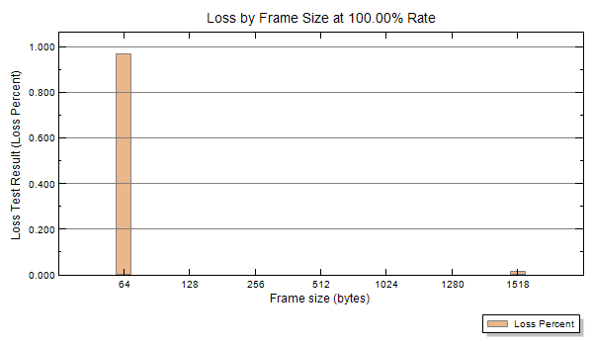
Test by Xena 2544 - 2 VLAN + 1 Layer
Packet loss
×
√
√
√
√
×
×

Slide 6
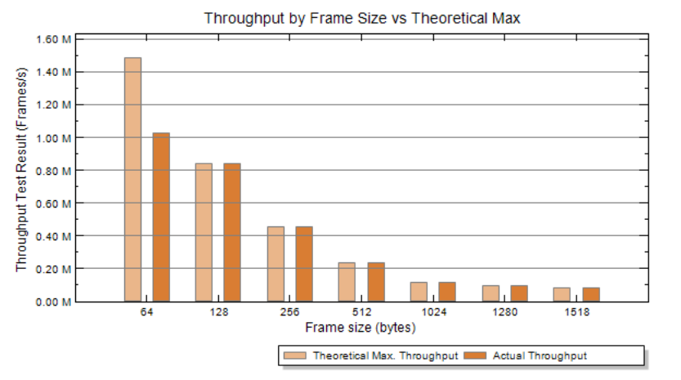
Test by Xena 2544 - No VLAN + 2 Layer
Throughput
×
√
√
√
√
√
√

Slide 7
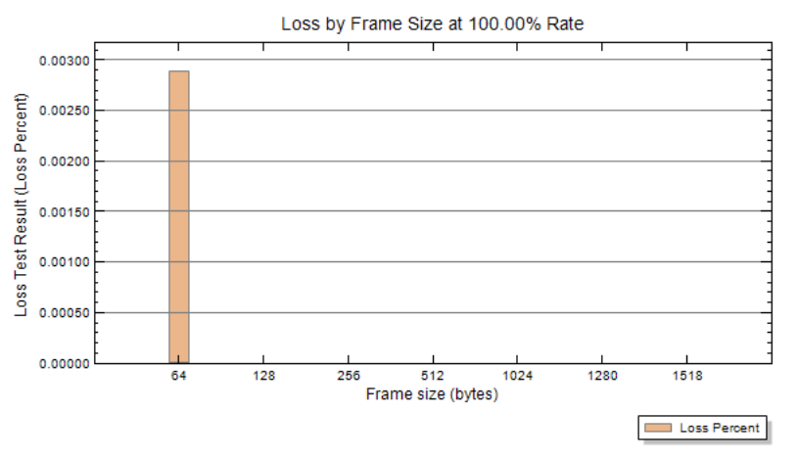
Test by Xena 2544 - No VLAN + 2 Layer
Packet loss
×
√
√
√
√
√
√

Slide 8
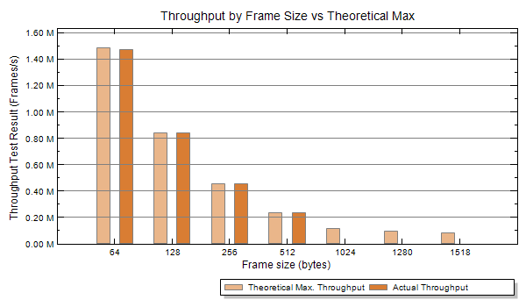
Test by Xena 2544 - 2 VLAN + 2 Layer
Throughput
×
√
√
√
×
×
×

Slide 9
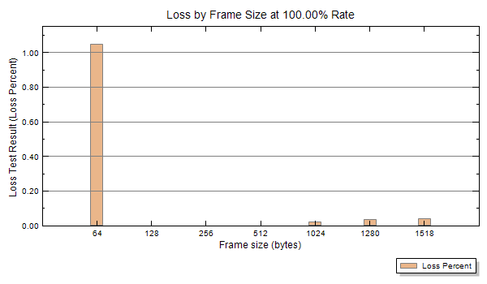
Test by Xena 2544 - 2 VLAN + 2 Layer
Packet loss
×
√
√
√
×
×
×

Slide 10
Test by Xena 2544 -110 bytes packet
110 bytes packets with high/low priority
Throughput is 1Gbps
Packet loss is 0
Packets with 110 bytes payload are OK
DM VLAN broadcast OK
DM VLAN unicast OK
B2B VLAN broadcast OK
All of these packets do not lose.
Latency ≤ 40us (with VLAN) 1Gbps
Jitter ≤ 30 us (with VLAN) 1Gbps

Slide 11
Simulation - Latency and jitter
DM VLAN broadcast 100Mbps 11 packets/s
DM VLAN unicast 10Mbps 3 packets/s + 2 B2B packets/s
B2B VLAN 28 packets/s
No noise
WR switch | DM VLAN Broadcast | DM VLAN Unicast | B2B VLAN
1 Layer | 3.810us ± 1.298us | 2.779us ± 312ns | 3.930us ± 1.419us
2 Layer | 8.264us±3.030us | 5.209us ± 216ns | 7.033us ± 1.752us
3 Layer | 10.862us ± 3.367us | 7.375us ± 312ns | 9.342us ± 1.804us

Slide 12
Simulation - Latency and jitter
DM VLAN broadcast 100Mbps 11 packets/s
DM VLAN unicast 10Mbps 3 packets/s + 6 B2B packets/s
B2B VLAN 28 packets/s
Low priority noise broadcast random 10Mbps
WR switch | DM VLAN Broadcast | DM VLAN Unicast | B2B VLAN
1 Layer | 10.573us ± 12.532us | 2.804us ± 336ns | 11.579us ± 10.415us
2 Layer | 17.453us ± 12.460us | 5.594us ± 553ns | 18.868us ± 13.903us
3 Layer | 20.002us ± 12.412us | 18.848us ± 10.150us | 21.466us ± 13.951us

Slide 13
Some test for latency
DM VLAN broadcast 100Mbps 11 packets/s
DM VLAN unicast 10Mbps 3 packets/s + 6 B2B packets/s
B2B VLAN 28 packets/s
Low priority noise broadcast random ?
2 Layer WR switch | Total Mbps | DM VLAN Latency (B) /us | DM VLAN Latency (U) /us | B2B VLAN Latency (B)/us | Pkg loss
10 ports×1Mbps | 90 | 32.030 ± 24.796 | 17.765 ± 12.556 | 19.565 ± 14.432 | 0.143%
10 ports×0.78Mbps | 70 | 29.215 ± 23.958 | 17.717 ± 12.676 | 25.194 ± 20.109 | 0.029%
10 ports×0.56Mbps | 50 | 28.878 ± 23.621 | 17.645 ± 12.652 | 18.796 ± 13.542 | 0.027%
10 ports×0.11Mbps | 10 | 21.446 ± 16.188 | 17.910 ± 12.844 | 17.930 ± 12.844 | 0.013%
10 ports×0.089Mbps | 8 | 20.074 ± 13.133 | 17.356 ± 12.315 | 18.747 ± 13.590 | 0.003%
10 ports×0.0797Mbps | 7 | 30.394 ± 25,232 | 17.934 ± 12.820 | 27.527 ± 22.346 | 0.017%

