Slide 1
Throughput and packet loss measurement
Test - No VLAN + 1 Layer WR switch
Test - VLAN + 1 Layer WR switch
Test - No VLAN + 2 Layer WR switch
Test - VLAN + 2 Layer WR switch
Timing WR network simulation
Latency measurement without Noise
Latency measurement with Noise

Slide 2
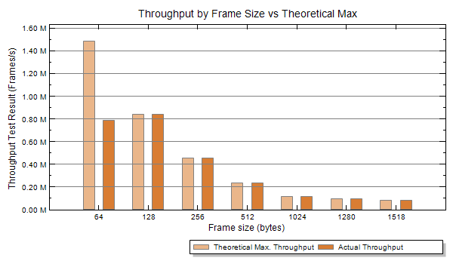
Test by Xena 2544 - No VLAN + 1 Layer
Throughput
×
√
√
√
√
√
√

Slide 3
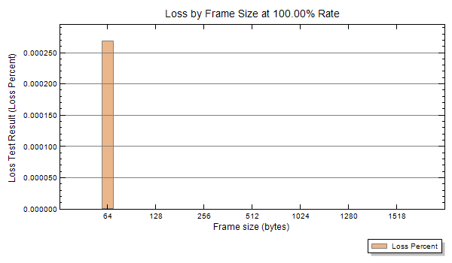
Test by Xena 2544 - No VLAN + 1 Layer
Packet loss
×
√
√
√
√
√
√

Slide 4
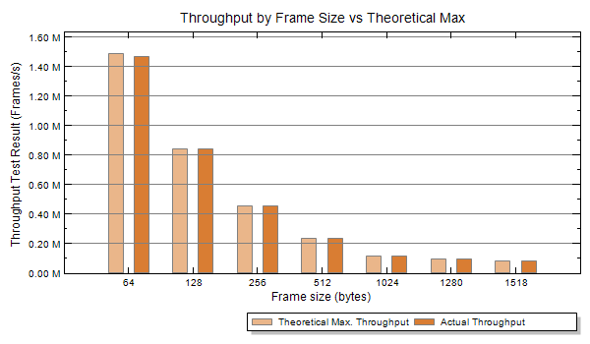
Test by Xena 2544 - 2 VLAN + 1 Layer
Throughput
×
√
√
√
√
√
√

Slide 5
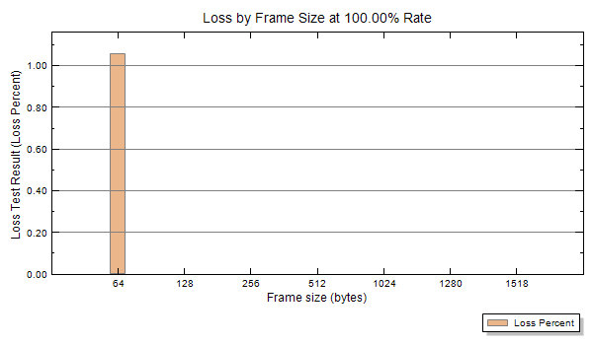
Test by Xena 2544 - 2 VLAN + 1 Layer
Packet loss
×
√
√
√
√
√
√

Slide 6
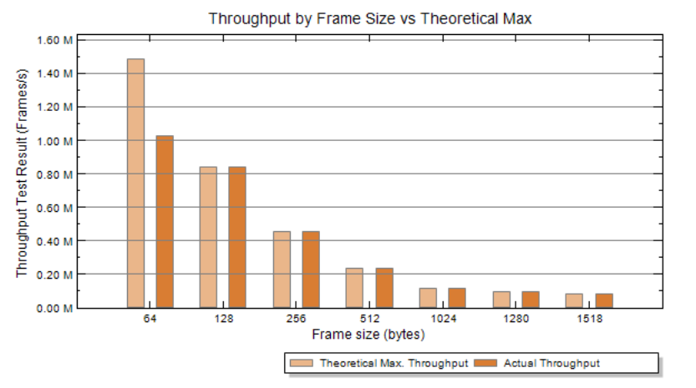
Test by Xena 2544 - No VLAN + 2 Layer
Throughput
×
√
√
√
√
√
√

Slide 7
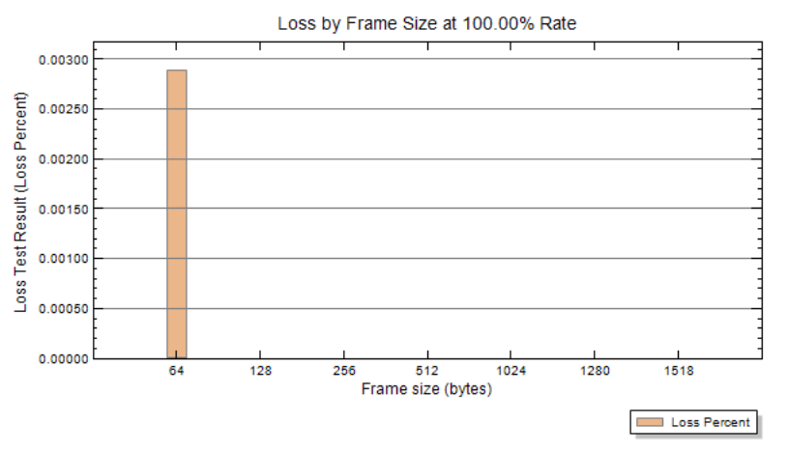
Test by Xena 2544 - No VLAN + 2 Layer
Packet loss
×
√
√
√
√
√
√

Slide 8
Test by Xena 2544 - 2 VLAN + 2 Layer
×
√
√
√
√
√
√

Slide 9

Test by Xena 2544 - 2 VLAN + 2 Layer
Packet loss
×
√
√
√
√
√
√

Slide 10
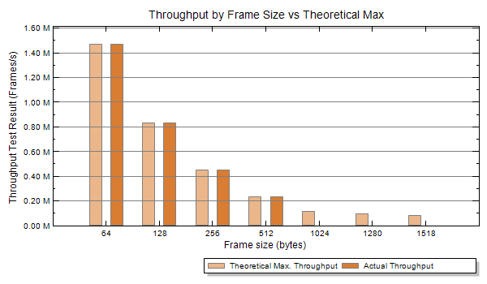
Test by Xena 2544 - No VLAN + 2 Layer using wr0
Throughput
2 WR switch
No VLAN
WR1 Port 1 <=> WR2 Port 0
WR1 Port 3 produces 10Mbps increasing packets 64 - 1516
WR2 Port 3 produces 10Mbps increasing packets 64 - 1516
√
√
√
√
×
×
×

Slide 11
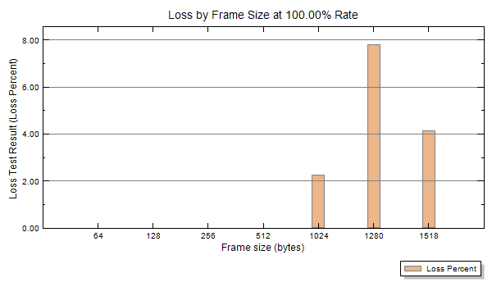
Test by Xena 2544 - No VLAN + 2 Layer using wr0
Packet loss

Slide 12

Test by Xena 2544 - 2 VLAN + 2 Layer using wr0
Throughput
×
√
√
√
×
×
×

Slide 13
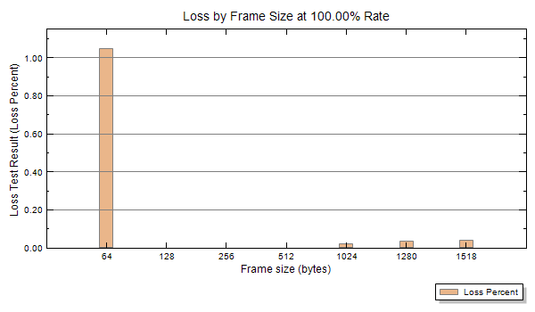
Test by Xena 2544 - 2 VLAN + 2 Layer using wr0
Packet loss
×
√
√
√
×
×
×

Slide 14
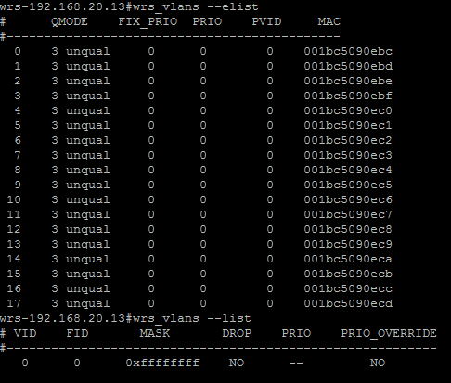
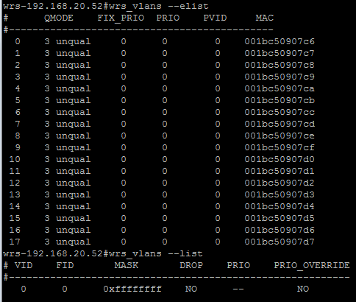
2 WR switch
No VLAN
WR1 Port 0 <=> WR2 Port 1
WR1 Port 3 produces 10Mbps random packets
No packet loss
WR2 Port 3 produces 10Mbps random packets
Packet loss
WR1 Port 1 <=> WR2 Port 0
WR1 Port 3 produces 10Mbps random packets
Packet loss
WR2 Port 3 produces 10Mbps random packets
No packet loss
WR1 Port 1 <=> WR2 Port 1
WR1 Port 3 produces 10Mbps random packets
No packet loss
WR2 Port 3 produces 10Mbps random packets
No packet loss
wr0 receiving problem

Slide 15
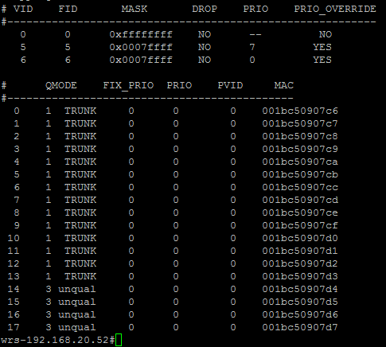
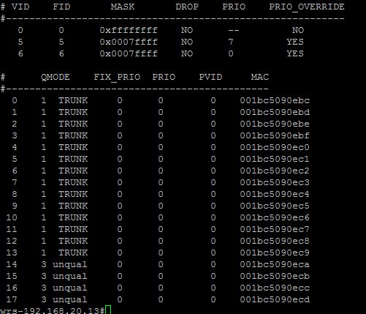
10Mbps B2B VLAN random
10Mbps B2B VLAN random
10Mbps B2B VLAN random
100Mbps DM VLAN
wr0 connection: packet loss
(both VLAN and No VLAN)
No wr0 connection: no packet loss
wr0 connection loses packet 1024-1518 bytes frame

Slide 16
2 WR switch
No VLAN
WR1 Port 0 <=> WR2 Port 1
WR1 Port 3 produces 10Mbps packets 64-1516 No packet loss
WR2 Port 3 produces 10Mbps packets 64-1516 Packet loss
WR2 Port 3 produces 10Mbps packets 128-512 bytes No packet loss
WR1 Port 1 <=> WR2 Port 0
WR1 Port 3 produces 10Mbps packets 64-1516 Packet loss
WR1 Port 3 produces 10Mbps packets 128-512 No packet loss
WR2 Port 3 produces 10Mbps packets 64-1516 No packet loss
WR1 Port 1 <=> WR2 Port 1
WR1 Port 3 produces 10Mbps random packets No packet loss
WR2 Port 3 produces 10Mbps random packets No packet loss
wr0 receiving problem with frame length 64, 1024, 1280 and 1516 bytes

Slide 17
Test by Xena 2544 -110 bytes packet
110 bytes packets with high/low priority
Throughput is 1Gbps
Packet loss is 0
Packets with 110 bytes payload are OK
DM VLAN broadcast OK
DM VLAN unicast OK
B2B VLAN broadcast OK
All of these packets do not lose.
Latency ≤ 40us (with VLAN) 1Gbps
Jitter ≤ 30 us (with VLAN) 1Gbps

Slide 18
Test by Xena Manager
?110 bytes frame DM VLAN + ?Random frame B2B VLAN
1 layer WR switch
No packets loss (high and low priority) when bandwidth ≤ 1Gbps
2 layer WR switch
No packet loss for high priority
Packet loss for low priority when bandwidth ≤ 1Gbps (e.g. 100Mbps + 90Mbps)
Two WR switch connection dose not use port 1 (wr0) => no lost
wr0 of the WR switch could not work properly.

Slide 19
Simulation - Latency and jitter
DM VLAN broadcast 100Mbps 11 packets/100us (3-5 normal)
DM VLAN unicast 10Mbps 3 packets/300us + 2 B2B packets/10ms
B2B VLAN 10 packets/10ms totally 28 packets/s
No noise
WR switch | DM VLAN Broadcast | DM VLAN Unicast | B2B VLAN
1 Layer | 3.810us ± 1.298us | 2.779us ± 312ns | 3.930us ± 1.419us
2 Layer | 8.264us±3.030us | 5.209us ± 216ns | 7.033us ± 1.752us
3 Layer | 10.862us ± 3.367us | 7.375us ± 312ns | 9.342us ± 1.804us

Slide 20
Simulation - Latency and jitter
DM VLAN broadcast 100Mbps 11 packets/100us (3-5 normal)
DM VLAN unicast 10Mbps 3 packets/300us + 2 B2B packets/10ms
B2B VLAN 10 packets/10ms totally 28 packets/s
Low priority noise broadcast random 10Mbps
WR switch | DM VLAN Broadcast | DM VLAN Unicast | B2B VLAN
1 Layer | 10.573us ± 10.532us | 2.804us ± 336ns | 11.579us ± 10.415us
2 Layer | 17.453us ± 12.460us | 5.594us ± 553ns | 18.868us ± 13.903us
3 Layer | 20.002us ± 12.412us | 18.848us ± 10.150us | 21.466us ± 13.951us

Slide 21
Some test for latency
DM VLAN broadcast 100Mbps 11 packets/s
DM VLAN unicast 10Mbps 3 packets/s + 6 B2B packets/s
B2B VLAN 28 packets/s
Low priority noise broadcast random ? use wr0
2 Layer WR switch | Total Mbps | DM VLAN Latency (B) /us | DM VLAN Latency (U) /us | B2B VLAN Latency (B)/us | Pkg loss
10 ports×1Mbps | 90 | 32.030 ± 24.796 | 17.765 ± 12.556 | 19.565 ± 14.432 | 0.143%
10 ports×0.78Mbps | 70 | 29.215 ± 23.958 | 17.717 ± 12.676 | 25.194 ± 20.109 | 0.029%
10 ports×0.56Mbps | 50 | 28.878 ± 23.621 | 17.645 ± 12.652 | 18.796 ± 13.542 | 0.027%
10 ports×0.11Mbps | 10 | 21.446 ± 16.188 | 17.910 ± 12.844 | 17.930 ± 12.844 | 0.013%
10 ports×0.089Mbps | 8 | 20.074 ± 13.133 | 17.356 ± 12.315 | 18.747 ± 13.590 | 0.003%
10 ports×0.0797Mbps | 7 | 30.394 ± 25,232 | 17.934 ± 12.820 | 27.527 ± 22.346 | 0.017%
For the same simulation of 1 layer WR switch, there is no packet loss

