Slide 1
INTERVIEW WALKTHROUGH
Presight Analytics Platform
A data engineering assessment: cleaning the data, building a versioned warehouse, processing event data at scale, orchestrating the pipeline, and covering governance.
Baiju Mohan

Slide 2
01 · GOAL
Goal
Set up Presight's data engineering platform to provide clean data for analysis and reporting, track employee history, process event data, and run scheduled pipelines reliably.
THE PROBLEM
Finance and Ops had no way to query project or spend data directly - every question meant opening CSVs by hand.
HR and Finance needed historical answers, but the data only ever showed the current state.
Over 100,000 platform usage events across 12 files had never been analysed.
The pipeline ran manually - no schedule, no automated quality checks, and nothing for Compliance to review.
IN SCOPE
Clean the data and detect quality issues
Build a star-schema warehouse with employee history (SCD2)
Answer 6 business questions and optimise one query
Build a Power BI dashboard
Process the event stream with Spark and Kafka
Schedule the pipeline in Airflow with a data quality gate
Containerise it with Docker, plus a governance document
OUT OF SCOPE
Multi-node Spark and a production Kafka setup - the goal was correct logic, not production scale
Cloud deployment - the env-var configuration already used makes that a straightforward next step
Final legal sign-off on retention periods - using reasonable defaults, flagged for Legal to review
Presight Analytics Platform — Data Engineering Assessment
2

Slide 3
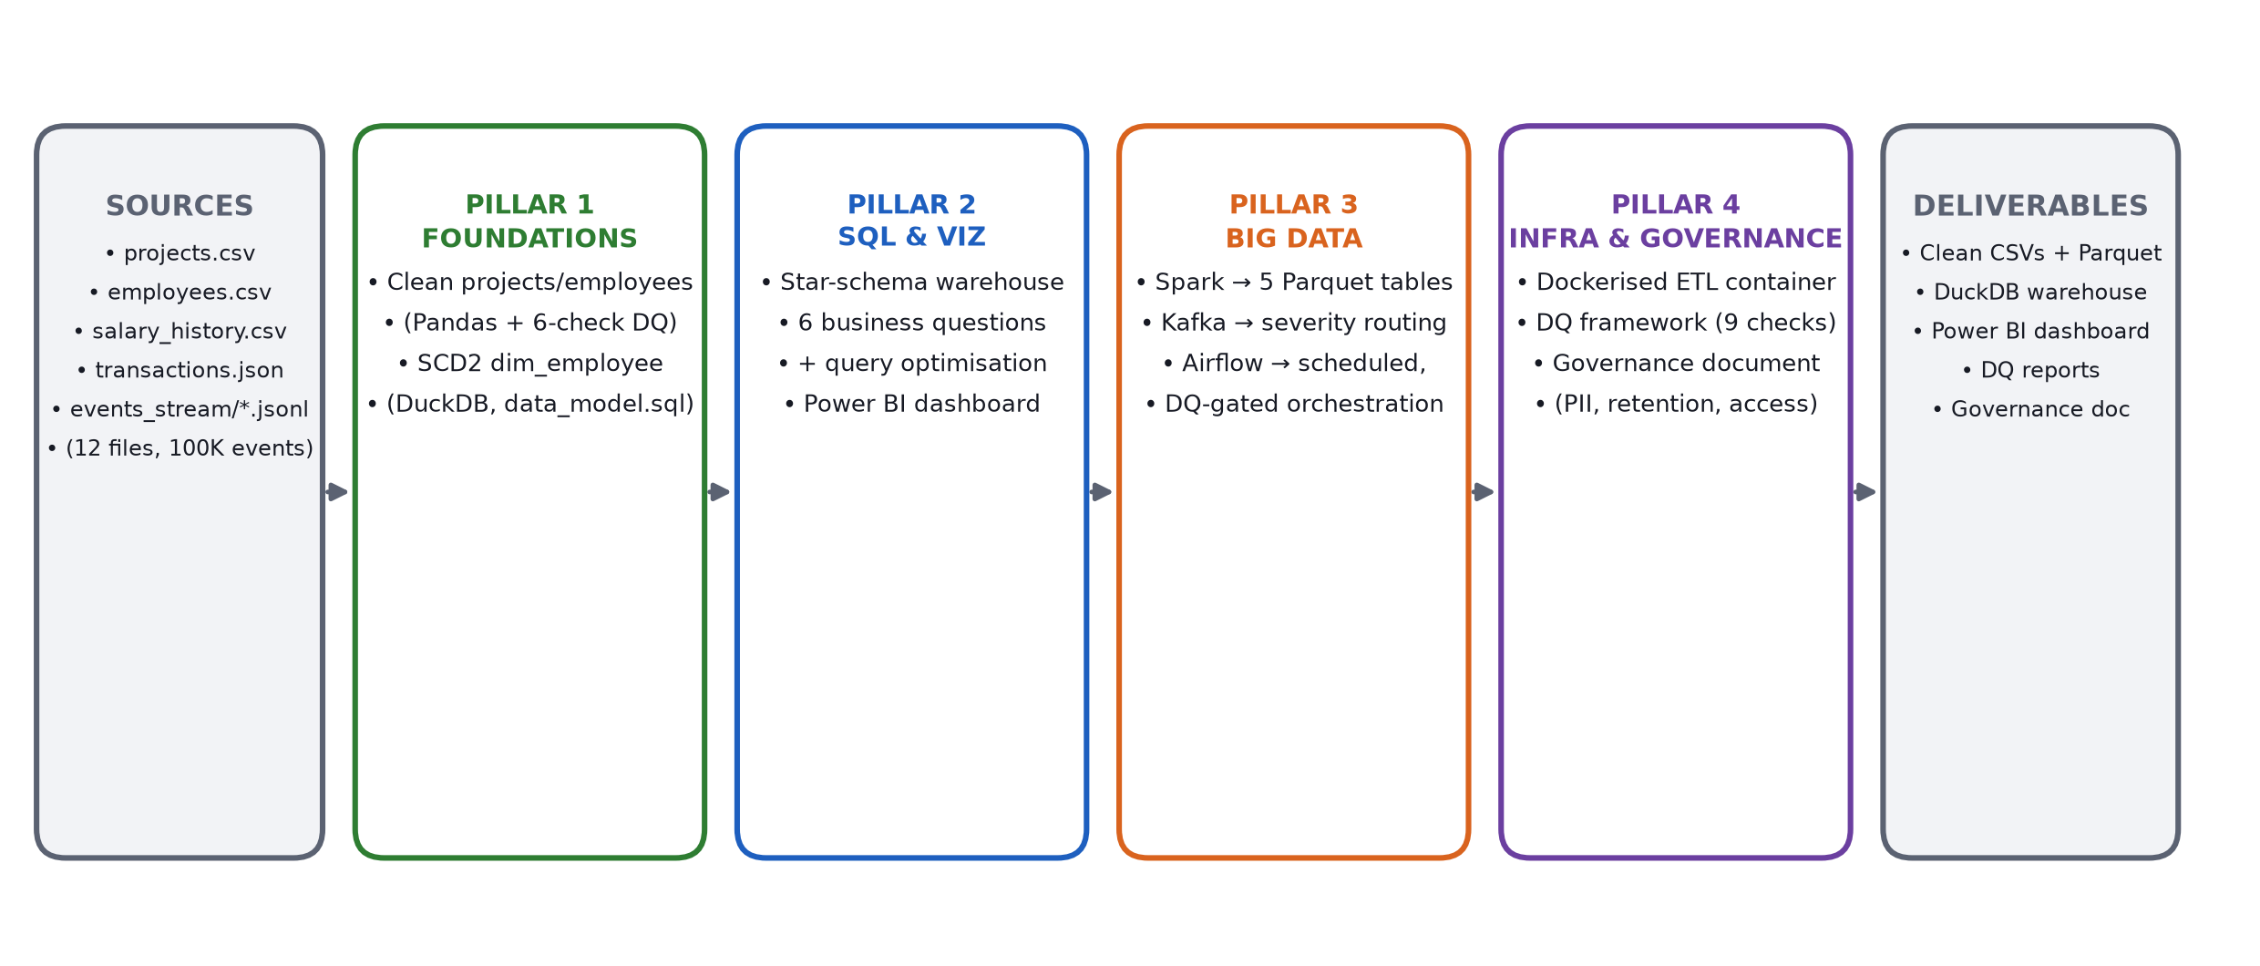
02 · ARCHITECTURE
Architecture & Data Flow
dim_employee tracks full history using SCD Type 2, built in from the start rather than added on later.
Presight Analytics Platform — Data Engineering Assessment
3

Slide 4
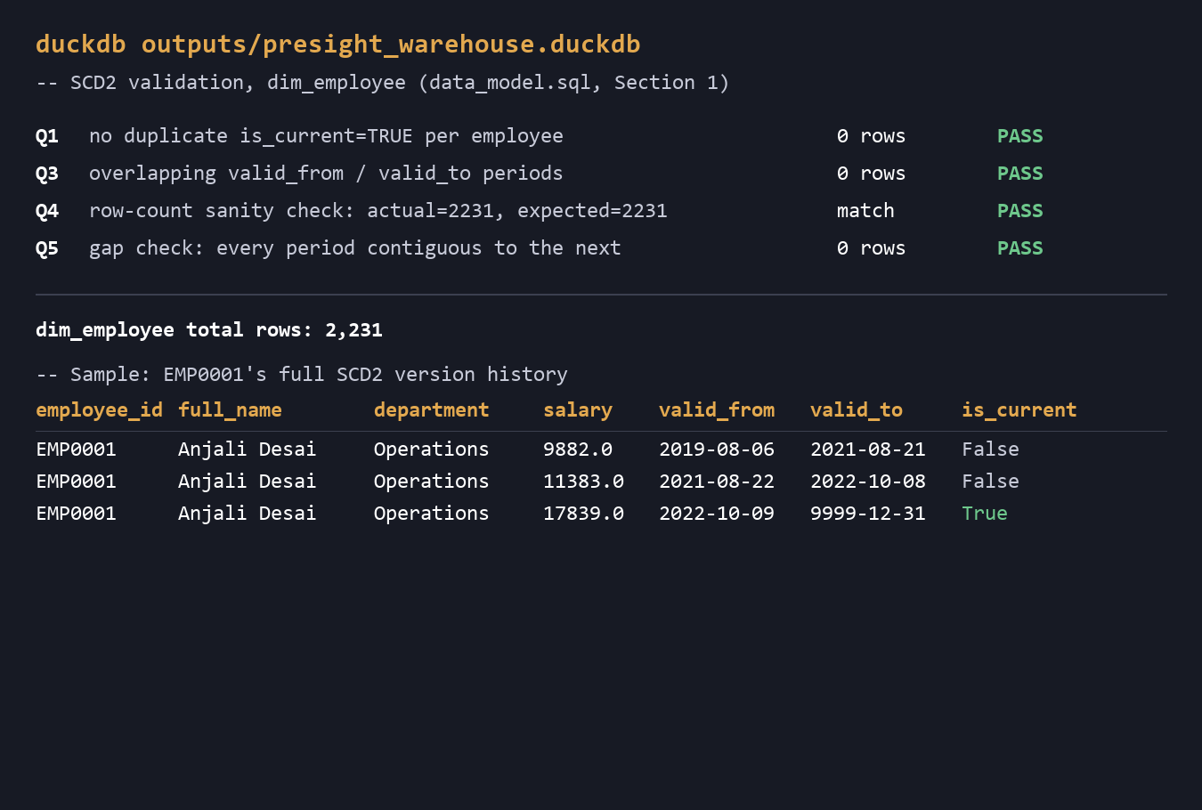
03 · PILLAR 1 OUTPUT
Foundations — Warehouse & DQ Output
INPUT
projects.csv, employees.csv, salary_history.csv (raw Presight exports)
WORK DONE
Cleaned data with Pandas, 6-category DQ checks (etl_pipeline.py)
Built SCD2 dim_employee table in SQL (data_model.sql)
OUTPUT
01_foundations/*_clean.csv · presight_warehouse.duckdb (dim_employee, 2,231 versions)
DECISIONS & TRADE-OFFS
Vectorised operations throughout - needed for speed at 50K+ rows
Found same-day duplicate history bug via validation, not code review
Fixed by collapsing same-day changes to final state before versioning
outputs/presight_warehouse.duckdb — Section 1 validation queries (Q1-Q5, all PASS)
Presight Analytics Platform — Data Engineering Assessment
4

Slide 5
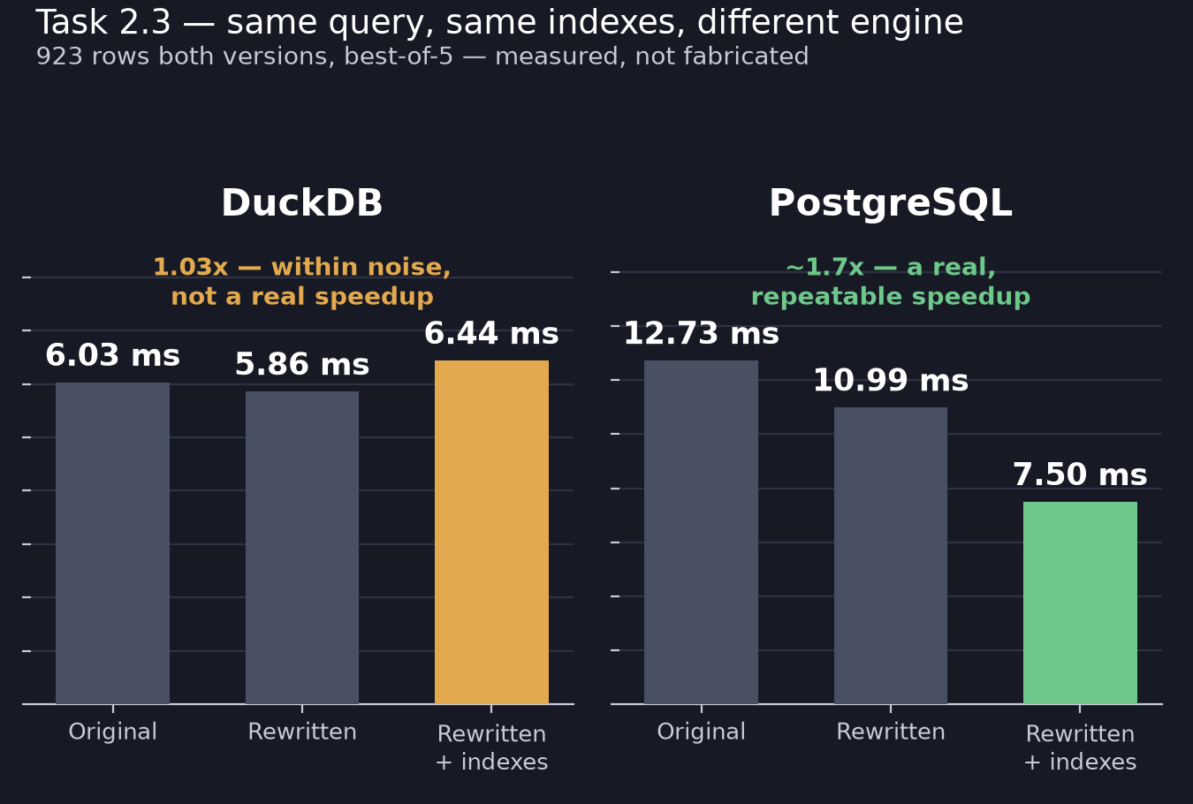
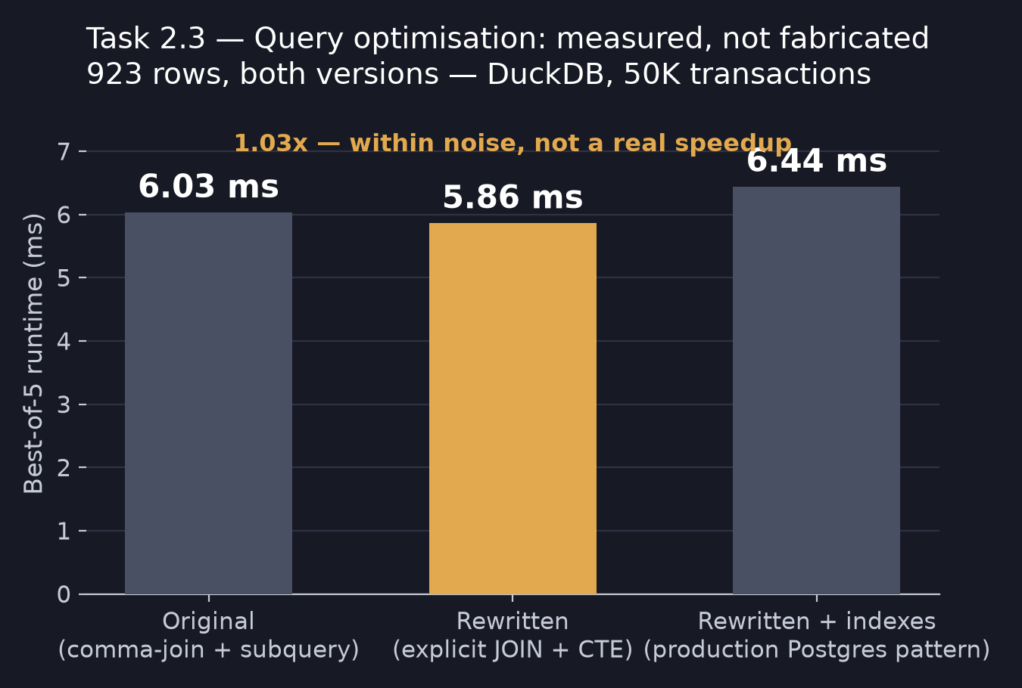
04 · PILLAR 2 OUTPUT
SQL & Visualization — Executive Dashboard
INPUT
Cleaned CSVs from Pillar 1 + transactions.json (raw)
WORK DONE
Transactions ETL and enrichment (etl_full.py)
Star-schema warehouse load (data_model.sql, Section 2)
6 business questions (queries.sql)
Query optimisation exercise (query_optimization.sql)
OUTPUT
transactions_clean.csv · warehouse tables · presight_dashboard.pbix
DECISIONS & TRADE-OFFS
Reported the actual result: no measurable DuckDB speedup (see chart)
Verified on real Postgres too - indexes gave a genuine ~1.7x there (row-store vs DuckDB columnar zone maps)
▢
Insert Power BI dashboard screenshot here
Suggested: outputs/results/baiju_mohan/02_sql_and_viz/presight_dashboard.pbix
Presight Analytics Platform — Data Engineering Assessment
5

Slide 6
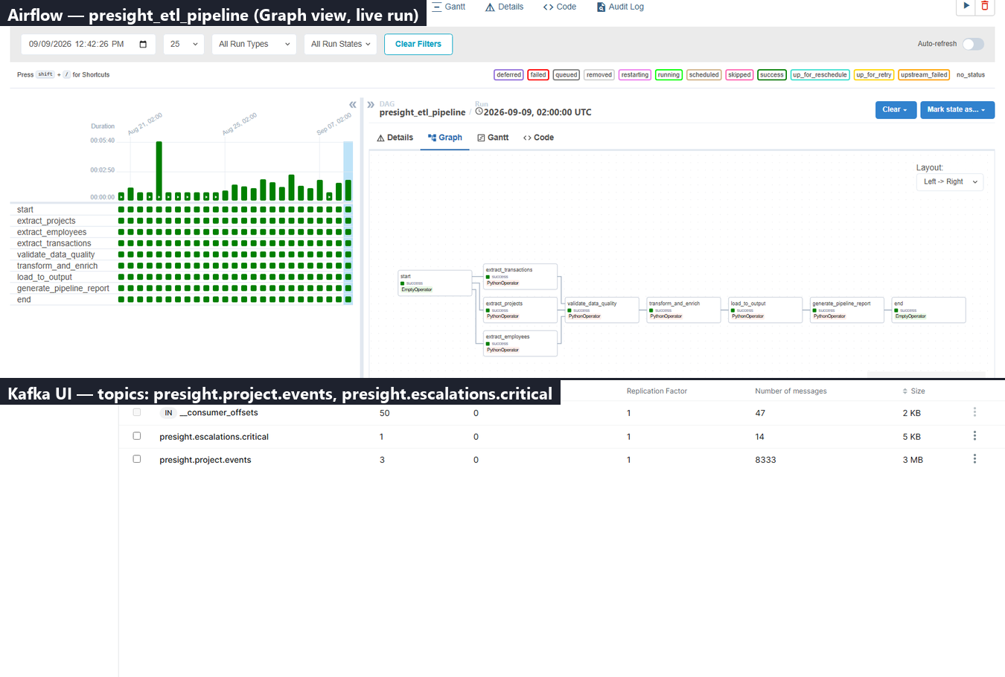
05 · PILLAR 3 OUTPUT
Big Data — Spark, Kafka & Airflow
INPUT
100,000 platform events across 12 monthly files; escalation raise/resolve events
WORK DONE
Spark batch -> 5 Parquet tables, 114.7s for 99,996 events (spark_pipeline.py)
Kafka producer/consumer with severity routing (kafka_streaming.py)
Airflow DAG: extract -> DQ gate -> transform -> load (airflow_dag.py)
OUTPUT
outputs/artifacts/.../spark/*.parquet · Kafka topics · presight_etl_pipeline DAG
DECISIONS & TRADE-OFFS
Rebuilt escalation matching: position-based to time-based
748 to 1,098 correctly matched, zero negative durations
Built DATA_DIR/OUTPUT_DIR pattern here, reused in Pillar 4
Airflow UI (localhost:8081) + Kafka UI (localhost:8080) — captured live
Presight Analytics Platform — Data Engineering Assessment
6

Slide 7
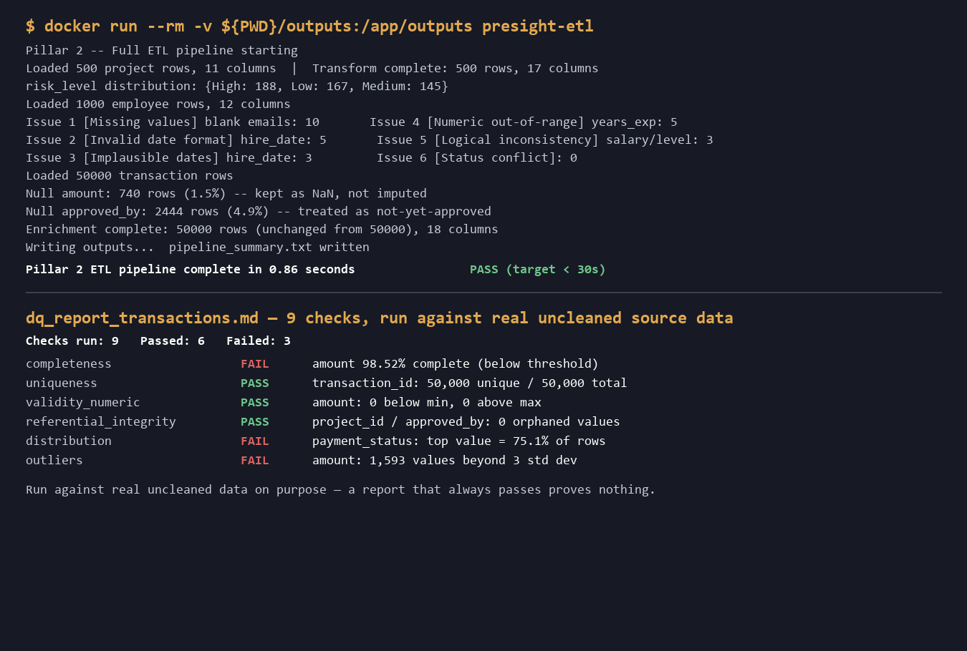
06 · PILLAR 4 OUTPUT
Infrastructure — Container & Data Quality
INPUT
Dockerfile + requirements.txt; cleaned datasets; raw data (for DQ checks)
WORK DONE
Two-step Docker build (Dockerfile, repo root)
9-check DQ framework run as a hard gate (dq_framework.py)
Data governance document (data_governance_document.md)
OUTPUT
presight-etl image · dq_report_*.md · data_governance_document.md
DECISIONS & TRADE-OFFS
Two-step build: smaller image, more complex build (strips unneeded Airflow deps)
Tested DQ gate by forcing failure, not assuming it works
2 real gaps found via peer review (manager_id check, salary/level consistency)
docker run output + outputs/results/baiju_mohan/04_infrastructure/dq_report_transactions.md
Presight Analytics Platform — Data Engineering Assessment
7

Slide 8
Questions
Full source: solutions/submissions/baiju_mohan/
Master narrative: SUBMISSION_NOTES.md · Run guide: HOW_TO_RUN.md

