Slide 1
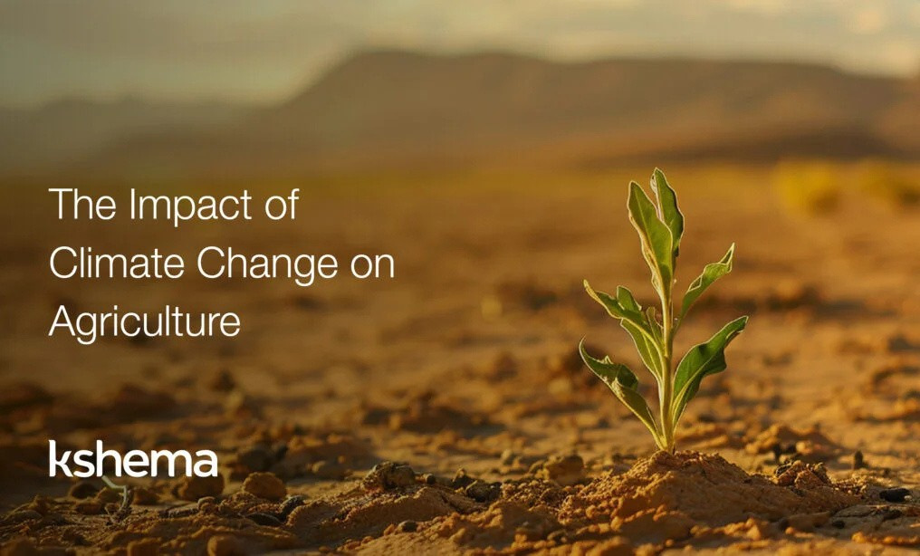
JAYAMUKHI INSTITUTE OF TECHNOLOGICAL SCIENCE
Climate Change Impact on Agricultural Land
Under The Guide of
Dr.P.Srinivas Rao
Presented By :-
CH.Aravind Reddy B.Raj Kumar M.Mahesh M.Nithin T.Karthikeya
22C41A6602
22C41A6614
22C41A6638
22C41A6640
22C41A6660

Slide 2
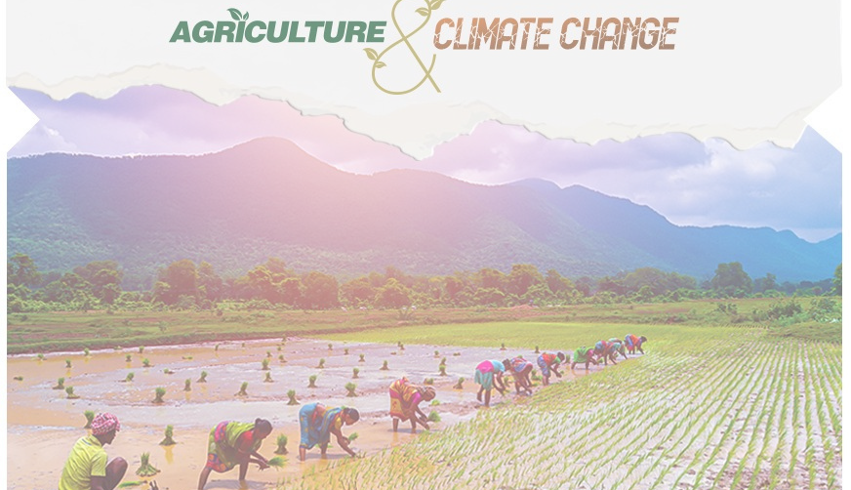
CONTENT
Abstract
Software and Hardware Requirements 3. Advantages & Disadvantages
4. Conclusion

Slide 3
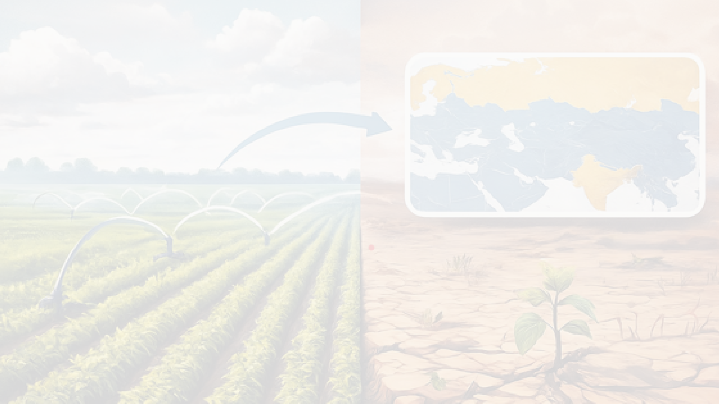
ABSTRACT:-
Abstract Climate change poses a significant threat to global food security by impacting agricultural productivity and land suitability.
This research aims to assess and predict the risks associated with land degradation and altered irrigation patterns, which directly influence food production systems.
Our model achieves an impressive accuracy of 86% and a mean average precision of 72%, demonstrating its potential to support informed decisionmaking.
The insights derived from this research are especially valuable for policymakers and agricultural planners in Eastern Europe and Northern Asia

Slide 4
Hardware Requirements
High-Performance Workstation / PC CPU: Intel i7/i9 or AMD Ryzen 7/9 RAM: 16–64 GB
Storage: SSD (512 GB–2 TB)
GPU (if using deep learning): NVIDIA RTX 3060/4060/4090 with CUDA support
Software Requirements
Python
R Programming AWS S3
Skipt Learning

Slide 5


Advantages-:
Studying climate change helps farmers protect their crops from damage. It allows us to improve farming methods for changing weather conditions. It helps ensure there is enough food for people in the future.
It guides governments and farmers in making better land-use plans. It helps us use water and soil more carefully and efficiently
Disadvantages-:
Time-consuming and labor-intensive.
Limited in predictive power for future climate scenarios. Often lacks accuracy and transparency.
Doesn't adapt well to sudden climate changes or new patterns

Slide 6
Conclusion-:
Climate change profoundly impacts agricultural land suitability in Eurasia, with regional variability requiring tailored responses. Interpretable machine learning offers powerful tools to assess and predict these changes, empowering stakeholders to implement adaptive, sustainable practices that enhance resilience and food security in a changing environment

Slide 7
Thank You

