Slide 1

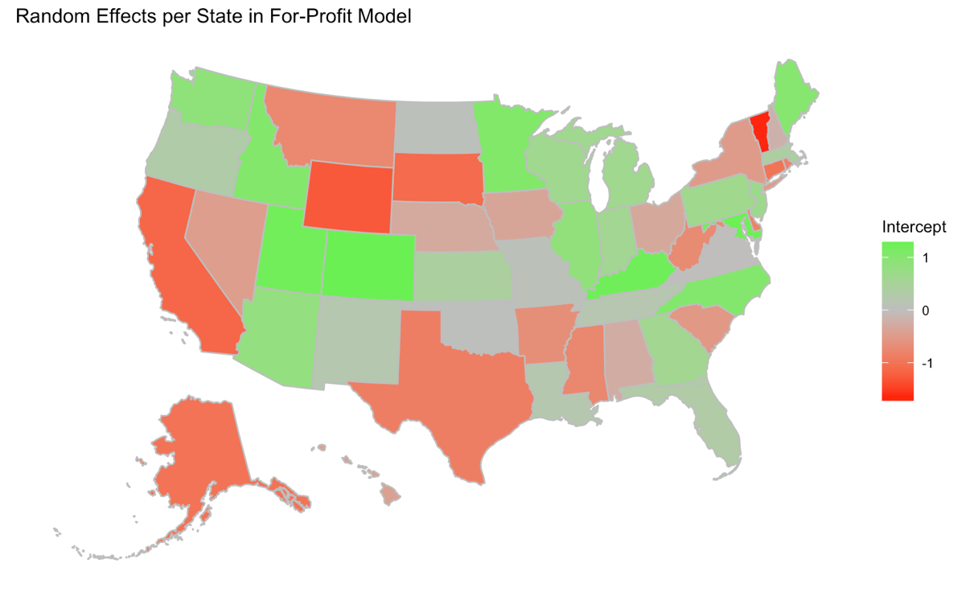
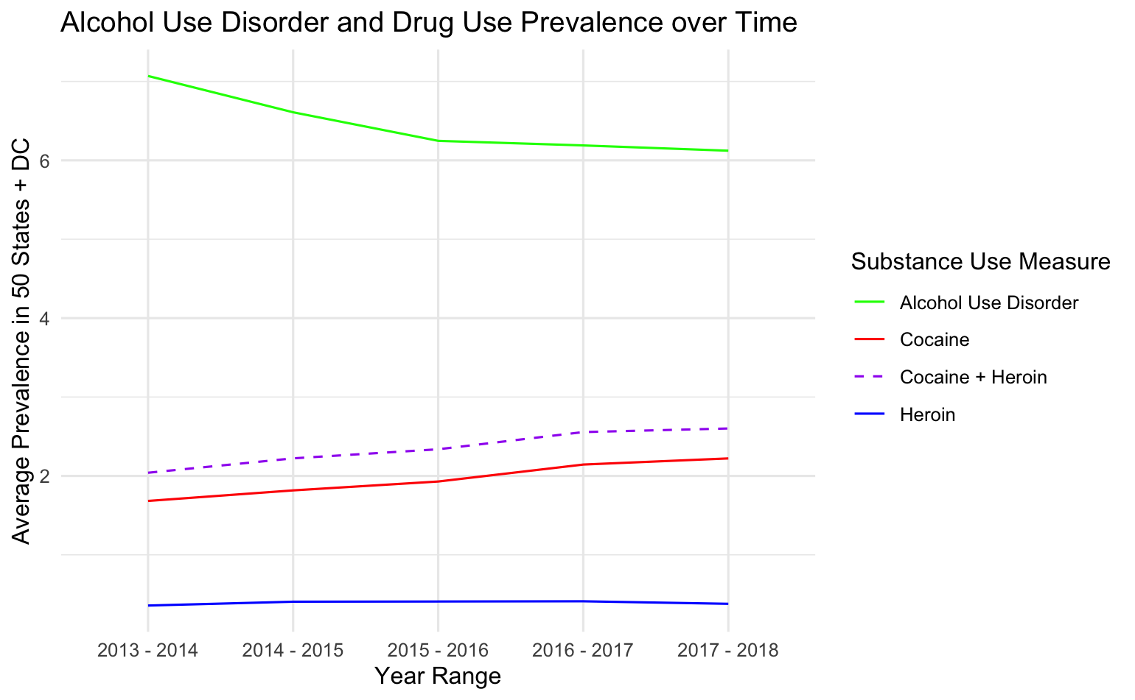

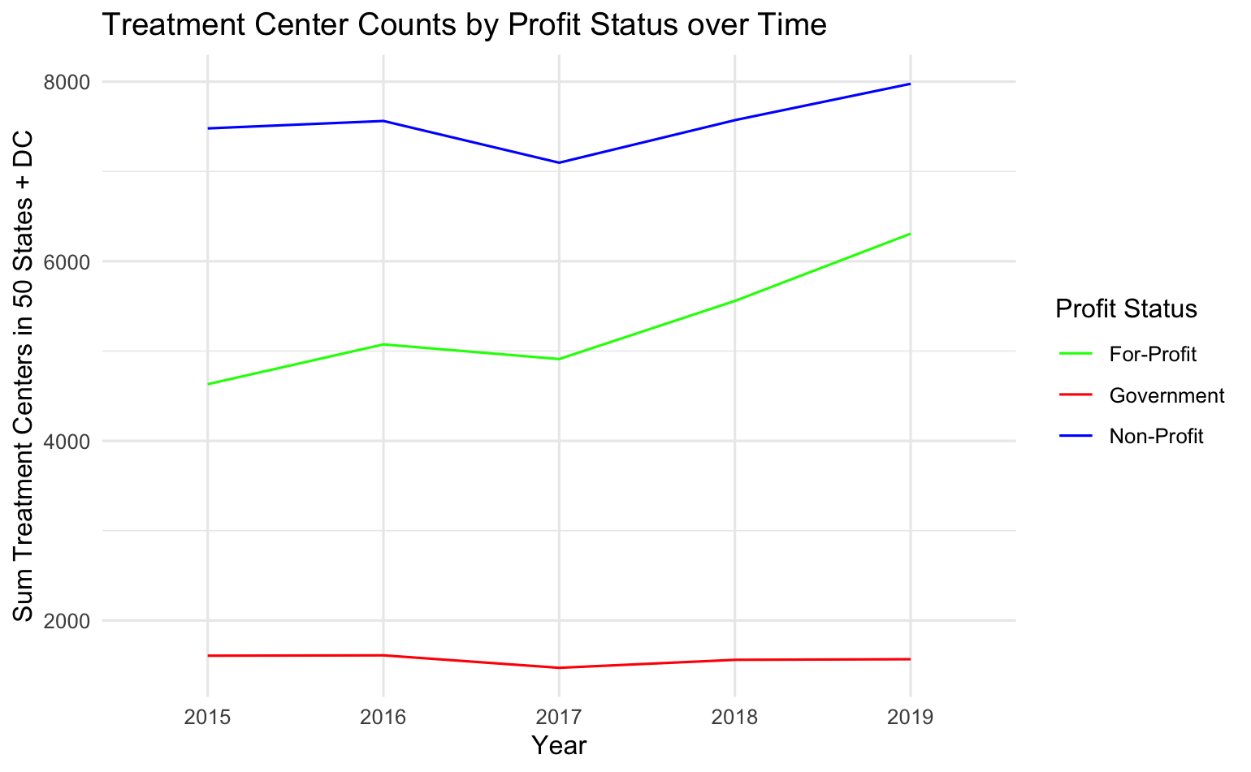
State treatment center counts as a market response to substance use prevalence: investigating differences by profit status
Bailey Wellen Osweiler BA, Timothy D. McBride MS PhD
Background:
Two important events coincided in 2013:
The Affordable Care Act (ACA) increased insurance coverage of substance use disorders (SUD), and
Overdose deaths skyrocketed, due largely to fentanyl
Since then, new SUD treatment centers have emerged across the U.S. but face criticism for profit-driven motives. This study investigates whether the number of SUD treatment centers may be a market response. Publicly available data from the U.S. Substance Abuse and Mental Health Services Administration (SAMHSA) form a panel dataset of 50 states and D.C. over five years (n = 255).
Demand Measure:
SAMHSA’s National Survey on Drug Use and Health (NSDUH) surveys Americans about substance use and aggregates to two-year periods in each state. Measures of interest were adults reporting alcohol use disorder (AUD) criteria and illicit drug use (cocaine + heroin) in each state-year.
State Random Effects on For-Profit Model
Supply Measure:
The National Survey on Substance Abuse Treatment Services (NSSATS) surveys treatment centers from all 50 United States and the District of Columbia. For-profit treatment center counts are increasing fastest.
Methods:
Three negative binomial distributions modeled the relationship between NSDUH substance use prevalence and
1) for-profit, 2) non-profit, and 3) government NSSATS treatment center counts, after controlling for population and with random effects for year and state.
Demand measures were lagged because administrative barriers prohibit a treatment center from responding to demand in the same year it emerges.
Findings:
For-profit treatment center counts are positively associated with drug use, indicating a potential market response to the “demand” of drug use post-ACA.
For-profit treatment center counts are negatively associated with AUD, suggesting this uptick is not a market response to AUD rates.
Random effects show surprising variation across states. Notably, California shows a negative random effect although it has been widely criticized for its for-profit SUD treatment industry
Fixed Effects on For-Profit Negative Binomial Model
 | Estimate | Std. Error | P. value
Intercept | 3.60710 | 0.21484 | < 0.001
Lagged Drug Use | 0.07862 | 0.03853 | 0.0413
Lagged AUD | -0.04868 | 0.02176 | 0.0253
Population (millions) | 0.09900 | 0.01543 | < 0.001
The project described was supported by Grant Number T32DA015035 from the National Institute on Drug Abuse. The content is solely the responsibility of the authors and does not necessarily represent the official views of the National Institute on Drug Abuse or the National Institutes of Health.
github.com/baileywellen/sud_treatment_profitstatus

