Slide 1

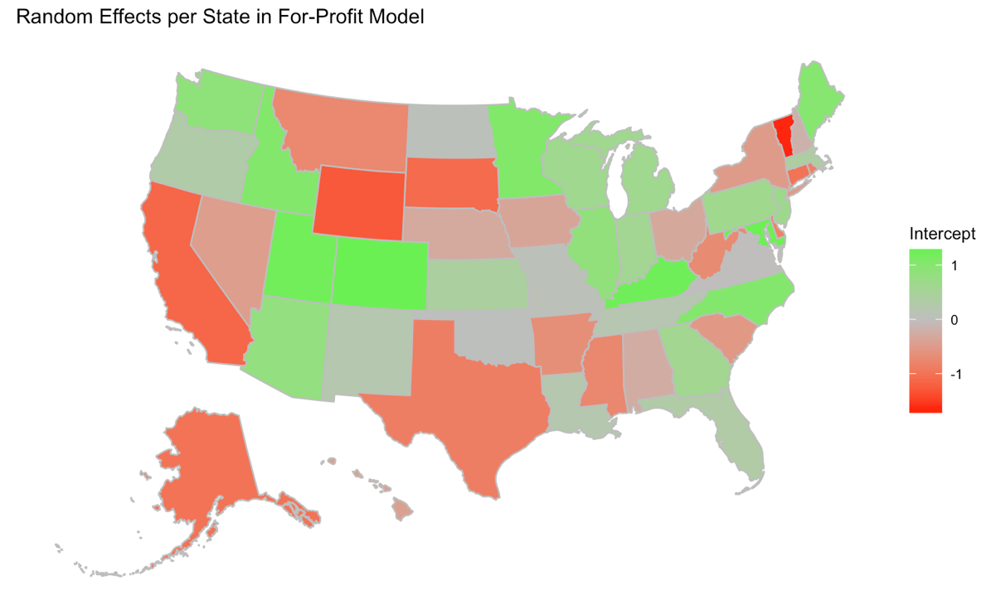
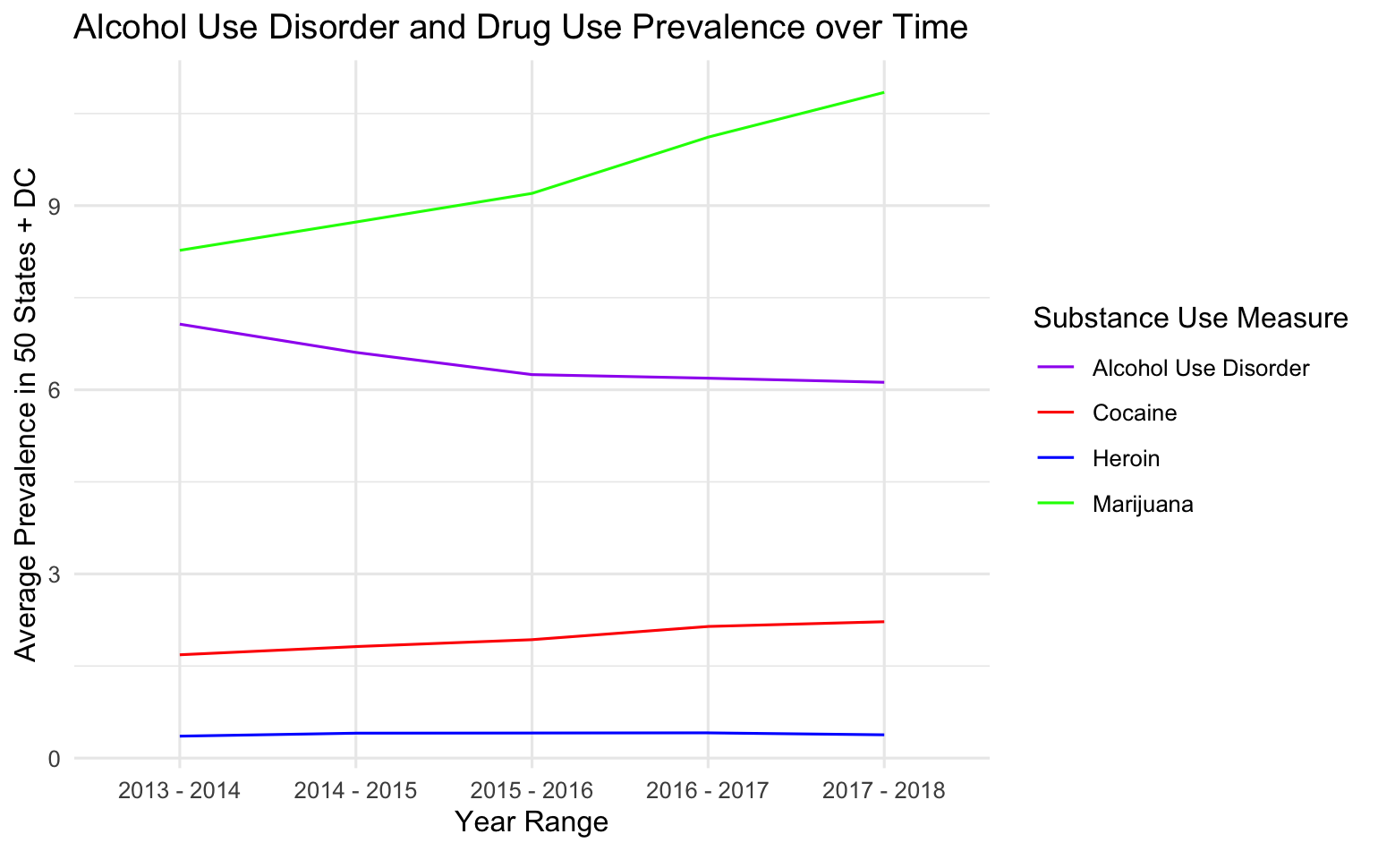
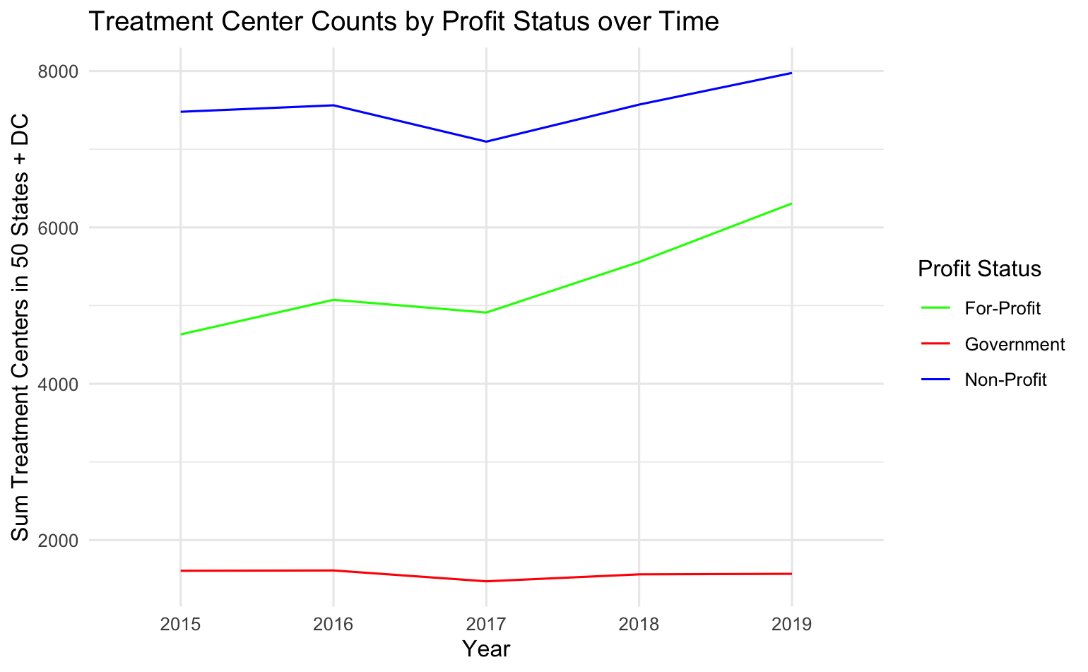
State treatment center counts as a market response to substance use prevalence: investigating differences by profit status
Bailey Wellen Osweiler BA, Timothy D. McBride MS PhD
Background:
The United States is in a drug overdose crisis, with drug fatalities increasing steadily this century. With the rise in overdose deaths, substance use disorders (SUDs) are more recognized and new treatment centers are emerging across the country. This study aims to reveal whether the number of SUD treatment centers may be a market response to demand for treatment centers (as measured by substance use rates) in the United States from 2014 – 2019.
The study used several publicly available data sources from the U.S. Substance Abuse and Mental Health Services Administration (SAMHSA).
Demand Measure:
SAMHSA’s National Survey on Drug Use and Health (NSDUH) surveys a sample of Americans about their experience with substances and mental health and aggregates to prevalence rates for two-year periods in states. Measures of interest were alcohol use disorder (AUD) and illicit drug use (summed cocaine + heroin use) in each state-year.
State Random Effects on For-Profit Model
Supply Measure:
The National Survey on Substance Abuse Treatment Services (NSSATS) surveys treatment centers from all 50 United States and the District of Columbia.
Implications:
The relationship between substance use and for-profit, non-profit, and government SUD treatment center trends differ. For-profit treatment center counts are associated with drug use after controlling for population, indicating a potential market response to the “demand” of drug use. However, for-profits’ relationship with AUD is negative, which does not suggest that this uptick is a response to AUD.
Additional research could reveal more details about this negative AUD relationship, other substances, granularity at the state-level, and treatment quality and accessibility implications for people with SUDs.
Methods:
Treatment demand measures were lagged because administrative barriers prohibit a treatment center from responding to demand in the same year it emerges.
Three negative binomial distribution modeled the count of for-profit, non-profit, and government treatment centers, with random effects for state and year.
Fixed Effects on For-Profit Negative Binomial Model
 | Estimate | Std. Error | P. value
Intercept | 3.60710 | 0.21484 | < 0.001
Lagged Drug Use | 0.07862 | 0.03853 | 0.0413
Lagged AUD | -0.04868 | 0.02176 | 0.0253
pop_millions | 0.09900 | 0.01543 | < 0.001
Funding provided by the National Institute on Drug Abuse (NIDA), T32DA01035
github.com/baileywellen/sud_treatment_profitstatus

