Slide 1

CSC 203 / CPE 203
Project-Based Object-Oriented
Programming and Design
(using Java)
Bill Foote
wffoote@calpoly.edu
(http://jovial.com)
Notes:
M: 1-14
T:; 1-22
W: To, or through python vars
R: UP to javadocs @ end
F: through 49

Slide 2
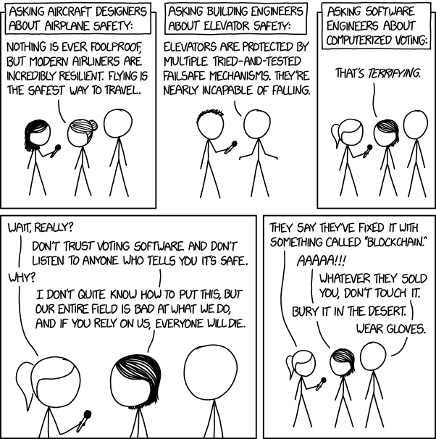

Slide 3
‘203 Class Project
This class has a high workload
The project assignments build off previous assignments
  It’s difficult to recover if you fall behind
My section has a slightly different project than others
  Different library
  More writing of original code

Slide 4

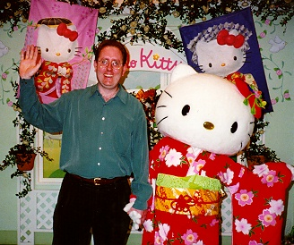




Slide 5
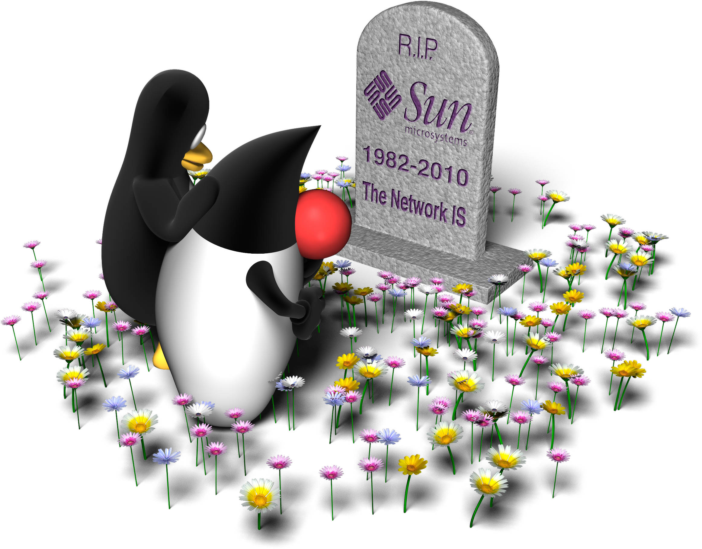

Slide 6




Slide 7
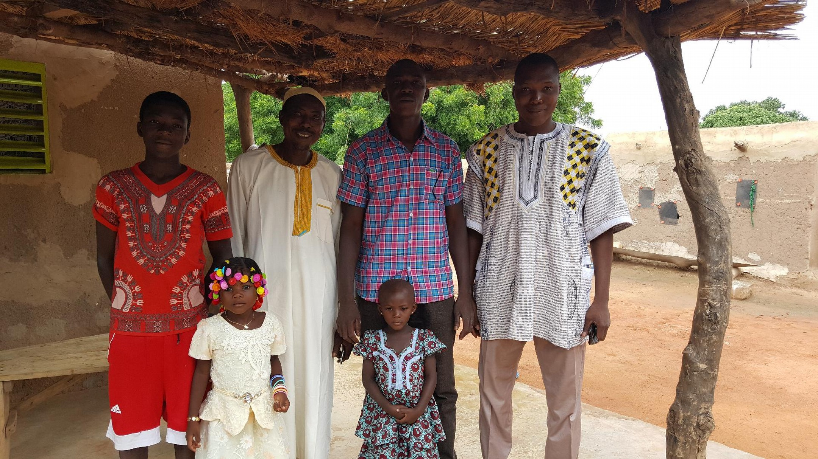

Slide 8




Slide 9


Slide 10

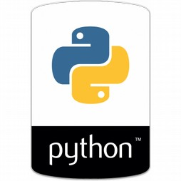
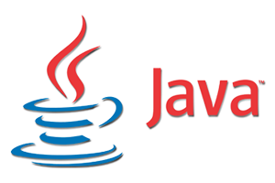
Class Objectives
Notes:
From procedural to Object-Oriented
along the way, from “Python” to Java

Slide 11
What is a Programming Language?
Notes:
A way to give instructions to a computer
A way to communicate with people
A way to communicate with your (future) self
==> Programming: deeply human activity.
Extremely social.

Slide 12

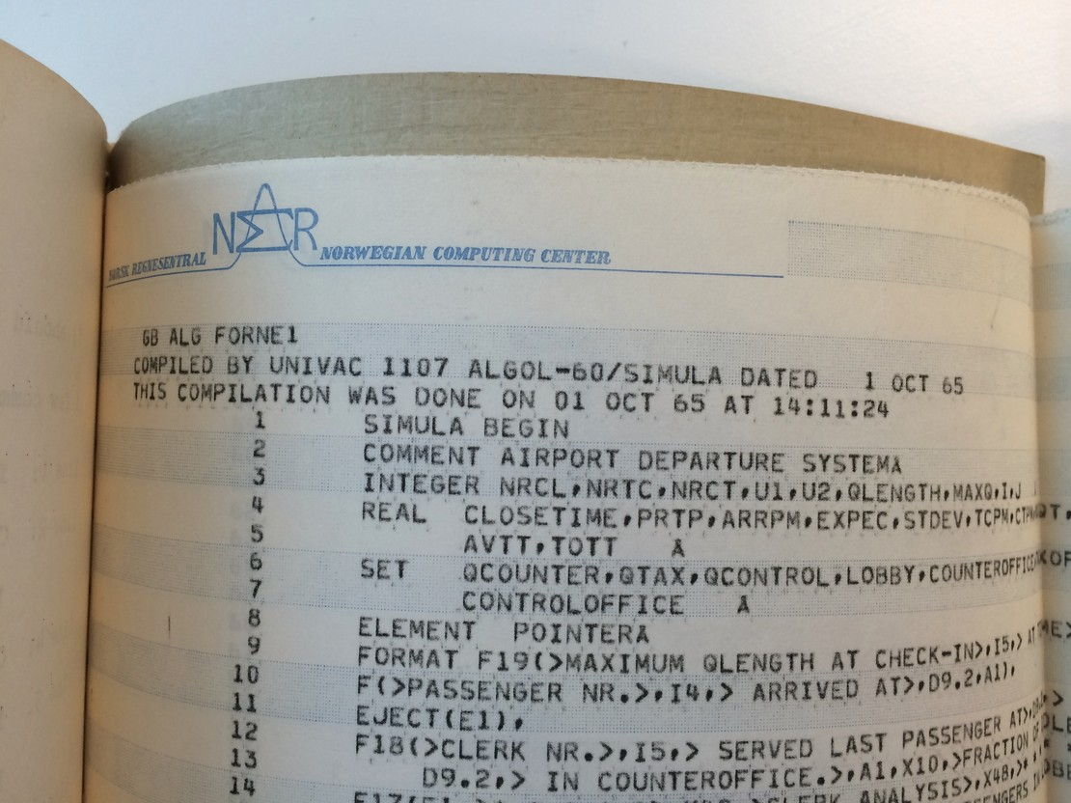
Object-Oriented Programming
Simula ‘67
University of Oslo
First OO program:
“Airport Departure System”

Slide 13
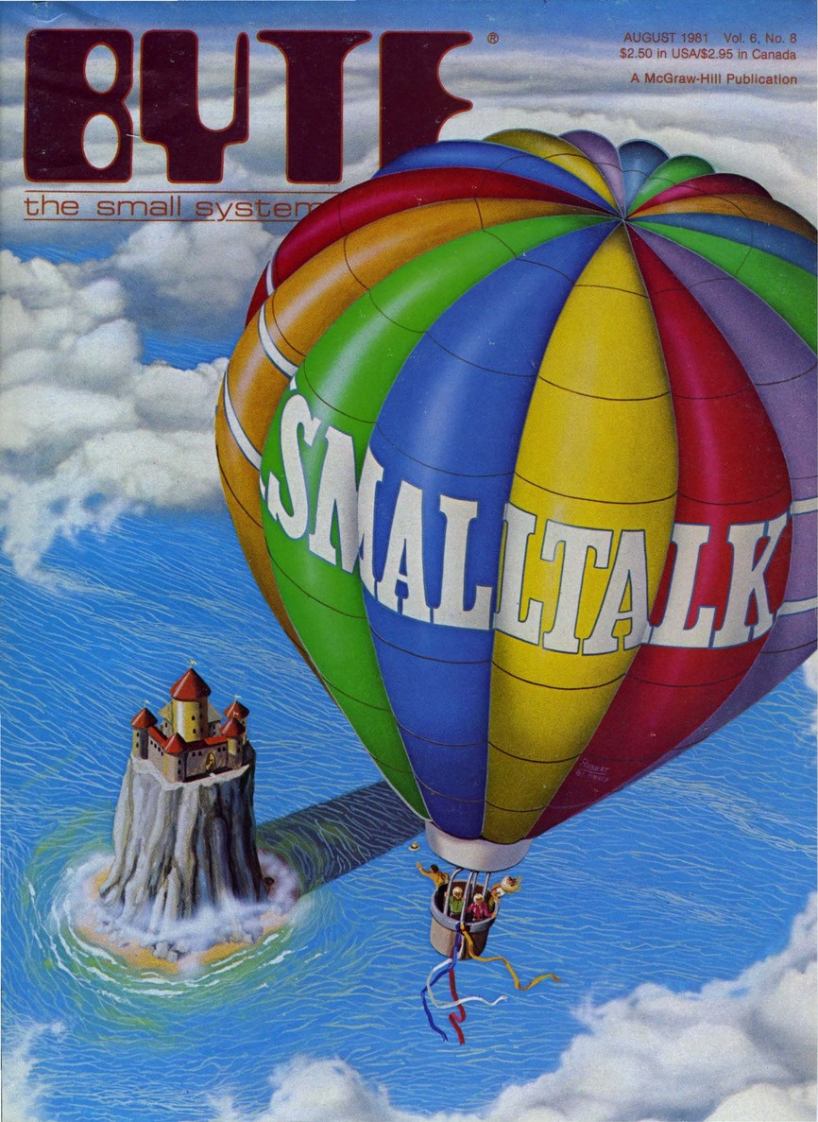

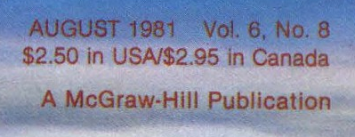
Xerox PARC
1973

Slide 14


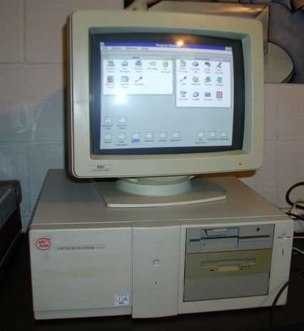
Early 80’s: Unix Workstations running X/10,
Apple Macintosh
Microsoft Windows 1.0
1990: Microsoft Windows 3.0
C
C++
Notes:
X and Motif broke C
Apple copied/adapted Smalltalk
Microsoft used C and C++
Defense layoffs
Predicted demise of software / 5GL
A lot of language development and innovation

Slide 15
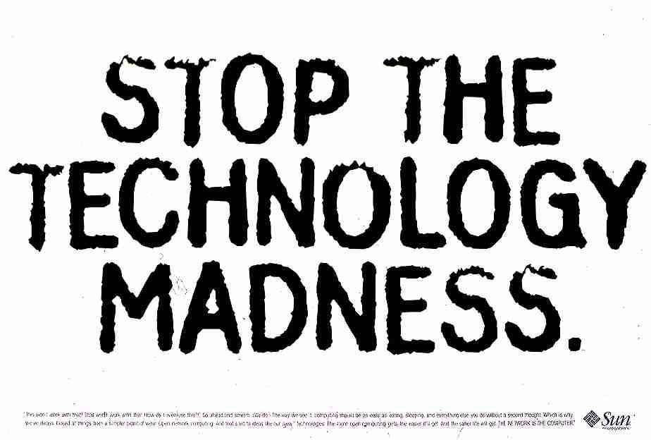

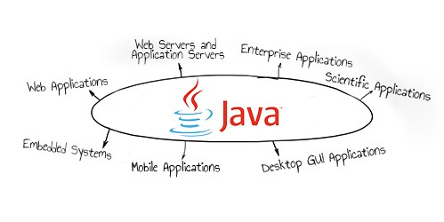
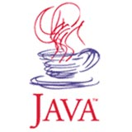

1995: Java
“Smalltalk in C++’s clothing”
Find errors early, e.g. static typing
“Write once, run anywhere”
Notes:
Arguably, first to really get OO “right”
Pragmatic
Rigorous
Slow
Multithreaded
Backwards (binary) compatible

Slide 16
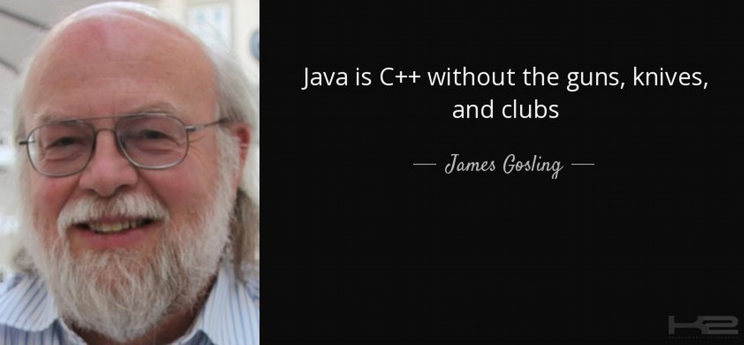

Slide 17
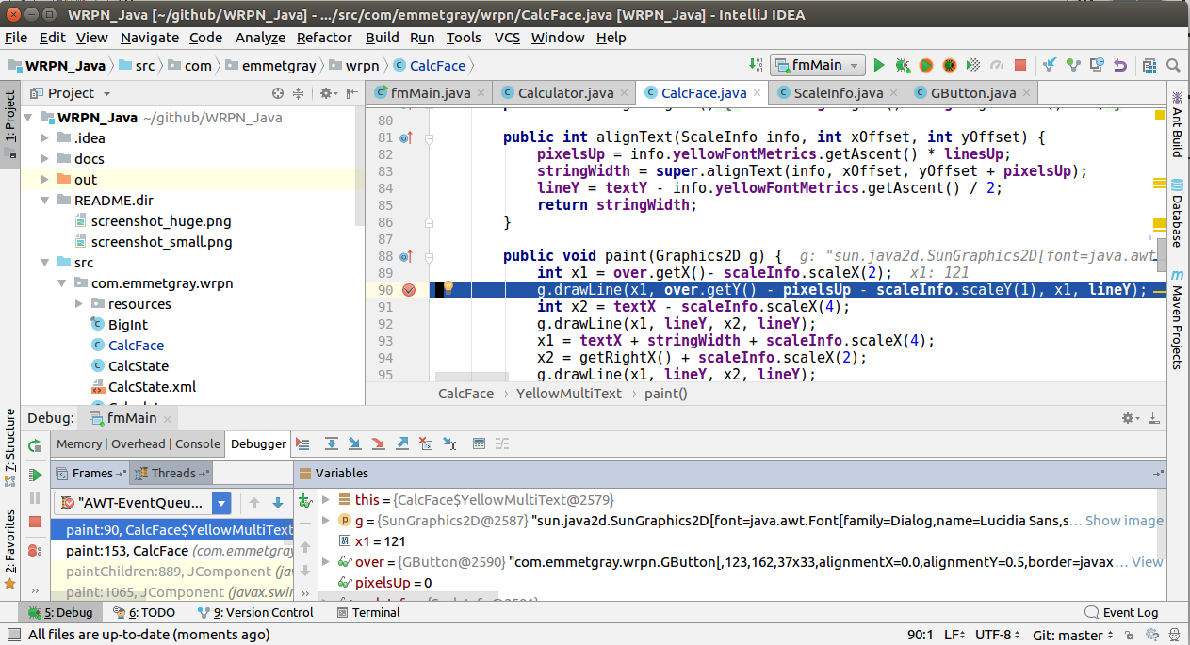
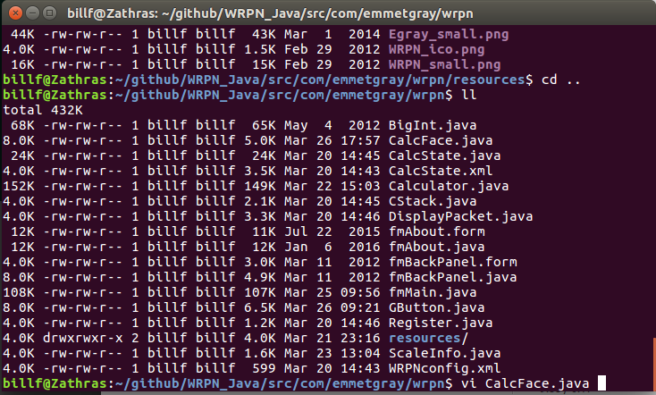
Logistics – Building and Running Programs
IDE or command-line?
GUI, or Terminal?
Notes:
Simple, quick vs.
debugger, navigation, automatic stuff
Start with terminal?

Slide 18
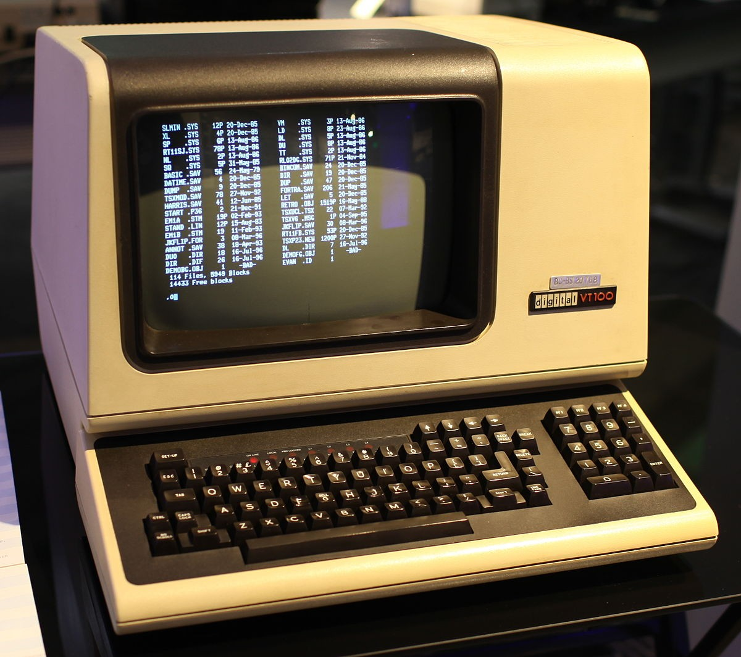
Notes:
At this point, to “hello world” in IDE and in terminal window

Slide 19
A few words about class organization

Slide 20
Logistics
Use the Comand Line
The unix servers are the primary development environment for this class
  unix1.csc.calpoly.edu through unix5.csc.calpoly.edu via ssh
  The lab computers
  Remember instructions in info/setup.txt
Java 11 (JDK 1.11) is used, but any version >= 1.8 is OK

Slide 21
Text Editors
“nano” and “pico” are available on the unix servers, and are simple
vi is always availabe
  Very capable editor
  Steep initial learning curve
  Dates back to 1976, UC Berkeley
  Name means “visual”
  Most common free version is “vim,” for “vi iMproved”.
  https://www.cs.colostate.edu/helpdocs/vi.html

Slide 22
Logistics - IDE
If you want to try using an IDE, IntelliJ IDEA is a good one for Java
  https://www.jetbrains.com/idea/
  The free version is fine
  A free license for the professional is available to students
  Also need “Java SE 11.x” from http://java.sun.com/
Use of an IDE is not required
Support for setting up your computer with an IDE will be minimal

Slide 23
Class Organization
Buy the book!
Take written notes!
Github
**** 9/20 I AM HERE ***

Slide 24

Code Conventions
Tabs set to 8
  violators will spend eternity in The Bad Place
Indent level set to 4
Other conventions in info/code_conventions.txt
Notes:
Courrier. Two spaces.

Slide 25
Logistics
Revision Control System
  github
checkgit
javac
With checkgit and javac, don’t ignore the messages it gives you!

Slide 26
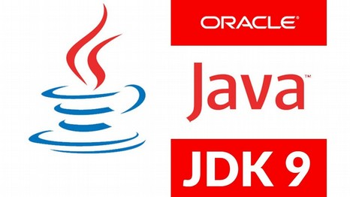
Command-Line set up
When you download Java:
  JavaSE. This is also called the JDK, and the Java SDK.
  Version 8, 9, 10 or 11 is fine, if you already have it installed
You may need to set these environment variables:
  JAVA_HOME <place where JDK was installed>
  PATH $PATH:<place where JDK was installed>/bin
  (Windows spells $PATH as “%PATH%”)
  You might need to set JDK_HOME and JRE_HOME too, but I don’t think this is necessary.
“Folder” and “directory” mean the same thing.

Slide 27
Development/Debugging Tools
grep
Thread dump: ^\
System.out.println()
javac
java -ea

Slide 28
From Python to Java…
Notes:
A way to give instructions to a computer
A way to communicate with people
A way to communicate with your (future) self
==> Programming: deeply human activity.
Extremely social.

Slide 29
Declaring and initializing variables
n = 42
name = “Zaphod Beeblebrox”
m = 99.44
int n = 42;
String name = “Zaphod Beeblebrox”;
float m = 99.44f;

Slide 30
Declaring and initializing variables
n = 42
name = “Zaphod Beeblebrox”
m = 99.44
int n = 42;
String name = “Zaphod Beeblebrox”;
float m = 99.44f;

Slide 31
Declaring Variables
int n;
String name;
float m;

Slide 32
Setting variables to a new value
n = 42
name = “Zaphod Beeblebrox”
m = 99.44
n = 42;
name = “Zaphod Beeblebrox”;
m = 99.44f;

Slide 33
Declaring and initializing variables
n = 42
name = “Zaphod Beeblebrox”
m = 99.44
int n = 42;
String name = “Zaphod Beeblebrox”;
float m = 99.44f;

Slide 34
Lists and Arrays
ppap = [‘Pen’, ‘Pineapple’,
‘Apple’, ‘Pen’ ]
String[] arr = {
“Pen”, “Pineapple”,
“Apple”, “Pen”
};
List<String> list
= java.util.Arrays.asList(
“Pen”, “Pineapple”,
“Apple”, “Pen”);

Slide 35
Lists and Arrays
ppap = [‘Pen’, ‘Pineapple’,
‘Apple’, ‘Pen’ ]
String[] arr = new String[4];
arr[0] = “Pen”;
arr[1] = “Pineapple”;
arr[2] = “Apple”;
arr[3] = “Pen”;

Slide 36
for loops
# Iterate 10 times
for n in range(1,11):
print(‘n=‘, n)
// Iterate 10 times
for (int n = 1; n <= 10; n++) {
System.out.println(“n=“ + n);
}

Slide 37
for loops
for s in ppap:
print(s, end=’ ‘)
print()
for (String s : ppapArray) {
System.out.print(s + “ “);
}
System.out.println();
for (String s : ppapList) {
System.out.print(s + “ “);
}
System.out.println();

Slide 38
for loops
for (int n = 0; n < arr.length; n++)
{
System.out.print(arr[n] + “ “);
}
System.out.println();
for (int n=0; n < list.size(); n++) {
System.out.print(list.get(n)
+ “ “);
}
System.out.println();
for i in range(0, len(ppap)):
print(s[i], end=’ ‘)
print()

Slide 39
Start-up code
if __name__ == “__main__”:
print(“Hello World”)
public class MyClass {
public static void
main(String[] args)
{
System.out.println(
“Hello World”);
}
}

Slide 40
Running a Program
python3 foo.py
javac MyClass.java
java MyClass

Slide 41
Defining and calling a function
public class MyClass {
public static int shout(String s)
{
System.out.println(s+”!”);
return 7;
}
public static void
main(String[] args) {
int x = shout(“Huzzah”);
System.out.println(x);
}
}
def shout(s):
print(s + ‘!’)
return 7
x=shout(‘Huzzah’)
print(x)

Slide 42
Defining and calling a function
>>> def add_numbers(a, b):
... sum = a + b
... print str(a) + " + " +
str(b) + " = " + str(sum)
>>> add_numbers(2,2)
2 + 2 = 4
>>> add_numbers("2", "2")
2 plus 2 is 22
void add_numbers(int a, int b) {
int sum = a + b;
System.out.println(
a + " + " + b +
" = " + sum);
}
...
add_numbers(2, 2);
add_numbers("2","2");
Does not compile!

Slide 43
Start here Friday

Slide 44
Project Assignment #1
Pay attention to what your specification tells you what not to do.
  “Explicit non-requirement”
  “For this assignment, you might be annoyed by the fact that you're forced to write relatively inefficient O(n^2) code in EventSchedule. You should be! As you learned in prior classes, there are more efficient data structures for maintaining a queue of elements that is sorted from earliest to latest, like event schedule. You will be addressing this in a later assignment, once we've learned some more language constructs that are helpful for this. ”

Slide 45
Project Assignment #1
Don’t get lost in the Javadocs
  The given code has a List<Event> data member. What does list do?
    Adds elements to itself
    Removes elements from itself
    Iterates through its members
    Tells you how many items are on the list
    Gets the element at a certain index
    And about a hundred other things that are irrelevant to this assignment
      https://docs.oracle.com/en/java/javase/11/docs/api/java.base/java/util/List.html

Slide 46
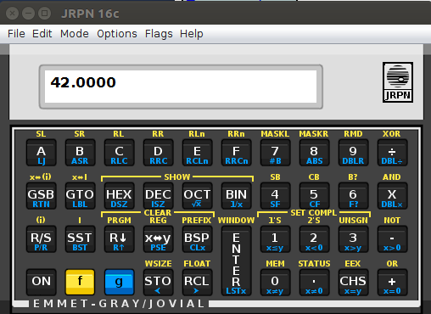
OOP:
An Object-Oriented Calculator!
Notes:
A way to give instructions to a computer
A way to communicate with people
A way to communicate with your (future) self
==> Programming: deeply human activity.
Extremely social.

Slide 47
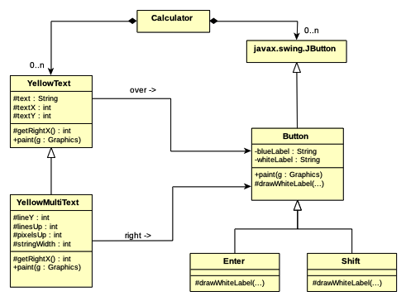
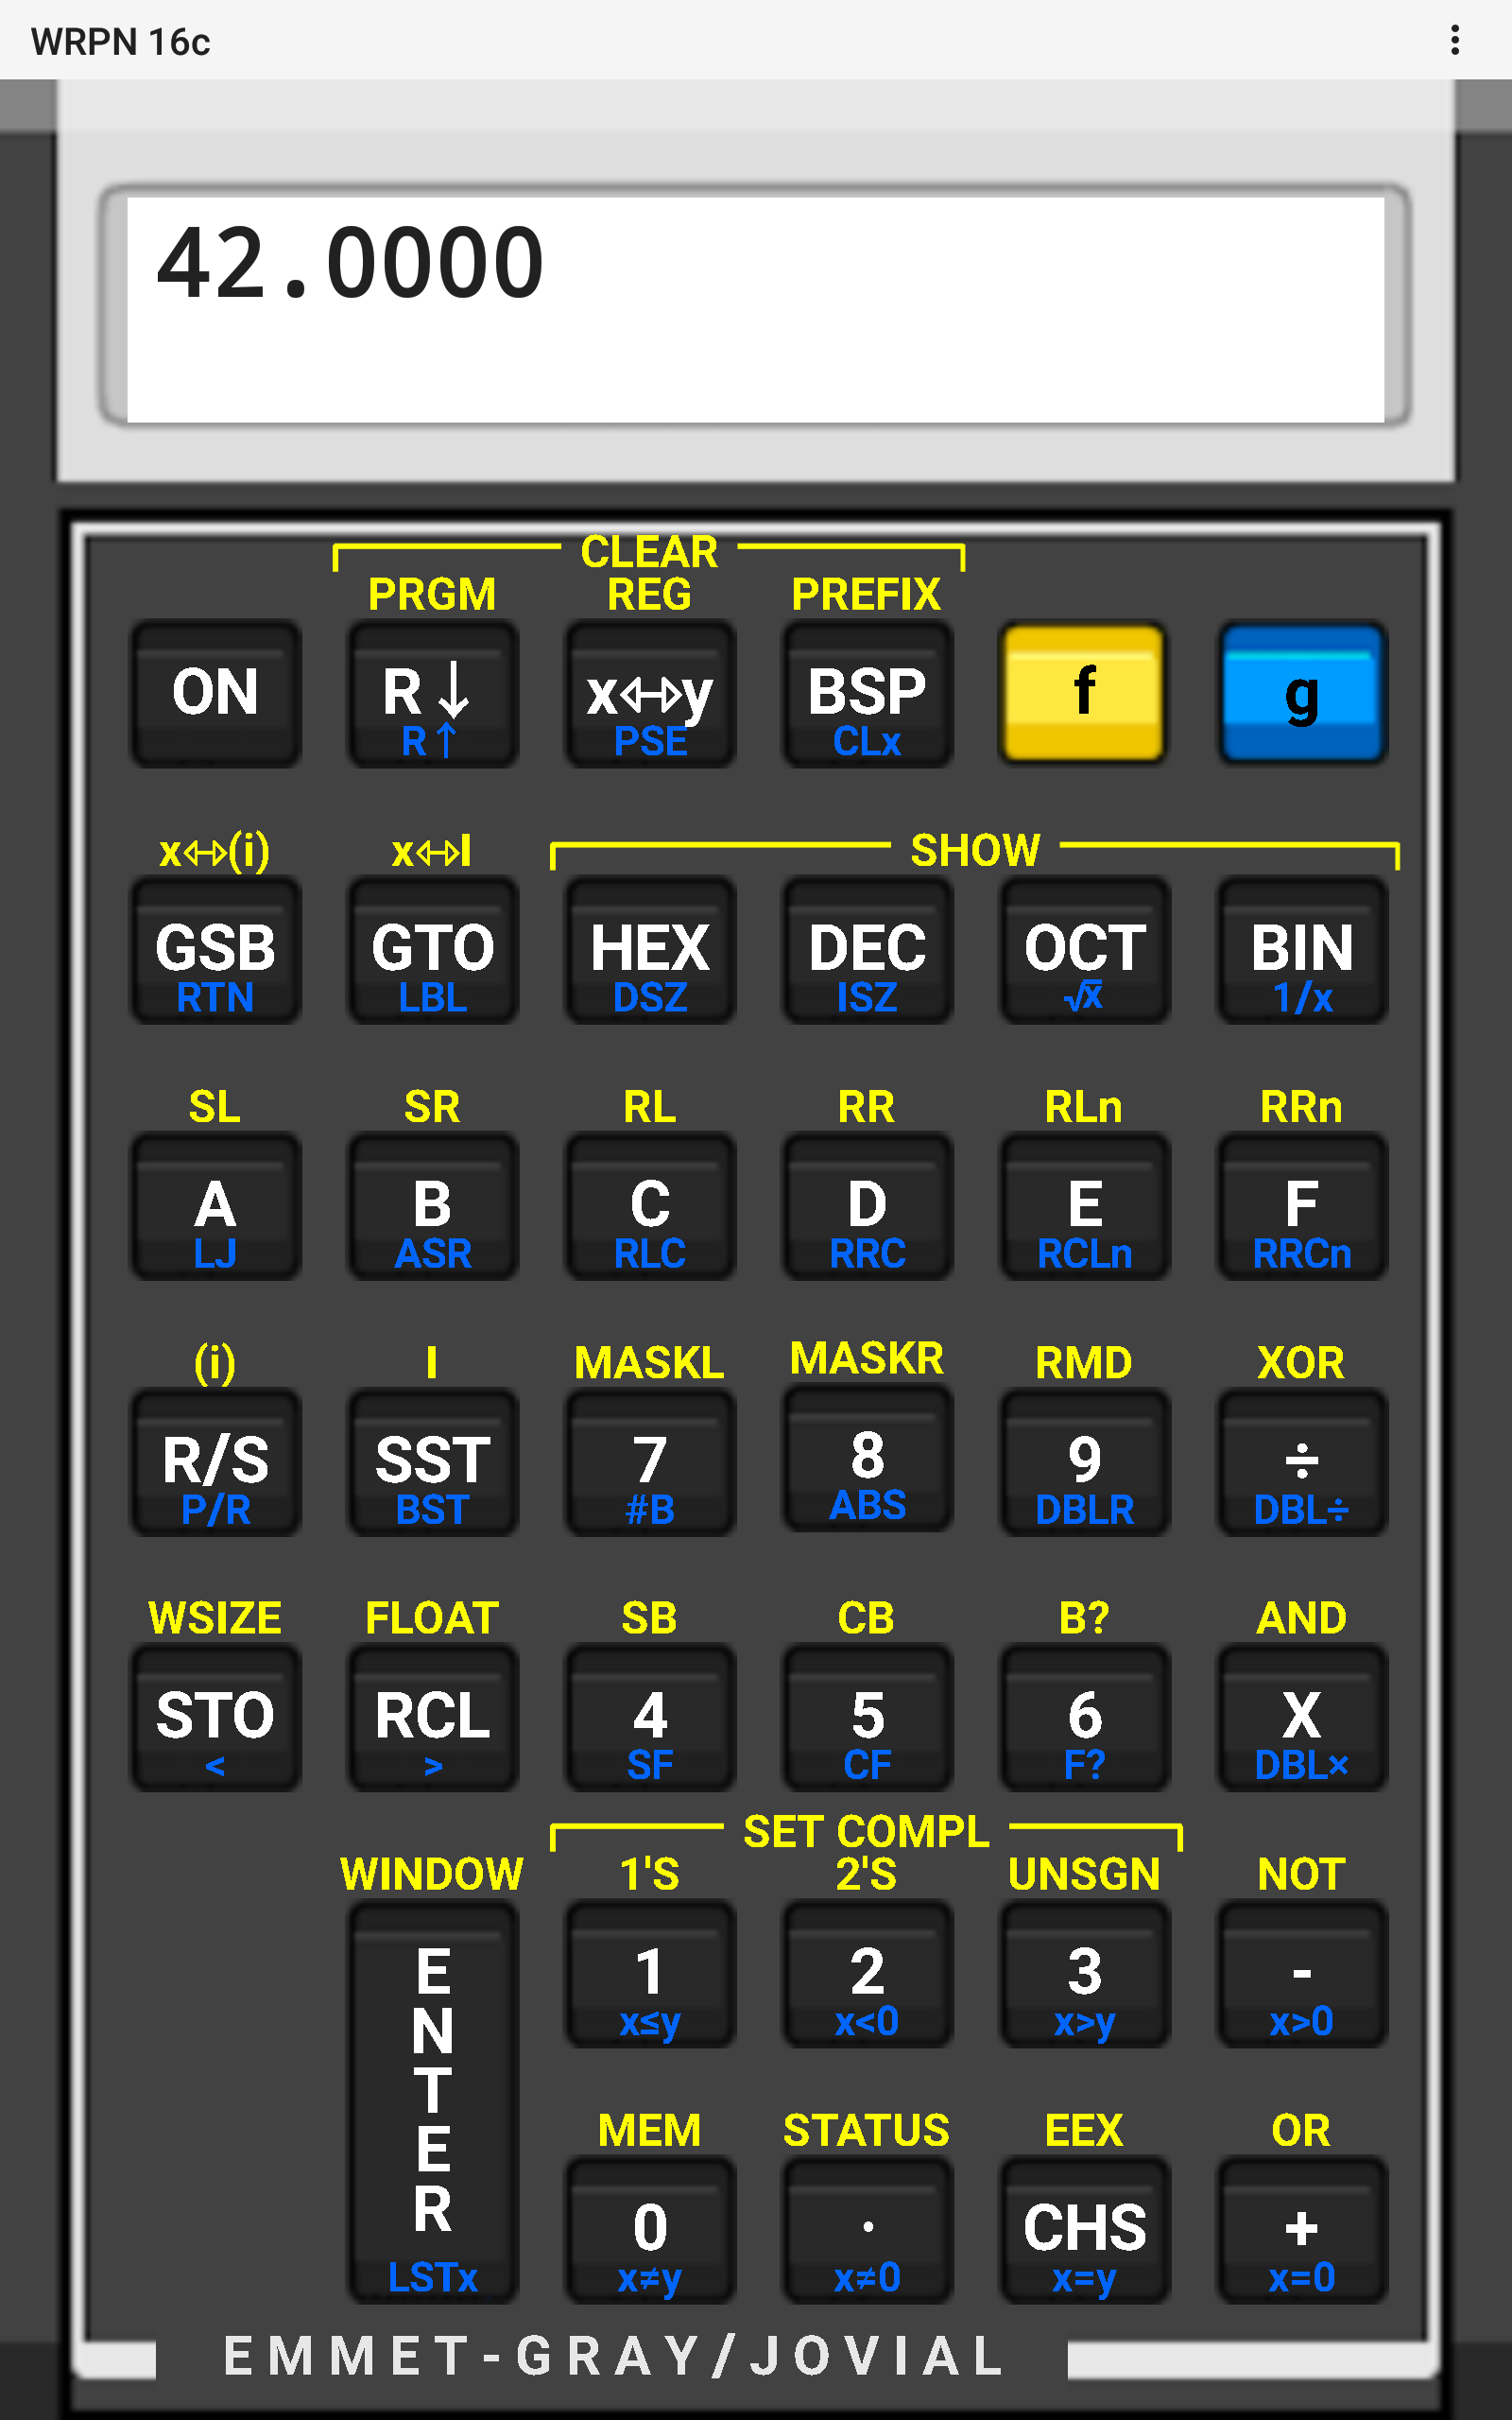

Slide 48
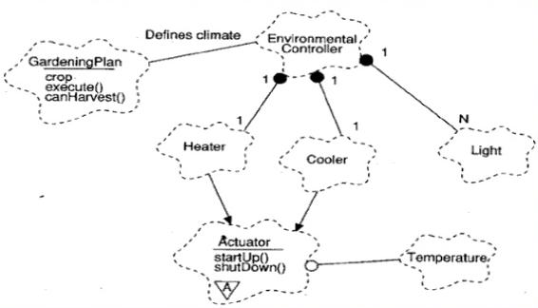
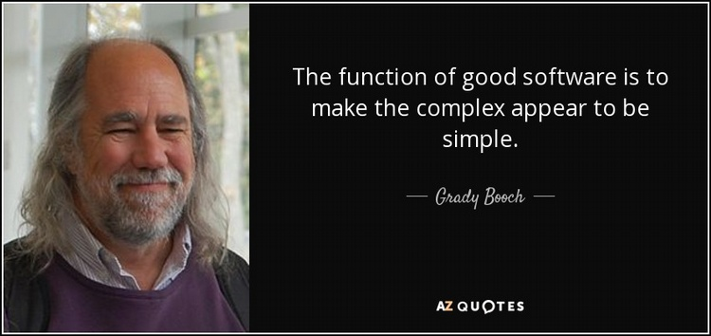
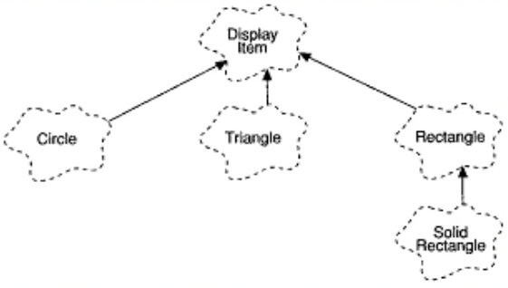

Notes:
OO Method Wars
Object Behavioralists vs. Object Structuralists
Object Behavioralists
Rebecca Wirfs-Brock
Use Cases
Grady Booch
Jim Rumbaugh
Ivar Jacobson

Slide 49
Spritely Documentation
https://spritely.jovial.com/
UML is used to give an overview and introduction

Slide 50
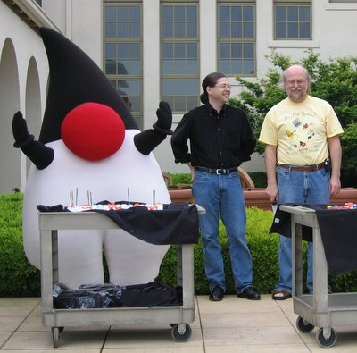
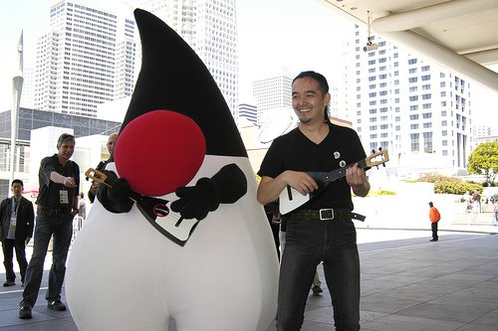
A bit more about Java...
Notes:
A way to give instructions to a computer
A way to communicate with people
A way to communicate with your (future) self
==> Programming: deeply human activity.
Extremely social.

Slide 51
Non-object data types
byte byte b = 0x7f; b = (byte) 0xff;
short short s = 32767;
int 42
long 27L
char ‘c’, ‘\t’, ‘\n’
boolean true, false
float 3.7f
double 42.0
Notes:
All signed

Slide 52
Constants
public final static int MY_HAPPY_CONSTANT = 777;
public final static String MY_NAME = “Krusty”;
Notes:
All signed

Slide 53
Other stuff...
Check out section 3.5 of the book, “Operators”
Garbage collection
if/else, while, do/while, switch, break
  (section 3.8)
final

Slide 54
Implementing a method
See p1/*.java

Slide 55
Objects, like Strings
String s = null;
System.out.println(s);
s = “hello”;
System.out.println(s);
Notes:
identity
state
behavior

Slide 56
Objects, like Strings
String s = null;
System.out.println(s);
s = “hello”;
System.out.println(s);
“411” is an object. Is 411 an object?
Notes:
identity
state
behavior

Slide 57

Objects, like Strings
String s = null;
System.out.println(s);
s = “hello”;
System.out.println(s);
Notes:
identity
state
behavior

Slide 58
== vs equals()
3 == 3
3 == 47
“hello” == “hello”
String s = getH() + “ello”; // getH returns “h”
“hello” == s
“hello”.equals(s)
s.equals(“hello”)
“null”.equals(null)
s = null
s.equals(“null”)
s.equals(null)

Slide 59
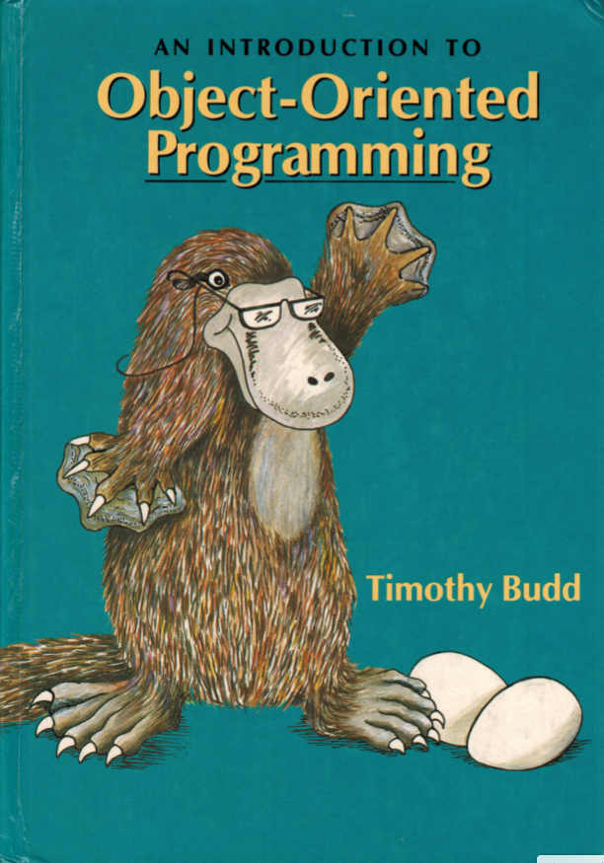
What is OO all about
classes
instances
methods
members
polymorphism

