Slide 1

CSC 203 / CPE 203
Week 6
Project-Based Object-Oriented
Programming and Design
(using Java)
Bill Foote
wffoote@calpoly.edu
(http://jovial.com)
Notes:
M: 1-14
T:; 1-22
W: To, or through python vars
R: UP to javadocs @ end
F: through 49

Slide 2
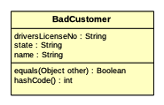

Slide 3
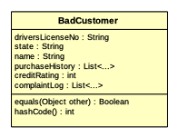

Slide 4
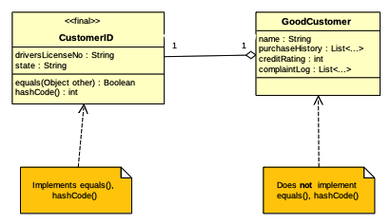

Slide 5
Challenge:
Make it so that a given customer is only ever represented by one instance of GoodCustomer.
The “canonical GoodCustomer instance”

Slide 6
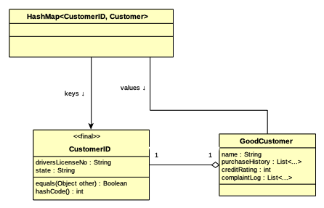

Slide 7
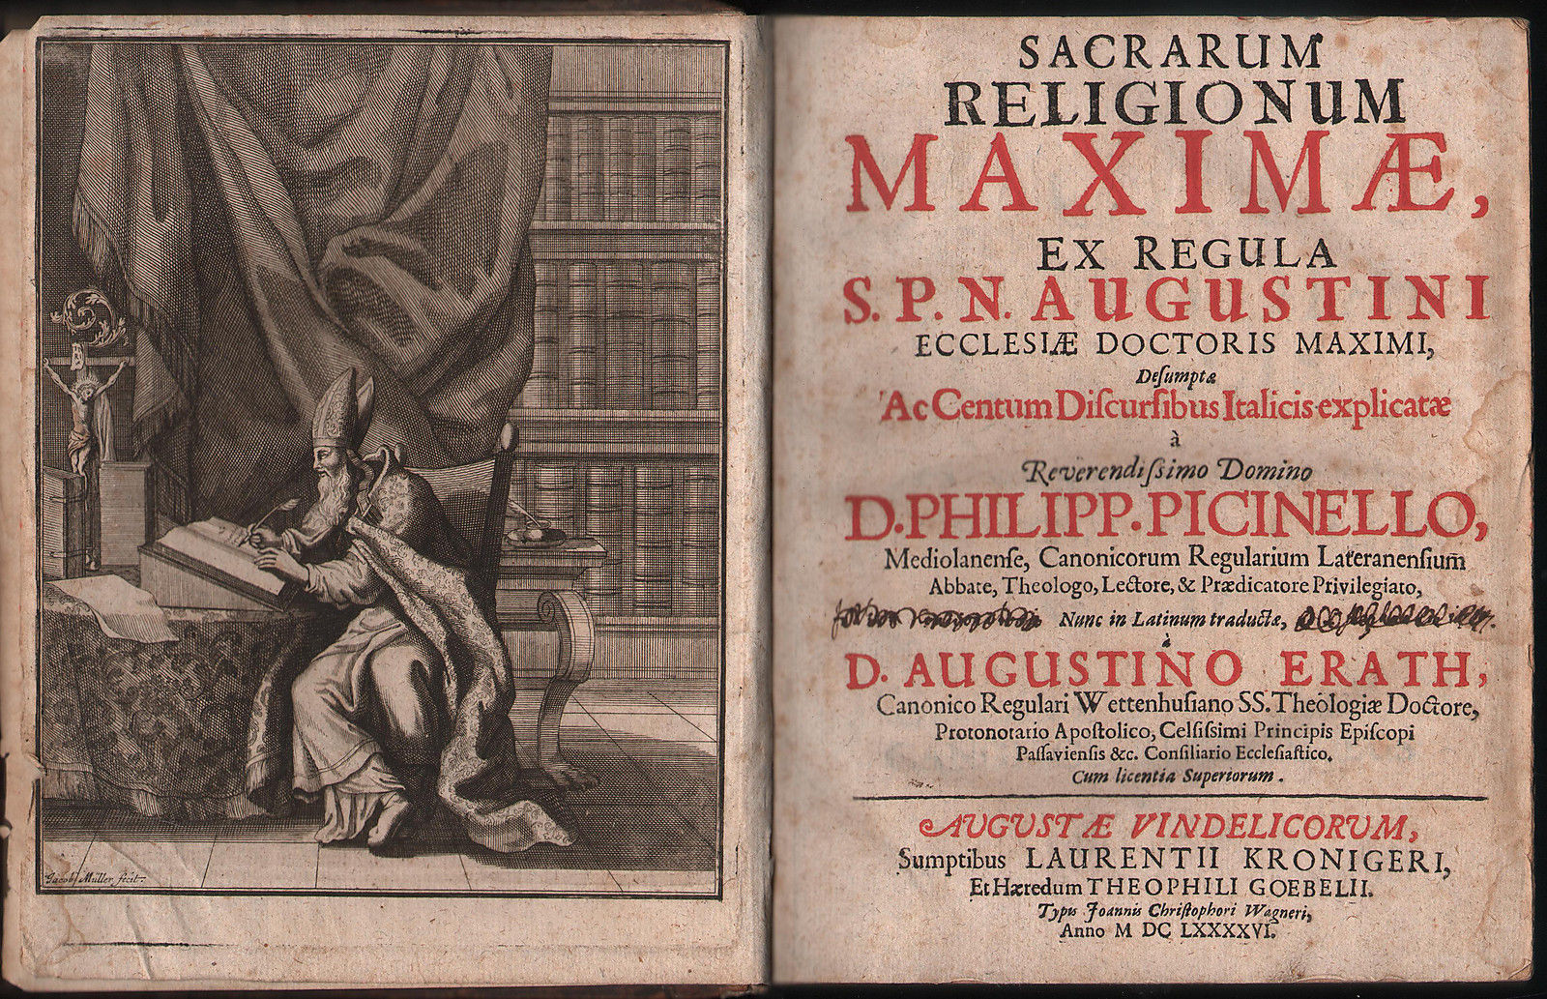
Canonicalizing Objects

Slide 8
canonical
(Historically, "according to religious law")
<mathematics>
1. A standard way of writing a formula. Two formulas such as 9 + x and x + 9 are said to be equivalent because they mean the same thing, but the second one is in "canonical form" because it is written in the usual way, with the highest power of x first.
http://foldoc.org/canonical

Slide 9
Every time we see a driver’s license...
String state = ...;
String driversLicenseNo = ...;
CustomerID id = new CustomerID(state, driversLicenseNo);
if (the hash map doesn’t contain a GoodCustomer at [id]) {
Create a new GoodCustomer object
store it in the hash map at [id]
}
Use the object in the hash map at [id]

Slide 10
Are they the same customer?
GoodCustomer c1 = ...;
GoodCustomer c2 = ...;
if (they are the same customer) {
do something
}

Slide 11
Are they the same customer?
GoodCustomer c1 = ...;
GoodCustomer c2 = ...;
if (c1 == c2) { // Each customer has just one instance!
do something
}

Slide 12
Midterm Results

Slide 13
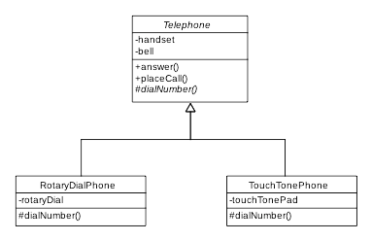
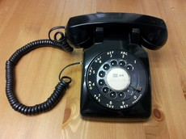
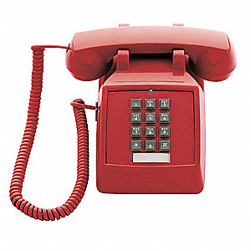
Inheritance and Abstract Classes

Slide 14
public class Telephone {
public void answer() {
do the answer stuff;
}
public void placeCall() {
handset.takeOffHook();
dial.dial(7);
dial.dial(7);
dial.dial(2);
...
handset.talkAndListen();
handset.hangUp();
}
}
ZAbKGHCEkSC6

Slide 15
abstract public class Telephone {
public void placeCall() {
handset.takeOffHook();
dialNumber();
...
handset.talkAndListen();
handset.hangUp();
}
public void answer() {
do the answer stuff;
}
abstract protected void dialNumber();
}
ZAbKGHCEkSC6

Slide 16
public class RotaryDialPhone extends Telephone {
private RotaryDial dial;
@Override protected void dialNumber() {
dial.dial(7);
dial.dial(7);
dial.dial(2);
}
}
ZAbKGHCEkSC6

Slide 17
public class TouchTonePhone extends Telephone {
private TouchTonePad pad;
@Override protected void dialNumber() {
pad.push(7);
pad.push(7);
pad.push(2);
}
}`
ZAbKGHCEkSC6

