Slide 1

CSC 203 / CPE 203
Week 7
Project-Based Object-Oriented
Programming and Design
(using Java)
Bill Foote
wffoote@calpoly.edu
(http://jovial.com)
Notes:
M: 1-14
T:; 1-22
W: To, or through python vars
R: UP to javadocs @ end
F: through 49

Slide 2
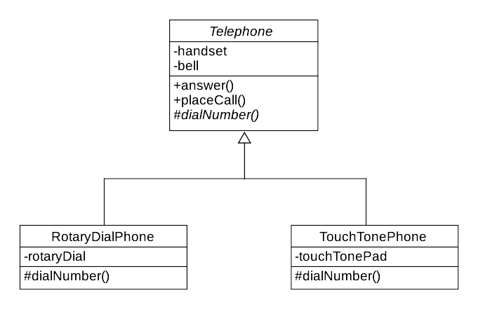

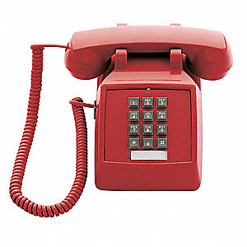
Inheritance and Abstract Classes

Slide 3
Lab 6
“Each sessionId is a unique identifier represented as a String”
  NOT: “A string that ends in a number.”
Object model of log file:

Slide 4
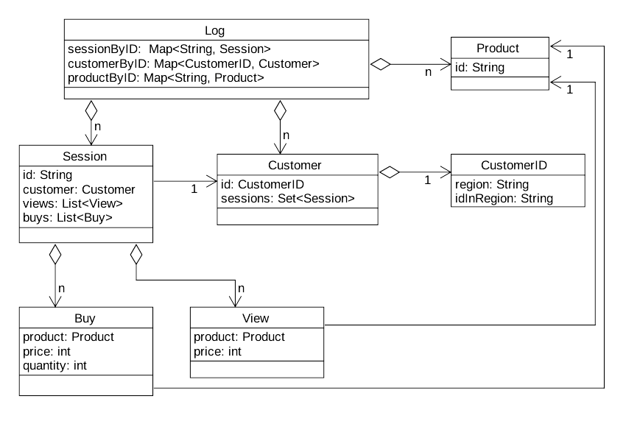

Slide 5
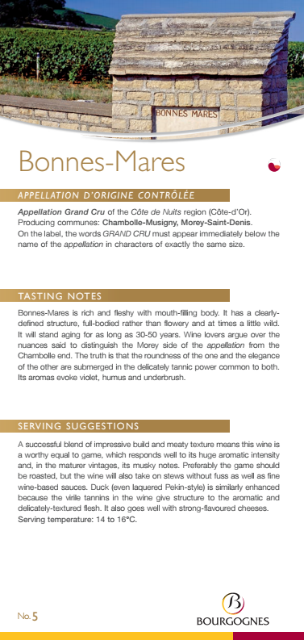

A Wine-y Mapping Contract

Slide 6
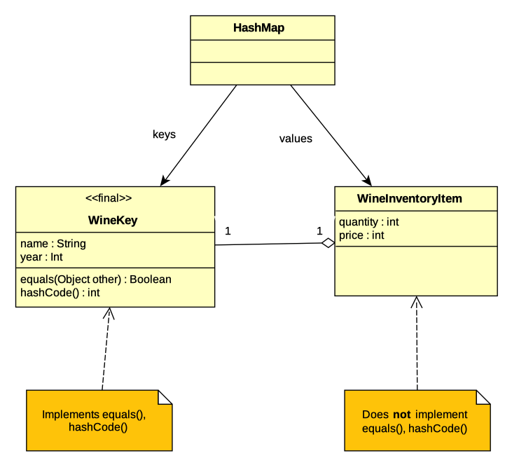

Slide 7
WineInventory Contract
??
public class WineInventory {
private final Map<WineKey, WineInventoryItem> stock;
public WineInventory() {
stock = new HashMap<WineKey, WineInventoryItem>();
}
public WineInventoryItem getWine(String name, int year) {
return stock.getOrCreateItem(new WineKey(name, year), ...);
}
}

Slide 8
WineInventory Contract
??
public class WineInventory {
public WineInventory() {
...
}
public WineInventoryItem getWine(String name, int year) {
...
}
}

Slide 9
public class WineInventoryItem {
/**
* Get the wine's name (appellation)
*/
public String getName() { ... }
}
/**
* Get the wine's year
*/
public int getYear() { ... }
/**
* Get the quantity on hand
*/
public int getQuantity() { ... }
/**
* Set the quantity on hand
*/
public void setQuantity(int quantity) { ... }
/**
* Get the price
*/
public int getPrice() { ... }
/**
* Set the price
*/
public void setPrice(int price) { ... }
}

Slide 10
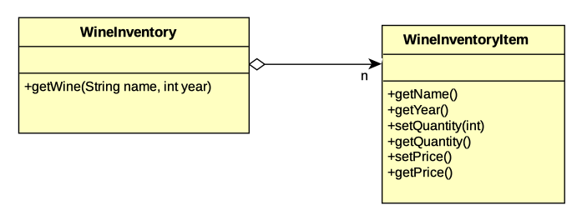

Slide 11
But wait, there’s more!
What do the methods actually do?
  Postconditions
What do they require?
  Preconditions
What about the class is always true?
  Invariants
How is all this explained?
  Text documentation
  Formally, with preconditions, postconditions and invariants?

Slide 12
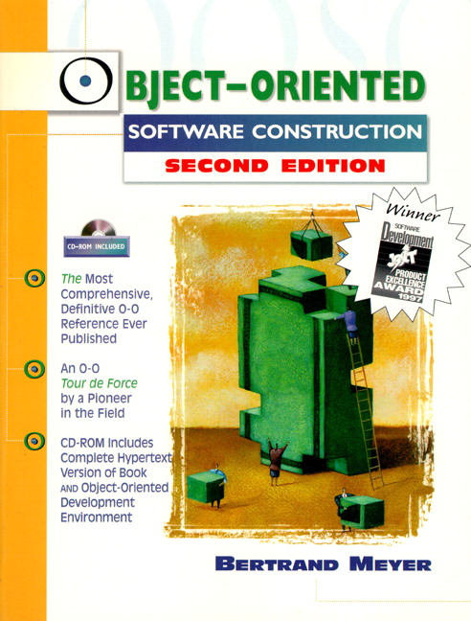
Let’s Get Assertive
About (API) Contracts
public class foo {
public static void
main(String[] args)
{
assert 1 == 3;
System.out.println(
"hello");
}
}

Slide 13
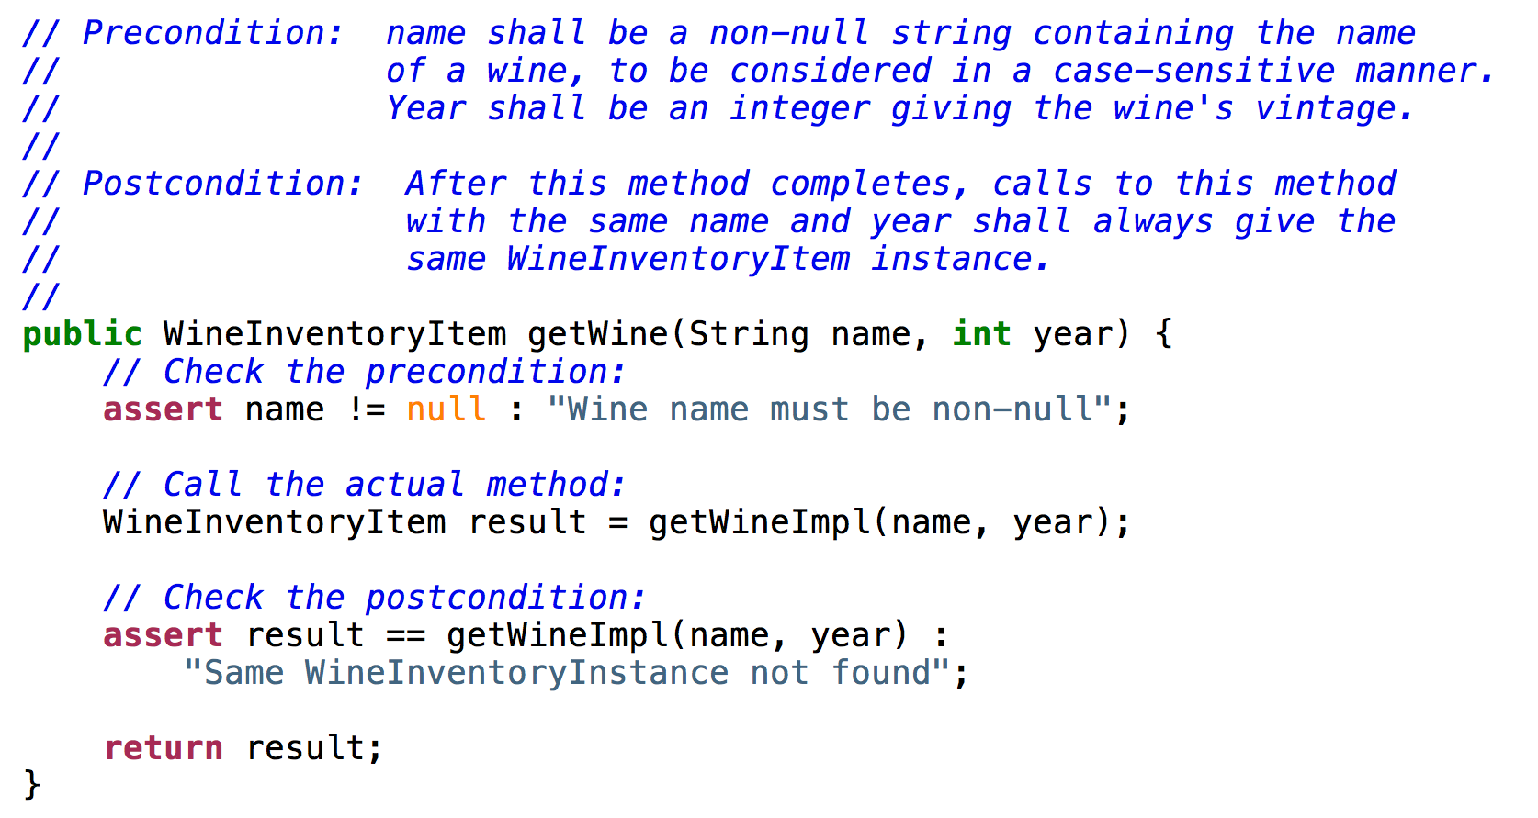

Slide 14
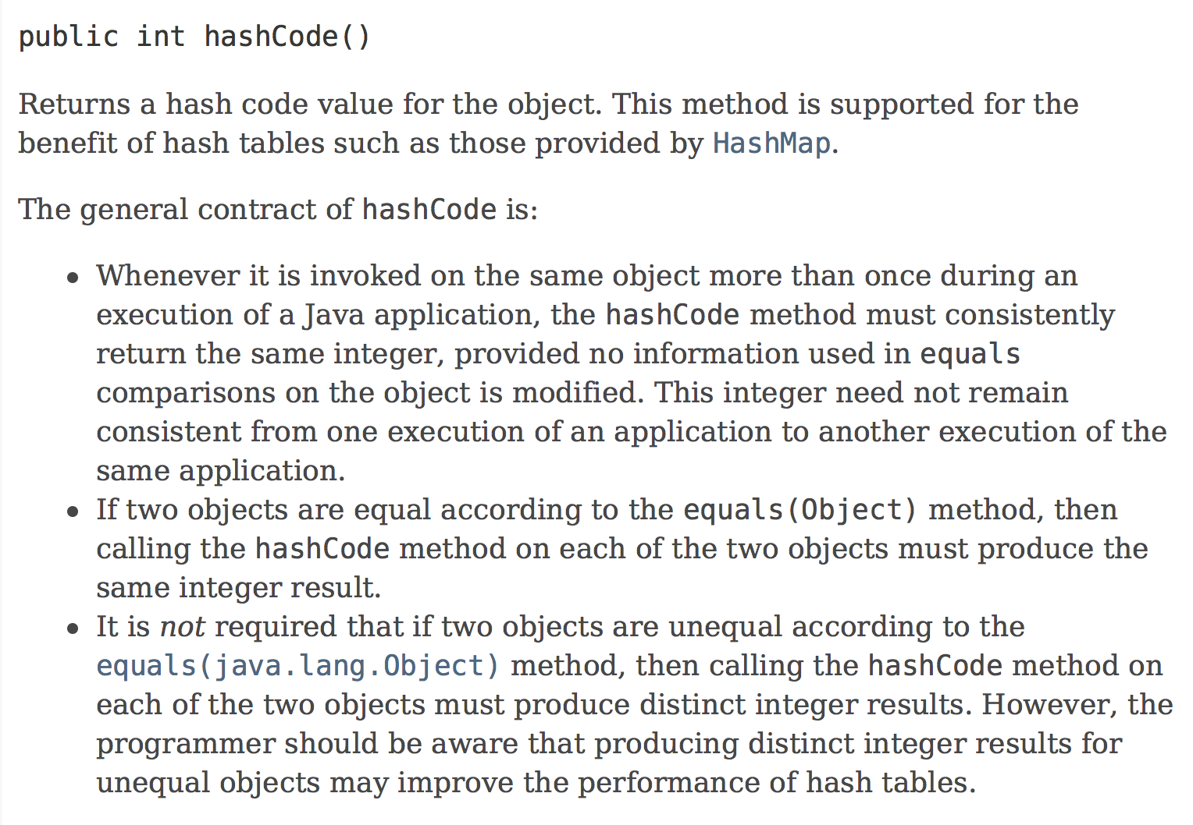

Slide 15
Can we validate equals/hash code contract for keys?
Yes, but it’s a little expensive. Good unit test, though!
  This validates an invariant of WineInventory
    “Each <wine name, year> pair has <= 1 WineInventoryItem instance”
    For all keys k1 in the map {
    int numMatches = 0
    for all keys k2 in the map {
    if k1.equals(k2) {
    assert k1.hashCode()
    == k2.hashCode();
    numMatches++
    }
    }
    assert numMatches == 1;
    }

Slide 16
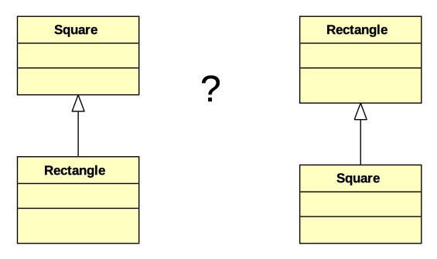
Is a square a rectangle, or is a rectangle a square?

Slide 17
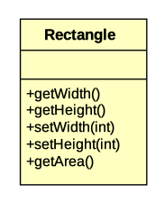
What is the contract for Rectangle?

Slide 18
What is the contract for Rectangle?
// Sets the width to w.
// Postcondition:
// After this method completes,
// calls to getWidth() shall
// return w, and the result
// of calling getHeight()
// shall remain unchanged.
//
void setWidth(int w) { ... }

Slide 19
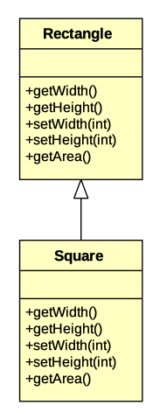
Does Square get to violate Rectangle’s contract?
// Sets the width to w.
// Postcondition:
// After this method completes,
// calls to getWidth() shall
// return w, and the result
// of calling getHeight()
// shall remain unchanged.
//
void setWidth(int w) { ... }

Slide 20

Does Square get to violate Rectangle’s contract?
No, no, no!
// Sets the width to w.
// Postcondition:
// After this method completes,
// calls togetWidth() shall
// return w, and the result
// of calling getHeight()
// shall remain unchanged.
//
void setWidth(int w) { ... }

Slide 21
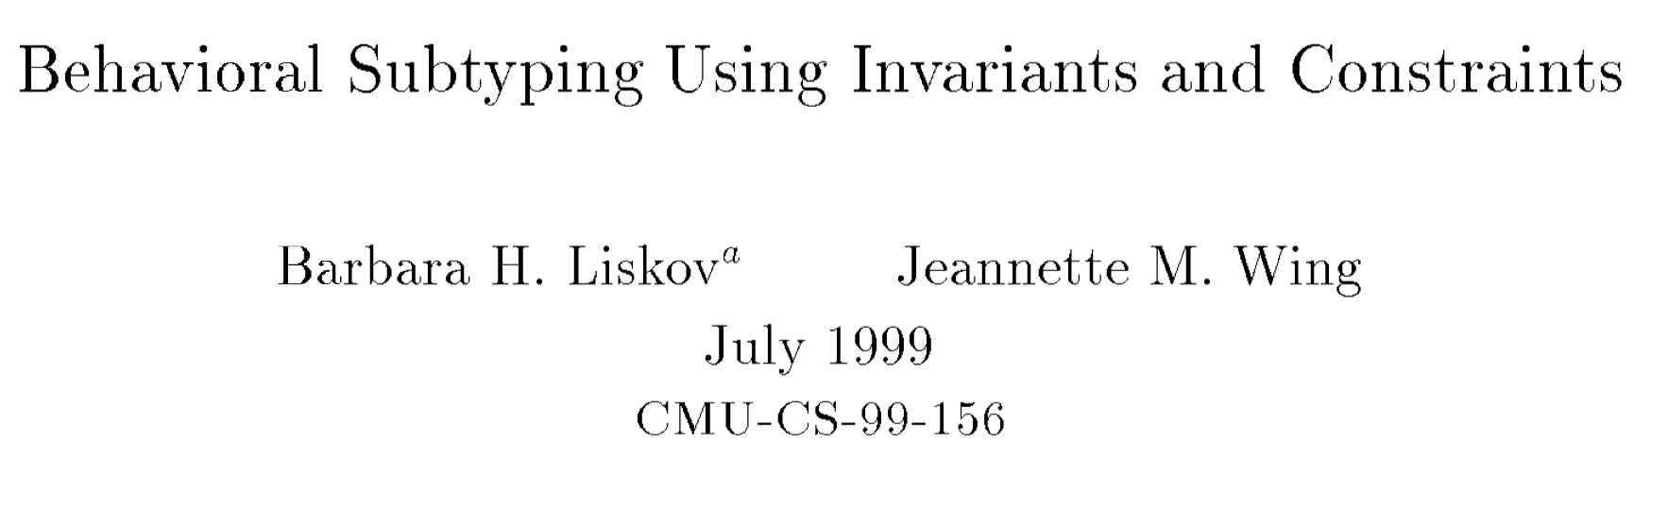
Liskov Substitution Principle
(First published in 1994, updated in 1999)

Slide 22
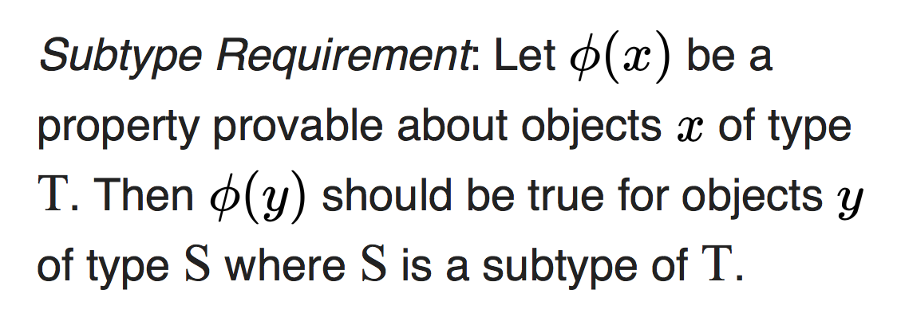
// Sets the width to w.
// Postcondition:
// After this method completes,
// calls togetWidth() shall
// return w, and the result
// of calling getHeight()
// shall remain unchanged.
//
void setWidth(int w) { ... }

Slide 23
LSP: Subtype Requirements
Preconditions may only be weakened
Postconditions may only be strengthened
Invariants must be preserved
Subtypes may not allow state changes that are not permissible in the supertype (“history rule”)`

Slide 24
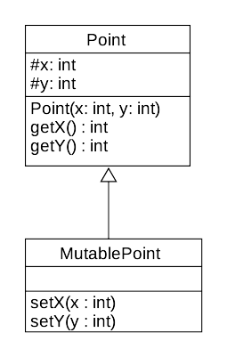

State Rule Violation

Slide 25
LSP: Subtype Requirements
Preconditions may only be weakened
Postconditions may only be strengthened
Invariants must be preserved
Subtypes may not allow state changes that are not permissible in the supertype (“history rule”)
Are all “subtypes” in an OO system really Liskov-Substitutable?
Should they be?

Slide 26
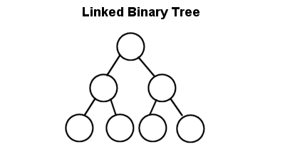
Different types of lists...
12
99
37
6
6 12 37 99

Slide 27
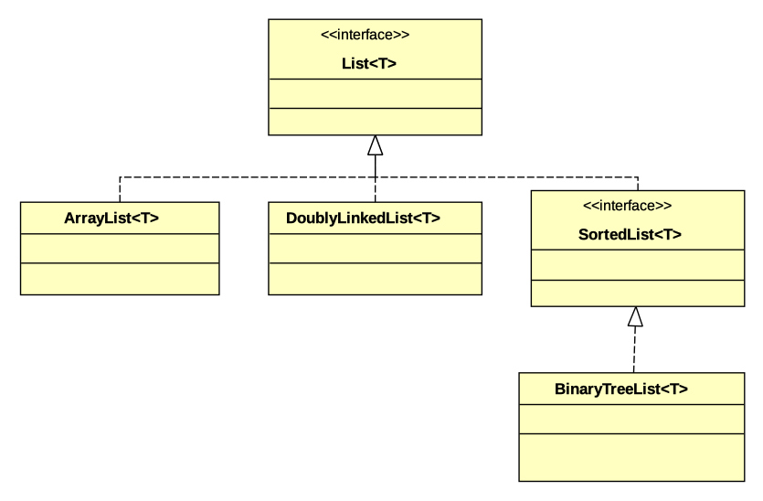

Slide 28
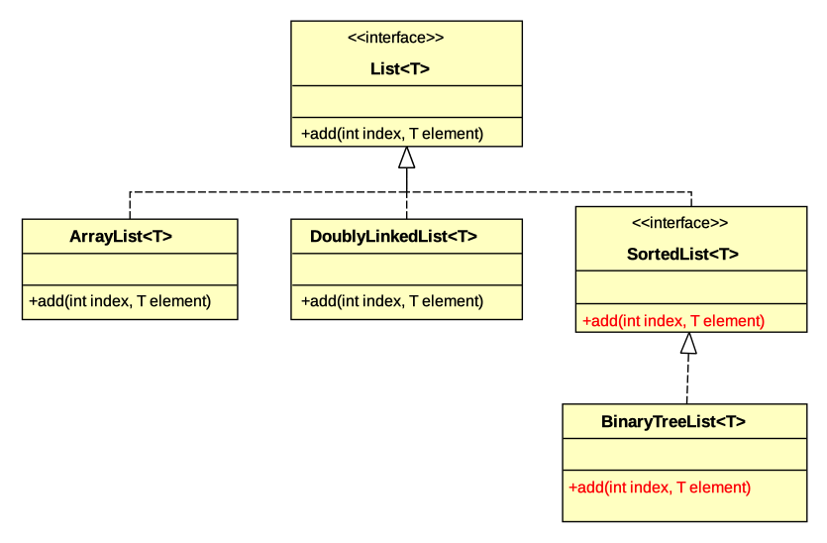

Slide 29
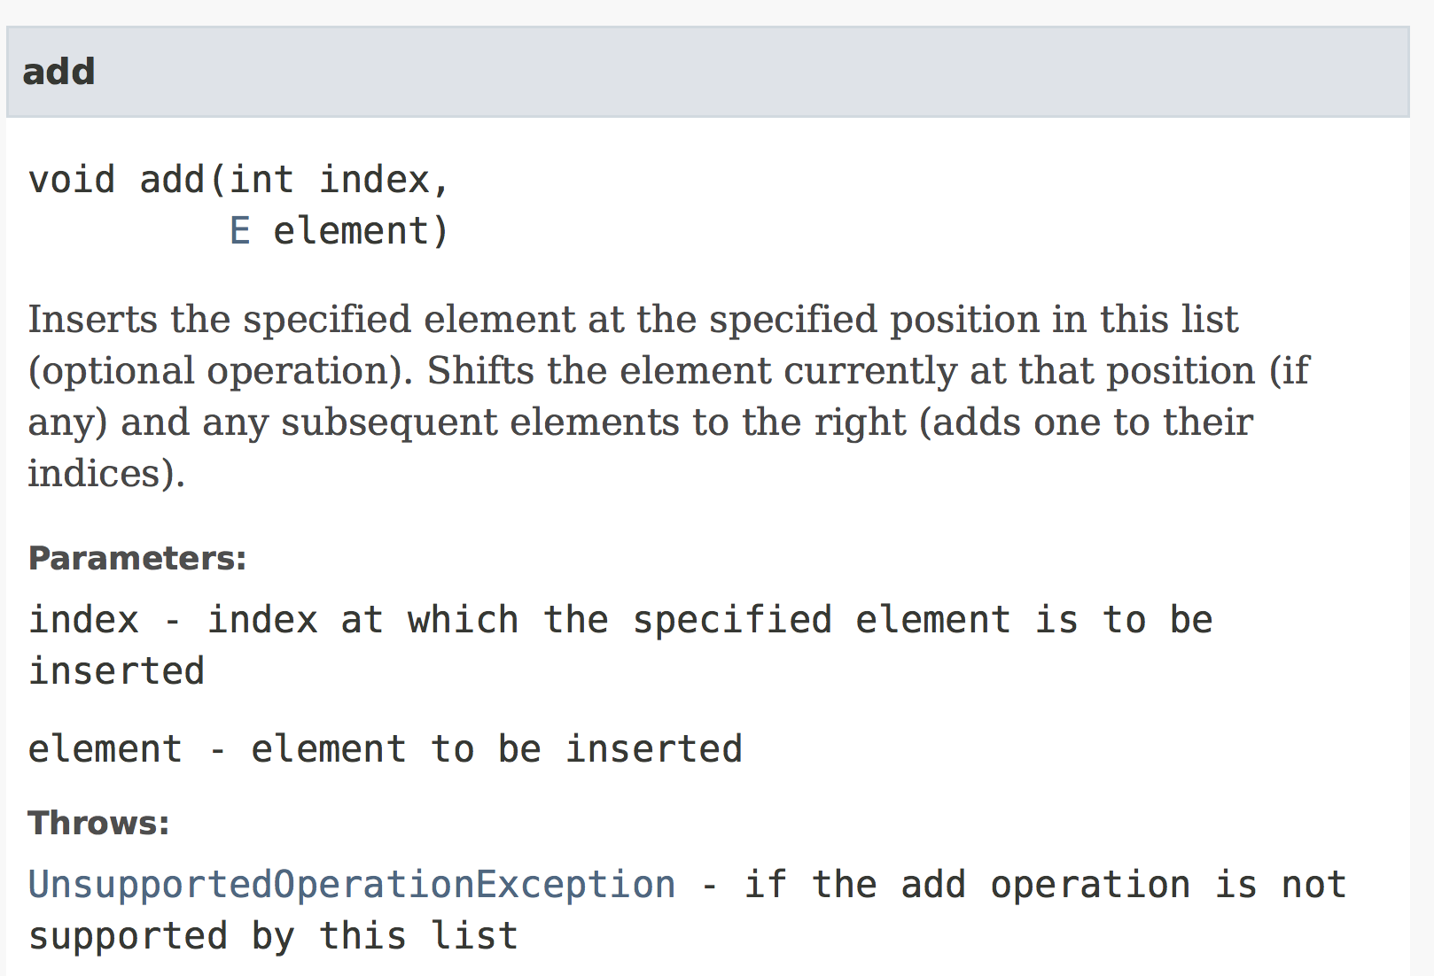

Slide 30
What’s in a Name?

Slide 31
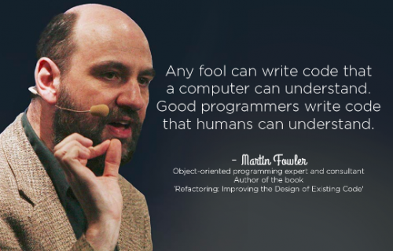
What’s in a Name?

Slide 32
“Define an interface that expresses what your animation action needs to know about entities, and have Entity implement this interface.”

Slide 33
“Define an interface that expresses what your animation action needs to know about entities, and have Entity implement this interface.”
What should this interface be called?

Slide 34
Acronyms!
SOLID
  Single Responsibility Principle
  Open/Closed Principle
  Liskov Substitution Principle
  Interface Segregation Principle
  Dependency Inversion Principle

Slide 35
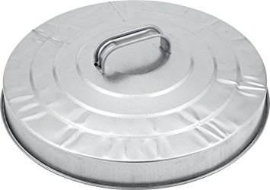

Beware of Acronyms!
SOD-LID
  Single Responsibility Principle
  Open/Closed Principle
  Design By Contract
  Liskov Substitution Principle
  Interface Segregation Principle
  Dependency Inversion Principle

Slide 36
Acronyms!
SOLID
  Single Responsibility Principle
  Open/Closed Principle
  Liskov Substitution Principle
  Interface Segregation Principle
  Dependency Inversion Principle

Slide 37
Interface Segregation Principle
Robert Martin, consulting for Xerox

Slide 38
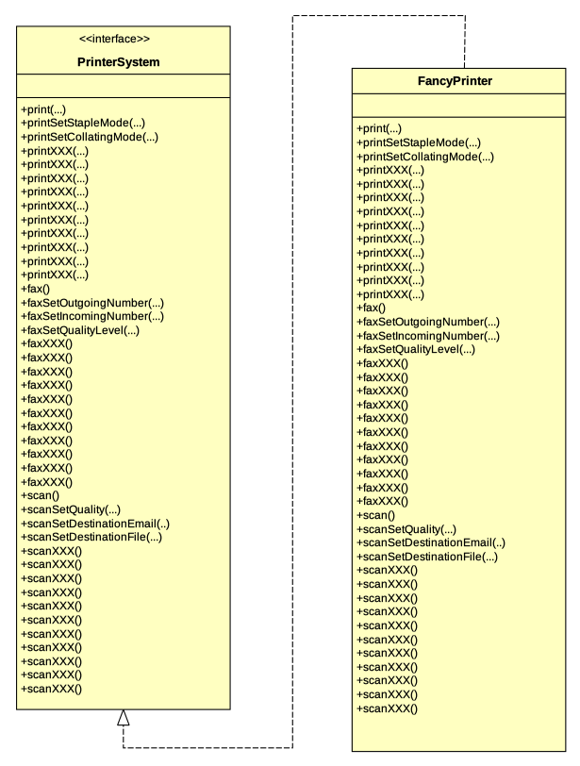

Slide 39
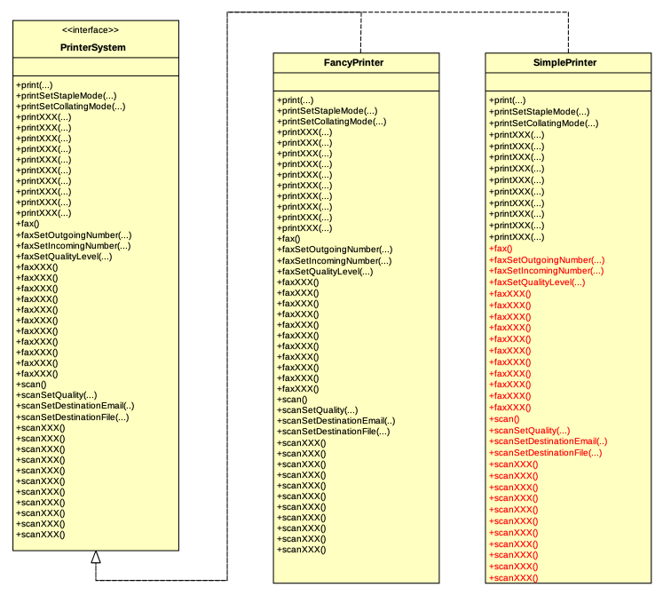

Slide 40
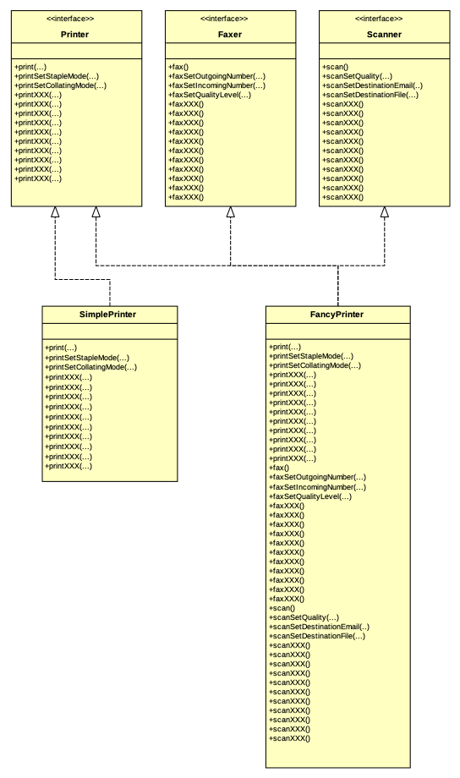

Slide 41
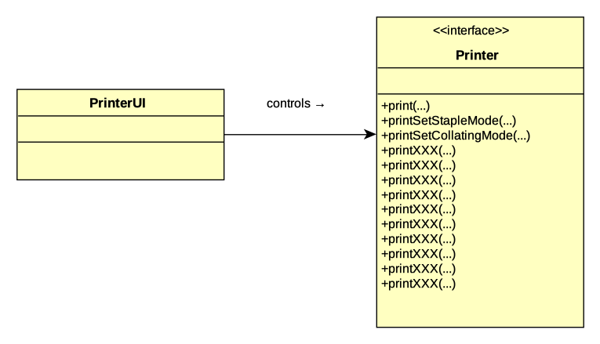

Slide 42
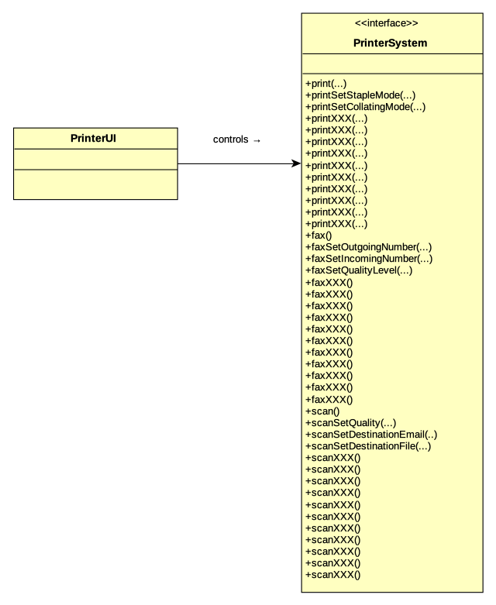
“Clients should not be forced to depend on methods that they do not use.”
Interface
Segregation
Principle

Slide 43
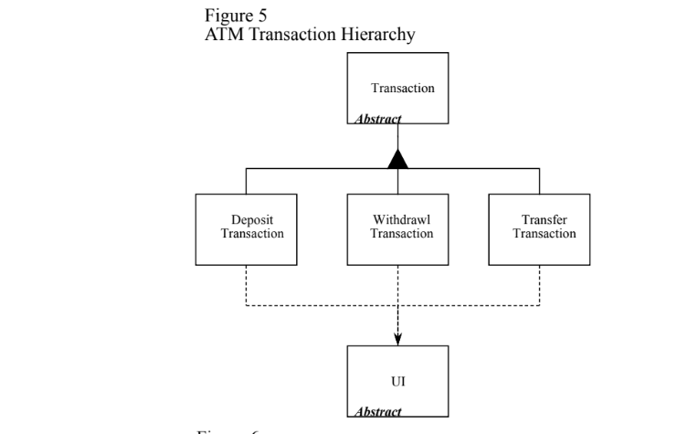
https://drive.google.com/file/d/0BwhCYaYDn8EgOTViYjJhYzMtMzYxMC00MzFjLWJjMzYtOGJiMDc5N2JkYmJi/view

Slide 44
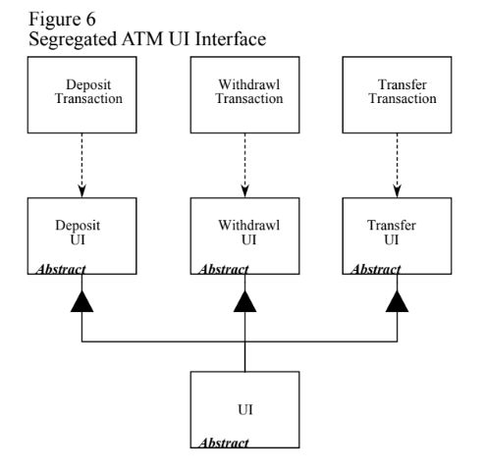
“Role Interfaces”
https://drive.google.com/file/d/0BwhCYaYDn8EgOTViYjJhYzMtMzYxMC00MzFjLWJjMzYtOGJiMDc5N2JkYmJi/view

Slide 45
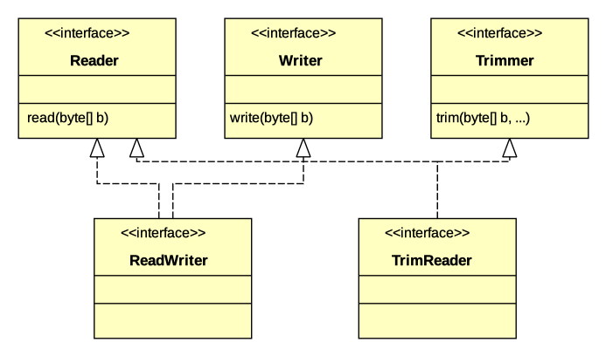
A questionable example...
https://codeburst.io/understanding-solid-principles-interface-segregation-principle-b2d57026cf6c

Slide 46
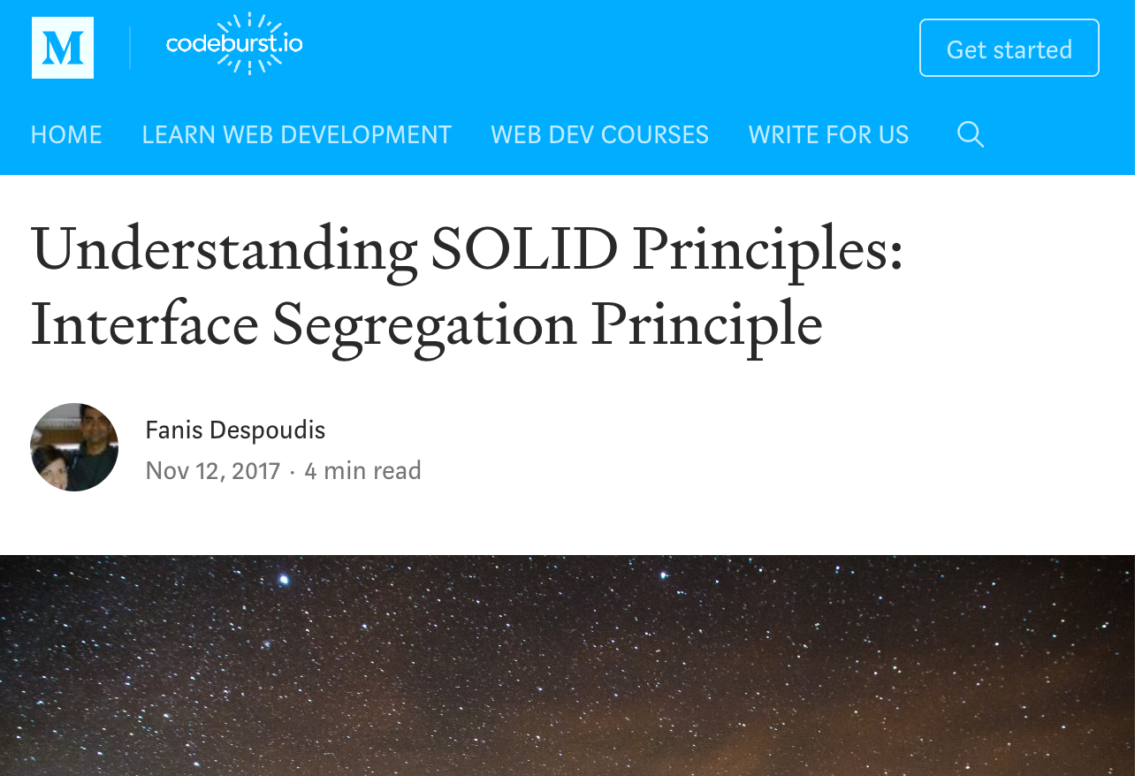

Slide 47


Slide 48
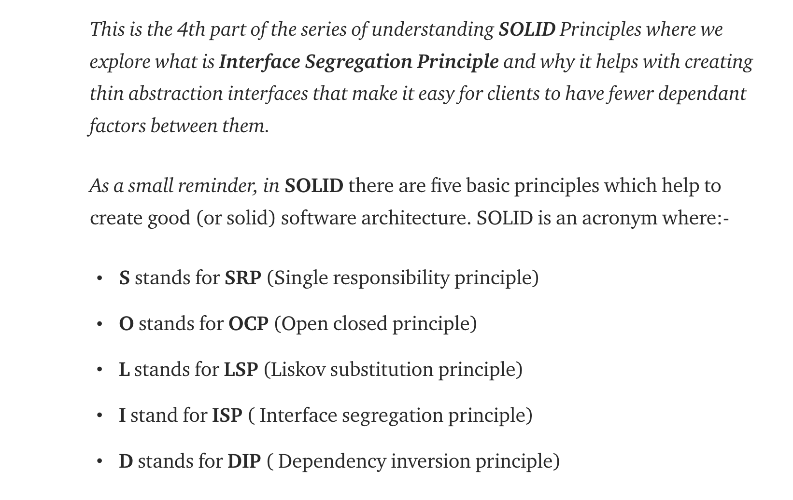

Slide 49
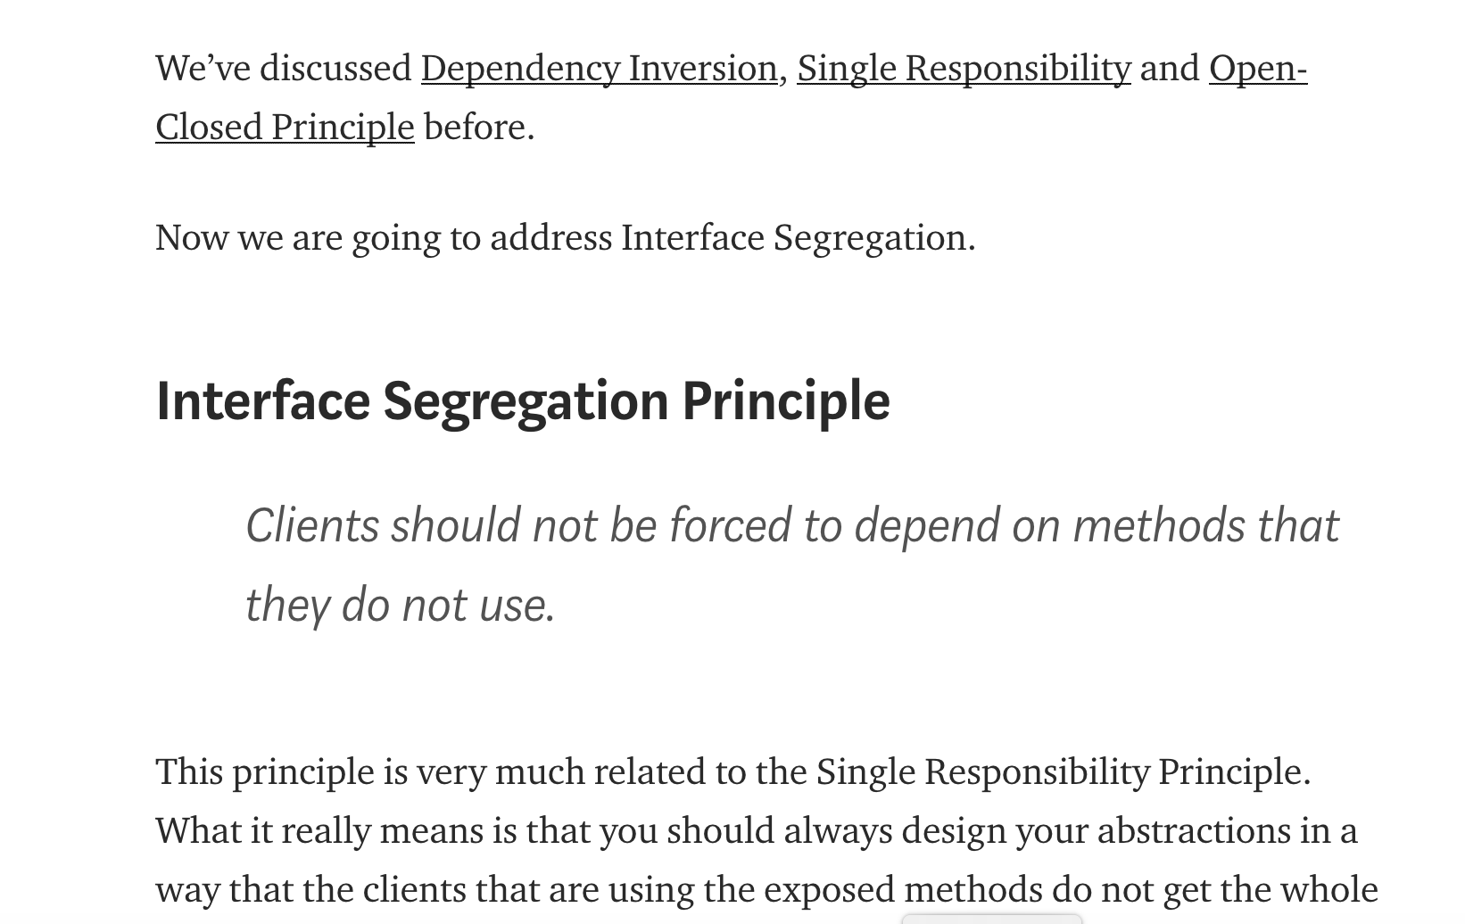

Slide 50
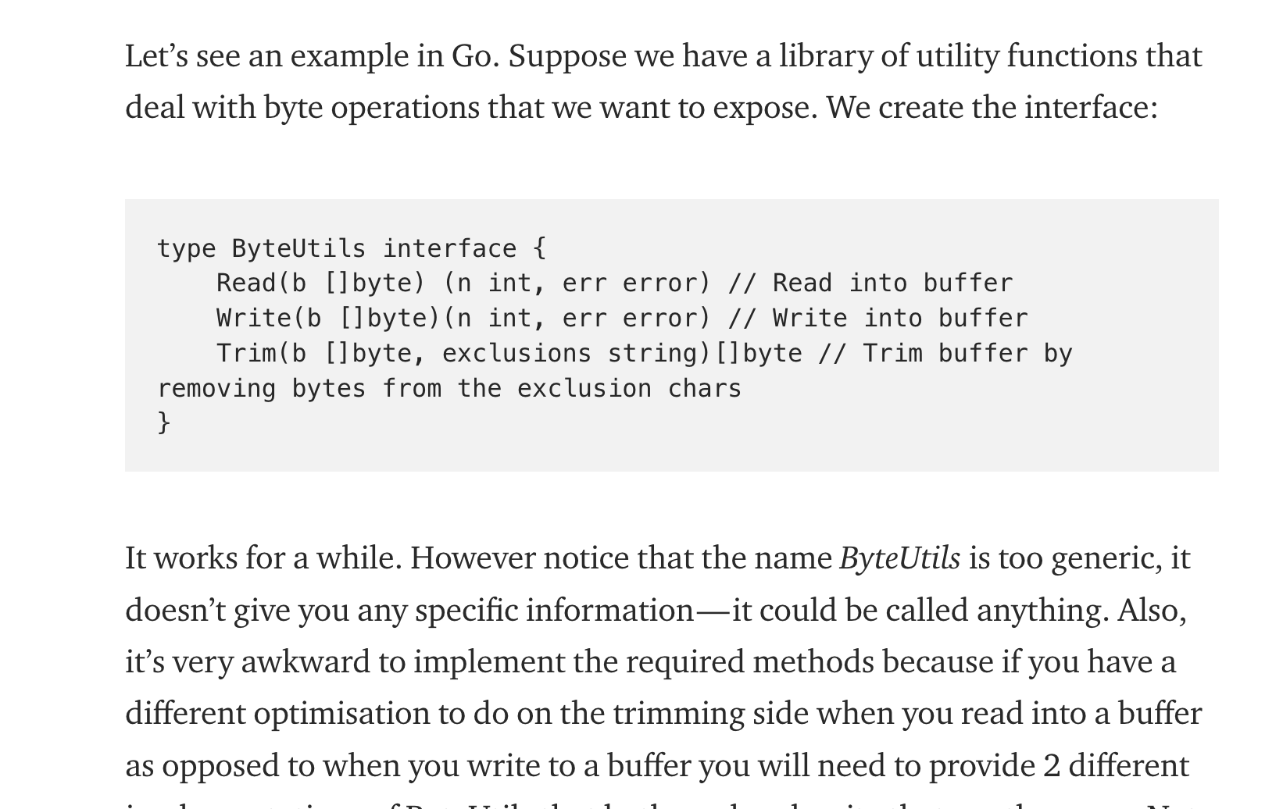

Slide 51
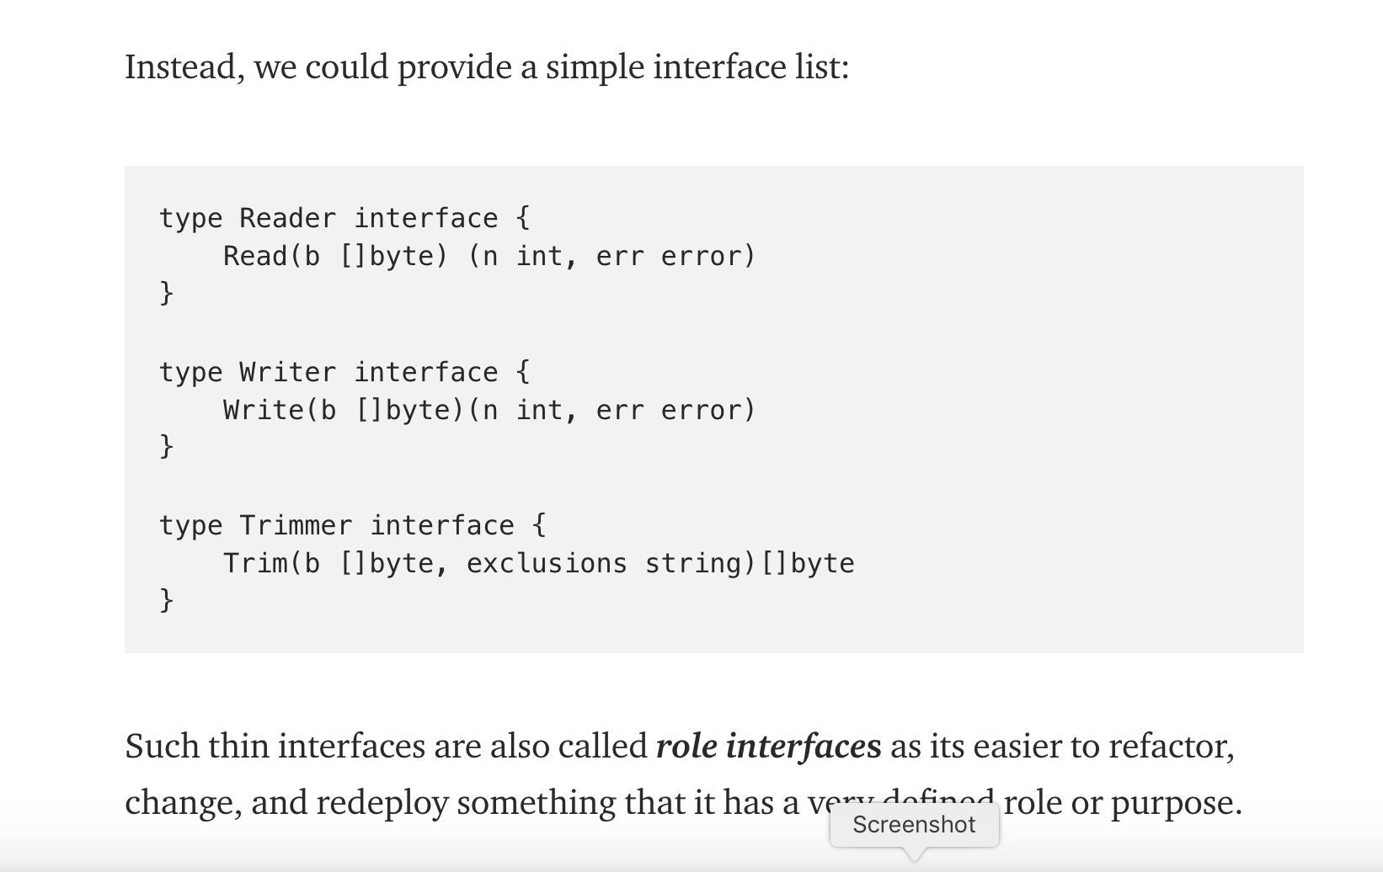

Slide 52
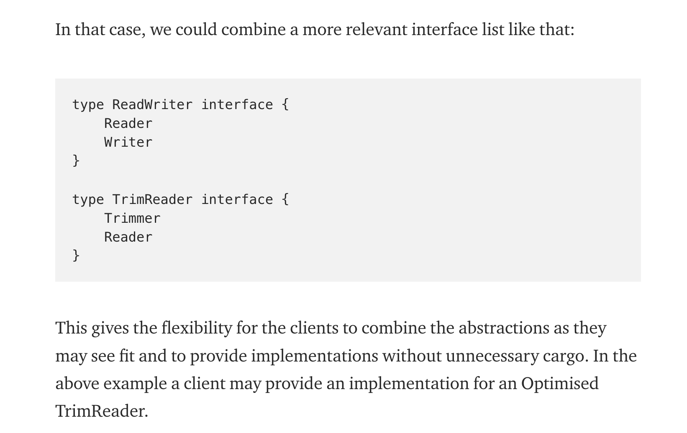

Slide 53
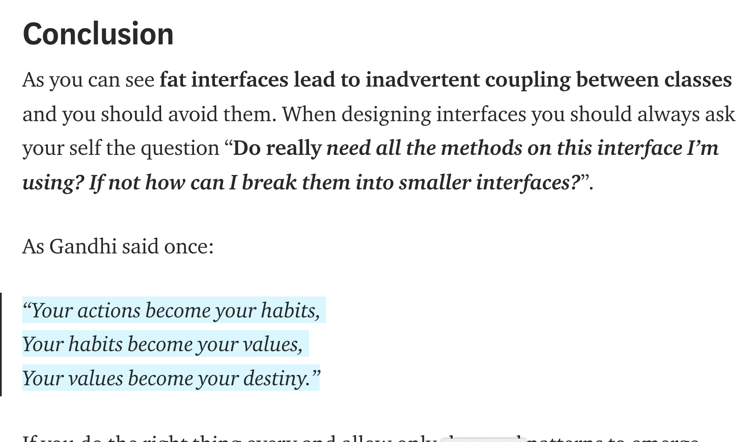

Slide 54
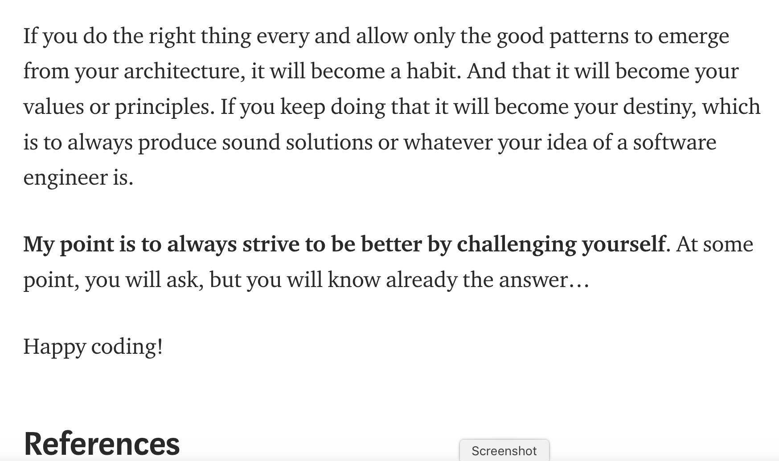

Slide 55

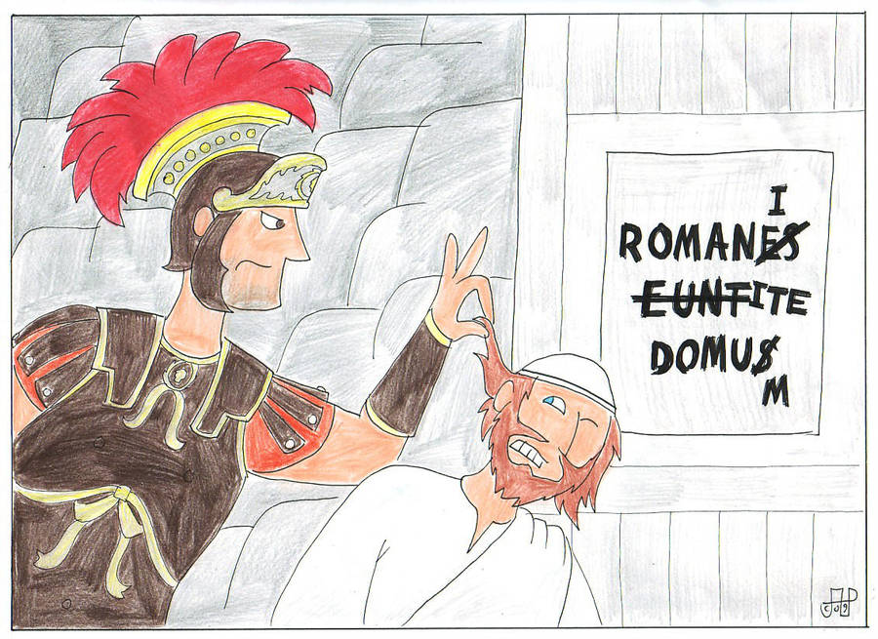

Slide 56
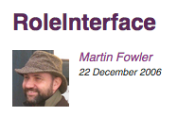
https://martinfowler.com/bliki/RoleInterface.html
...
With a role interface, however, we look at how the collaborating objects are actually used.
...
The strength of a role interface is that it clearly communicates the actual collaboration between an activity and its successors. Often a class doesn't use all the methods of a class, so it's good to show which ones are actually needed.
The disadvantage of a role interface is that it's more effort to come up with, since you need to look at each collaboration to form the role interface. ... There is also a sense of dependence on your consumers. I say a "sense" because there isn't a formal dependency, but it's still enough to make many people uncomfortable.
On the whole I much prefer role interfaces, so I suggest pushing towards them as much as you can. There is work involved in doing it, but my belief has always been that you should only use interfaces when you really need substitutability, and if you do need interfaces you should think hard about what the consumer of that interface needs.

Slide 57
A reasonable caution...
“This principle comes naturally when you start decomposing your problem space with identifying major roles that take part in your domain. And it’s never a mechanical action. No principle can automatically lead you to the correct object model.”
“So ISP is a poor guidance when designing software, but an excellent indicator of whether it’s healthy or not. Don’t think about ISP when designing your software. Think about whether your abstractions are reusable and composable, and whether your objects are encapsulated and cohesive.”
https://medium.com/@wrong.about/interface-segregation-principle-bdf3f94f1d11

Slide 58
Acronyms!
SOLID
  Single Responsibility Principle
  Open/Closed Principle
  Liskov Substitution Principle
  Interface Segregation Principle
  Dependency Inversion Principle

Slide 59
Dependency Inversion Principle
A. High-level modules should not depend on low-level modules. Both should depend on abstractions.
B. Abstractions should not depend on details. Details should depend on abstractions.

Slide 60
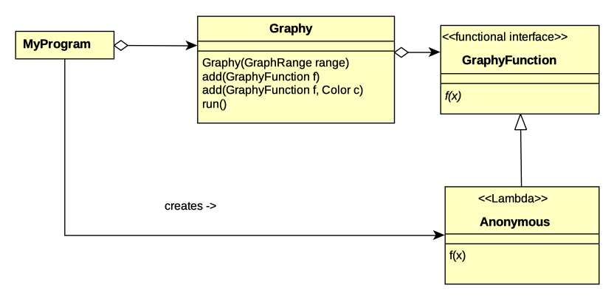
Cartesian graph generation embedded in Graphy

Slide 61
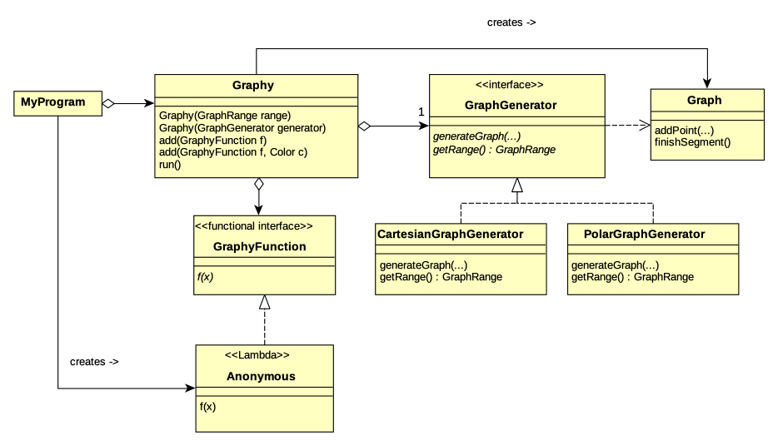

Slide 62
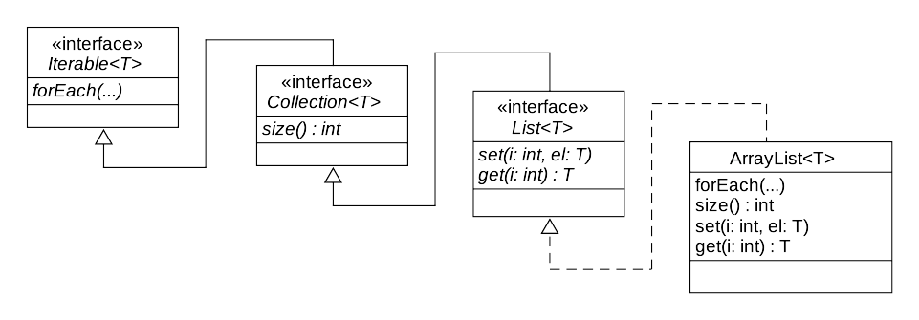

Slide 63
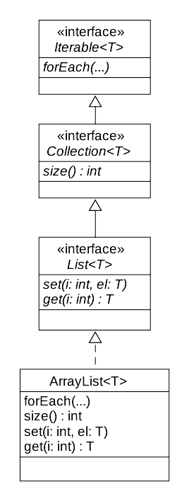
Which is better?
public void sort(ArrayList<String> list)
{ ... }
public <T> void sort(List<T> coll,
Comparator<T> comp)
{ ... }
public <T> List<T> sorted(
Collection<T> collection,
Comparator<T> comparator)
{ ... }
public <T> List<T> sorted(
Iterable<T> collection,
Comparator<T> comparator)
{ ... }

Slide 64
Final Time
State Rule Violation
Code examples

