Slide 1

CSC 203 / CPE 203
Week 8
Project-Based Object-Oriented
Programming and Design
(using Java)
Bill Foote
wffoote@calpoly.edu
(http://jovial.com)
Notes:
M: 1-14
T:; 1-22
W: To, or through python vars
R: UP to javadocs @ end
F: through 49

Slide 2
A bit about the class project...

Slide 3
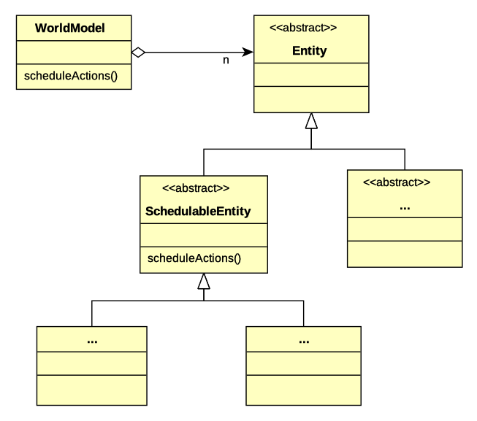

Slide 4
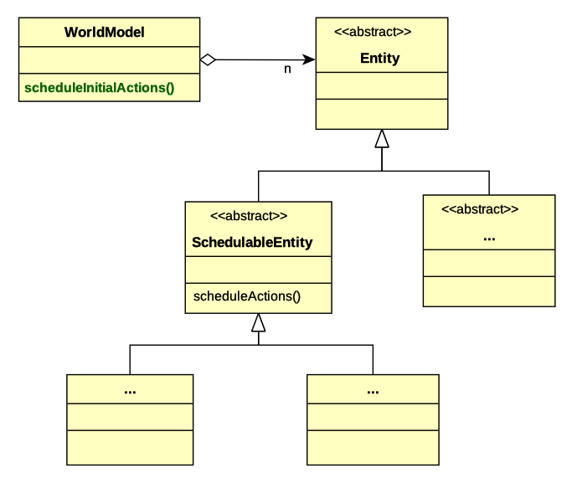

Slide 5
In WorldModel:
public void scheduleInitialActions(
EventScheduler scheduler,
ImageStore imageStore)
{
for (Entity entity : getEntities()) {
if (entity instanceof SchedulableEntity) {
((SchedulableEntity) entity).
scheduleActions(scheduler,
this, imageStore);
}
}
}

Slide 6
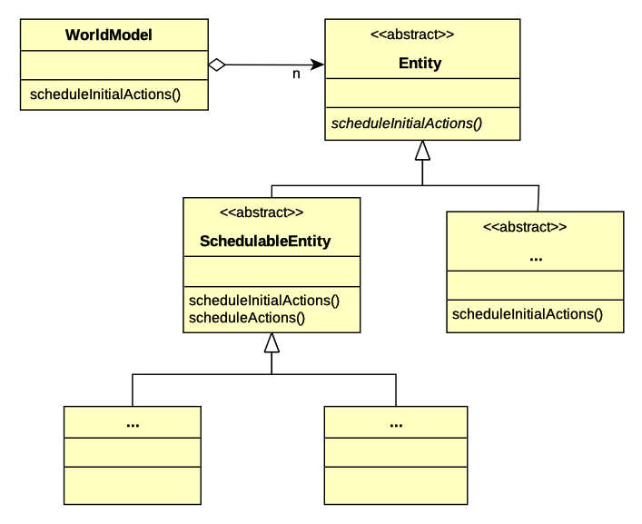

Slide 7
In WorldModel:
public void scheduleInitialActions(
EventScheduler scheduler,
ImageStore imageStore)
{
for (Entity entity : getEntities()) {
entity.scheduleInitialActions(scheduler,
this, imageStore);
}
}

Slide 8
In Entity:
public abstract void
scheduleInitialActions(
EventScheduler scheduler,
ImageStore imageStore);

Slide 9
In SchedulableEntity:
@Override
public void scheduleInitialActions(
EventScheduler scheduler,
ImageStore imageStore)
{
scheduleActions(scheduler, this, imageStore);
}

Slide 10
In ...Entity:
@Override
public void scheduleInitialActions(
EventScheduler scheduler,
ImageStore imageStore)
{
}

Slide 11
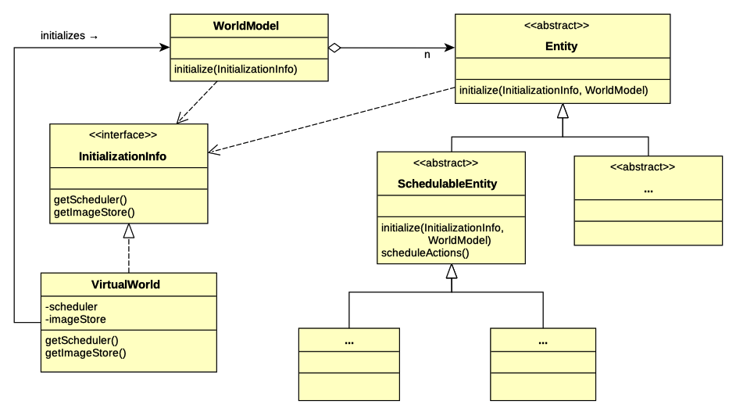

Slide 12
What kind of interface is
InitializationInfo?

Slide 13
In Entity:
/**
* Initialize this entity. Subclasses may override
* this method; if they do they shall invoke this
* method (by calling super.initialize(info, world))
*/
public void initialize(
InitializationInfo info,
WorldModel world)
{
}

Slide 14
In SchedulableEntity:
@Override
public void initialize(
InitializationInfo info
WorldModel world)
{
super.initialize(info, world);
scheduleActions(info.getScheduler(),
world,
info.getImageStore());
}

Slide 15
Assignment 5
https://en.wikipedia.org/wiki/A*_search_algorithm

Slide 16

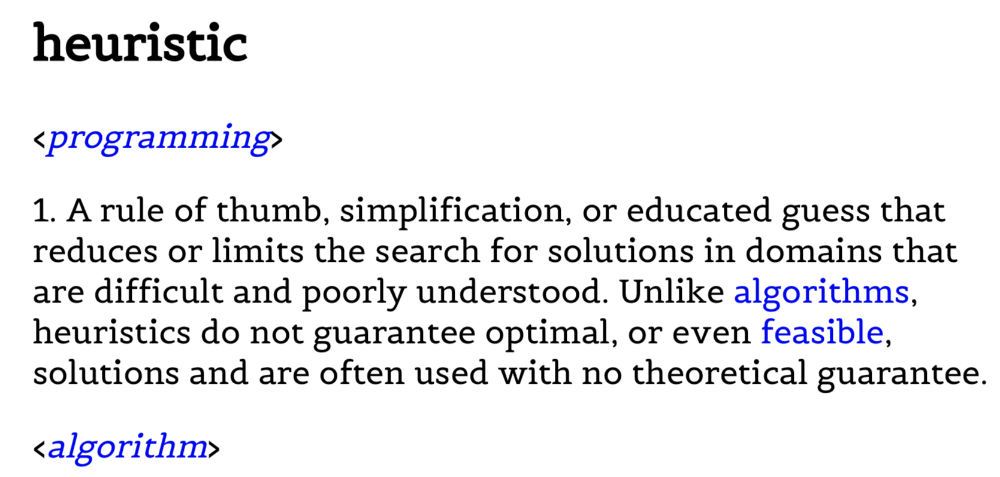

Slide 17
0,0 | 0,1 | 0,2 | 0,3 | 0,4
1,0 | 1,1 | 1,2 | 1,3 | 1,4
2,0 | 2,1 | 2,2 | 2,3 | 2,4
3,0 | 3,1 | 3,2 | 3,3 | 3,4
4,0 | 4,1 | 4,2 | 4,3 | 4,4

Slide 18
0,0 | 0,1 | 0,2 | 0,3 | 0,4
1,0 | 1,1 | 1,2 | 1,3 | 1,4
2,0 | 2,1 | 2,2 | 2,3 | 2,4
3,0 | 3,1 | 3,2 | 3,3 | 3,4
4,0 | 4,1 | 4,2 | 4,3 | 4,4
/Users/wffoote/cpe203/general/notes/astar_pseudocode.pdf

Slide 19
java.util.Predicate
As featured in p5.html
Core Java, page 319
https://docs.oracle.com/javase/8/docs/api/java/util/function/Predicate.html

Slide 20
Wednesday
Inheritance Review

Slide 21
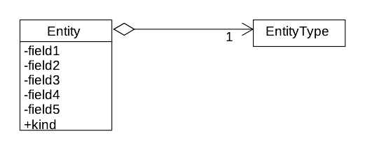

Slide 22
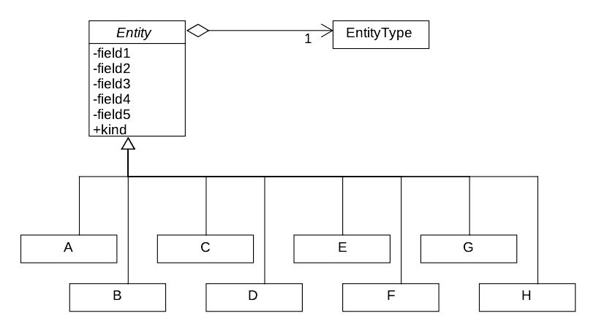

Slide 23
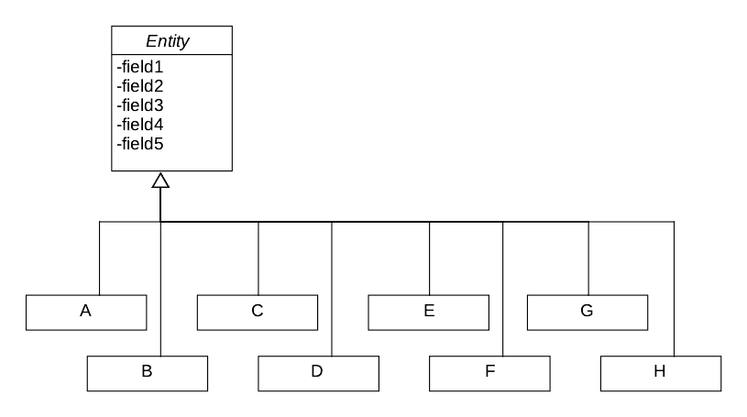

Slide 24
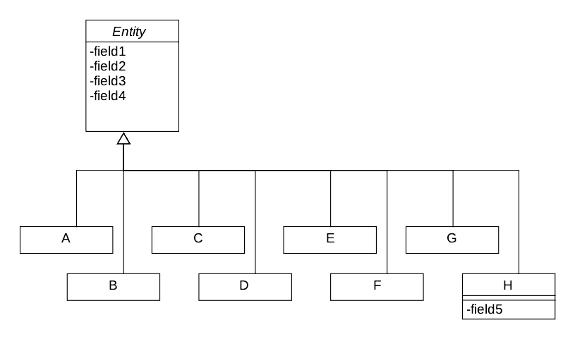

Slide 25
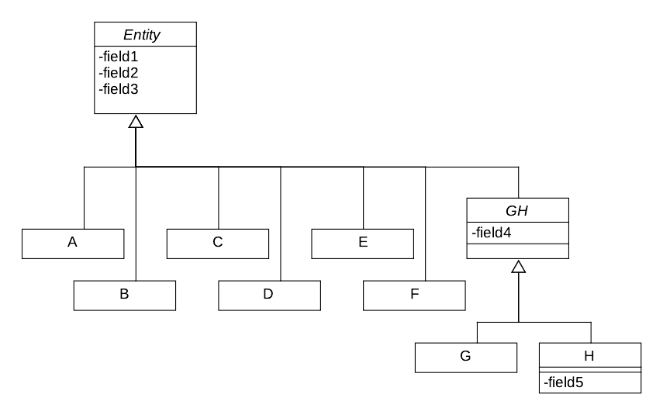

Slide 26
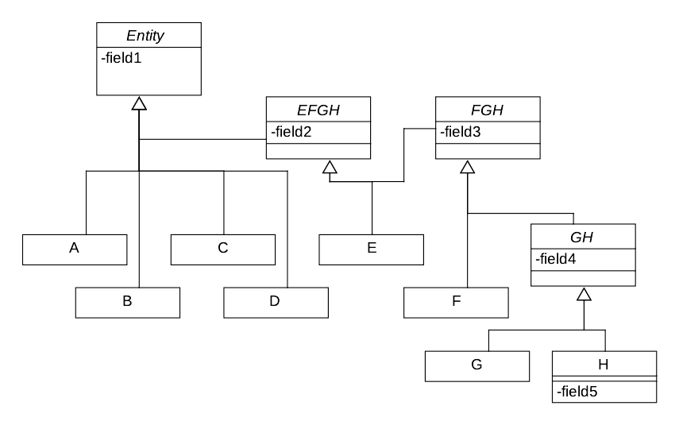

Slide 27
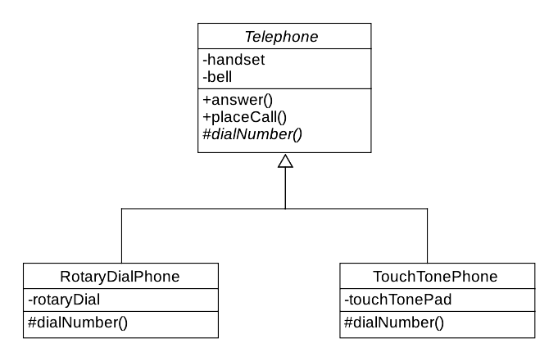
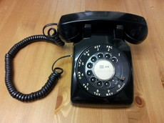
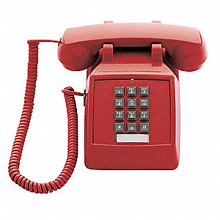
Inheritance and Abstract Classes

Slide 28
Java Generics

Slide 29
Today
{
List<Point> pointList
= new ArrayList<Point>();
pointList.add(new Point(1, 2));
Point p = pointList.get(1);
}

Slide 30
Before JDK 1.5
{
List pointList = new ArrayList();
// Like today’s List<Object>
}

Slide 31
Before JDK 1.5
{
List pointList = new ArrayList();
// Like today’s List<Object>
pointList.add(new Point(1, 2));
}

Slide 32
Before JDK 1.5
{
List pointList = new ArrayList();
// Like today’s List<Object>
pointList.add(new Point(1, 2));
Point p = pointList.get(0);
}

Slide 33
Before JDK 1.5
{
List pointList = new ArrayList();
// Like today’s List<Object>
pointList.add(new Point(1, 2));
Point p = (Point) pointList.get(0);
}

Slide 34
Today
{
List<Point> pointList
= new ArrayList<Point>();
pointList.add(new Point(1, 2));
Point p = pointList.get(0);
}

Slide 35
public class Pair<T> {
private T left;
private T right;
public Pair(T left, T right) {
this.left = left;
this.right = right;
}
public T getLeft() { return left; }
public T getRight() { return right; }
}

Slide 36
What is a subtype of what?
Is List<Point> a subtype of List<Object>?
Is List<Object> a subtype of List<Point>?

Slide 37
What is a subtype of what?
Is List<Point> a subtype of List<Object>?
  List<Point> myPointList = ...;
  myPointList.add(new Object())
Is List<Object> a subtype of List<Point>?
  List<Object> myObjectList = ...;
  Point p = myObjectList.get(0);
What would Barbara Liskov say?

Slide 38
What is a subtype of what?
Is List<Point> a subtype of List<Object>?
  List<Point> myPointList = ...;
  myPointList.add(new Object())
Is List<Object> a subtype of List<Point>?
  List<Object> myObjectList = ...;
  Point p = myObjectList.get(0);
What would Barbara Liskov say?
  No, no, no!

Slide 39
List<Object>
List<Point>
list.add(new Object())
int size = list.size()
Point p = list.get(0)
Neither set of operations is a subset of the other, therefore,
neither is a Liskov-substitutable subtype of the other

Slide 40
Java Generics Compared
C++
  The code is copied and re-compiled
  List<String> and List<Point> are different, separately compiled classes
Java
  List is compiled once, and re-used for all kinds of lists
  The compiler enforces the types where they are used

Slide 41
Java Generics
C++
  The code is copied and re-compiled
  List<String> and List<Point> are different, separately compiled classes
Java
  List is compiled once, and re-used
  The compiler enforces the types where they are used
    Essentially, for a List<Foo>,
    “list.get(3)” becomes “(Foo) list.get(3)”

Slide 42
Java Generics: A Work in Progress
Java
  List is compiled once, and re-used
  This means the type information is lost inside the implementation of List!
“Type Erasure”

Slide 43
Generic Methods
In a normal (non-generic) class, we can write:
public <T> T secondToLast(List<T>) {
...
}
...
List<String> strList = ...;
String str = secondToLast(strList);
class_slides/week_08/2_generic

Slide 44
Generic Method
We can write this:
public <T> T findNearest(Point pos) {
return null; // TODO: Implement this
}
...
Blob blob = findNearest<Blob>(pt);

Slide 45
Generic Method
We can write this:
public <T> T findNearest(Point pos) {
What goes here?
}
...
Blob blob = findNearest<Blob>(pt);

Slide 46
Generic Method
Can we write this?
public <T> Entity findNearest(Point pos) {
for (Entity e : entities) {
if (e instanceof T) {
...
}
}
}

Slide 47
Generic Method : Type Erasure
Can we write this?
public <T> Entity findNearest(Point pos) {
for (Entity e : entities) {
if (e instanceof T) {
...
}
}
}
foo.java:6: error: illegal generic type for instanceof
if (o instanceof T) {
^

Slide 48
Generic Method : Type Erasure
public Entity
findNearest(
Point pos,
java.util.function.Predicate<Entity> isTarget)
{
for (Entity e : entities) {
if (isTarget.test(e)) {
...
}
}
}
...
Blob blob = (Blob) world.findNearest(pos, (Entity e) -> {
return e instanceof Blob;
});

Slide 49
Friday

Slide 50
Generic Method : Type Erasure
public Entity
findNearest(
Point pos,
java.util.function.Predicate<Entity> isTarget)
{
for (Entity e : entities) {
if (isTarget.test(e)) {
...
}
}
}
...
Blob blob = (Blob) world.findNearest(pos, e -> e instanceof Blob);

Slide 51
NOTE: Reflection API
world.findNearest(pos, e -> e instanceof Blob);
if (isTarget.test(e) ...)
world.findNearest(pos, Blob.class);
for (Entity e : entities) {
if (type.isInstance(e)) {
...
}
}

Slide 52

NOTE: Reflection API
world.findNearest(pos, e -> e instanceof Blob);
if (isTarget.test(e) ...)
world.findNearest(pos, Blob.class);
if (type.isInstance(e) ...)
or if (type == e.getClass() ...)
.class is the reflection API: BAD!

Slide 53


Slide 54
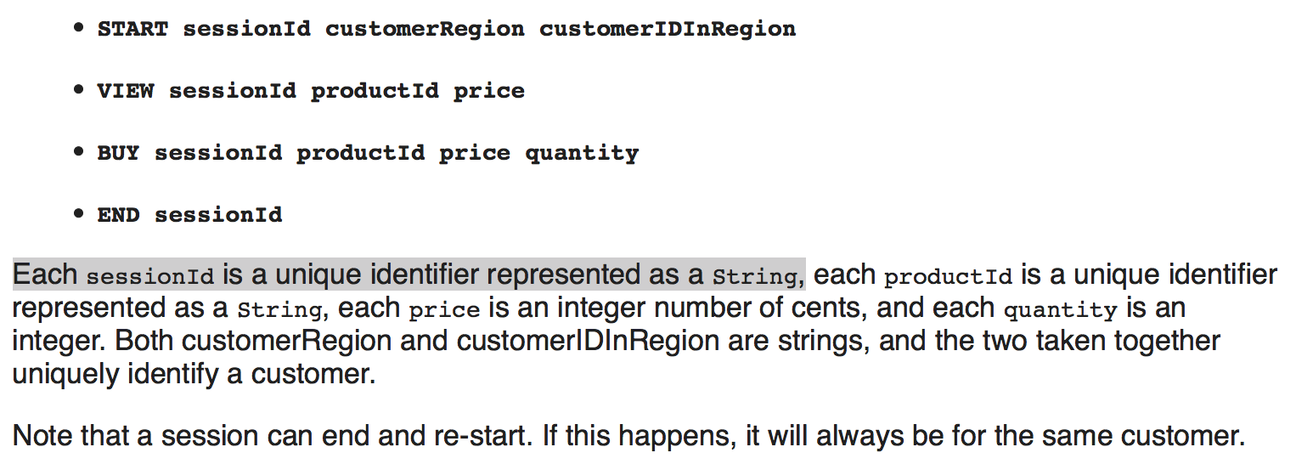
Here’s a contract...

Slide 55
How to write broken code
(in six easy slides)

Slide 56

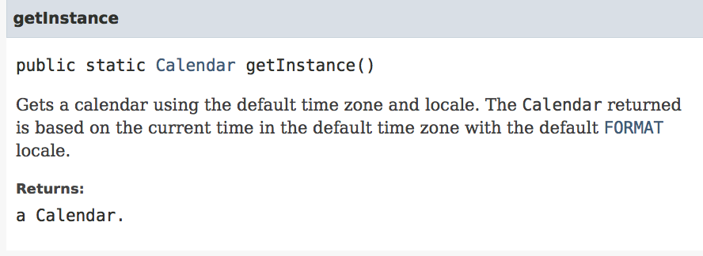

Slide 57
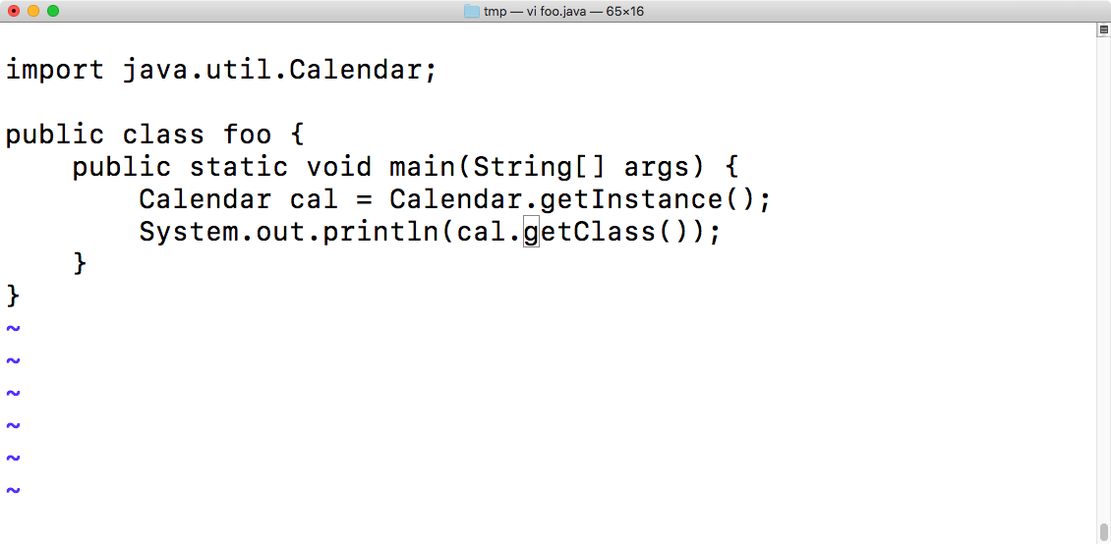

Slide 58
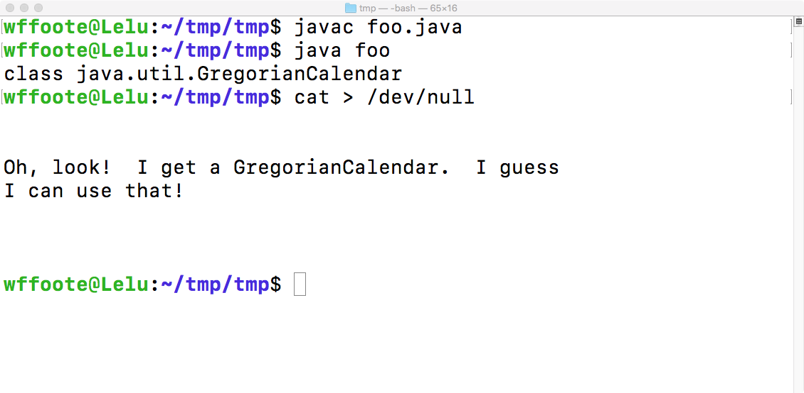

Slide 59
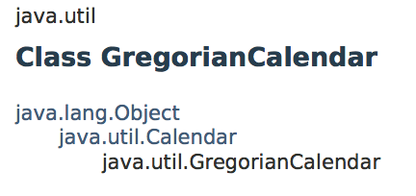
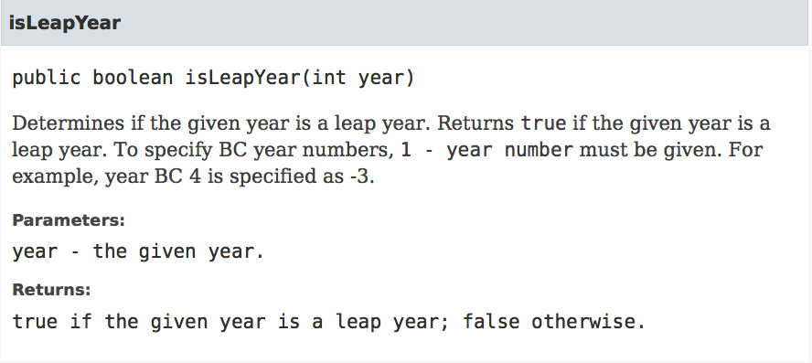

Slide 60
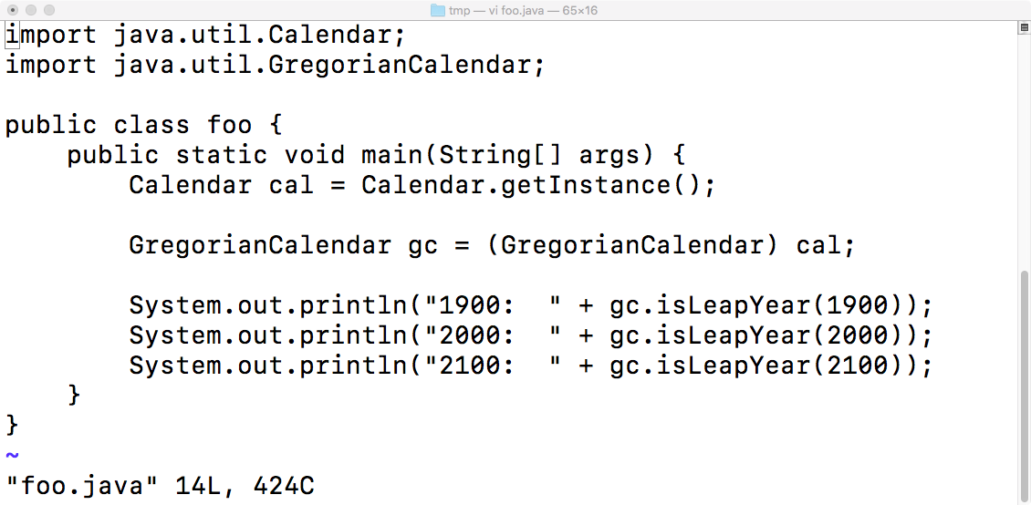

Slide 61
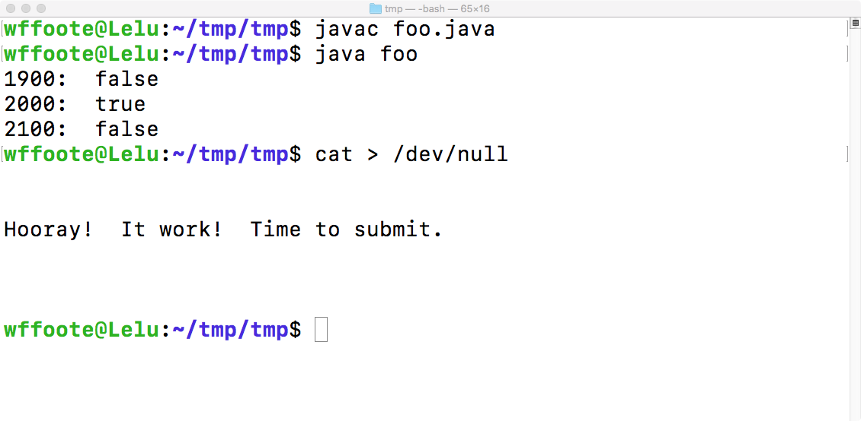

Slide 63

Don’t ignore the contract!

Slide 64
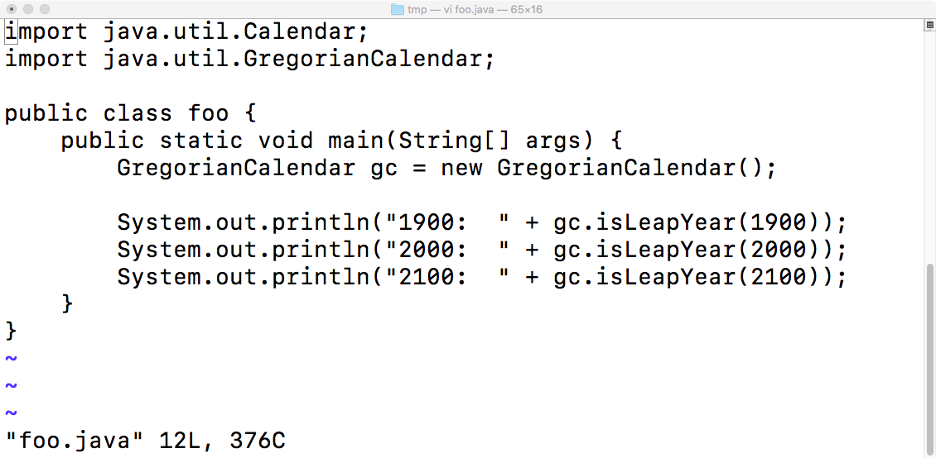

Slide 65
More Broken Software...

Slide 66
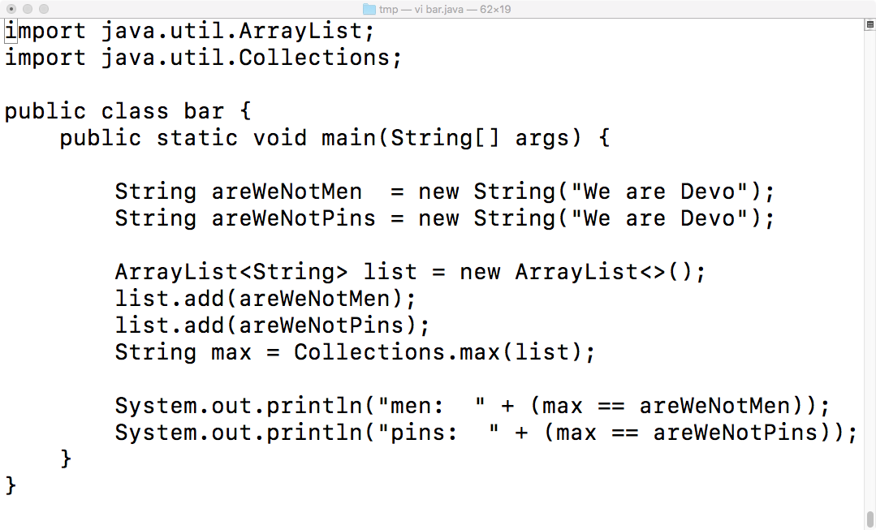

Slide 67
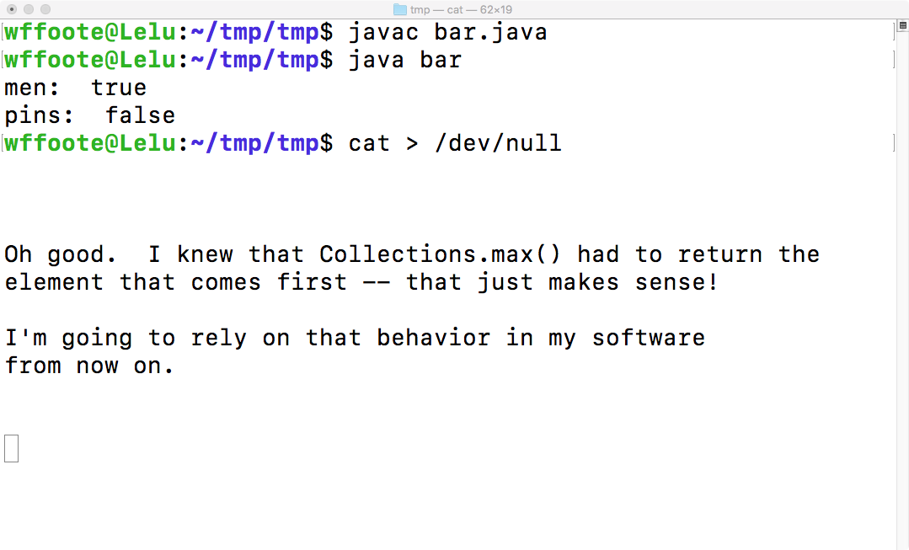

Slide 69
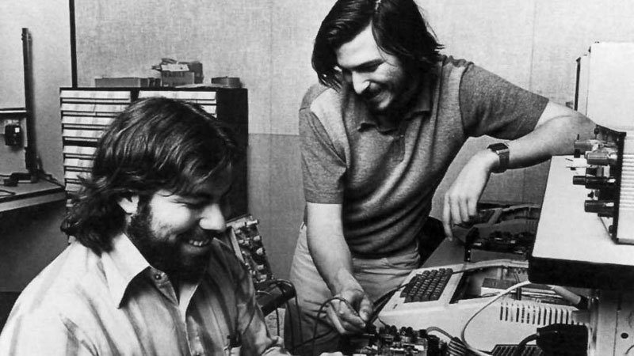
A bit of history...
Heroic
Entrepreneurs
in a
Garage:
Beginning
of the
computer
industry?

Slide 70
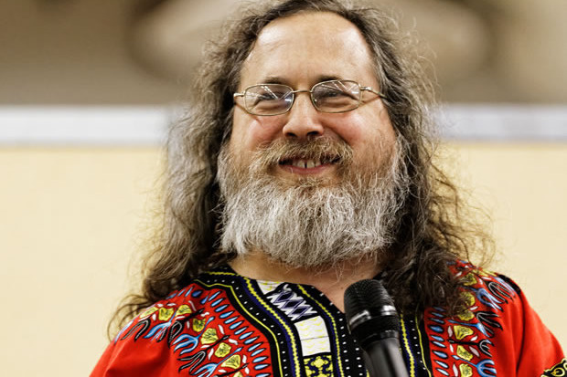
Hippie
Academics:
Beginning
of the
computer
industry?
https://yourstory.com/2017/08/techie-tuesdays-richard-stallman
https://youtu.be/9sJUDx7iEJw?t=20
AI Research

Slide 71
Technology and Public Policy
1998, “Internet Tax Freedom Act”
https://en.wikipedia.org/wiki/Internet_Tax_Freedom_Act

Slide 72
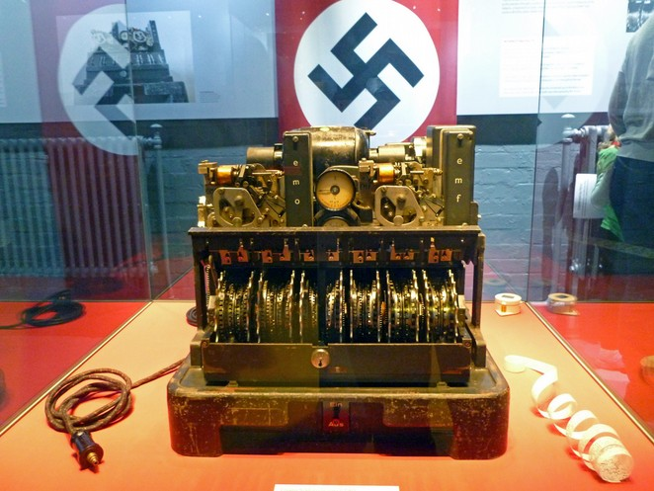
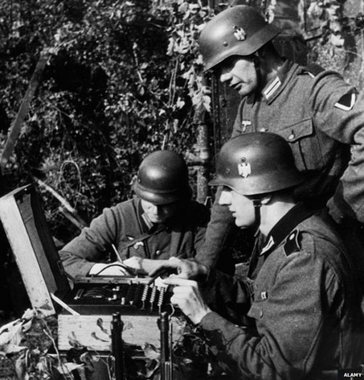

Slide 73
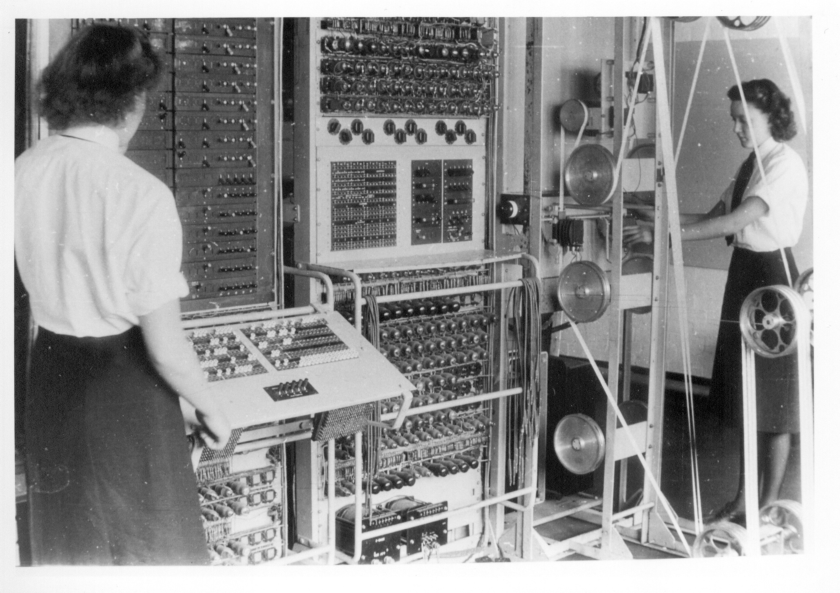

Slide 74
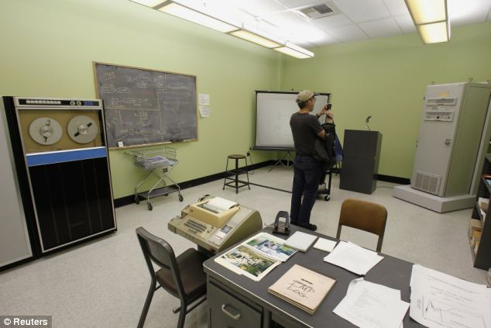

3420
Boelter
Hall,
UCLA
Birthplace
of the
DARPAnet
(Internet)
10/29/69
“lo”

Slide 75
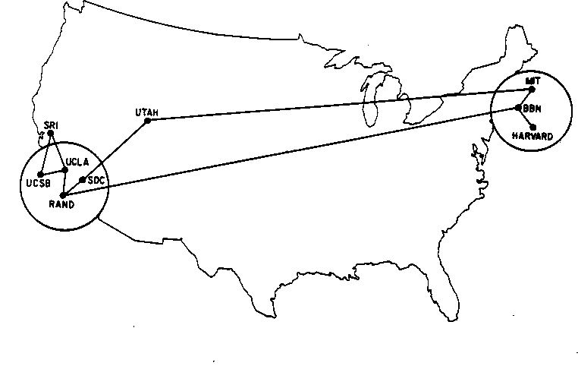
ARPANET, June 1970

Slide 76
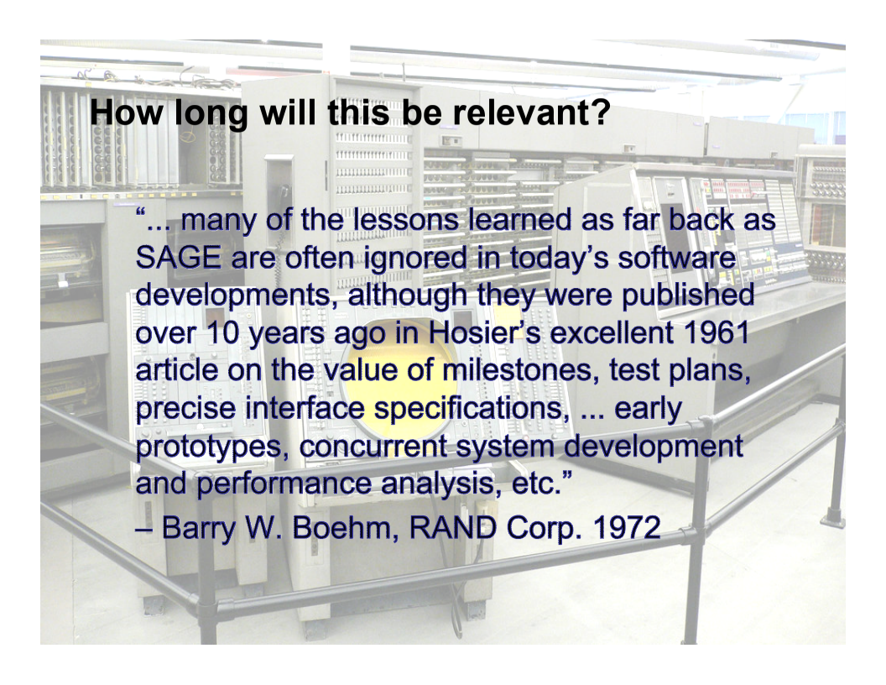

Slide 77
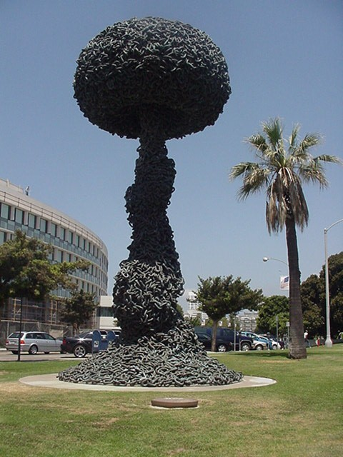
RAND Corporation
“Chain Reaction” (1991)
Sculpture on the grounds of the
Santa Monica Courthouse

Slide 78
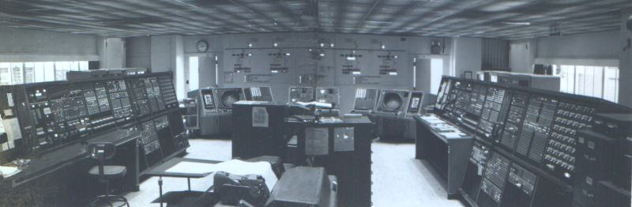
Semi-Automatic Ground Environment
Development started ~1953
Operational ~1958-1980
https://www.youtube.com/watch?v=iCCL4INQcFo

Slide 79

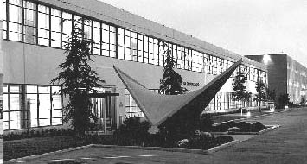
System Development Corp.
Founded 1955
2500 Colorado Ave.
Santa Monica, CA
First software company.
https://www.youtube.com/watch?v=06drBN8nlWg&feature=youtu.be&t=8m21s
http://jovial.com/JOVIAL/k_c_foote_resume.jpg
https://www.youtube.com/watch?time_continue=4&v=sXjCqa4W4iQ
(-2:20)

