Slide 1

CSC 203 / CPE 203
Week 9
Project-Based Object-Oriented
Programming and Design
(using Java)
Bill Foote
wffoote@calpoly.edu
(http://jovial.com)
Notes:
M: 1-14
T:; 1-22
W: To, or through python vars
R: UP to javadocs @ end
F: through 49

Slide 2
Today
Assignment 5 debrief
Assignment 6
Rest of week
  Generics: Wildcard types
  Lab 8: Generics

Slide 3
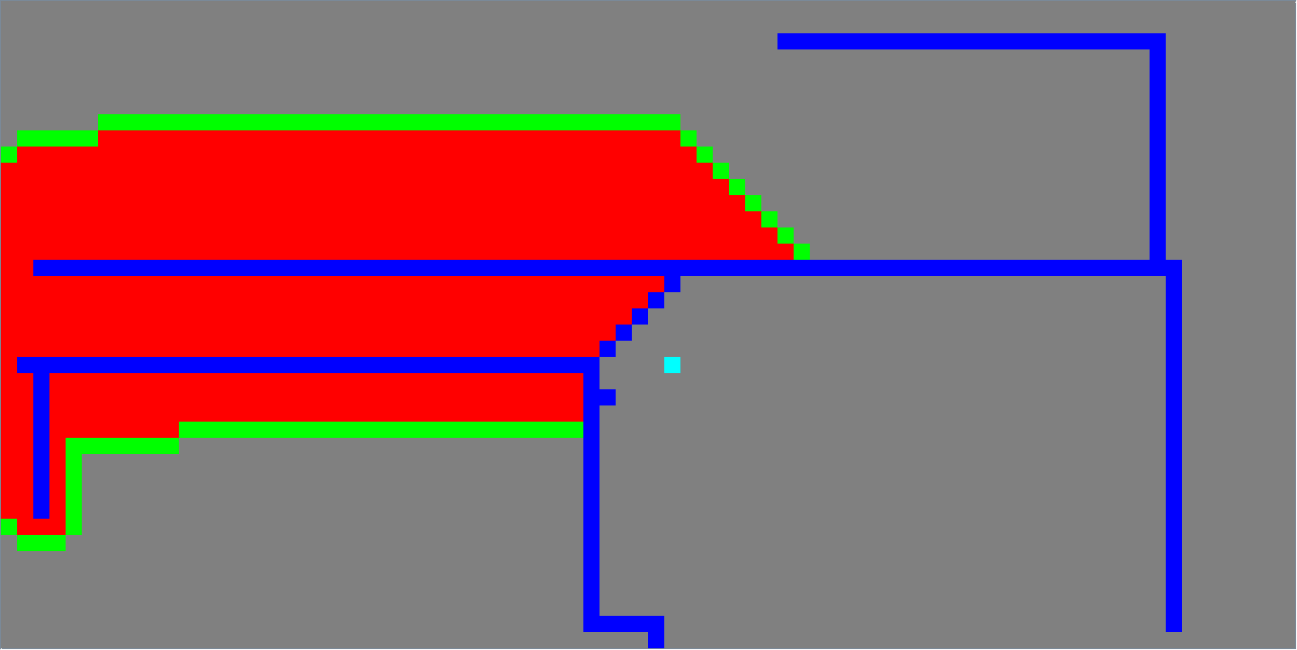
Assignment 5

Slide 4
A*: Did you work this out on paper?
0,0 | 0,1 | 0,2 | 0,3 | 0,4
1,0 | 1,1 | 1,2 | 1,3 | 1,4
2,0 | 2,1 | 2,2 | 2,3 | 2,4
3,0 | 3,1 | 3,2 | 3,3 | 3,4
4,0 | 4,1 | 4,2 | 4,3 | 4,4

Slide 5
A*: How about this?
0,0 | 0,1 | 0,2 | 0,3 | 0,4
1,0 | 1,1 | 1,2 | 1,3 | 1,4
2,0 | 2,1 | 2,2 | 2,3 | 2,4
3,0 | 3,1 | 3,2 | 3,3 | 3,4
4,0 | 4,1 | 4,2 | 4,3 | 4,4

Slide 6
A*: Maybe this?
0,0 | 0,1
1,0 | 1,1
2,0 | 2,1

Slide 7
Lab 9
Hint: Don’t ignore compiler warnings!

Slide 8
List<Object>
List<Point>
int size = list.size()
list.add(new Object())
Object o = list.get(0)
list.add(new Point(...))
Point p = list.get(0)
Neither set of operations is a subset of the other, therefore,
neither is a Liskov-substitutable subtype of the other

Slide 9
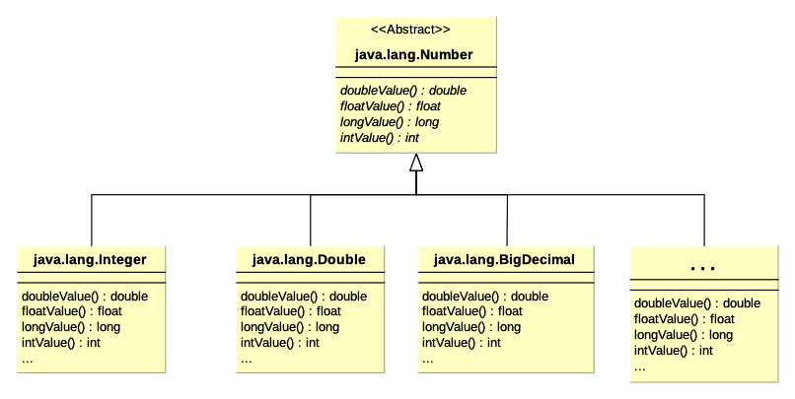

Slide 10
Wildcard Types in Generics
public static double mean(List<Number> list) {
double total = 0.0;
for (Number element : list) {
total += element.doubleValue();
}
return total / (double) list.size();
}
<...>
List<Number> numList = Arrays.asList(new BigDecimal("0.1"), 2.2, 3);
System.out.println(
"The mean value of " + numList + " is " + mean(numList));

Slide 11
Wildcard Types in Generics
public static double mean(List<Number> list) {
double total = 0.0;
for (Number element : list) {
total += element.doubleValue();
}
return total / (double) list.size();
}
<...>
List<Integer> numList = Arrays.asList(1, 2, 4);
System.out.println(
"The mean value of " + numList + " is " + mean(numList));

Slide 12
Wildcard Types in Generics
public static double mean(List<Number> list) {
double total = 0.0;
for (Number element : list) {
total += element.doubleValue();
}
return total / (double) list.size();
}
<...>
List<Integer> numList = Arrays.asList(1, 2, 4);
System.out.println(
"The mean value of " + numList + " is " + mean(numList));
code 1

Slide 13
Wildcard Types in Generics
public static double mean(List<? extends Number> list) {
double total = 0.0;
for (Number element : list) {
total += element.doubleValue();
}
return total / (double) list.size();
}
<...>
List<Integer> numList = Arrays.asList(1, 2, 4);
System.out.println(
"The mean value of " + numList + " is " + mean(numList));

Slide 14
Wildcard Types in Generics
public static void addSeven (List<Integer> list) {
list.add(7);
}
<...>
List<Integer> intList = new ArrayList<Integer>();
intList.add(3);
addSeven(intList);
addSeven(intList);
System.out.println("1: " + intList);

Slide 15
Wildcard Types in Generics
public static void addSeven (List<Integer> list) {
list.add(7);
}
<...>
List<Number> numberList = new ArrayList<Number>();
numberList.add(3.7);
numberList.add(new BigDecimal("5.9"));
addSeven(numberList);
addSeven(numberList);
System.out.println("1: " + numberList);

Slide 16
Wildcard Types in Generics
public static void addSeven (List<Integer> list) {
list.add(7);
}
<...>
List<Number> numberList = new ArrayList<Number>();
numberList.add(3.7);
numberList.add(new BigDecimal("5.9"));
addSeven(numberList);
addSeven(numberList);
System.out.println("1: " + numberList);
code 2

Slide 17
Wildcard Types in Generics
public static void addSeven (List<? super Integer> list) {
list.add(7);
}
<...>
List<Number> numberList = new ArrayList<Number>();
numberList.add(3.7);
numberList.add(new BigDecimal("5.9"));
addSeven(numberList);
addSeven(numberList);
System.out.println("1: " + numberList);

Slide 18
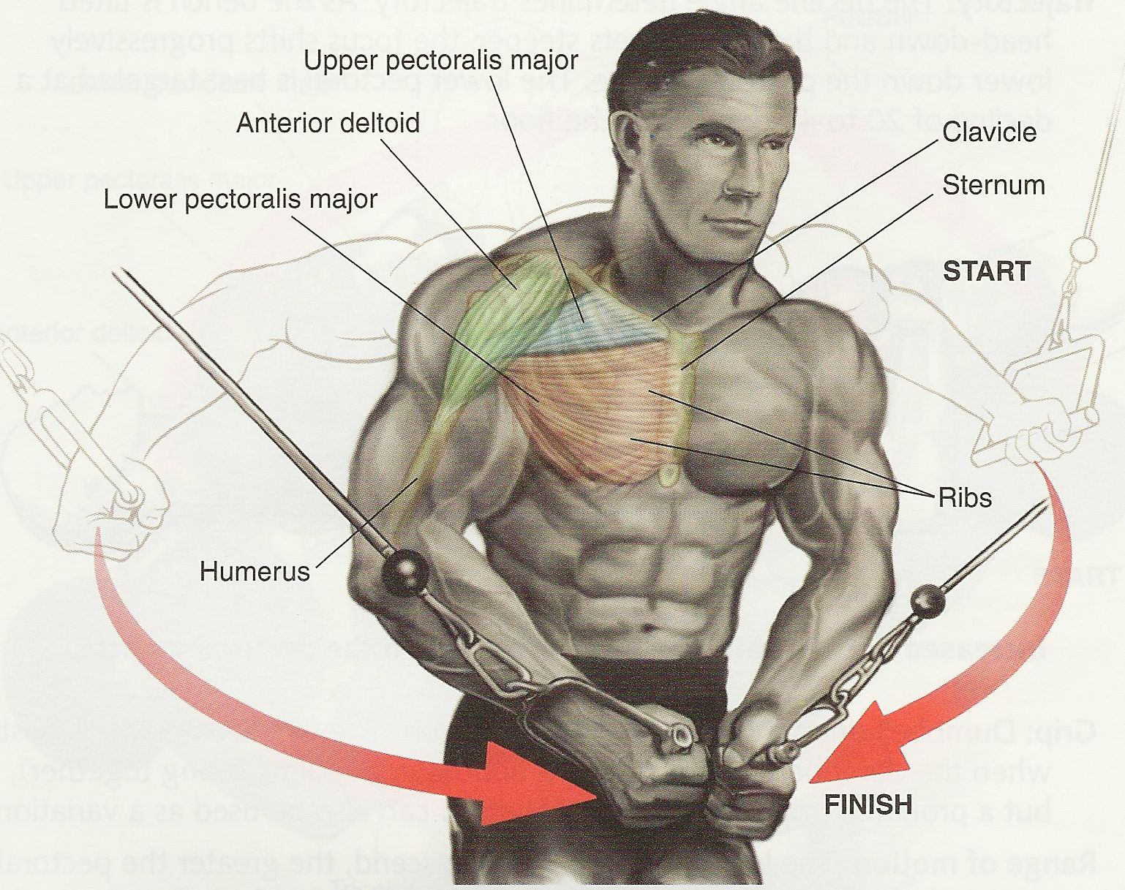
Wildcard Types in Generics: PECS
public static double mean(List<? extends Number> list) {
double total = 0.0;
for (Number element : list) {
total += element.doubleValue();
}
return total / (double) list.size();
}
public static void addSeven (List<? super Integer> list) {
list.add(7);
}
PECS - “Producer Extends, Consumer Super”
For mean(), the list produces values
For addSeven(), the list consumes values

Slide 19
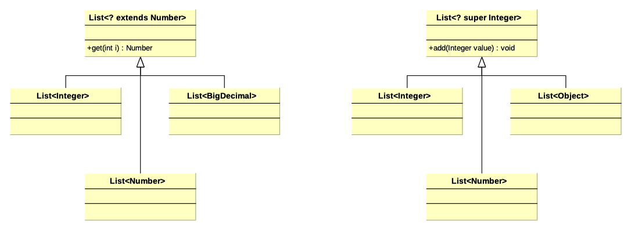

Slide 20
Lab 9: Generics

Slide 21
Assignment 6

Slide 22

image courtesy https://www.zdnet.com/article/cloud-computing-will-virtually-replace-traditional-data-centers-within-three-years/

Slide 23

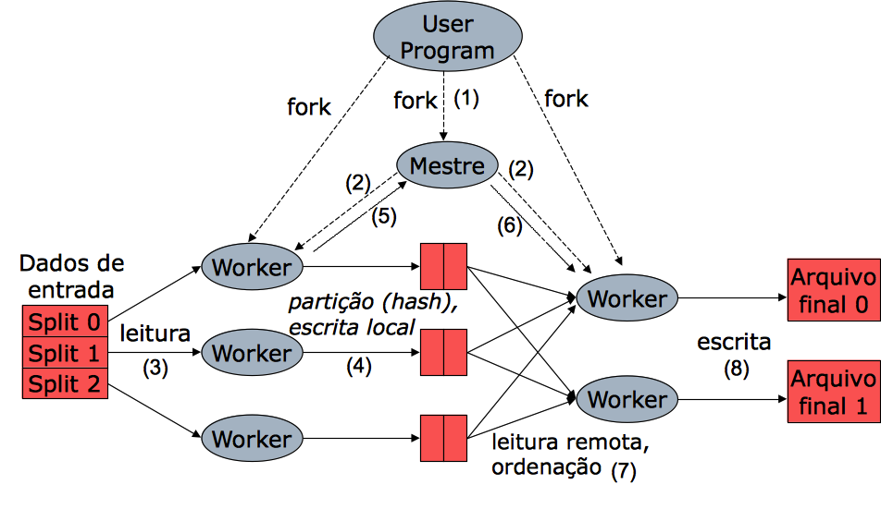
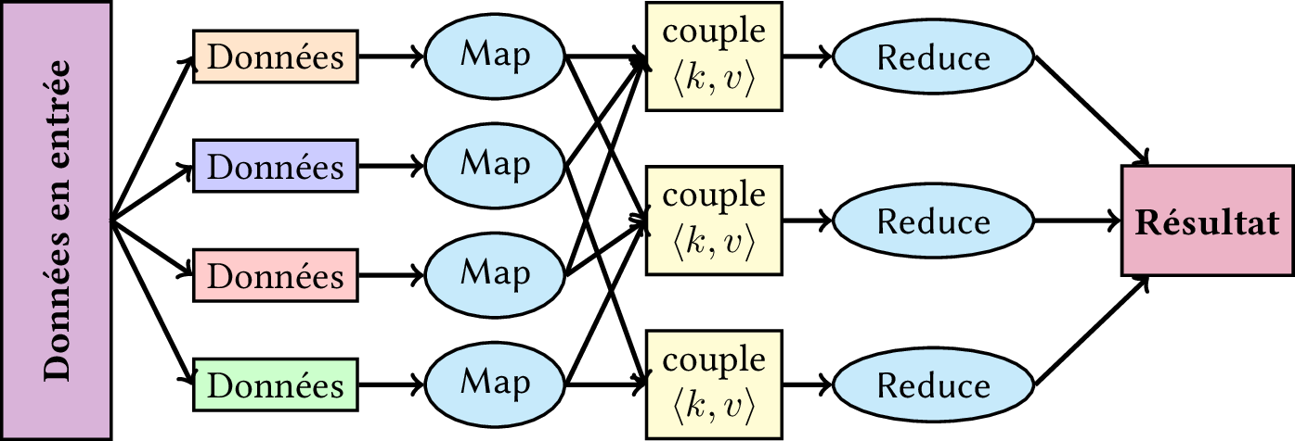
(since 2011)

Slide 24
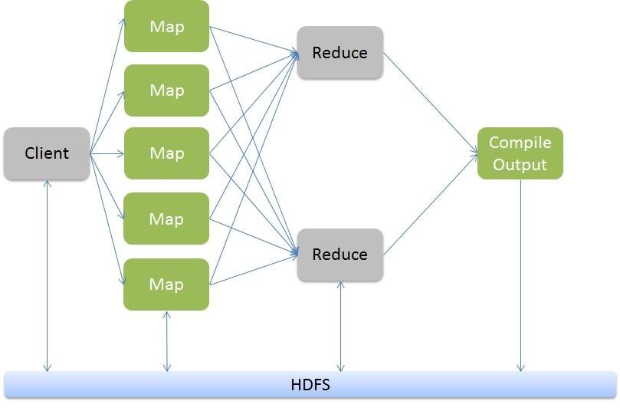
From https://www.dezyre.com/hadoop-tutorial/hadoop-mapreduce-tutorial-

Slide 25
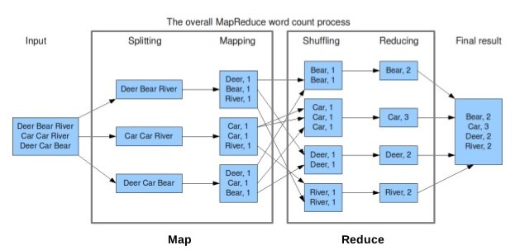
From https://www.dezyre.com/hadoop-tutorial/hadoop-mapreduce-tutorial-

Slide 26
In Java: The Streams API
https://docs.oracle.com/javase/8/docs/api/java/util/stream/package-summary.html
Released with JDK 1.8, released in 2014

