Slide 1

CSC 203 / CPE 203
Week 10
Project-Based Object-Oriented
Programming and Design
(using Java)
Bill Foote
wffoote@calpoly.edu
(http://jovial.com)
Notes:
M: 1-14
T:; 1-22
W: To, or through python vars
R: UP to javadocs @ end
F: through 49

Slide 2
Today
lab09
The Strategy Design Pattern
The Template Method Design Pattern
Design by Contract, LSP

Slide 3
Design Patterns
Swapping in different algorithms...

Slide 4
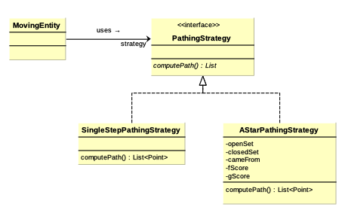

Slide 5
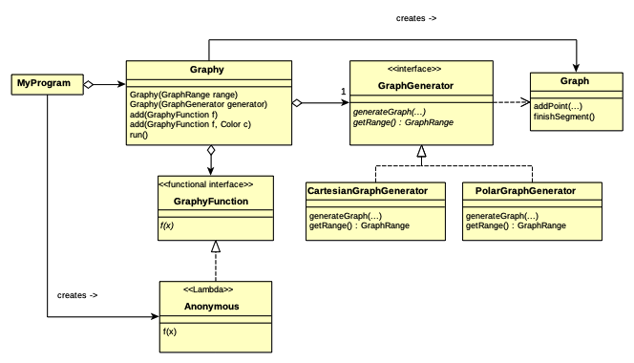
(program 7)

Slide 7
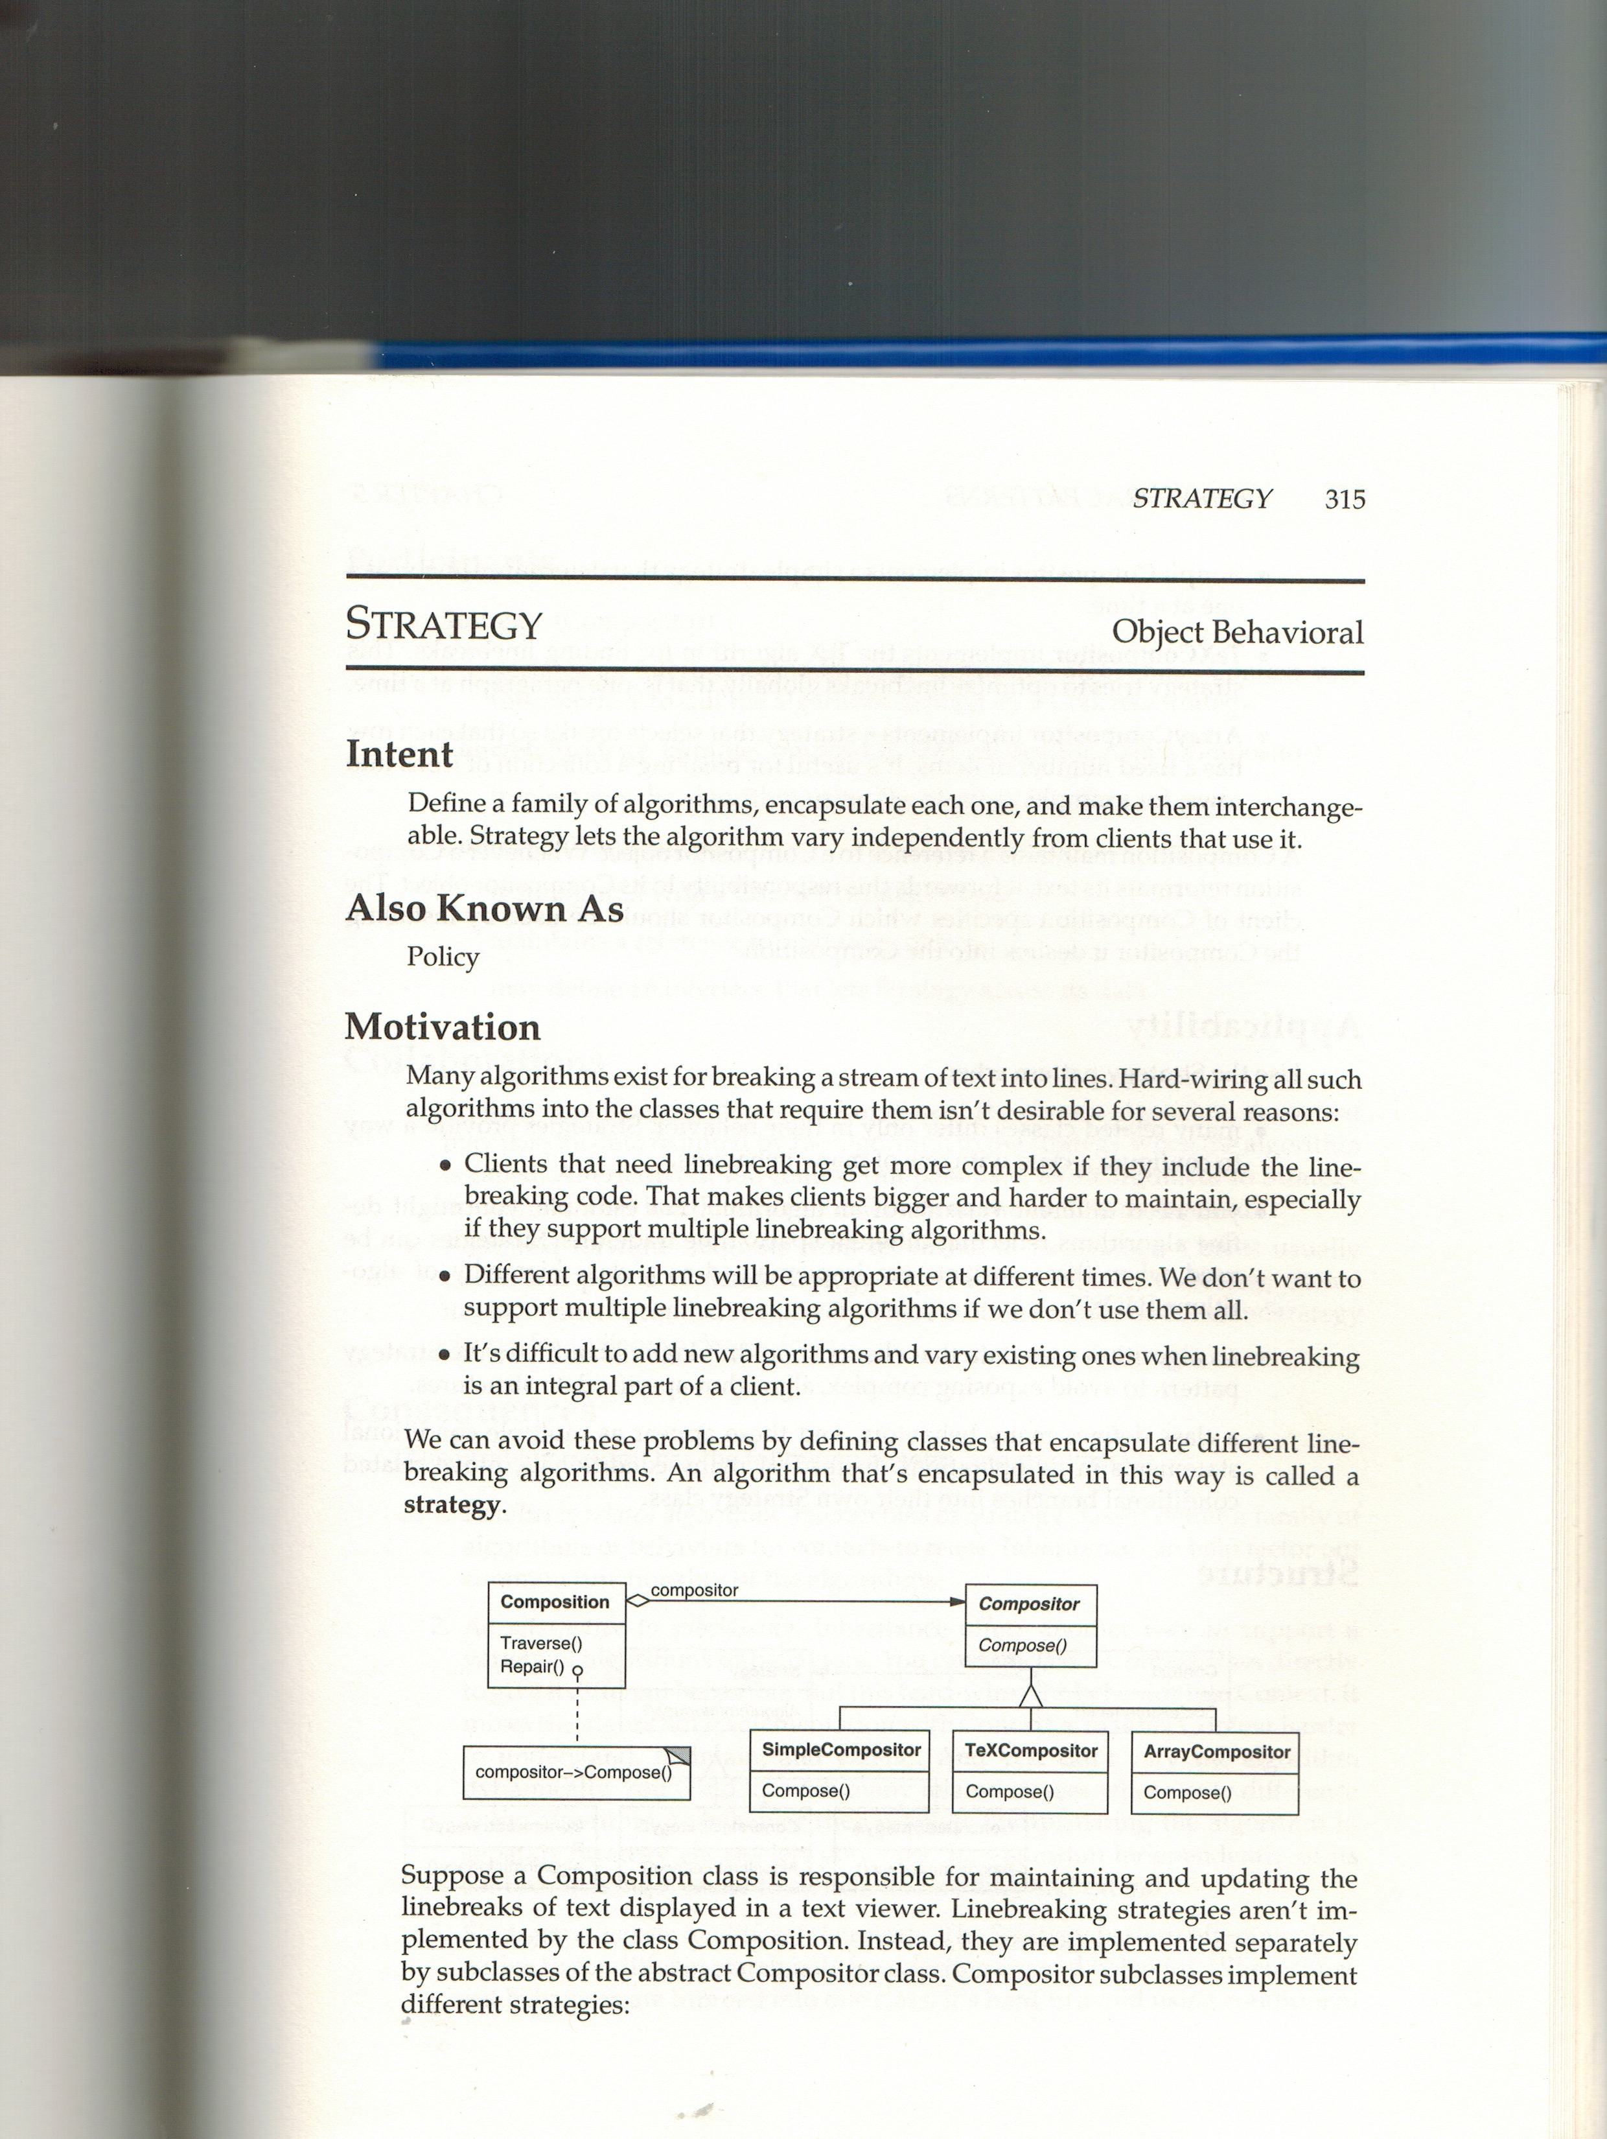
/Users/wffoote/cpe203/general/class_slides/week_10/gof_strategy.jpeg

Slide 8
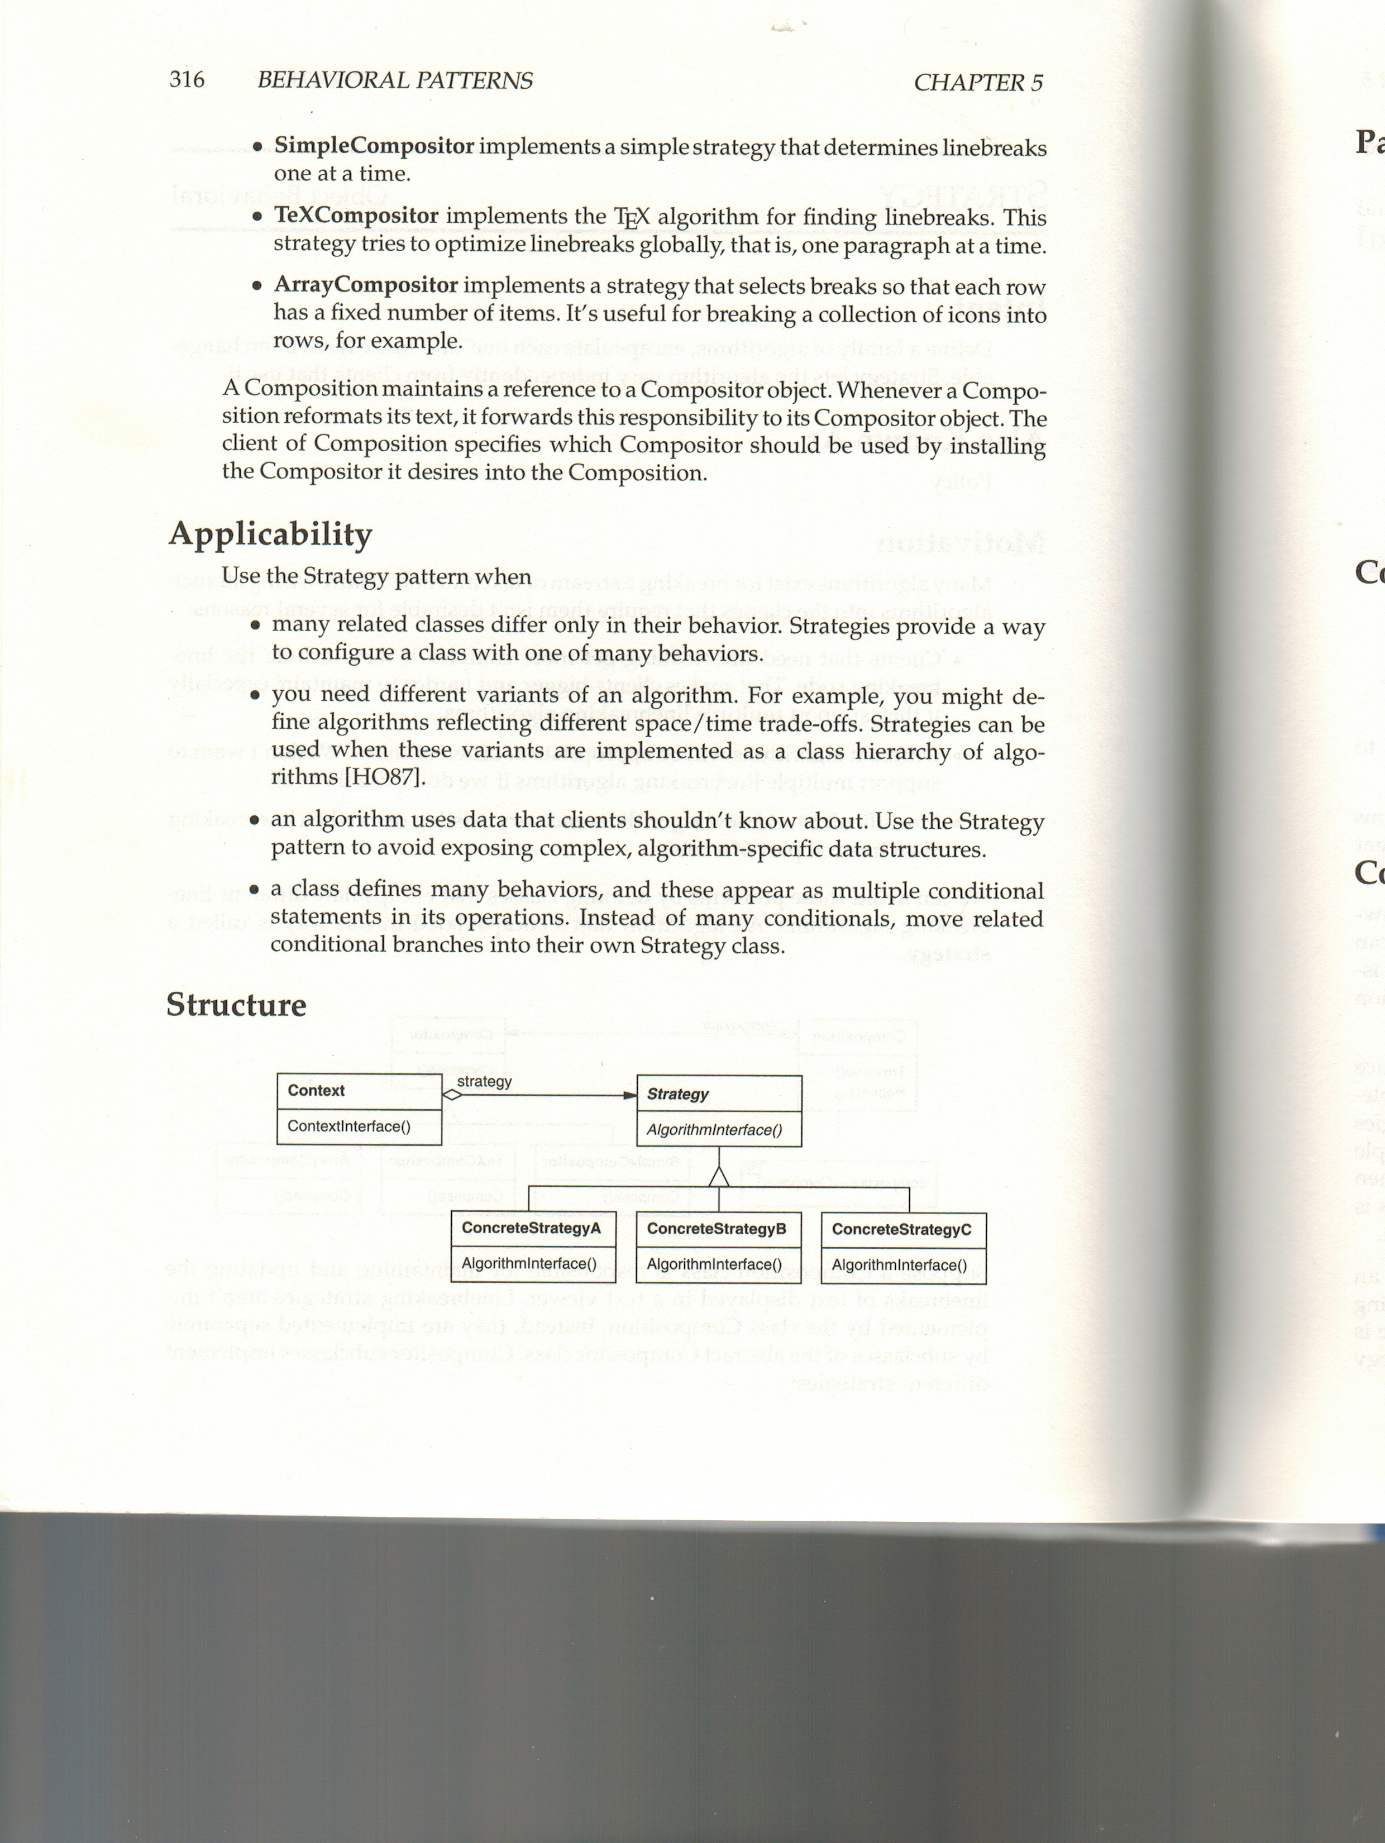
/Users/wffoote/cpe203/general/class_slides/week_10/gof_strategy_2.jpeg

Slide 9
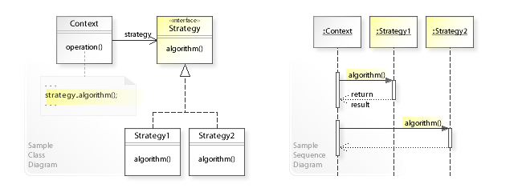
https://en.wikipedia.org/wiki/Strategy_pattern

Slide 10
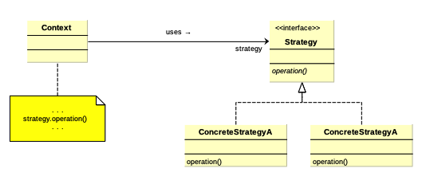
GoF Strategy Pattern

Slide 11
Design Patterns
Customizing an algorithm...

Slide 12
(program 7)

Slide 13
// in Miner:
void nextPosition(...) {
xxx
if (world.isOccupied(pos) && yyy) {
// in OreBlob:
void nextPosition(...) {
xxx
Entity occupant = world.getEntity(pos);
if (occupant != null && !(occupant instanceof Ore)
&& yyy) {

Slide 14
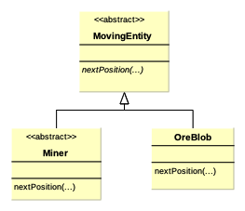

Slide 15
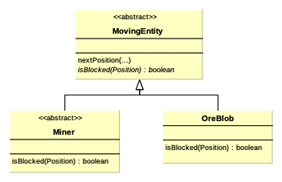

Slide 16
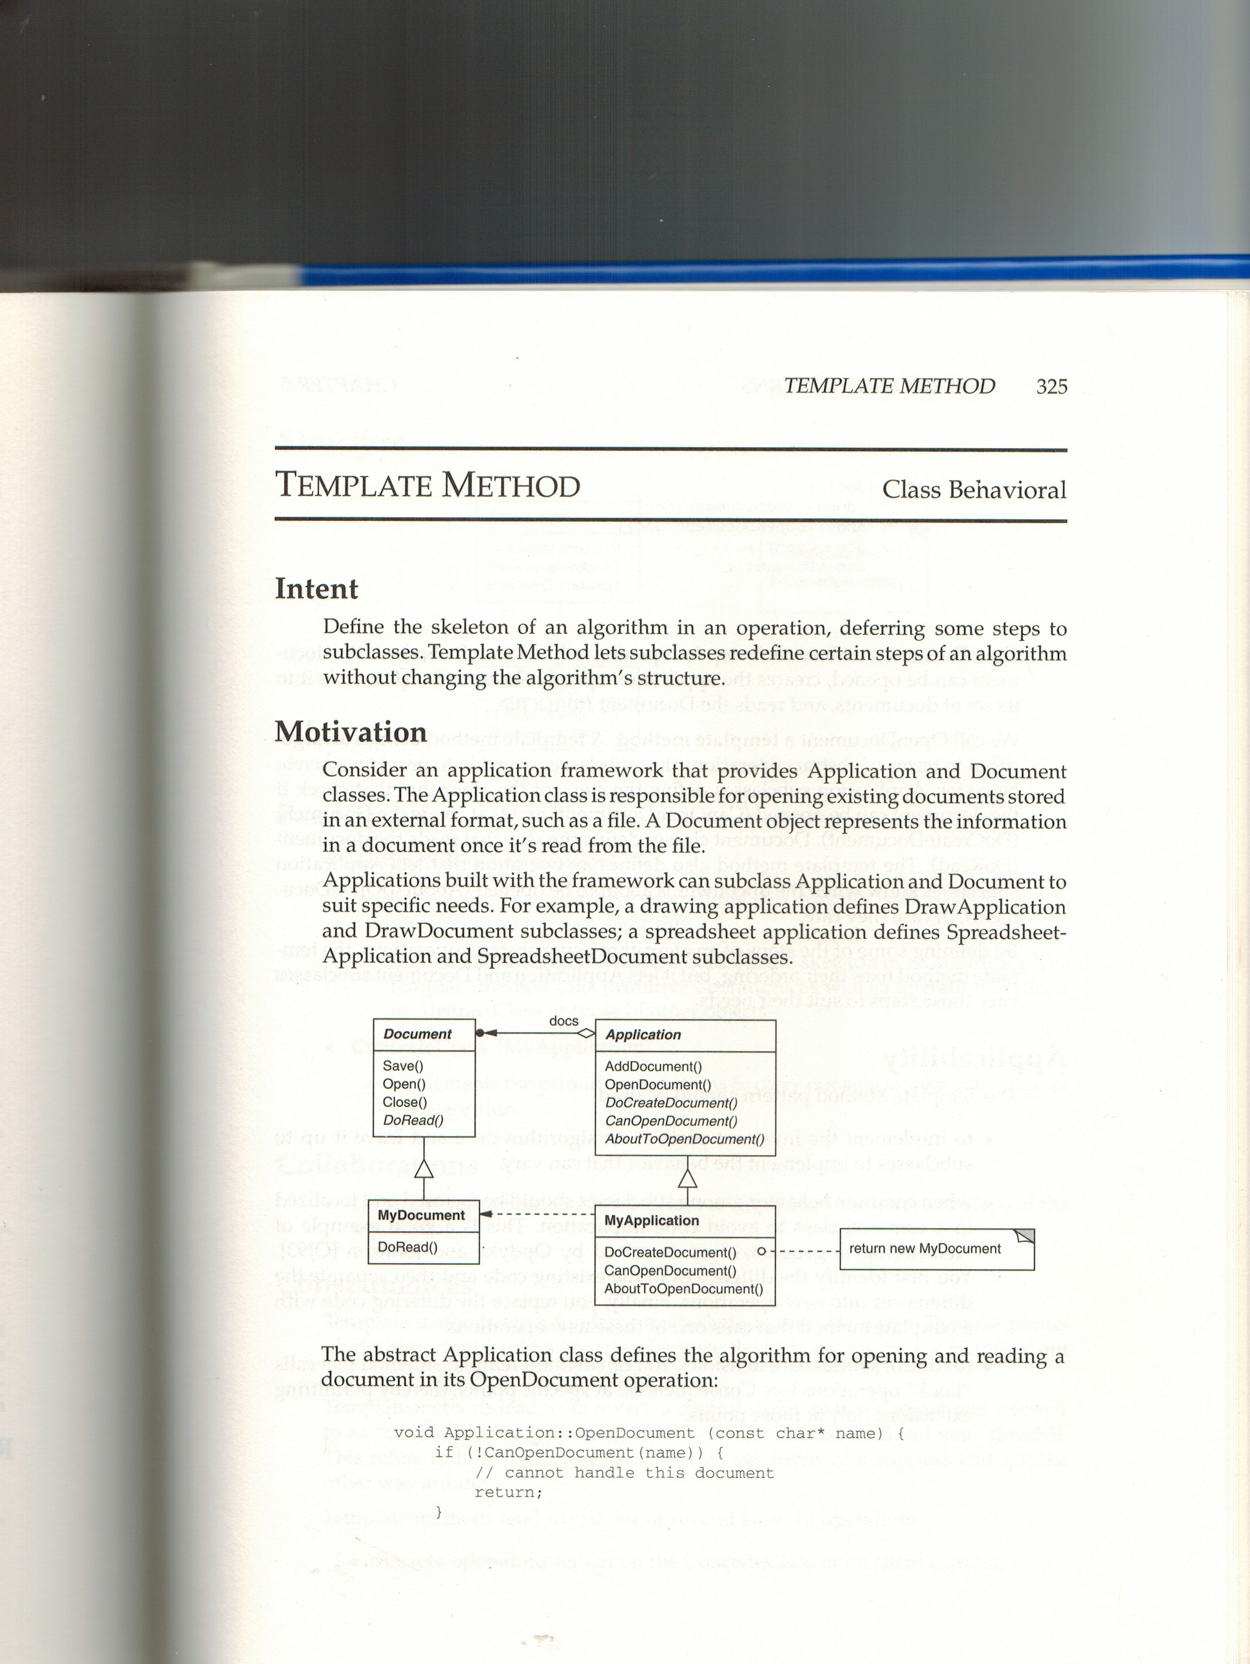
/Users/wffoote/cpe203/general/class_slides/week_10/gof_template.jpeg

Slide 17
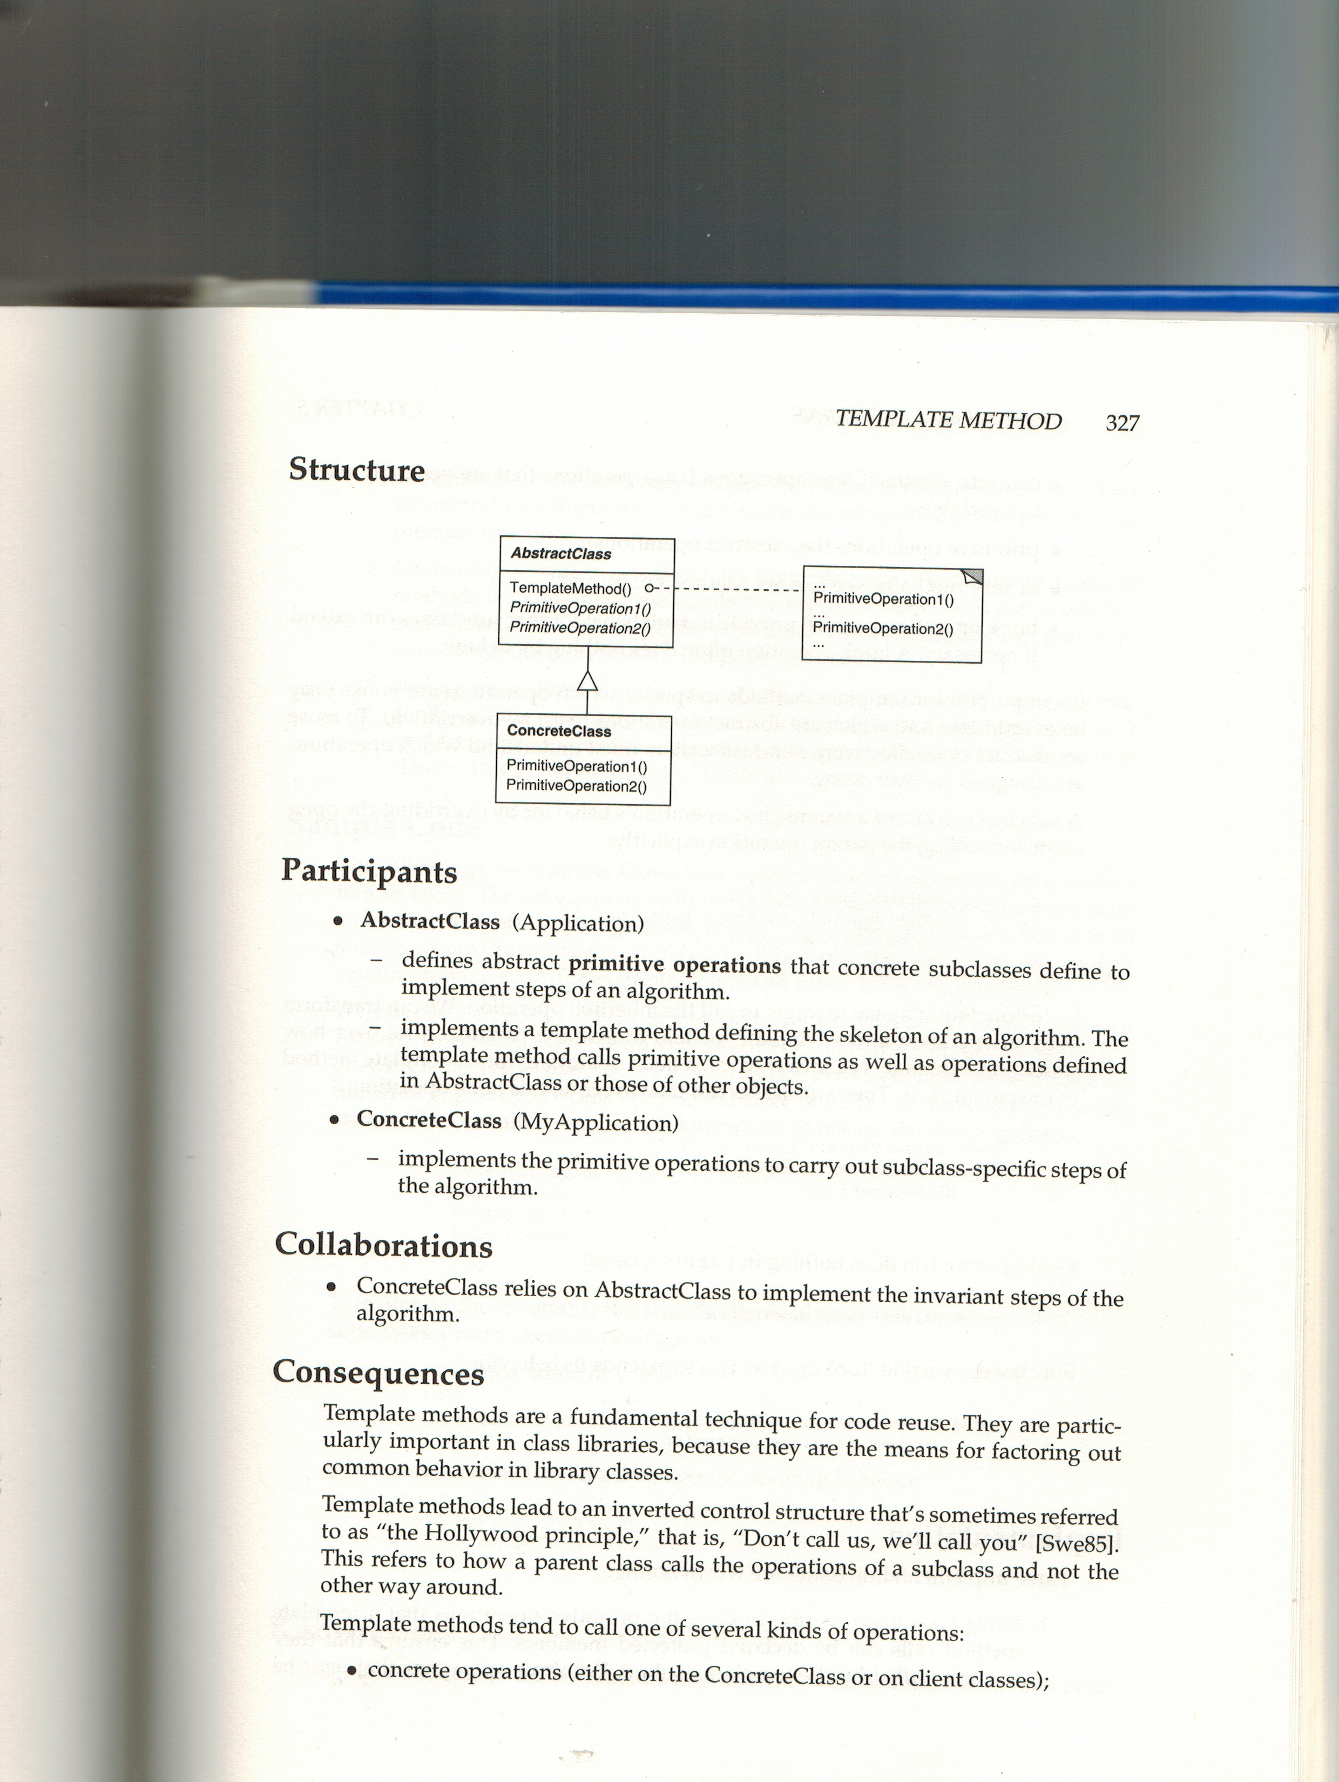
/Users/wffoote/cpe203/general/class_slides/week_10/gof_template_2.jpeg

Slide 18
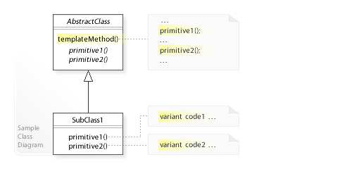
https://en.wikipedia.org/wiki/Template_method_pattern

Slide 19
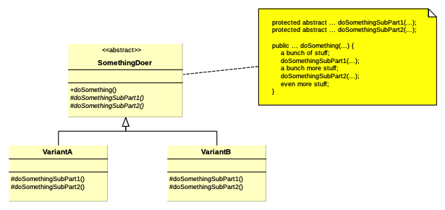
GoF TemplateMethod Pattern

Slide 20
Design by Contract
And LSP
  (week 7)

Slide 21
Final Materials
/Users/wffoote/cpe203/general/final/StudyProblems.pdf
/Users/wffoote/cpe203/general/final/StudyTopics.pdf

Slide 22
Supertype, Subtype or Neither
From midterm
With Generics

Slide 23
Supertype, Subtype or Neither
List<Point> vs. List<Object>
List<? super Point> vs. List<Point>
List<? extends Point> vs. List<Point>

Slide 24
List<Point>
List<? super Point>
List<? extends Point>
int size = list.size()
Point p = list.get(0)
list.add(new Point())

Slide 25
Friday
Object Canonicalization
  TrackingCookie and TrackedPerson
Start with SRP
Include visitor
  Week 3

