Slide 1

CSC 203 / CPE 203
Week 2
Project-Based Object-Oriented
Programming and Design
(using Java)
Bill Foote
wffoote@calpoly.edu
(http://jovial.com)
Notes:
M: 1-14
T:; 1-22
W: To, or through python vars
R: UP to javadocs @ end
F: through 49

Slide 2
A quick tour of the javadocs...
https://docs.oracle.com/en/java/javase/11/docs/api/index.html
Notes:
10 minutes needed after this

Slide 3
Including libraries
$ javac *.java
<...>
100 errors
$ javac -cp ../../../../libs/testy.jar *.java
$ java -cp ../../../../libs/testy.jar:. TestCases
5 total tests:
0 failed.
5 passed.

Slide 4
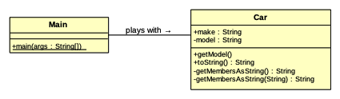
Creating your own objects
(see 1_car)
Notes:
LAST SLIDE!
Terminal, week01/Car.java

Slide 5
Class Names
Normal nouns:
  Car
  Vehicle
  Action
  Entity
  Event
  EventSchedule
  VirtualWorld
  WorldModel
Slightly odd nouns:
  ActionKind
  EntityKind
Not nouns that have anything to do with the problem:
  Functions
  Main
  TestCases

Slide 6
Java Import
public class MyClass {
…
private void use(
edu.calpoly.spritely.SprintWindow w)
{
w.pauseAnimation(30);
}
}

Slide 7
Java Import
import edu.calpoly.spritely.SpriteWindow;
public class MyClass {
…
private void use(
SpriteWindow w)
{
w.pauseAnimation(30);
}
}

Slide 8
Java Import
public class MyClass {
…
private void someTest()
{
edu.calpoly.testy.Assert.assertEquals(4, 2+2);
}
}

Slide 9
Java Import
import edu.calpoly.testy.Assert;
public class MyClass {
…
private void someTest()
{
Assert.assertEquals(4, 2+2);
}
}

Slide 10
Java Import
import static edu.calpoly.testy.Assert.assertEquals;
public class MyClass {
…
private void someTest()
{
assertEquals(4, 2+2);
}
}

Slide 11
Assignment 1
(not to be confused with Lab 1)
EventSchedule
  Unit tests are your friend!
  For example:
    Add 10 events to EventSchedule
    call advanceToTime to a time when 5 have been executed
    Verify that five execute
      For now, you’ll need to change the behavior of Event.execute() to test it
      Be sure to change it back!
      You can use println()
    Make sure they execute in order
    Play around with it; make sure it works in different scenarios!

Slide 12
Git Hint
DO use the github website to make sure you pushed the files you think you did.
DO NOT use the github website to upload files.
  If you do this, git may have different, conflicting versions of files on the server and on your local computer.
  This can be messy to fix.
  If you make this mistake, delete the local copy of your repository, clone a new copy, and manually add back in any changes you’ve lost.

Slide 13
Wednesday

Slide 14
checkgit hint
From materials/info/setup.txt:
“You can check that it's set up by typing ‘checkgit’ - you should get back a "usage" message for the command. The help message you get explains other useful features of checkgit.”

Slide 15
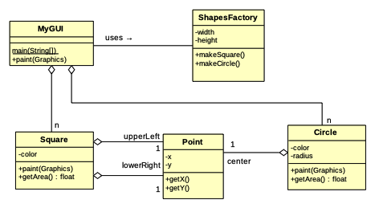
Testing code
Note the aggregation ↑
Notes:
Introducing a little program to draw some stuff. First, let’s test the classes!

Slide 16

https://junit.org/junit4/
org.junit.JUnitCore, org.junit.Assert

Slide 17
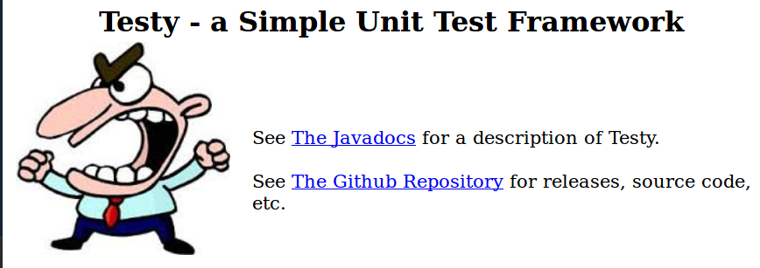
https://testy.jovial.com/

Slide 18
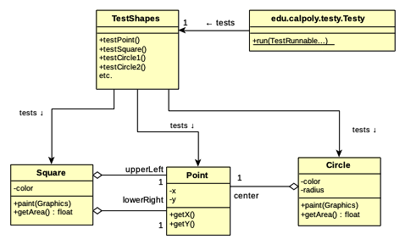
Notes:
cf. 2_testing/TestShapes

Slide 19
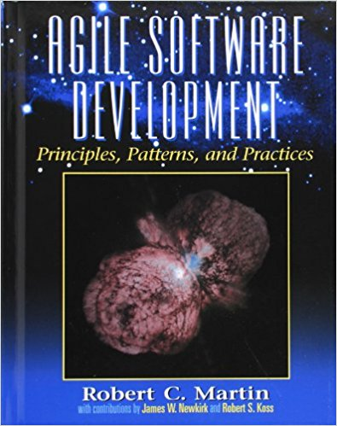
Single Responsibility Principle
“A class / module / etc. should have only one reason to change”
  Martin, Robert C. (2003). Agile Software Development, Principles, Patterns, and Practices
  “do one thing only,” but what is “one thing?”
Other ways we’ve said this:
  “High cohesion, low coupling”
  “Encapsulation”
  “Separation of concerns”
  “information hiding”

Slide 20
Testing code
Do Square and Circle each have a single responsibility?
Notes:
Introducing a little program to draw some stuff. First, let’s test the classes!

Slide 21
Friday

Slide 22

API Contract
What does it say? What doesn’t it say?

Slide 23
Open/Closed Principle

Slide 24
Java Mechanisms
public vs. private
  (and package-private)
Method overloading
Constructors
Instance members (methods & fields) vs. static
getters and setters
final

Slide 25
Unix Tools
vi, pico
grep, grep -i
info/unix_commads.txt

Slide 26
Next Week
Chapter 5, “Inheritance”
  Ignore anything to do with reflection

