Slide 1

CSC 203 / CPE 203
Week 3
Project-Based Object-Oriented
Programming and Design
(using Java)
Bill Foote
wffoote@calpoly.edu
(http://jovial.com)
Notes:
M: 1-14
T:; 1-22
W: To, or through python vars
R: UP to javadocs @ end
F: through 49

Slide 2
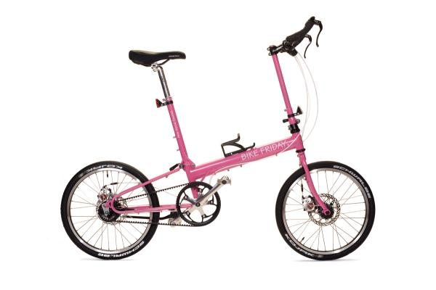
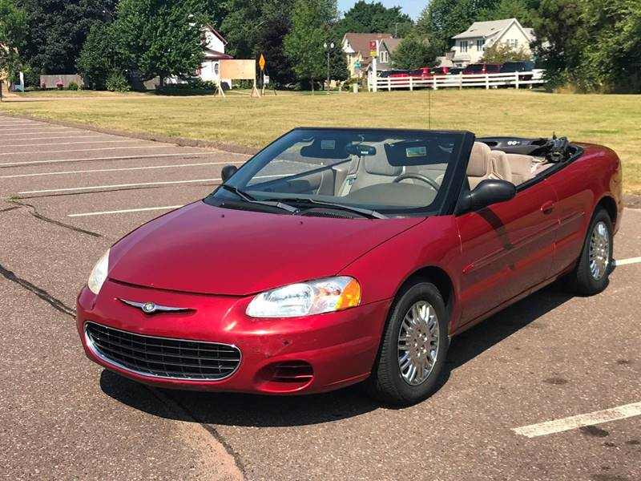
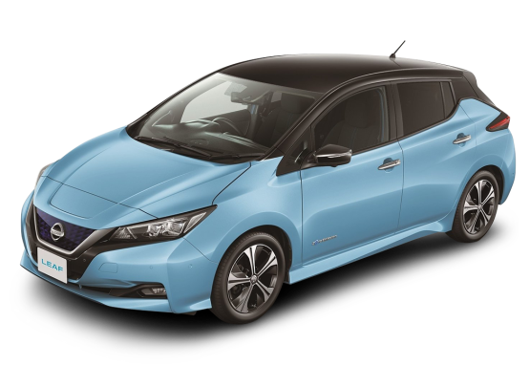
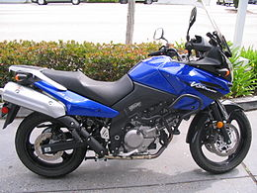
Interfaces and Polymorphism
Sebring s = new Sebring();
s.move();
Bicycle b = new Bicycle();
b.move();
+move()
+move()
+move()
+move()
+move()

Slide 3

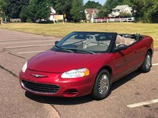
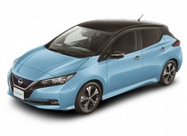
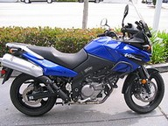
<<interface>>
Vehicle
+move()
+move()
+move()
+move()
+move()
+move()
+move()

Slide 4
List<Vehicle> list
= new ArrayList<Vehicle>();
list.add(new Sebring());
list.add(new Bicycle());
for (Vehicle v : list) {
v.move();
}
<<interface>>
Vehicle
TYPE:
v is of Type “Vehicle”
Sebring, Car, etc. are Subtypes
+move()
+move()
+move()
+move()
+move()
+move()
+move()

Slide 5
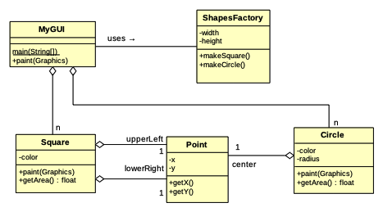
Before…
But we don’t really care about point...

Slide 6
Before...

Slide 7
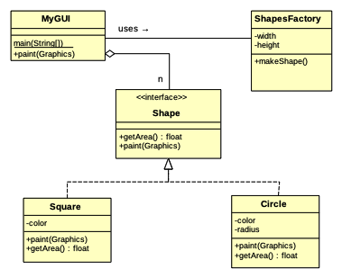

Slide 8
Wednesday
Assignment 1 part 1 (EventSchedule)
More painting, visitor pattern

Slide 9


p1 part 1: EventSchedule
Where is the EventSchedule contract?
(see also week_03/grading_snippet.txt)

Slide 10
instanceof / downcast
Shape s = ...;
if (s instanceof Triangle) {
Triangle t = (Triangle) s;
...
}

Slide 11
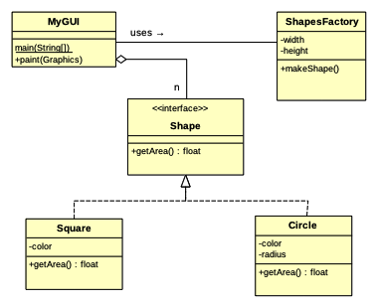
Adding paint when it doesn’t exist...

Slide 12
public void paint(Graphics g) {
for (Shape s : shapes) {
if (s instanceof Circle) {
Circle c = (Circle) s;
... paint the circle ...
} else if (s instance of Square) {
....
}
}

Slide 13
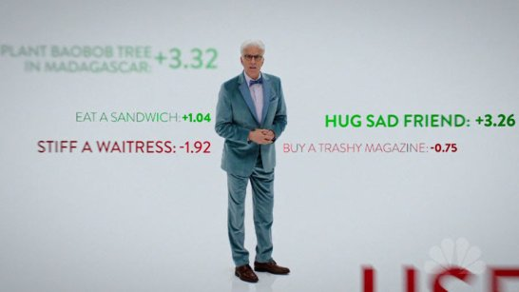
public void paint(Graphics g) {
for (Shape s : shapes) {
if (s instanceof Circle) {
Circle c = (Circle) s;
... paint the circle ...
} else if (s instance of Square) {
....
}
}
instanceof
chain: -42.0

Slide 14
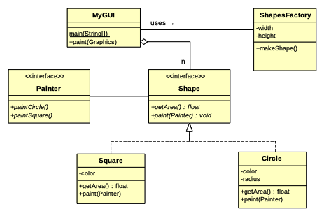

Slide 15
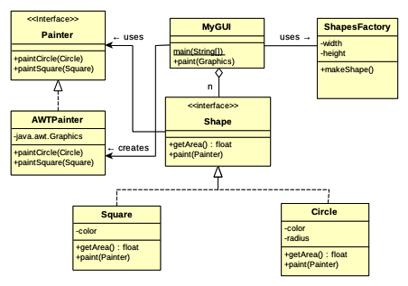

Slide 16

https://polylearn.calpoly.edu/AY_2017-2018/pluginfile.php/666124/block_html/content/Gamma_Design%20Patterns%20inside%20cover.pdf
https://polylearn.calpoly.edu/AY_2017-2018/pluginfile.php/666124/block_html/content/Gamma_Design%20Patterns.pdf

Slide 17
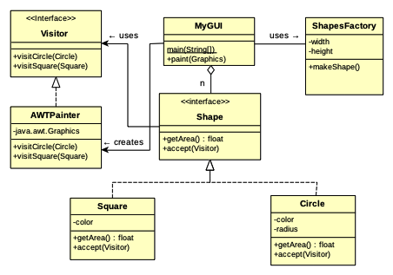
Visitor
Pattern

Slide 18
Friday

Slide 19
Code
(Code in 2_single_resp_code)

Slide 20
Ponder this:
What happens to the Visitor design version when we want to add triangles?

Slide 21
Another Kind of Polymorphism
“Implementation Inheritance”
  Usually just “Inheritance”

Slide 22
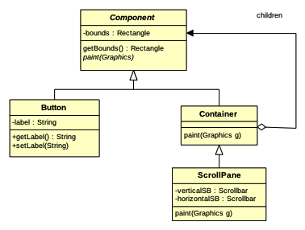

Slide 23
https://docs.oracle.com/javase/8/docs/api/index.html?java/awt/Component.html
week_03/impl_inheritance.txt

Slide 24
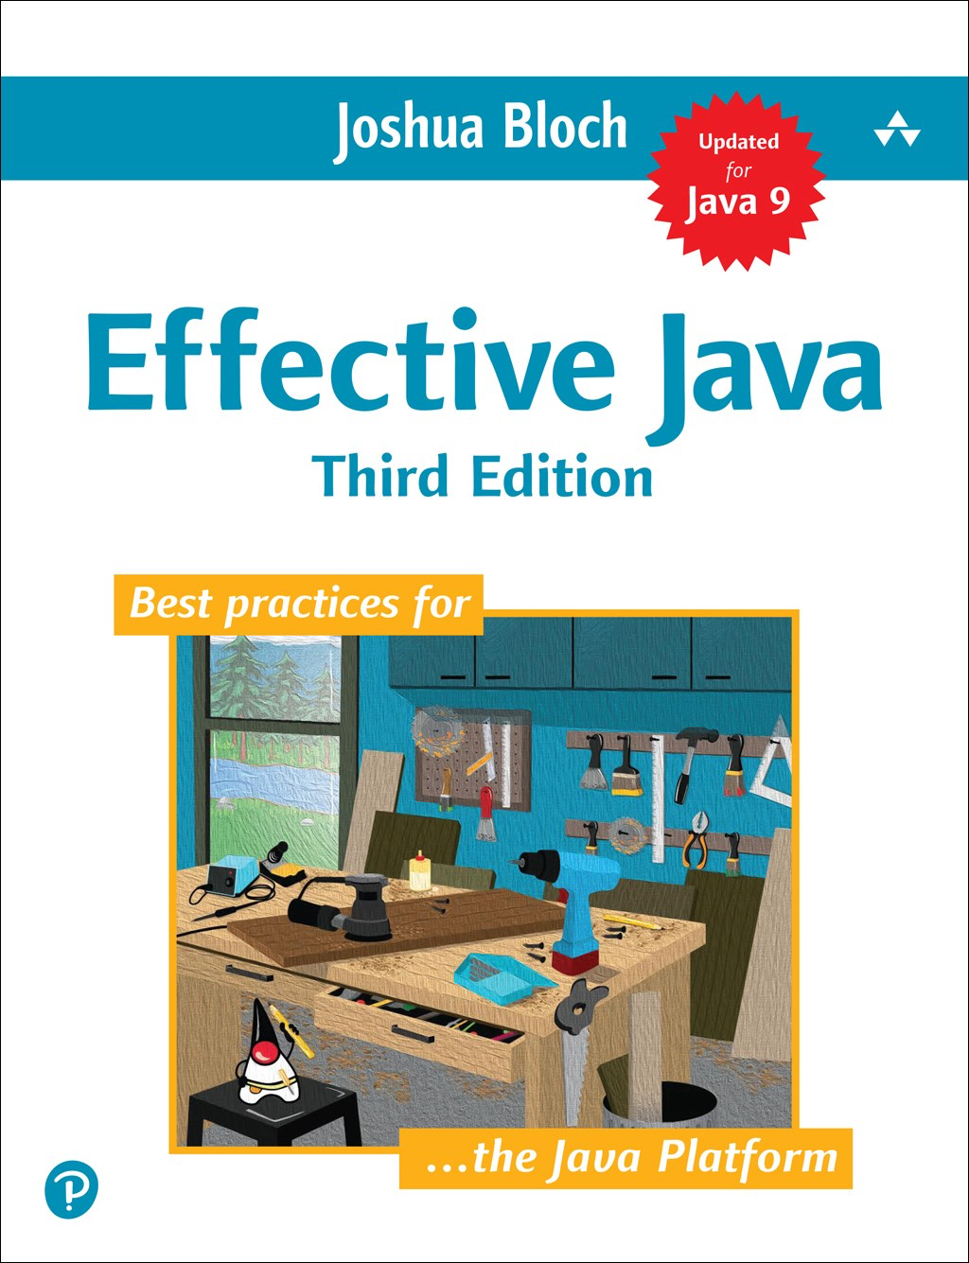
Interfaces vs. Superclasses
When you have a choice, prefer interfaces
  To much subclassing leads to fragile code
A class can only have one superclass, but it can implement multiple interfaces

Slide 25


Slide 26
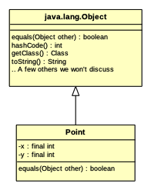

Slide 27
Are all objects created .equals()?
See 4_equals/1/Main.java for the answer!

Slide 28
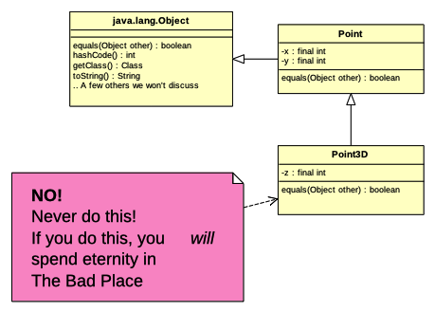


Slide 29
Recommended Approach
You don’t always have to implement equals()!
equals() is often useful for “data holder” classes, especially ones used as keys in maps
Data holder classes should usually be final, so that they can’t be subclassed
So, finally...

Slide 30
So much yes!
public final class Point {
...
@Override
public boolean equals(Object other) {
if (!(other instanceof Point)) {
// This handles the case where other == null
return false;
} else {
Point oP = (Point) other;
return this.x == oP.x && this.y == oP.y;
}
}
// Coming soon: hashCode()
}

Slide 31
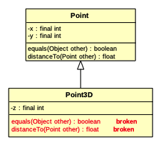

Slide 32
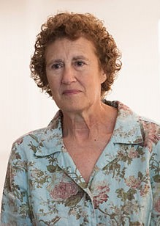

Liskov Substitution Principle
“Strong Behaviorial Subtyping”
“If S is a subtype of T,
then objects of type T
may be replaced with
objects of type S without
altering any of the desirable
properties of the program”
https://en.wikipedia.org/wiki/Liskov_substitution_principle

Slide 33
Assignment 1
Which methods were hard?

Slide 34
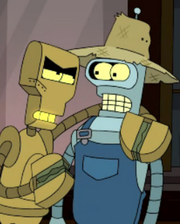
Assignment 1
clamp()
unscheduleAllEvents()
isOccupied()
shiftView()
getAnimationPeriod()
createXXX()
executeXXXActivity()
parseXXX()

Slide 35
Assignment 2

