Slide 1

CSC 203 / CPE 203
Week 5
Project-Based Object-Oriented
Programming and Design
(using Java)
Bill Foote
wffoote@calpoly.edu
(http://jovial.com)
Notes:
M: 1-14
T:; 1-22
W: To, or through python vars
R: UP to javadocs @ end
F: through 49

Slide 2
Open / Closed Principle
“Software entities (classes, modules, functions, etc.) should be open for extension, but closed for modification”
  It should be possible to use your (library) code without modifying the source
Are you tempted to modify the source code of java.util.ArrayList.sort()?

Slide 3
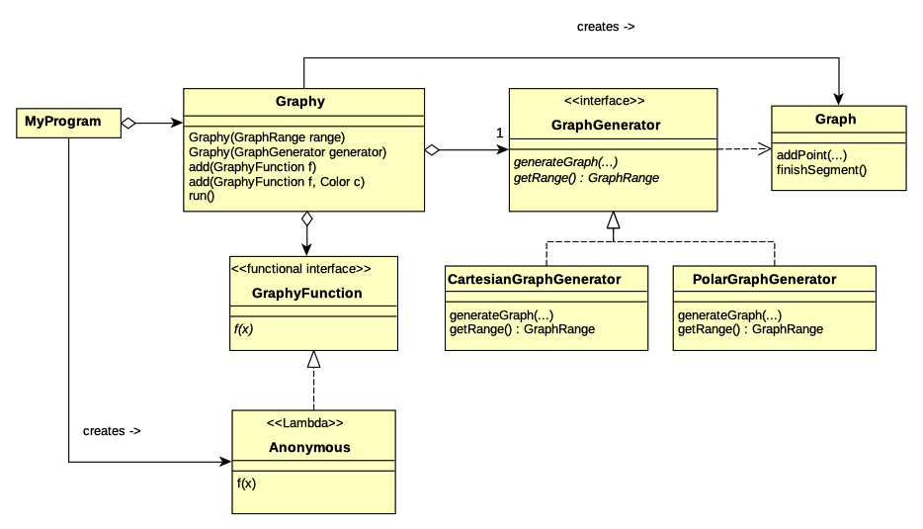

Slide 4
Open!

Slide 5
Template Method Pattern

Slide 6
And now, for something completely different...

Slide 7
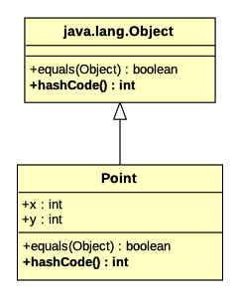

Slide 8
HashMap<String, Point>
Entry[hashCode]
1
2
“foo”
“bar”
3
4
HashMap<String, Point> map
= new HashMap<String, Point>();
map.add(“foo”, new Point(1, 2));
map.add(“bar”, new Point(3, 4));
Map.add(“baz”, new Point(9, 9));
map.add(“baz”, new Point(5, 6));
“baz”
5
6

Slide 9
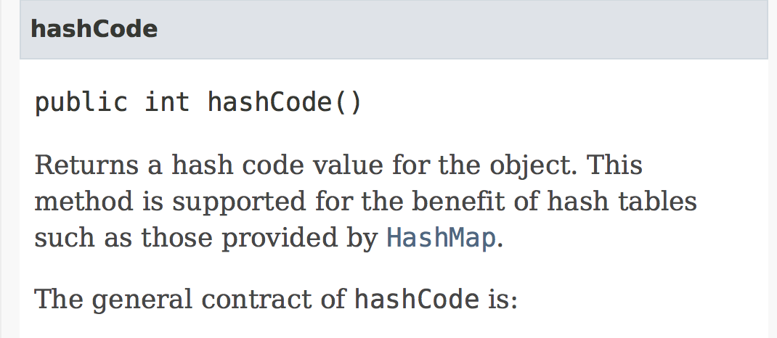
https://docs.oracle.com/javase/8/docs/api/java/lang/Object.html#hashCode--

Slide 10
HashMap<Point, ...>
public final class Point {
final int x, y;
…
public boolean equals(Object other) { … }
public int hashCode() {
return 42;
}
}

Slide 11
HashMap<Point, ...>
public final class Point {
final int x, y;
…
public boolean equals(Object other) { … }
public int hashCode() {
return x+y;
}
}

Slide 12
HashMap<Point, ...>
public final class Point {
final int x, y;
…
public boolean equals(Object other) { … }
public int hashCode() {
return x*97 + y;
}
}

Slide 13
HashMap<Point, ...>
public final class Point {
final int x, y;
…
public boolean equals(Object other) { … }
public int hashCode() {
return java.util.Objects.hash(x, y);
}
}

Slide 14
HashMap<MyList, ...>
public final class MyList {
int[] values;
…
public boolean equals(Object other) { … }
public int hashCode() {
int result = 0;
for (int i = 0; i < values.length; i++) {
result *= 97;
result += values[i];
}
return result;
}
}

Slide 15
HashMap<MyList, ...>
public final class MyList {
Point[] values;
…
public boolean equals(Object other) { … }
public int hashCode() {
int result = 0;
for (int i = 0; i < values.length; i++) {
result *= 97;
result += values[i].hashCode();
}
return result;
}
}

Slide 16
HashMap<Object, Object>
Entry[hashCode]
1
2
“foo”
7
11
“zoo”
HashMap<Object, Object> map
= new HashMap<Object, Object>();
map.add(“foo”, new Point(1, 2));
map.add(“bar”, “glorp”);
map.add(new Point(7, 11), “zoo”);
“bar”
“glorp”

Slide 17
HashMap<int, Point>
Is this possible?

Slide 18
HashMap<Integer, Point>
Entry[hashCode]
3
4
17
1
2
HashMap<Integer, Point> map
= new HashMap<Integer, Point>();
map.add(new Integer(42),
new Point(1, 2));
map.add(new Integer(17),
new Point(3, 4));
42

Slide 19
HashMap<Integer, Point>
Entry[hashCode]
3
4
17
1
2
HashMap<Integer, Point> map
= new HashMap<Integer, Point>();
map.add(42,
new Point(1, 2));
map.add(17,
new Point(3, 4));
42

Slide 20
For Wedesday 2/6/19:
Point review: Code 1, 2

Slide 21
Autoboxing
3/Autobox.java

Slide 22
Subclassing and Inheritance

Slide 23
Action and ActionKind
Your code gave you ersatz classes.
  (action.kind is a bit like Object.getClass())

Slide 24
Horstman vs. Foote
You might have noticed that the book recommends using getClass() in equals()
  Some others recommend this too
I don’t recommend that this be done as a rule that gets applied without thinking. A word about why...

Slide 25
I recommend final to prevent subclassing
public final class Point {
final int x, y;
public int hashCode() { ... }
public boolean equals(Object other) {
if (other instanceof Point) {
Point op = (Point) other;
return x == op.x && y == op.y;
} else {
return false;
}
}
}

Slide 26
Others recommend getClass() to “patch up” equals()...
public class Point { // No final... Go ahead and subclass!
final int x, y;
public int hashCode() { ... }
public boolean equals(Object other) {
if (other == null || other.getClass() != getClass()) {
return false;
} else {
Point op = (Point) other;
return x == op.x && y == op.y;
}
}
}

Slide 27
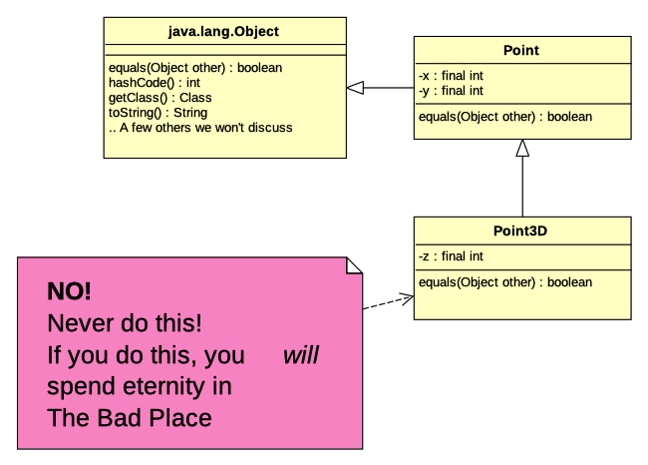


Slide 28
Also...
Using getClass() in equals() is often wrong.
In fact, in real code that doesn’t blatantly abuse the type system (like Point3D does), one would be hard pressed to argue that blindly using getClass() is even statistically more likely to be correct than blindly using instanceof.
Consider java.util.Set:
https://docs.oracle.com/javase/8/docs/api/java/util/Set.html#equals-java.lang.Object-

Slide 29
Also...
getClass() is an example of “reflection.”
Rules for using reflection:
  Don't.
  If you think it's absolutely essential, see rule 1.
  If you made it here, OK, maybe. But think very, very carefully about why you think you need it, use as little of it as possible, and try to find a better way.
  Please reconsider your use of reflection. See rule 1.

Slide 30
Guidelines for a hashtable key...
Must correctly implement equals() and hashCode()
Key class should be final (no subclasses/subtypes)
  unless it has been carefully designed, like java.util.Set
Values in key objects should never change
  Often best done with an immutable object
    e.g. final fields, no public mutator methods, etc.

Slide 31

Note about reflection and Assignment 4
In assignment 4, you are replacing EntityKind.
You could use reflection, viz:
Entity e = ...;
Class classObject = OreBlob.class;
if (e.getClass() == classObject) {
...
}
See previous slide on when to use refletion...

Slide 32
Note about reflection and Assignment 4
A better way, using lambdas and a functional interface:
OreBlob blob =
(OreBlob) w.findNearest(
(Entity e) ->
e instanceof OreBlob)

Slide 33
sqrt() gone bad!
4/Sqrt.java

Slide 34
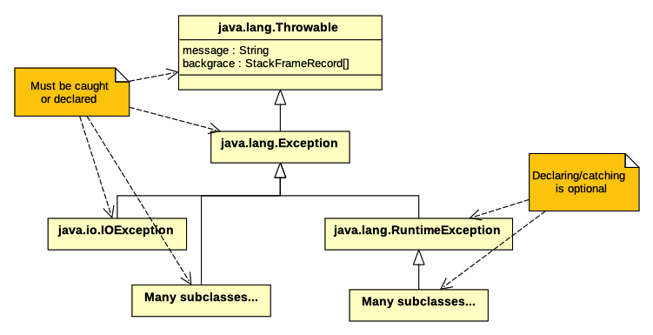

Slide 35
FileIO
5/FileIO.java

Slide 36
Exceptions
try / catch / finally
RuntimeException vs. Exception subclasses
  RuntimeException doesn’t need to be caught

Slide 37
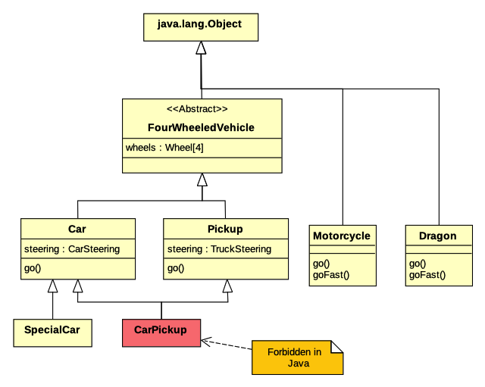

Slide 38
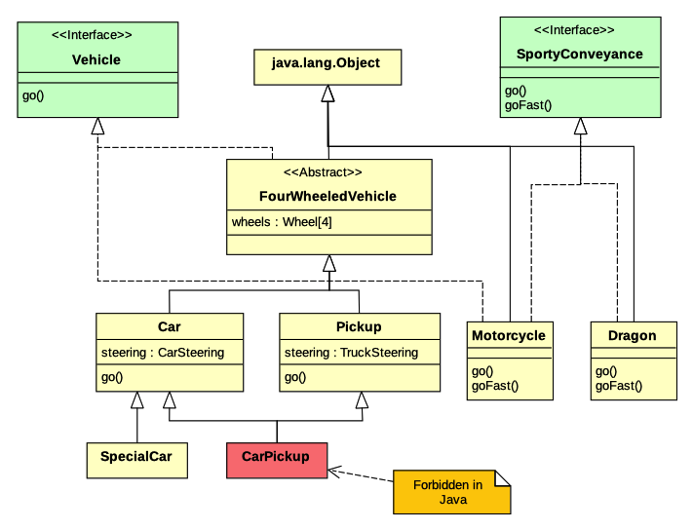

Slide 39
Review

