Slide 1

CSC 203 / CPE 203
Week 4
Project-Based Object-Oriented
Programming and Design
(using Java)
Bill Foote
wffoote@calpoly.edu
(http://jovial.com)
Notes:
M: 1-14
T:; 1-22
W: To, or through python vars
R: UP to javadocs @ end
F: through 49

Slide 2
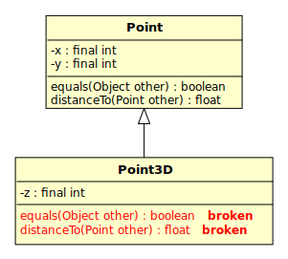

Slide 3
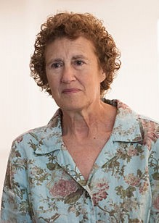
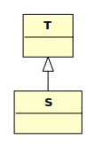
Liskov Substitution Principle
“Strong Behaviorial Subtyping”
“If S is a subtype of T,
then objects of type T
may be replaced with
objects of type S without
altering any of the desirable
properties of the program”
https://en.wikipedia.org/wiki/Liskov_substitution_principle

Slide 4
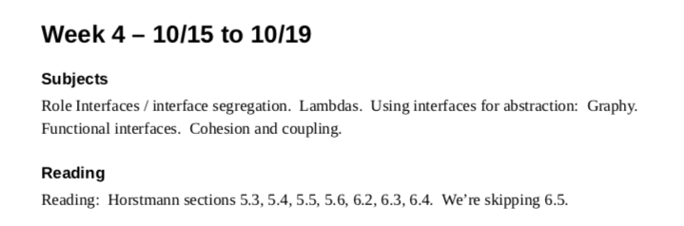

Slide 5
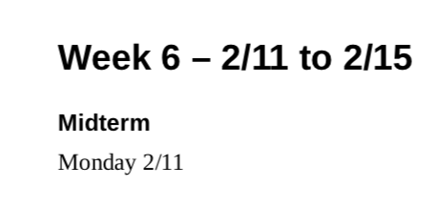

Slide 6
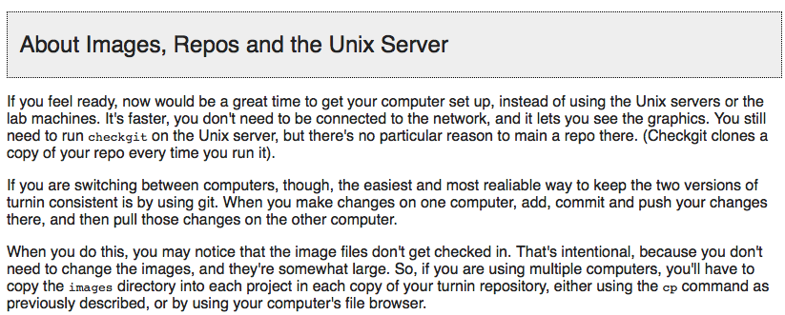

Slide 7
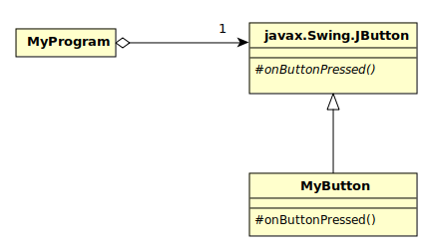

Slide 8
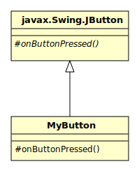
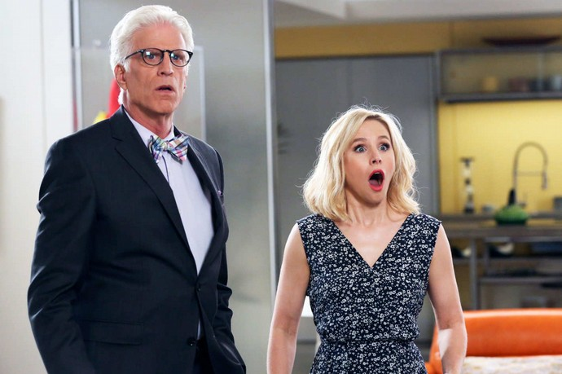

Slide 9
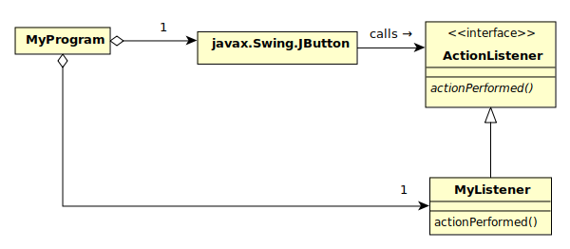
(code 1)

Slide 10

(code 2)

Slide 11
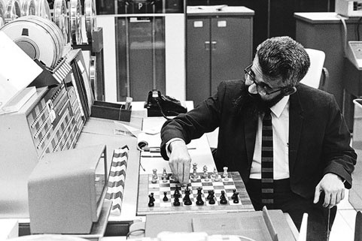
John McCarthy – LISP – 1958 (http://history-computer.com/ModernComputer/Software/LISP.html )
Alonzo Church – Lambda Calculus - 1930’s

Slide 12
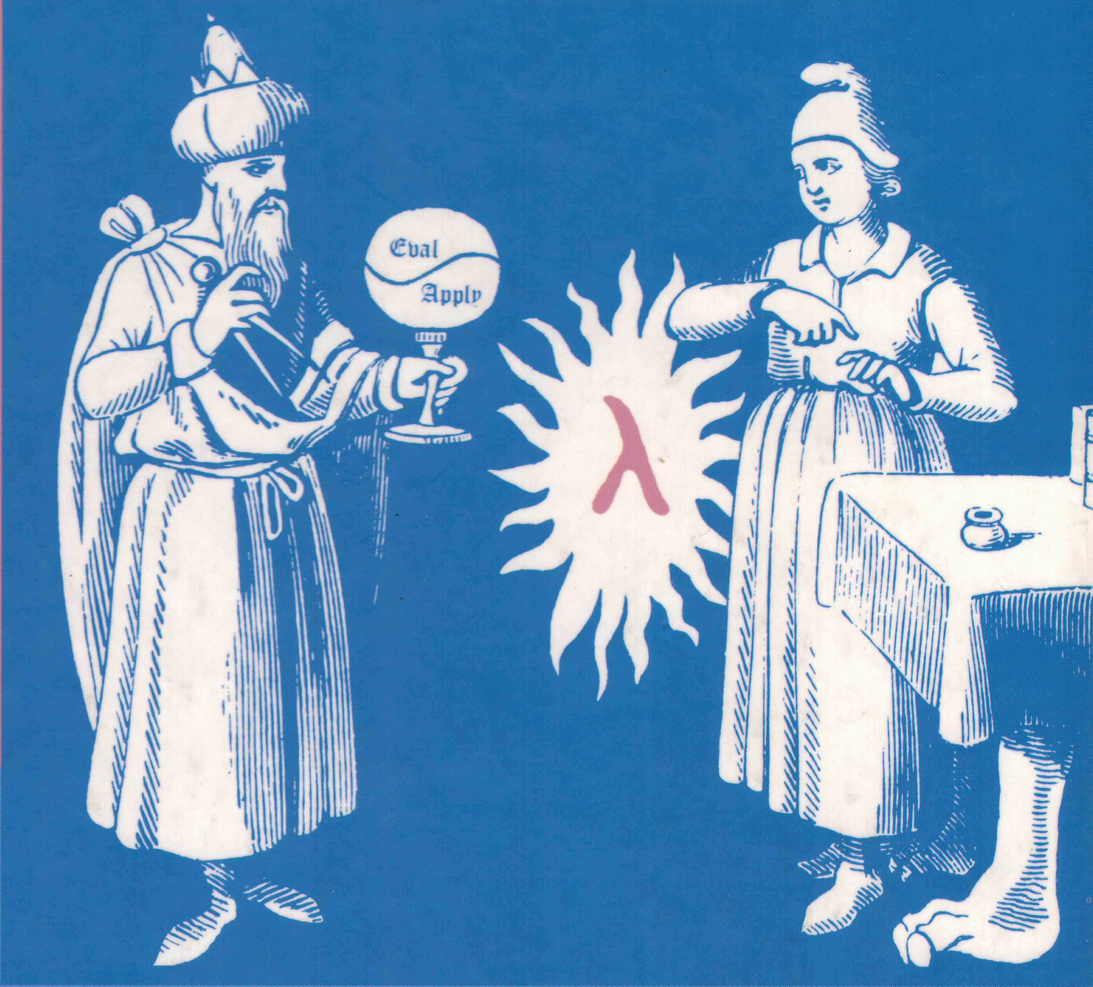

Slide 13
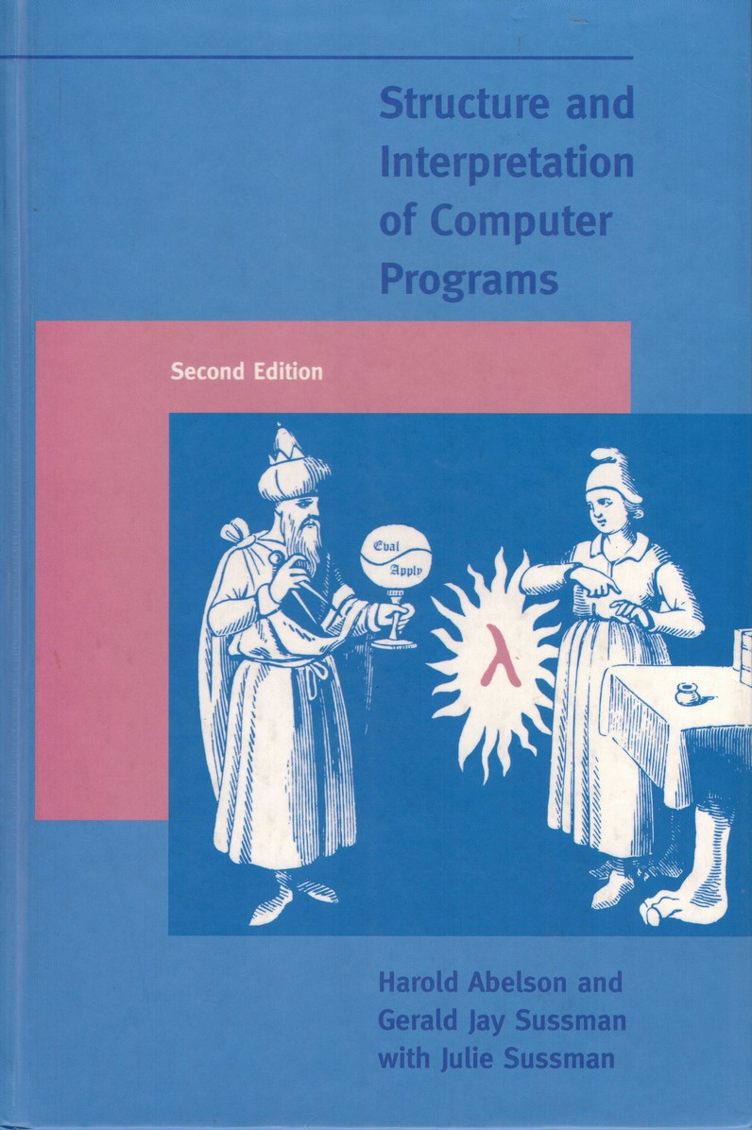
More Fun with Lambdas
See Testy
See program 4
On Wednesday:
5

Slide 14
Cohesion and Coupling
(not in Horstmann book)

Slide 15
Cohesion: Good
“The act or state of sticking together tightly; especially : unity”
  #1 under https://www.merriam-webster.com/dictionary/cohesion
In computer science:
  Applied at every layer of the system
  https://en.wikipedia.org/wiki/Cohesion_(computer_science)

Slide 16
Coupling: Bad unless necessary
“The act of bringing or coming together : pairing”
  https://www.merriam-webster.com/dictionary/coupling
https://en.wikipedia.org/wiki/Coupling_(computer_programming)

Slide 17
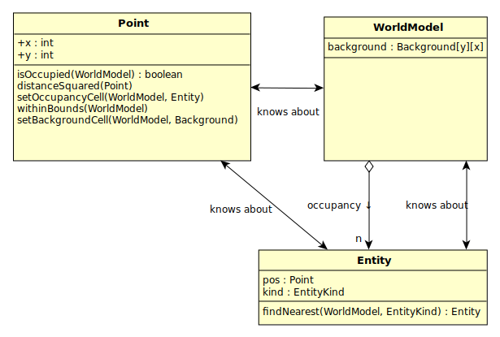

Slide 18
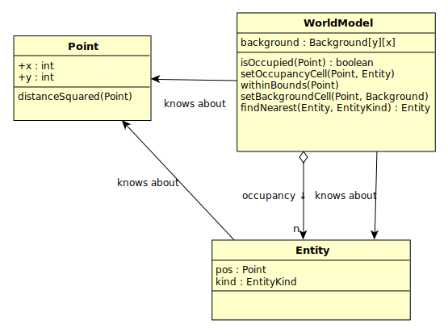

Slide 19
Lambdas and Interfaces: Meet Graphy!
(program 6)

Slide 20
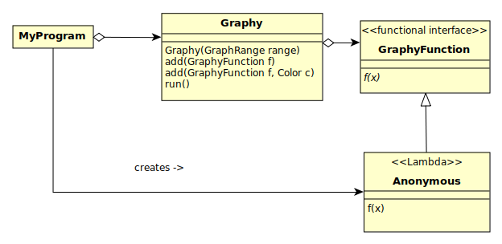

Slide 21
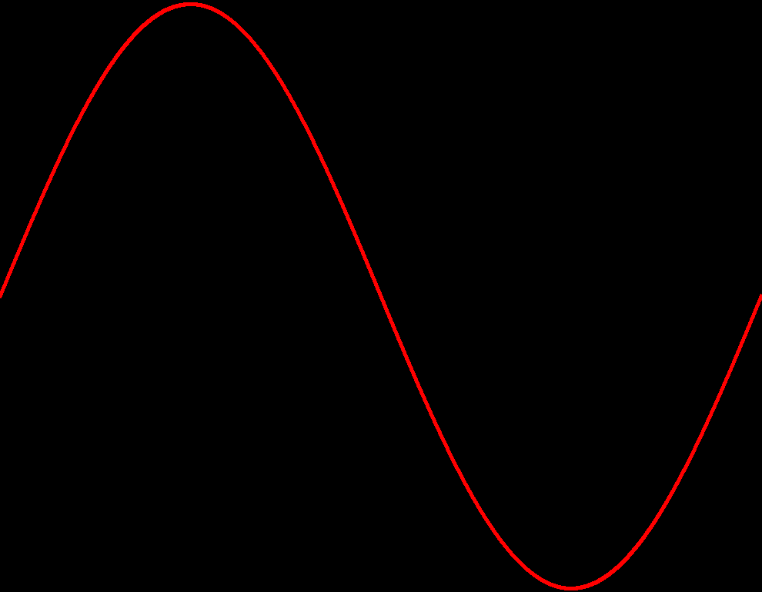
Graphy can graph everything!

Slide 22
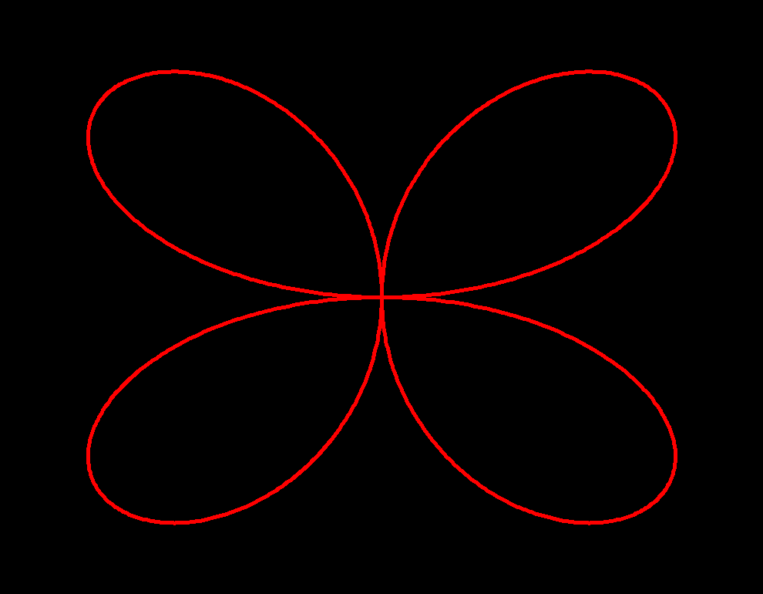

Slide 23
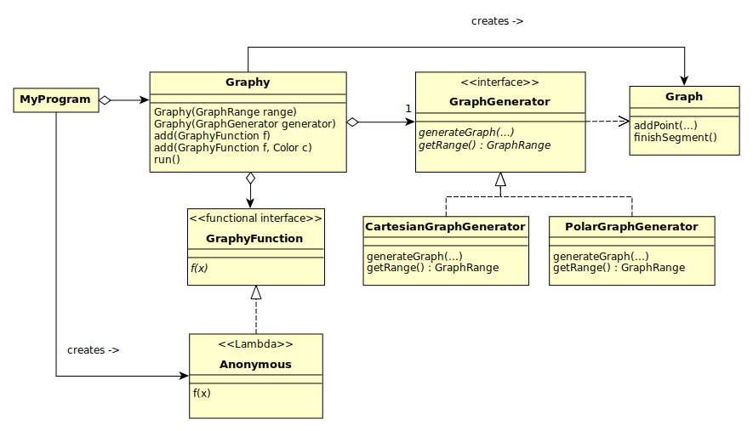
(program 7)

Slide 24
Look familiar?
(program 7)

