Slide 1
House pricing predictions
Author: Mamadou Baïlo CISSE

Slide 2
Introduction
The goal of this data science project is to build an efficient machine learning model to predict house prices. To achieve this, our supervised model (the price is the label) will learn from a training data set in which we'll select the most relevant features that best explain the house prices
This is the different steps to achieve our goal.
In the first part of the project :
We will make some data explorations along with data cleaning by dealing with duplicate values (if there are any), null values...
Then we will use the correlation technique (Pearson correlation matrix) to select the features that are best correlated with the dependent variable (house price)
Then we will build our model and make some accuracy analysis on three different set of variables.
Finally, we are going to verify our model against the test data.
In the second part of the project, we will make further transformations to try perform better on the test dataset :
First, we will apply the same transformations as in the first part of the project
Then, we are going to treat categorical columns with some imputation and the use of ANOVA technique.
Finally, we will compare the performance of this new model to the models built in the first part of the project on the test data
In a general context, one can use this kind of model in real world to estimate a house price. It can even be useful for real estate agencies.
In the dataset, we have 82 variables (including Unnamed: 0 and Id columns) that describe different aspects of a hundred houses including their prices
*Please add slides as required.

Slide 3
The Data
We have been provided two datasets:
A training dataset 'houseSmallData.csv' that will help us train the model
A testing dataset 'jtest.csv' that is intended to test our model
Each dataset has 100 records.
In the data, we have 40 numeric columns, including Unnamed: 0 and Id columns (continuous and discrete) and 42 categorical columns (nominal and ordinal).
Continuous variables generally qualify areas (lot area, living area, etc.). The discrete variables indicate the number of occurrences of standard rooms in the dwelling (number of bedrooms, bathrooms). Among other things, we find the years of construction and renovation of the house and the garage.
Nominal variables identify housing types, materials, garages, environmental conditions while ordinal variables evaluate the different elements of the property.
A description of the data is provided in data_description.txt file.
*Please add slides as required.

Slide 4
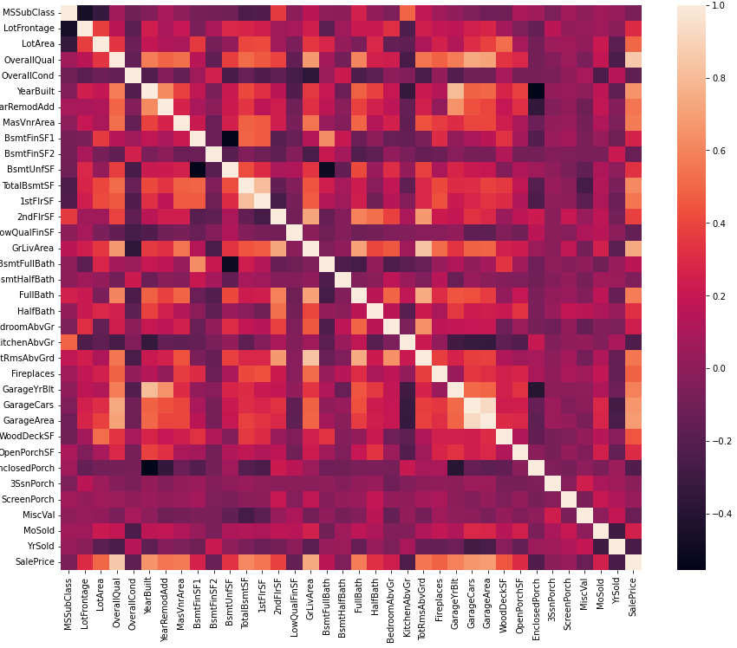
Data Exploration
Analyzing the heatmap correlation matrix helps us in identifying the variables that are the most correlated with SalePrice. We can cite for example OverallQual and GrLivArea
*Please add slides as required.

Slide 5
Data Preparation
The necessary steps of the data preparation are :
Delete columns that are not needed
Impute null values
Mean for numeric variables
most-frequent strategy for categorical variables
Replace ordinal categorical variables with numeric values
Create dummy variables for nominal categorical variables
Analyze the correlations
Select the most correlated features
Pearson correlation for numeric variables
P-value for nominal categorical variables
In the first part of the project, we applied the steps 1, 2.a, 5 ,and 6.a as we only used numeric variables
In the second part of the project, we applied all the steps from 1 through 6 because we used both numeric and categorical variables
*Please add slides as required.

Slide 6
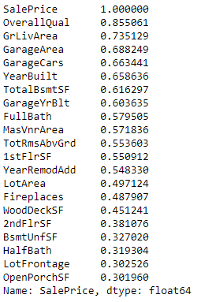
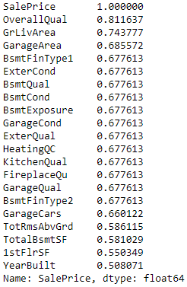
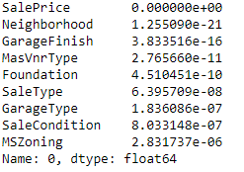
Correlation
In the first part of the project
In the second part of the project after further transformations
Numeric variables
Nominal categorical variables (p-value) against SalePrice

Slide 7
Project Description 1/2
In our analysis, we found linear relationships that makes us comfortable in using linear regression algorithm.
In the first part of the project, after analyzing the dataset using data description file along with some exploration steps, we selected three sets of features based on their correlation with the SalePrice (dependent variable).
We then built three models (model10, model15, model20) against those three sets of features (10, 15, 20 most correlated features) and demonstrated that the model model20 was the one that performed the best on the training data regarding the three metrics R^2 (0.88), MAE - Mean Absolute Error - (18 356.27) ,and MSE - Mean Square Error (600 490 969.09).
*Please add slides as required.

Slide 8
Project Description 2/2
In the first part of the project, we were not performing well on the test dataset.
We then decided to perform further transformations (second part of the project) by including categorical (ordinal and nominal) variables to build a new model "NewModel". We selected the best correlated categorical features by using most-frequent imputation (to deal with null values) and ANOVA (ANalysis Of VAriance) technique.
By doing so, we improved :
R^2 metric from 0.88 (model20) to 0.95 (NewModel) on the train dataset.
R^2 metric from 0.74 to 0.78 on the test dataset.

Slide 9
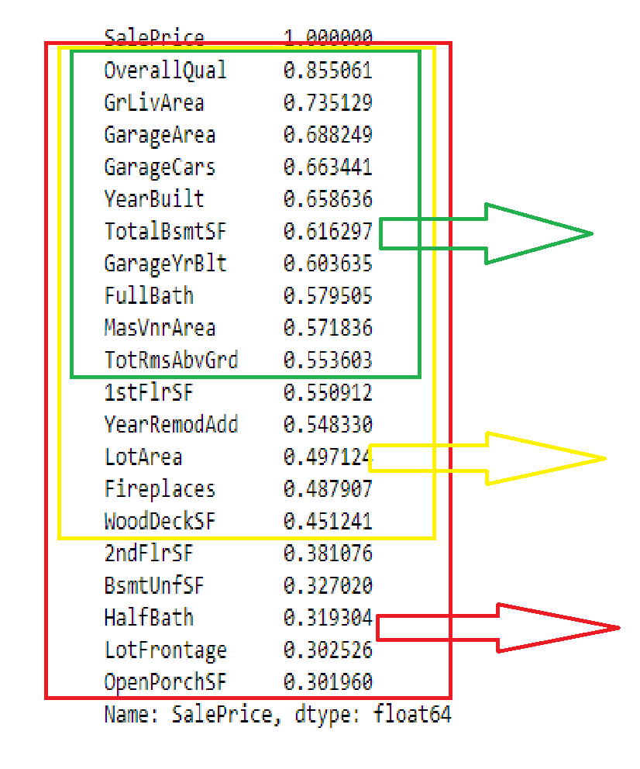
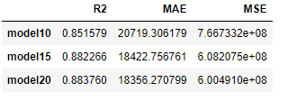
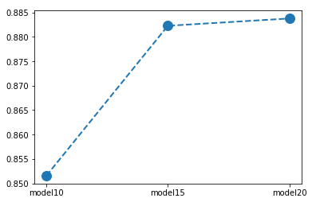
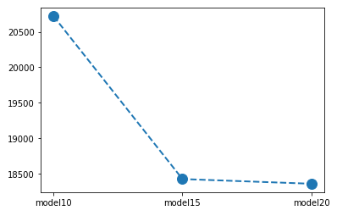
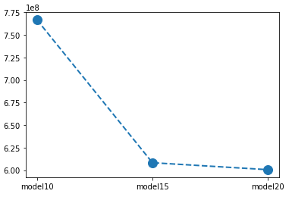
Analysis and Results 1/2
10-most correlated features
Summary of the results
15-most correlated features
20-most correlated features
Plot R^2
Plot MAE
Plot MSE
After analyzing the different metrics, we conclude that model20 built with the 20-most correlated features to the SalePrice is the one that performs better because it has the highest R^2 and the lowest MAE and MSE compared to model10 and model15. This can be explained by the fact that we included more correlated features in model20 that might explain the SalePrice.
*Please add slides as required.

Slide 10
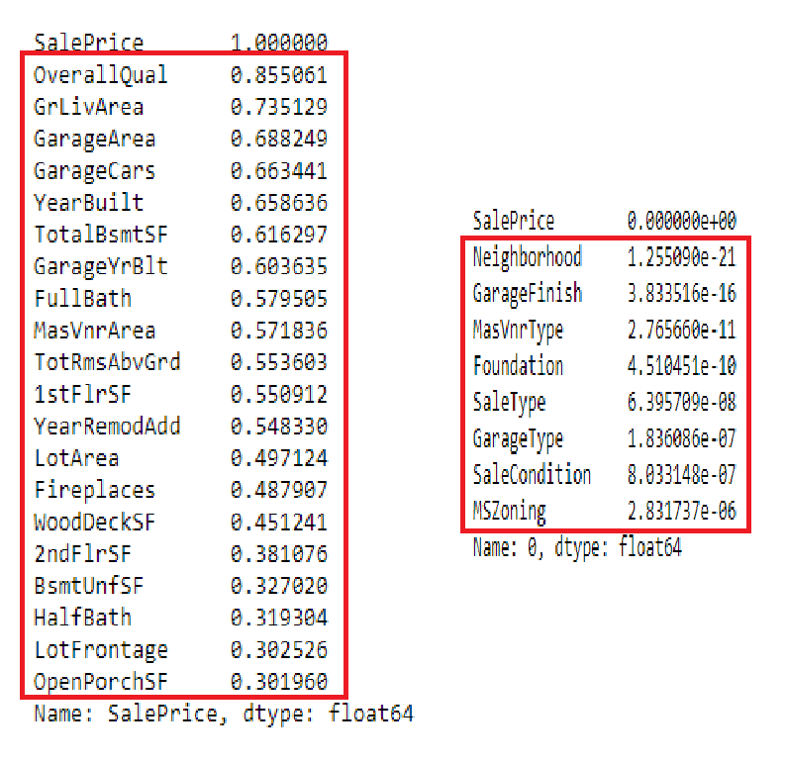
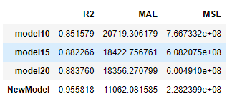
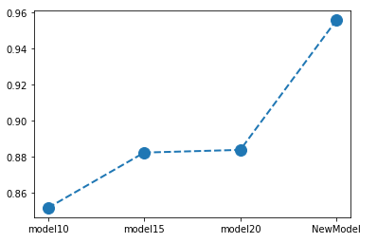
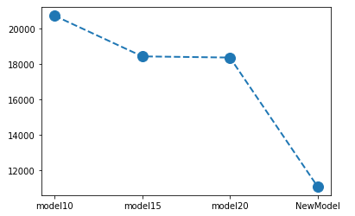
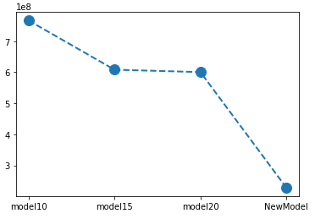
Analysis and Results 2/2
20-most numeric
correlated features
Summary of the results
8-most nominal categorical correlated features (based on the p-value)
Plot R^2
Plot MAE
Plot MSE
After analyzing the different metrics, we conclude that the model NewModel built using further transformations performs better because it has the highest R^2 and the lowest MAE and MSE compared to model10, model15 ,and model20.**
This can be explained by the fact that we included more correlated features (including categorical ones) that might explain the SalePrice.
*Please add slides as required.

Slide 11
Verification 1/2
For the first part of the project, we tested the model model20 against the test data because it was the one that performed the best.
In one hand, the coefficient R^2 was 0.74 which means we're not as good as the train data where the coefficient R^2 was 0.88
In the other hand, when we compare how our model20 performs on the test data set (0.74) against Dr. Williams model (0.74), we see that we perform the same.
*Please add slides as required.

Slide 12
Verification 2/2
For the second part of the project, we tested the model NewModel against the test data because it was the one that performed the best.
In one hand, the coefficient R^2 was 0.78 which means we're not as good as the train data where the coefficient R^2 was 0.95.
In the other hand, however, we can see that the model NewModel performs better on test data (0.78) compared to the model20 (0.74) and Dr. Williams model on test data (0.74). We improved the performance.
*Please add slides as required.

Slide 13
Conclusion
In the first part of the project, we demonstrated that we performed better with model20 that is built with the most 20-correlated features with the SalePrice.
In the second part of the project, by applying further transformations and including the categorical features in the analysis, we built a new model "NewModel" that performed better than model20.
This demonstrates the importance of data cleaning and analysis techniques when creating a prediction model. We need to know well our data and transform them the way we can get the features that explain the best the dependent variable.
In this project, we learned techniques such as imputation strategies for categorical variables ,and ANOVA to analyze the correlation between a categorical and a numerical variable ,and we also learned the metrics MAE (Mean Absolute Error) ,and MSE (Mean Squared Error) for model evaluation. However, we faced some difficulties when dealing with dummy variables.
Linear regression is just one algorithm in the machine learning world. We could have used other algorithms such as Lasso or XGBoost.
*Please add slides as required.

Slide 14
References
MIT XPRO, 2022. https://student.emeritus.org/courses/4750/pages/making-predictions-with-linear-regression?module_item_id=1302803
Hashmi, Farukh. "Thinking neuron" Thinking neuron. Thinking Neuron, 2022. https://thinkingneuron.com/how-to-measure-the-correlation-between-a-numeric-and-a-categorical-variable-in-python/
Scikit learn, 2022. https://scikit-learn.org/stable/modules/model_evaluation.html#regression-metrics
*Please add slides as required.

