Slide 1
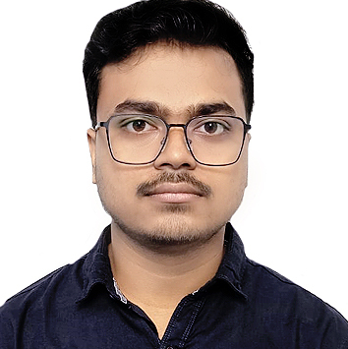


ISAN BAIN
Bachelor of Computer Application : 2019 - 2022
Associate/Software Associate
Skills
C# | Basics, OOPS, Exception Handling, Arrays, Collection and Generics, Delegates and Events, File IO and Serialization.
.Net | ADO.NET, ASP.NET with MVC and WEB API, Entity Framework
Angular | Components, Services, Modules, Routing, Forms & Validation
ADO.Net | Basics Architecture
Database | Microsoft SQL Server
Tools | GIT, SSMS, Visual Studio, Visual Studio Code
Cloud | Microsoft Azure AZ-900 Microsoft Azure AZ-204
UI Technology | HTML5, CSS JavaScript & Angular
Add on Skills | Communication skills Team Management
Bangalore
xxxxx.xxxxx@capgemini.com
+91 8777063483
A3
Full Stack Developer
Railway Reservation System:
Case Study on Railway Reservation System using ASP.NET Core with Entity Framework ,Web API and SQL Server Management Studio, User Interface created with HTML5, CSS3, JavaScript and Angular. Backend with WEB API and fronted with Angular. It is a Website for Customers so that they can easily book their Train Tickets online from their comfort zone.
Degreed:
Successfully completed the degreed training in Git, HTML, CSS, SQL, C#, .Net Core, Angular
Technologies used:
ANGULAR
ASP.NET Core
Microsoft SQL Server
Hands on experience on C#,ADO.NET,SQL Server , ASP.NET MVC5 with WEBAPI.
Hands on experience in developing web pages using HTML5, CSS3, Object Oriented Java script, ES6
Knowledge on creating Single Page Web Applications using Angular
Having Knowledge on Git and GitHub.
Attended training on ITransform-Microsoft.Net
Documents
UI
API
Check out my work on GitHub & Video Profile

