Slide 1

Intelie by Viasat Data Science Challenge

Slide 2
Project goal
Extract insights to help in the development of
Slip to Slip connection time KPI.

Slide 3
Workflow
Exploratory data analysis
Analyse time series-related properties in the features
Pre-processing
Prepare data to modeling
Machine learning
Identify when slip is on or off
Conclusion
Analyse the pros and cons

Slide 4
Exploratory Data Analysis
Features description
Feature | Description | Stationary | Granger test | Outliers
BDEP | Bit depth | Yes | All features | 0.7 %
TPO | Fluid flow | No | HL, WOB | 3.0 %
HL | Hook load | No | BHT | 0.3 %
BHT | Block position | No | HL, WOB | 0.5 %
WOB | Weight on bit | No | BHT | 0.3 %
Note: RPM, TOR and DEPT were removed due to null/constant value.

Slide 5
Story behind the data
Trip out operation
Constant values for RPM, TOR and DEPT features.
HL and WOB have an antagonistic behaviour.
BHT quickly decreases when on_slips
and slowly increases when off_slips.
BDEP has a downward trend.
TPO correlates with a change in seasonality.

Slide 6
Seasonality
Average window time:
on_slips = 2 minutes
off_slips = 4 minutes
Outlier pattern from 02:12 to 02:28
Precedes peak values of TPO

Slide 7
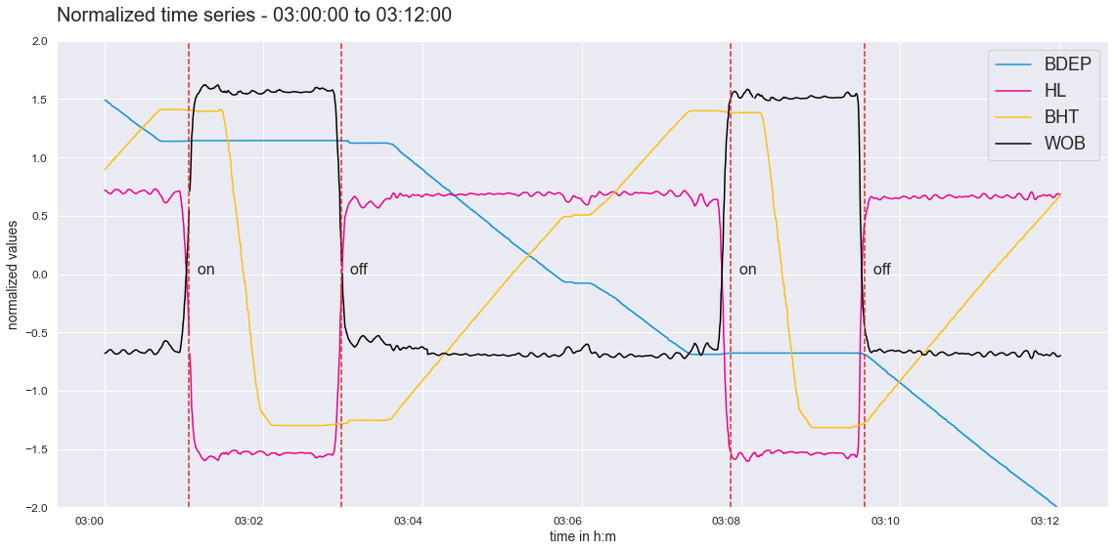
Time series pattern

Slide 8
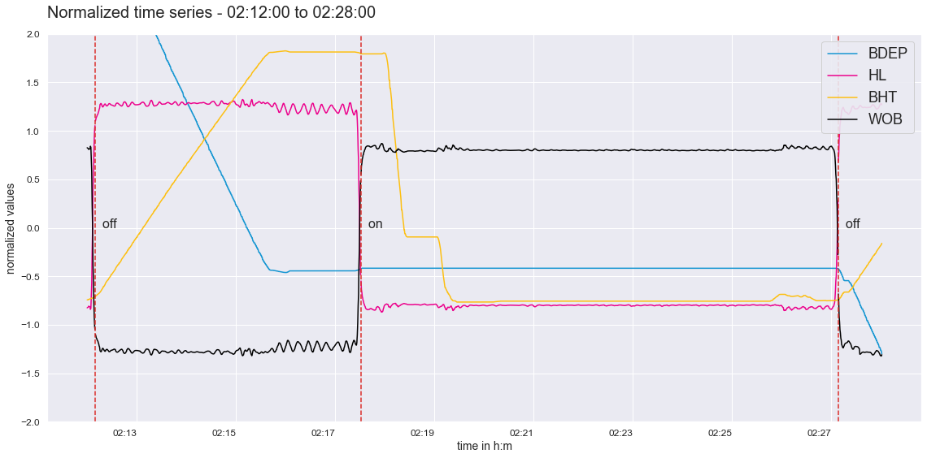
Time series pattern

Slide 9
Preprocessing
Missing data
Removed due to low percentage, 0.27%
Signal noise
Smoothed with moving average
Empty values for Annotation
Filled forward and then backwards

Slide 10
Preprocessing
Feature engineering
Rolling mean, std and lag features
Split values for time series
K-fold method for cross validation
Normalize values
Standard scaling

Slide 11
Modeling
Random Forest
XGBoost
LSTM neural network

Slide 12
Baseline model
Random Forest Classifier with default params
to use as a benchmark.
Cross validation score: 0.9907
F1-score for Train dataset: 1.0
F1-score for Test dataset: 0.99

Slide 13
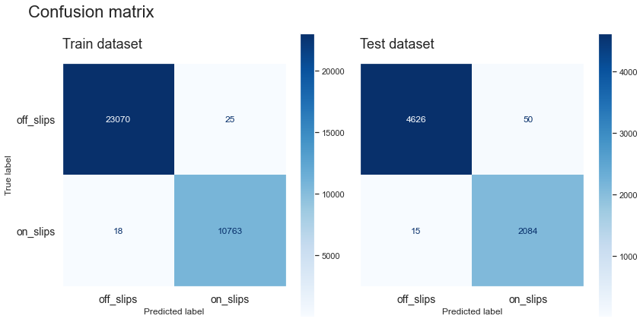
XGBoost evaluation

Slide 14
Model overfitting
Solutions to avoid overfitting:
Use cross-validation ✔
Apply regularization
Collect more data

Slide 15
Model overfitting
Using regularization on Random Forest
had no impact.
Adding noise to the Test data lowered the
F1-score to 0.87 for off_slips and 0.53 for on_slips.

Slide 16
XGBoost Classifier
Early stop at 62º epoch
High score on both datasets: 0.97
2 high importance features:
WOB ≅ 0.8
HL ≅ 0.16

Slide 17
XGBoost Classifier
Predicting future variables with similar
datasets produces good predictions.
When adding noise, the model complete
fails to predict on_slips labels.

Slide 18
LSTM model
This model can handle long-term dependencies
Ability to capture seasonality and trends
Additional regularization techniques

Slide 19
LSTM model
Performance slight less overfitted
if compared to XGBoost
Still unable to predict label on_slips with
noise dataset.

Slide 20

LSTM evaluation

Slide 21
Conclusions
Both XGBoost and LSTM were good at
predicting labels for time series with the
same distribution.
It had no impact if the time between on/off
slips changed. Just if heavy noises
were introduced, or different patterns occurs.

Slide 22
Next steps
Try more robust regularization methods,
or even increase layers for LSTM.
Collect more data in order to understand
different patterns.

Slide 23
Thank you!
João Francisco Baiochi
Github: @Baiochi
E-mail: joao.Baiochi@outlook.com.br
Code in Jupyter notebook

