Slide 1
Mentor-Mentee Meeting
16-09-2026

Slide 2
WANG Dingchao
Year-4, Data Science

Slide 3
Contact
E-mail: dc.wang@my.cityu.edu.hk
WhatsApp: (+852)6076 3312
WeChat: baipine
IG: @baipinins

Slide 4
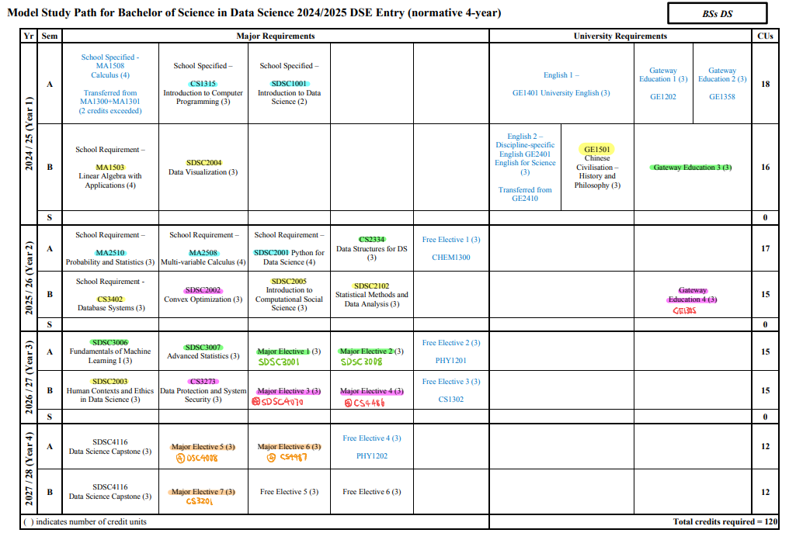

Slide 5
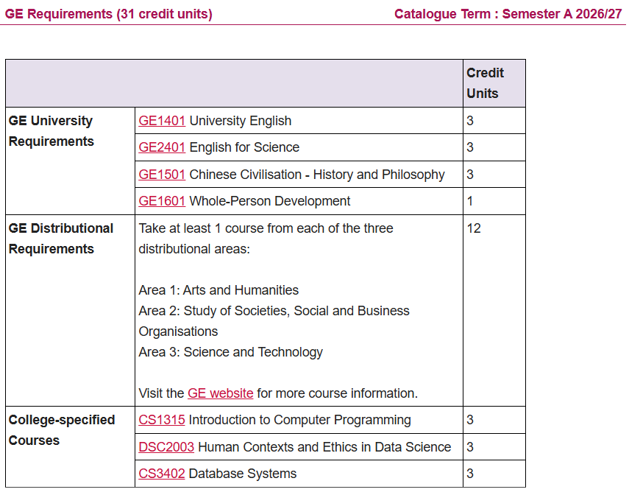
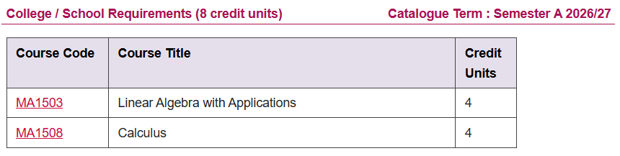
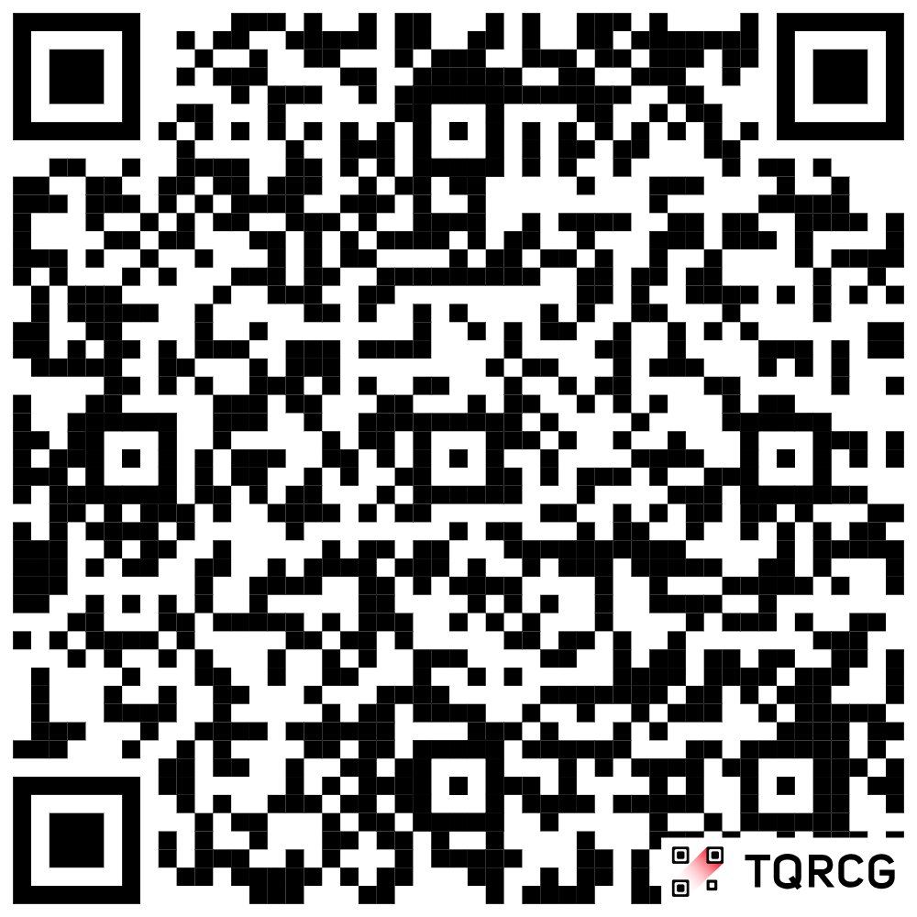
https://www.cityu.edu.hk/catalogue/ug/current/Major/BSC1_DSC-1.htm

Slide 6
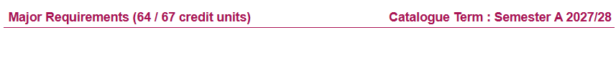
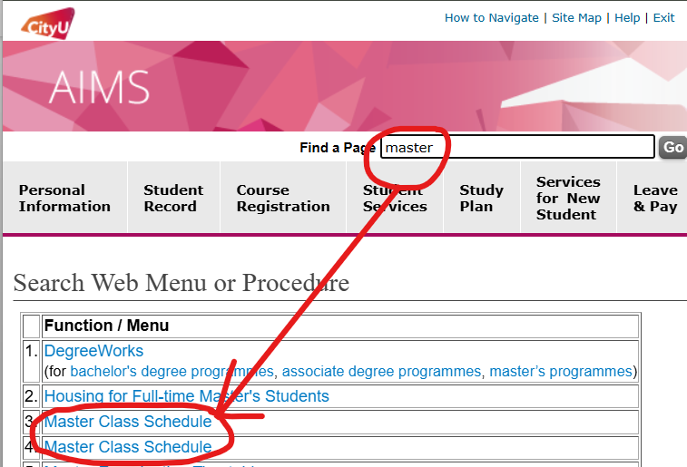

Slide 7
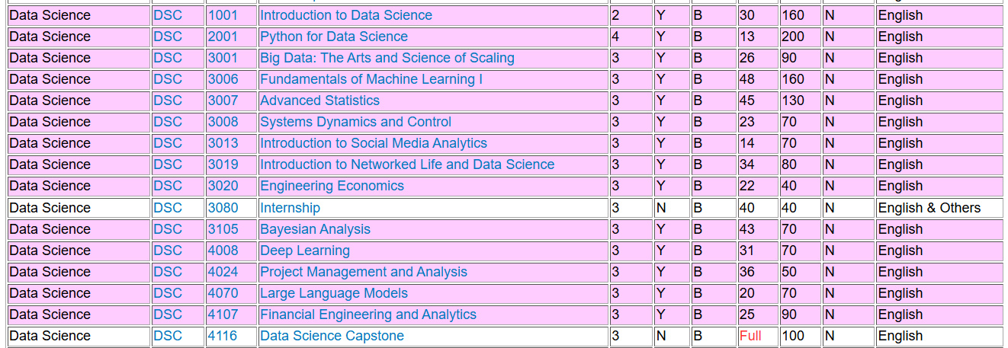

Slide 8
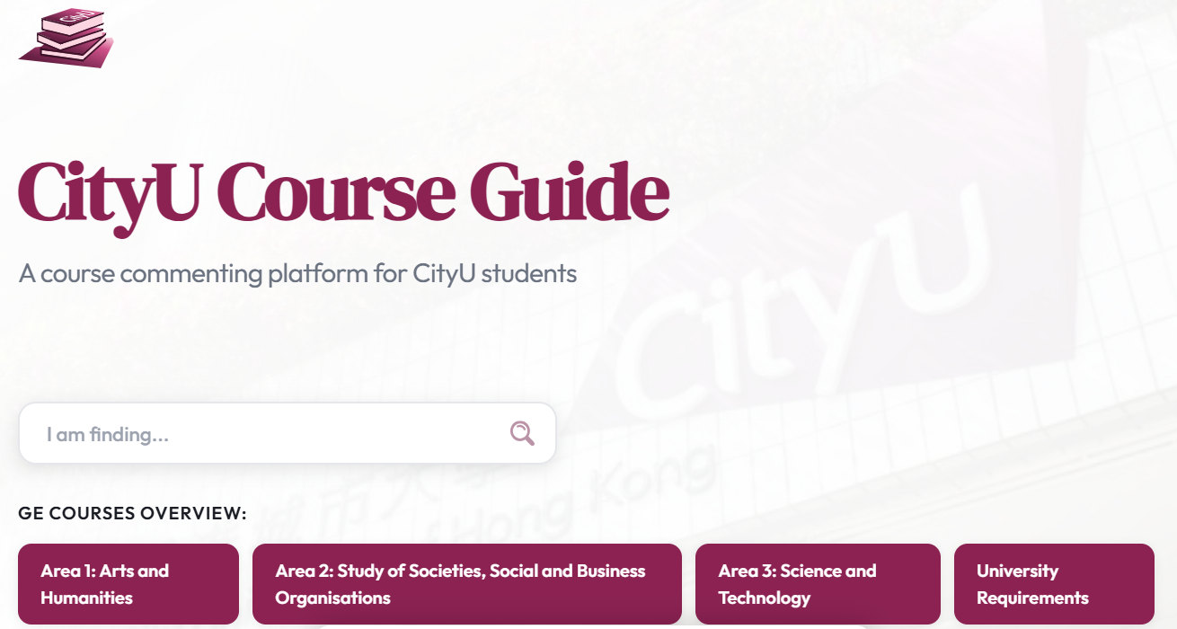
GE Courses
Recommend personally:
https:// cityuge.com

Slide 9
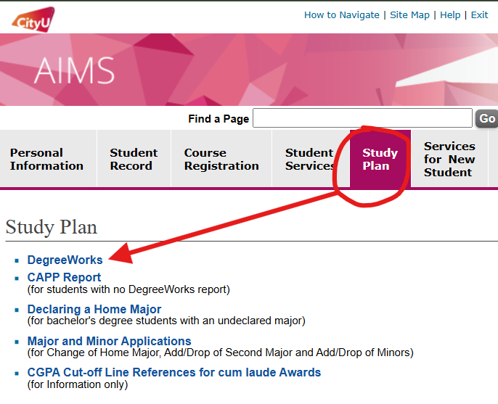
DegreeWorks

Slide 10
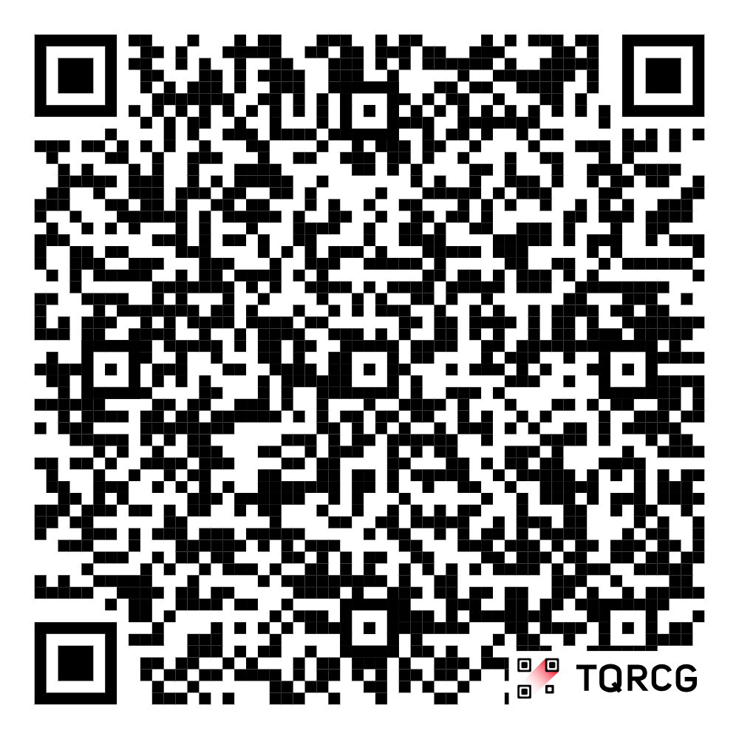
Internship & Research
Search by yourself
AIMS: Student Services -> JobPlus Vacancies
ITC STEM Internship:
https://www.cityu.edu.hk/cc/student-life-and-learning/internship-schemes/itc-stem-internship-scheme

Slide 11
Internship & Research
Find What You are Interested

Slide 12
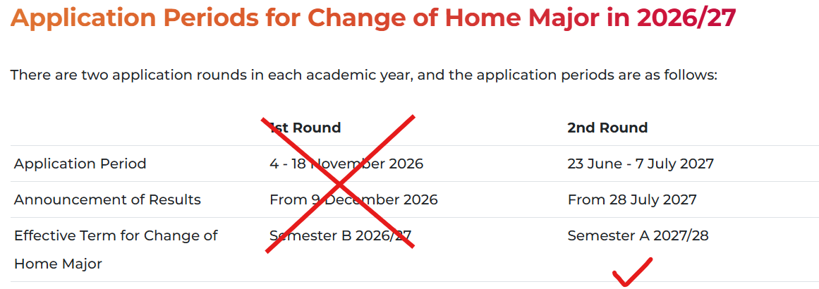
Major Change

Slide 13
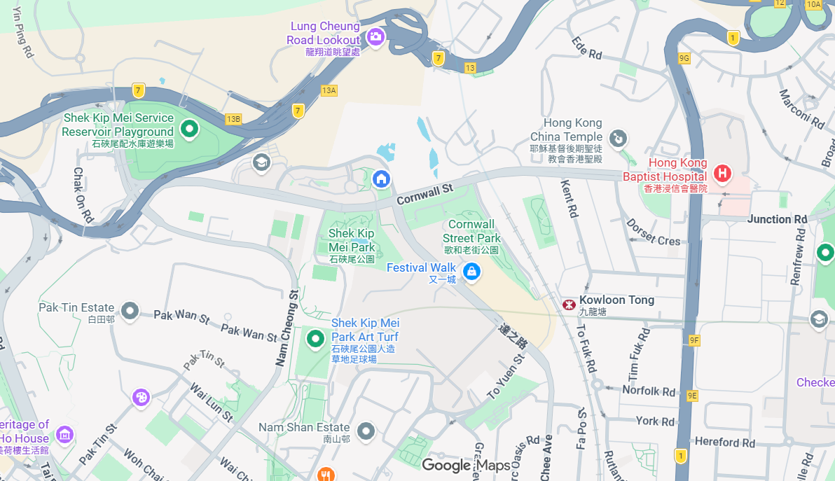
Life Around CityU

Slide 14
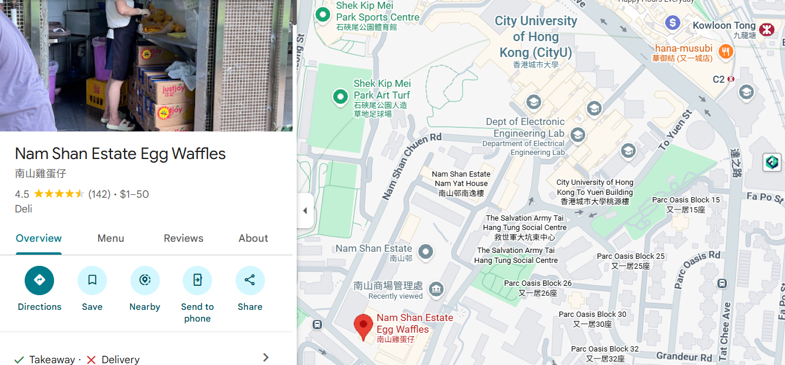
Life Around CityU

Slide 15
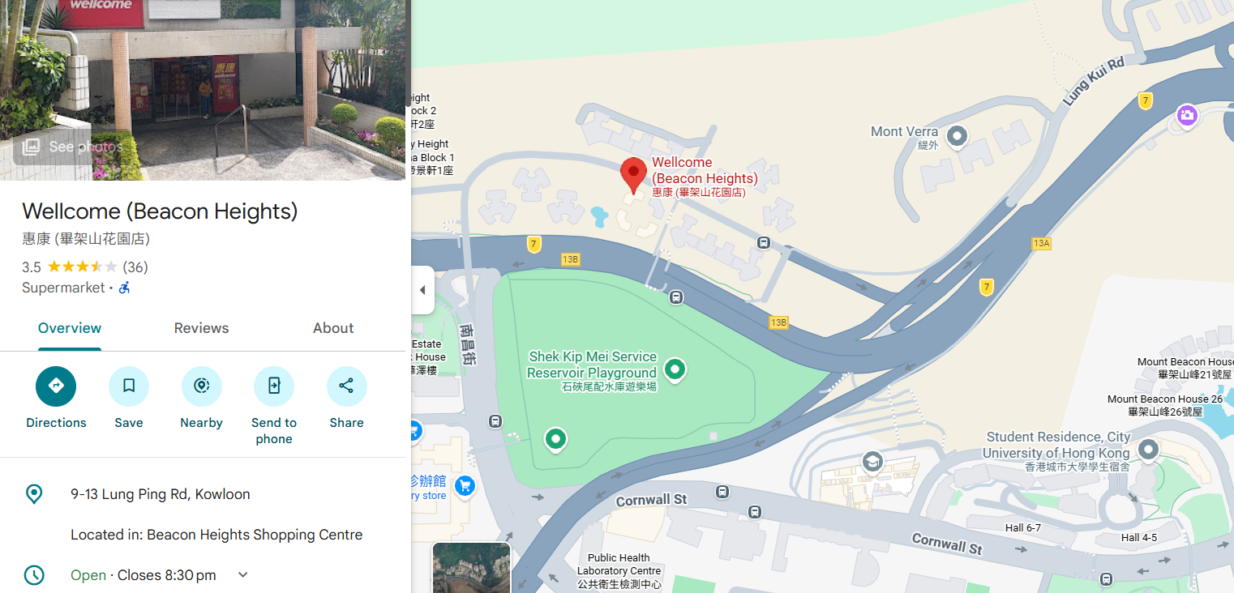
Life Around CityU

Slide 16
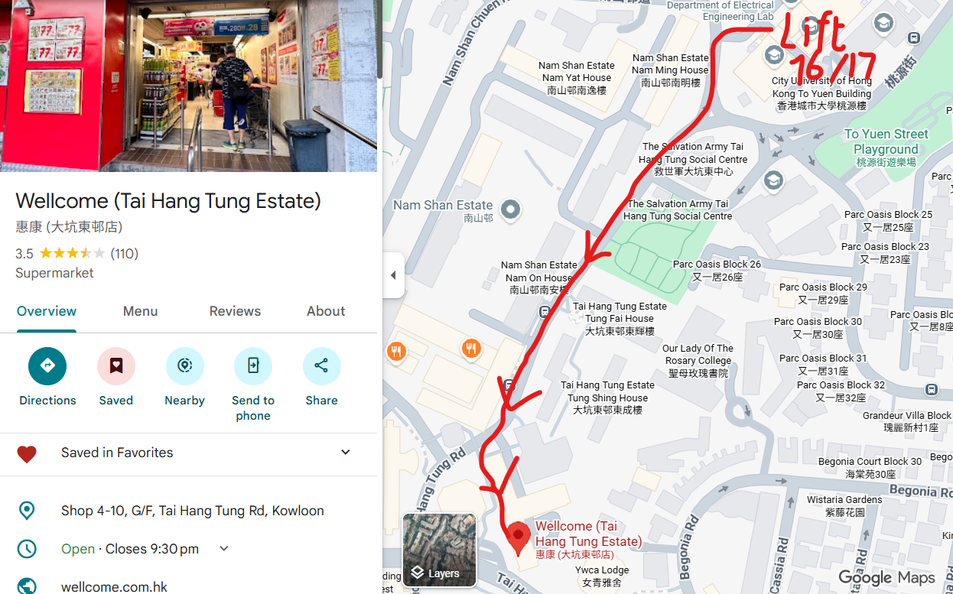
Life Around CityU

Slide 17
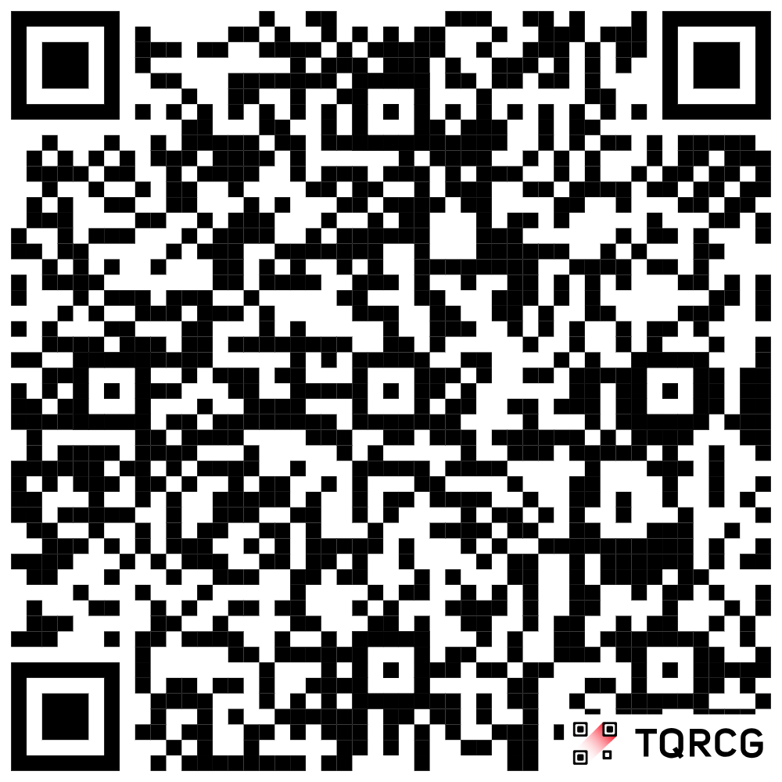
Get this PowerPoint:
For mentees mentored by me, I will send this as an attachment to your email inbox.
Download link:
https://drive.google.com/file/d/12XhJAL0oKvsKZxEgO9YuZEHZvoDko9fm/view?usp=sharing

Slide 18
Thanks!
Disclaimer: This PowerPoint is for the use of the mentor-mentee meeting only and may contain personal information and/or copyright material. Please do not re-distribute, or do any other form of unauthorized dissemination of the contents.

